Slide 1
GE108: The Changing Face of Germany in Film and Text
Library & internet resources
Richard Perkins
October 2014

Slide 2


one search box for books, journals, DVDs, articles, digitised materials and archives
limit your search to specific resources, such as ebooks
tag anything, write reviews and start discussions
find out more about Encore at Warwick > http://checkthis.com/encore

Slide 3
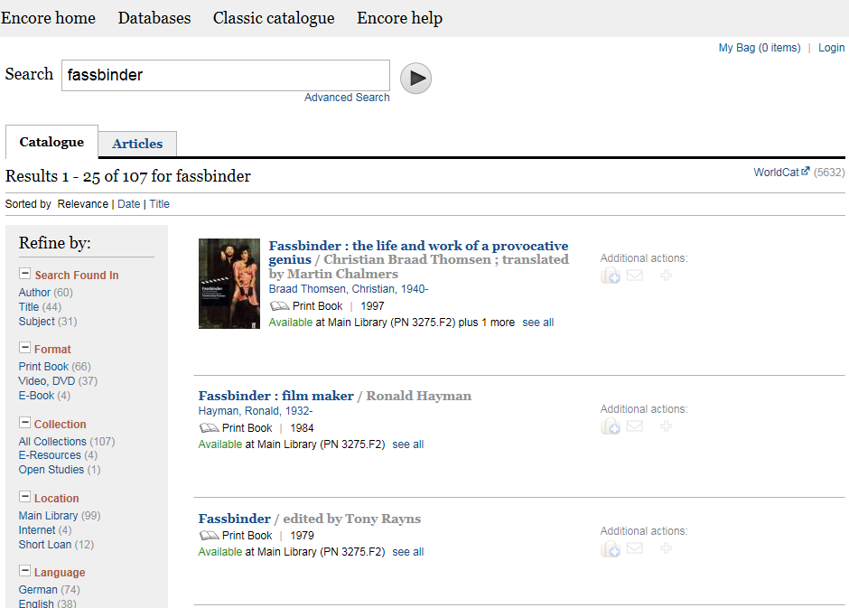

Slide 4
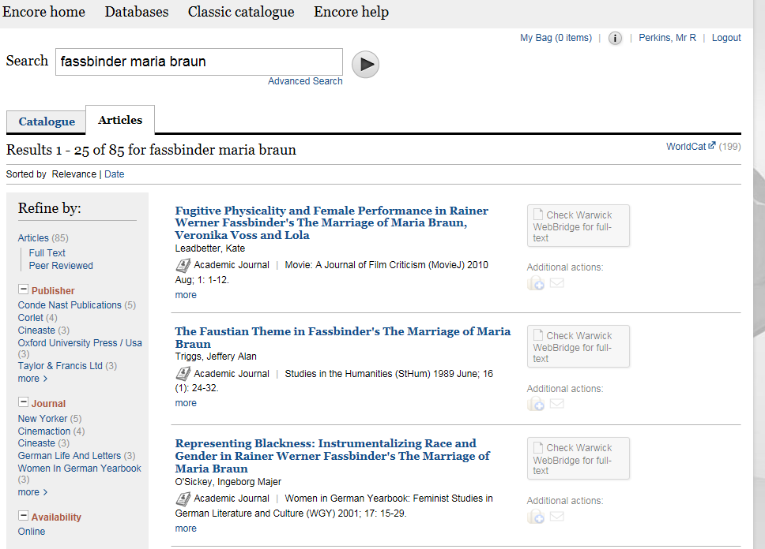
Journal articles on Maria Braun

Slide 5
You need to be able to recognise a reference like this as a journal article
Uecker, M., 2001. A Fatal German Marriage: The National Subtext of Fassbinder’s Die Ehe Der Maria Braun
German Life & Letters, 54 (1), pp. 45-59.

Slide 6
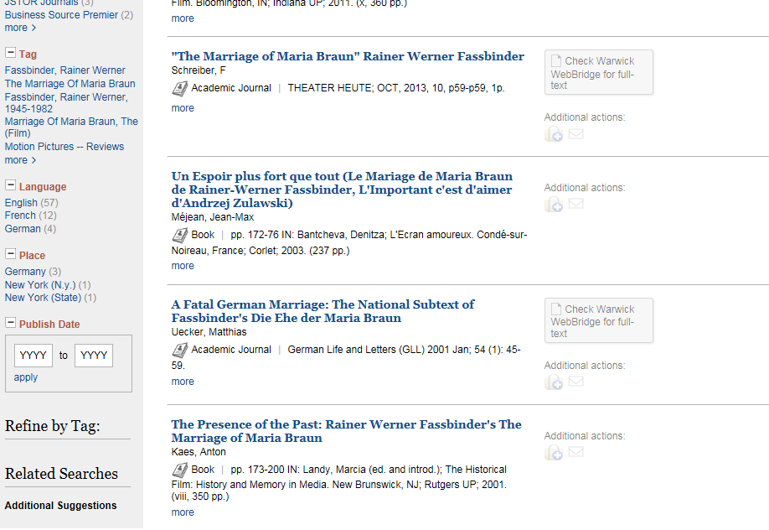
An Encore search on the article title

Slide 7
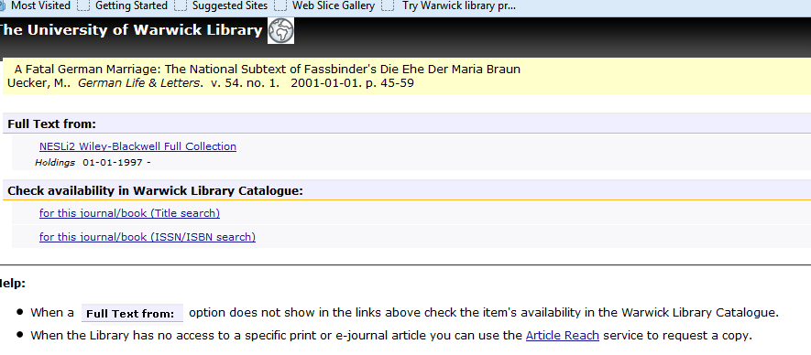

Slide 8
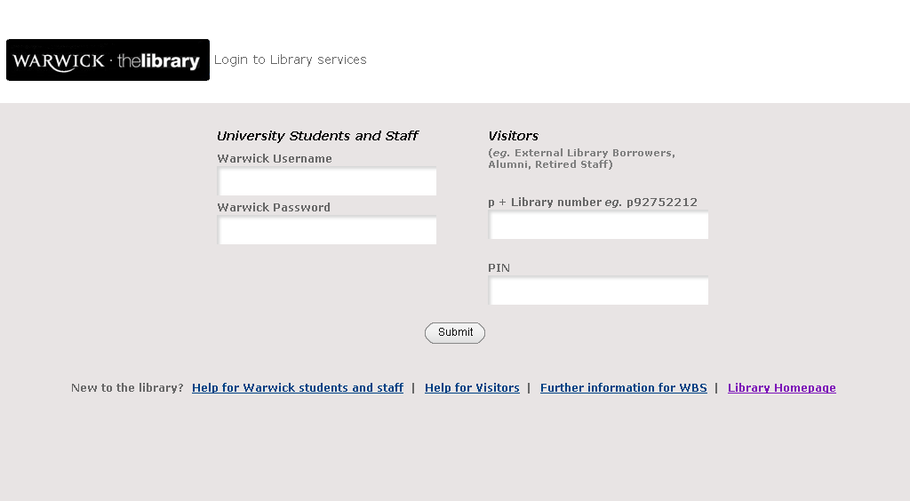
bsxxxx

Slide 9
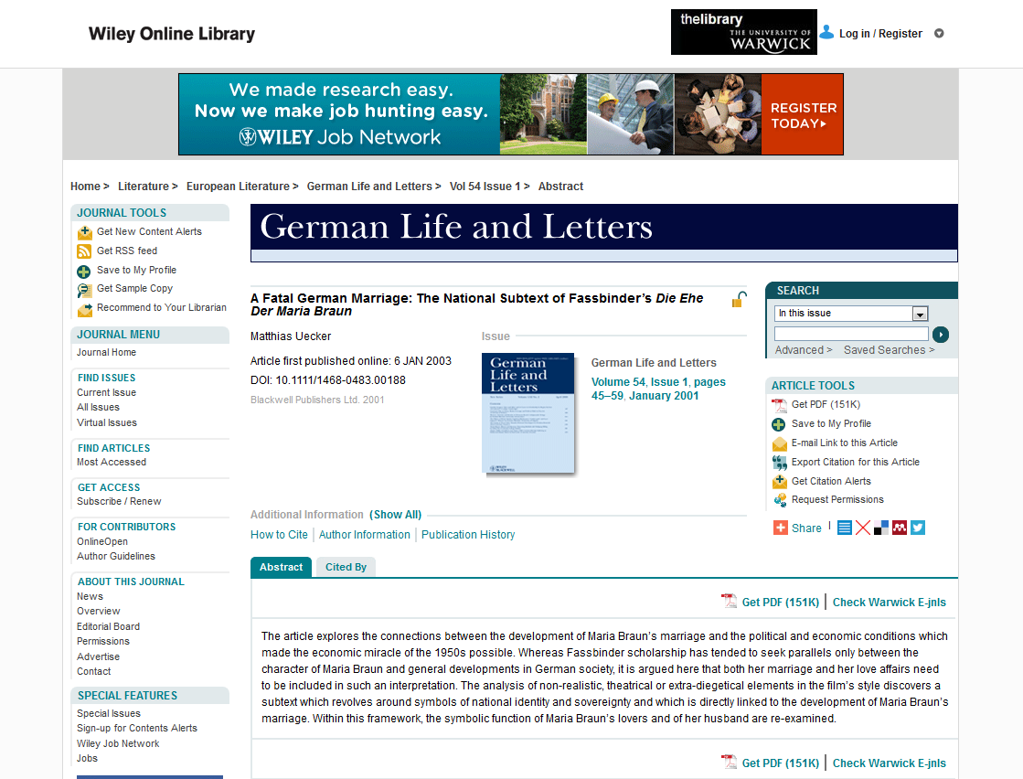

Slide 10
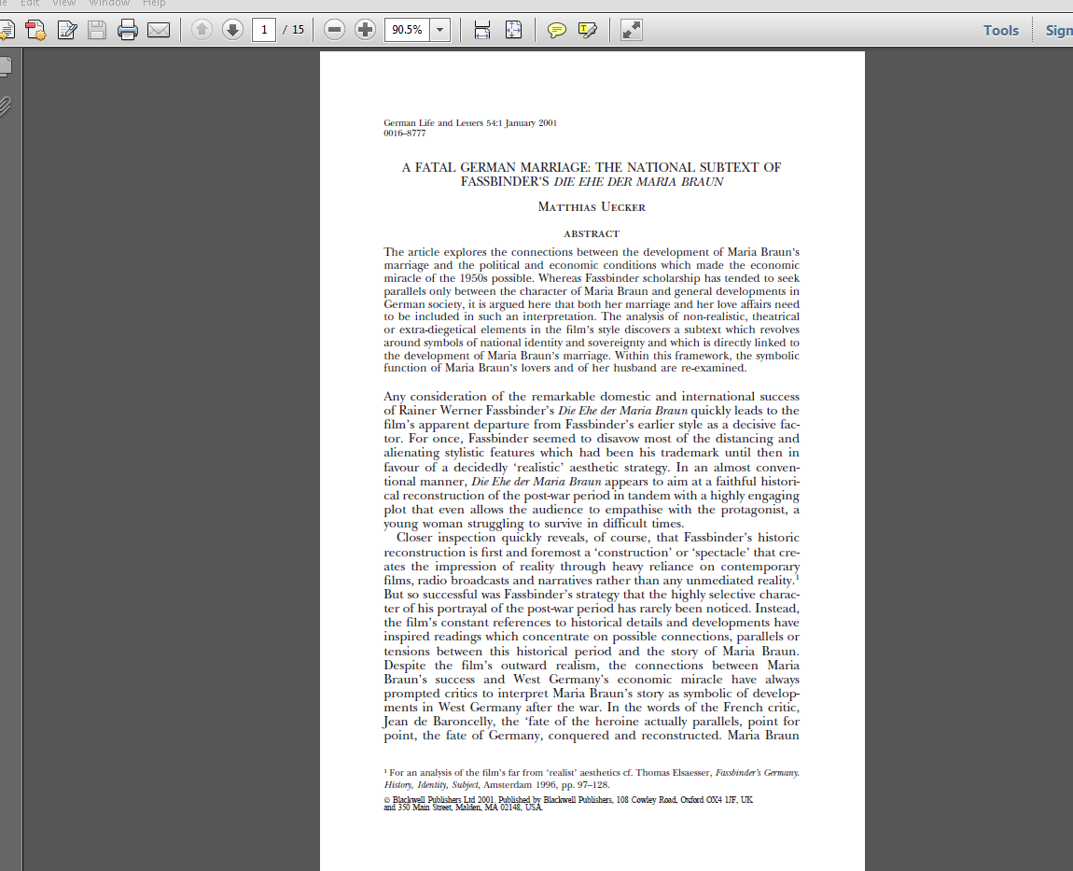

Slide 11
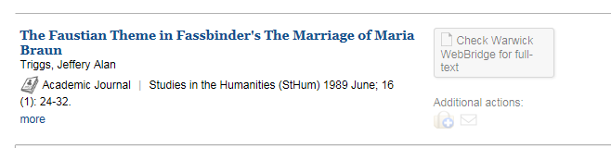
If Web Bridge doesn’t give you full text…

Slide 12
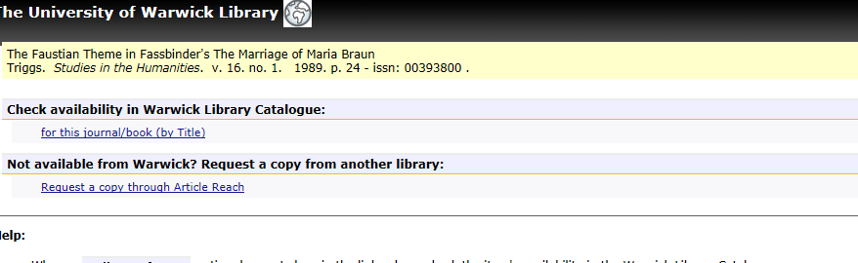
…use the free Article Reach service

Slide 13
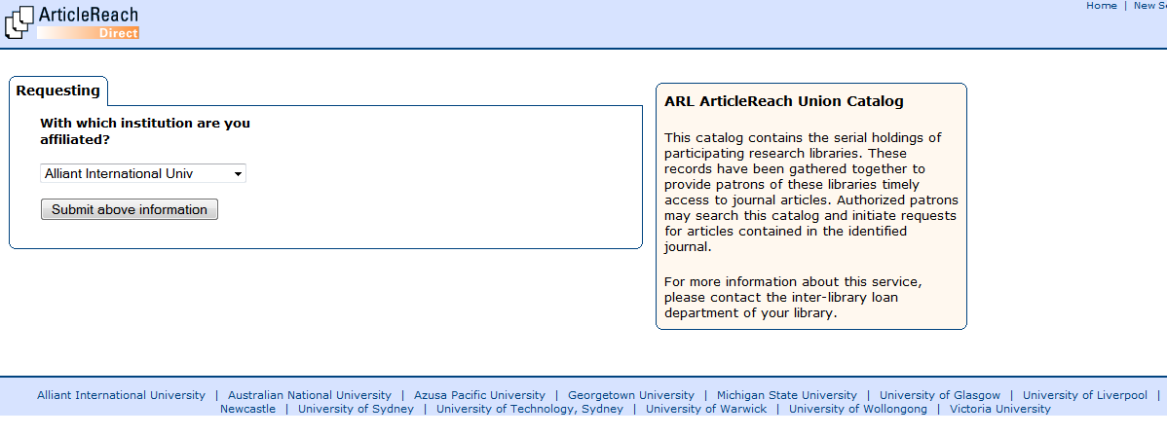

Slide 14
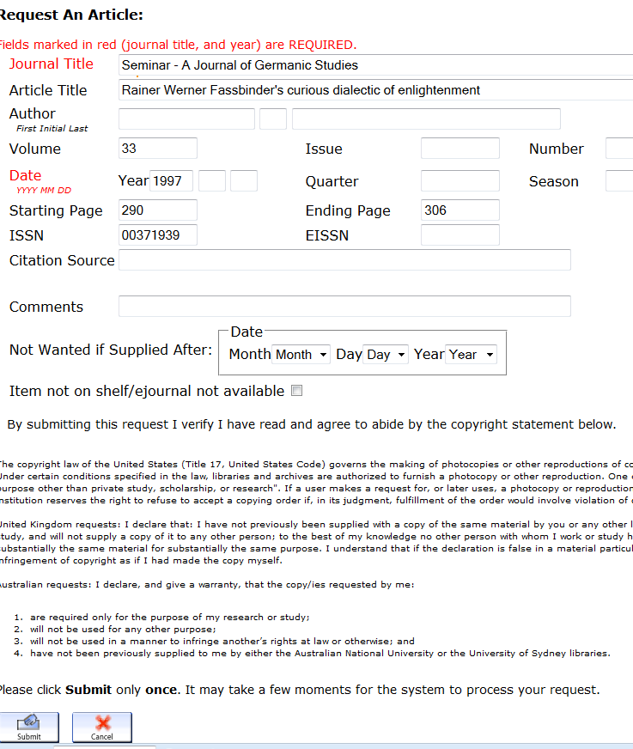

Slide 15
Article Reach is a consortium of libraries which have agreed to share their journal holdings. Requests are free, and do not have to be authorised by your lecturer / tutor. So far 58% of requests have been successful, with delivery on average within 27 hours.

Slide 16
To find other books on the same topic, use the Subject Headings embedded in the Encore catalogue records.

Slide 17
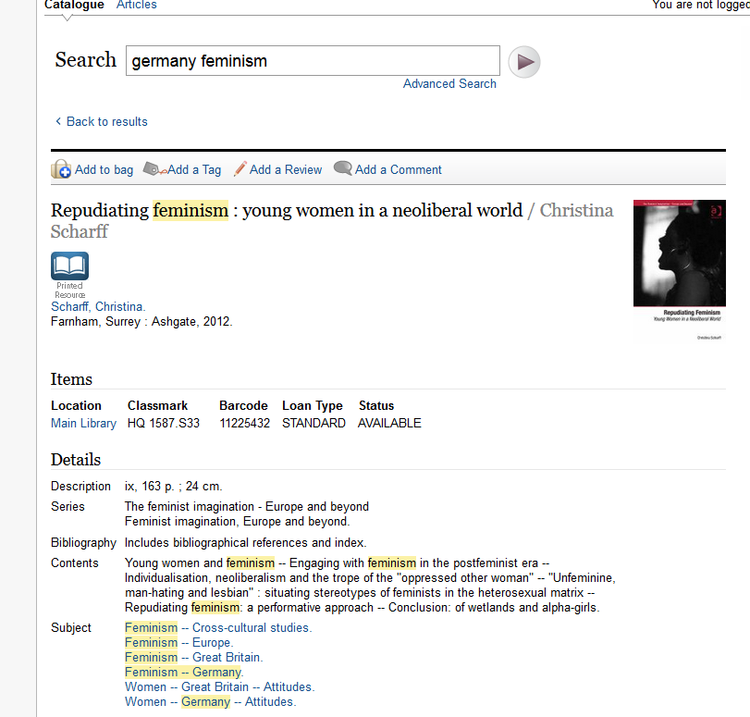

Slide 18
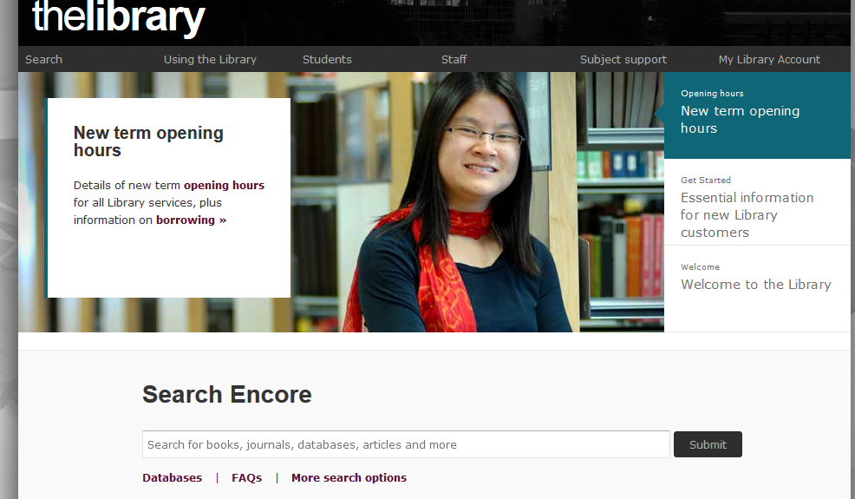
Don’t forget Course Extracts

Slide 19
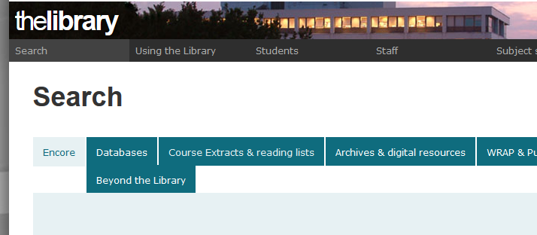

Slide 20
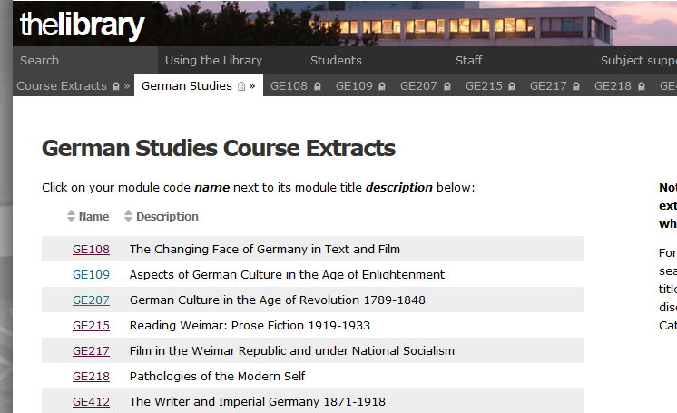

Slide 21
What about Google?
Two questions to ask yourself:
1.How comprehensive are your results?
2. How reliable is Wikipedia?

Slide 22
Most of us assume that when we google a term, we all see the same results—the ones that the company’s famous … algorithm suggests are the most authoritative based on other pages’ links. But … this is no longer true. Now you get the result that Google’s algorithm suggests is best for you in particular—and someone else may see something entirely different. In other words, there is no standard Google anymore. (Pariser: The Filter Bubble, 2011)

Slide 23
"You shouldn't really use Wikipedia as the sole source for anything, ever. You shouldn't use anything as the sole source for anything, in my view."
Jimmy Wales, Guardian interview 19/11/11

Slide 24
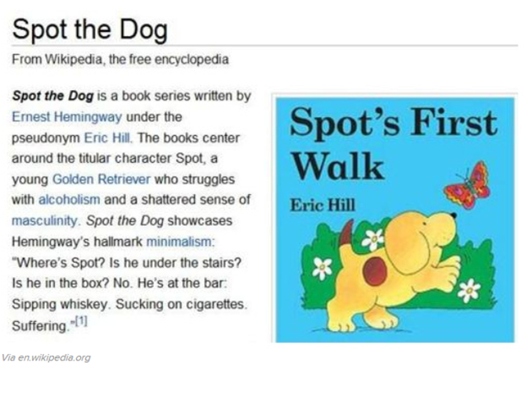

Slide 25
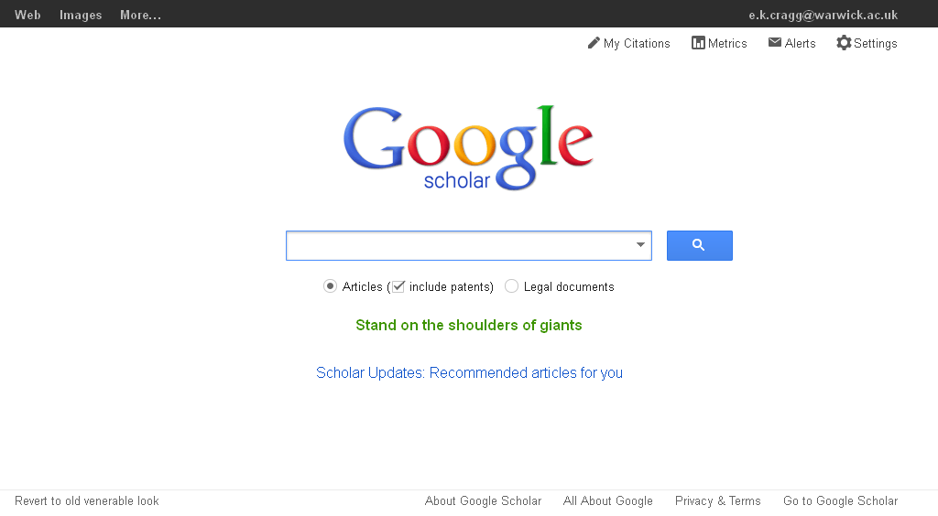

Slide 26
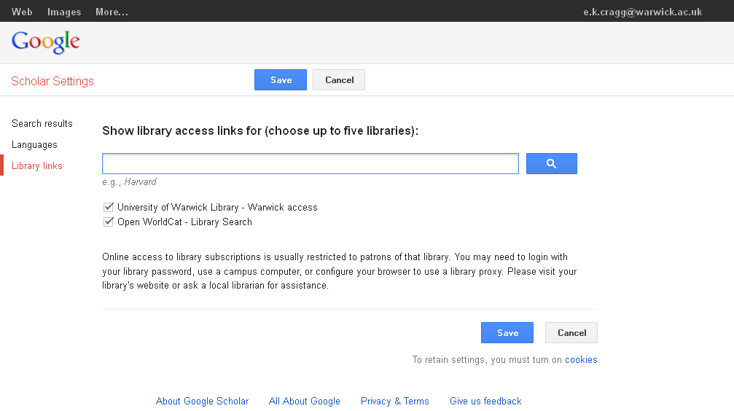

Slide 27
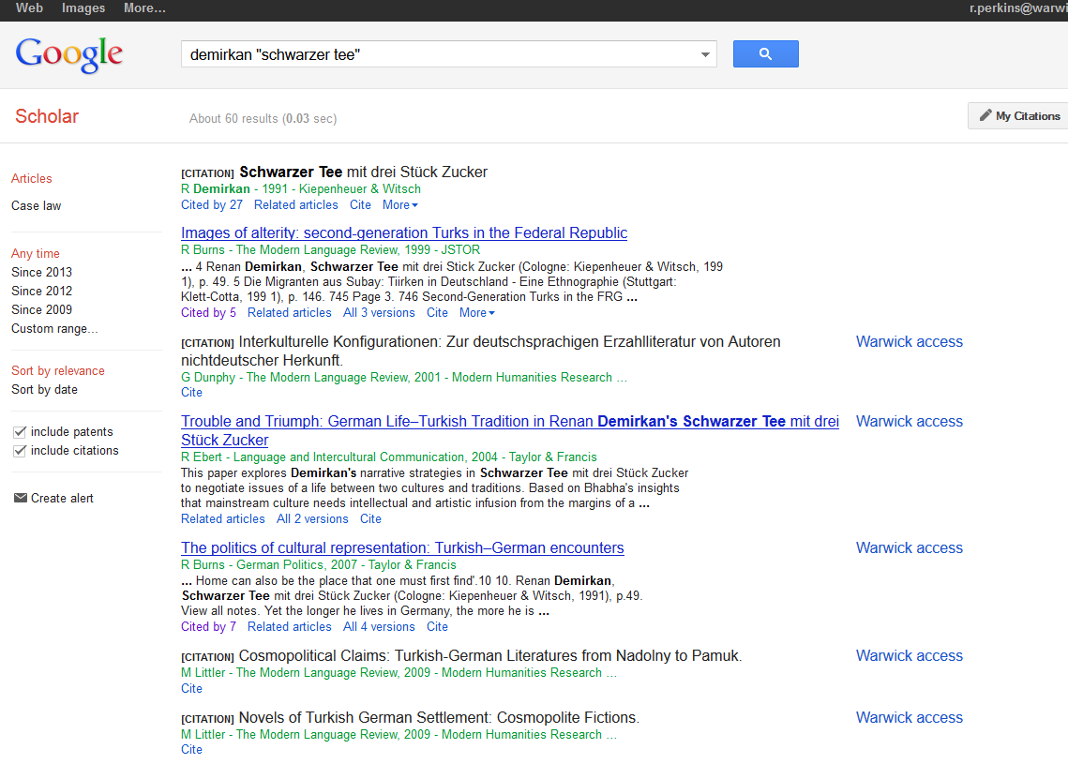

Slide 28
You can do more sophisticated searches using subject-specific databases

Slide 29
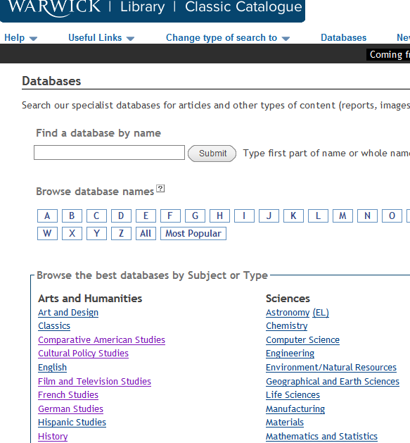

Slide 30
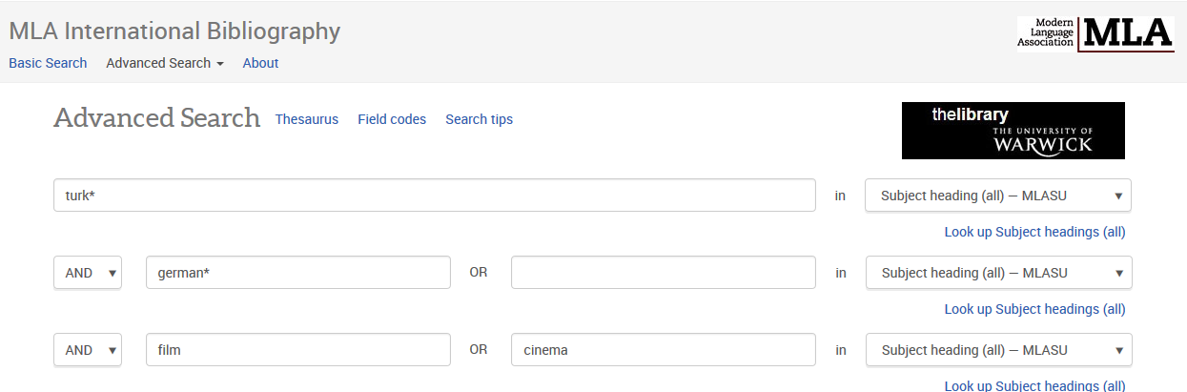

Slide 31
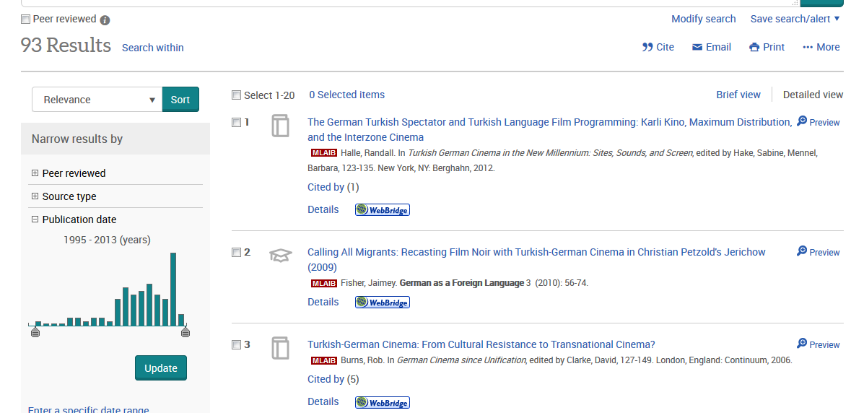

Slide 32
For articles from German newspapers, use Factiva, which is available on the Library catalogue

Slide 33
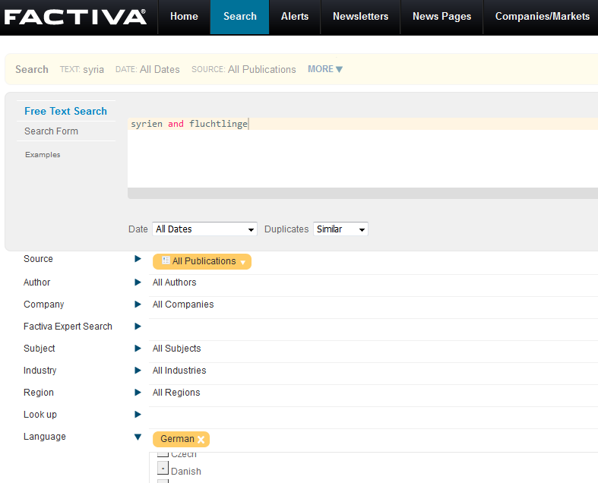

Slide 34
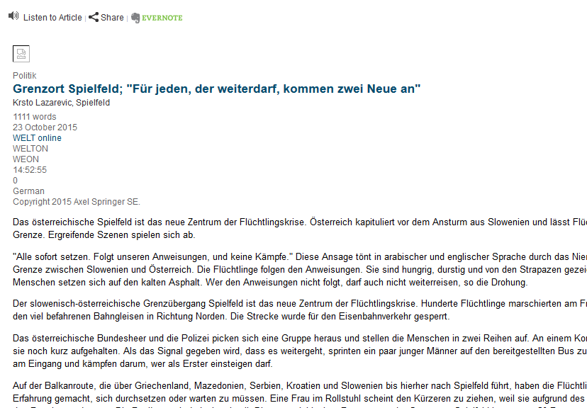

Slide 35
Use Box of Broadcasts to find UK TV & Radio programmes, including German films

Slide 36
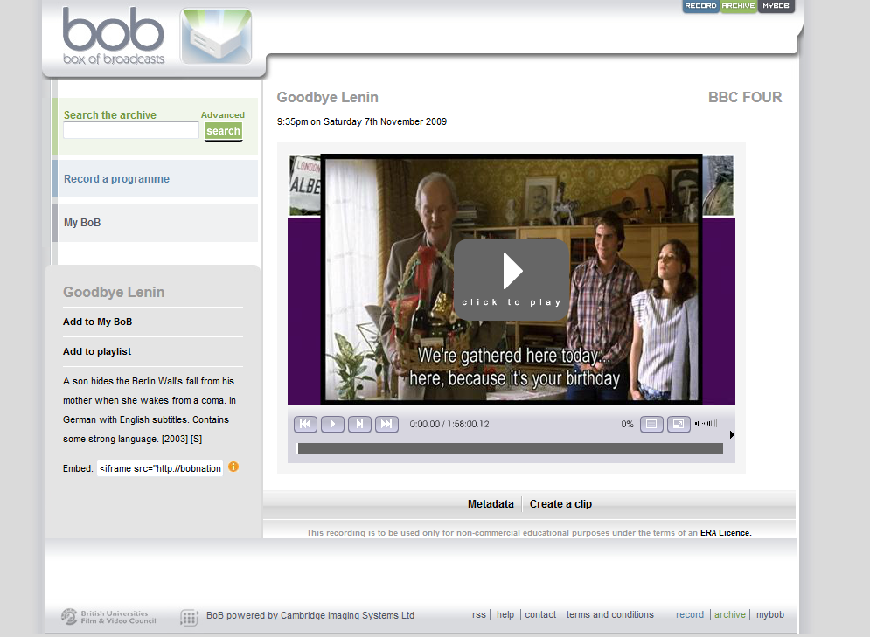

Slide 37
Use the Warwick German Studies Web to find useful websites

Slide 38
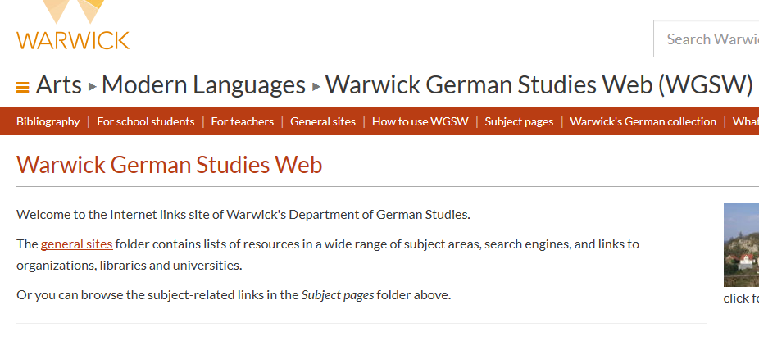

Slide 39
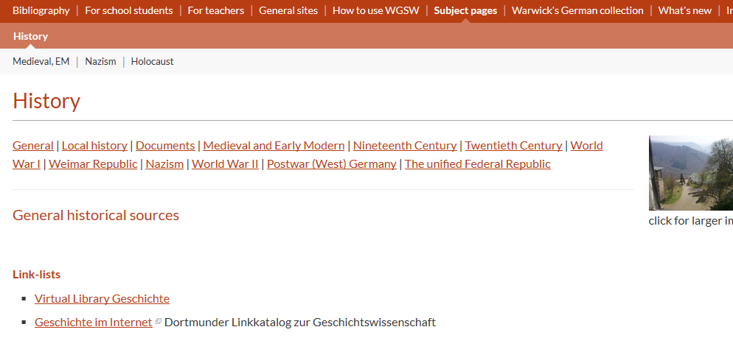

Slide 40


Slide 41
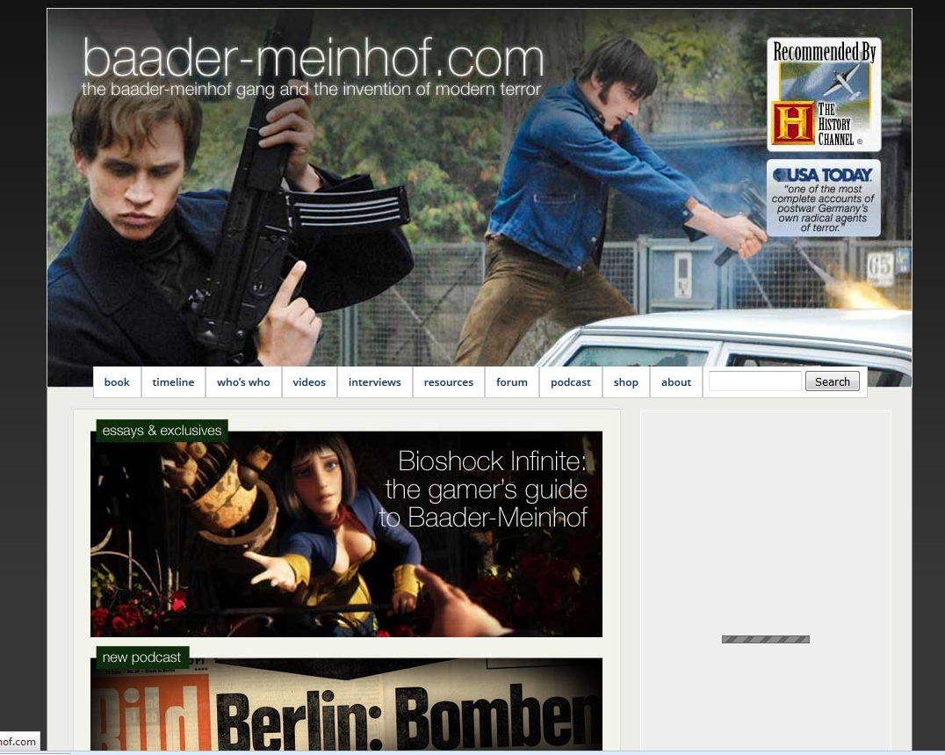

Slide 42
Evaluate websites. For example: Who created the content? Are they an authority, or an enthusiast?

Slide 43
