Slide 1
Vergangenheitsbewältigung and German Cinema

Slide 2
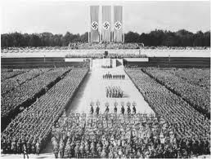
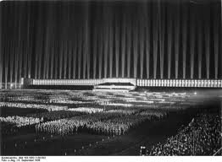
Hitler: Eine Karriere (Joachim Fest, 1977)
Attempts to evoke fascination of Hitler by showing
  the carefully choreographed images of parades, speeches and party rallies
  the union between Hitler and the people as both pseudo-religion and erotic

Slide 3

Holocaust (NBC, 1978)
4 episodes, 8 hrs
US audience: 120 mio
West German audience:
20 mio (= 50% adult viewers)

Slide 4
Edgar Reitz
‘The most serious act of expropriation there is, occurs in when people are deprived of their history. With Holocaust, the Americans have taken away our history’

Slide 5
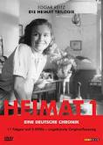
Heimat (Edgar Reitz, 1984)
11 parts, 16 hrs
Tells story of fictional Simon family from village of Schabbach in the Hunsrück region between 1919 and 1982
9 mio viewers per episode

Slide 6
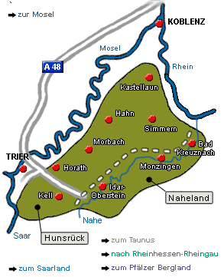
Der Hunsrück (Rheinland-Pfalz)
Rural region between Koblenz, Mainz and Trier

Slide 7
Heimat
Home
Embeddedness in community
Identity through being part of a shared culture
Particular geographical space (often rural)
Implies homogeneous community (i.e. ‘us’ vs. ‘them’)
Since 19th ct: concept used to compensate for loss of identity throughmodernisation processes
Exploited by political right (esp. under Nazism)

Slide 8



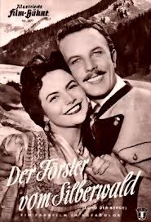
The post-war Heimatfilm
Arch-German genre under Hitler
National chauvinism, racial ideology, ‘blood and soil’
In 1950s more than 300 Heimatfilme
Idealised and nostalgic picture of Germany
Sentimental and kitschy image of world

Slide 9

Deutschland, bleiche Mutter (Sanders-Brahms, 1980)

Slide 10

Die bleierne Zeit (Margarethe von Trotta, 1981)

