Slide 1
GE 108
Writers, Media & Society in Contemporary Germany
Library & internet resources
Richard Perkins
October 2014

Slide 2


one search box for books, journals, DVDs, articles, digitised materials and archives
limit your search to specific resources, such as ebooks
tag anything, write reviews and start discussions
find out more about Encore at Warwick > http://checkthis.com/encore

Slide 3
Sample journal article reference
MacDonald, S, 2009. From Underground to Multiplex: An Interview With Todd Haynes. Film Quarterly, 62 (3), pp. 54-64.

Slide 4
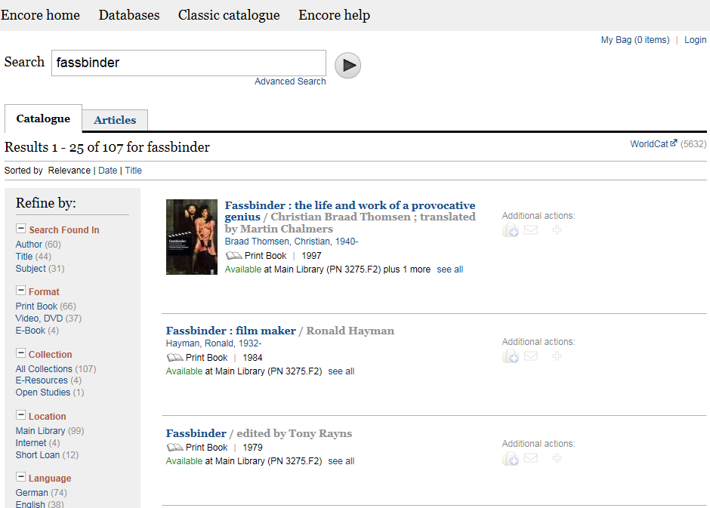

Slide 5
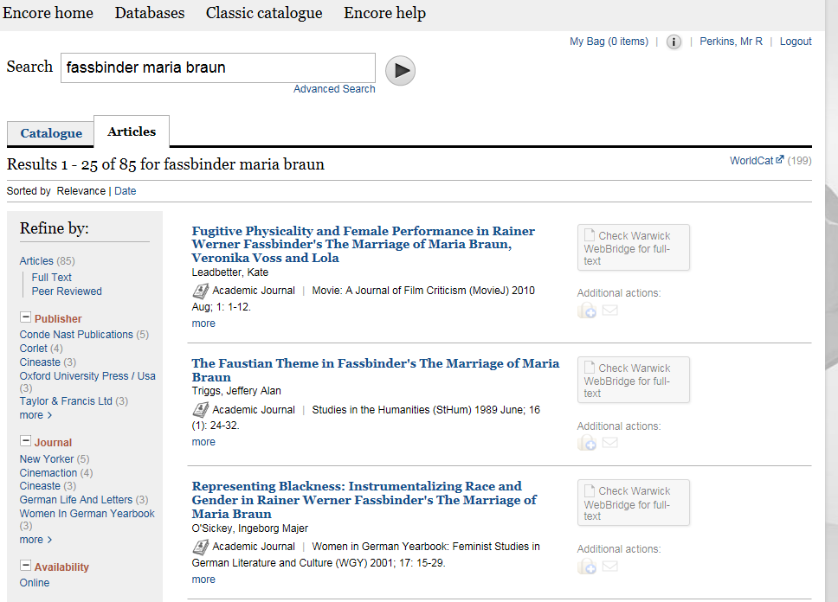

Slide 6
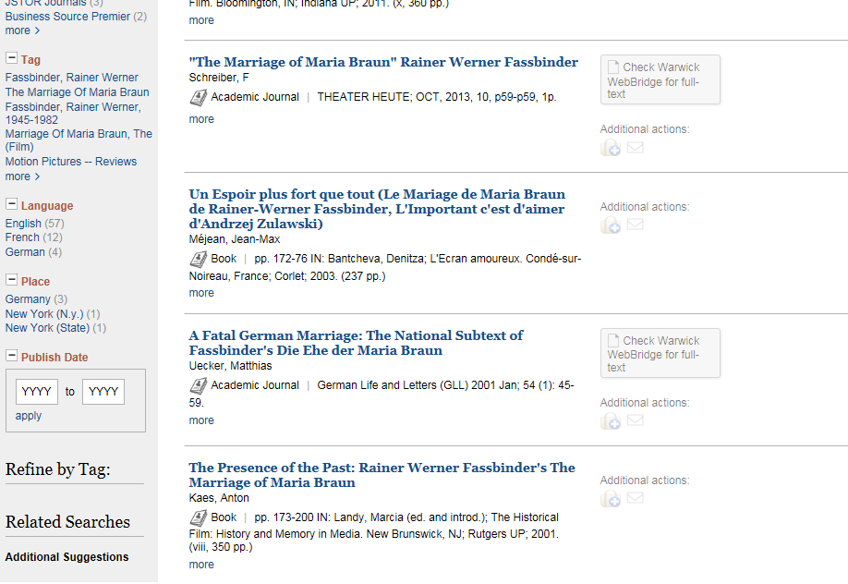

Slide 7
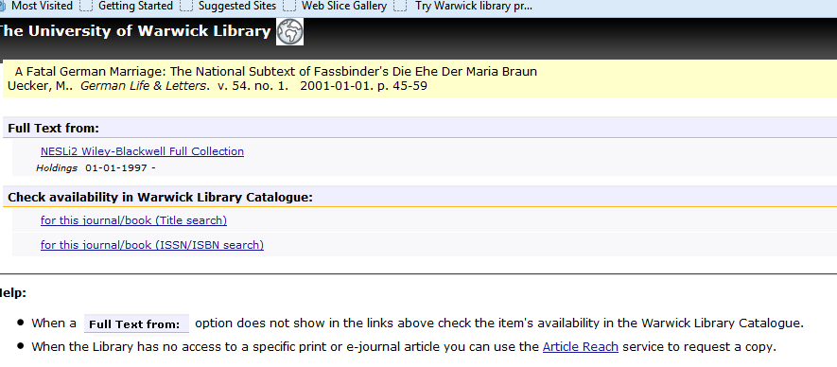

Slide 8
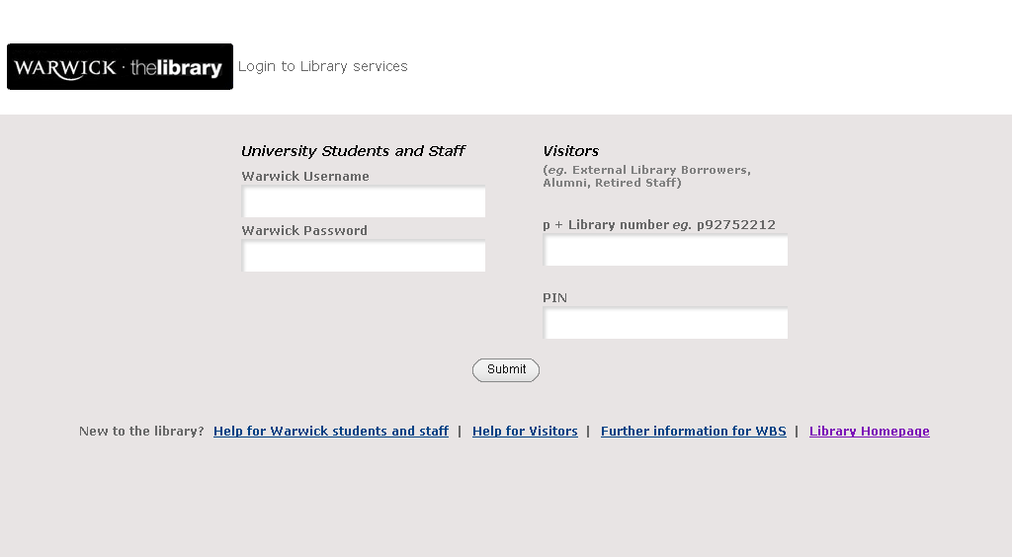
bsxxxx

Slide 9
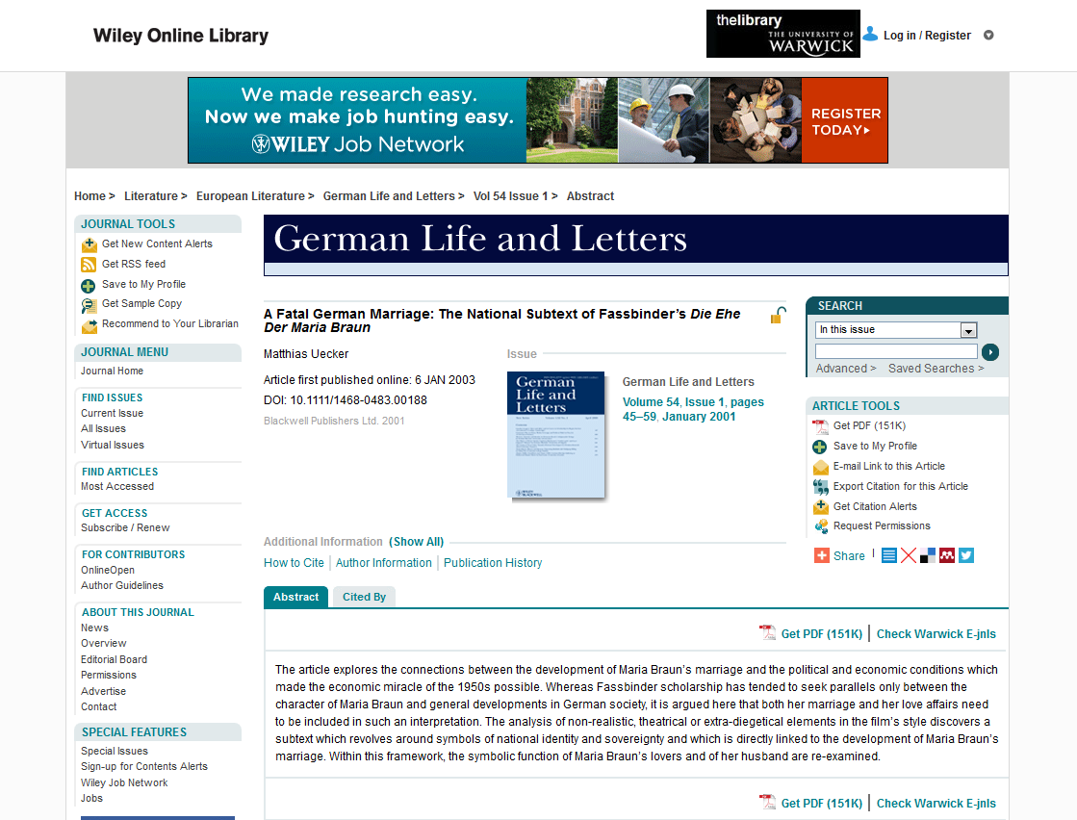

Slide 10
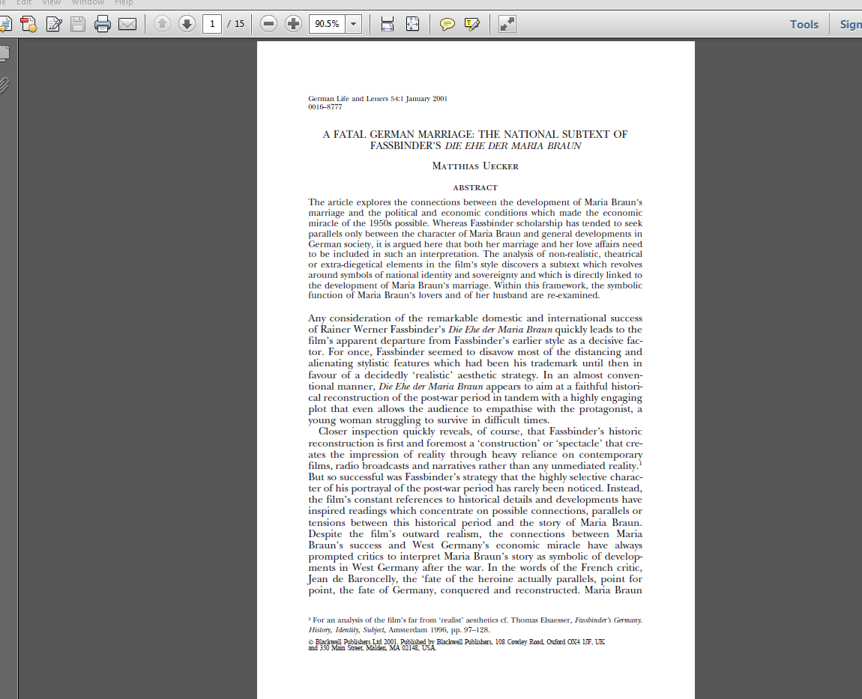

Slide 11
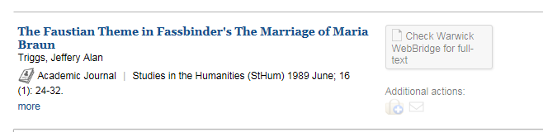

Slide 12
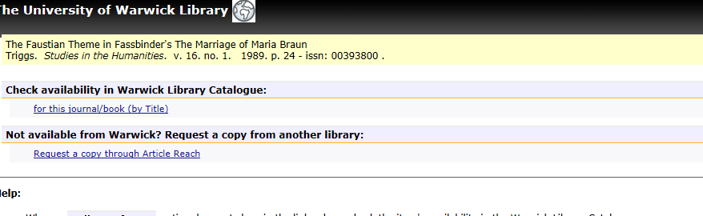

Slide 13
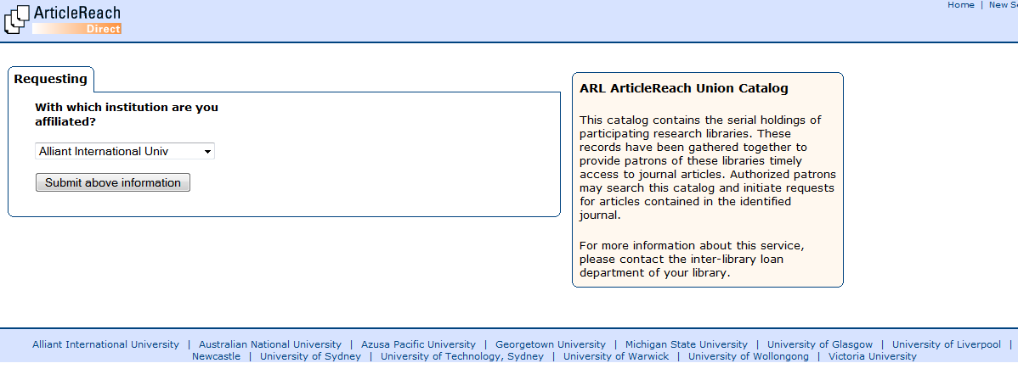

Slide 14
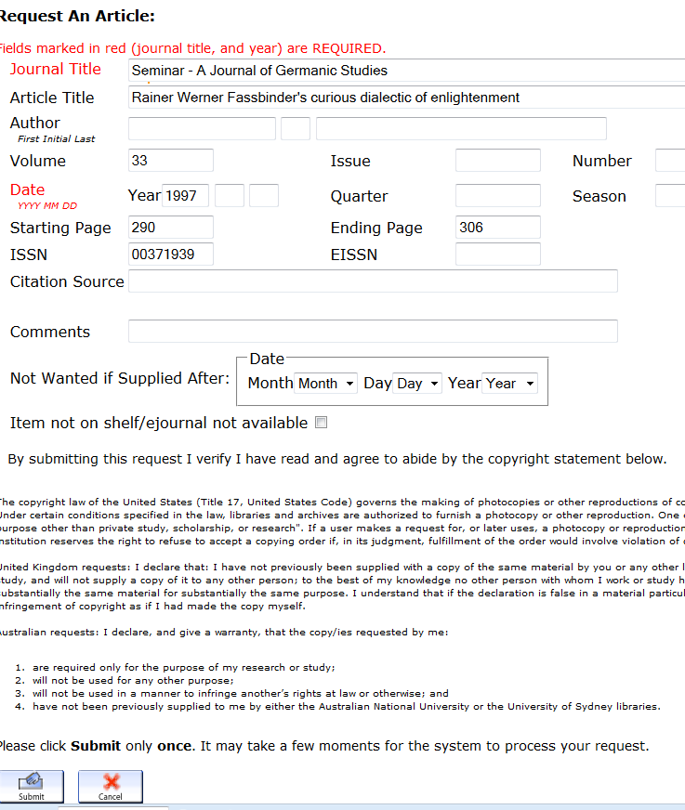

Slide 15
Article Reach is a consortium of libraries which have agreed to share their journal holdings. Requests are free, and do not have to be authorised by your lecturer / tutor. So far 58% of requests have been successful, with delivery on average within 27 hours.

Slide 16
To find other books on the same topic, use the Subject Headings embedded in the Encore catalogue records.

Slide 17
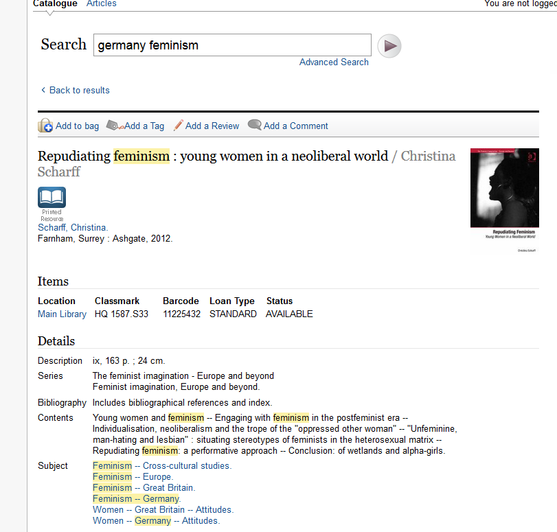

Slide 18
What about Google?
Two questions to ask yourself:
1.How comprehensive are your results?
2. How reliable is Wikipedia?

Slide 19
Most of us assume that when we google a term, we all see the same results—the ones that the company’s famous … algorithm suggests are the most authoritative based on other pages’ links. But … this is no longer true. Now you get the result that Google’s algorithm suggests is best for you in particular—and someone else may see something entirely different. In other words, there is no standard Google anymore. (Pariser: The Filter Bubble, 2011)

Slide 20
"You shouldn't really use Wikipedia as the sole source for anything, ever. You shouldn't use anything as the sole source for anything, in my view."
Jimmy Wales, Guardian interview 19/11/11

Slide 21
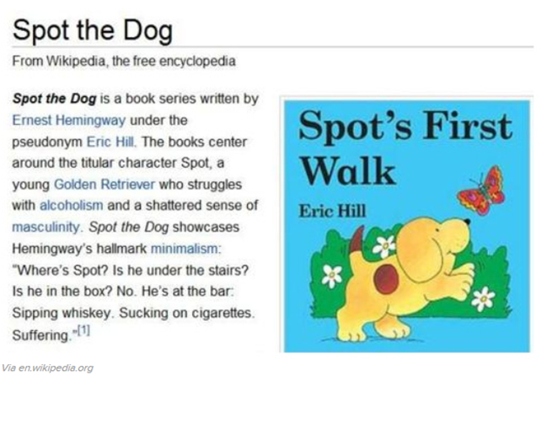

Slide 22
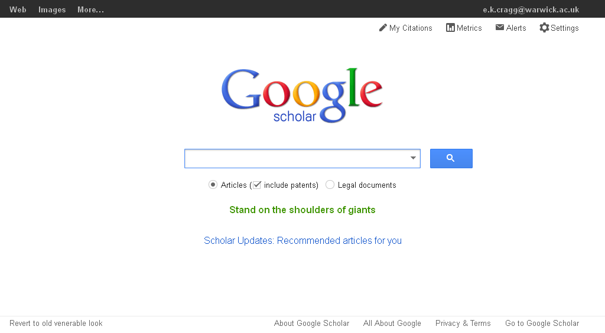

Slide 23
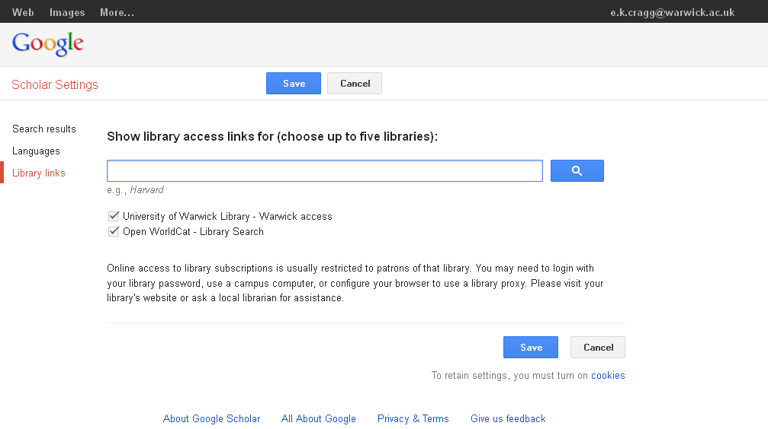

Slide 24
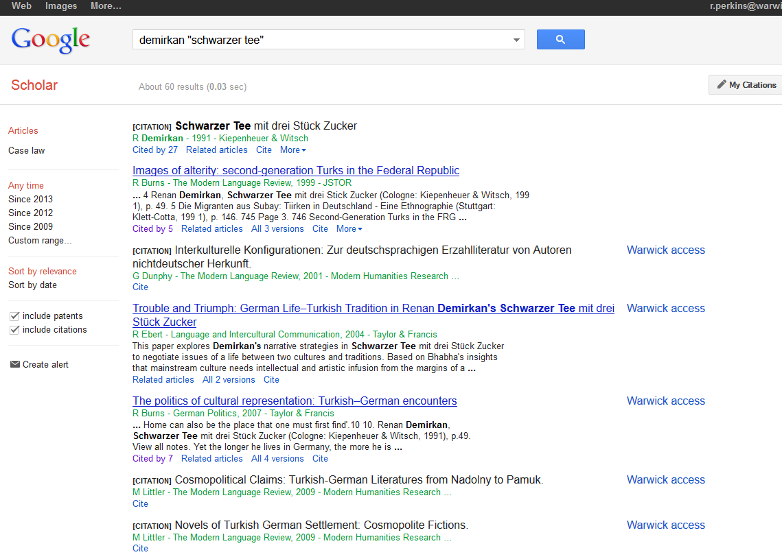

Slide 25
For articles from German newspapers, use Factiva, which is available on the Library catalogue

Slide 26
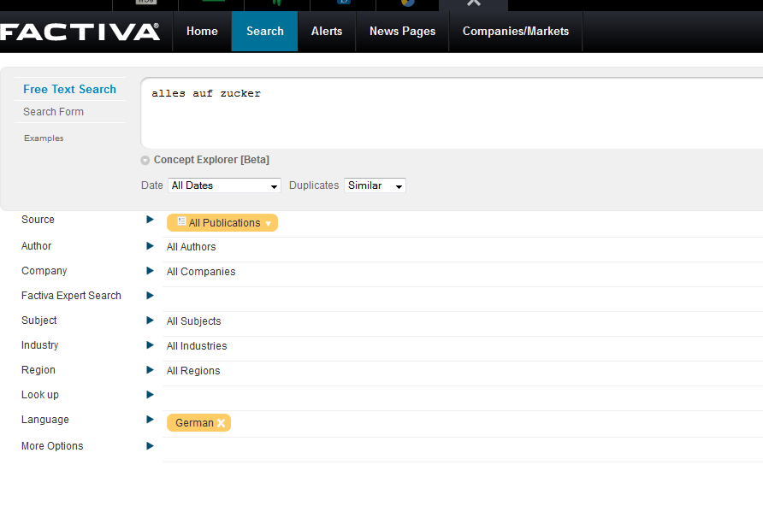

Slide 27
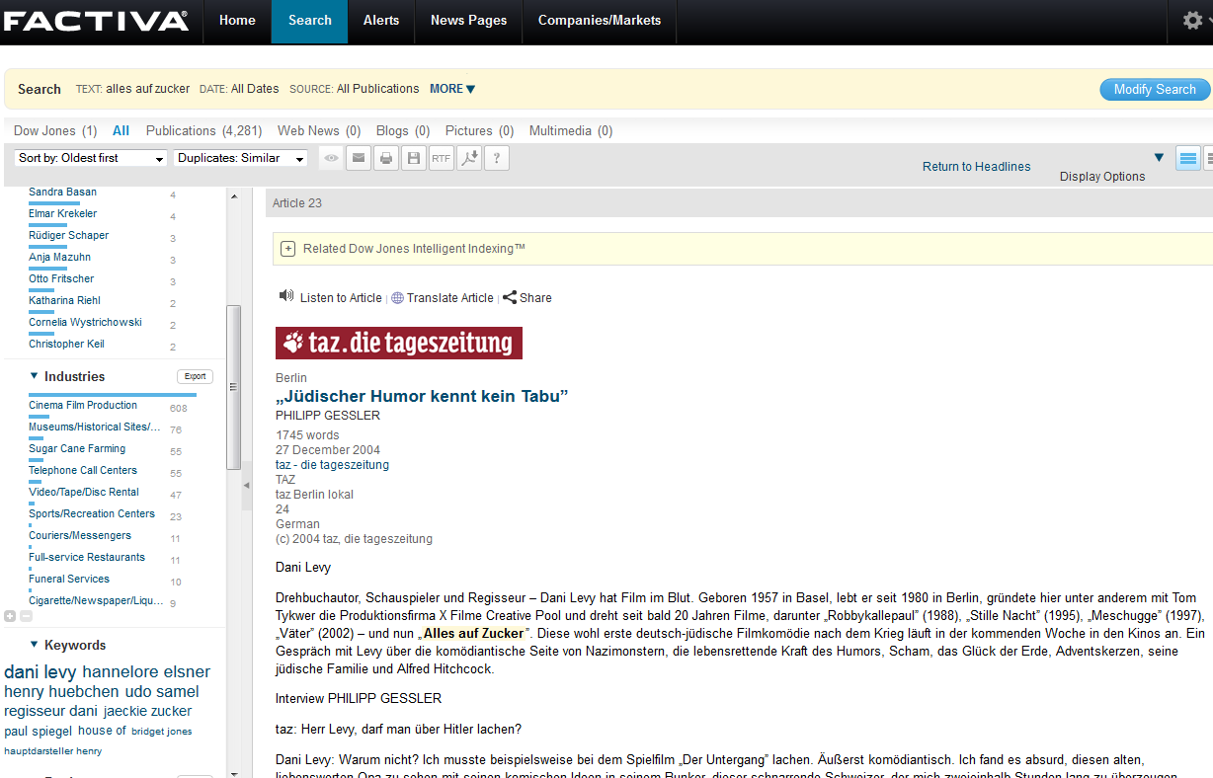

Slide 28
Use Box of Broadcasts to find UK TV & Radio programmes, including German films

Slide 29
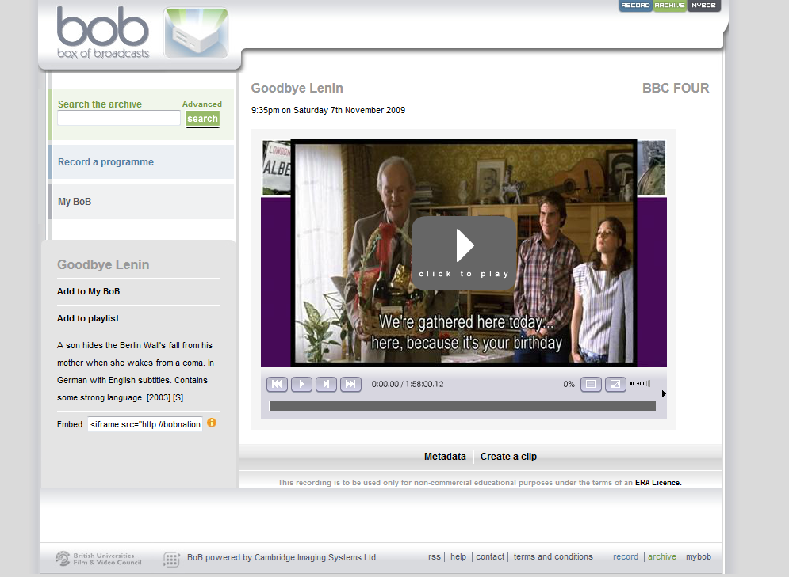

Slide 30
Use the Warwick German Studies Web to find useful websites

Slide 31
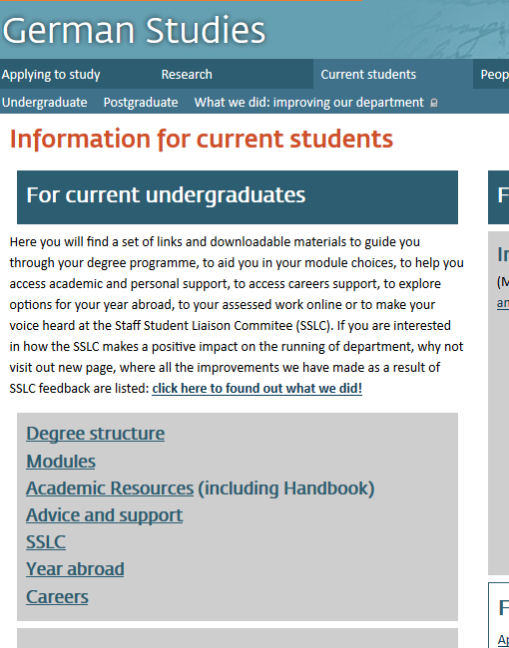

Slide 32
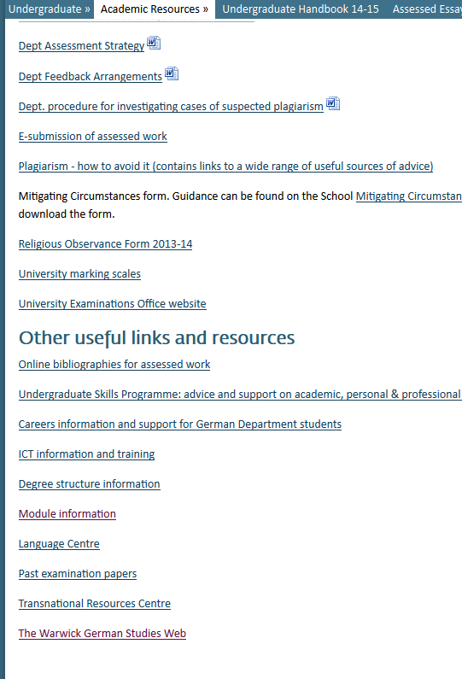

Slide 33
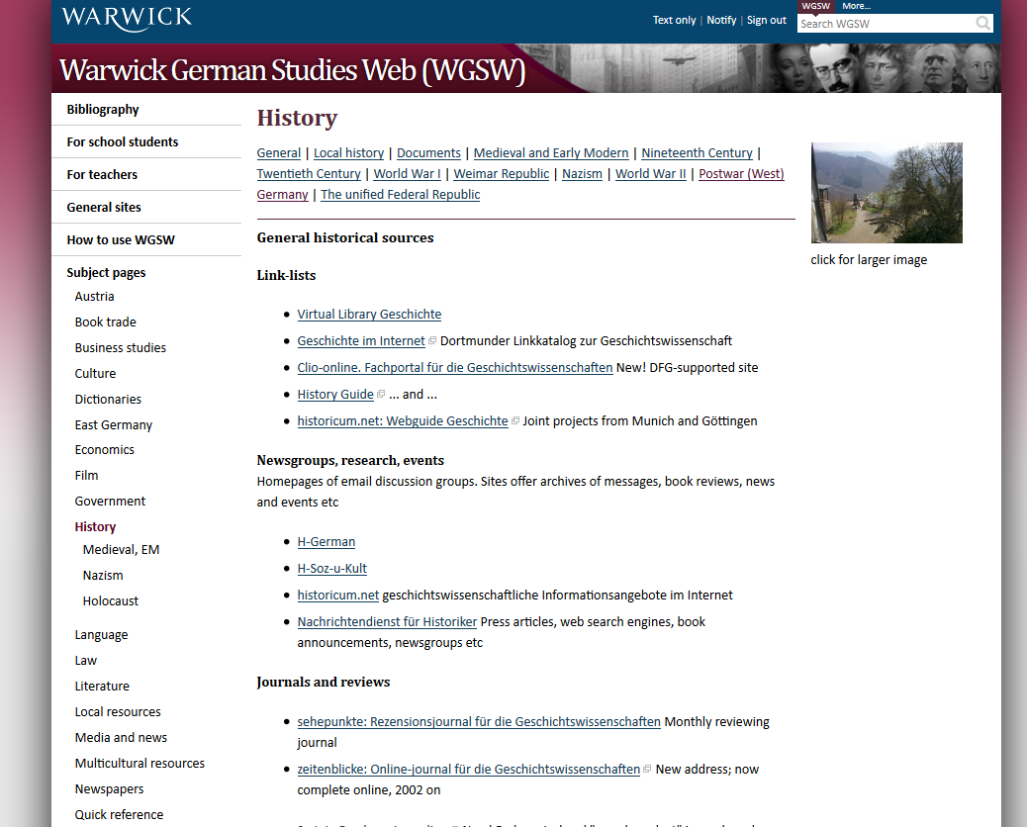

Slide 34
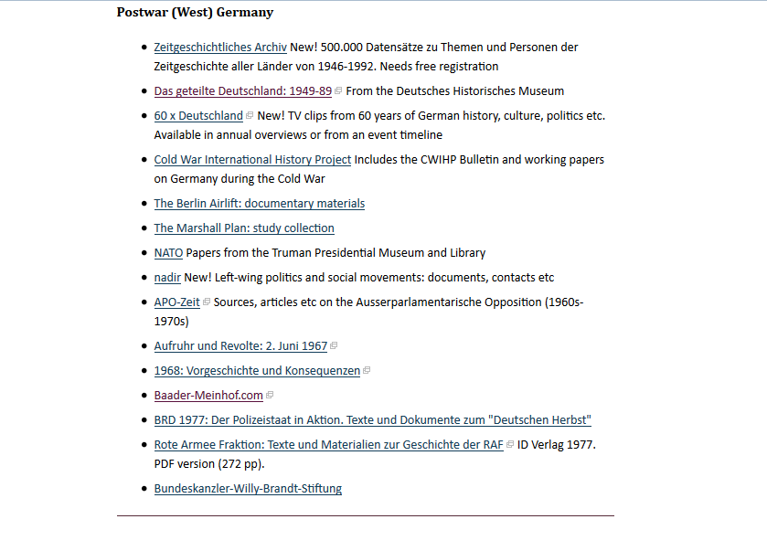

Slide 35
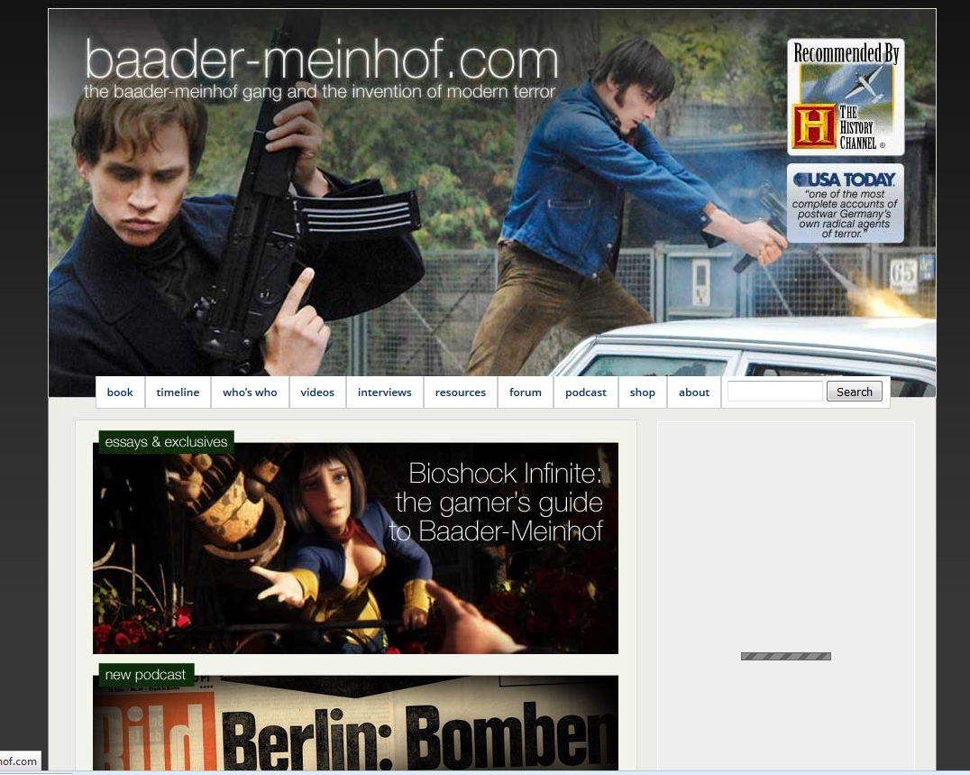

Slide 36
Evaluate websites. For examples: Who created the content? Are they an authority, or an enthusiast?

Slide 37
