Slide 1
GE108 The Changing Face of Germany Multicultural Germany Lecture 1: Post-war migration to the Federal Republic 1955-1990

Slide 2
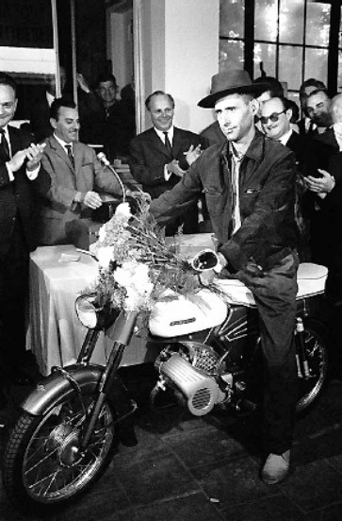

Slide 3
Phase 1: 1955-1973: recruitment– a positive start
‘Pull’ factors
Economic growth: 1950 – 25.0%; 1951 – 18.1%; unemployment fell from 10.3% in 1950 to 1.2% in 1960.
War deaths skewed the population profile towards the elderly and the female; depressed the birth rate; led to a labour shortage in a time of unprecedented economic reconstruction and growth.
Improved education & prospects for Germans - & hence reluctance to work in non- & low-skilled jobs.

Slide 4
‘Push’ factors
Unemployment
Poverty
Underdevelopment

Slide 5
The labour shortage was initially covered by expellees (7.8m) and emigrants from Eastern Germany/GDR (3m during 1945-61).
August 1961: the building of the Berlin Wall.

Slide 6
‘Anwerbeverträge’
Italy (1955)
Spain & Greece (1960)
Turkey (1961 & 1964)
Portugal (1964)
Tunisia (1965)
Yugoslavia (1968)
Matching labour with industrial demand

Slide 7
In theory, an arrangement of mutual benefit.
‘Deutschland ist kein Einwanderungsland’: guest workers would stay 2-3 years (without families) before being replaced.
The ‘Rotationsprinzip’ would prevent settlement.

Slide 8
Armando Rodrigues de Sa, Bahnhof Köln Deutz, Sept. 1964 the millionth Gastarbeiter

Slide 9
‘Man hat Arbeitskräfte gerufen, und es kommen Menschen’ (Max Frisch)
Ozan Ata Canani: Deutsche Freunde (197?)
http://www.youtube.com/watch?v=o2QITWrBkFE

Slide 10
Phase 2, 1973-1980: Consolidation – the bubble starts to burst
1961: 137,200 non-working foreigners in the FRG
1973: 1.37m
Increasing number of families settling (‘Familiennachzug’)
1972/3 oil crisis
November 1973 ‘Anwerbestopp’
Ironically, this encouraged foreigners already in the FRG to stay longer

Slide 11
Foreign workers in the FRG
1960 | 280,000
1965 | 1.2m
1973 | 2.6m
Late 70s | 4m+

Slide 12
Phase 3, 1981-1990: Tightening of immigration policy
The 1980s saw political polarisation between:
those seeking greater civil and voting rights for foreigners
those seeking to limit immigration.
Mid-1983: SPD-FDP coalition gives way to CDU-CSU-FDP
Late 1983: the introduction of ‘Rückkehrprämien’ of DM 10,500 per adult and DM 1,500 per child.
But, by February 1984 only 150,000 claims had been lodged.

Slide 13
1988: proposal for tightening immigration failed in the face of broad-based social opposition – churches, charities, ‘Ausländerbeauftragte’, unions, employers, SPD, Greens, the liberal wing of the FDP and the left of the CDU.
Despite attempts to restrict immigration in the 1980s, the non-German population grew 6%, from 4.5m to 4.8m.
January 1991: a new immigration law made little apparent change, but widened the latitude for bureaucratic interpretation of regulations.

Slide 14
From Gastarbeiterliteratur to Diasporic Literature
1970s: mainly Italian guest workers began to publish literary and documentary accounts of their experiences of migration in Italian journals – poetry, short stories, reportage.
A largely male phenomenon, based in the workplace or the immediate environment of the guest worker.
Gritty social realism – a Literatur der Betroffenheit which held up a mirror to German policies and attitudes but also contained a therapeutic dimension.

Slide 15
It represents the first phase in contemporary German-language diasporic writing:
Literature produced by migrants to Germany and subsequent generations
which arises from or thematises the experience of diaspora
the forced or necessary emigration from (normally) a country of origin
which is marked by some form of trauma (economic, social, linguistic etc.)
And leaves an imprint in terms of memory

Slide 16
Literature from the mid-1980s looked beyond the day-to-day aspects of life as a foreigner in Germany, and began to explore complex issues relating to identity.
Migrant writers began to explore the bi-polar nature of existing between two distinct cultures.
This is reflected in a plethora of metaphors and images in which the migrant is trapped or suspended perilously between cultures: the bridge, the gate, the high wire, being between banks or shores.

Slide 17
This self-conceptualisation became the dominant paradigm (the ‘two worlds paradigm’) for critics’ approach to migrant literature, and is still in evidence.
This situation became clichéd as ‘zwischen zwei Stühlen’, a phrase coined ironically by a migrant writer.
Cf. poems ‘Dazwischen’ by Alev Tekinay and ‘Doppelmann’ by Zafer Senoçak.

Slide 18
By the mid-1990s, this model began to break down:
second and subsequent generations no longer conceived of themselves as between two cultures
the supposedly distinct edges of cultural ‘blocks’ became fuzzy
the upsurge in racist violence in the early 1990s undermined hopes for harmonious community relations
reunification had relegated the situation of foreigners in the hierarchy of social priorities.

