Slide 1
Welcome meeting for Visiting students
School of Modern Languages and Cultures (five sections)

Slide 2
Who is who in the School?
Dr Philippe Le Goff—Director of Incoming Visiting Students
Contact SMLC staff via email. See here for a list of academic staff

Slide 3
Your Personal Tutor
The role of the Personal Tutor is pastoral and academic
Personal tutors and all academics have dedicated advice and feedback hours—check their webpages for details
They are your first point of contact for any pastoral issues

Slide 4
Academic life
The Warwick academic year is divided into three terms of 10 weeks each;
the term times are approximately;
Autumn: October to December,
Spring: January to March,
Summer: April to June.
Reading weeks: weeks 6 in terms 1 & 2 – check whether or not your class is running
Term dates are available on this webpage.
Teaching: lectures and seminars are mainly held in the Autumn and Spring Terms.
The Summer Term is mainly reserved for revision and examinations, although there are some subject areas which continue teaching modules.

Slide 5
Monitoring Points
Attendance at teaching events is compulsory for students
If you cannot attend a teaching event you MUST email the tutor involved
In the School of Modern Languages and Cultures, we are obliged to monitor students’ attendance

Slide 6
Monitoring Points
Term 1
Contact with department’s Incoming Visiting Students Co-ordinator or Personal Tutor by the end of Week 1
Submission of Learning Agreement to School Office by end Week 3
Attendance at a face-to-face or live online synchronous teaching event in Week 5
Attendance at a face-to-face or live online synchronous teaching event in Week 7
Attendance at a face-to-face or live online synchronous teaching event in Week 9
Attendance at a face-to-face or live online synchronous teaching event in Week 10
Term 2
Attendance at a face-to-face or live online synchronous teaching event in Week 1
Attendance at a face-to-face teaching event in Week 4
Attendance at a a face-to-face or live online synchronous teaching event in Week 8
Attendance at a a face-to-face or live online synchronous teaching event in Week 10
Term 3
Completion of agreed summative assessment tasks
*note that not all visiting students stay for the whole academic year; only those Monitoring Points which cover the duration of the visit apply.

Slide 7
Learning Agreements
The Erasmus Plus Learning Agreements are provisional (for funding);
You should finalise the Erasmus Plus Learning Agreement once you have a place on your modules
The confirmed Learning Agreements should show an accurate list of Warwick modules taken

Slide 8
Module selection
For SMLC-based modules, please complete the module preference form as soon as possible.
See here for the list of available module in the School of Modern Languages and Cultures
For History, English, CAL (Centre for Applied Linguistics) and other departments: you will need to contact the relevant departments. English normally only possible from week 2.
Most teaching begins next week, i.e. w/c Monday 30 September
Philippe Le Goff can provide academic support for choosing modules. You can also contact module leaders to ask about module content, level, assessment etc.

Slide 9
Please note: subject departments at Warwick may not correspond to subject areas in the home University
You should always check with your host institution to ensure the modules you have chosen are suitable

Slide 10
Language Centre modules
Webpage for Language Centre academic modules
How to enrol for Language Centre modules
If you take an academic module for CATS, i.e. as part of your academic studies, enrolment opened at 12pm Friday 20 September.
See here for information on language courses (called Lifelong Language Learning) that are not for CATS, i.e. an extra-curricular activity.

Slide 11
Part-year student assessment
Special Assessment methods are available for students who leave Warwick prior to the Summer Term or who do not complete a full academic year.
Special Assessment methods can consist of written exams, the submission of individual essays, or other types of tests, where appropriate.
Please speak to smlcoffice@warwick.ac.uk

Slide 12
Credits (CATS)
Credit is given in CATS: one ECTS is equivalent to two Warwick CATS
Full Year 100% of the total CATS credits workload = 120 CATS
Full modules (full academic year) are normally 30 CATS (15 ECTS);
Half modules (one term) are counted as 15 CATS (7.5 ECTS);
Part-year students: the weighting used for a year-long module is normally 40% for Autumn Term, 40% for Spring Term and 20% for Summer term
The above information about module selection is available for you to consult on the Visiting Students webpage

Slide 13
Language Support
English language tuition is offered by Warwick Foundation Studies
Full information can be found on this webpage
If you have any questions email insessional@warwick.ac.uk
Places are booked on courses on a 1st come 1st served basis. These courses are not ‘for credit’, however informal recognition of this can be obtained.
Home institutions may then decide whether sessions can be credited in their system.

Slide 14
IT @ Warwick
Tabula – timetable, registration status, personal tutor information
Moodle – teaching and learning resources, assessed work submission and feedback
Software – available on managed computers and personal computers
Central University Resources – remote access drive, help, advice and training

Slide 15
Webmail http://go.warwick.ac.uk/mymail
E-mail
Synchronize to Phone / Tablet / Laptop / PC
Follow instructions for software / app using settings below:
Type of Account: Exchange
E-mail address: IT services usercode followed by @live.warwick.ac.uk
e.g. u1234567@live.warwick.ac.uk
Username: Same as e-mail address
Password: IT services account password

Slide 16
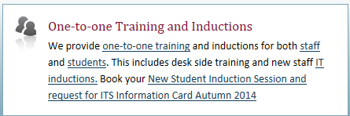
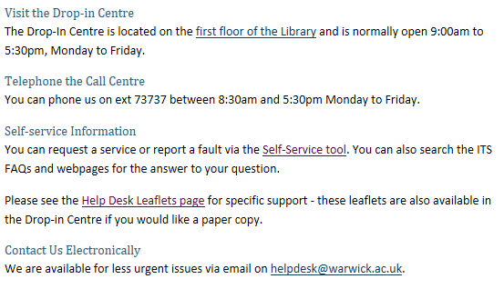
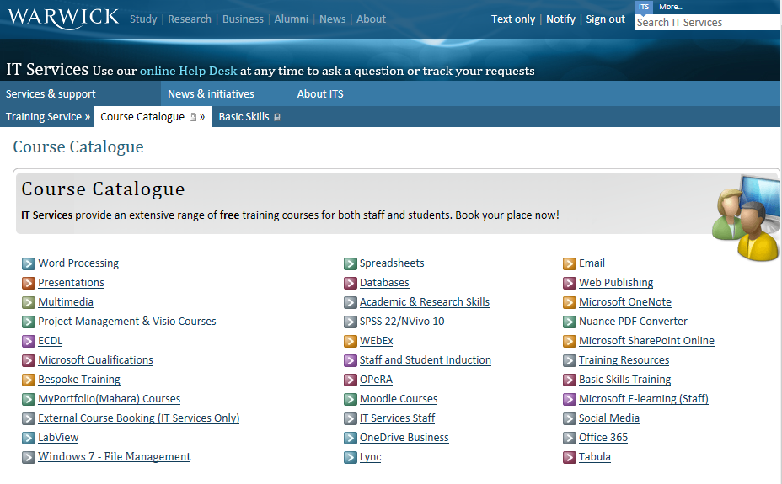
IT Help
http://www2.warwick.ac.uk/services/its/servicessupport/

Slide 17
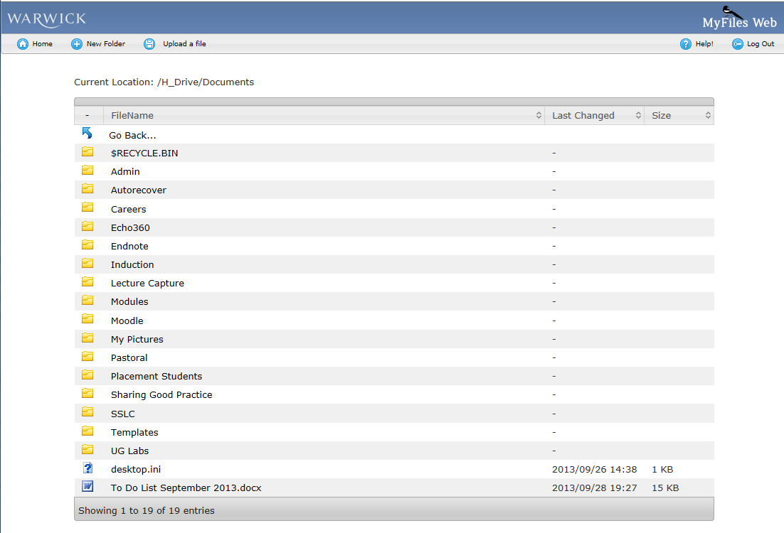
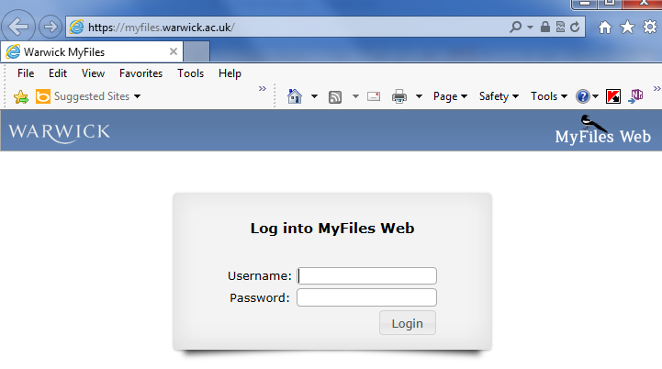
H: Drive
Access your files everywhere!
On managed desktops (e.g. library)
  → Computer → H: Drive
Own computer
  Use WebDAV: https://www2.warwick.ac.uk/services/its/servicessupport/datastorage/myfiles/myfiles-webdav
Web Browser
  myfiles.warwick.ac.uk
  http://www2.warwick.ac.uk/services/its/servicessupport/datastorage/myfiles/

Slide 18
Further support and information
In the first instance, contact your personal tutor
Student Support Services at Warwick include the Counselling Service
Nightline—24hrs confidential support for students

Slide 19
Financial queries
Your home university’s International Office or Exchange Office can provide support for home university bureaucracy
Financial, Visa and Erasmus Plus queries at Warwick—contact Study Abroad team at Warwick:
studyabroad@warwick.ac.uk

Slide 20
Meeting new students
The Students’ Union has over 250 student-run societies.
Part of the British university experience. A good way to meet people.
Language societies:
French society
German society
Hispanic society
Italian society

Slide 21

SSLC -
What it’s about
What it can do for you
Role of the SSLC rep
How to take part

Slide 22

What it’s about
SSLC = student staff liaison committee
Dialogue between students and staff
A way for students to have their say on their educational experience at Warwick

Slide 23
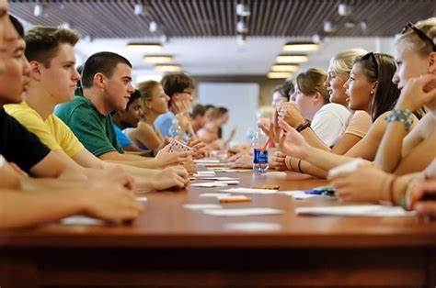
What it can do for you
If you have a student representing you on the SSLC, you can raise an issue with your rep who will discuss it at the meeting and then report back
Issues discussed: teaching, assessment, resources, student support, careers development…

Slide 24

Role of the SSLC rep
Collect views from the student group you represent and discuss these at SSLC meetings
Attend the online SSLC meetings (around 5 a year)
Report back decisions taken at the SSLC meetings
Advantages for the rep: bring about change, get to know fellow students and work with staff, something interesting on the CV

Slide 25

How to take part
Interested in becoming a rep and representing all the incoming visiting students? Contact Margaux Whiskin m.whiskin@warwick.ac.uk by Friday 18 October, 5pm (week 3)

Slide 26
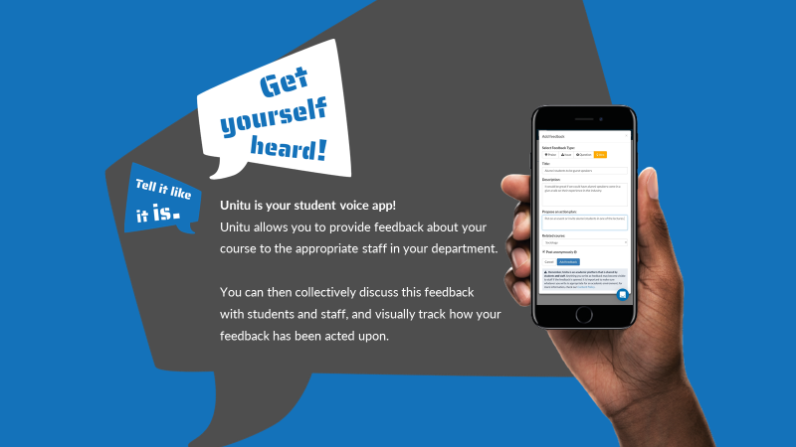
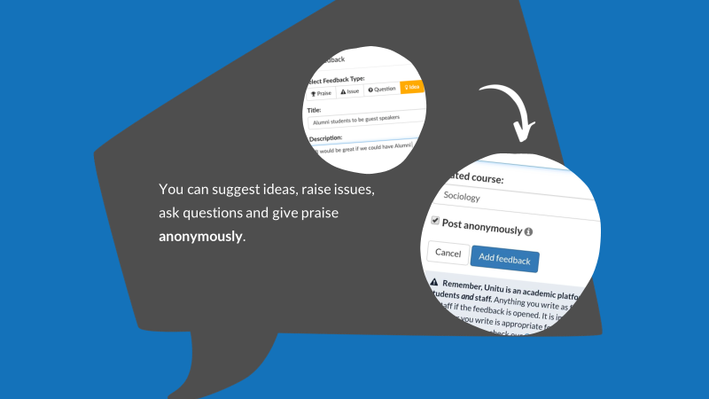
UNITU
YOUR STUDENT-VOICE
PLATFORM

Slide 27
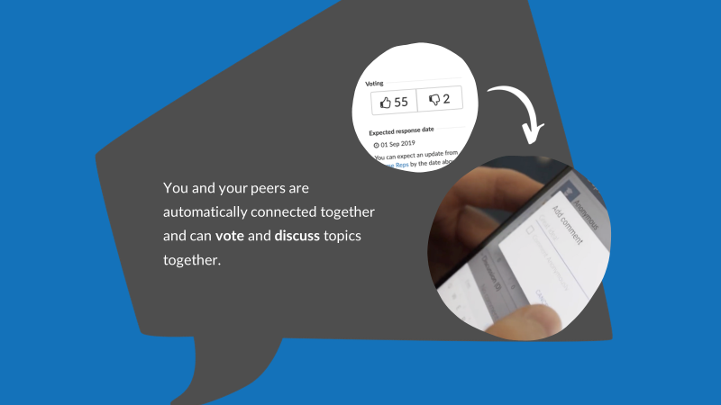
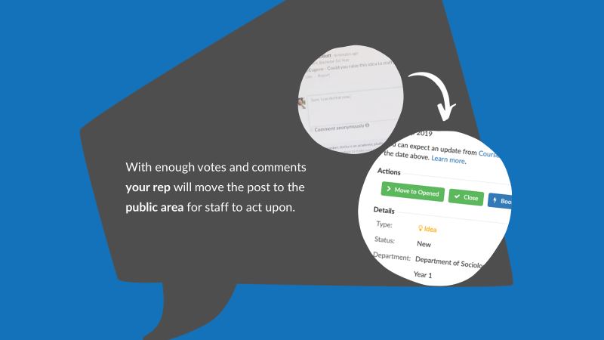
UNITU
YOUR SPACE – OWN IT!

Slide 28
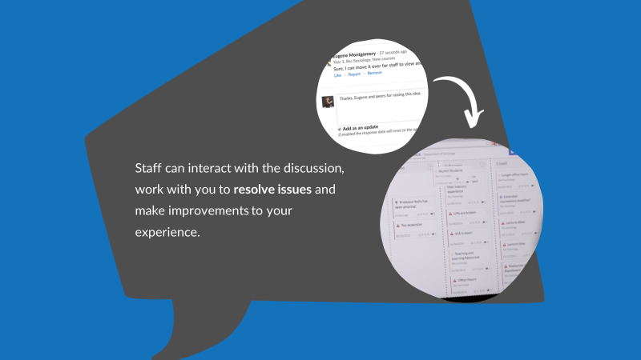
UNITU, YOUR STUDENT-VOICE PLATFORM
Use Unitu to contact your rep
To take part in discussions
To see how student feedback has been acted upon

Slide 29
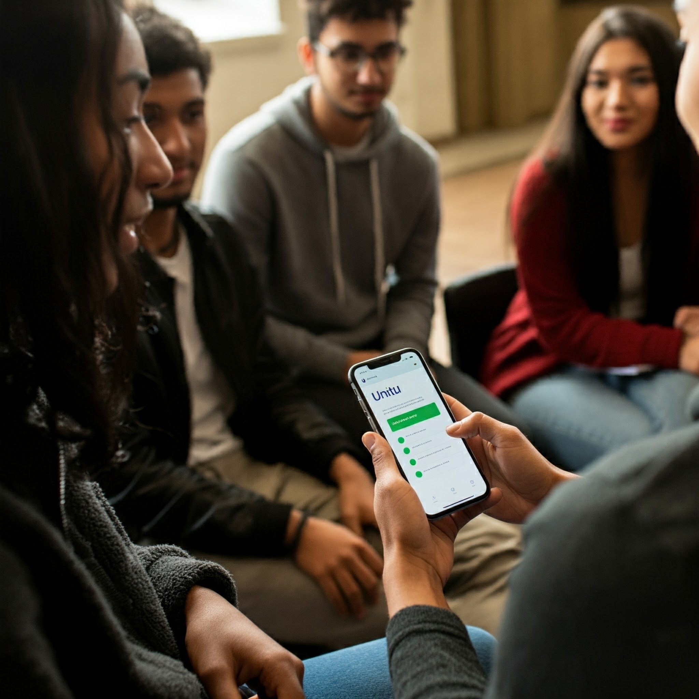

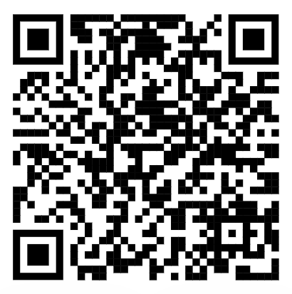
https://warwick.unitu.co.uk/Account/Login

Slide 30

Find your Language Buddy

Slide 31

What it’s about…
Interested in meeting other students in the School of Modern Languages and Cultures?
Do you want an opportunity to practise your English outside of the classroom?
Would you be happy, in exchange, to give a student the opportunity to practise French/Spanish/Italian/German?

Slide 32

How it works…
Send an email to Margaux Whiskin by Friday 18 October, 5pm (m.whiskin@warwick.ac.uk)
We will pair you up with a student and help organise your first meeting

Slide 33
What next?
Any academic questions can be directed to Philippe Le Goff
Any administrative questions can be directed to the SMLC office: smlcoffice@warwick.ac.uk
Visiting students webpage: https://warwick.ac.uk/fac/arts/modernlanguages/intranet/undergraduate/visitingstudents/

