Slide 1
Welcome meeting for Visiting students
School of Modern Languages and Cultures (five sections)

Slide 2
Who is who in the School?
Philippe Le Goff—Director of Incoming Visiting Students
Carol Rice – Incoming Visiting Students Secretary and Programme Coordinator
Sarah Barton – Module Availability for Incoming Visiting Students
Contact SMLC staff via email. See here:
https://warwick.ac.uk/fac/arts/modernlanguages/academic/
SMLC Face-to-Face Drop-in Sessions. Book here:
https://warwick.ac.uk/fac/arts/modernlanguages/drop-in

Slide 3
Your Personal Tutor
The role of the Personal Tutor is pastoral and academic
Personal tutors and all academics have dedicated office hours—check their webpages for details
They are your first point of contact for any pastoral issues

Slide 4
The Warwick academic year is divided into three terms of 10 weeks each;
the term times are approximately;
Autumn: October to December,
Spring: January to March,
Summer: April to June.
(http://www2.warwick.ac.uk/study/termdates)
Teaching: lectures and seminars are mainly held in the Autumn and Spring Terms.
The Summer Term is mainly reserved for revision and examinations; although there are some subject areas which continue teaching modules.

Slide 5
Choosing modules in Warwick
Philippe Le Goff can provide academic support for choosing modules
You should complete the initial SMLC-level Module Request form to confirm modules.
Carol Rice will send you this form by email after this meeting. Please complete and return the form by email to her no later than Friday 16 October
Space on modules must be checked with Sarah Barton

Slide 6
Learning Agreements
The Erasmus Plus Learning Agreements so far are provisional (for funding);
You should finalise the Erasmus Plus Learning Agreement once you have a place on your modules
The confirmed Learning Agreements should show an accurate list of Warwick modules taken

Slide 7
Subject departments at Warwick may not correspond to subject areas in the home University
You should always check with your host institution to ensure the modules you have chosen are suitable

Slide 8
Module choices
https://warwick.ac.uk/fac/arts/modernlanguages/intranet/undergraduate/visitingstudents
Available Modules in the School of Modern Languages and Cultures
SMLC modules
History, English, CAL (Centre for Applied Linguistics) and other departments: you will need to contact the relevant departments. English normally only possible from week 2.

Slide 9
Language Centre modules
If you plan to take an academic module for CATS (as part of your degree study), please make sure that your department is in agreement and that you are aware of any restrictions.
https://warwick.ac.uk/fac/arts/languagecentre/academic/enrolment/
https://warwick.ac.uk/fac/arts/languagecentre/academic/
Please note: enrolment for Language Centre modules in 2020-21 will take place remotely.
If you take an academic module for CATS (as part of your studies), enrolment opens on Monday 21 September. The deadline to complete pre-enrolment is Wednesday 7 October.
If you take an Language Centre not for CATS, enrolment will open Monday 5 October). The deadline to complete a pre-enrolment form is Friday 9 October.

Slide 10
Language Centre (2)
If you are taking the module for credit as part of your degree studies, you must register the module on your e-vision (online module registration).
Full-year, or part-year doing one-term module: Select assessment method B or B1
Part-year students on a year-long module: (two terms): select VA
(also applies to other SMLC modules)

Slide 11
Part-year student assessment
Special Assessment methods are available for students who leave Warwick prior to the Summer Term or who do not complete a full academic year.
Special Assessment methods can consist of written exams, the submission of individual essays, or other types of tests, where appropriate.
Please speak to Sarah Barton s.a.davenport@warwick.ac.uk or
Carol Rice c.a.rice@warwick.ac.uk or refer to the Visiting Students handbook.

Slide 12
Credits (CATS)
Credit is given in CATS: one ECTS is equivalent to two Warwick CATS
Full Year 100% of the total CATS credits workload = 120 CATS
Full modules (full academic year) are normally 30 CATS (15 ECTS);
Half modules (one term) are counted as 15 CATS (7.5 ECTS);
Part-year students: the weighting used for a year-long module is normally 40% for Autumn Term, 40% for Spring Term and 20% for Summer term

Slide 13
Study Skills Training
To help you understand
teaching and assessment methods in SMLC and at Warwick
Study Skills:
lecture programmes (asynchronous recordings)
introductory information
advice
lecture slides

Slide 14
Language Support
Language Support 1. English language tuition is offered by the Centre for Applied Linguistics
Full information can be found at http://www2.warwick.ac.uk/fac/soc/cal/learningenglish/
Places are booked on courses on a 1st come 1st served basis. These courses are not ‘for credit’, however informal recognition of this can be obtained.
Home institutions may then decide whether sessions can be credited in their system 2.
In-sessional English language courses (held online): certificates of completion will be provided if students attended a minimum of 80% of the course.

Slide 15
Monitoring Points
Attendance at teaching events is compulsory for students
If you cannot attend a teaching event you MUST email the tutor involved
In the School of Modern Languages and Cultures, we are obliged to monitor students’ attendance

Slide 16
Monitoring Points
Term 1
Contact with department’s Incoming Visiting Students Co-ordinator or Personal Tutor by the end of Week 1
Submission of Learning Agreement to School Office by end Week 3
Attendance at a face-to-face or live online synchronous teaching event in Week 5
Attendance at a face-to-face or live online synchronous teaching event in Week 7
Attendance at a face-to-face or live online synchronous teaching event in Week 9
Attendance at a face-to-face or live online synchronous teaching event in Week 10
Term 2
Attendance at a face-to-face or live online synchronous teaching event in Week 1
Attendance at a face-to-face teaching event in Week 4
Attendance at a a face-to-face or live online synchronous teaching event in Week 8
Attendance at a a face-to-face or live online synchronous teaching event in Week 10
Term 3
Completion of agreed summative assessment tasks
*note that not all incoming Erasmus students stay for the whole academic year; only those Monitoring Points which cover the duration of the visit apply.

Slide 17
IT @ Warwick
Tabula – timetable, registration status, personal tutor information
Moodle – teaching and learning resources, assessed work submission and feedback
Software – available on managed computers and personal computers
Central University Resources – remote access drive, help, advice and training

Slide 18
Webmail http://go.warwick.ac.uk/mymail
E-mail
Synchronize to Phone / Tablet / Laptop / PC
Follow instructions for software / app using settings below:
Type of Account: Exchange
E-mail address: IT services usercode followed by @live.warwick.ac.uk
e.g. u1234567@live.warwick.ac.uk
Username: Same as e-mail address
Password: IT services account password

Slide 19
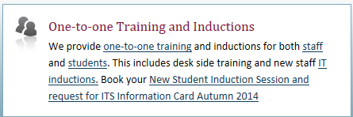
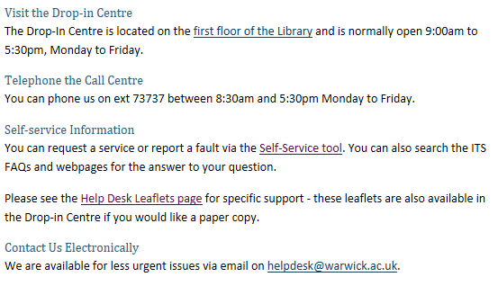
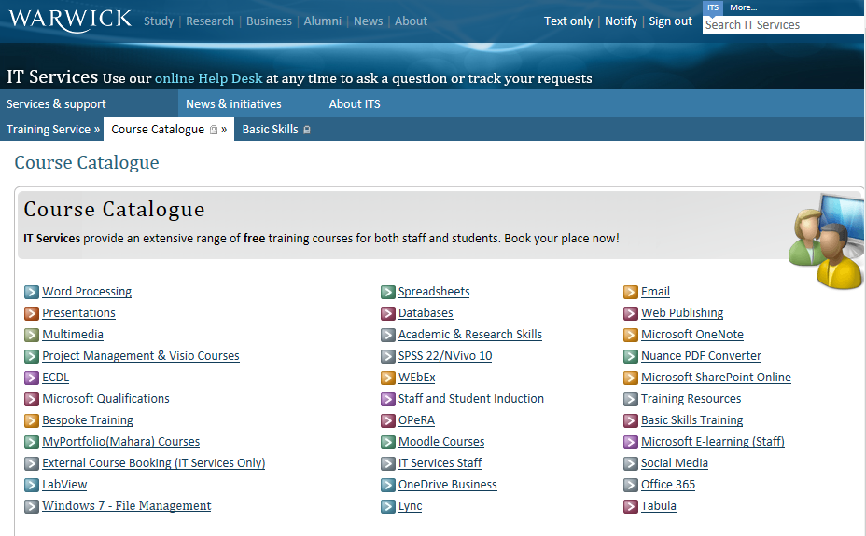
IT Help
http://www2.warwick.ac.uk/services/its/servicessupport/

Slide 20
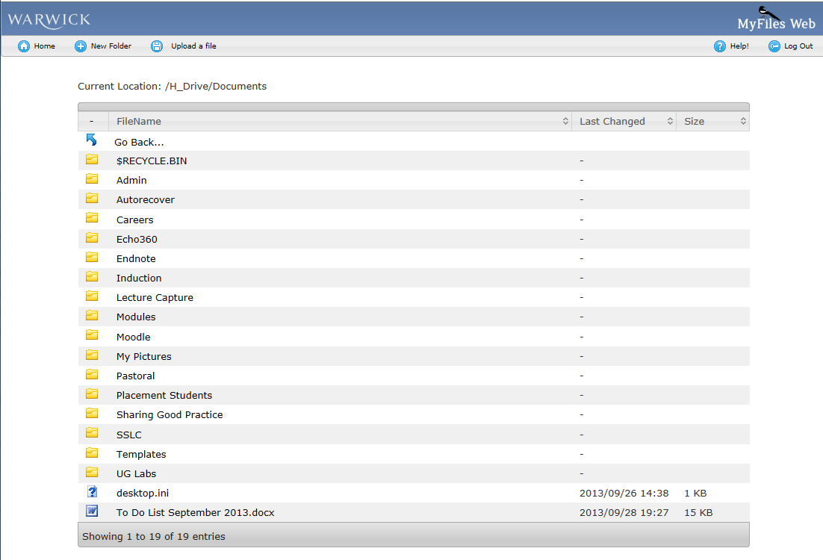
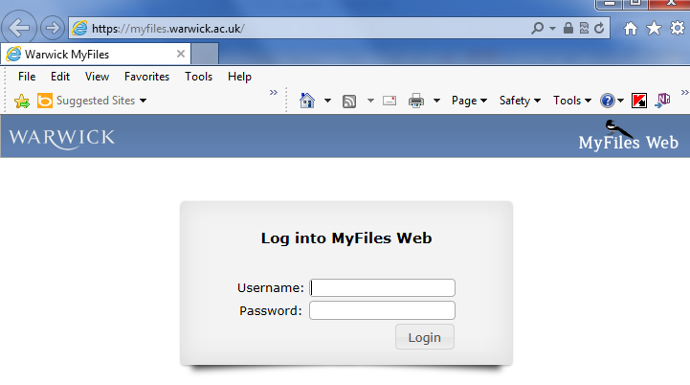
H: Drive Access your files everywhere!
On managed desktops (e.g. library)
→ Computer → H: Drive
Own computer
Use WebDAV: https://www2.warwick.ac.uk/services/its/servicessupport/datastorage/myfiles/myfiles-webdav
Web Browser
myfiles.warwick.ac.uk
http://www2.warwick.ac.uk/services/its/servicessupport/datastorage/myfiles/

Slide 21
Further support and information
In the first instance, contact personal tutor in your host section
Student Support Services at Warwick include the Counselling Service
Nightline—24hrs confidential support for students

Slide 22
Financial queries
Your home university’s International Office or Exchange Office can provide support for home university bureaucracy
Financial and Erasmus Plus queries at Warwick—contact Study Abroad team at Warwick:
Europemobility@warwick.ac.uk for European students
studyabroad@warwick.ac.uk for overseas students

Slide 23
Meeting new students
The Students’ Union has over 250 student-run societies.
Part of the British university experience. A good way to meet people.
Language societies:
French society
German society
Hispanic society
Italian society

Slide 24

SSLC -
What it’s about
What it can do for you
Role of the SSLC rep
How to take part

Slide 25

What it’s about
SSLC = student staff liaison committee
Dialogue between students and staff
A way for students to have their say on their educational experience at Warwick

Slide 26
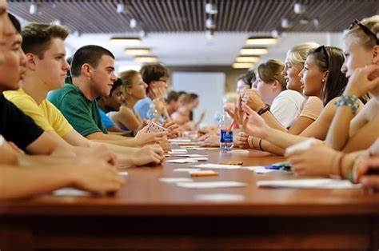
What it can do for you
If you have a student representing you on the SSLC, you can raise an issue with your rep who will discuss it at the meeting and then report back
Issues discussed: teaching, assessment, resources, student support, careers development…

Slide 27

Role of the SSLC rep
Collect views from the student group you represent and discuss these at SSLC meetings
Attend the online SSLC meetings (around 5 a year)
Report back decisions taken at the SSLC meetings
Advantages for the rep: bring about change, get to know fellow students and work with staff, something interesting on the CV

Slide 28

How to take part
Check out the SMLC SSLC page on Moodle under ‘Additional Courses’
Interested in becoming a rep and representing all the incoming Erasmus students? Contact Margaux Whiskin (m.whiskin@warwick.ac.uk) by Friday the 16th of October, 5pm (week 2)

Slide 29

Find your Language Buddy

Slide 30

What it’s about…
Interested in meeting other students in the School of Modern Languages and Cultures?
Do you want an opportunity to practise your English outside of the classroom?
Would you be happy, in exchange, to give a student the opportunity to practise French/Spanish/Italian/German?

Slide 31

How it works…
Send an email to Margaux Whiskin by Friday 9 October, 5pm (m.whiskin@warwick.ac.uk)
We will pair you up with a student and help organise your first meeting on Teams

Slide 32
What next?
Any academic/module choice questions can be directed to Philippe Le Goff
Any administrative questions can be directed to Carol Rice c.a.rice@warwick.ac.uk
Questions regarding space on SMLC modules can be directed to Sarah Barton S.A.Davenport@warwick.ac.uk

