Slide 1
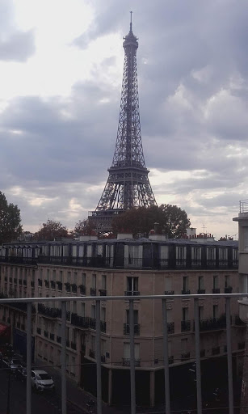
A Day Trip around Paris

Slide 2
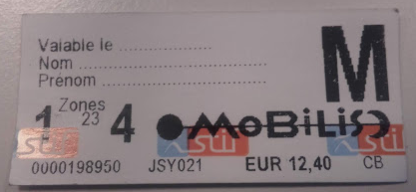
Getting to Paris
As I live so close to the city, one of my favorite weekend activities is to go to Paris.
To get there, I normally take the local train network, which is known as the RER. (Réseau express régionale).
This is an RER day pass. It lets you have unlimited travel on any RER train as well as the metro in Paris, so it’s very useful. However, it’s easy to loose these small paper tickets!

Slide 3
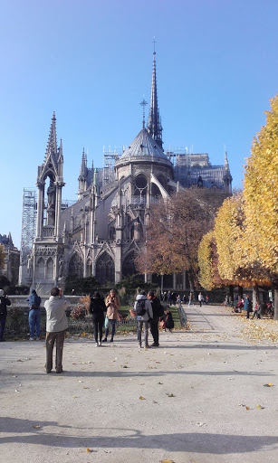
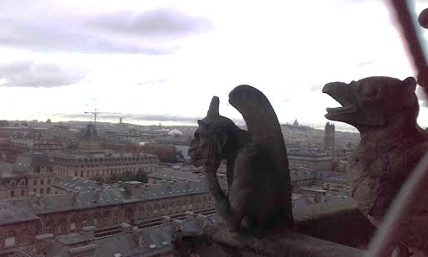
Notre Dame
I started my day with a trip to Notre Dame, a beautiful cathedral right in the heart of the city. It’s free for anyone to go inside, and people under 26 with an EU passport can even climb one of the towers for free!

Slide 4
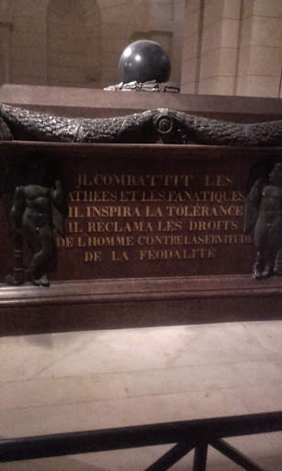
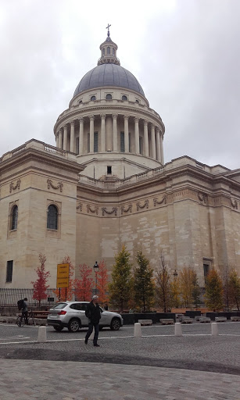
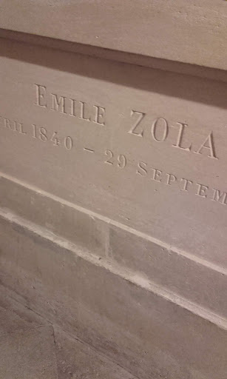
The Panthéon
After this, I walked south of the river for a little bit to get to the Panthéon. This building is a little like Westminster Abbey, as it houses the remains of many famous French people. Rousseau, Voltaire, Emile Zola and Victor Hugo are all buried here.

Slide 5

Musée de l’Orangerie
After getting something to eat, I went towards the East side of the city to see the Monet paintings at the Musée de l’Orangerie.
I really wanted to see them as I had studied Monet for my A Level French exam.

Slide 6
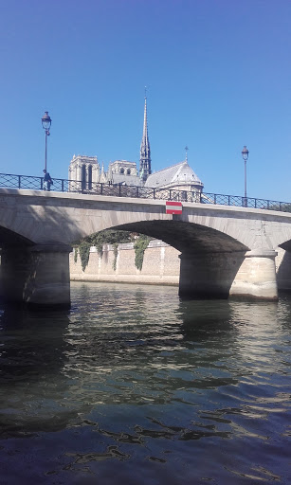
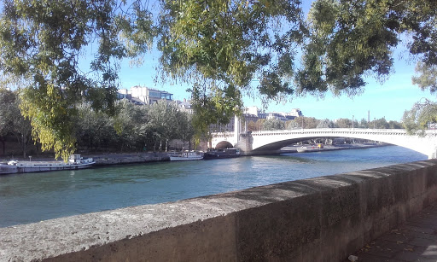
The Seine
I finished my day with a walk down the Seine. One of the big differences I’ve found between Paris and London is Paris’ laid back attitude. You will find many people relaxing in cafes or just sitting and talking by the river, in a way no one seems to do in London!

Slide 7
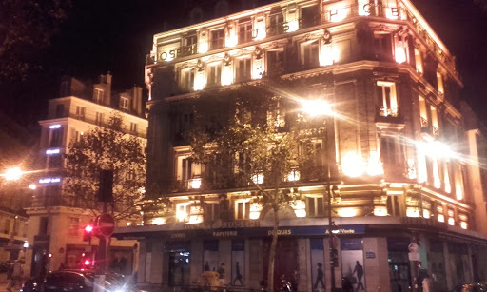
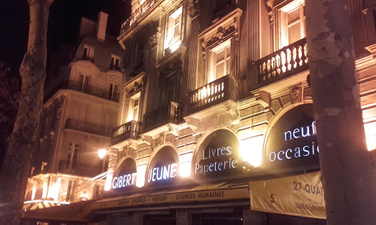
Nightime in Paris
By now it was getting late, so I finished my day by visiting a bar with some friends.
French nightlife is very different from the UK, as people do not drink as much and nightclubs are not that popular. Instead people tend to relax in cafes or bars.

