Slide 1

School life: France vs England

Slide 2
Institut St Louis St Clément
I work in a private school just outside of Paris, which is called St Louis St Clément.
It has a collège (secondary school) and a lycée (sixth form), and is linked with several other sites in the area.
The collège is very big, with around 30 pupils in each class and 7 classes in a year.
The collège ranges from sixieme (Year 7) to Trosième (Year 9)

Slide 3
Le Lycée
The Lycée is slightly smaller, with around 25 pupils in a class.
Rather than being divided just by year group, pupils are put into streams or ‘filières’ which determine what subjects they do.
For example:
Baccalauréat de sciences et technologies du management et de la gestion; STMG
Baccalauréat économique et social; ES
Baccalauréat littéraire; L
Pupils cannot just choose what subjects they want to do, unlike British A levels.

Slide 4
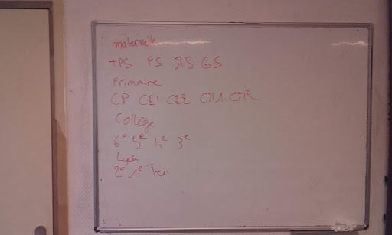
Stages of School
Here are the stages of French school which a pupil drew for me. Can you work out all the levels?

Slide 5
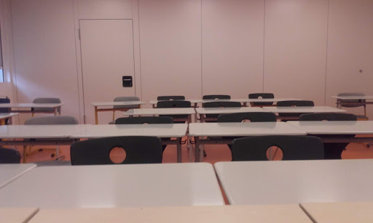
Organisation of the school
The French school day is much longer than the British one.
At my school, lessons start at 8.45 and end at 16.45, although if pupils have an after school slot they will finish at 17.40!
However there are two breaktimes and pupils have free periods throughout the day starting from Year 7.

Slide 6
Differences
Overall school life in the UK and France is rather similar. We both have lots of lessons and homework, with Exams in May and June.
However pupils here can wear their own clothes, and there is more freedom in terms of leaving school early. There is a canteen and a tuck shop, as well as a common room for Lycée students.
Overall I feel pupils are given more responsablity over their own work and grades, as the emphasis is on them to succeed. There are often more frequent tests in French schools too.

Slide 7
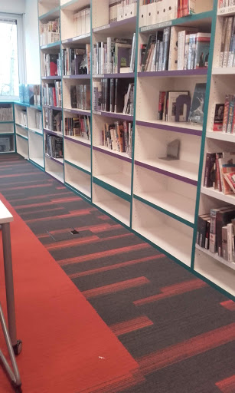
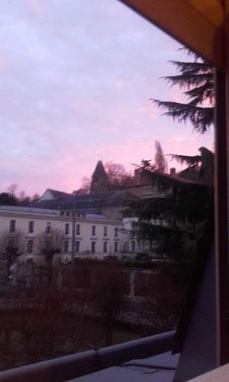
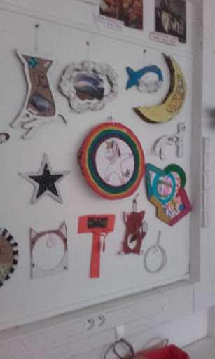
Pictures
The Library
The School
The Art room

