Slide 1
Ma Ville
My town

Slide 2
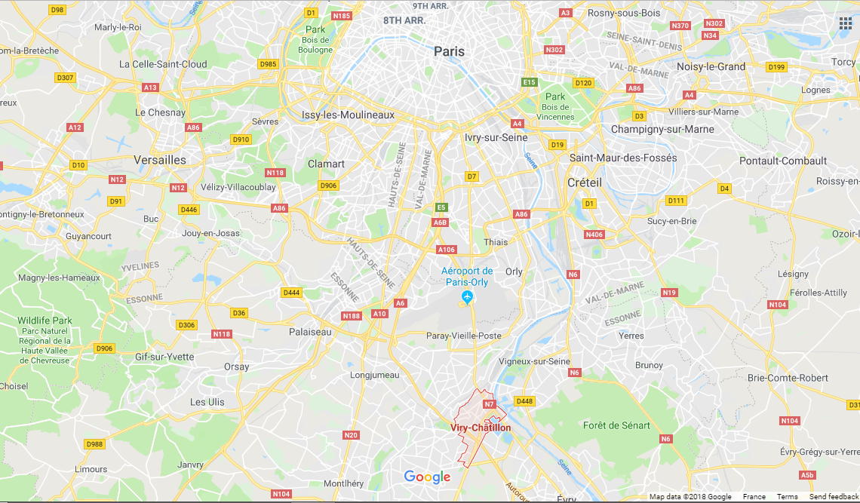
All about me!
Hi! My name is Stephen and I’m a British student currently working in France.
I live and work in a town called Viry-Châtillon, which is just outside Paris.
Here it is on a map!

Slide 3
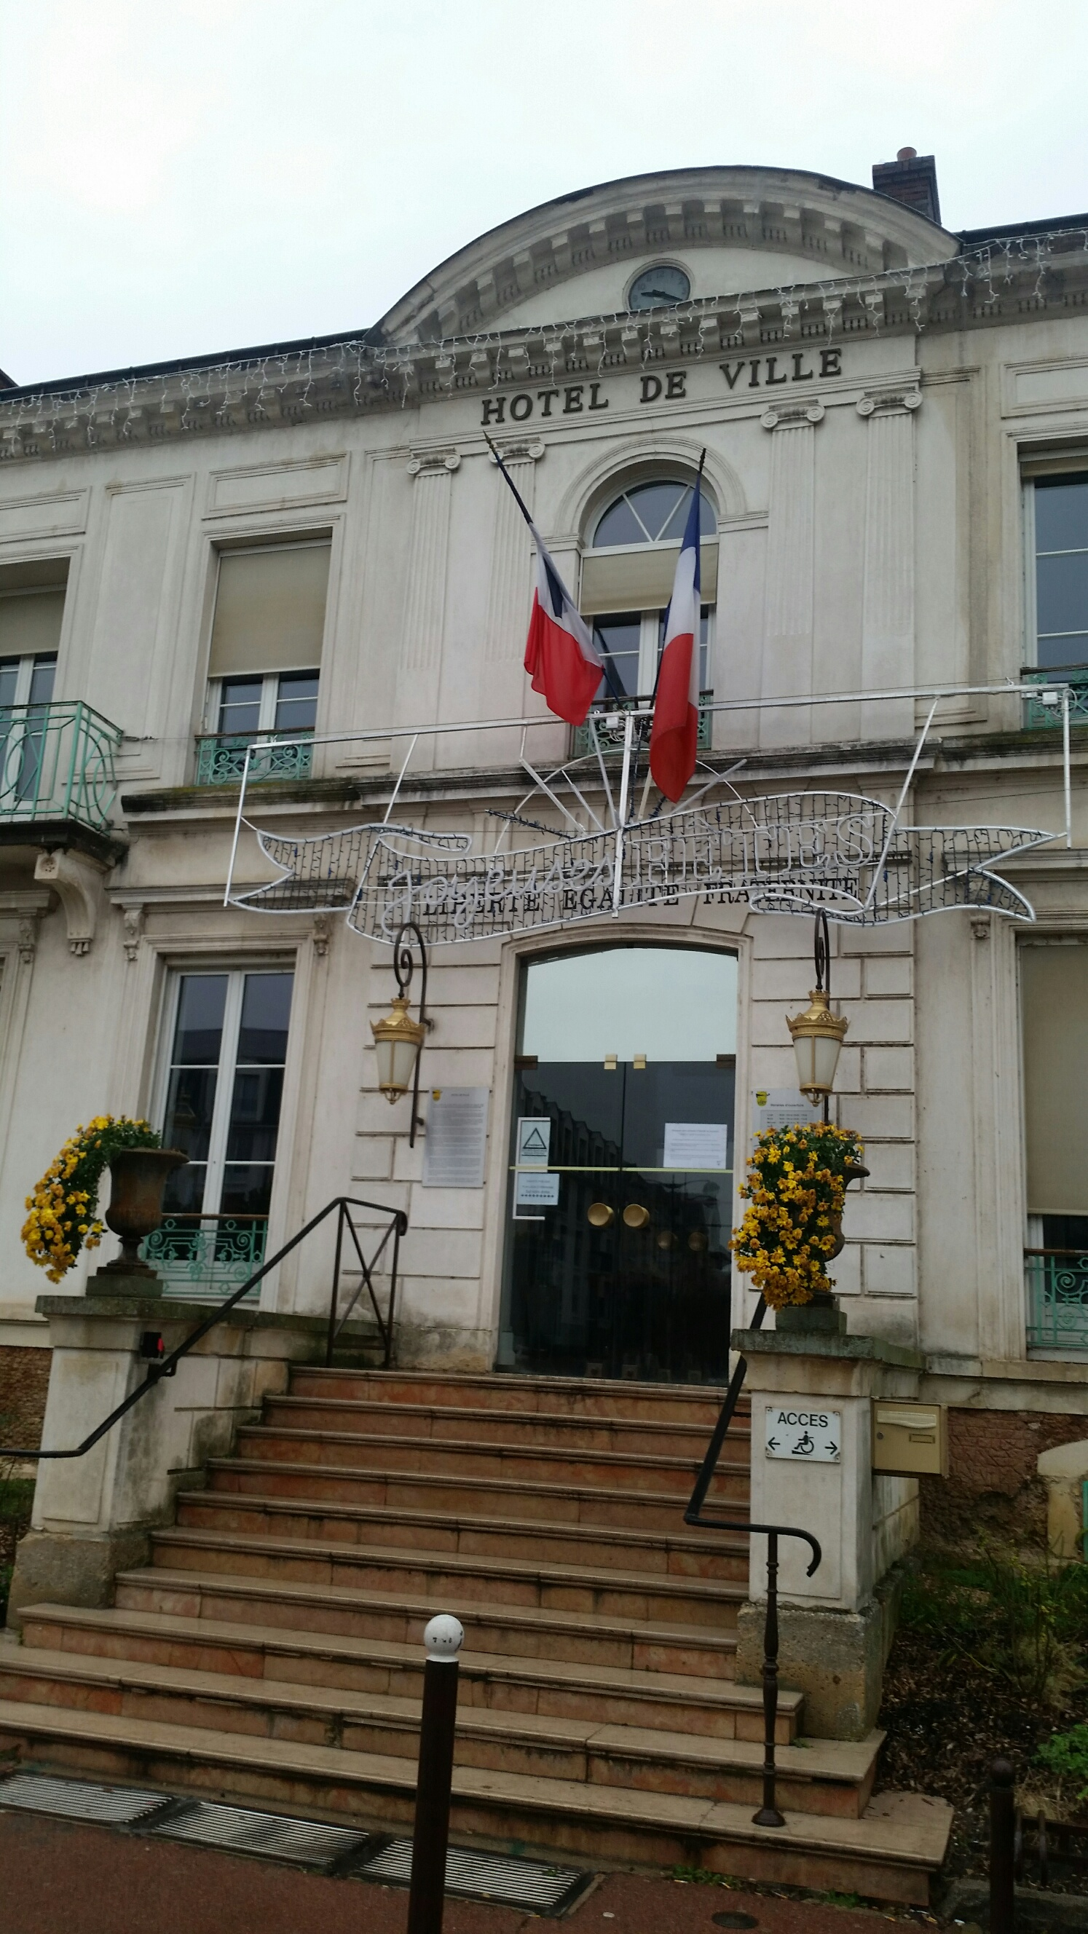
Sites around town
The town itself is a little bit quiet, as most people go to Paris to do shopping or other activities. Still, there are a lot of things to do!
This is the Mairie, also known as the Hôtel de Ville. Can you guess what it is used for?

Slide 4
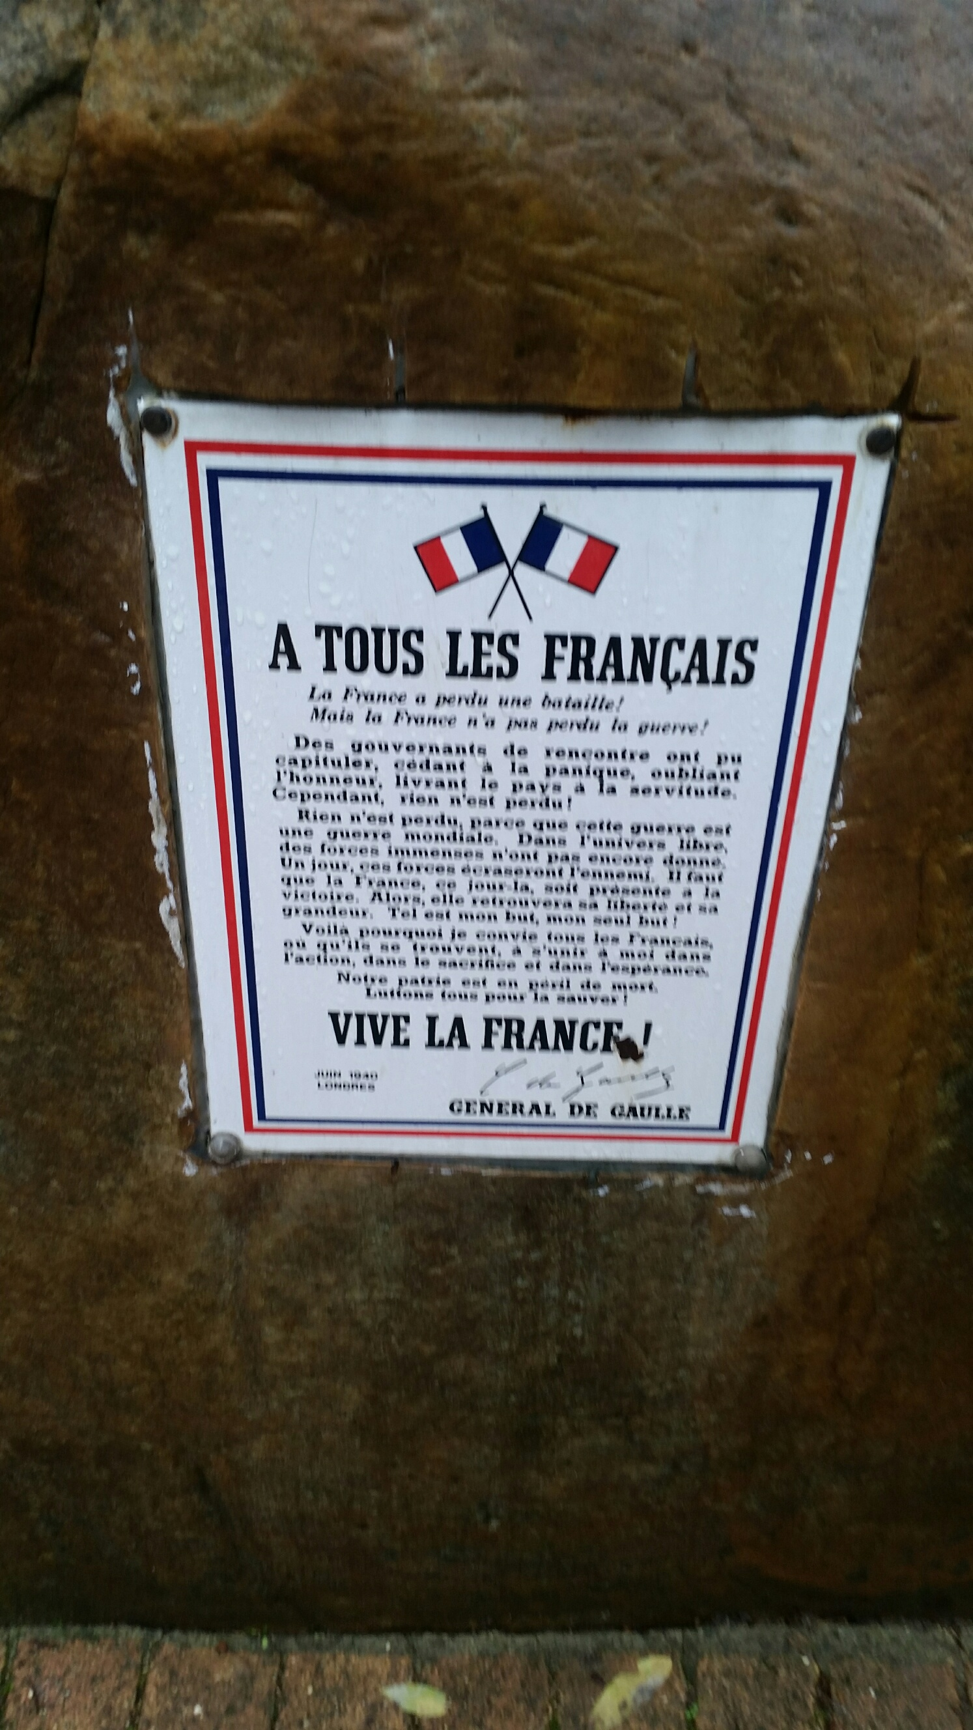
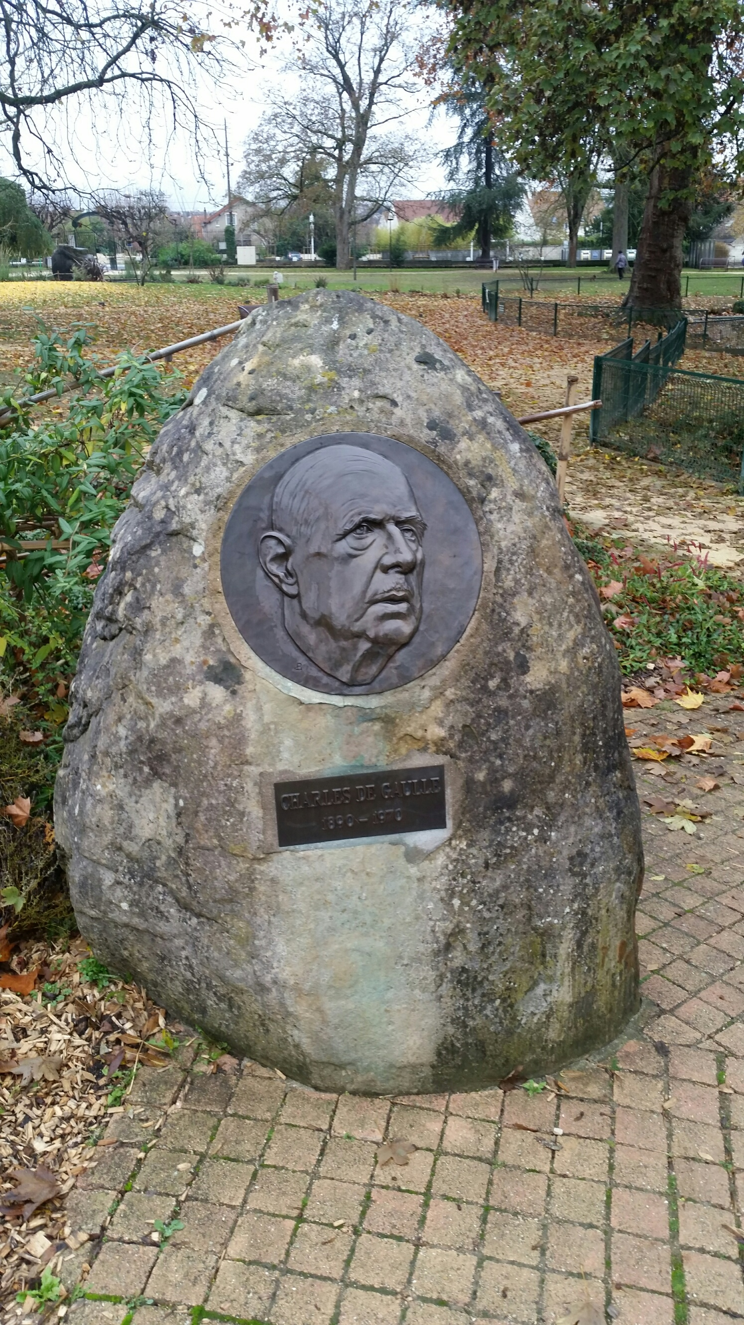
Sites around town
This is the local park. It is very relaxing and calm, especially when it is sunny.
This is a monument dedicated to former French president Charles de Gaulle. A copy of this speech (Right) can be found in most French parks

Slide 5
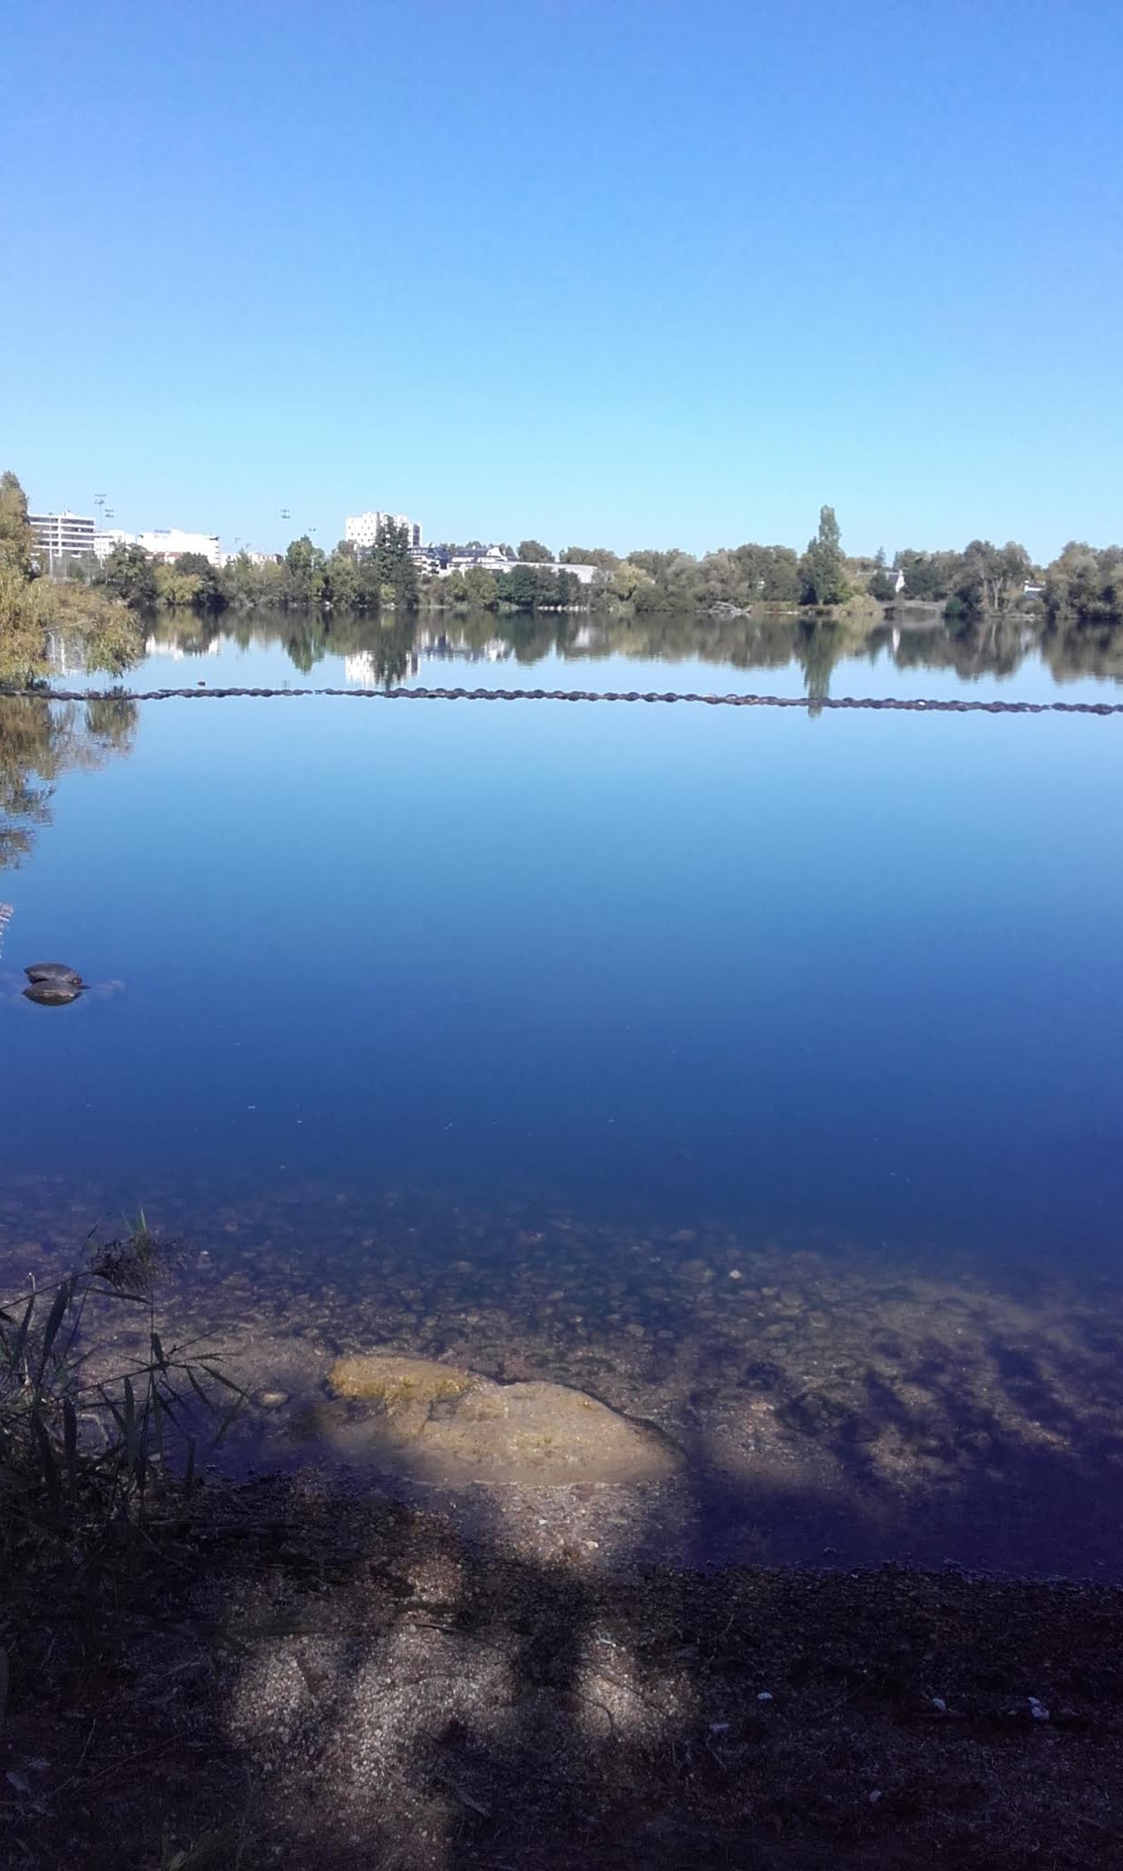
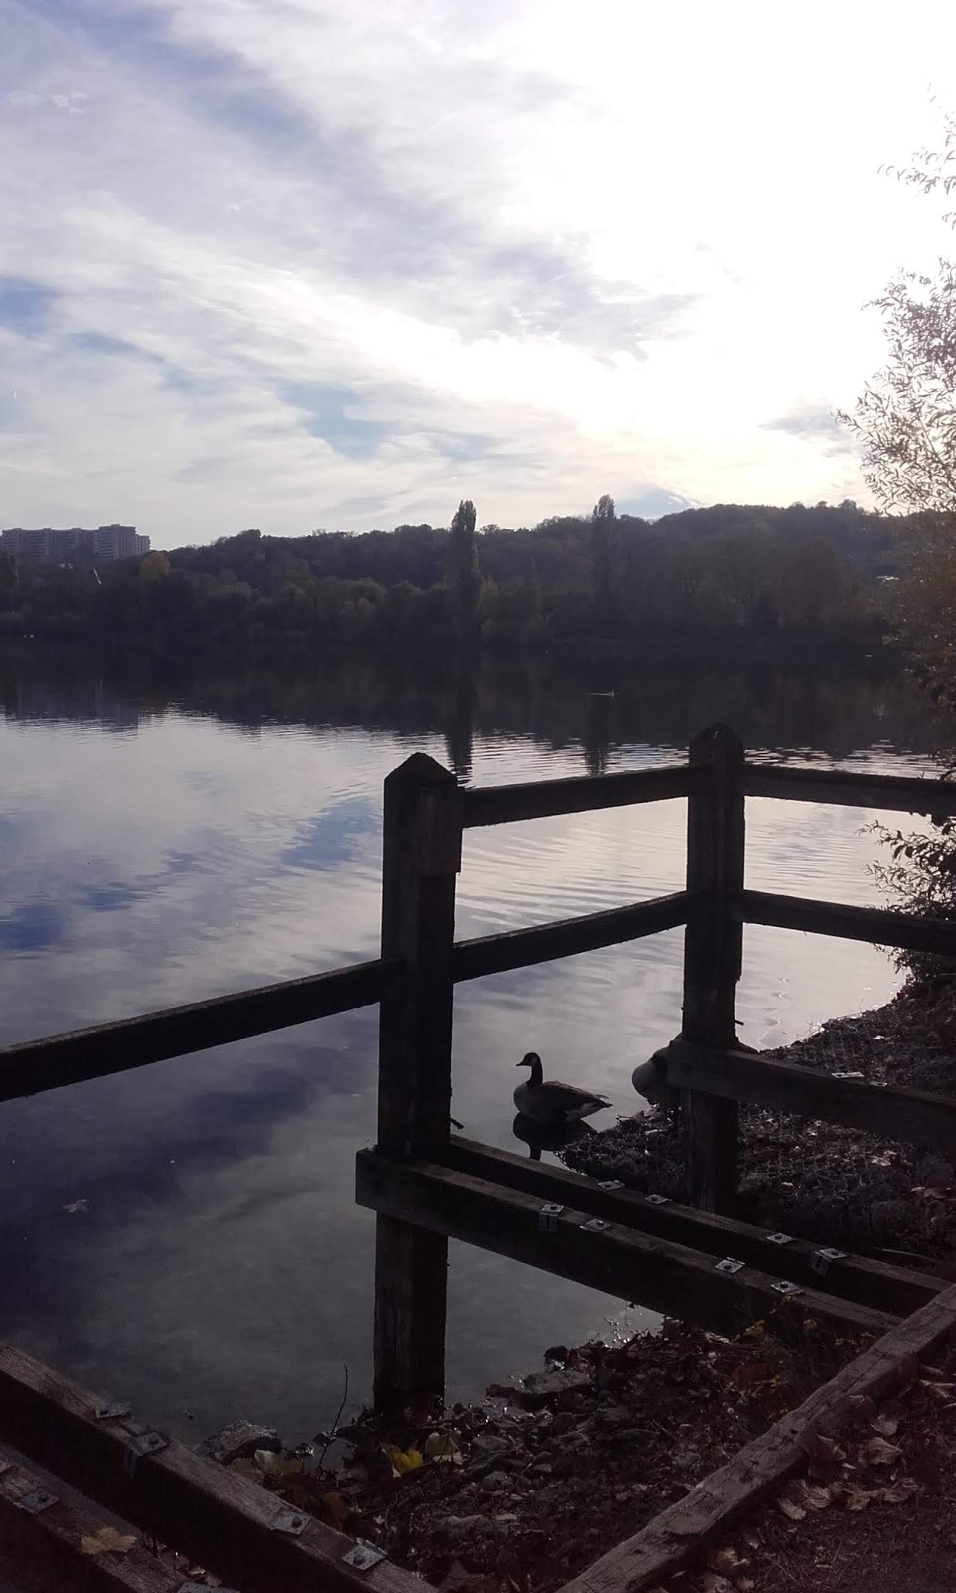
Sites around town
Viry-Châtillon is very famous for it’s large lakes, which are rare given how close the town is to Paris.
The lakes are really popular with joggers and fishermen, as well as a jet ski club too!

Slide 6
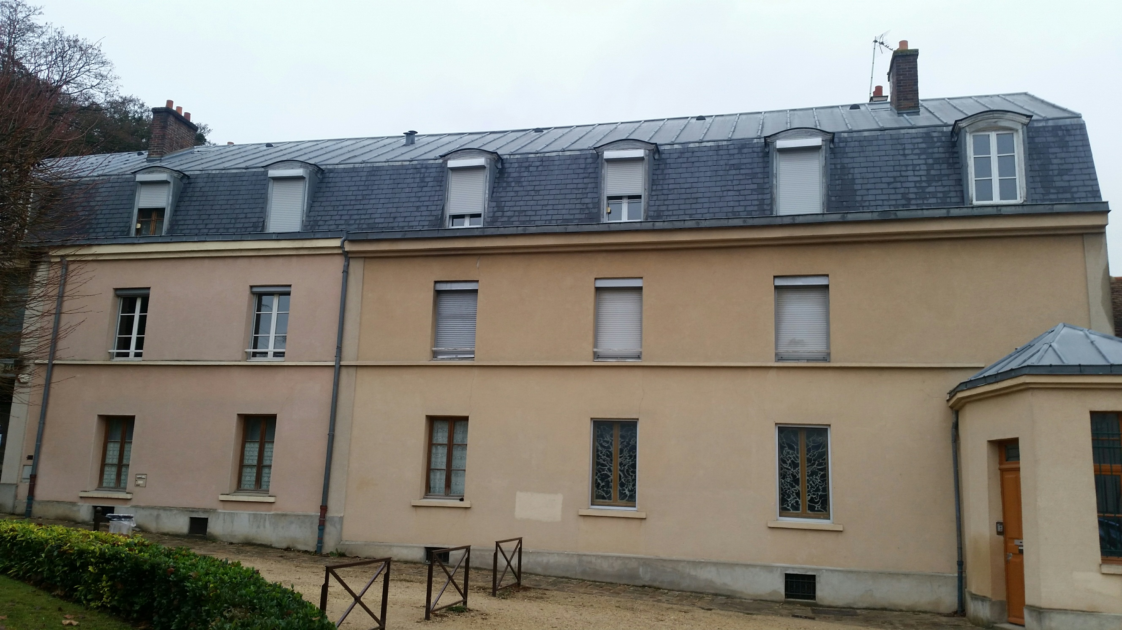
My apartment
This is my apartment building. I live in one of the rooms on the top floor.
The apartment is very nice, but it does not have a kitchen. I have to cook using two hobs near my sink. This is very common in apartments in Paris.
As my accommodation is provided by the school I work at, I actually live over la maternelle, or infants school!

Slide 7
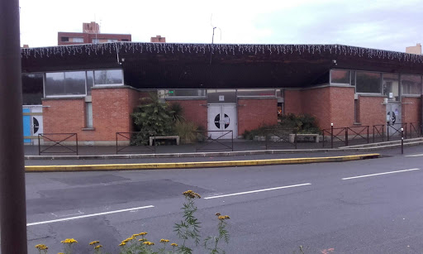
The shops
This is the local market. There is a market here every Wednesday and Sunday.
France in quite different from the UK in that there are fewer big supermarkets. Therefore I buy my veg with the grocer and bread in the bakery.

