Slide 1
Nature and the environment
Being active with languages!

Slide 2
HOW DOES NATURE MAKE US FEEL?
HOW CAN WE HELP NATURE ACROSS THE WORLD?
WHAT ACTIONS CAN WE TAKE TO PROTECT NATURE?

Slide 3
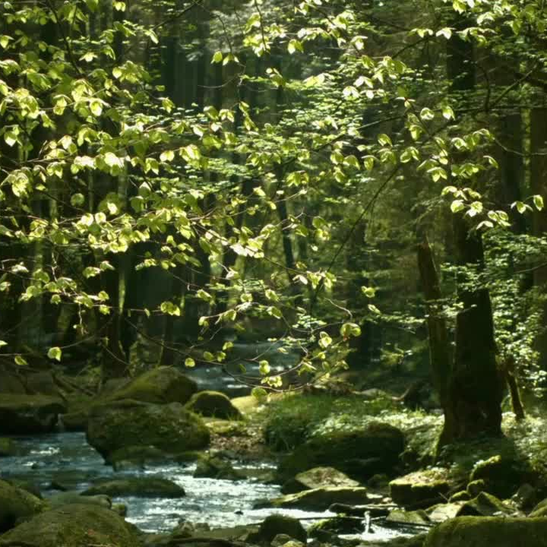
EXPLORE WITH YOUR NEIGHBOUR
WOULD YOU RATHER:
Walk through a forest or sit beside a river?
Play out in the sun or play out in the rain?
Build a den or dig a hole?
Grow flowers or grow vegetables?

Slide 4
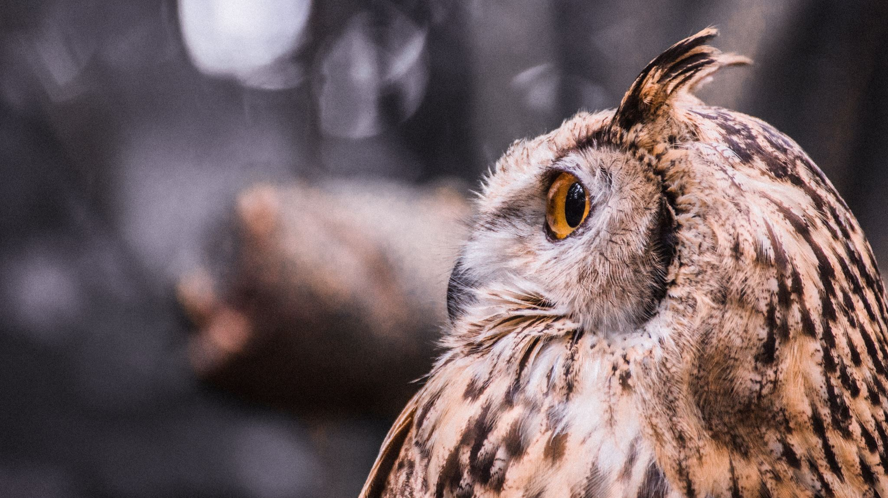
What wildlife have you spotted near where you live?

Slide 5
How beautiful can nature be?
When is nature loud?
When is nature quiet?
When is nature powerful?
When is nature gentle?
When is nature clever?
When is nature funny?
Notes:
Pupils to find examples which could them be used as the starting point for poem ideas.

Slide 6
Can our feelings be like nature?
Here are some common emotions:
Happy
Sad
Scared
Calm
Joyful
Tired
Angry
Surprised
Worried
…like the yellow sun
… like the dead tree
… like the little bird
… like …
… like …
… like …
… like …
… like …
… like …
Notes:
Children to think of other examples
They can then use their vocab sheets to think of examples in the target language.
Idea here is that the pupils realise that humans are intimately connected to the natural world, that their moods can be shaped by it and that it can help give shape to their inner feelings.

Slide 7
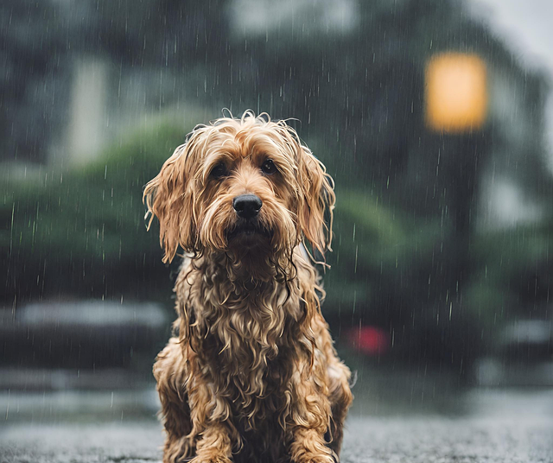
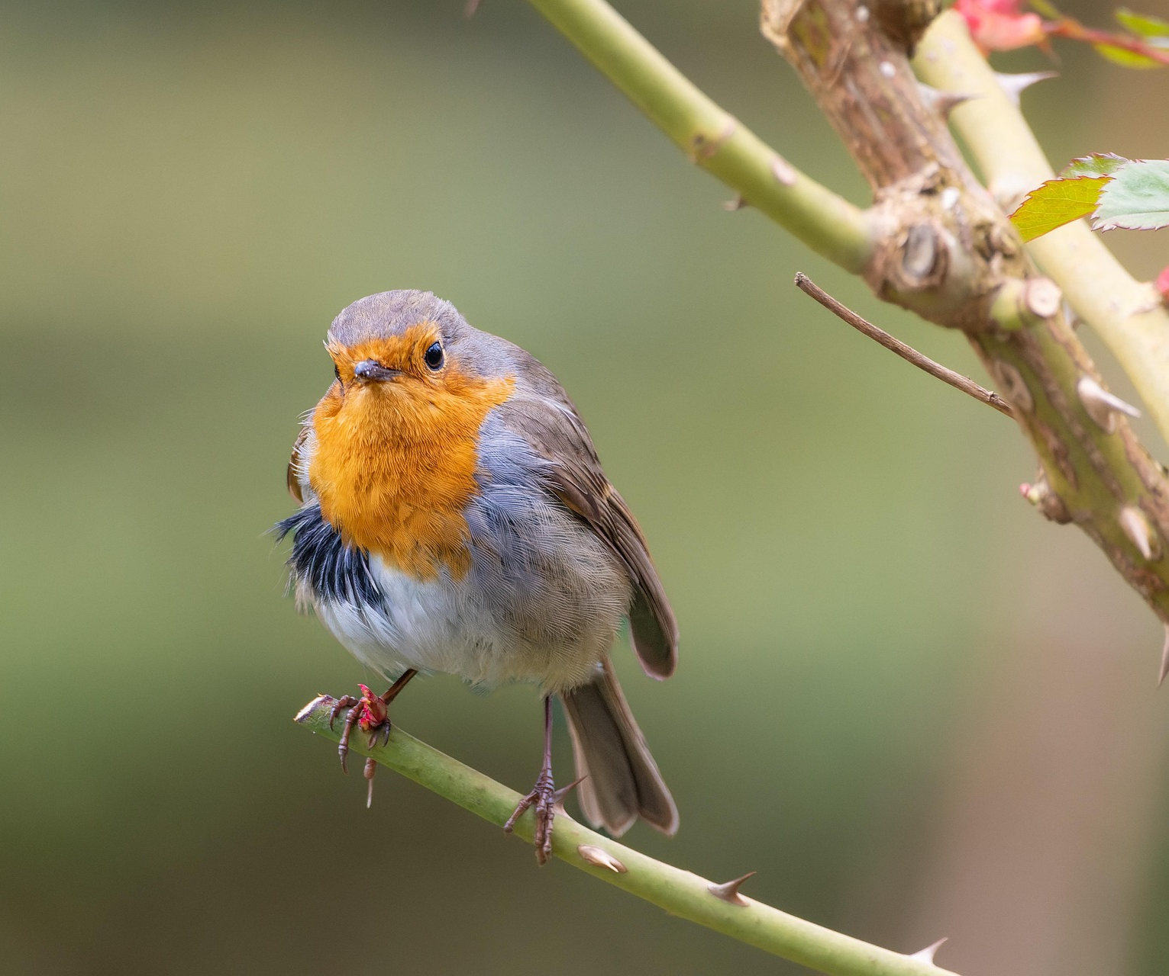
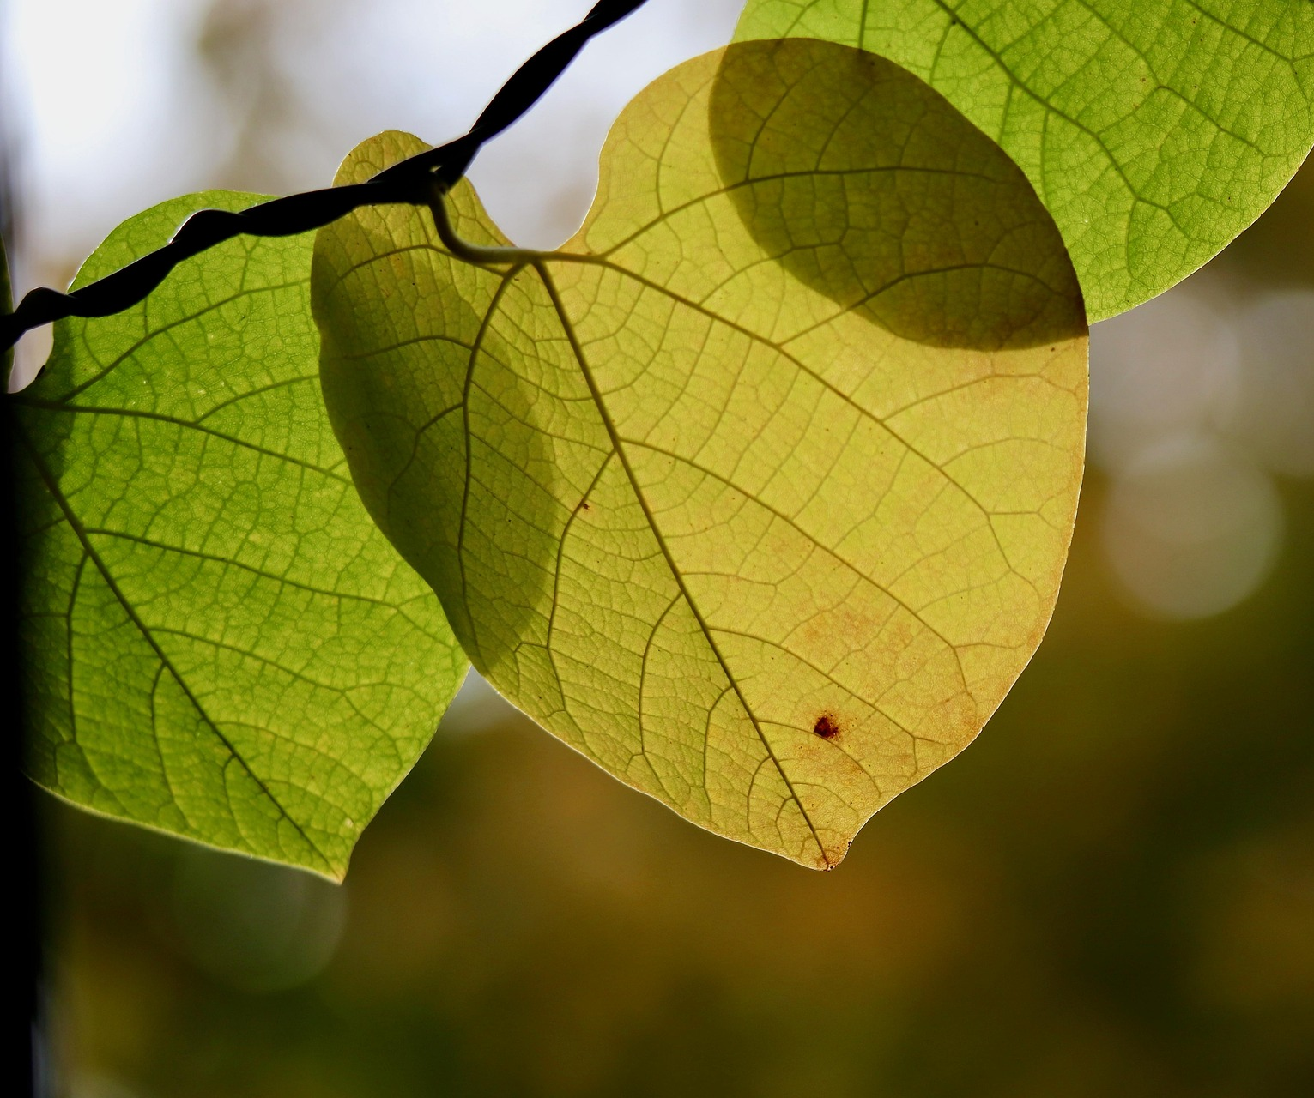
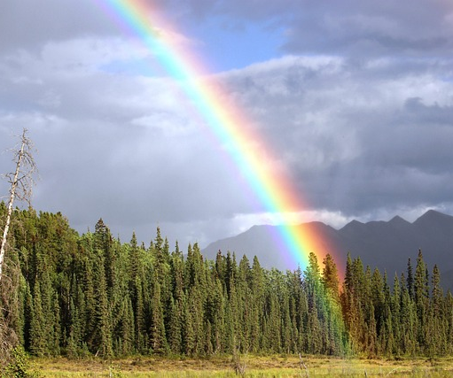
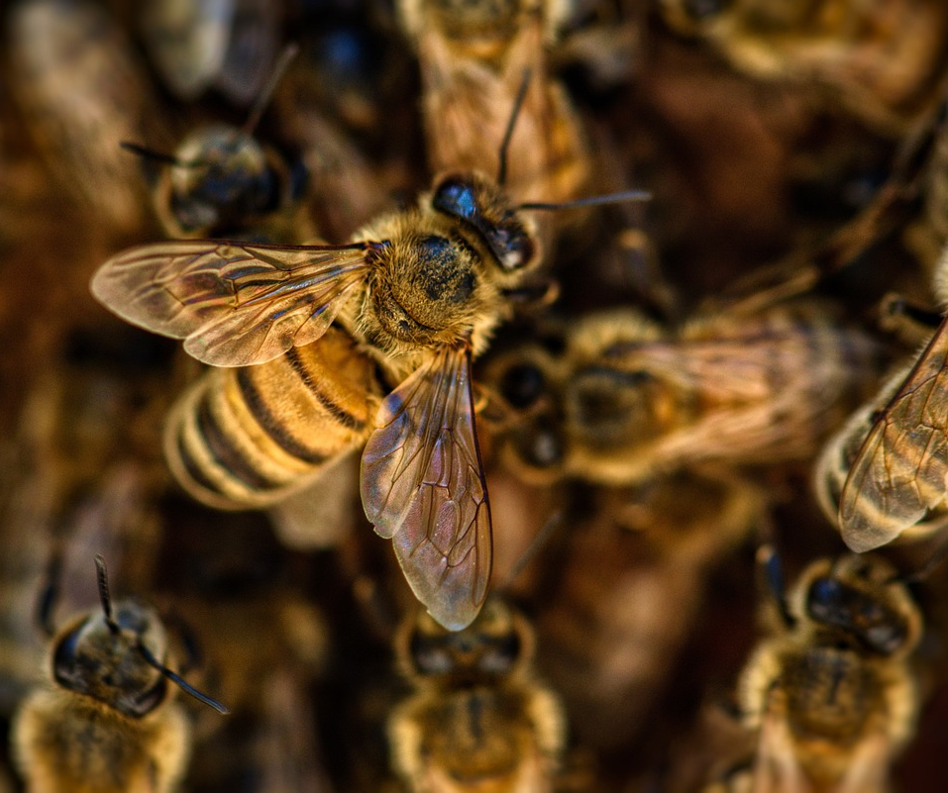
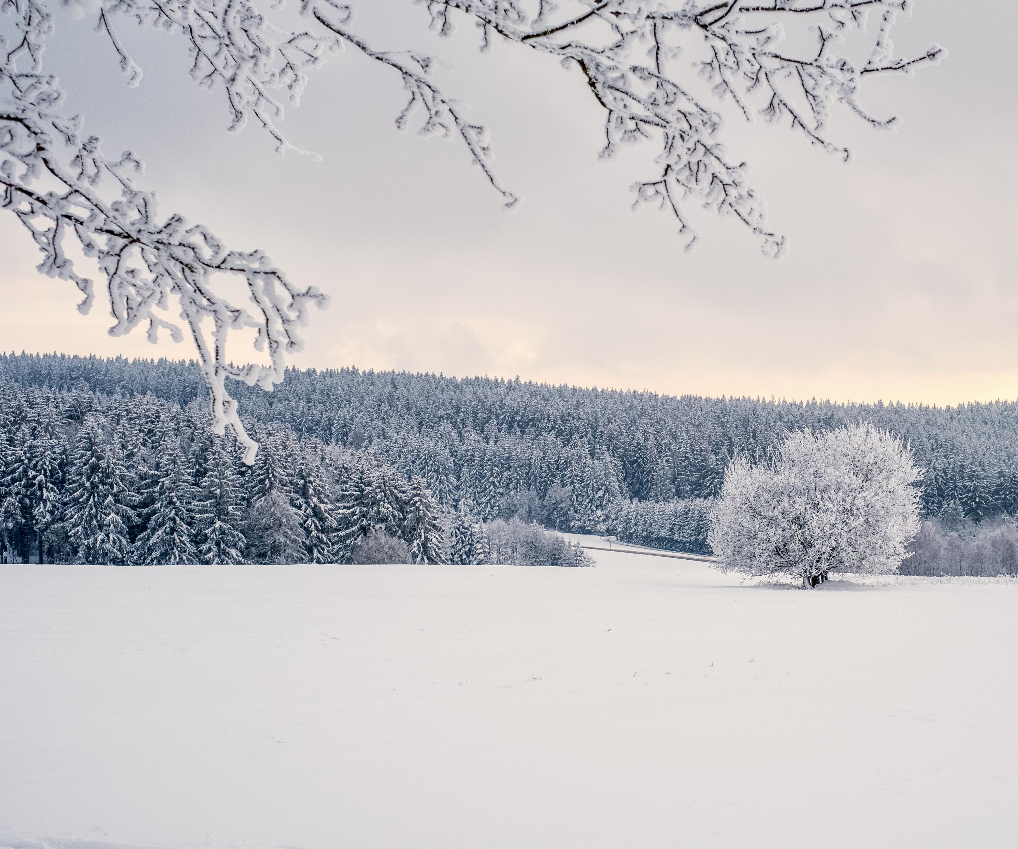
Notes:
Here are some ideas that might help the children think about emotions / similes / metaphors

Slide 8
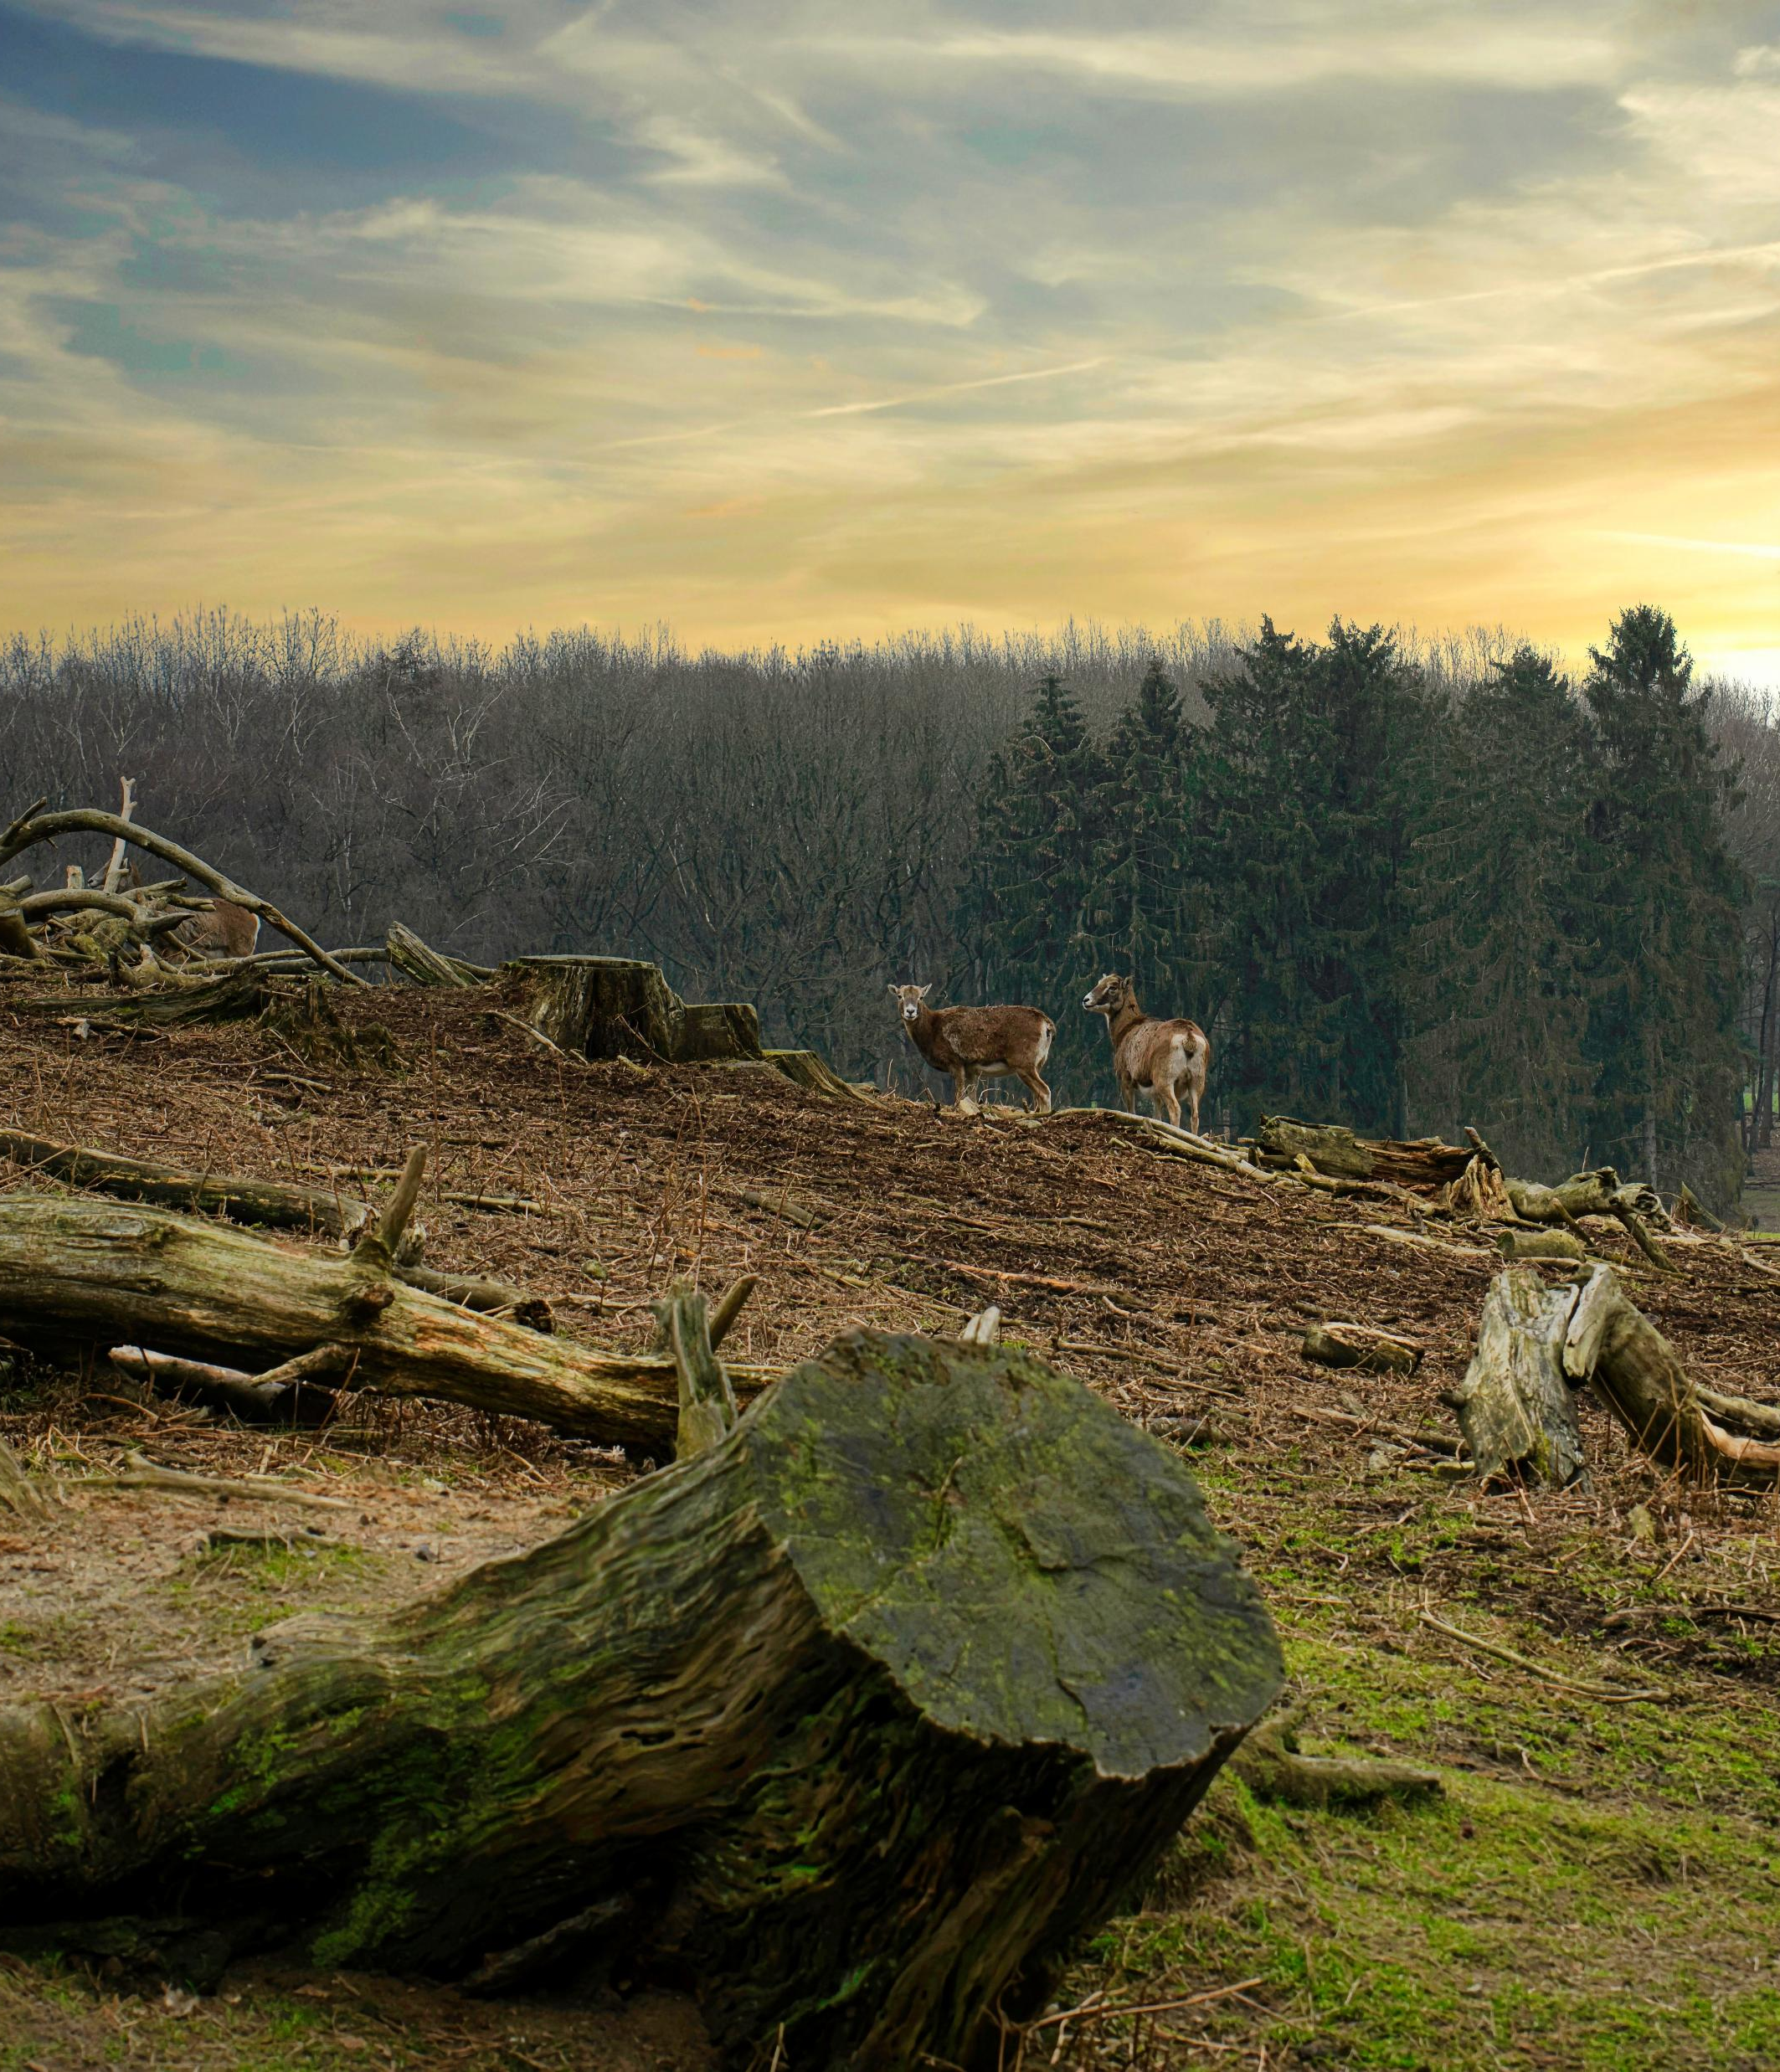
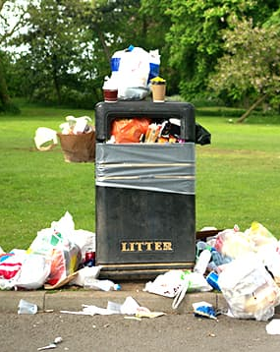
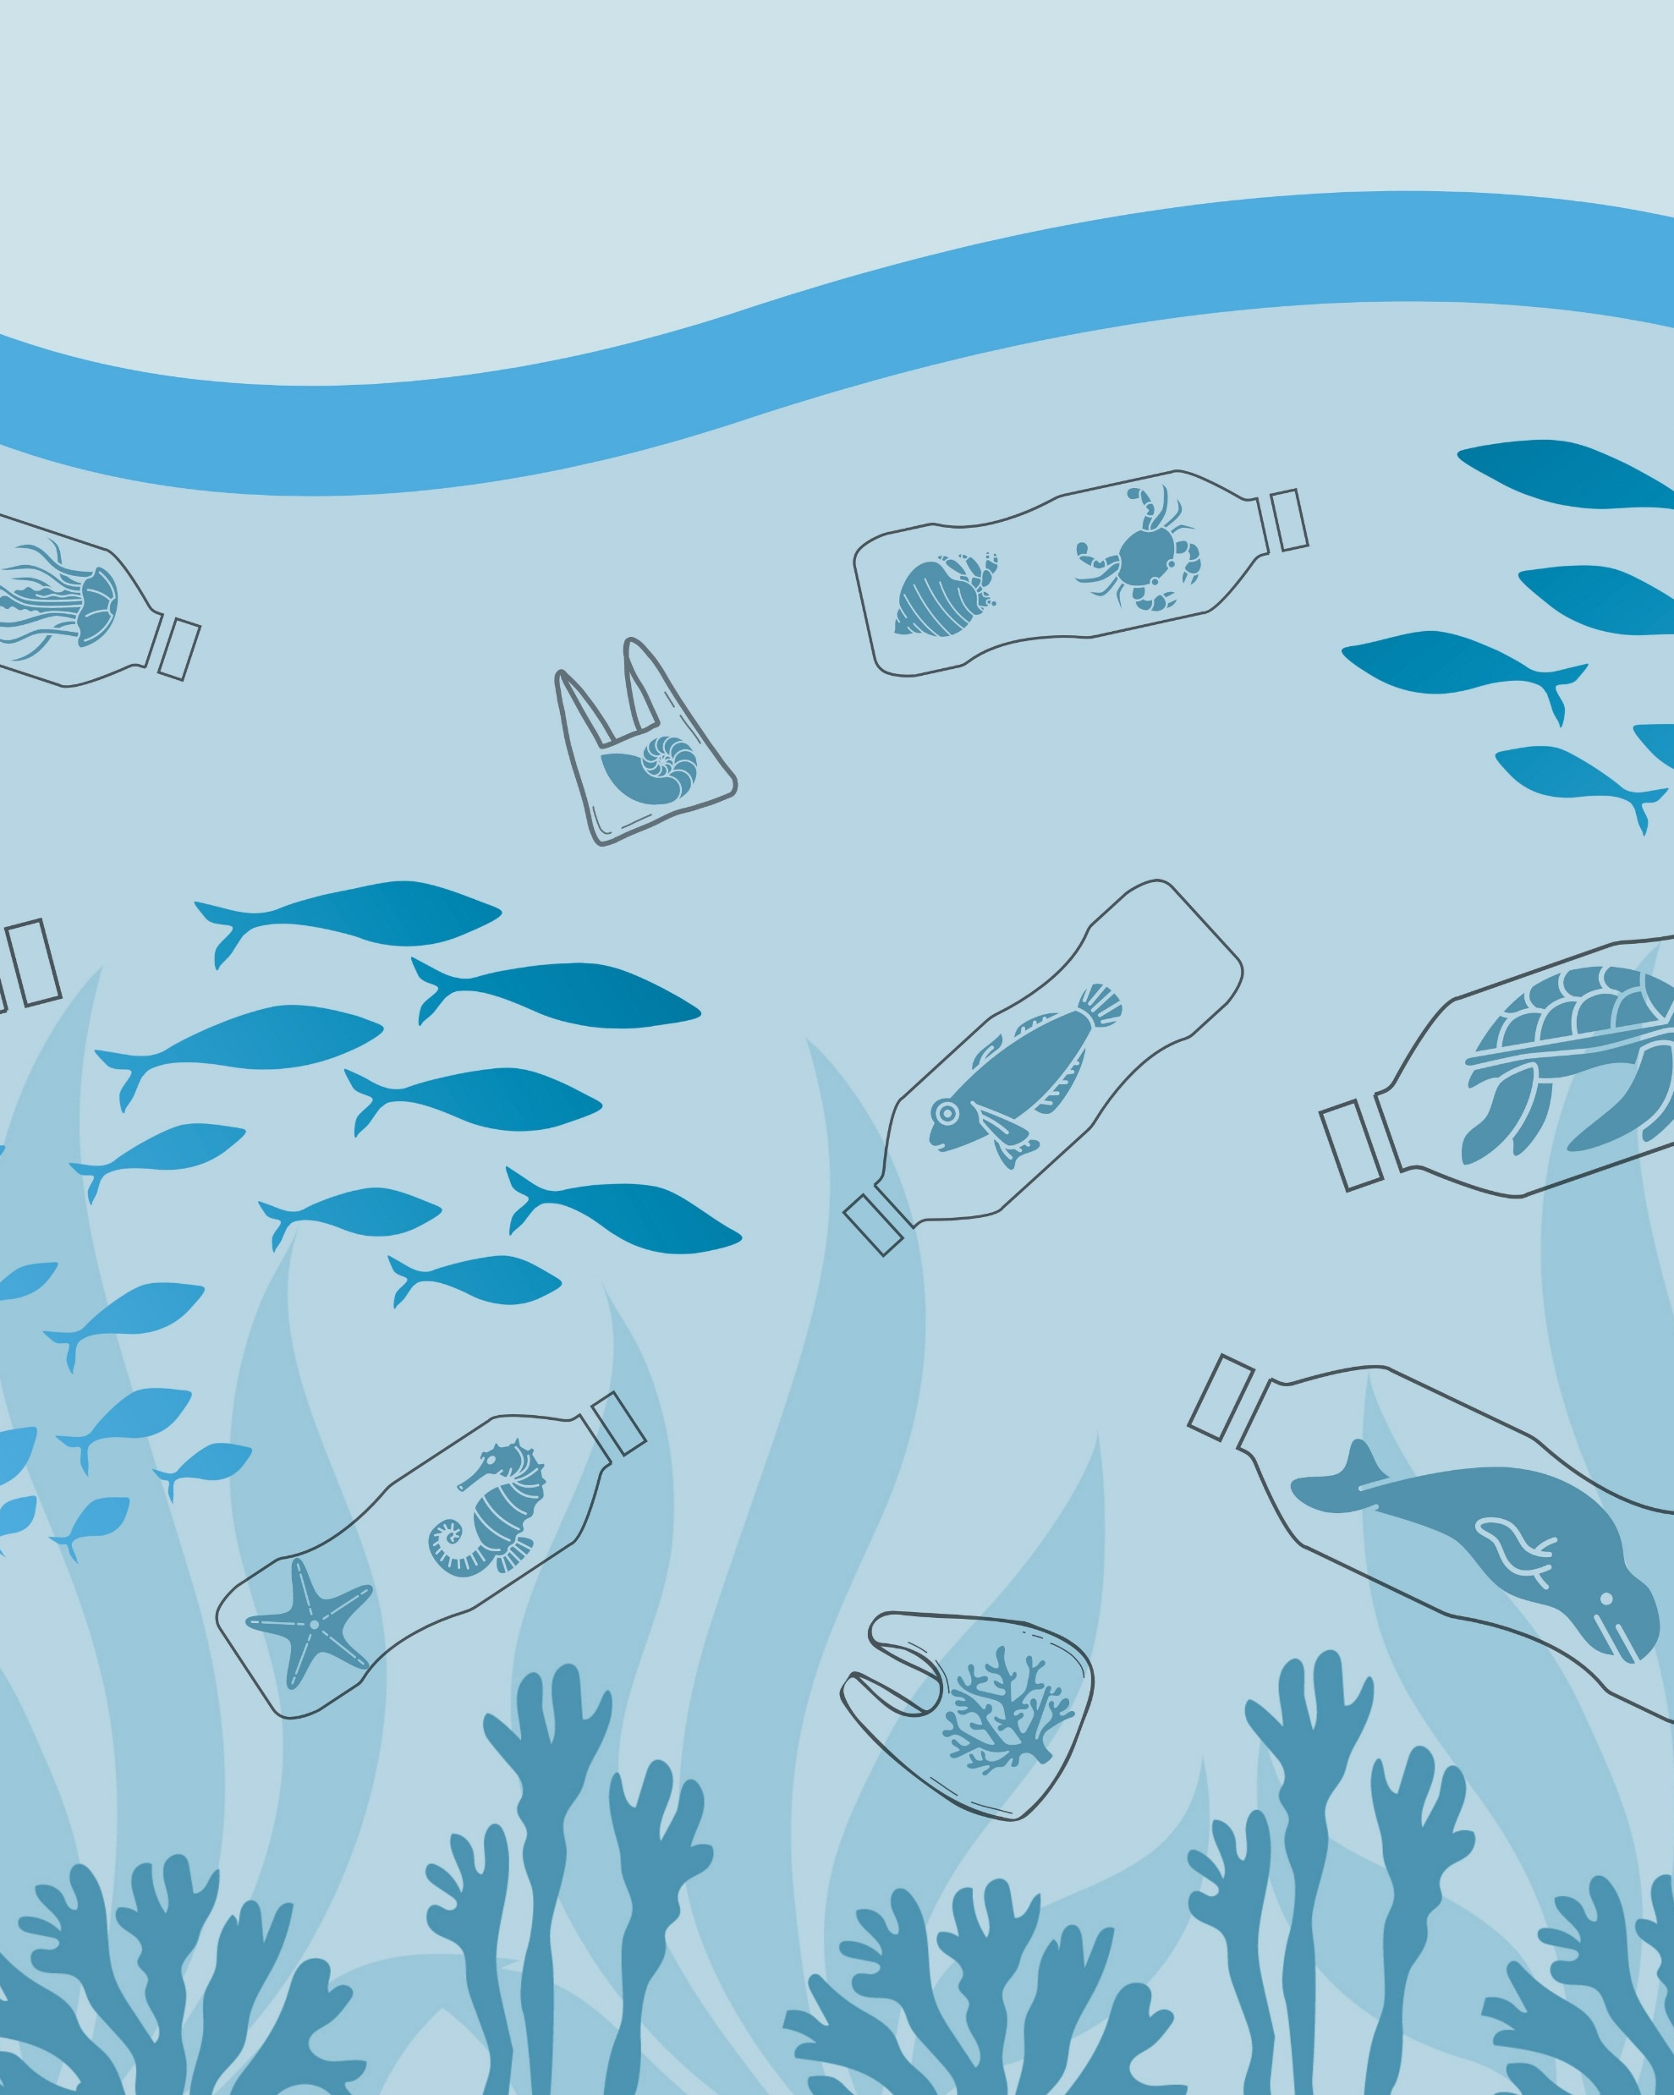
When might nature feel ‘sad’?
FamilyID=Office_ArchiveTorn

Slide 9
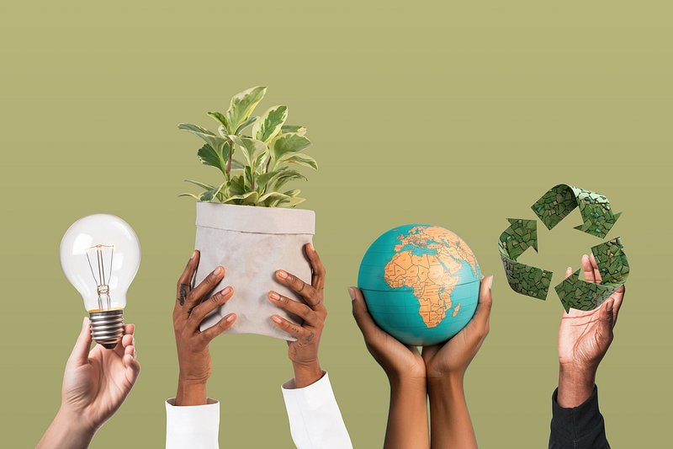
How can we take action for nature?
I / we can …
I / we want to…
I / we must …
help ….
plant …
recycle …
save …
Notes:
Chance to use modal verbs plus infinitives
Pupils to complete the sentences

Slide 10
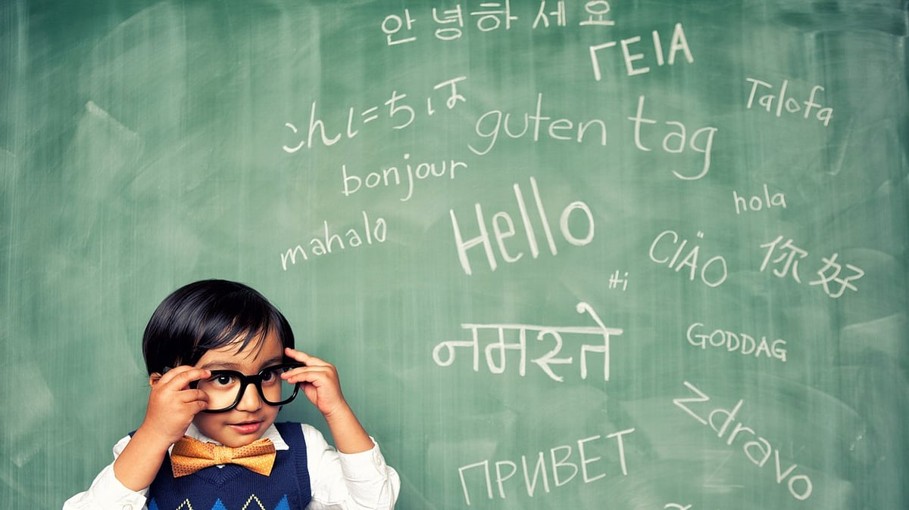
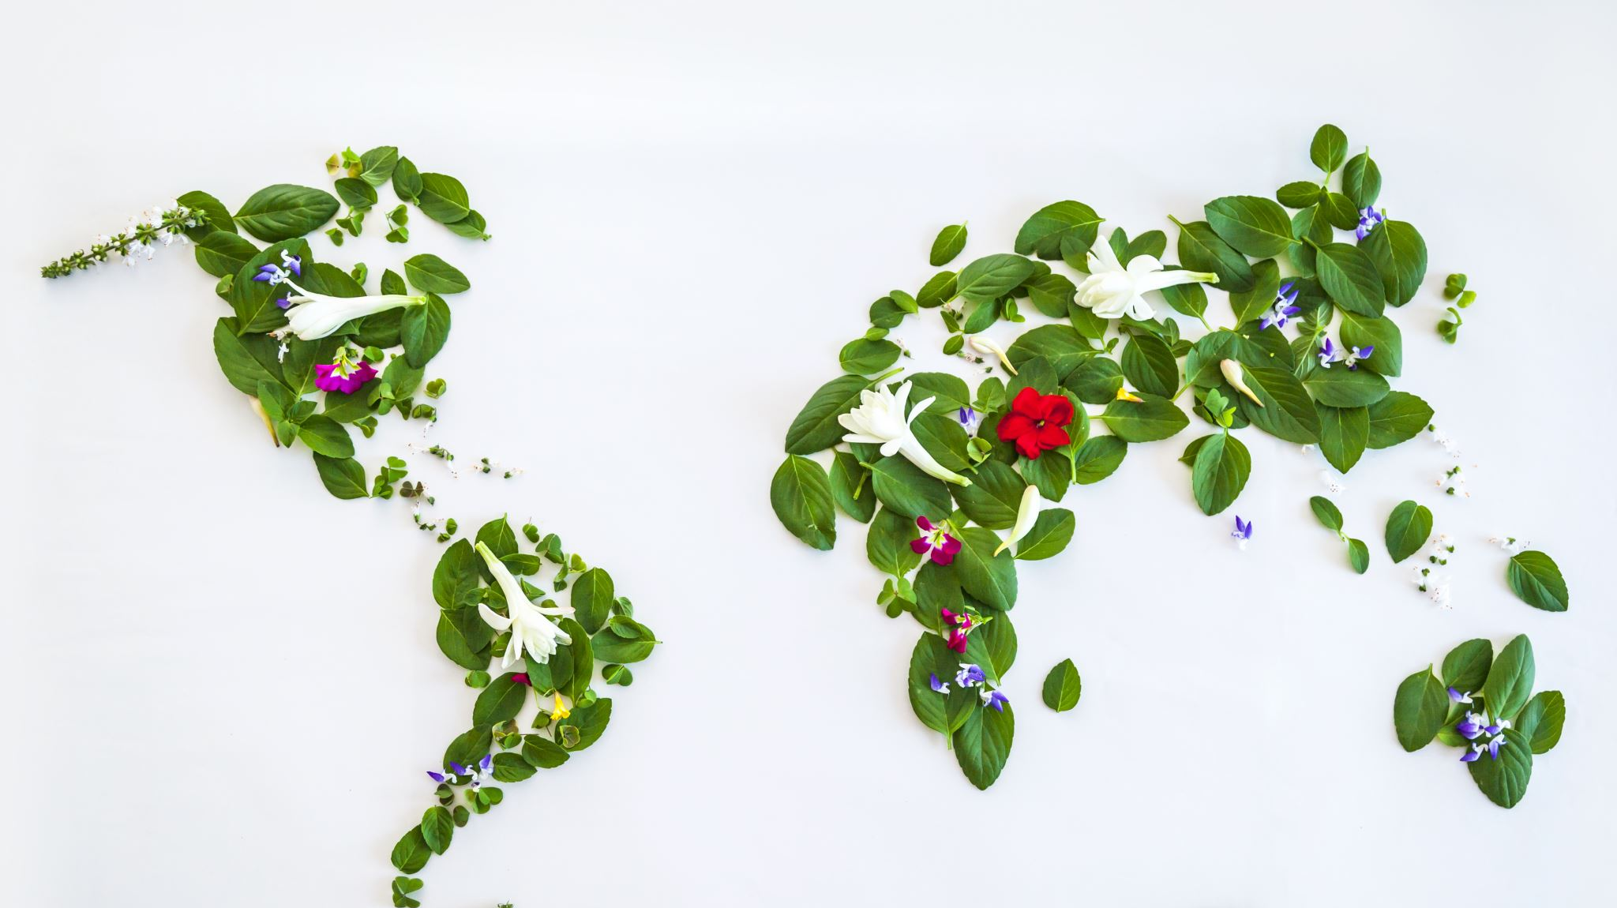
Using our languages to get involved with helping nature and the environment across the world.

Slide 11
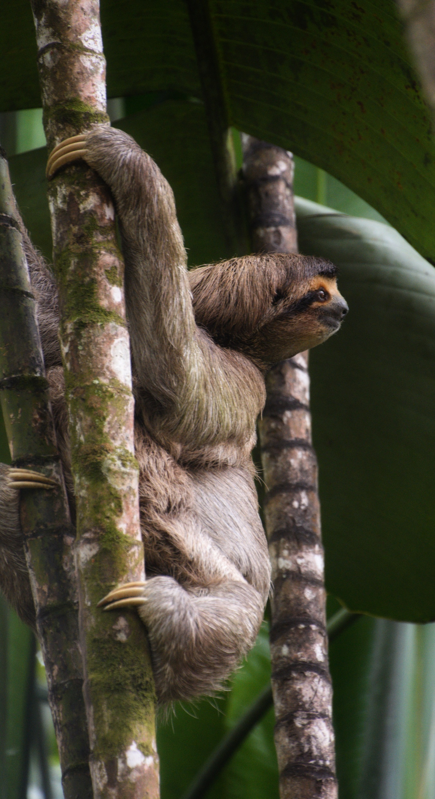
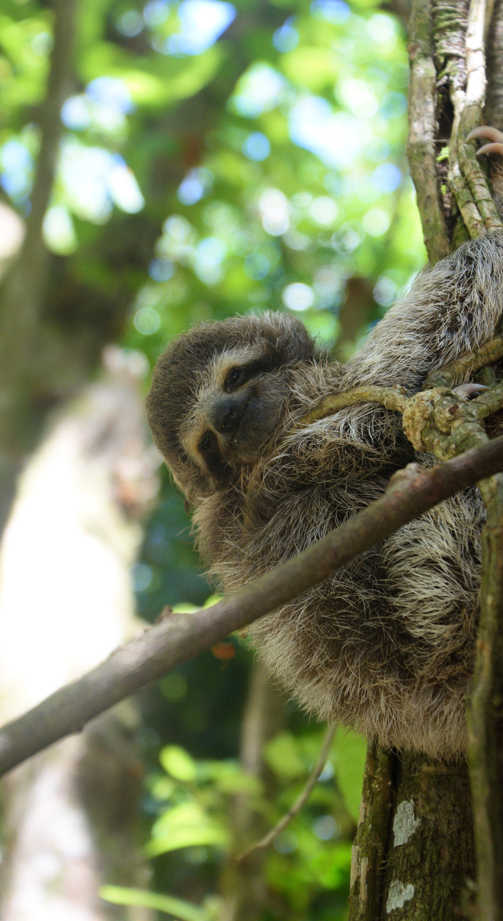
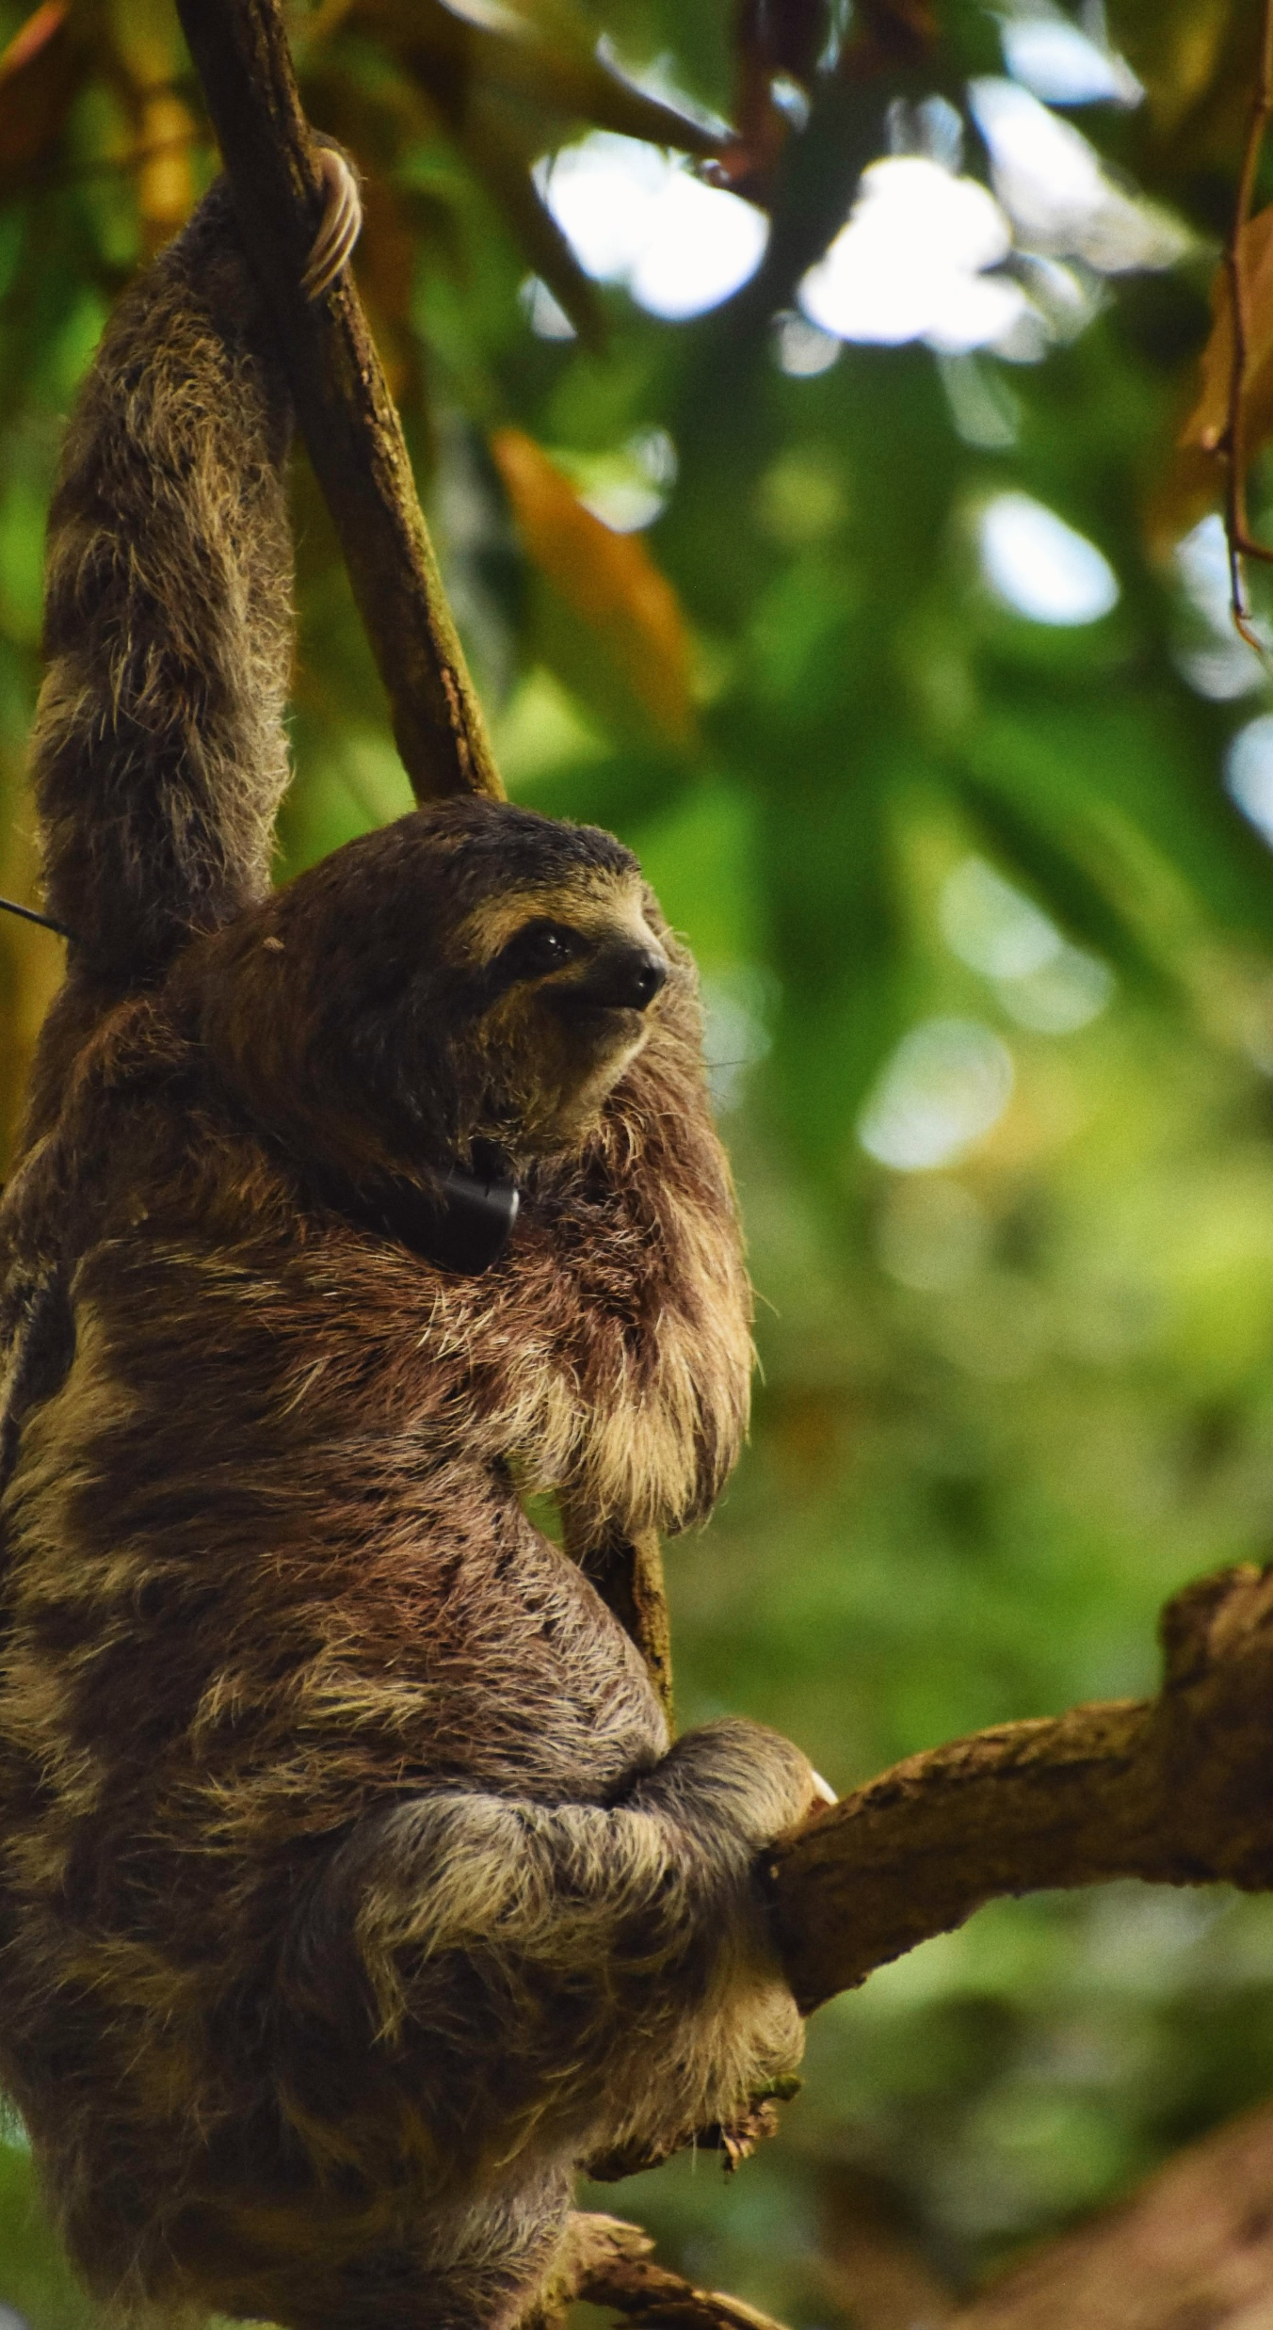
Travel and global environmental stories …
Anna’s story
Do you know what these animals are?
Sloths
Anna also worked at a turtle sanctuary
Notes:
Possible source for Spanish learners
The one on the left is called Tilly, the one in the middle is Leia and on the one on the right is called Wild

Slide 12
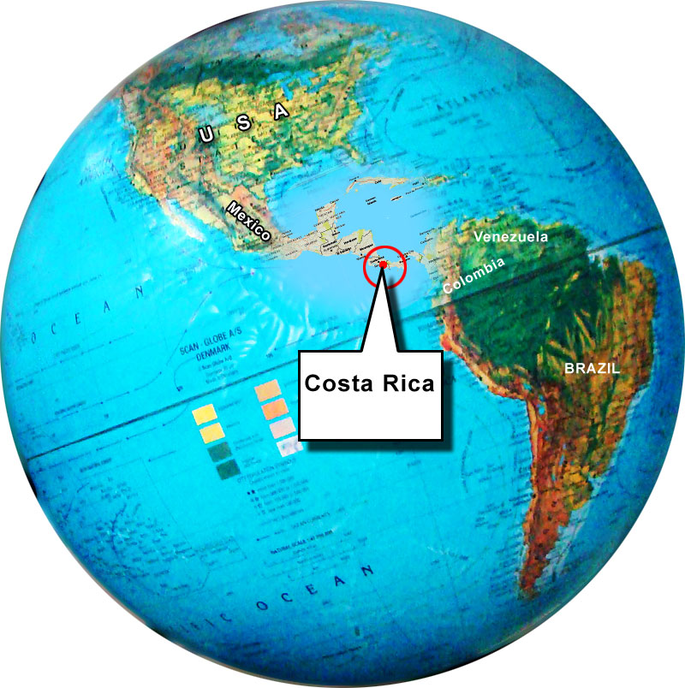
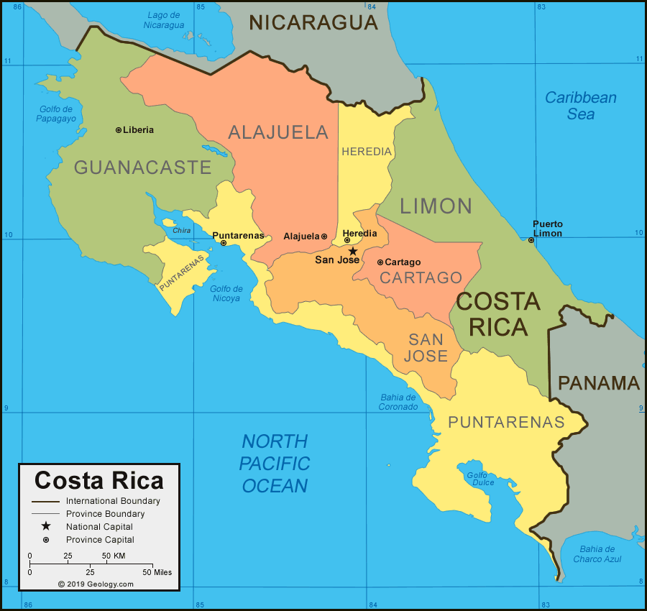
Where?
In Costa Rica
Which language is spoken in Costa Rica?
Home - The Sloth Institute
LAST (Latin American Sea Turtles) Association

Slide 13
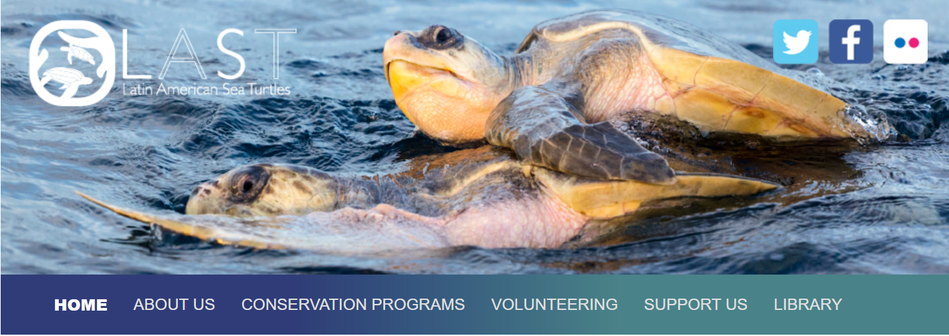
What Anna said …
Working at the turtle sanctuary ….
‘[…] gave me the opportunity to improve both spoken and written Spanish, and practise effective communication between members of our team as well as international volunteers.’
Notes:
(see more on Anna Bailey | LinkedIn)

Slide 14
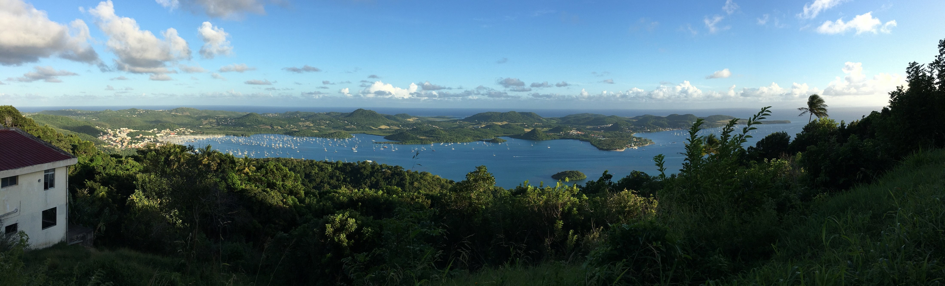
Travel and global environmental stories…
Maddie’s story
Where did Maddie travel to as part of her language studies at university?
Martinique
Listen to Maddie’s story about nature and the environment in Martinique…
Notes:
Possible source for French learners

Slide 15
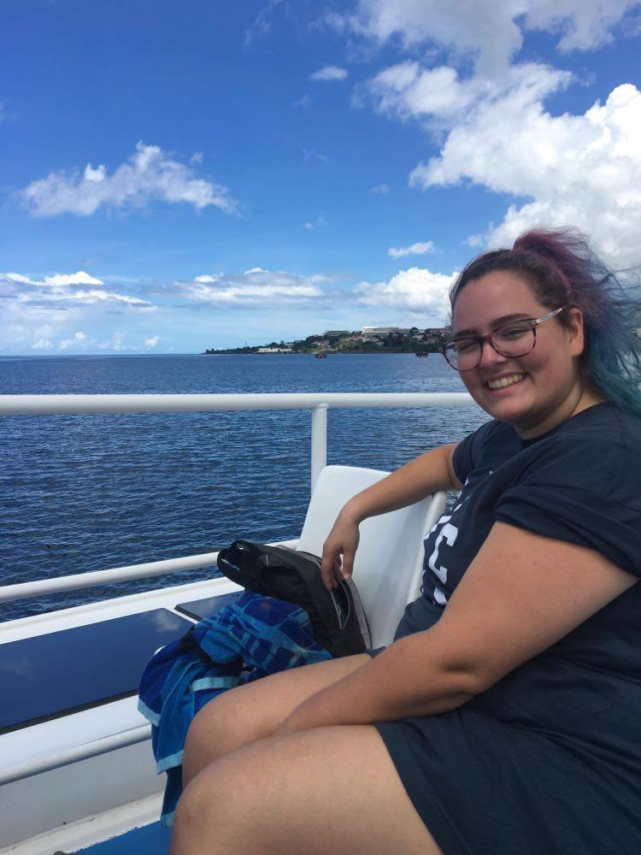


Slide 16
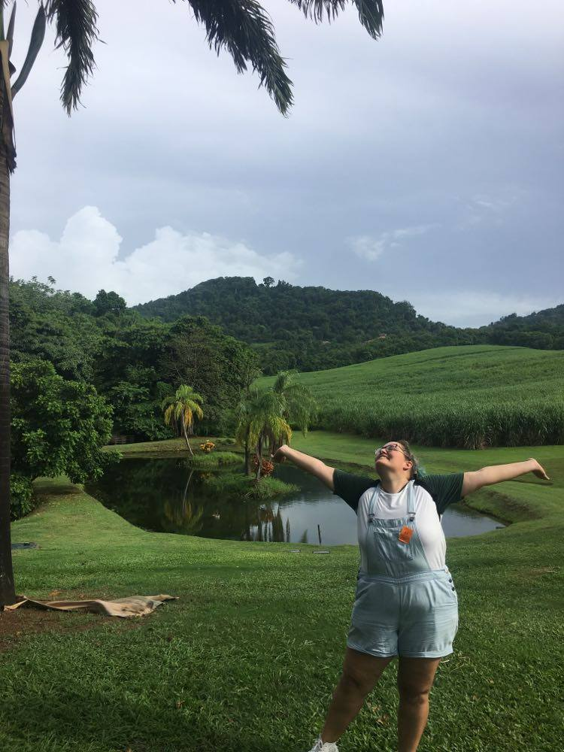

Slide 17
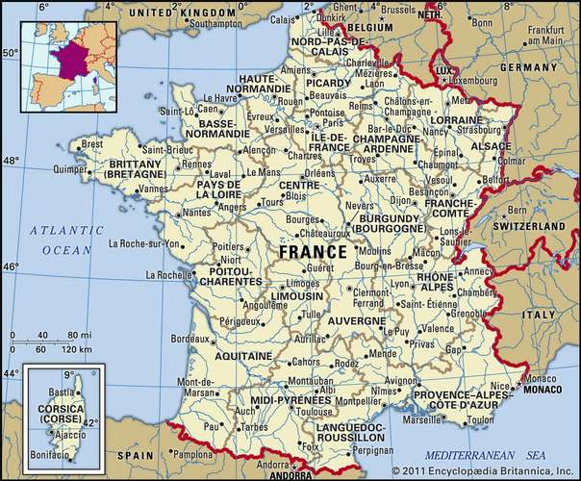

Slide 18
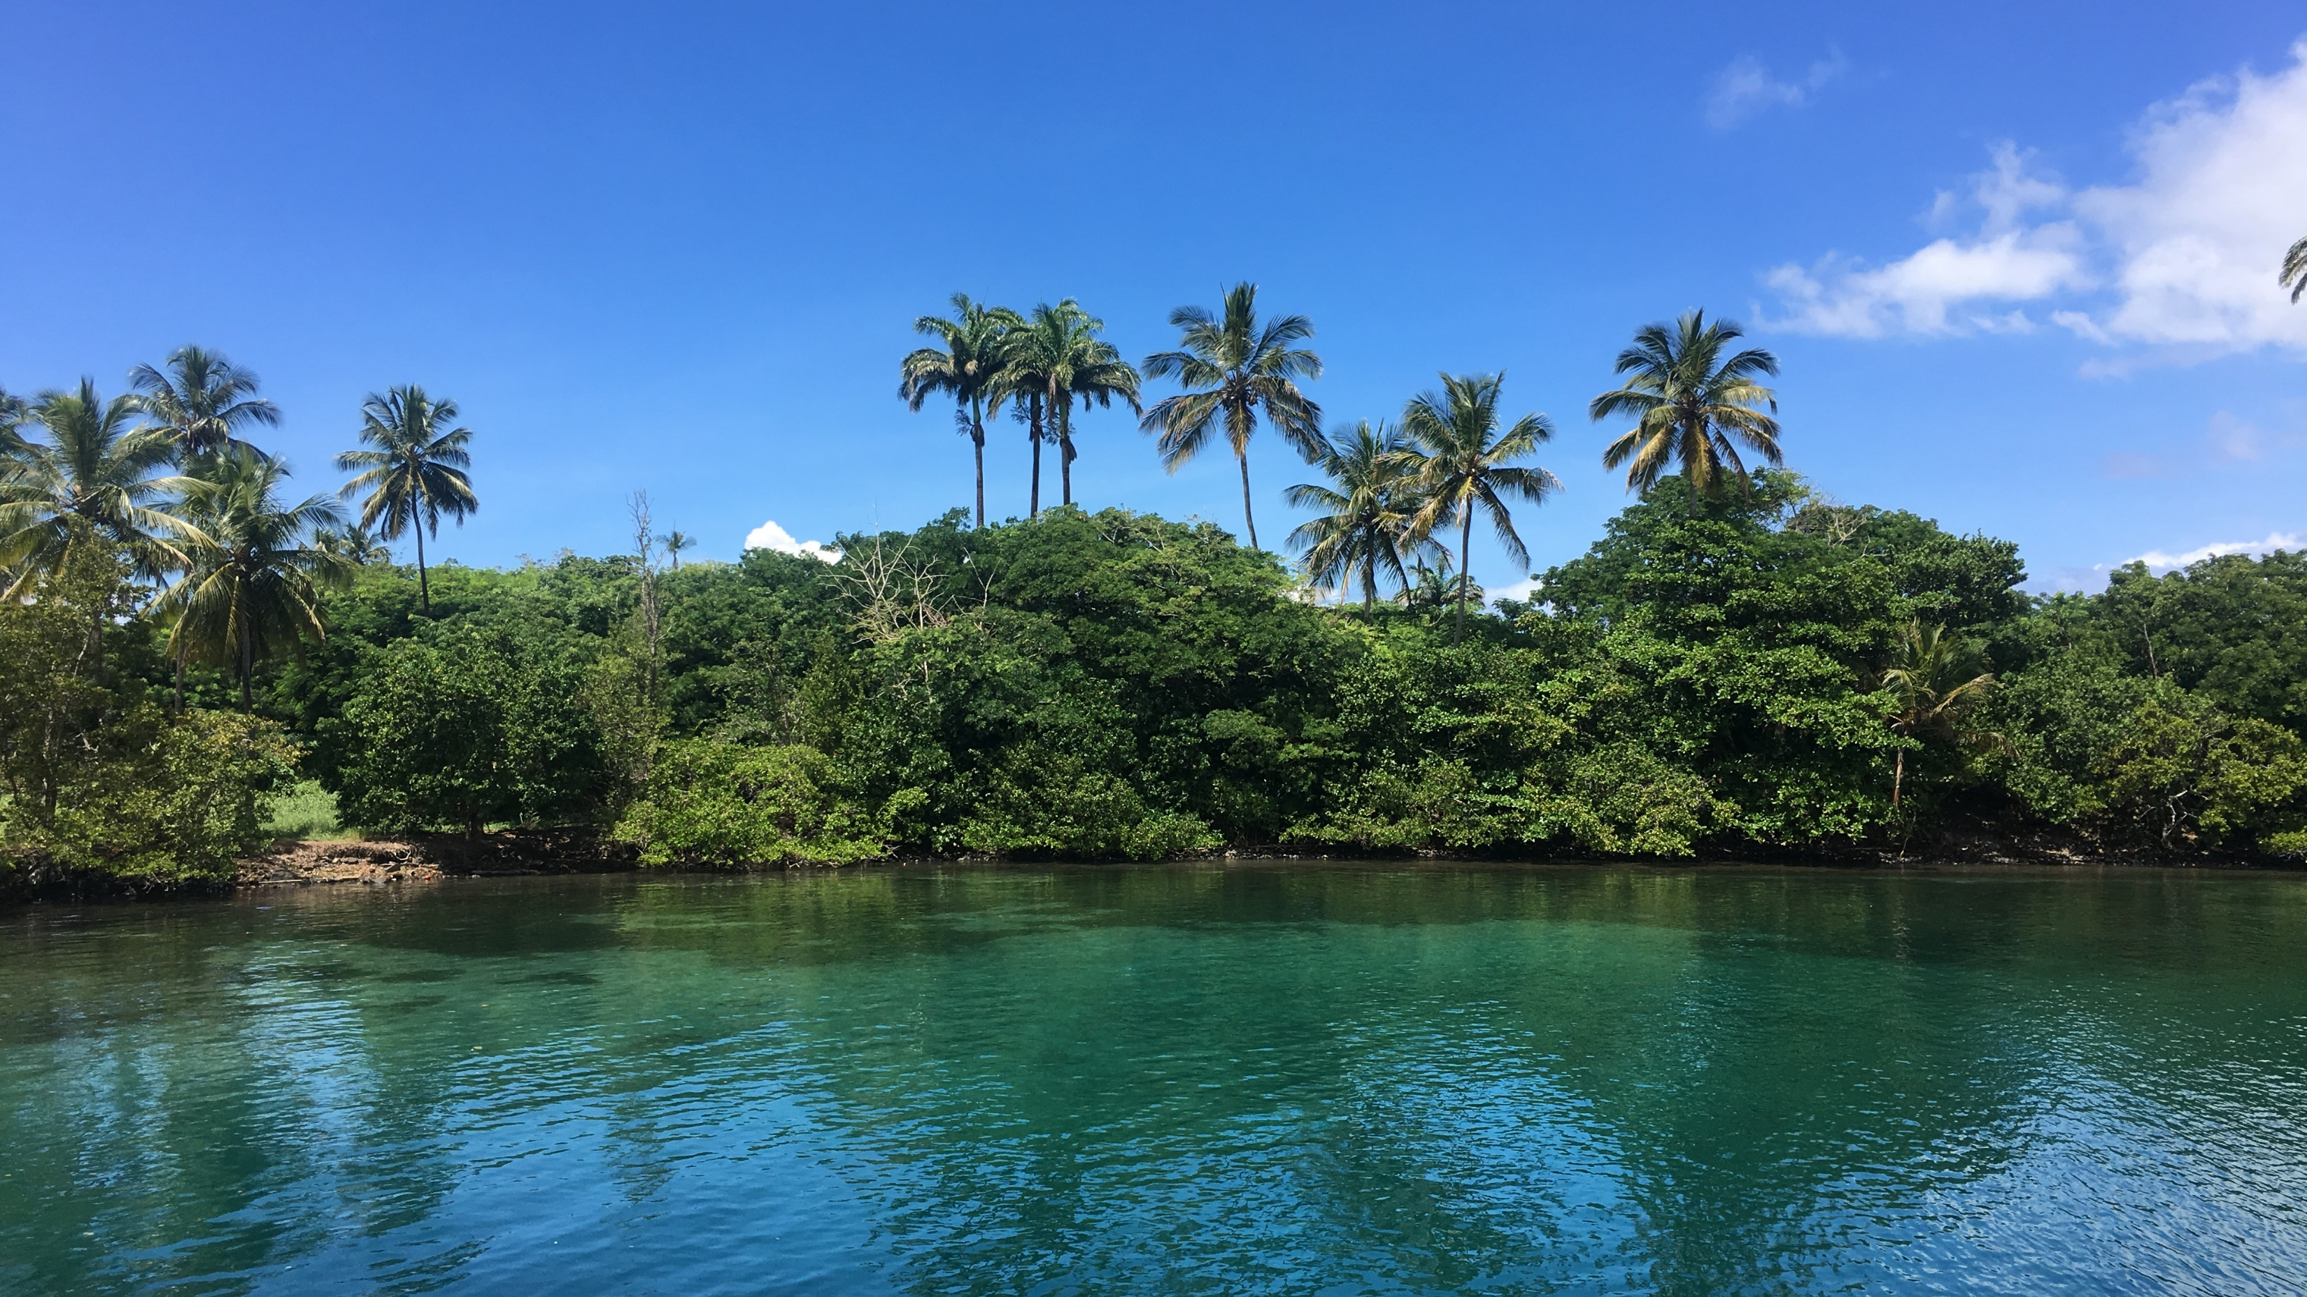

Slide 19
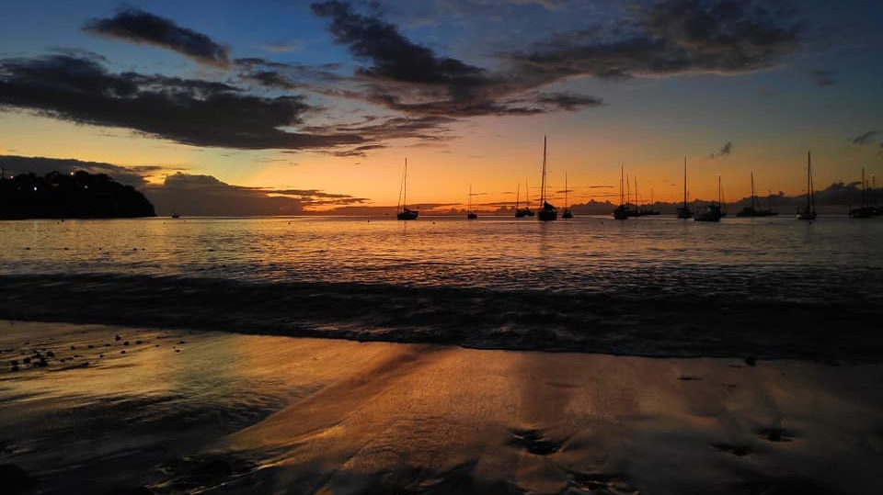

Slide 20
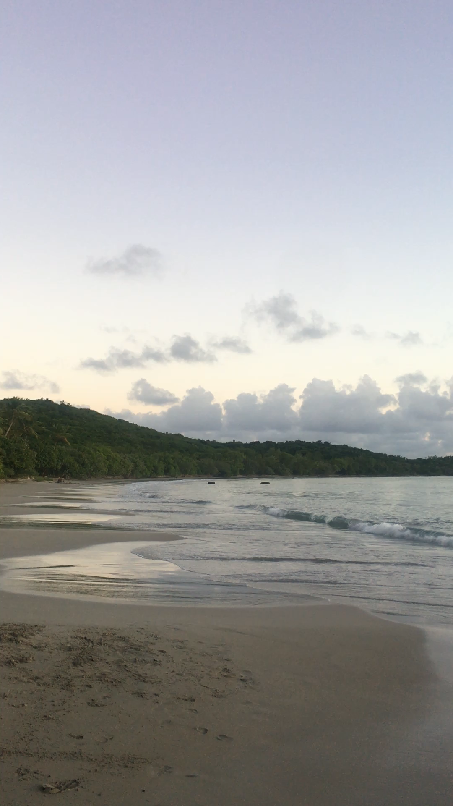
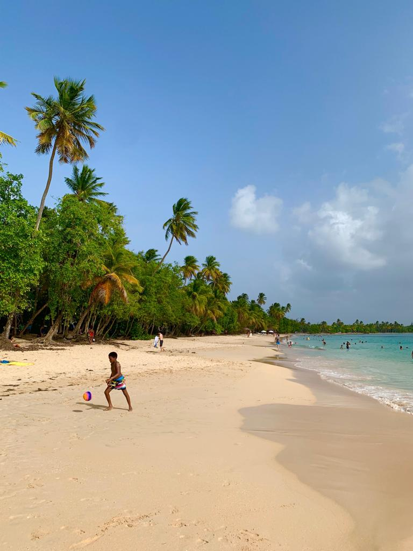

Slide 21
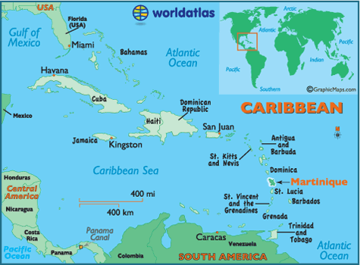

Slide 22
La nature

Slide 23
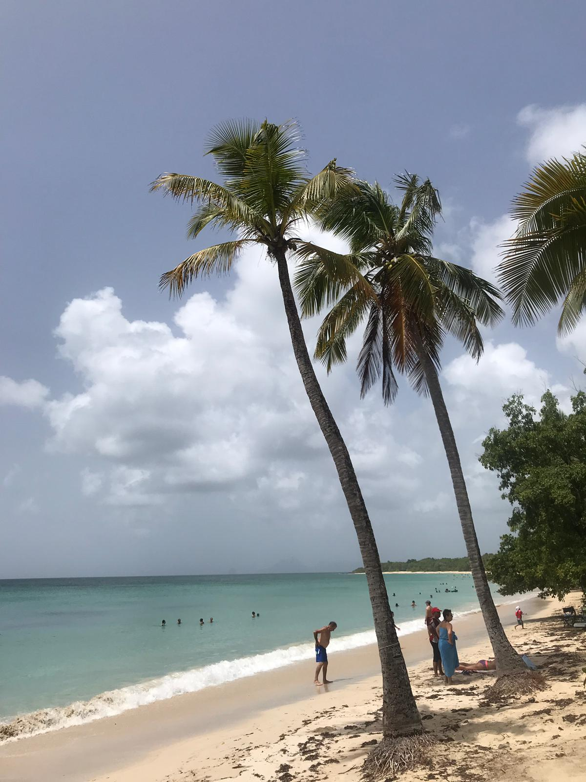
Un cocotier

Slide 24
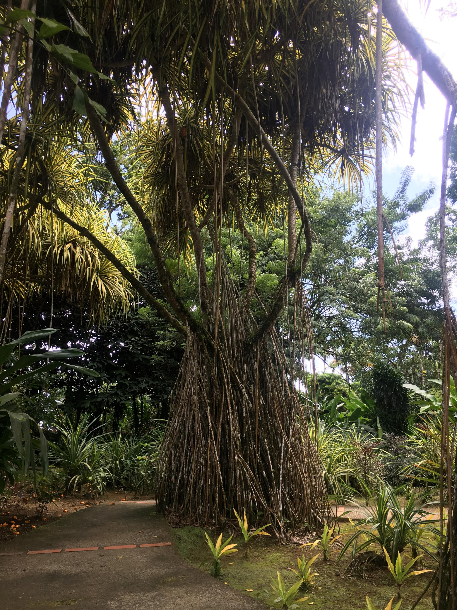
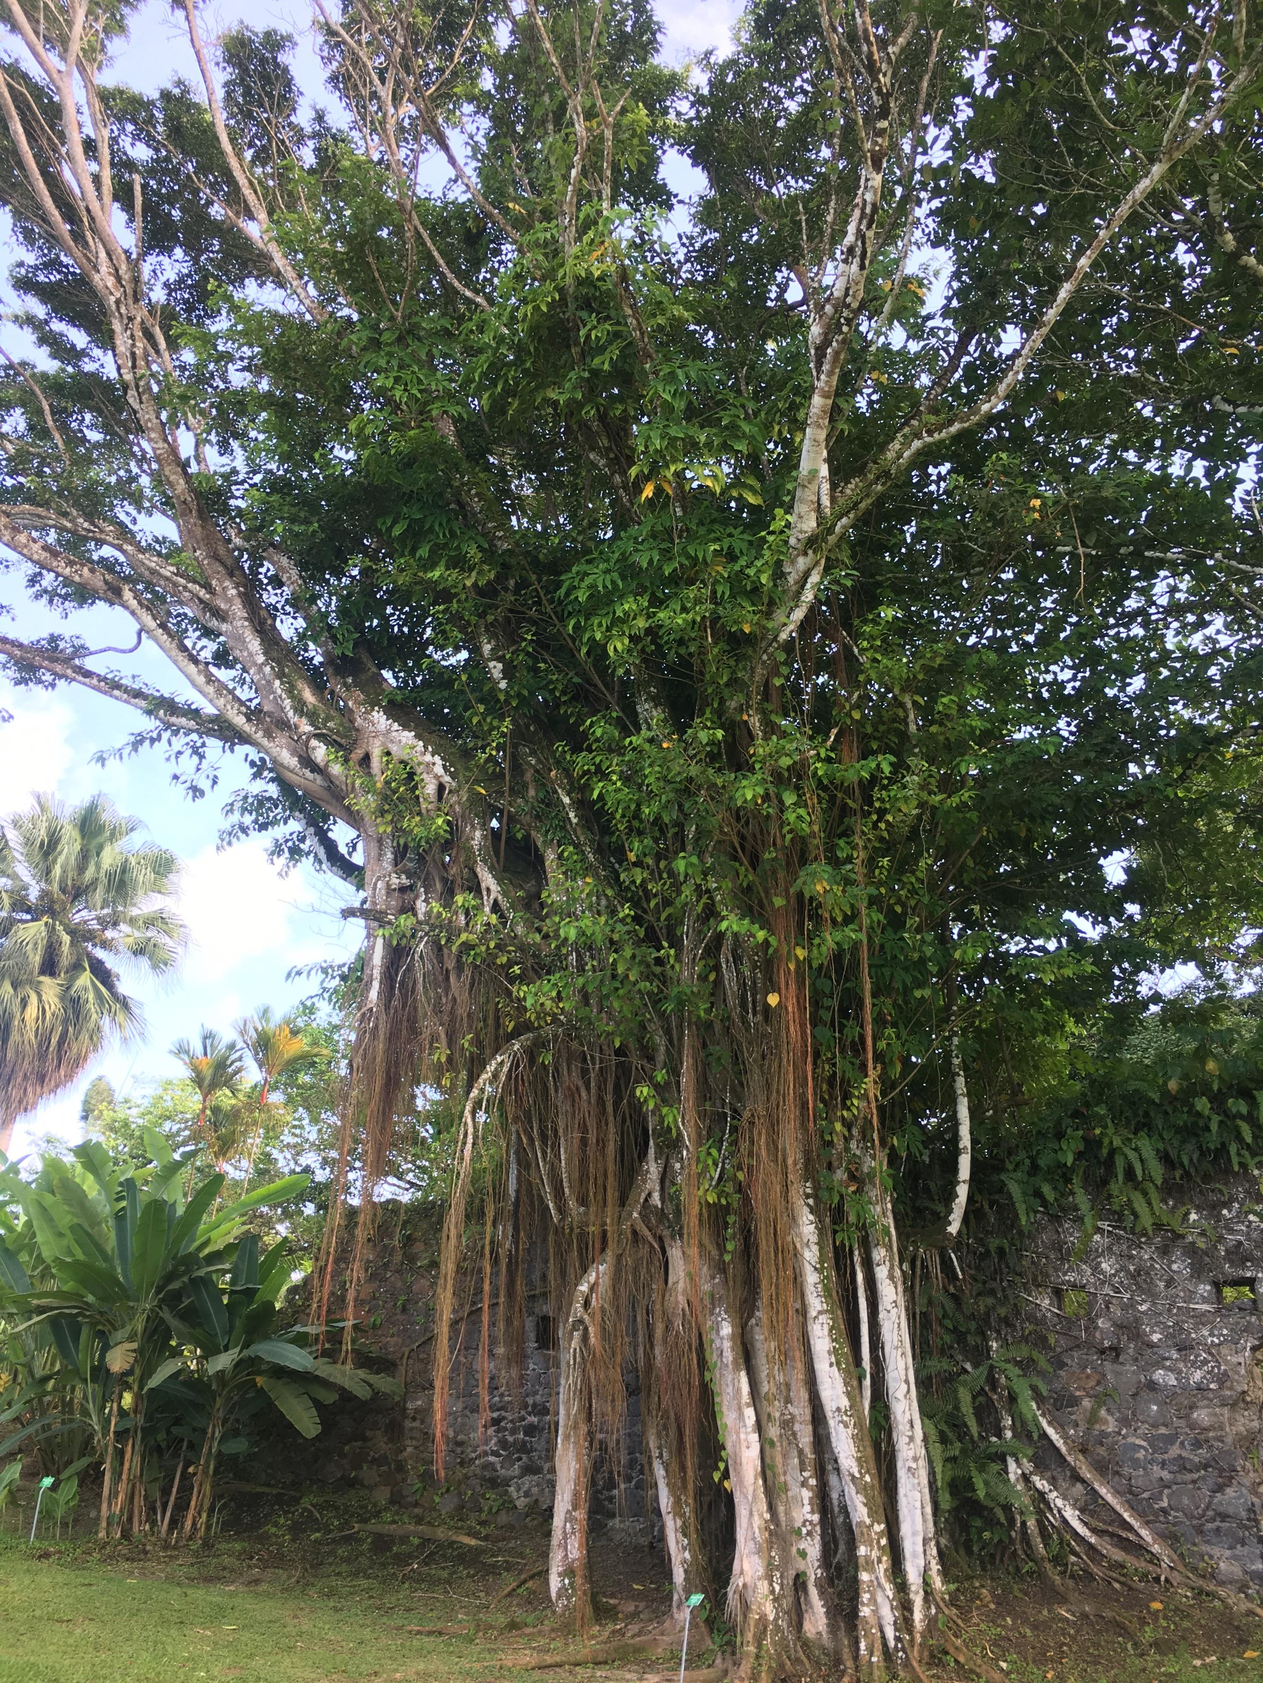
Le figuier maudit

Slide 25
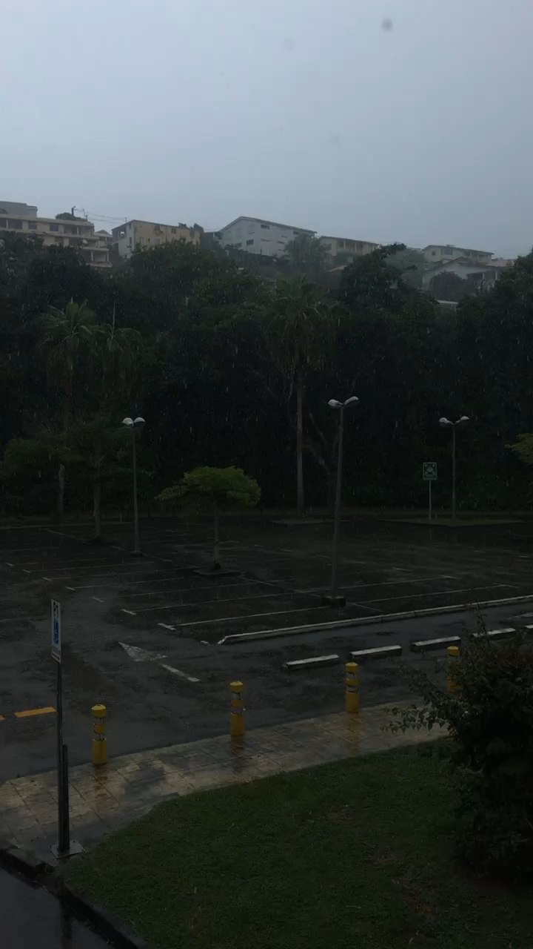
Un orage

Slide 26
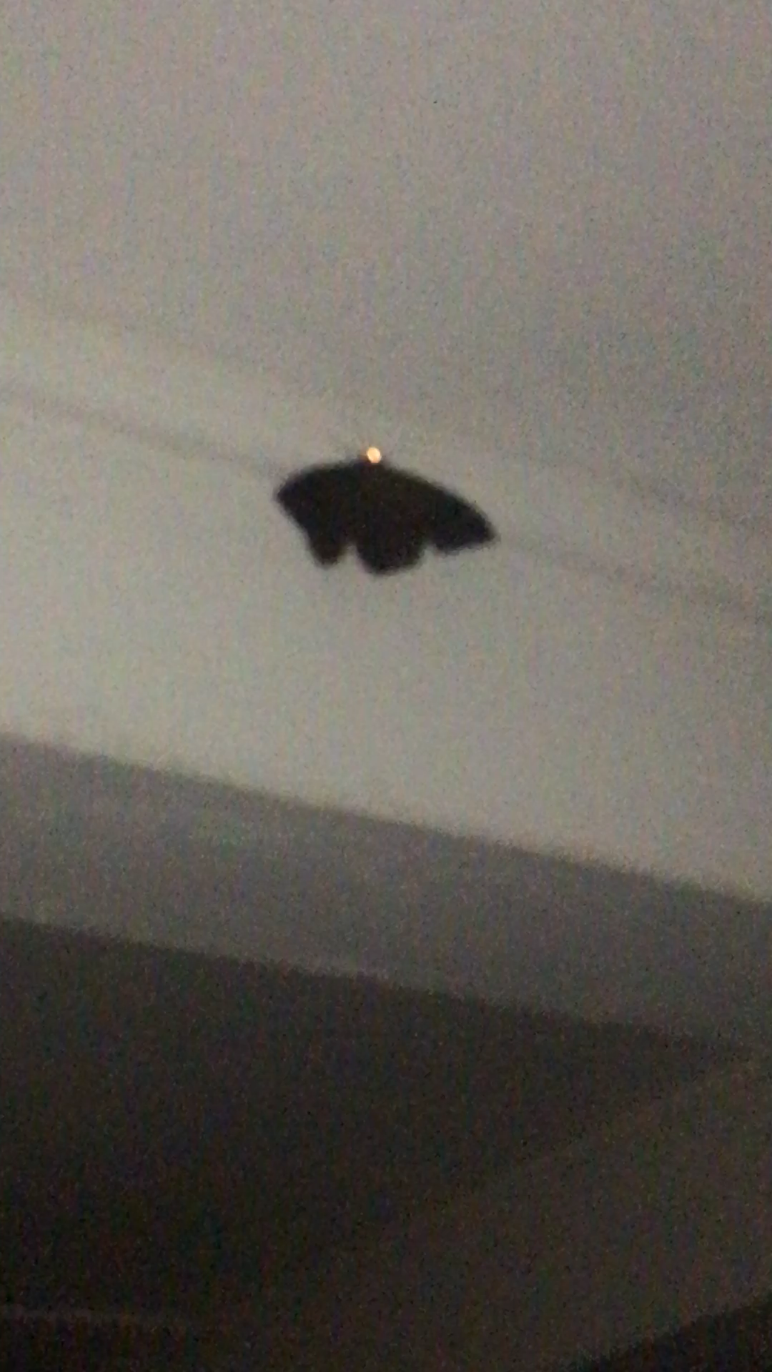
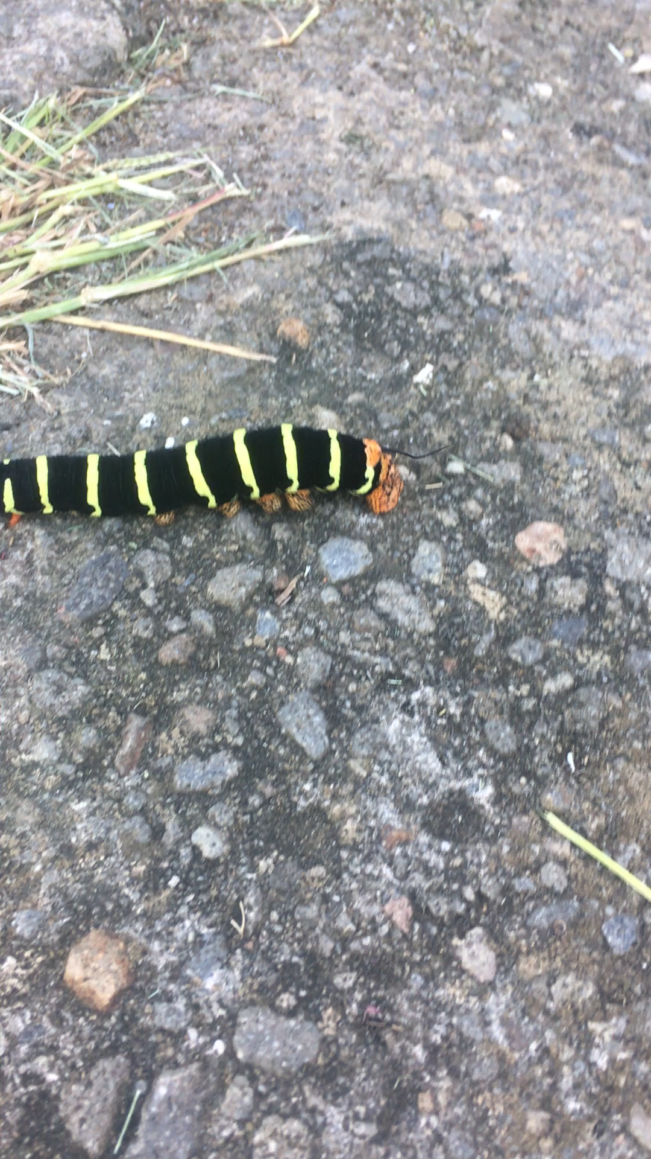
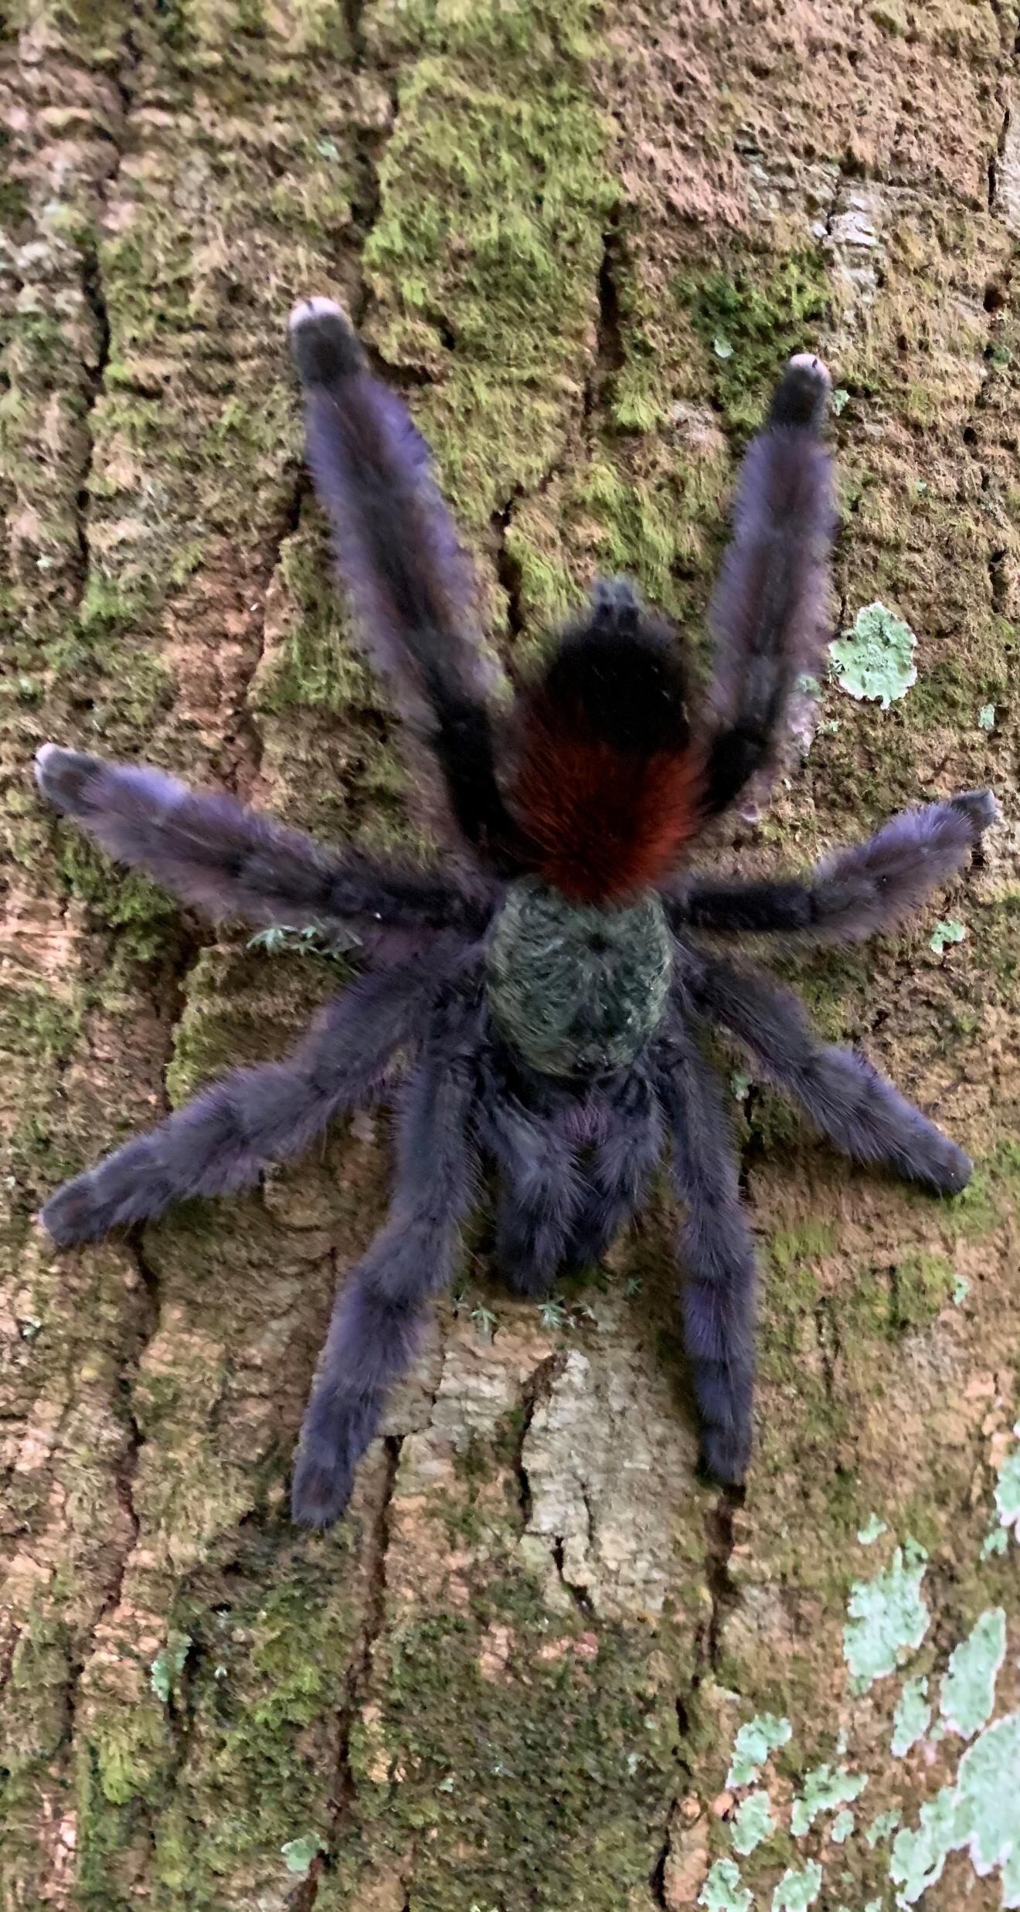
Un papillon de nuit
Une chenille
Une mygale

Slide 27
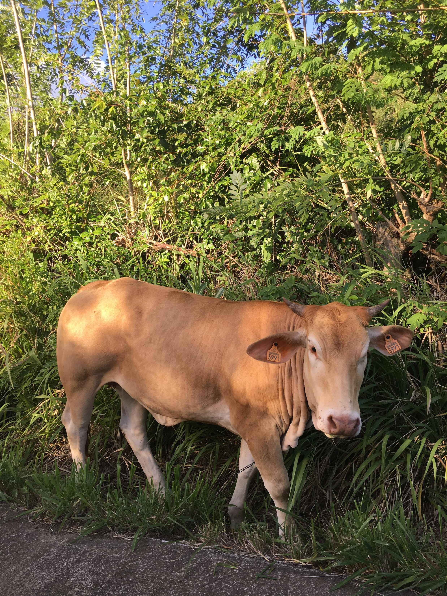
Une vache

Slide 28
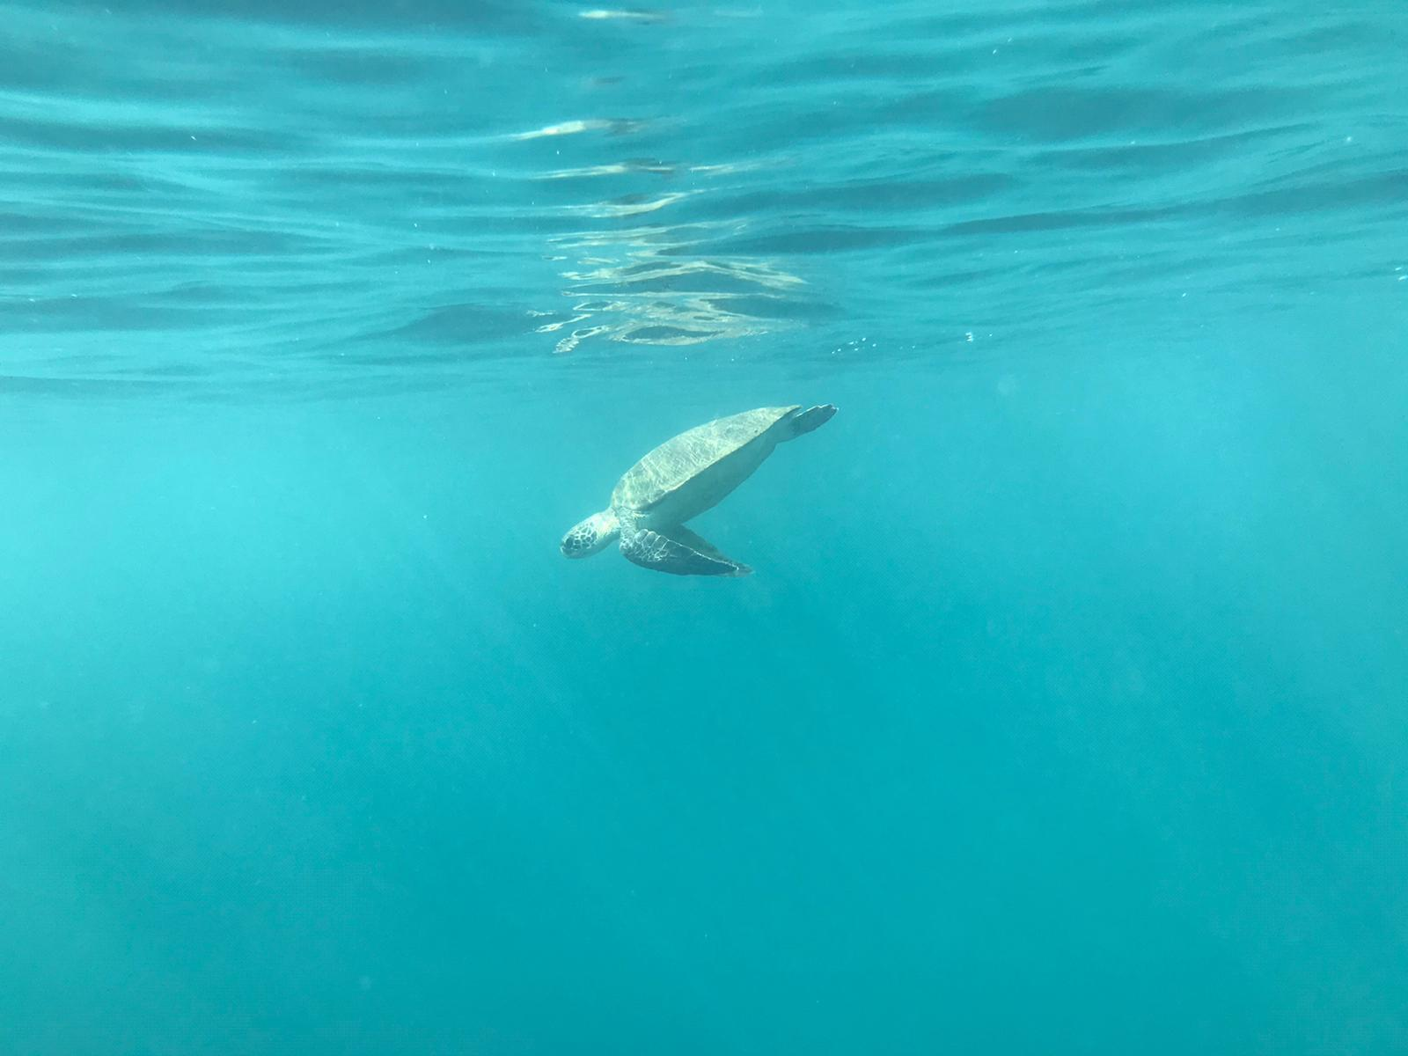
Une tortue de mer

Slide 29
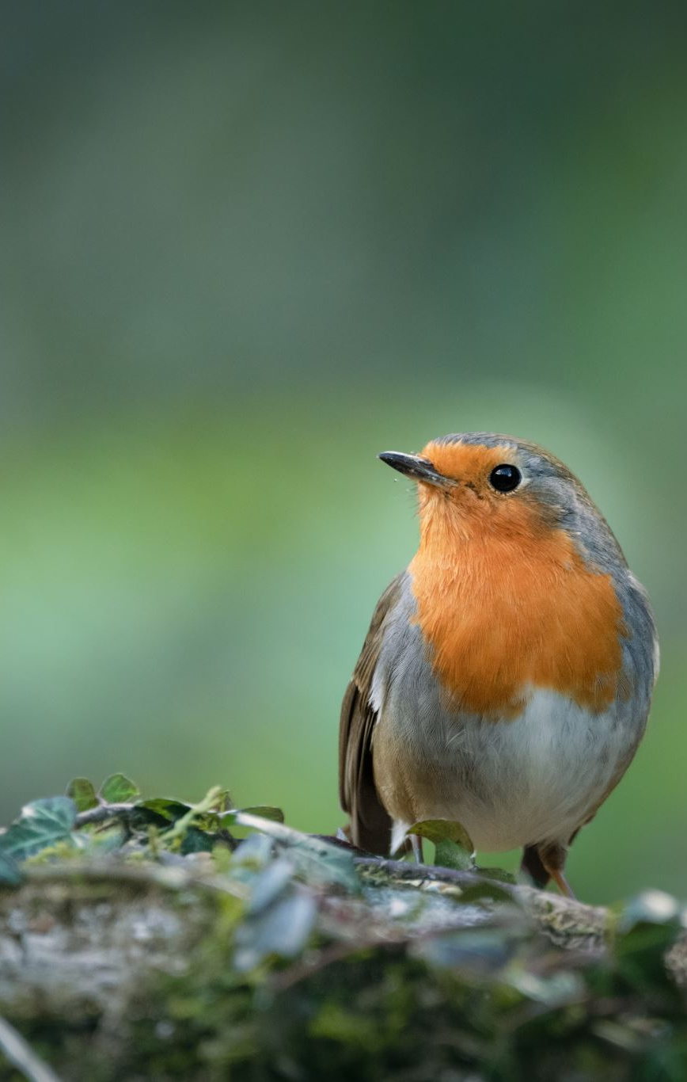
How can learning languages help nature around the world?
Take part in international conservation projects, like Anna
Help local people work with nature where they are
Help discover and preserve the names of rare species:
  If we know the names local people give to animals, birds, insects, plants and trees, they are easier to protect
LinguaMania Episode 2: Understanding our natural world: why languages matter | Creative Multilingualism

Slide 30
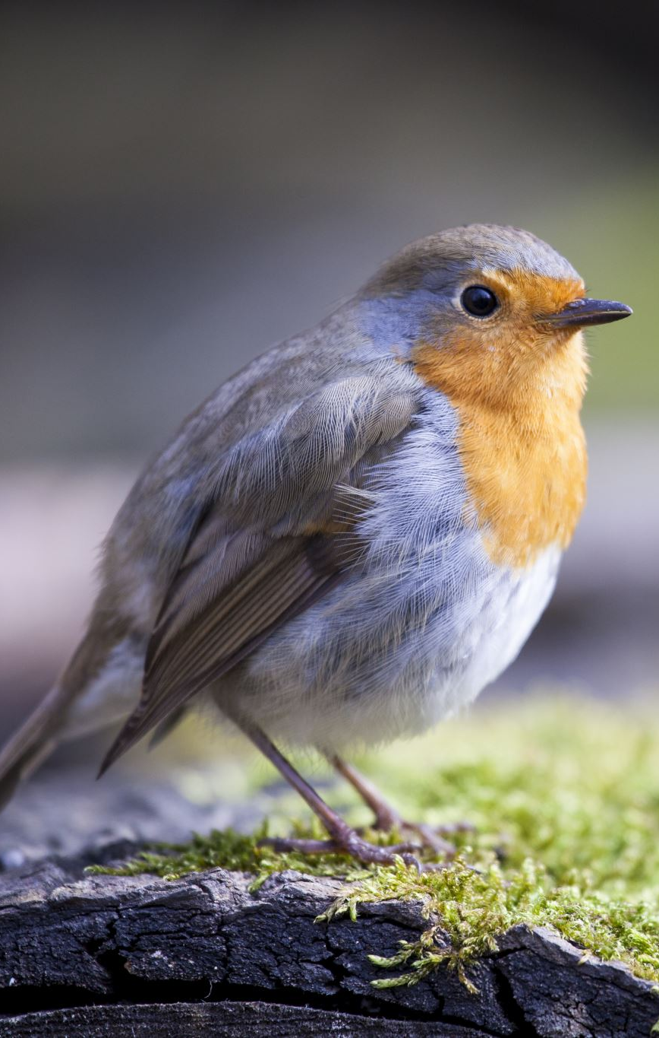
For instance:
In English, the robin has been given lots of names by different communities:
Ruddock
Robin redbreast
Bob robin
The Bobby Eric
The ploughman’s bird
Just imagine how many names for different species exist around the world!

Slide 31
Some language activities ..
Choose a favourite animal, bird, insect, plant, tree, etc…
Find out what it is called
In a language you are learning at school
In other languages you have learned
Invent an imaginary bird, animal, insect, plant, tree, etc…
How would you describe it, using the language you learn at school?
Where does it come from? Think about countries that speak French or Spanish …

Slide 32
Building sentences (1) je suis …
Content(e)
Triste
Effrayé(e)
Calme
Joyeux/se
Fatigué(e)
En colère
Surpris(e)
Inquiet(e)
…comme le soleil jaune
… comme l’arbre mort
… comme le petit oiseau
… comme …
… comme …
… comme …
… comme …
Notes:
Children to think of other examples
They can then use their vocab sheets to think of examples in the target language.
Idea here is that the pupils realise that humans are intimately connected to the natural world, that their moods can be shaped by it and that it can help give shape to their inner feelings.

Slide 33
Building sentences (2)
Les arbres sont…
Les fleurs sont…
Les oiseaux / animaux / insectes sont…
Le paysage est…
Les rivières sont…
Notes:
Dirty
Dead
Polluted
Tired
Quiet
Gone
Left
Died
Crying
Suffering

Slide 34
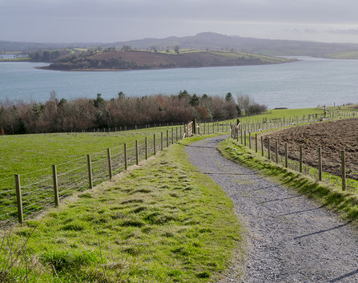
Making your nature / environment poem 1: writing in the language you’re learning
Don’t forget to illustrate / decorate your poem
This Photo by Unknown Author is licensed under CC BY-SA

Slide 35
Adjective poem - example
Line 1: Noun
Line 2: Same noun + is/are + adjective
Line 3: Same noun + is/are + adjective 1, adjective 2
Line 4: Is/are + adjective 1, adjective 2, adjective 3
Line 5: Adjective 1, adjective 2, adjective 3 , adjective 4
Line 6: New (related) noun OR New (related) phrase
Line 1: Les arbres
Line 2: Les arbres sont magnifiques
Line 3: Les arbres sont magnifiques et verts
Line 4: Les arbres sont magnifiques, verts et grands
Line 5: Les arbres sont magnifiques, verts, grands et importants
Line 6: Les oiseaux aiment les arbres …
Notes:
To do with accompanying sheet …

Slide 36
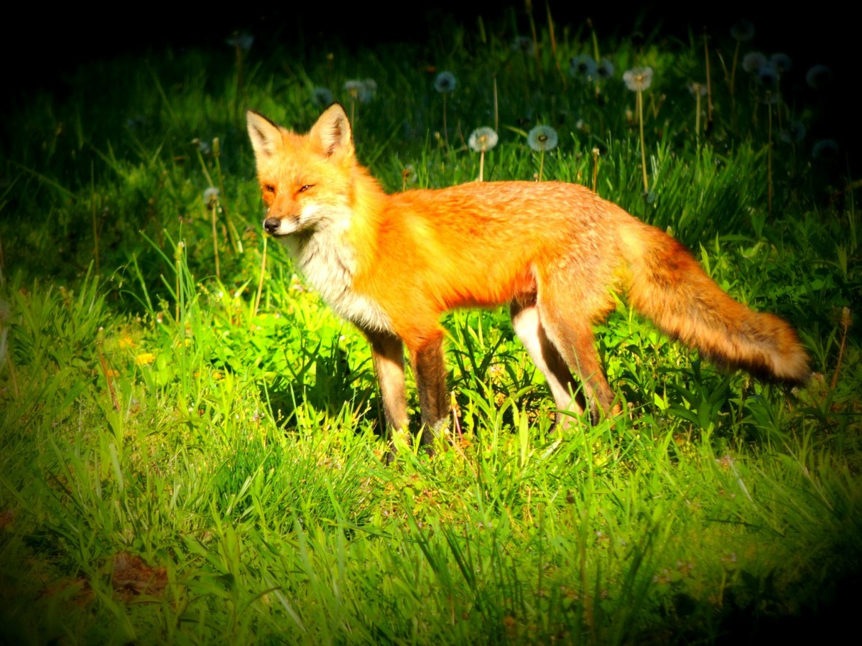
Acrostic poem
Nous
Aimons
Trouver
Un
Renard
Enorme

Slide 37
haiku
Line 1: Five syllables
Line 2: Seven syllables
Line 3: Five syllables
Je regarde l’insecte
Un papillon magnifique
Il est rouge et bleu

Slide 38
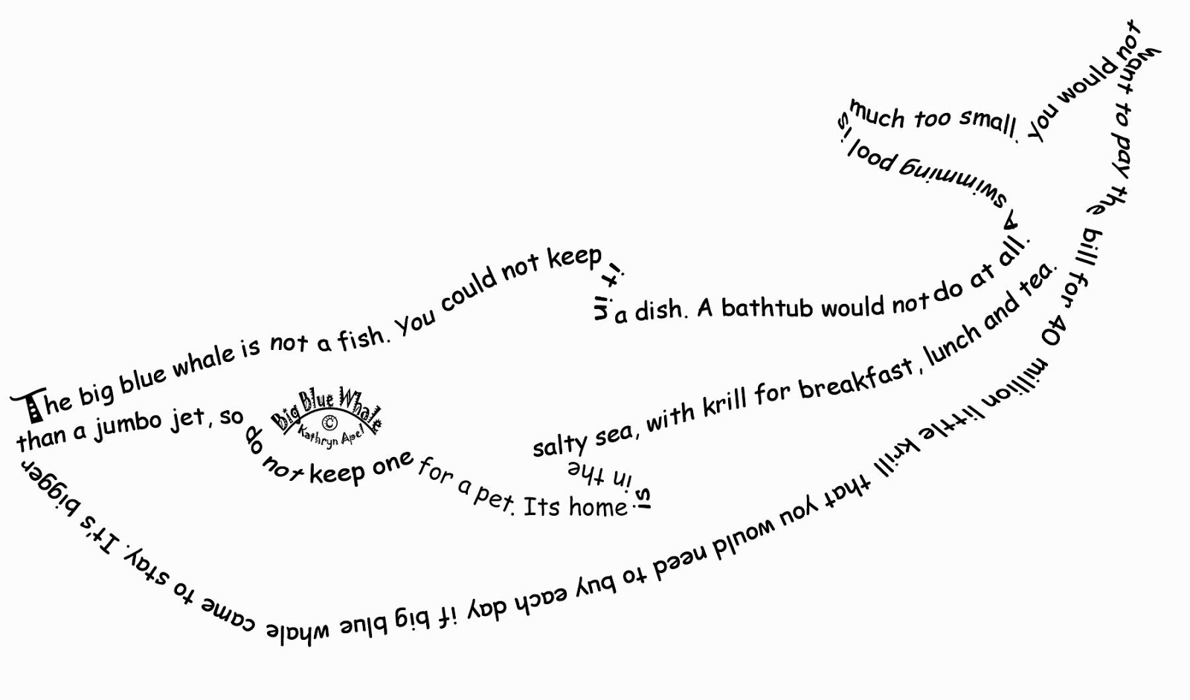
Caligram: write a poem in the shape of a symbol representing a peace idea
This Photo by Unknown Author is licensed under CC BY-NC
Notes:
Creating Calligrams

