Slide 1
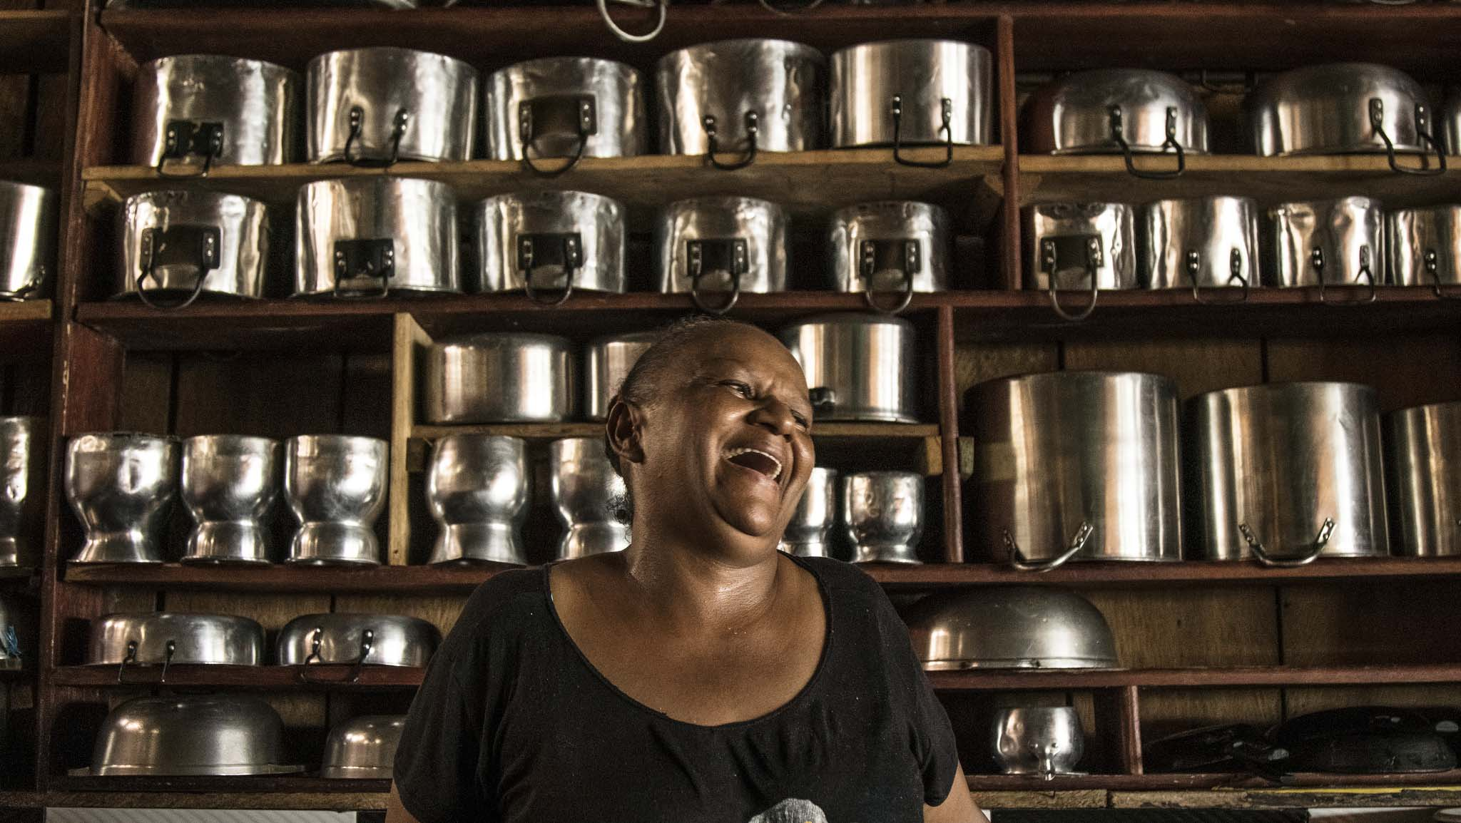

Colombia´s Reincorporation and Normalization Agency

Slide 2
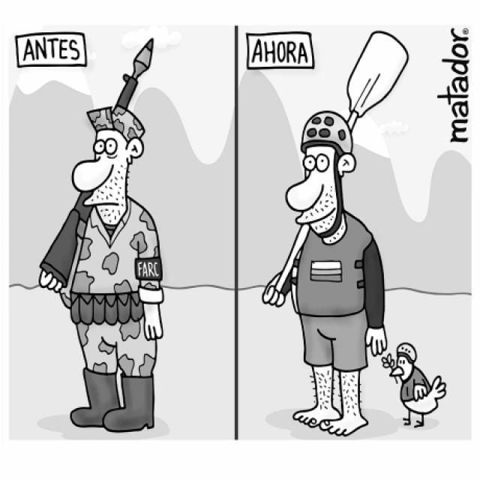
A picture is worth a thousand words
Then
Now
A picture is worth a thousand words

Slide 3
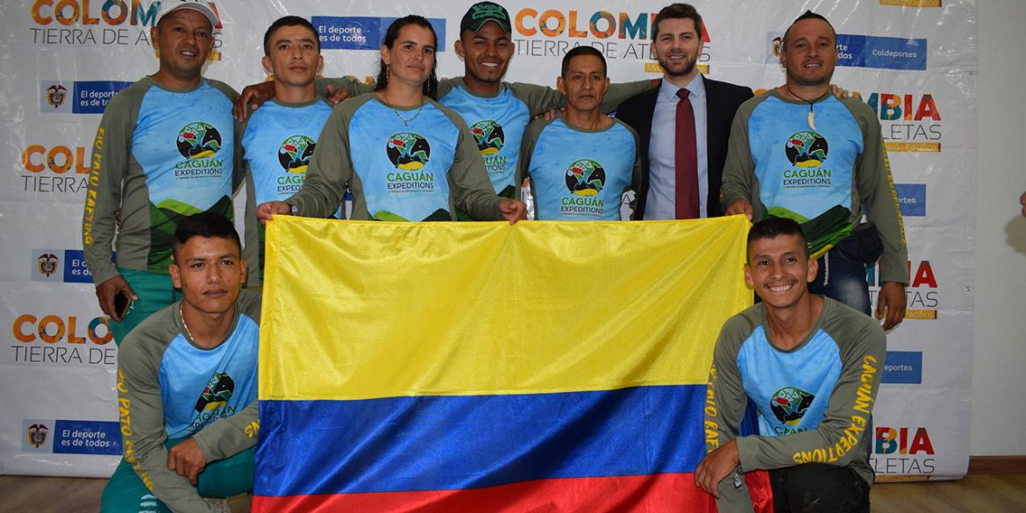
Former FARC fighters to represent Colombia at international rafting championships

Slide 4
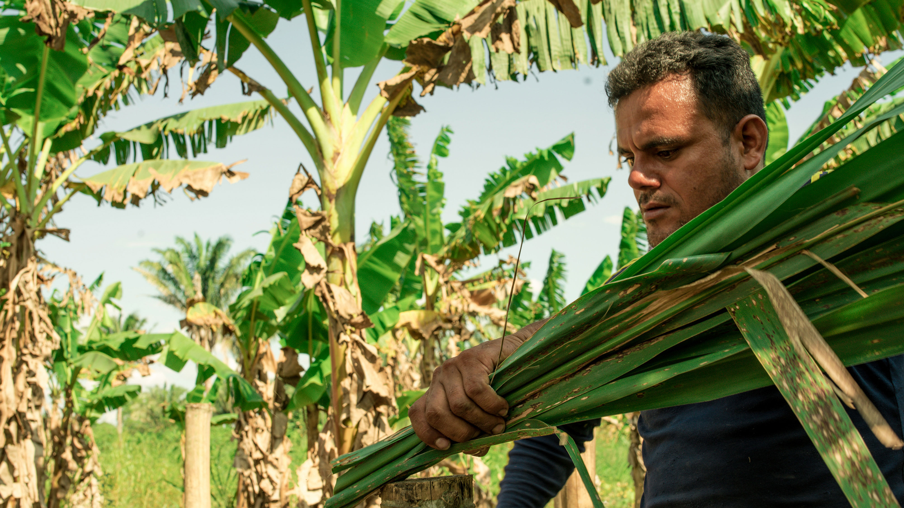
Program Evolution
Reincorporation to civil life program- (outsourced services)
High Counseling for Reintegration
(appropriation of services)
Colombian Reintegration Agency
(multidimensional services)
ARN
Reincorporation and Normalization Agency
2003
2006
2011
2017

Slide 5
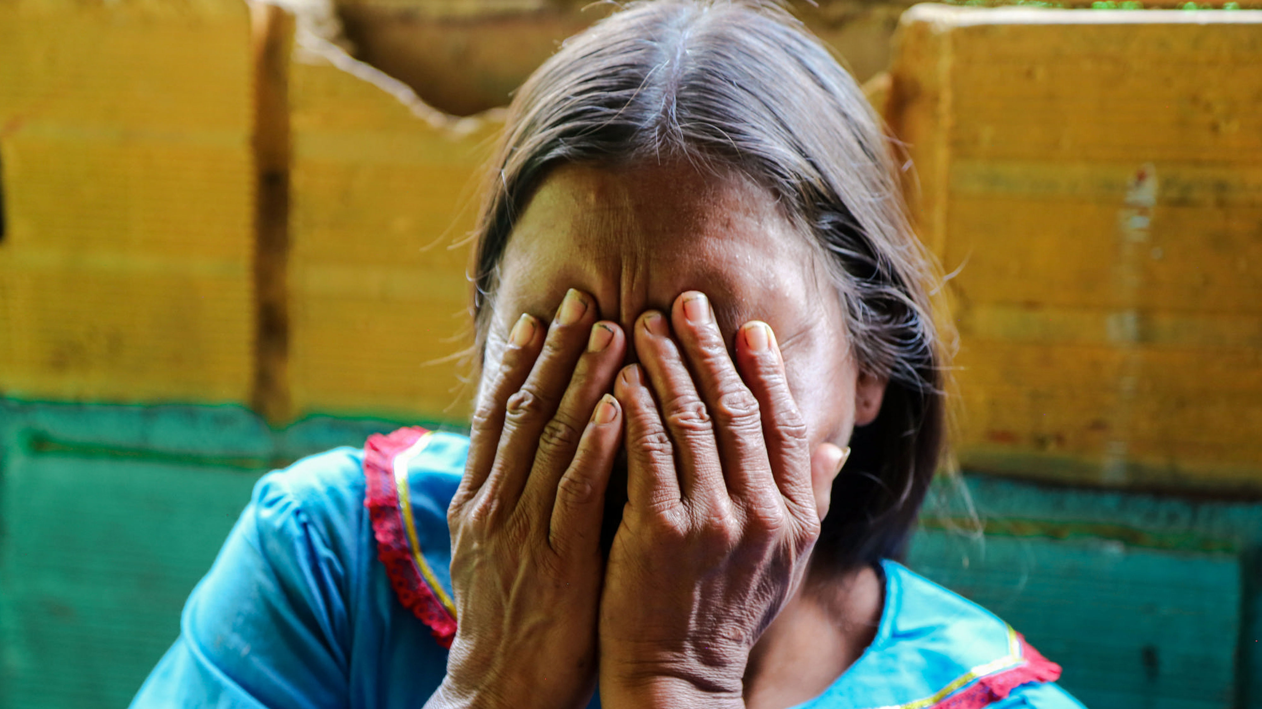




Disarmament – Demobilization and Reintegration (DDR)
Disarmament and Demobilization
Individual
Collective
Ministry of Defense
Office of the High Commissioner for Peace
Accreditation document
Rights Restoration
Minors
Minors
Adults
Adults
Reintegration

Slide 6




13.190
51.026*
Enter the Reincorporation Process
Enter the Reintegration Process
24 ETCR
Completed | 24.313
Current in process | 5.868
Absent | 2.958
Out of the process | 17.887
40 37 Regional offices y 3 national offices
919 municipalities

Slide 7
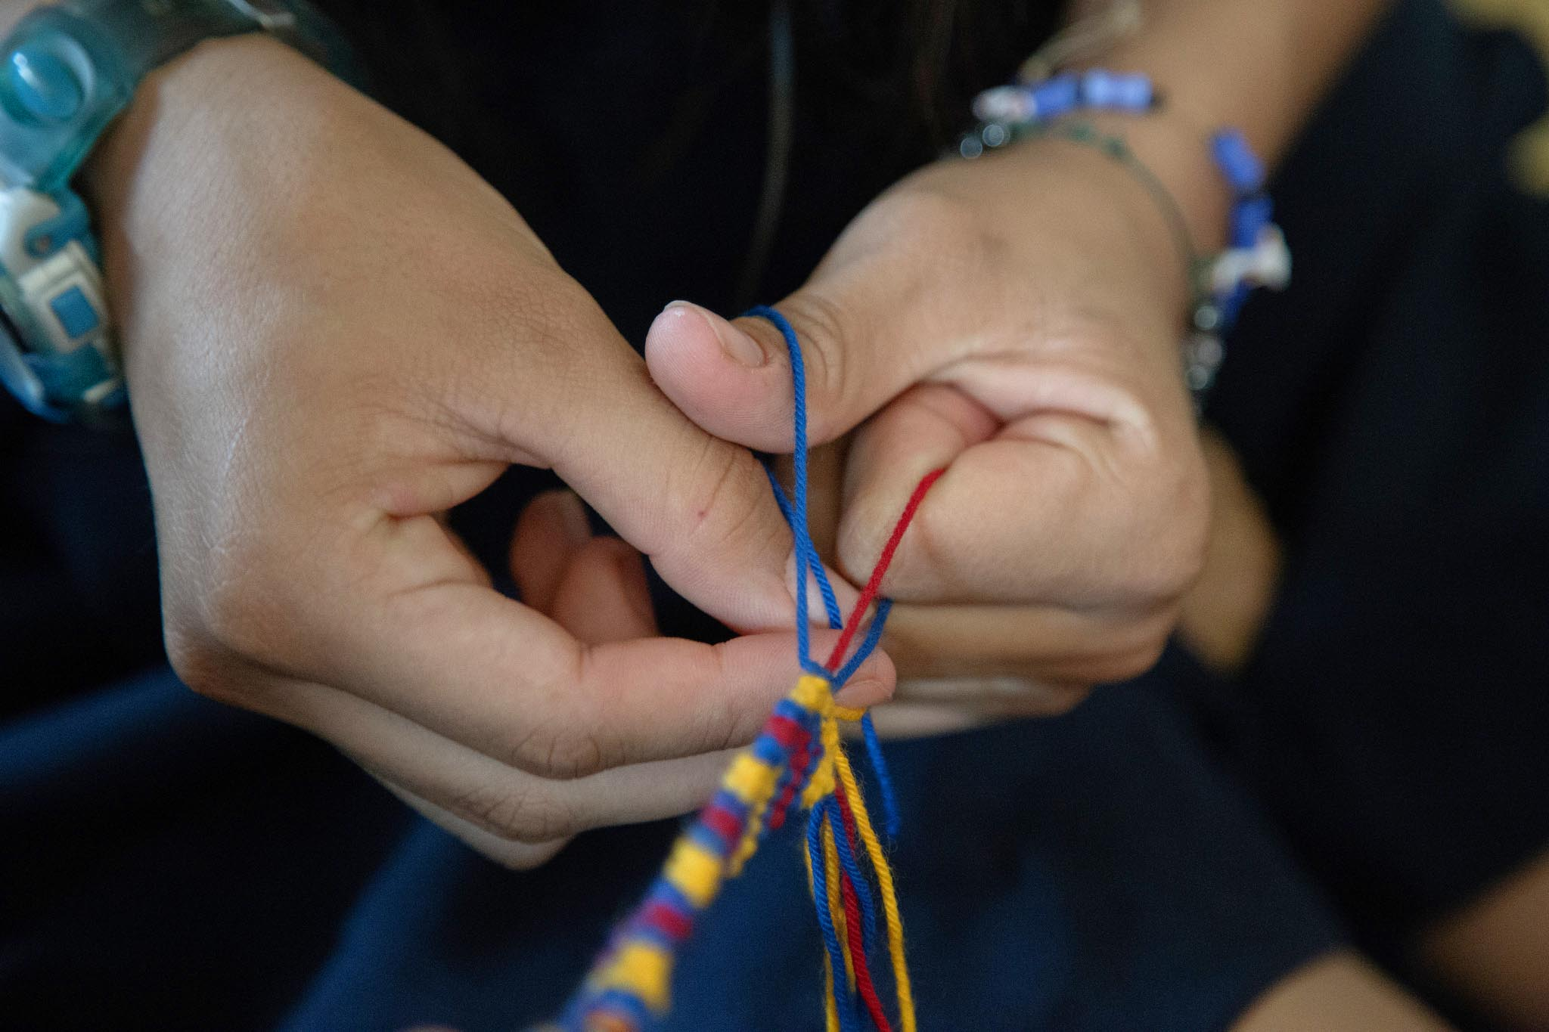
01.Reintegration

Slide 8
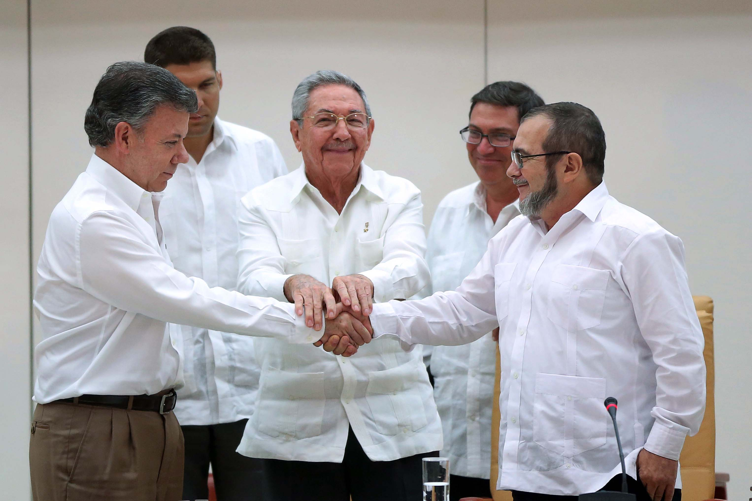

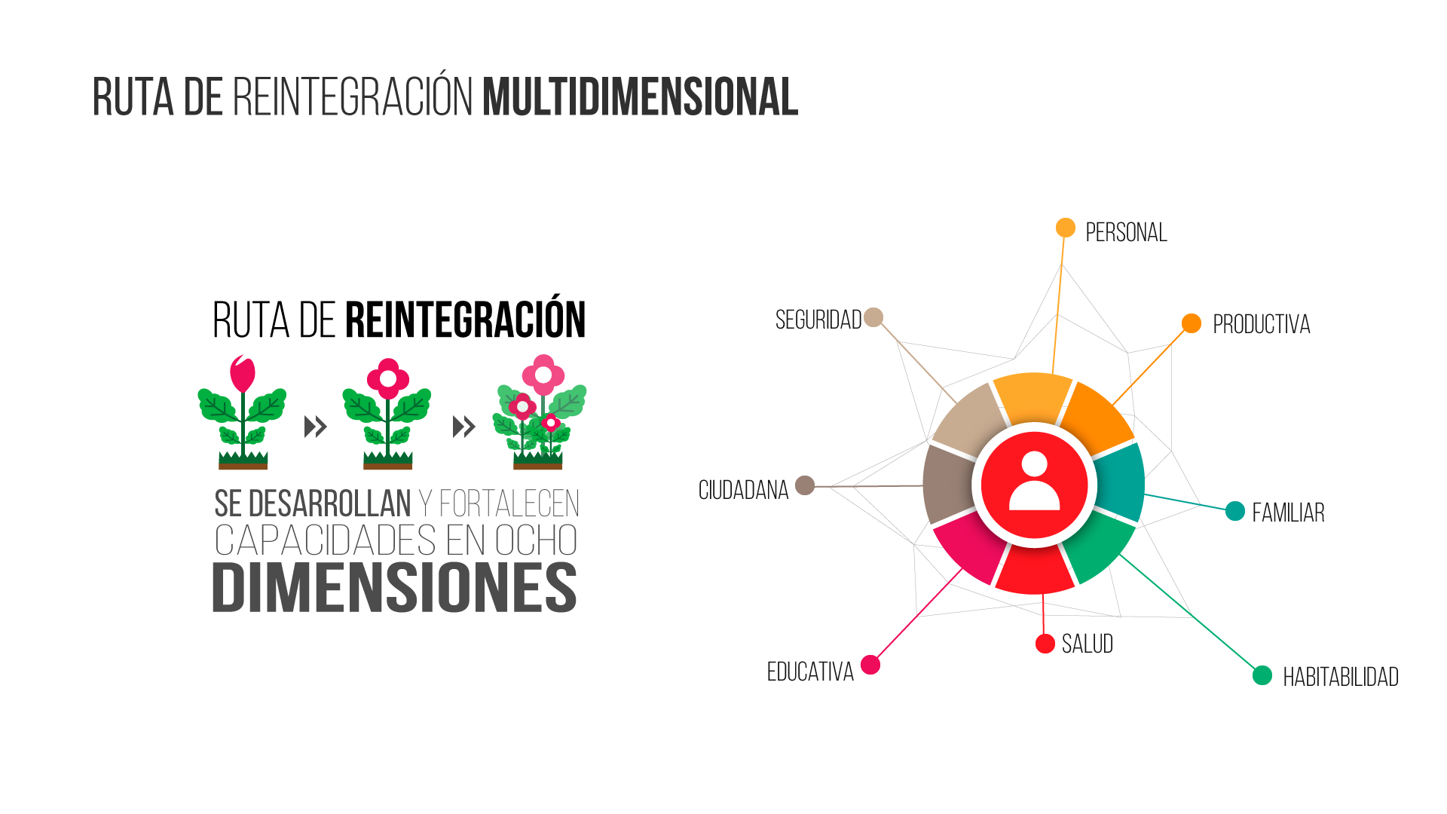
MULTIDIMENSIONAL ROUTE
SECURITY
PRODUCTIVE
CITIZENSHIP
FAMILY
HEALTH
EDUCATION
HABITAT

Slide 9

1. Comprehensive rural reform
2. Political Participation
Colombia´s Agreement- Main Topics
3.End of the conflict
4. Solution to the problema of illicit drugs
6. Implementation and verification mechanisms
5.Victims of the conflict

Slide 10

02.
Reincorporation

Slide 11
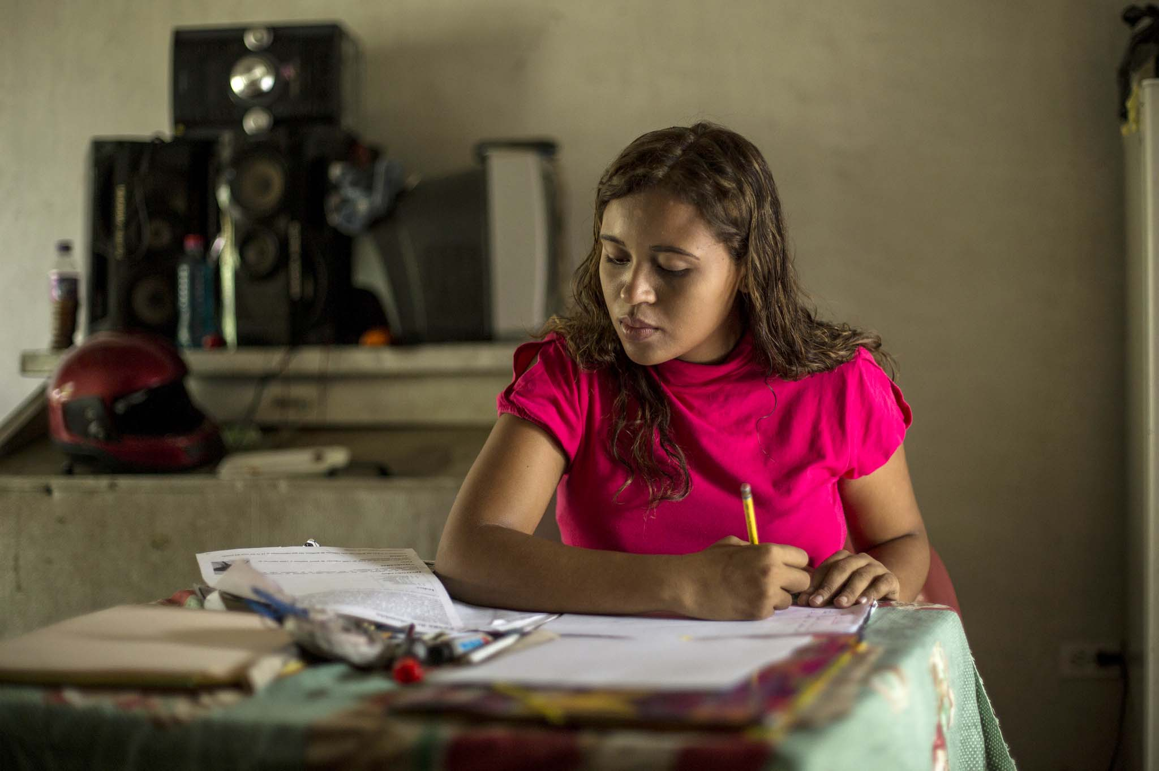
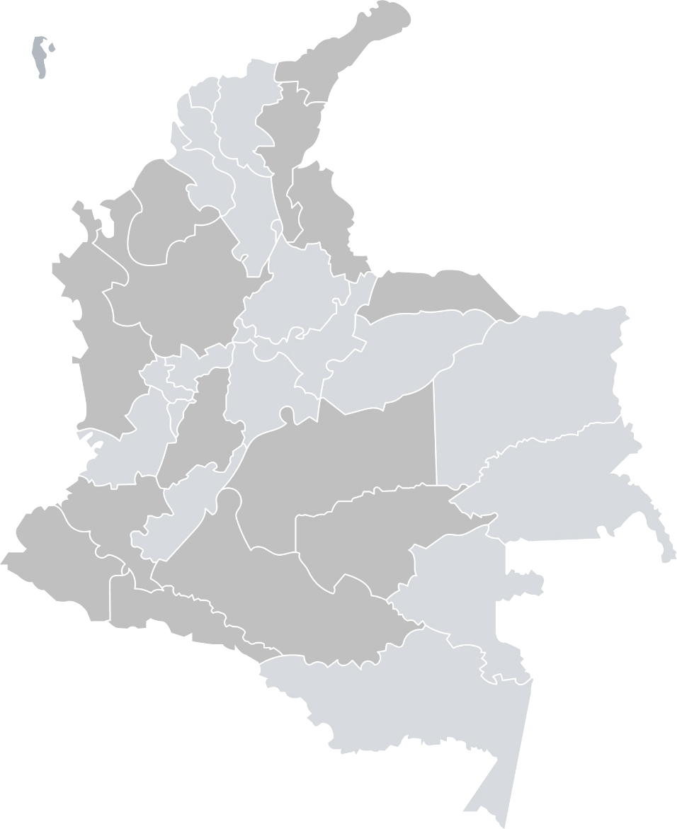


REINCORPORTION
Distributed in
450
Municipalities
8.459
People in the ARN´s offices
Attended by
60
facilitators
3.479
People in ETCR

Slide 12
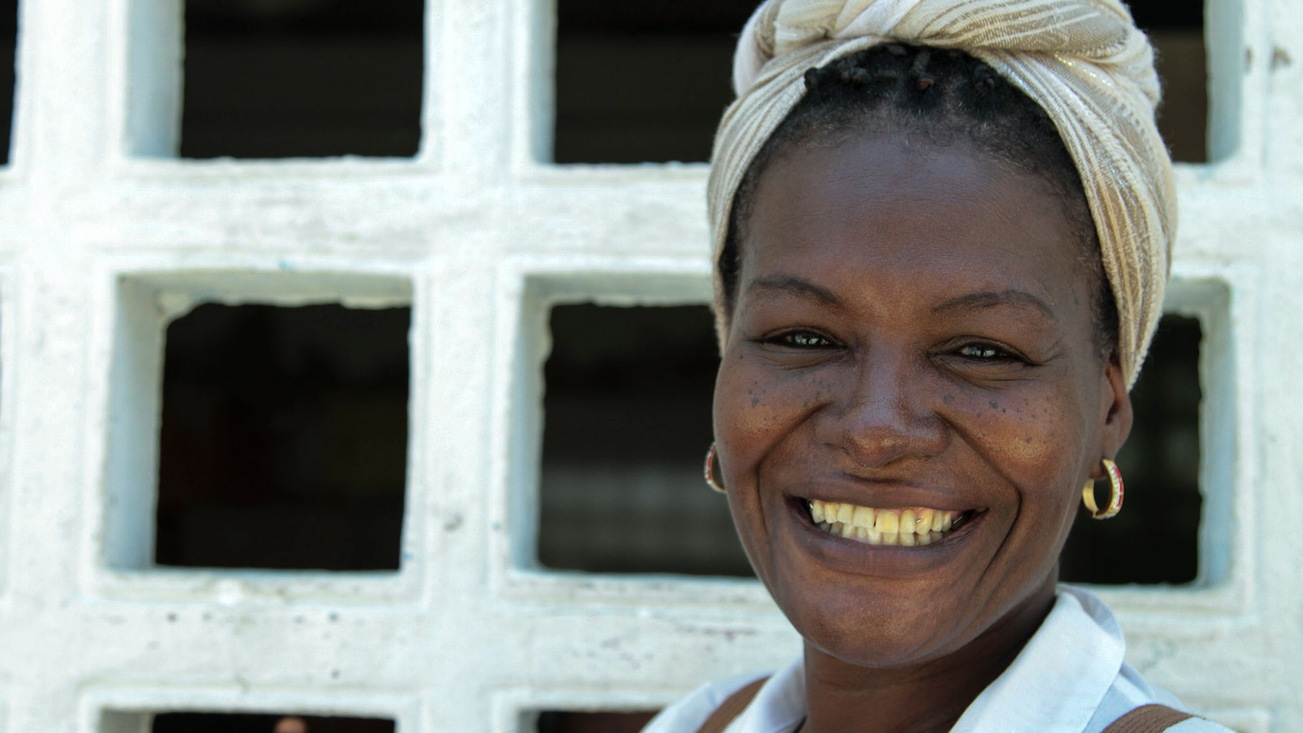



















03.
Shared responsibility

Slide 13
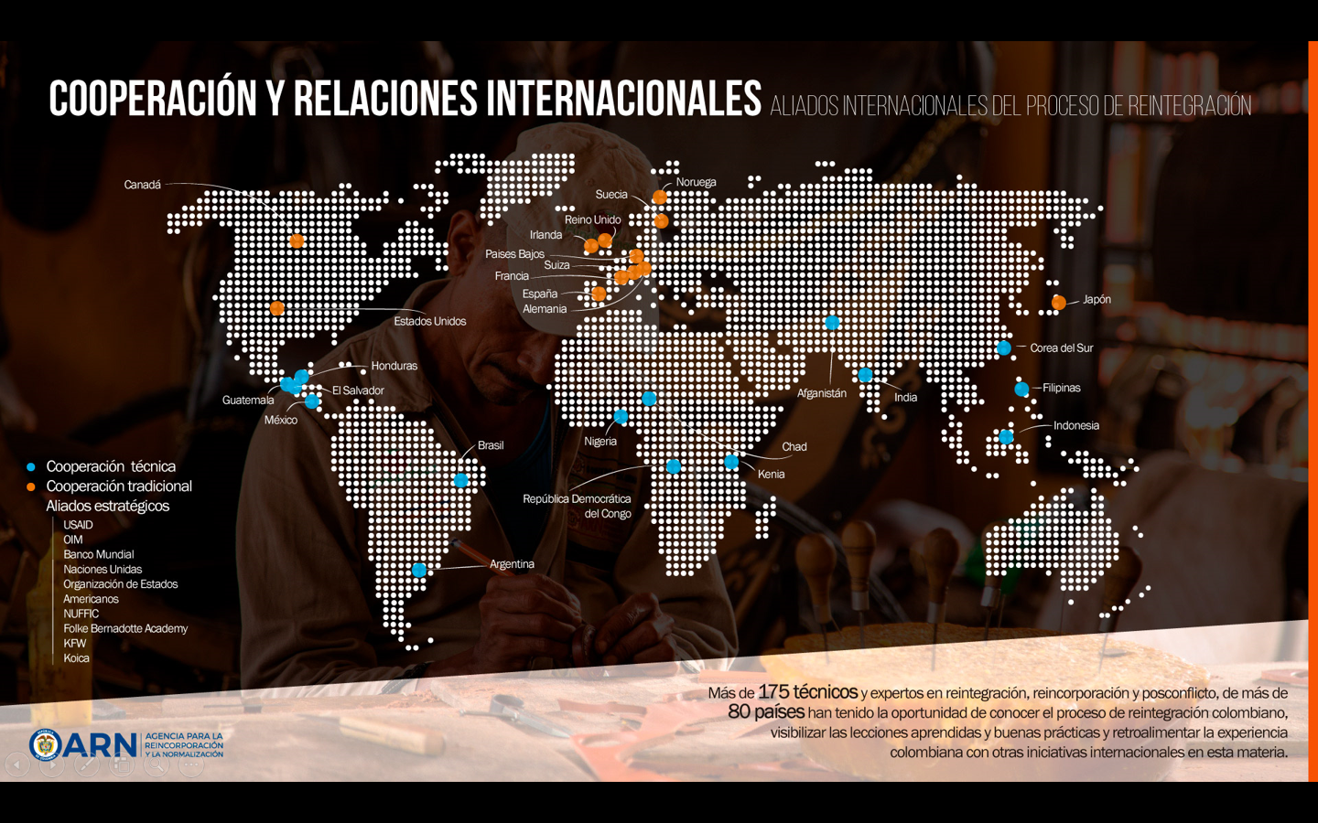
Cooperation and International Affairs
More tan 180 technicians and experts from 60 different countries have known about the reintegration and Reincorporation processes.

