Slide 1
Introduction to the French Revolution
Dr Katherine Astbury

Slide 2
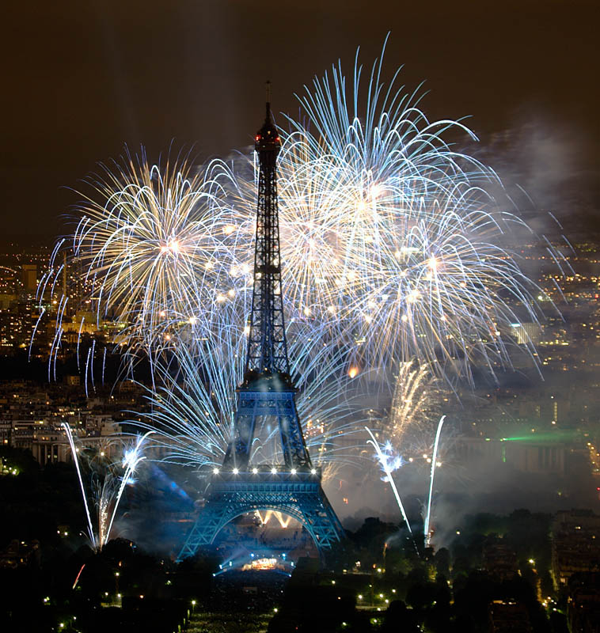
Le 14 juillet

Slide 3
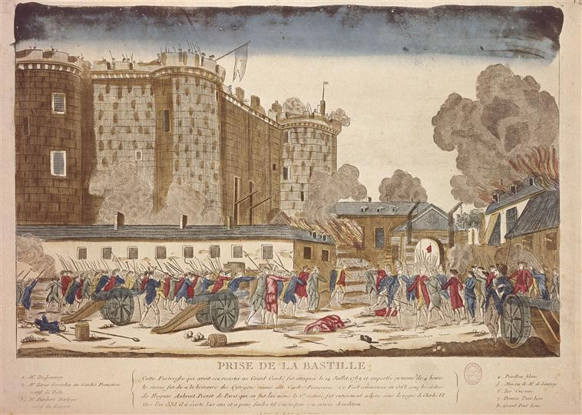
La prise de la Bastille

Slide 4
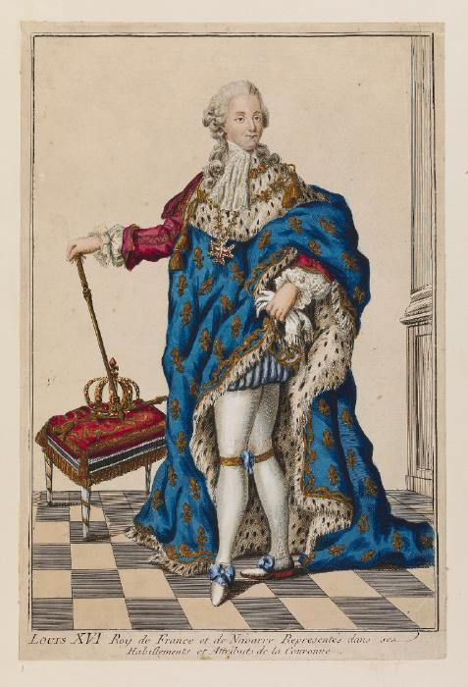
Le Roi Louis XVI

Slide 5
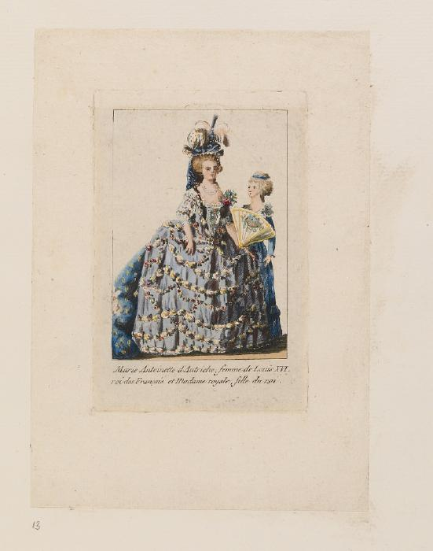
Marie-Antoinette

Slide 6
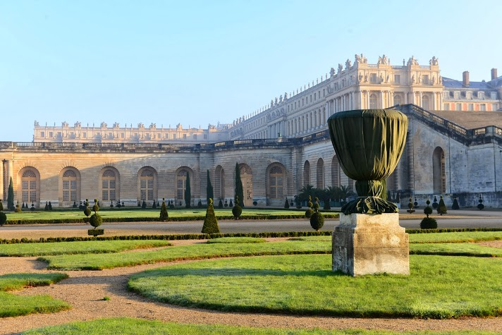

Slide 7


Slide 8
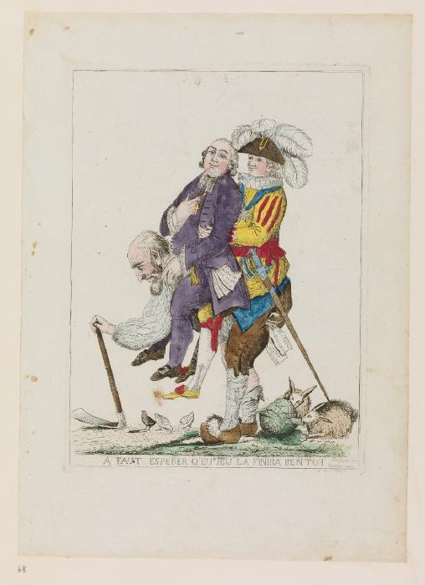

Slide 9
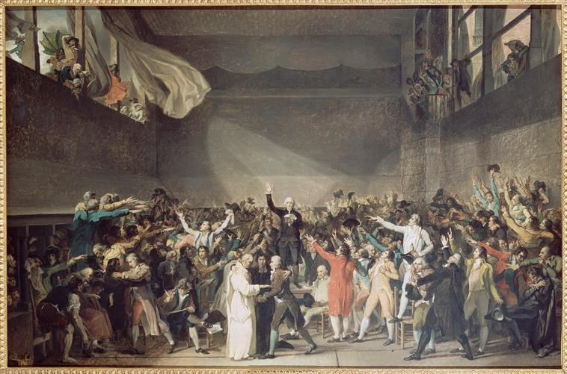
David, Tennis Court Oath

Slide 10
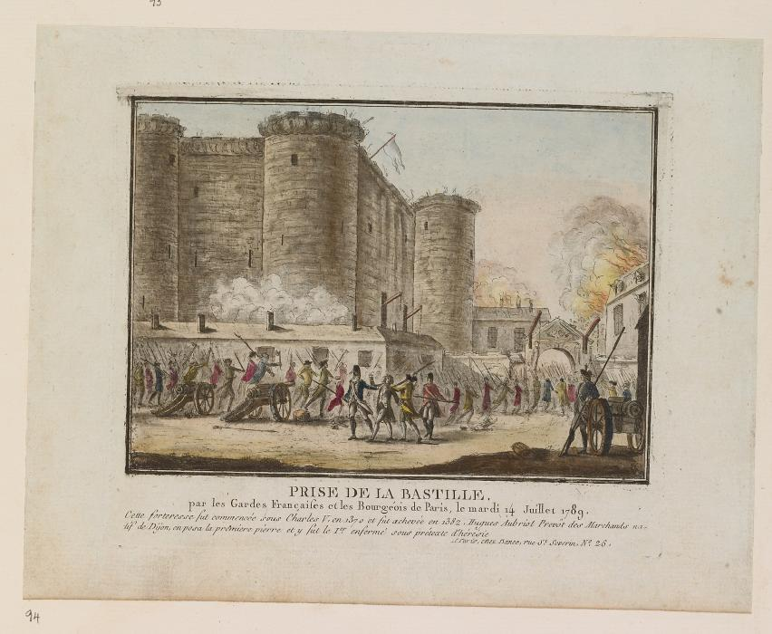

Slide 11
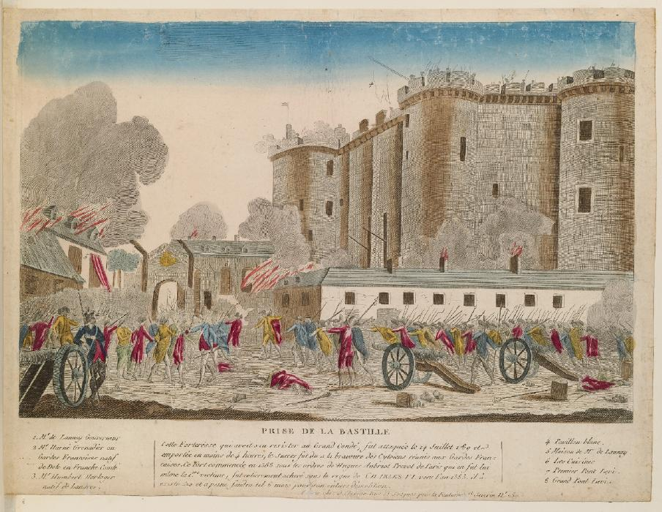

Slide 12
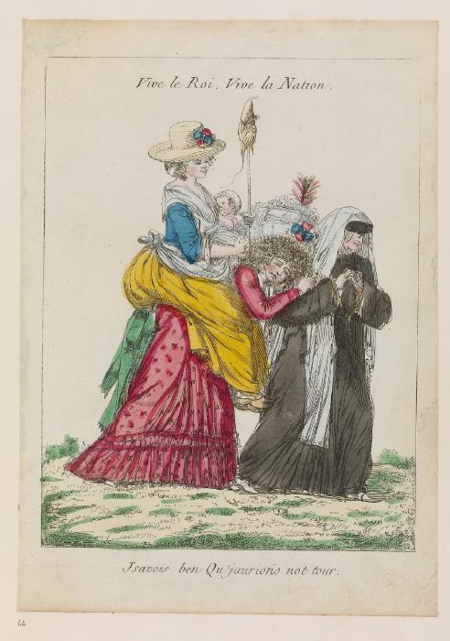

Slide 13
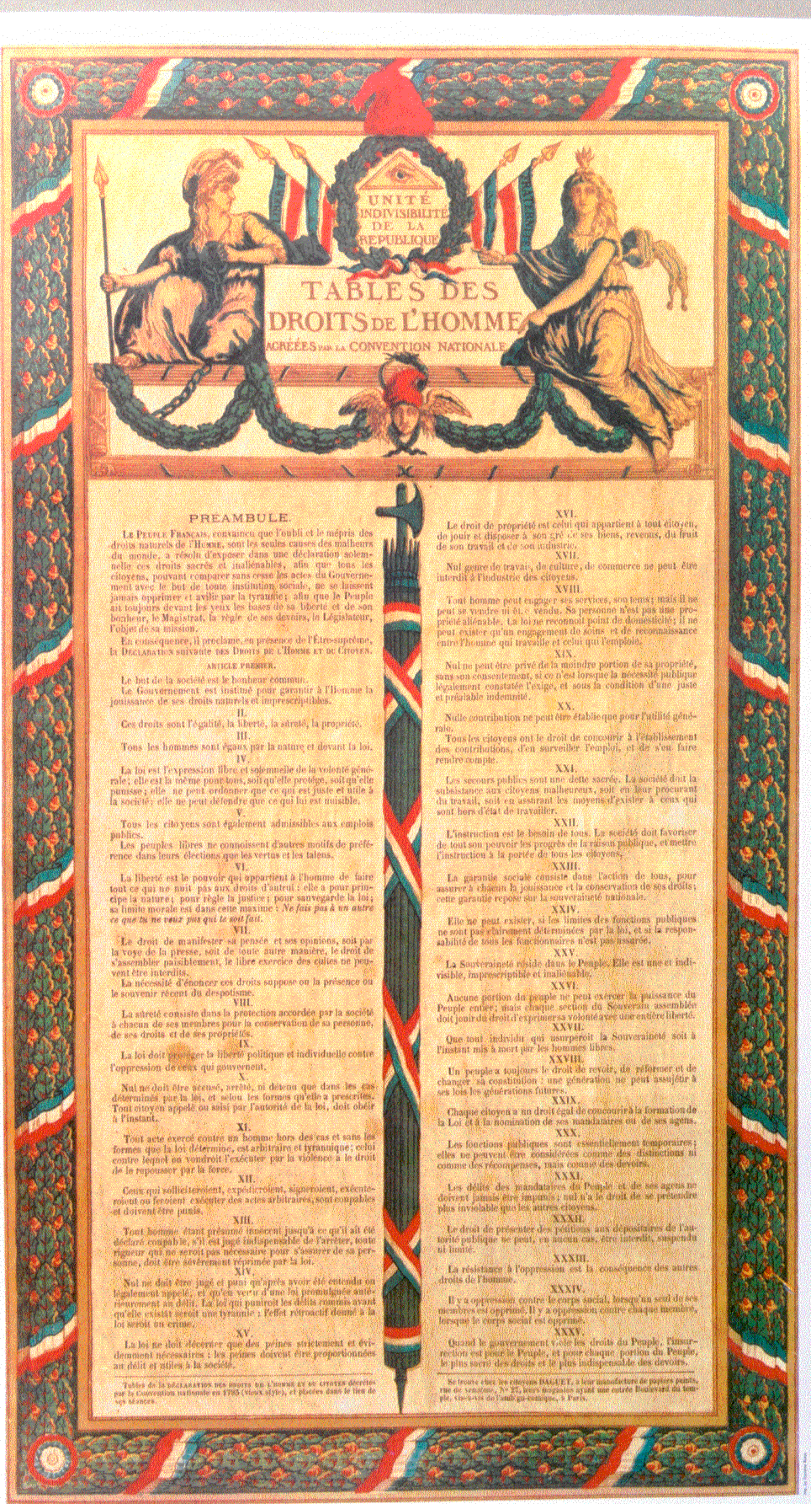

Slide 14
Stop-motion animation
http://www.youtube.com/watch?v=xM9en0m87pU

Slide 15
Lady Gaga and Horrid Histories
http://www.youtube.com/watch?v=wXsZbkt0yqo
http://www.youtube.com/watch?v=otnADq4Y0-A
More resources can be found on the Warwick website: http://www2.warwick.ac.uk/fac/arts/french/research/previousprojects/revolutionaryprints/stopmotion/

