Slide 1
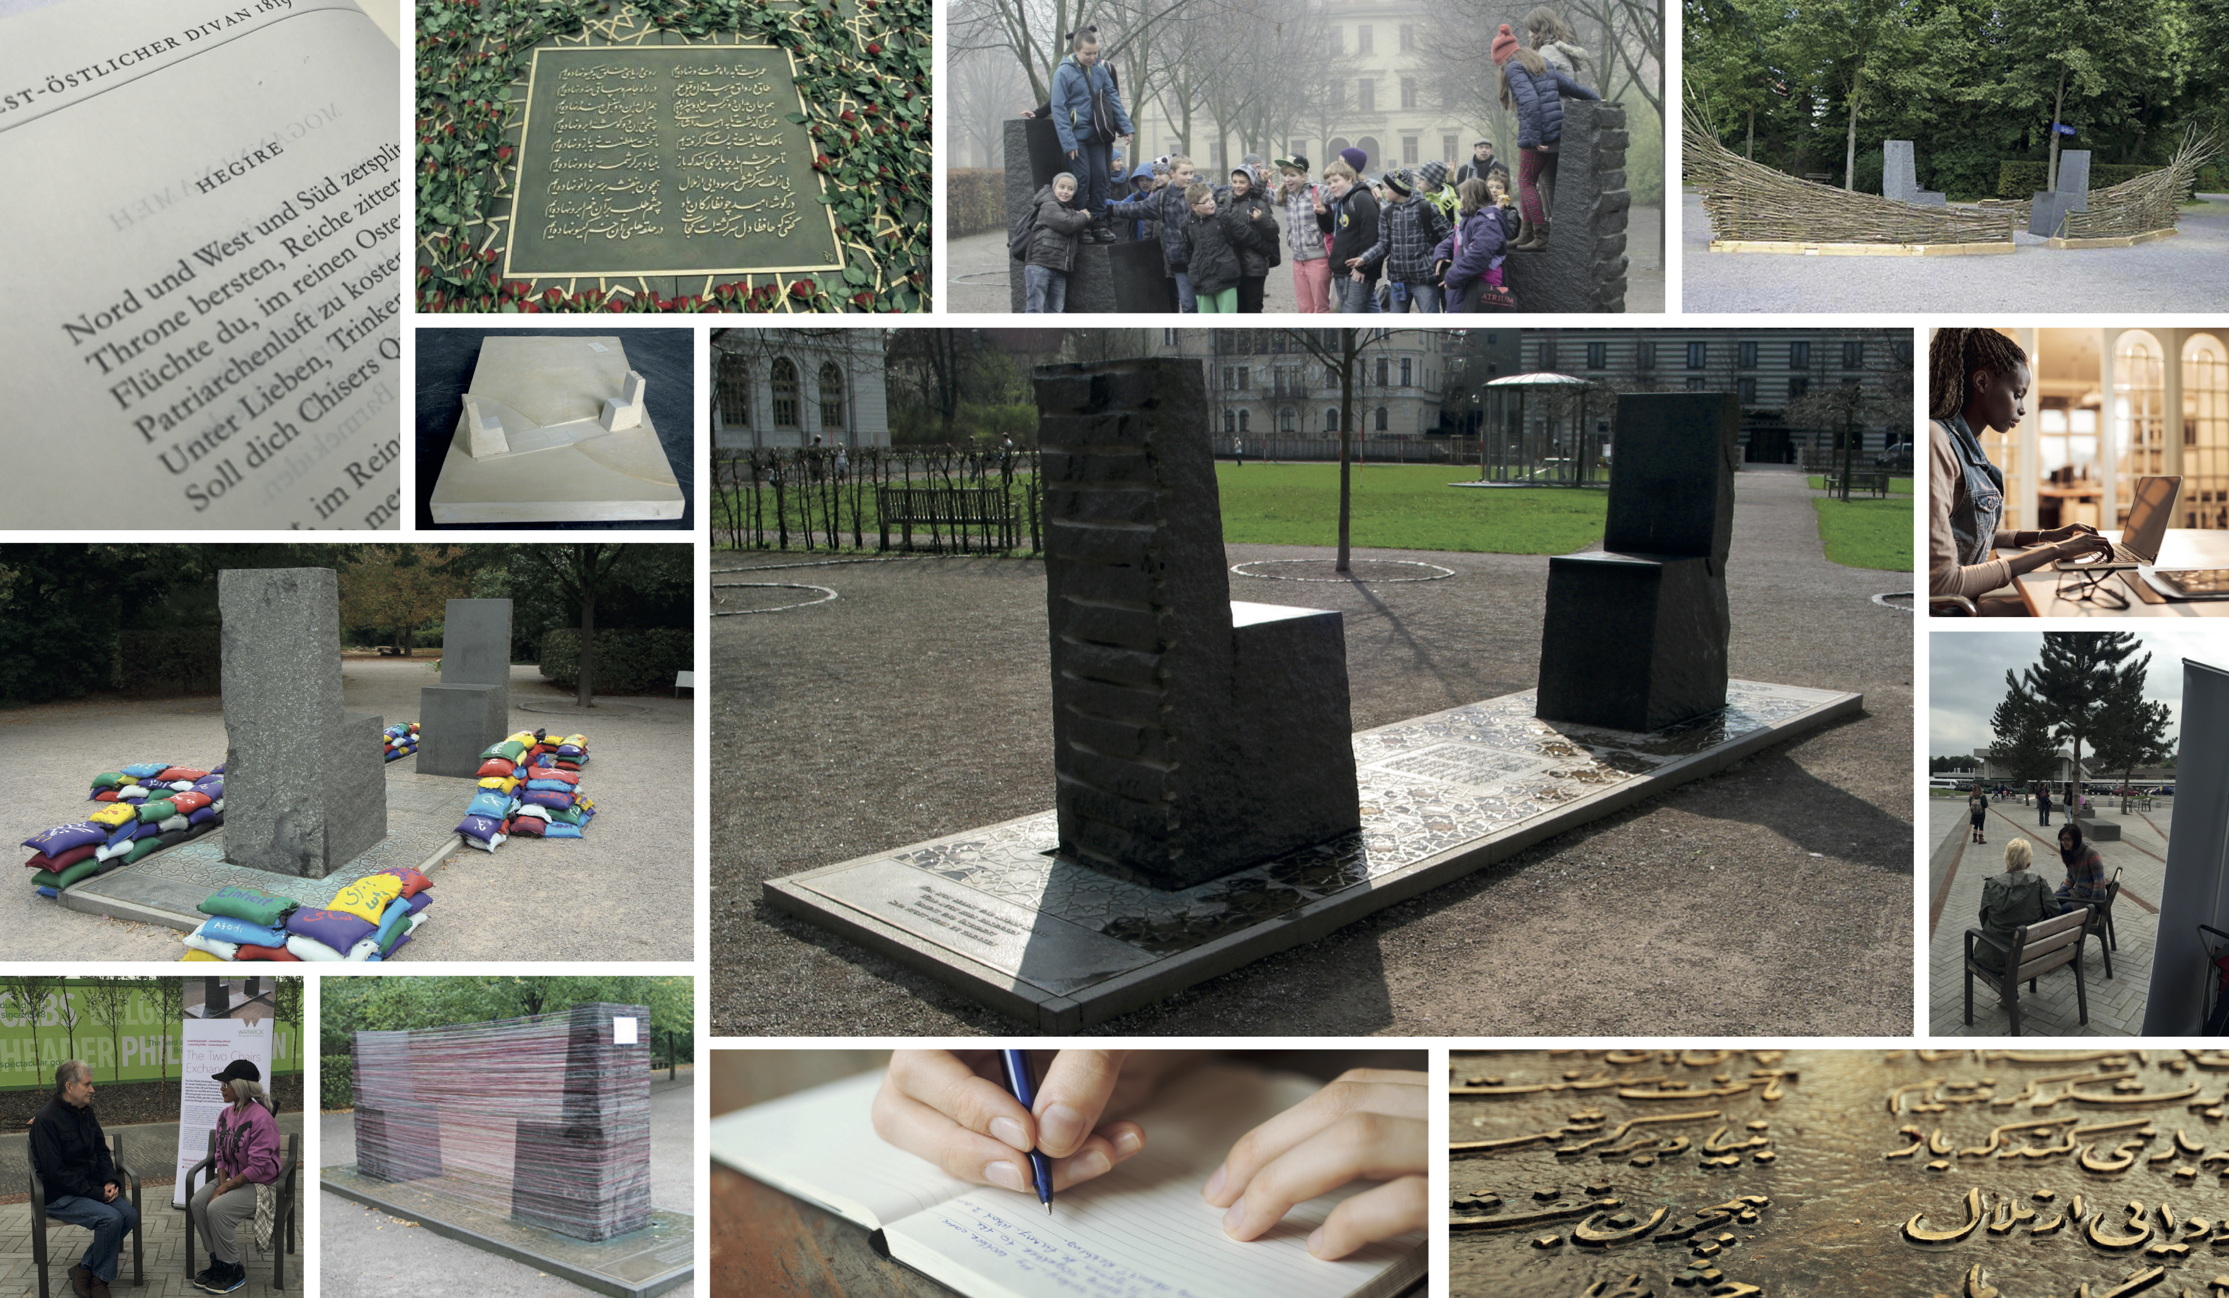
Two Chairs Creative Writing Competition, 2017-18

Slide 2
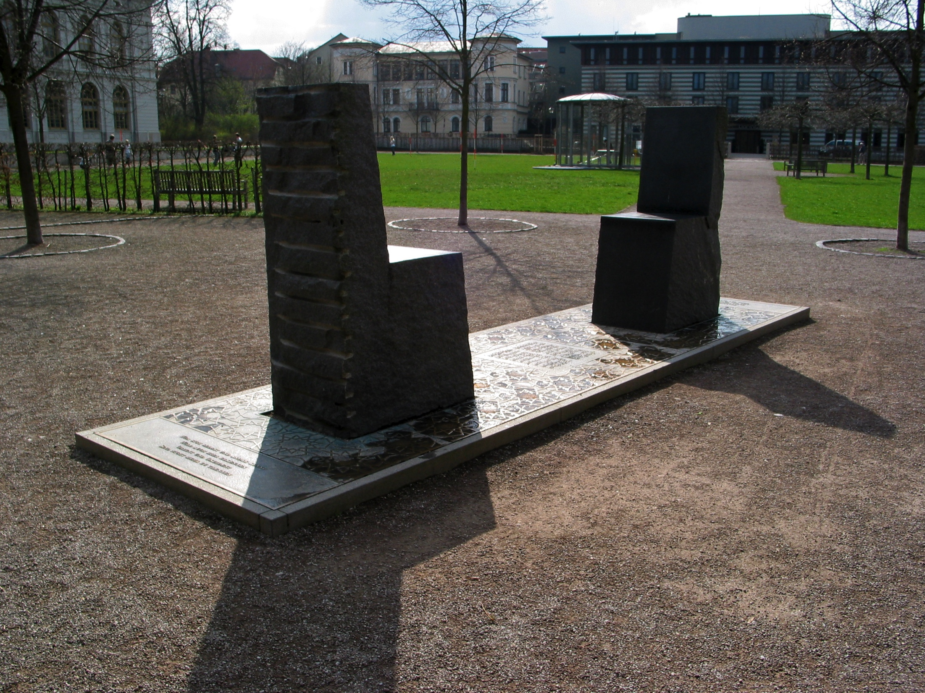
This monument is in Weimar in Germany
Two separate chairs, but connected … cut from the same stone.
What do they mean?
A meeting of two different cultures -
strange yet familiar.
Dialogue, exploring new realtionships?

Slide 3
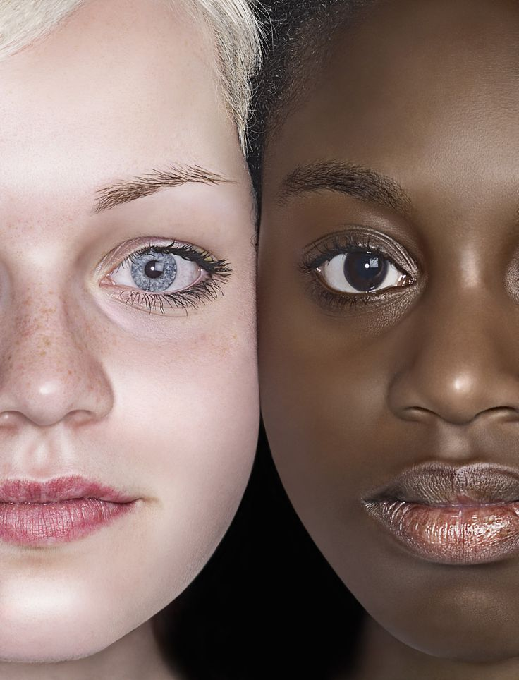
Relate this to an experience
A meeting, an encounter, a relationship with another culture.
Personal or fictional?
Travel, meeting, chance encounter?
How did you/ the people involve feel at first?
Did things change? How?

Slide 4
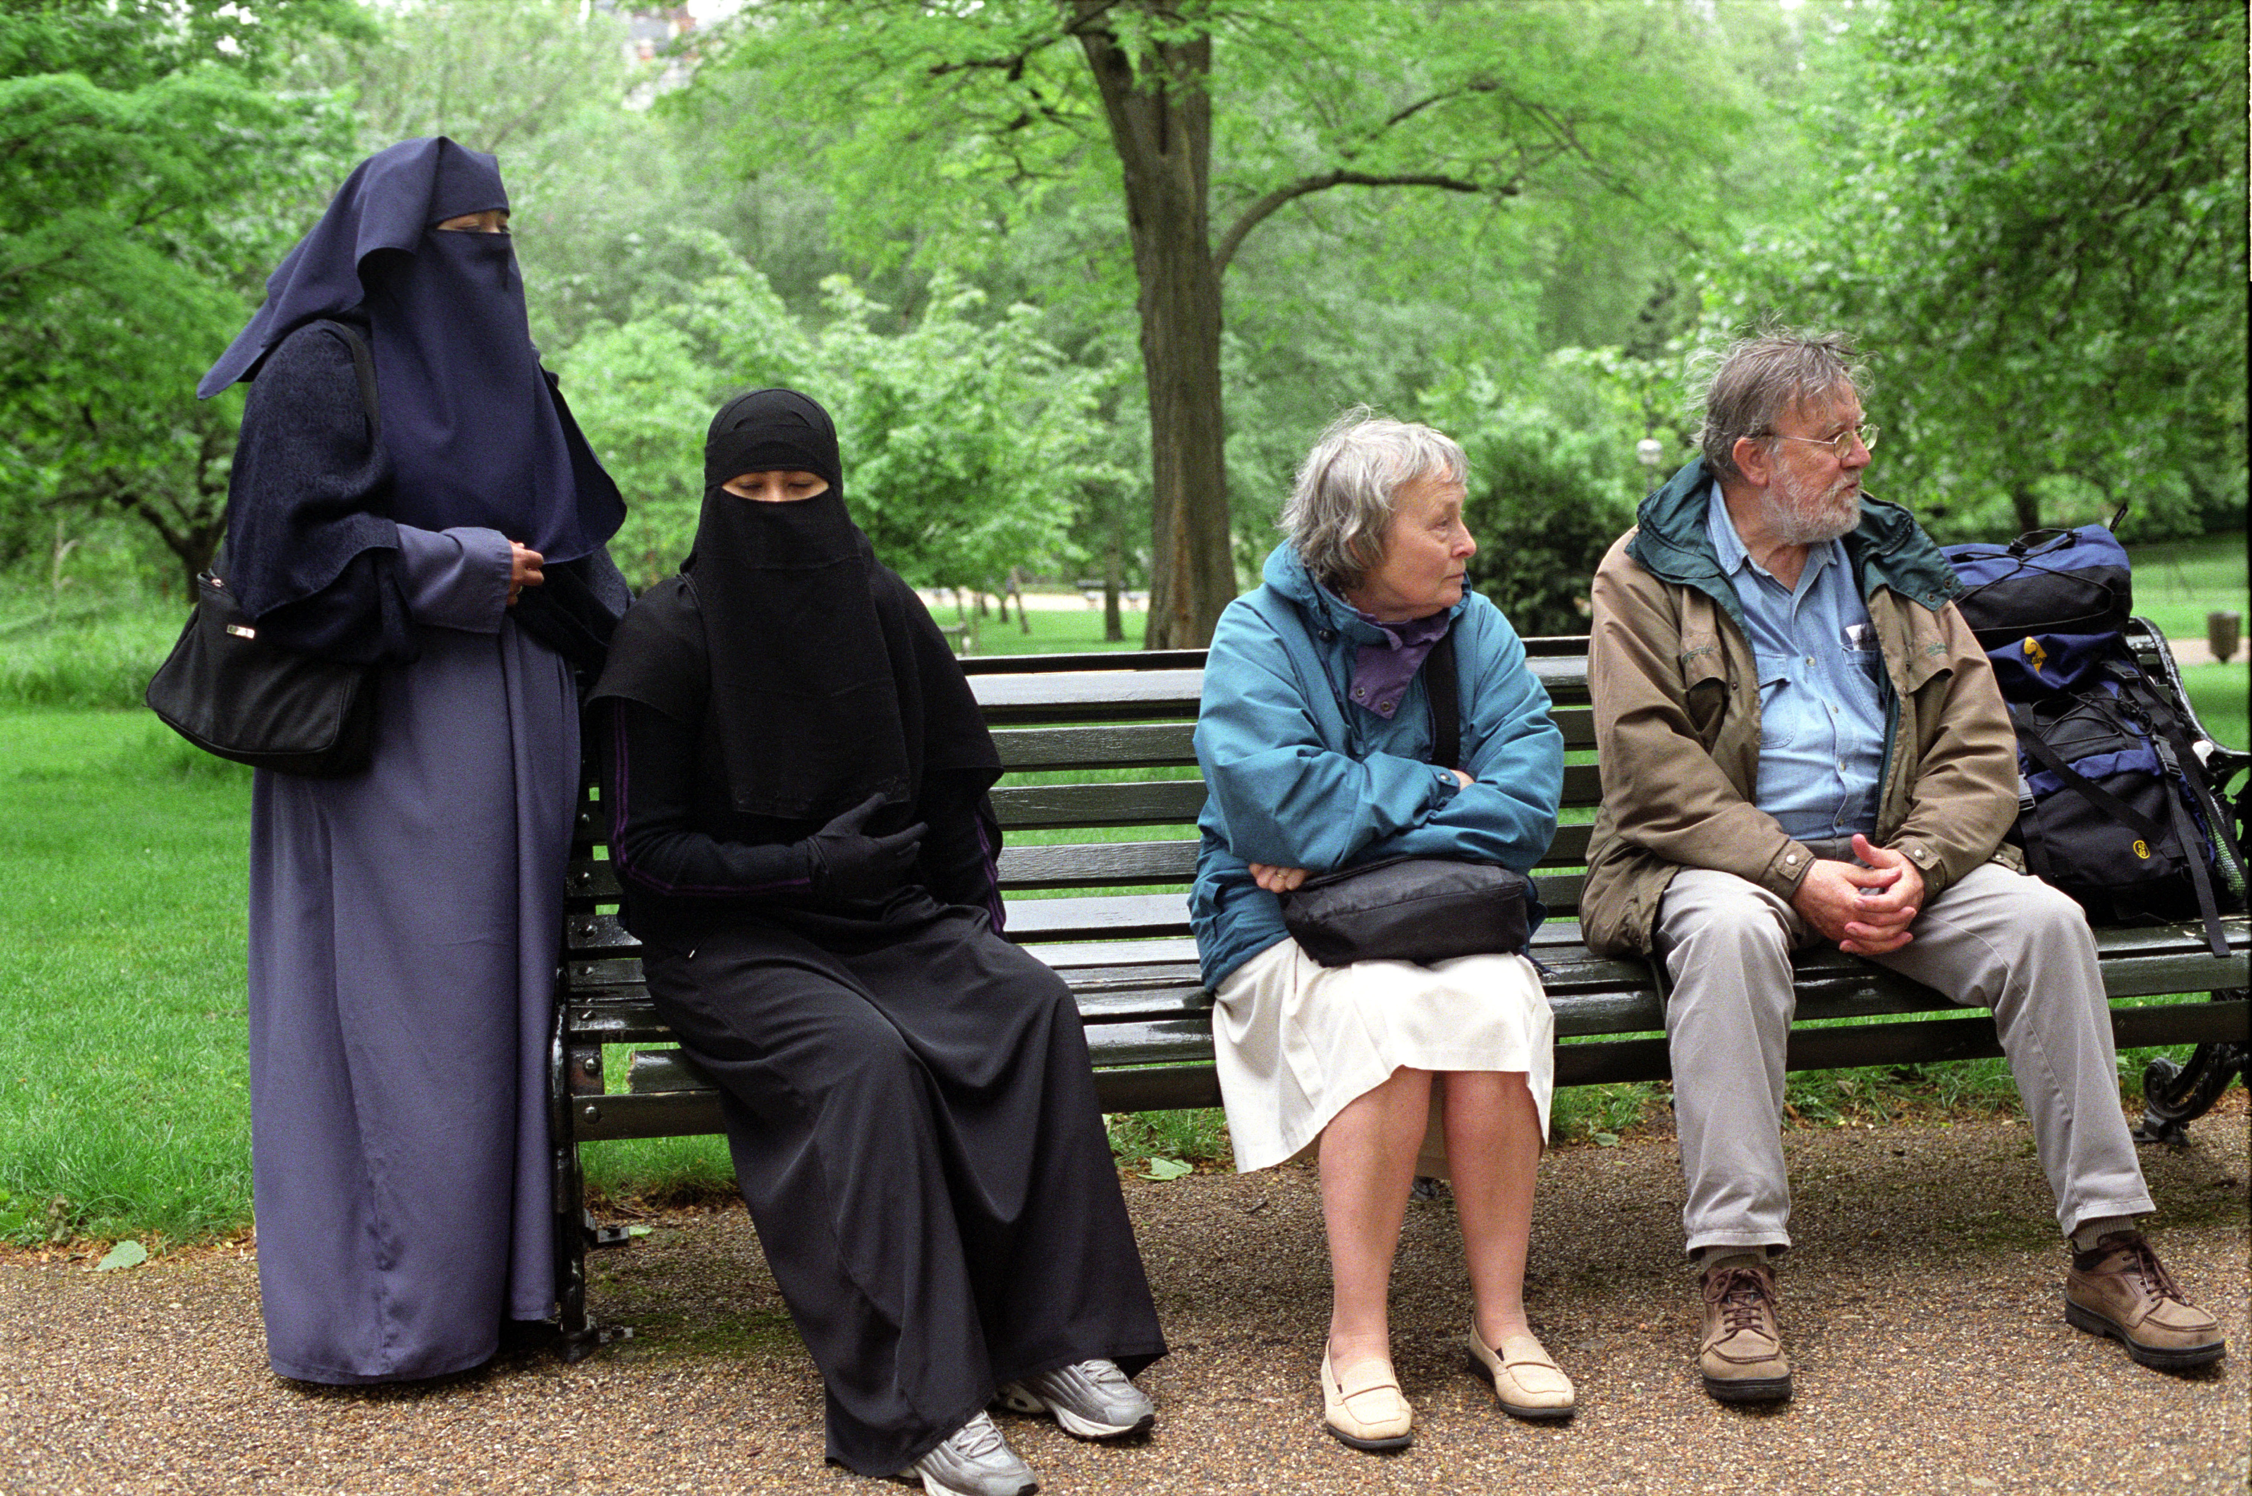
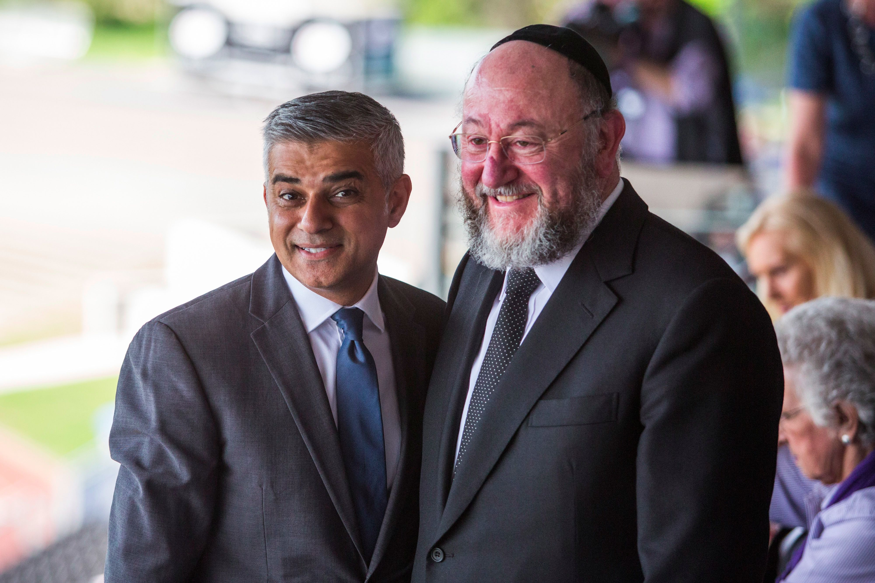
Was it difficult – or easy?

Slide 5
Imagine a piece of writing
A imaginative reworking piece of coursework, describing another person or culture
A piece of imaginative writing – a poem, short story, diary entry doing the same – based on the ideas of the two chairs.
In English – or in German.

Slide 6
Enter the competition
Enter by March 2, 2018
Under 18’s or over 18’s categories
Win a £250 prize and ….

Slide 7
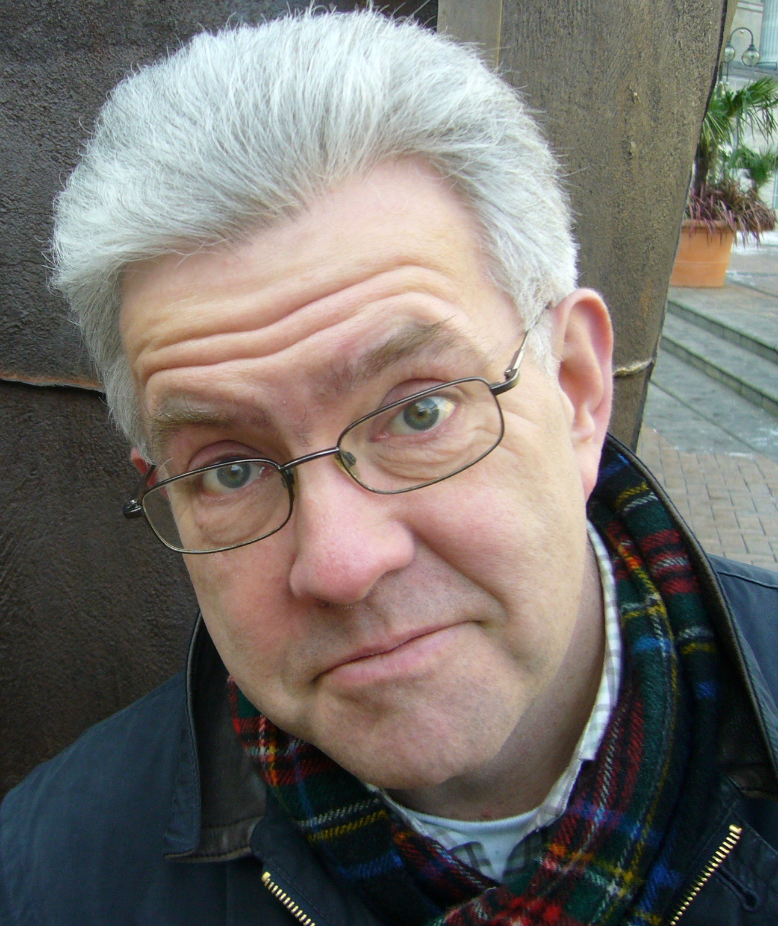


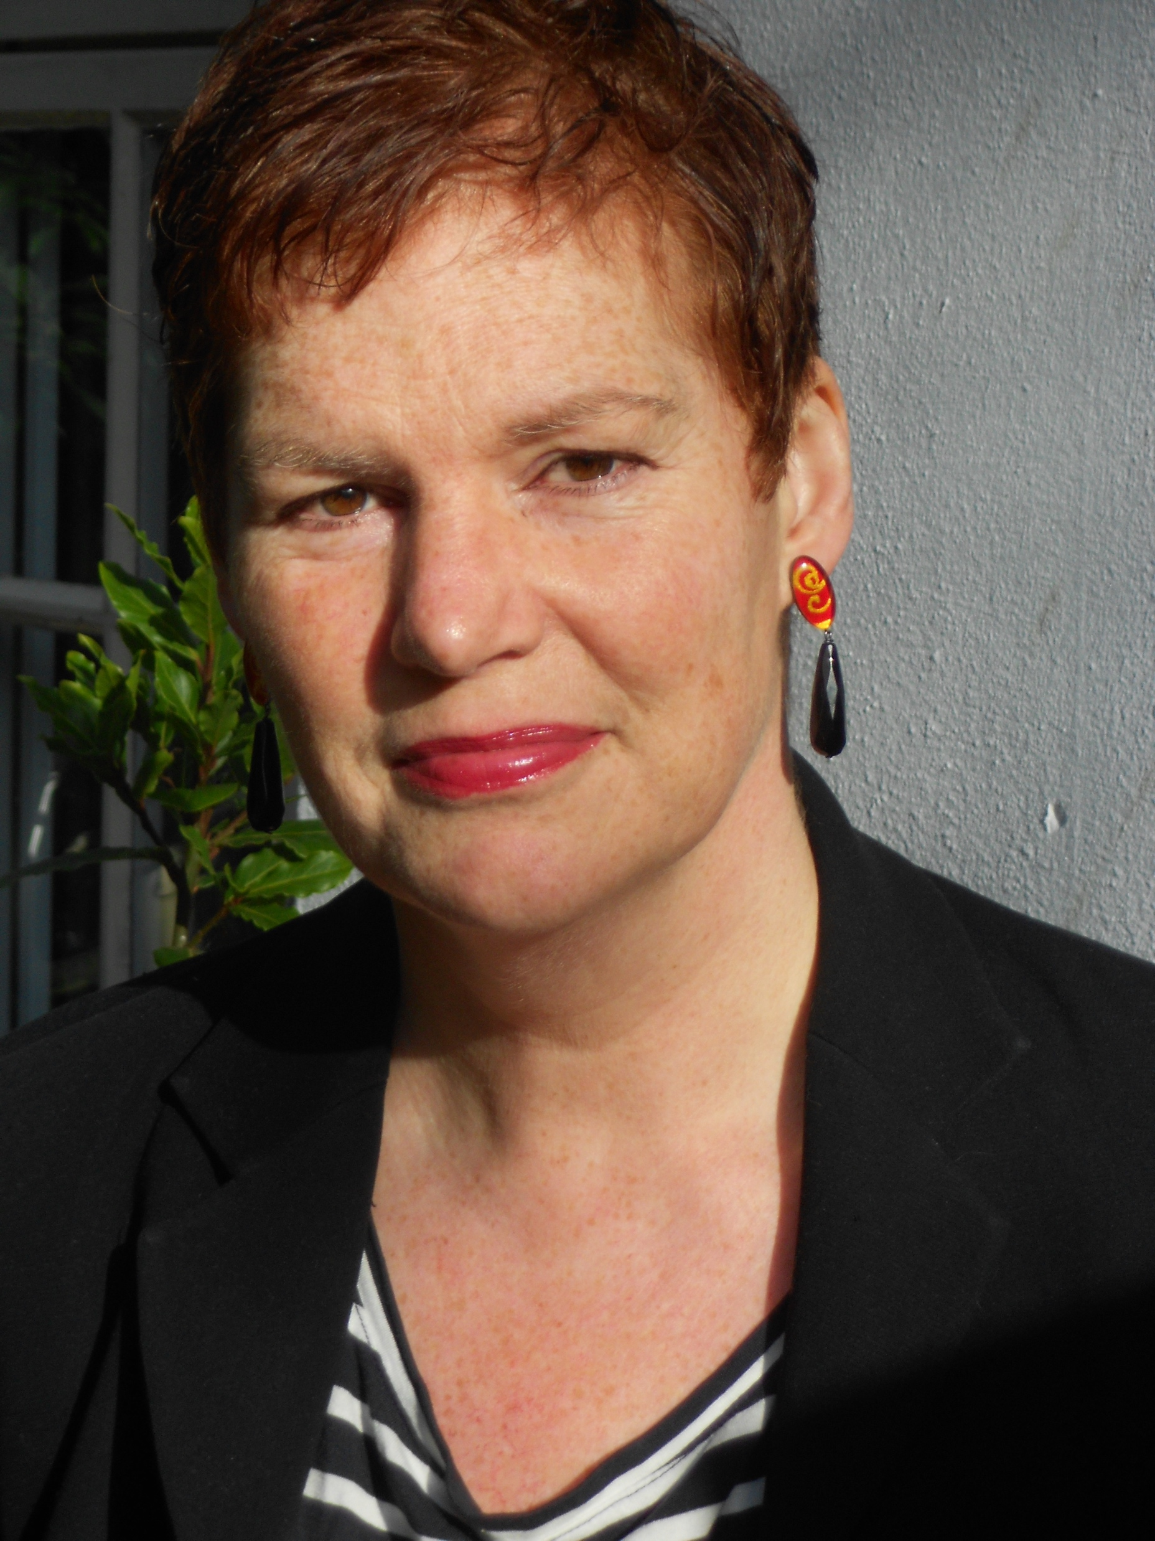
… a day in Oxford with the competition judges (May 2018)
Poets Ian McMillan, Hanan Issa, Momtaza Mehri and Professor Karen Leeder
Performances and workshops!

