Slide 1
Good Morning! Before we start …
Please take time to fill in the questionnaires:
Please fill in parts 1a and 1b before the event, and part 2 at the end.
Please think and answer for yourself.
This will help me in my research. Thank you!

Slide 2
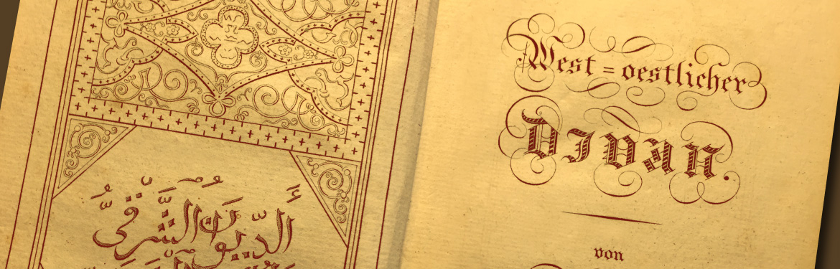
Europe’s “other” Faith?
Islam in German History and its Implications for Britain today.
Dr. James Hodkinson, Warwick University.
St Catherine’s, Bramley.

Slide 3

Islam and Germany:
What do these terms make us think of?

Slide 4
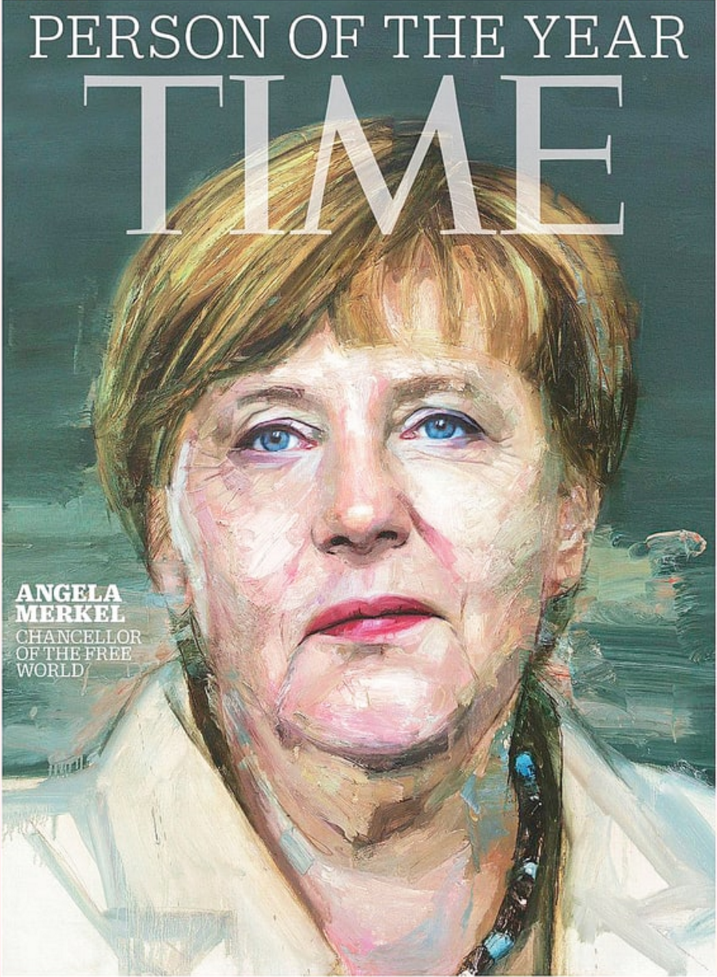

Islam and Merkel’s fortunes?

Slide 5
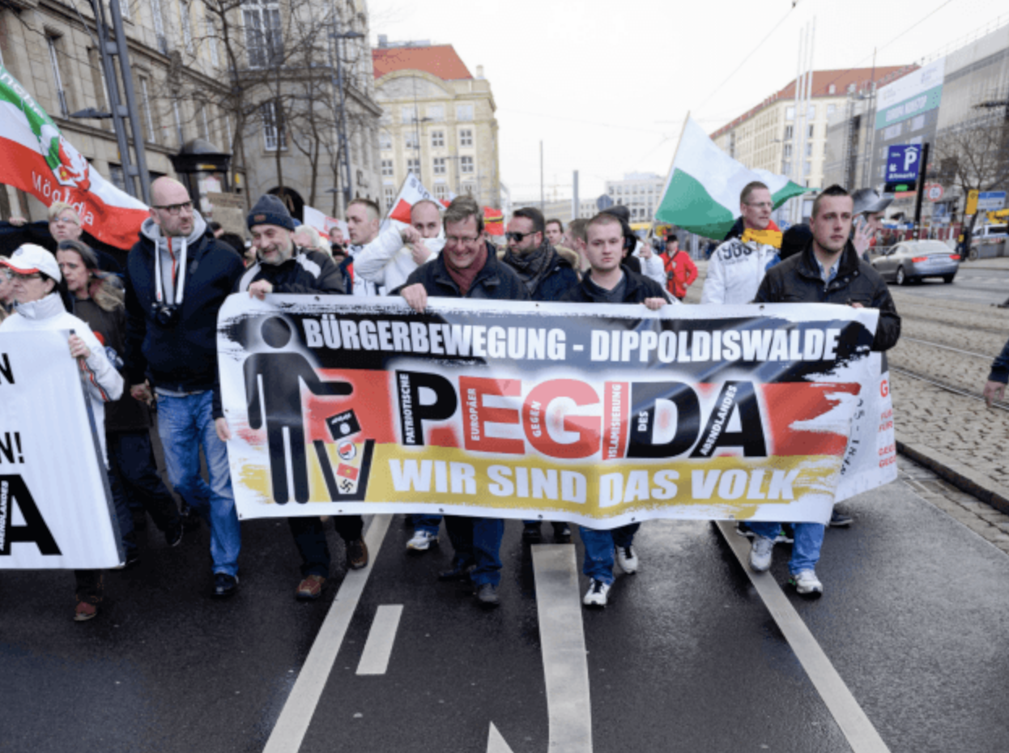
P.E.G.I.D.A?

Slide 6
It’s complicated …
… with a long history.
A different history to other ‘multi-cultural’ European nations (France, Britain).

Slide 7
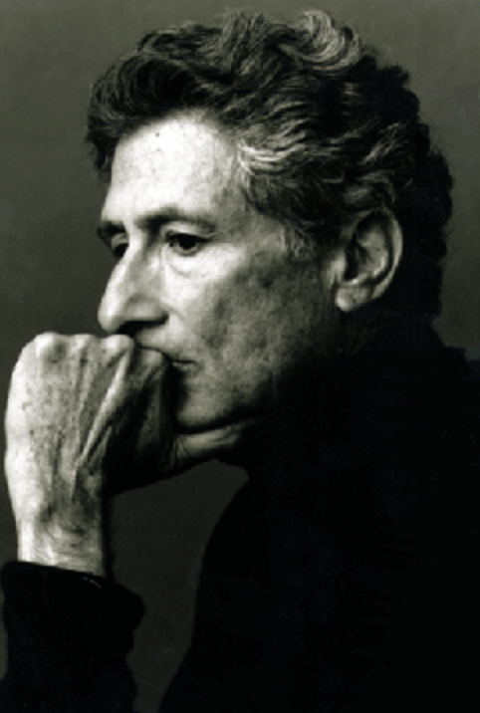
Islam as the “other” in Europe
Edward Said Orientalism (1977):
The Muslim became
“the very epitome of an outsider, against which the whole of European civilization from the Middle Ages on was founded.”
Does this idea fit for Germany?

Slide 8
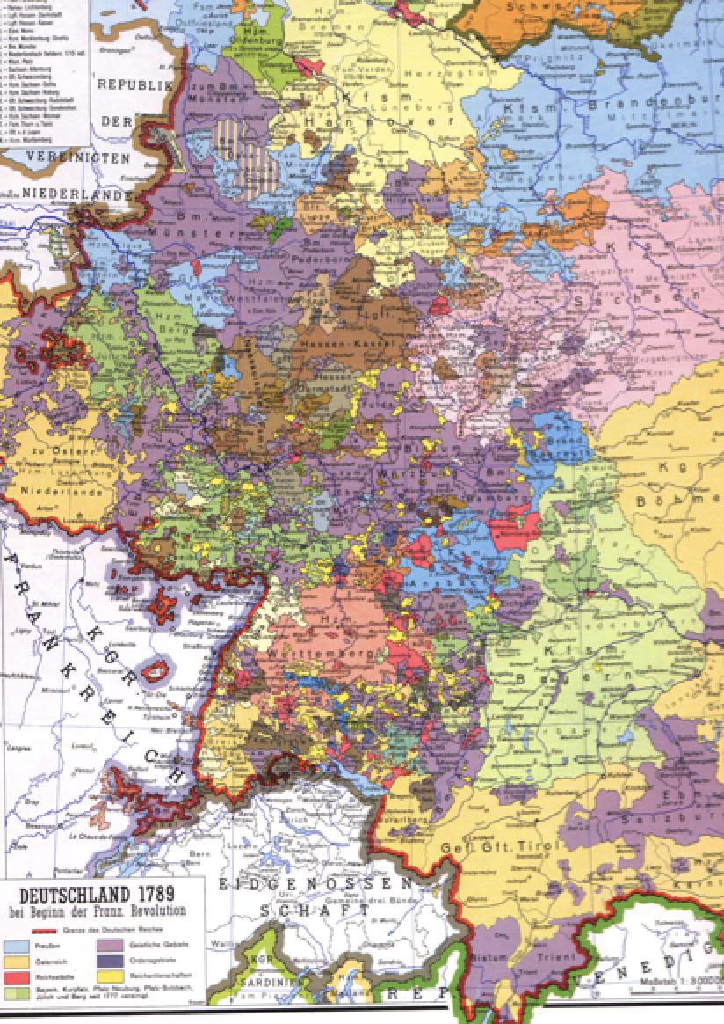
Germany and Enlightenment
Germany in the late 18th century: politically fragmented.
Enlightenment movement growth of a national culture and academia.
The culture of reason and Islam. Different possibilities:
Religion subject to reasoned criticism: Islam’s ‘failings’
Possibility of non-colonial outlook, a nation of culture relating differently to the (Islamic) world

Slide 9
Islam and Similarity
New approaches to look at mutual similarities in intercultural encounters
Shared values and traditions
Difference not always bound up with negative values
Similarity not always positive – enforced uniformity

Slide 10
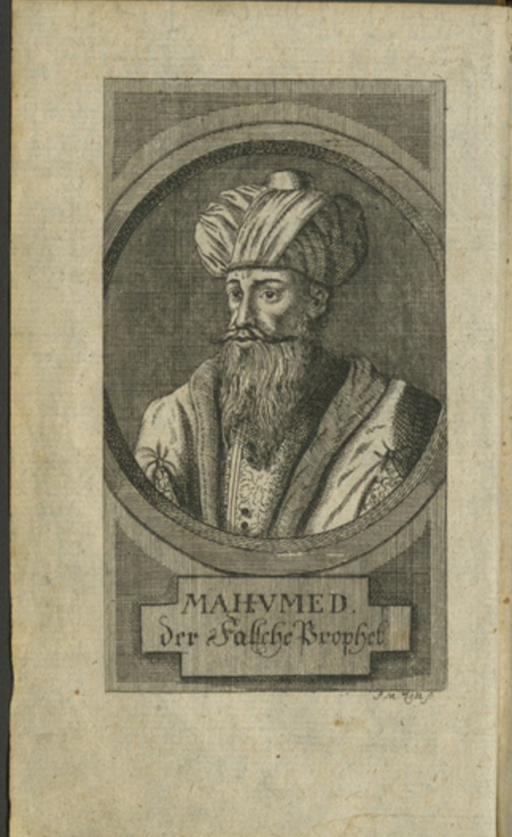
D.F Megerlin’s German Koran
The ‘Turkish Bible’ (1772) (direct from Arabic to German)
Mohammed as the false Prophet
Islam as religion of lies, half truths,
drawing on other traditions; similarity as threat.
Megerlin on the Koran:
“here and there good and less vexing
passages can also be found, which anyone
might read and use to edify themselves.”

Slide 11
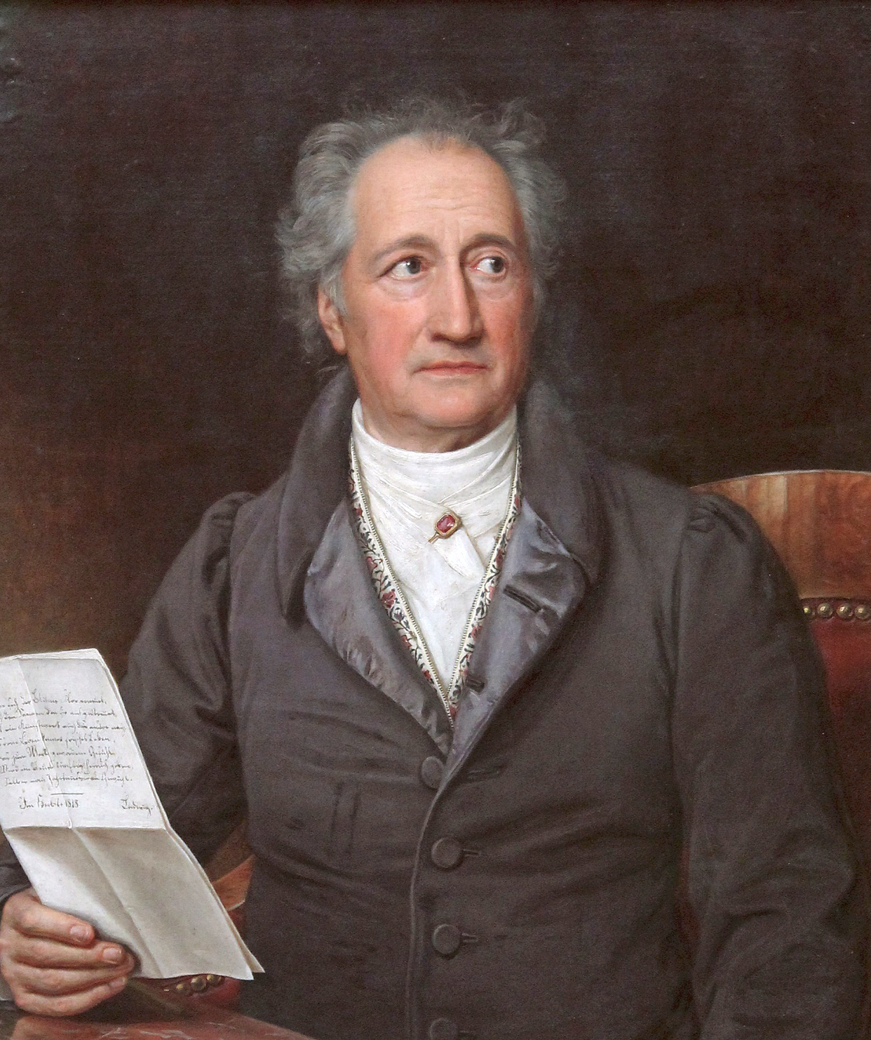
Goethe’s Islamic Poems
Goethe’s West-eastern Divan (1819)
Wenn Islam "Gott ergeben" heißt,
In Islam leben und sterben wir alle.
If Islam means surrender to God,
Then we all live and die in Islam.
‘Hikmet Nameh’ (‘Book of Sayings’)
Experiment; empathy and imagination

Slide 12
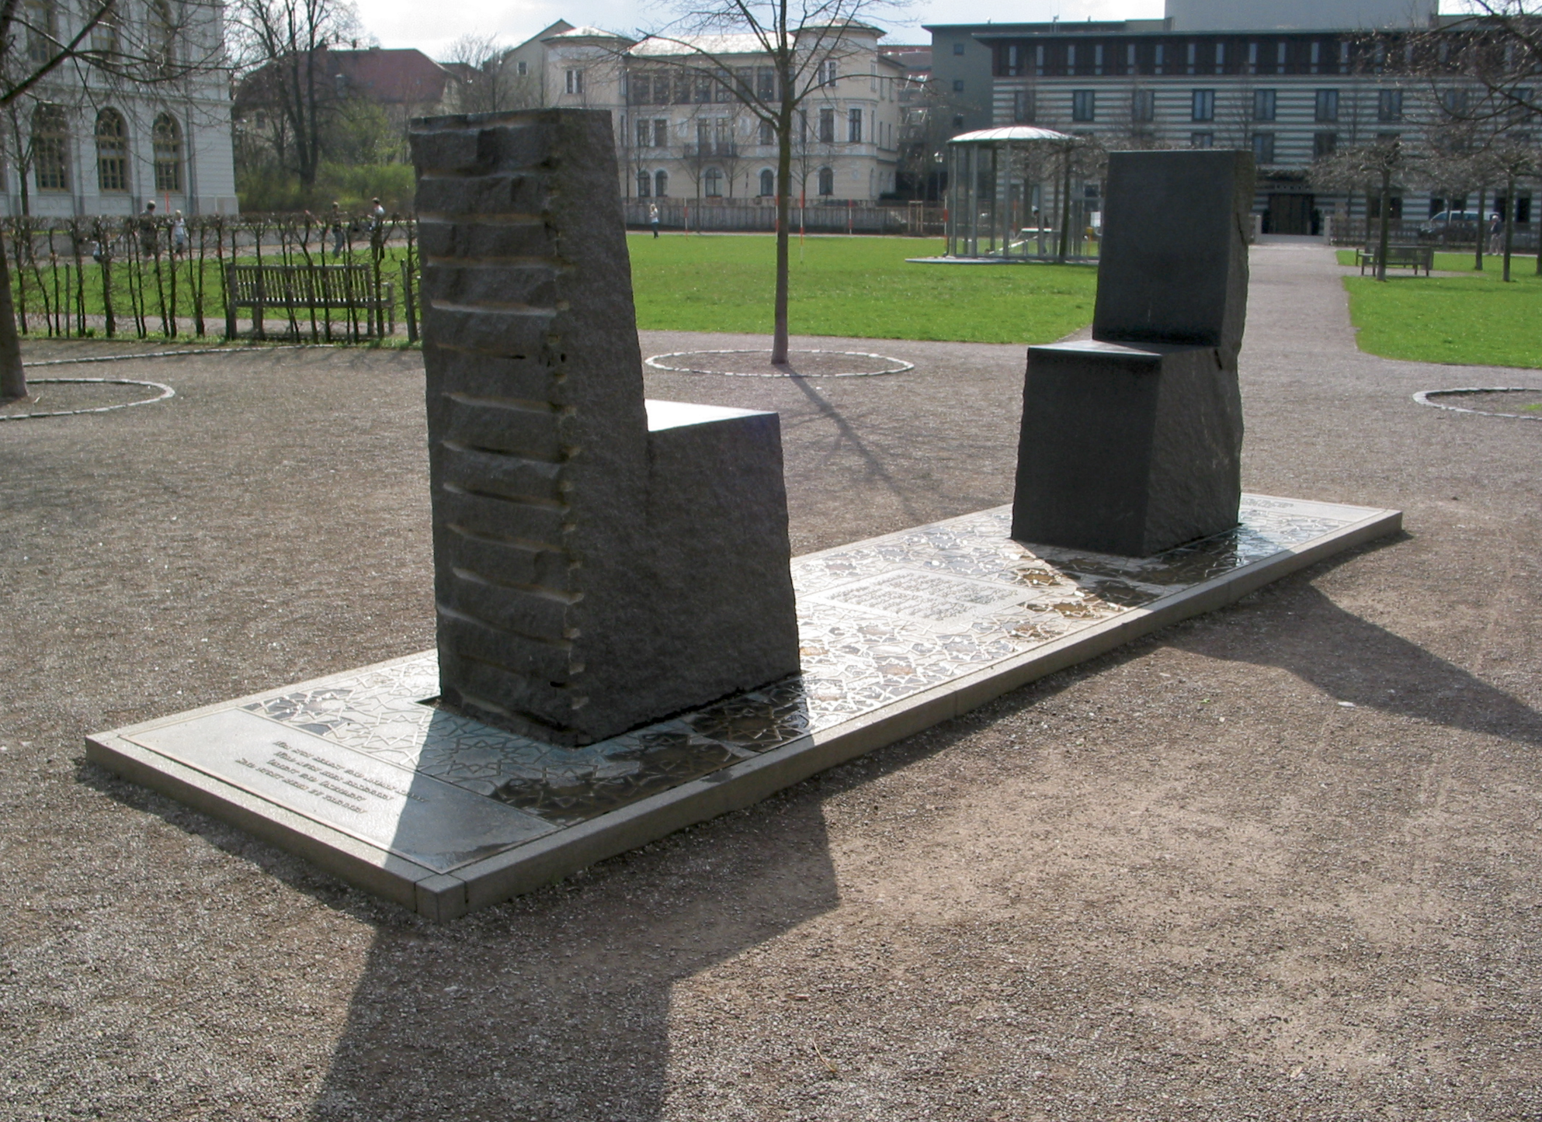
Two chairs: The Hafis Monument
a form of dialogue, but more than that,
similar, yet distinct.

Slide 13
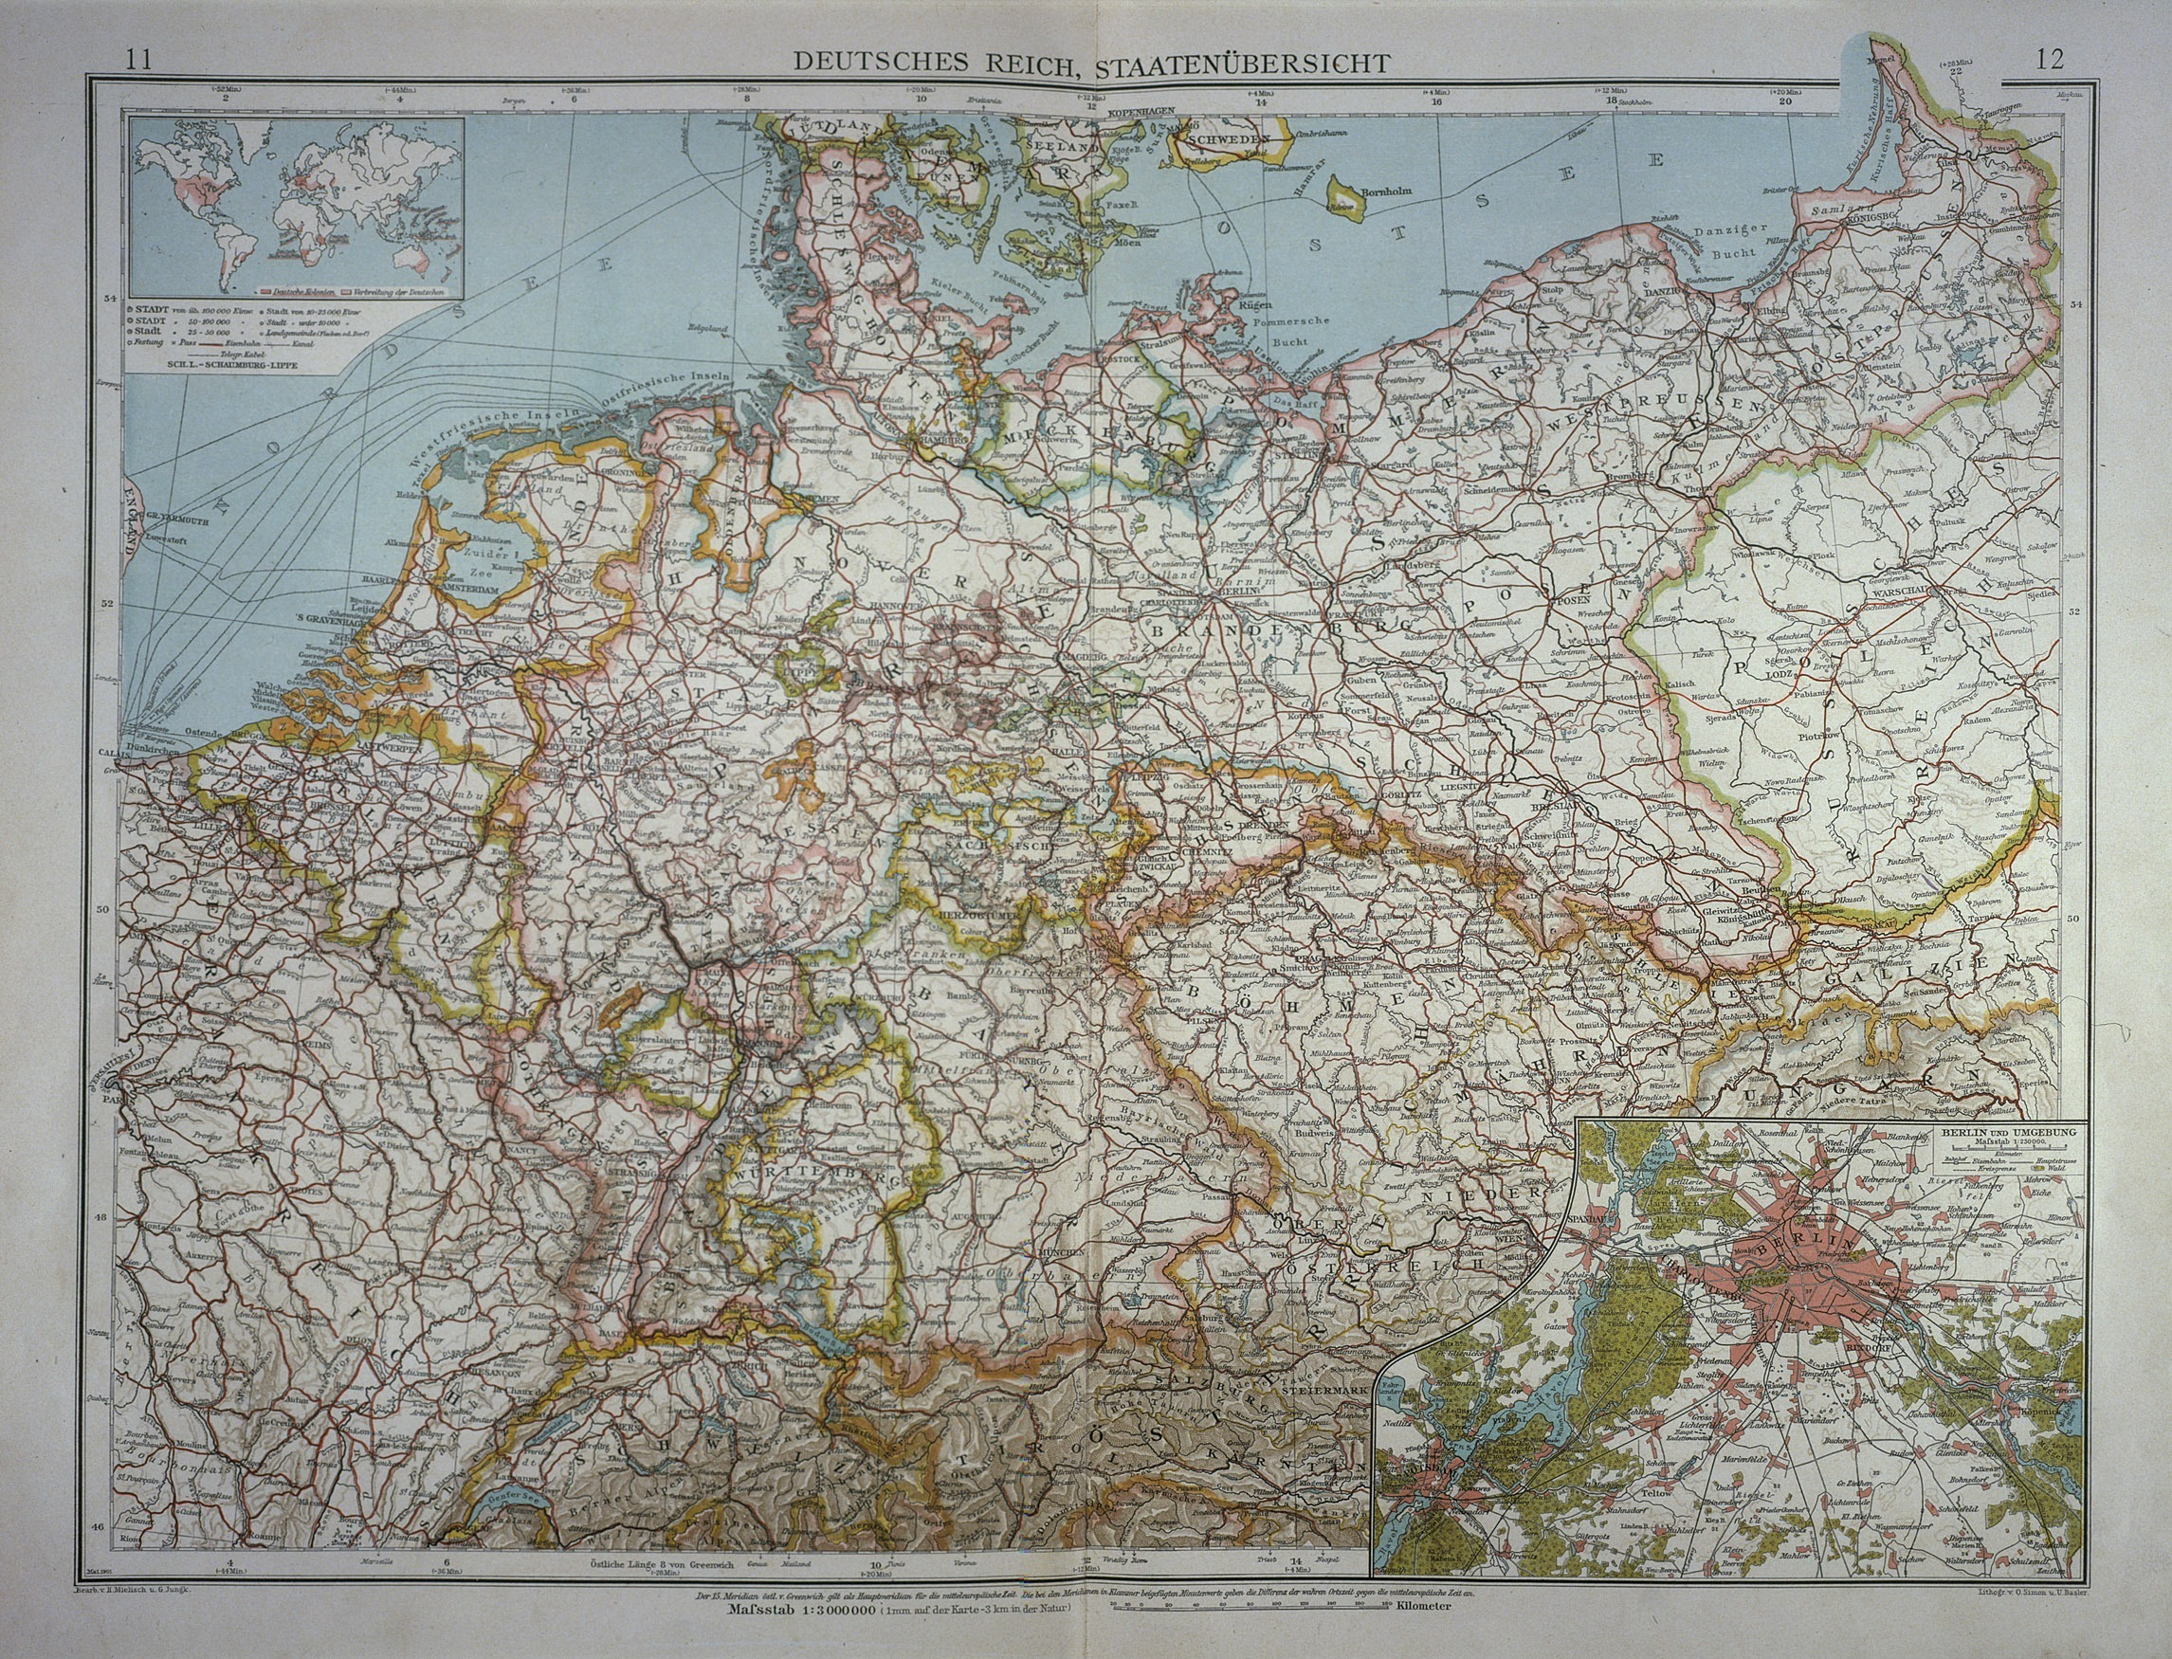
Times change …
1871 … 1884

Slide 14
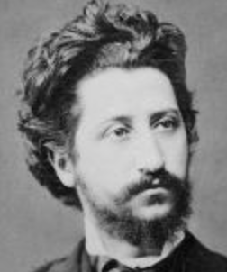
Learning about Islam: I
Ignaz Goldziher (1850-1921)
“In those weeks, I truly entered into the spirit of Islam to such an extent that ultimately I became inwardly convinced that I myself was a Muslim, and judiciously discovered that this was the only religion, which, even in its doctrinal and official formulation, can satisfy philosophical minds. My ideal was to elevate Judaism to a similar rational level. Islam, as my experience taught me, is the only religion, in which superstitious and heathen ingredients are not frowned upon by rationalism, but by orthodox doctrine.” Oriental Diary (1874)

Slide 15
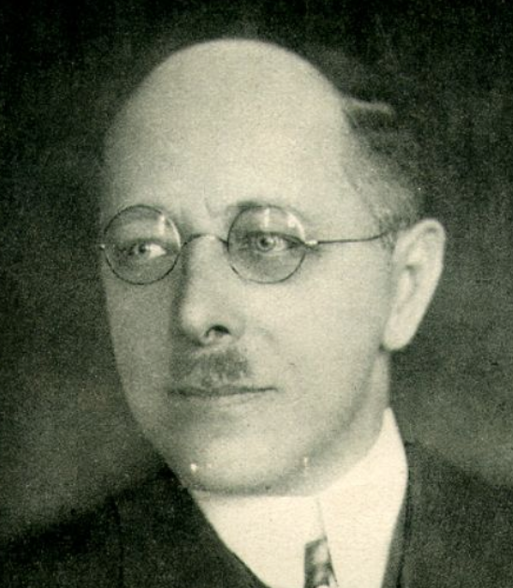
Learning about Islam II
Carl Heinrich Becker (1876-1933 )
Modern sociological view of religion:
faiths contained within secular society
Essay: Islam as a Problem (1910) :the
need to “remove Islam’s threat to Europe”
Educational programmes and propaganda
for Muslims living in/ near to German colonies
in Africa
Make Muslims similar (more like) Europeans

Slide 16
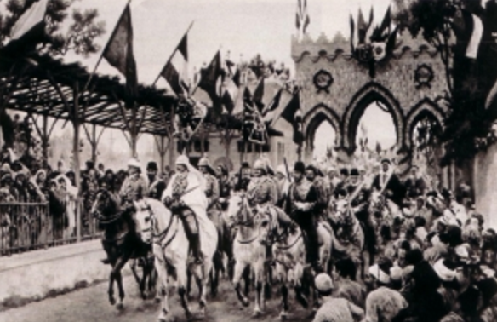
Kaiser Wilhelm in Damascus

Slide 17
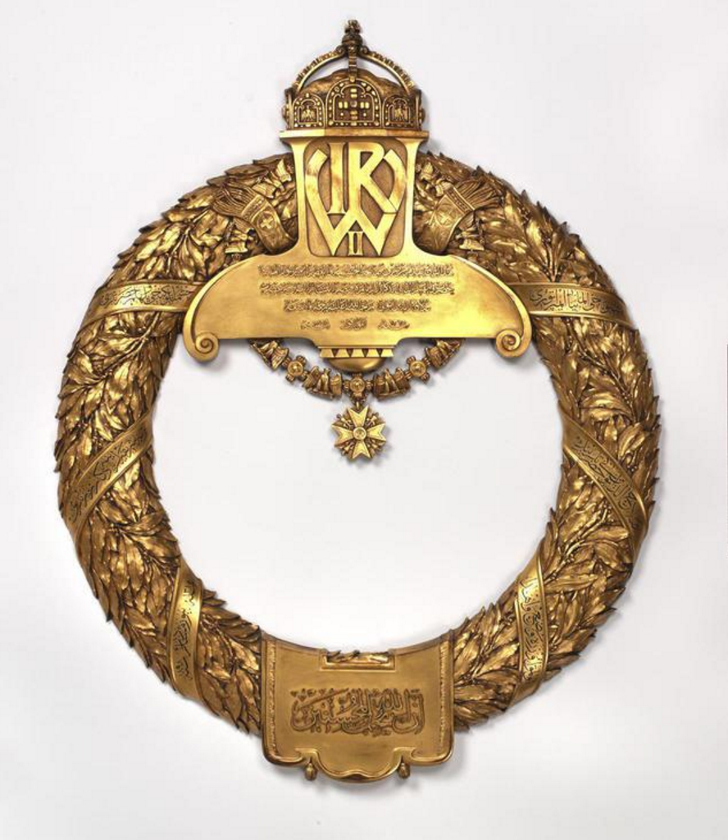
The Kaiser’s ‘Kranz’
‘This crown was presented by His Majesty, the Emperor of Germany his presence Wilhelm the Second in memory of his pilgrimage to the tomb of his presence Salah el Din el Ajubi.’
Inscription in Arabic (Damascus, 1898)

Slide 18
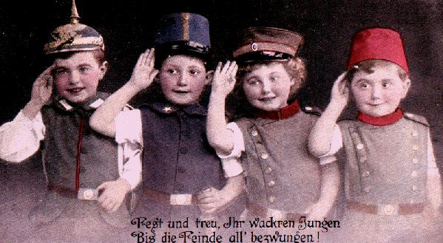
As WWI approaches: a family of nations

Slide 19
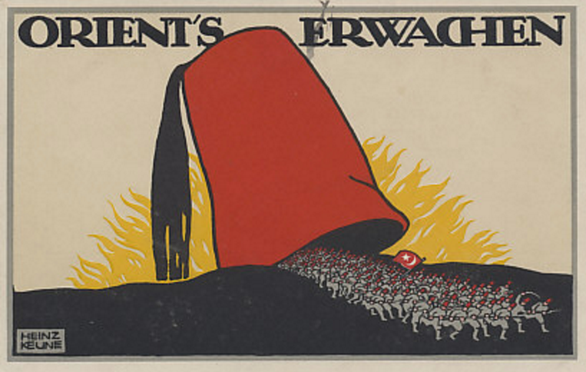
Still afraid of Muslims …

Slide 20
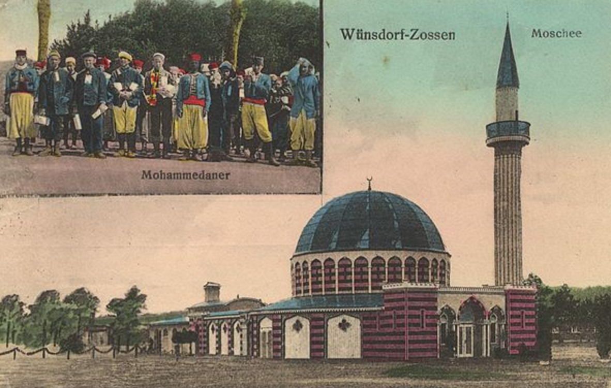
The Half Moon Camp

Slide 21
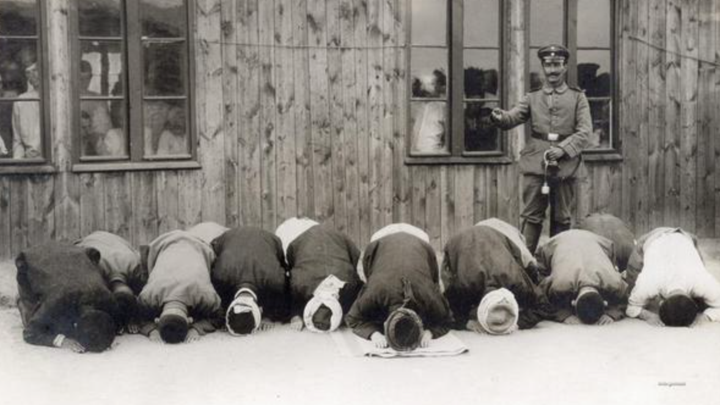
Propaganda and
‘friendship with Mohammedans’

Slide 22
Lessons from history: the UK today
images of faith communities reflect on the culture producing them;
difference and similarity: difference not always negative, similarity not always positive; a balance needed for an integrated society
the old problem of the acceptable vs. the unacceptable Muslim;
importance of academia, education and the arts: resisting the pull towards black and white thinking; but not invulnerable.
Politics shapes agendas – literature and scholarship not immune.
The importance of self-critical re-evaluation when forming our understanding of other faiths and cultures.

