Slide 1
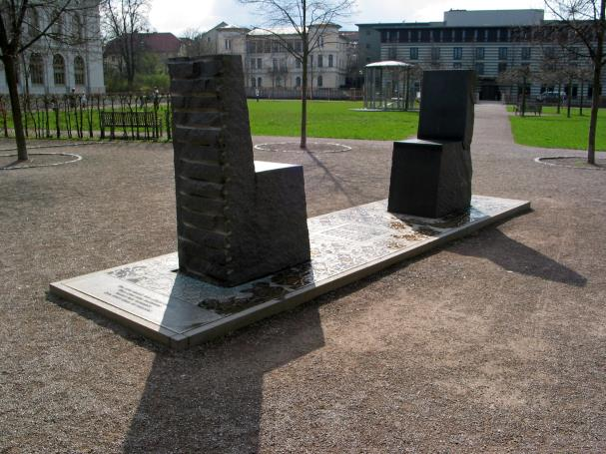
Two Chairs Exchange
For AQA RS GCSE RS

Slide 2
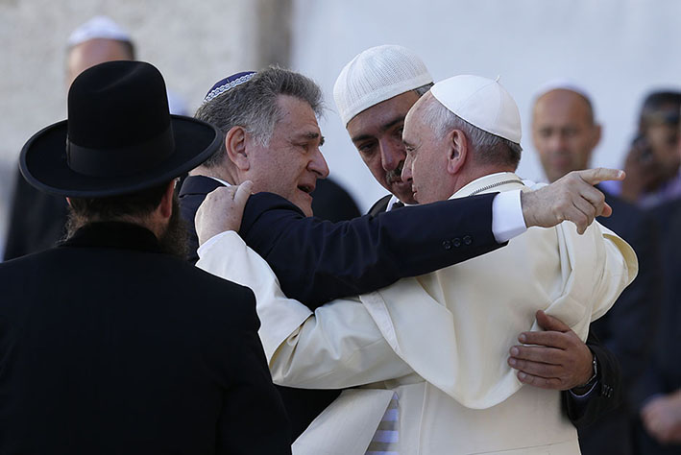
Lesson 4: Conflict, Peace and Resolution

Slide 3

Starter I: Two Chairs Exchange
Review mind-map on the core ideas of the Two Chairs exchange

Slide 4
Today we’ll ask:
Does Christianity view Islam view as barbaric or peaceful?
Does Islam view Christianity as barbaric or peaceful?
What teachings do both faiths offer on violence, war and peace?
How can Two Chairs thinking help us discuss these issues?

Slide 5
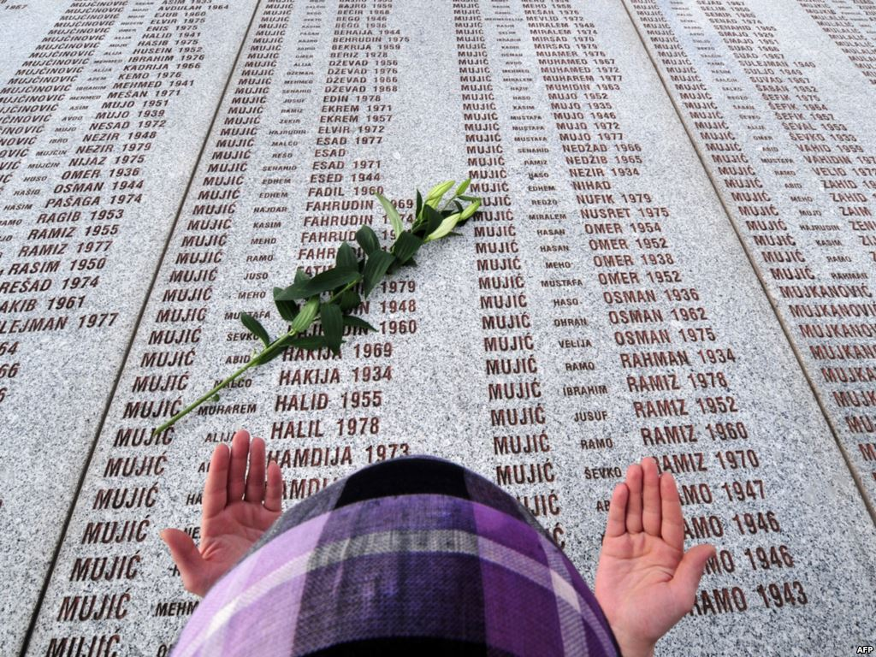
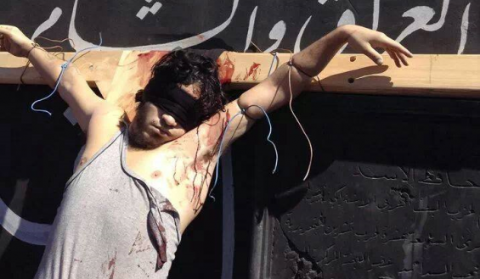
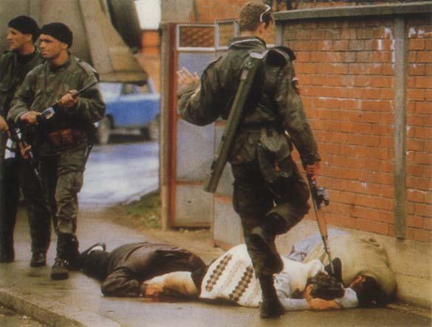
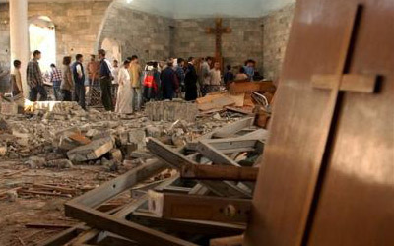
Starter II: Responding to Images
Mutual brutality.
Left: the Bosnian War (1990s). Right: the Syrian Civil Year (2011 to date…)

Slide 6
Research I: Comparing scripture
Christian teachings on violence and pacifism
Jesus' teachings on pacifism
Just war theory? (see worksheet)
Muslim teachings on war
Quran and Hadith passages
Principles of jihad (see worksheet)

Slide 7
Class Discussion
What would a Muslim say about Jesus’s teachings on violence, pacifism and justice?
What would a Christian say about Muhammad’s teachings on violence, pacifism and justice?
Are there more points of similarity or difference between the religion’s teachings on justice?

Slide 8
Pair work: Two Chairs…
Proposition: ‘The goal of life is to seek peace and do good.’ How true of this of both religions?
In pairs, use the core principles of the Two Chairs Exchange to answer the question above. Ask how true the statement is of both faiths, and try to reach a differentiated viewpoint about each.

Slide 9
Essay title
Assessment:
‘Religion helps to bring about peace in the world.’ Evaluate this statement
In your answer you:
should give reasoned arguments in support of this statement
should give reasoned arguments to support a different point of view
should refer to differing religious arguments
may refer to non-religious arguments
should reach a justified conclusion.
Without referring to the Two Chairs idea directly, try to bring out differences and similarities between Christianity and Islam. Try to compare and contrast what you have found out about how the two faiths teach on violence, justice and peace to help you answer the question.
12 marks

