Slide 1
Welcome meeting for Erasmus students
School of Modern Languages and Cultures

Slide 2
Introductions
Key staff in the School of Modern Languages and Cultures

Slide 3
Who is who in the School?
Dr David Lees—Director of Year Abroad
Evan Stewart—Director of Incoming Erasmus
Dr Margaux Whiskin—Incoming Erasmus, French Studies
Dr Mila Milani—Incoming Erasmus, Italian Studies
Dr Linda Shortt—Incoming Erasmus, German Studies
Dr Rich Rabone—Incoming Erasmus, Hispanic Studies

Slide 4
Your coordinator
The Erasmus coordinator(s) for your language are also your Personal Tutor(s) at Warwick
The role of the Personal Tutor is pastoral and academic
Personal tutors and all academics have dedicated office hours—check their websites or their office doors for details
They are your first point of contact for any pastoral issues or for approval of your Learning Agreement

Slide 5
Choosing modules
Evan Stewart and your coordinators can provide support for choosing module
You should complete the Learning Agreement for the School
You should also complete the Erasmus Plus Learning Agreement once you have a place on your modules

Slide 6
You should always check with your host institution to ensure the modules you have chosen are suitable

Slide 7
Module choices
SMLC modules – discuss in section meetings this week
History, English and other departments: you will need to visit the relevant departments. English only possible from week 2.

Slide 8
Monitoring Points
Attendance at seminars and lectures is compulsory for students
If you cannot attend a lecture or seminar you MUST email the tutor involved
In the School of Modern Languages and Cultures, we are obliged to monitor students’ attendance

Slide 9
Monitoring Points
Term 1
1. Attendance at start of year meeting with department’s incoming Erasmus Co-ordinator or Personal Tutor in Week 1
2. Submission of Erasmus Learning Agreement to School Office by end Week 3
3. Attendance at a teaching event in Week 5
4. Attendance at a teaching event in Week 7
5. Attendance at a teaching event in Week 9
6. Attendance at a teaching event in Week 10
Term 2
7. Students to sign-up to confirm return on sign-up sheet in School Office by end Week 1
8. Attendance at a teaching event in Week 4
9. Attendance at a teaching event in Week 8
10. Attendance at a teaching event in Week 10
Term 3
11. Completion of agreed summative assessment tasks

Slide 10
IT @ Warwick
Tabula – timetable, registration status, personal tutor information
Moodle – teaching and learning resources, assessed work submission and feedback
Software – available on managed computers and personal computers
Central University Resources – remote access drive, help, advice and training

Slide 11
Webmail http://go.warwick.ac.uk/mymail
E-mail
Synchronize to Phone / Tablet / Laptop / PC
Follow instructions for software / app using settings below:
Type of Account: Exchange
E-mail address: IT services usercode followed by @live.warwick.ac.uk
e.g. u1234567@live.warwick.ac.uk
Username: Same as e-mail address
Password: IT services account password

Slide 12
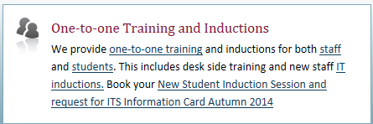
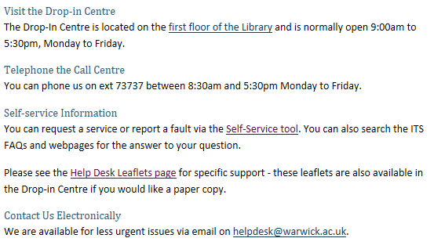
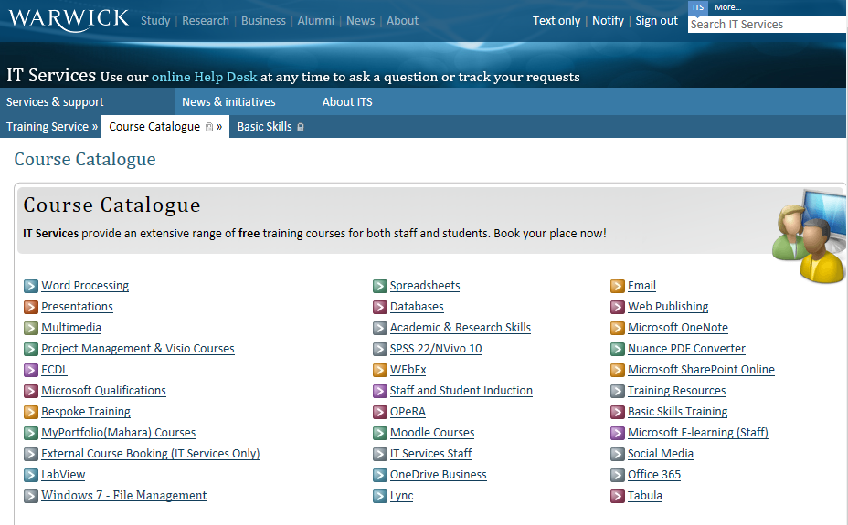
IT Help
http://www2.warwick.ac.uk/services/its/servicessupport/

Slide 13
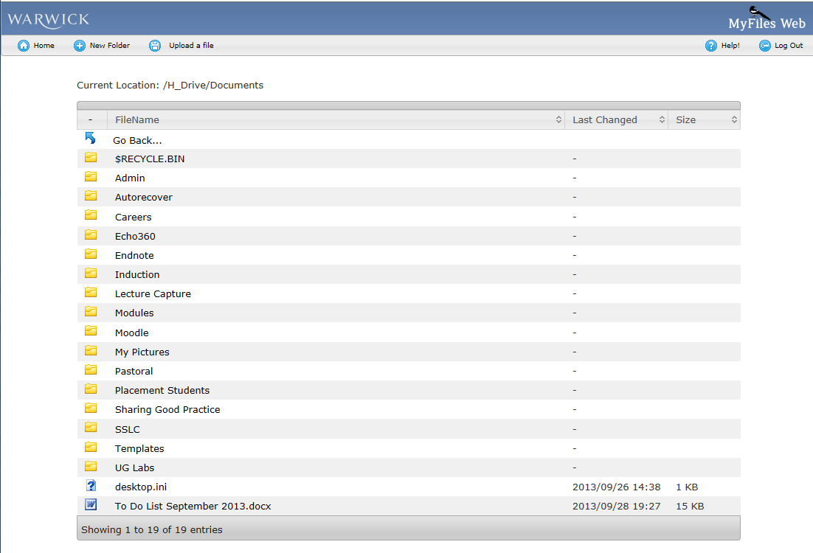
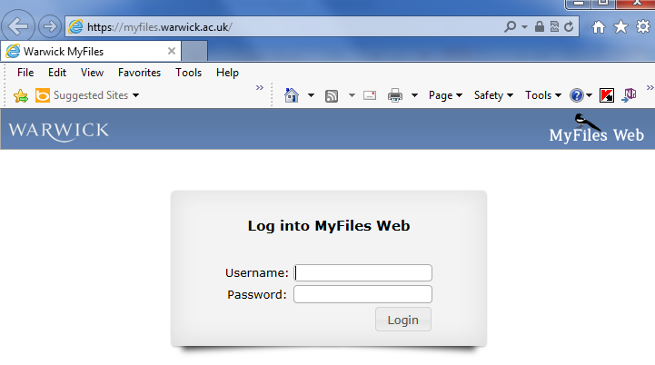
H: Drive Access your files everywhere!
On managed desktops (e.g. library)
→ Computer → H: Drive
Own computer
Use WebDAV: https://www2.warwick.ac.uk/services/its/servicessupport/datastorage/myfiles/myfiles-webdav
Web Browser
myfiles.warwick.ac.uk
http://www2.warwick.ac.uk/services/its/servicessupport/datastorage/myfiles/

Slide 14
Further support and information
In the first instance, contact Incoming Erasmus Coordinator in your host section
Your Personal Tutor (if different) can provide further pastoral and academic support
Student Support Services at Warwick include the Counselling Service
Nightline—24hrs confidential support for students

Slide 15
Financial queries
Your home university’s International Office or Exchange Office can provide support for home university bureaucracy
Financial and Erasmus Plus queries at Warwick—contact Study Abroad team at Warwick: erasmus+-region1@warwick.ac.uk /Erasmus+-region2@warwick.ac.uk

Slide 16
Meeting new students
The Students’ Union has over 250 student-run societies
School of Modern Languages and Cultures Welcome drinks: this evening, 6pm, in the Language Centre concourse, Ground floor, Humanities Building

Slide 17
What next?
Your ‘host’ section will have a meeting arranged to answer further questions
Any questions can be directed to the coordinators in your section

