Slide 1

Adopt a class

Slide 2
Adopt a class project
The “adopt a class” project aims to connect undergraduate language students on their Year Abroad with local schools

Slide 3
Whilst abroad you, the student linguists, will maintain links with classes in Primary and Secondary Schools, using digital technologies to communicate aspects of culture, news, everyday life and language, back to pupils at home in the UK.

Slide 4
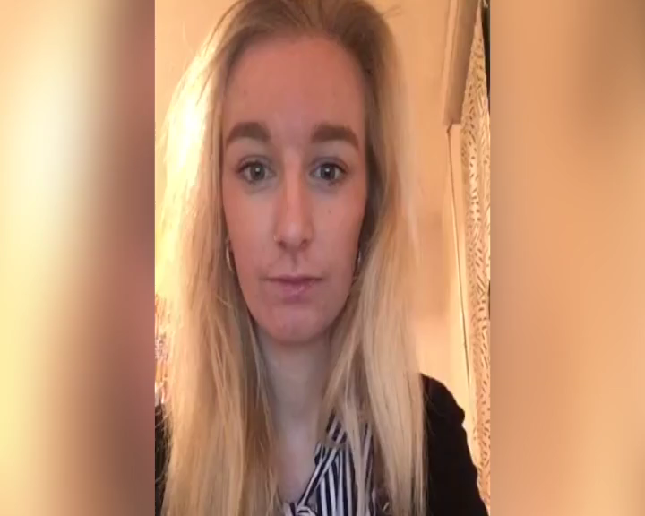
Here’s Lucy to explain the project:

Slide 5
Benefits for schools
Schools will have a link person “on the ground” to provide cultural and linguistic insights, direct links with native speakers and materials.
Pupils from a spectrum of backgrounds will thus experience lessons enriched with authentic target language, relevant and immediate cultural connections and responsive communication with native speakers.

Slide 6
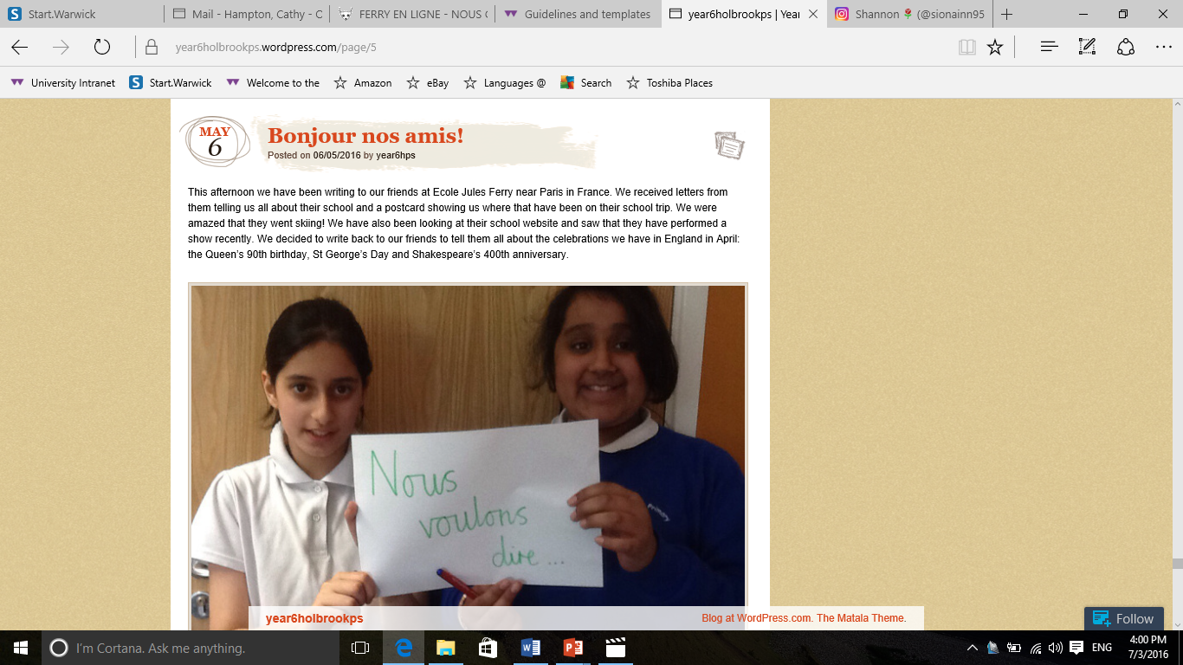
Exchange of letters, c. bi-monthly

Slide 7
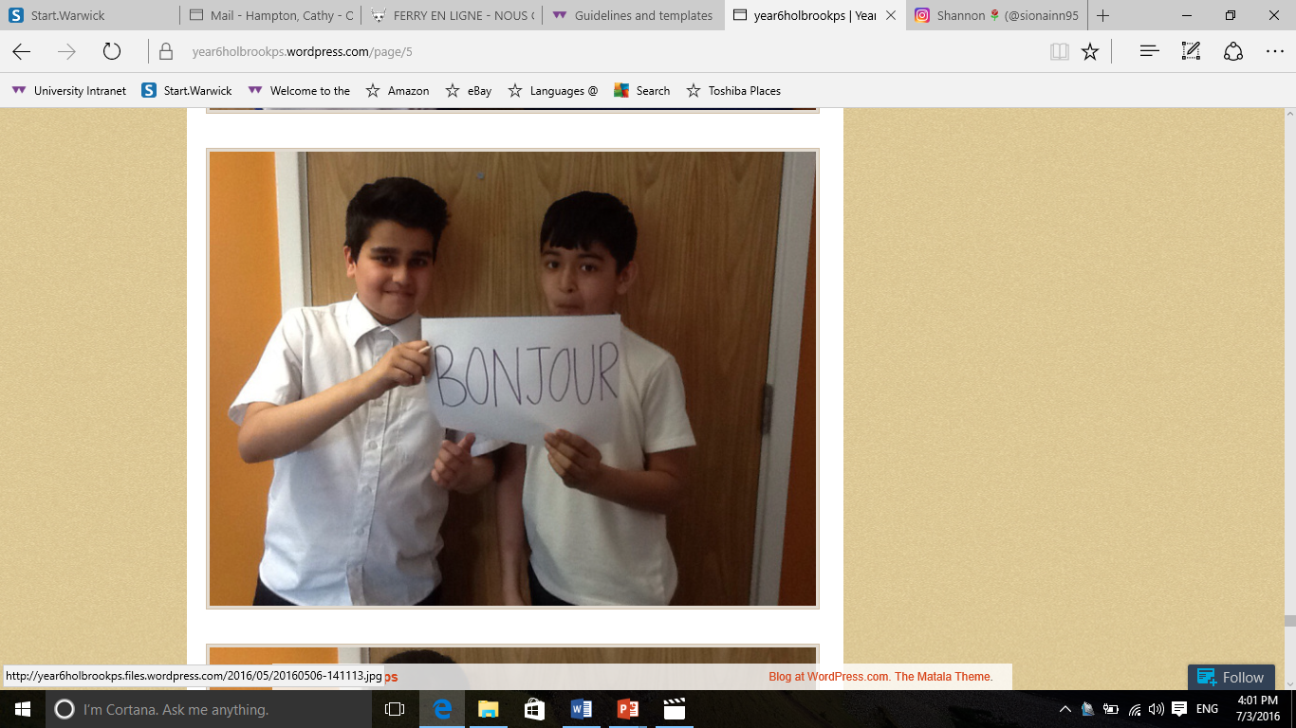

Slide 8
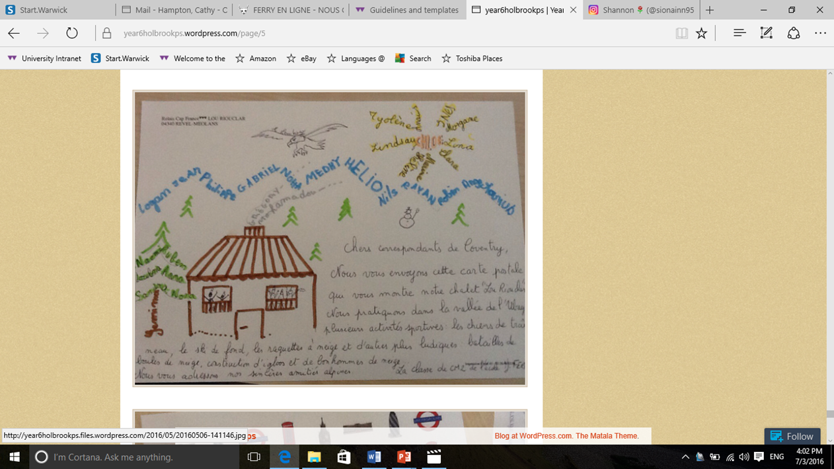

Slide 9
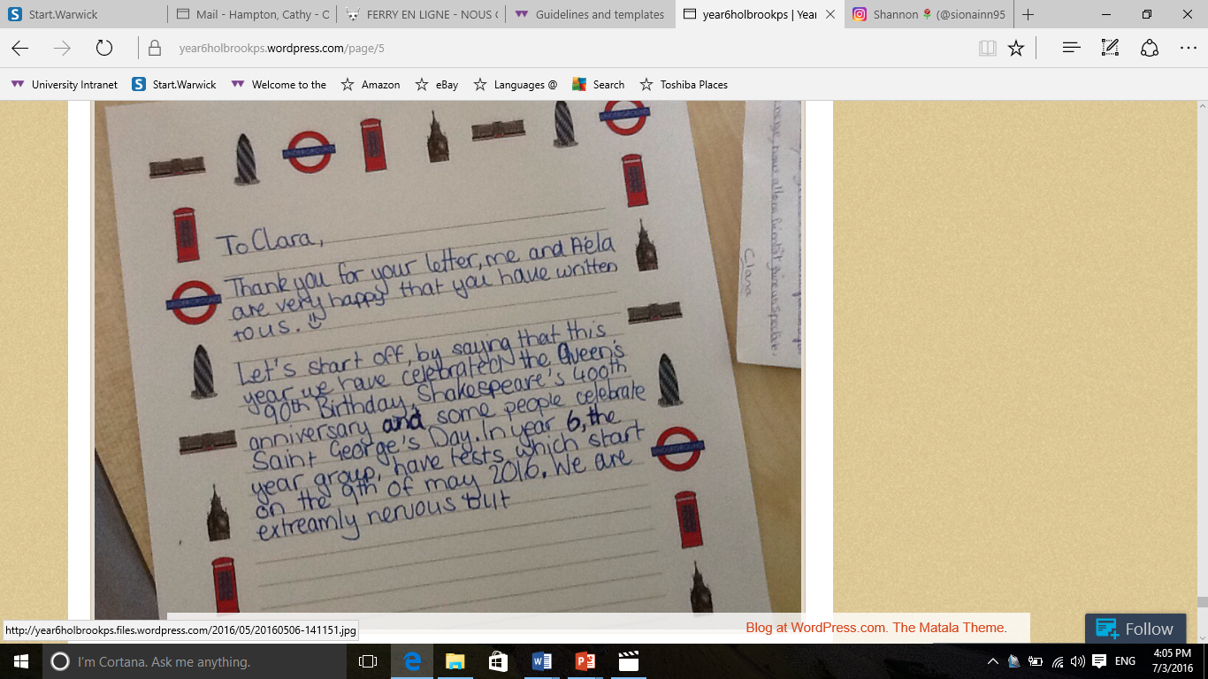

Slide 10
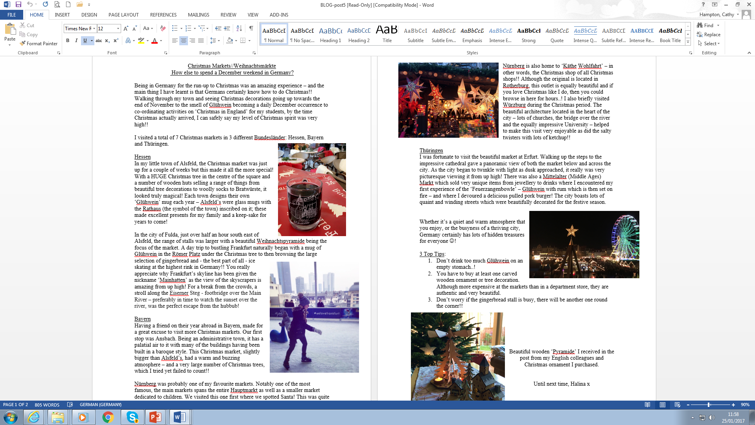
Blogging: Halina in Germany

Slide 11
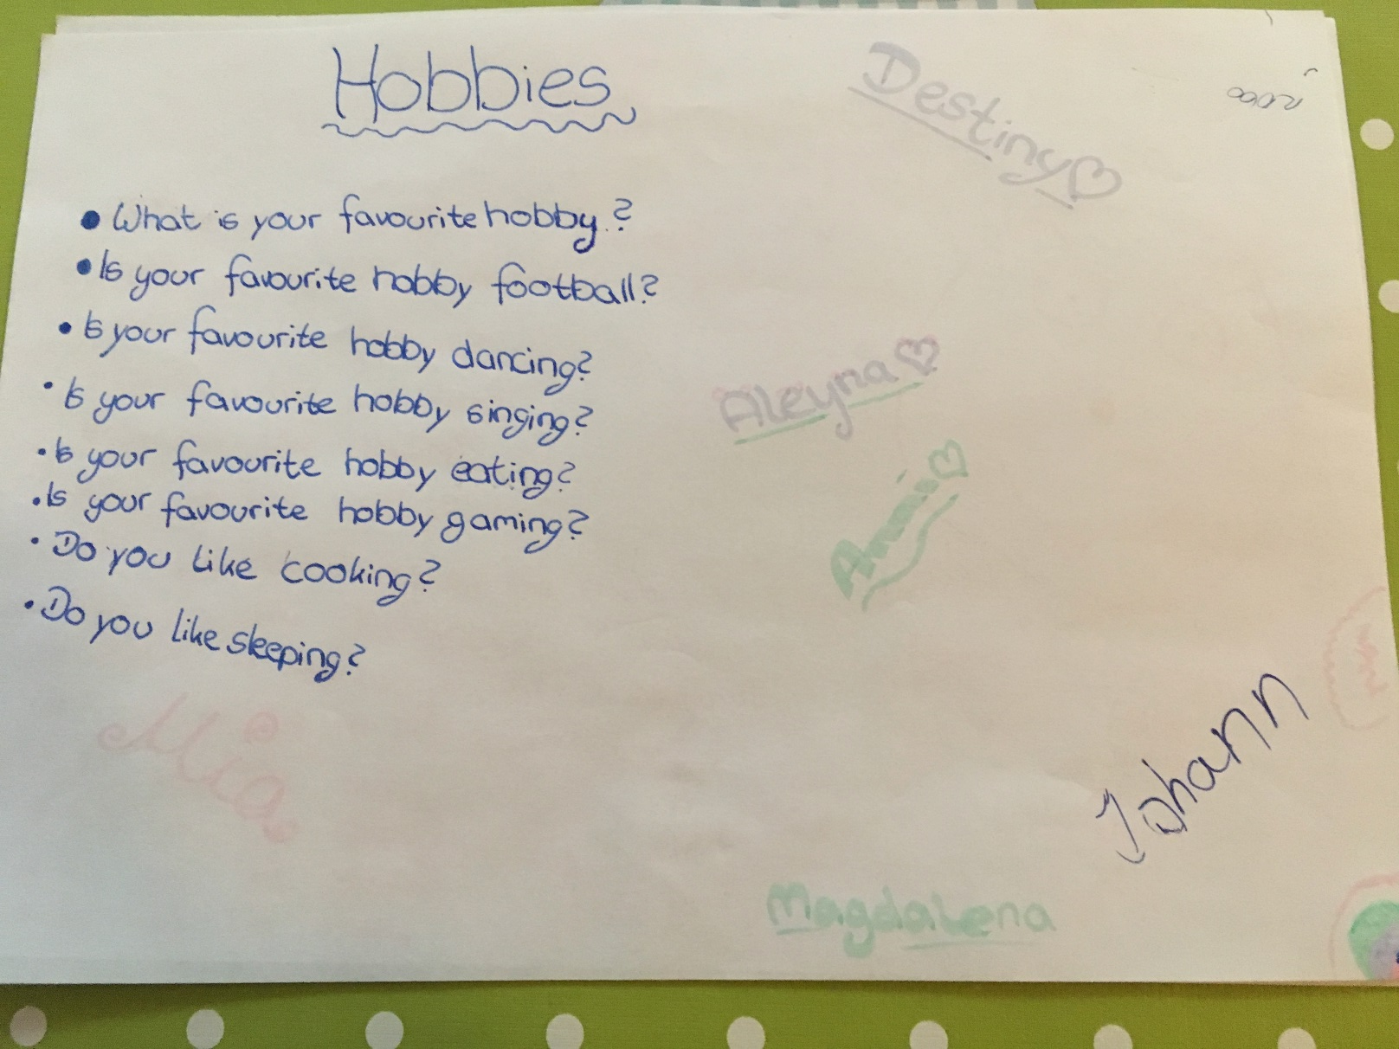

Slide 12
How does process work?
Find a school
Make contact with school
Draw up project plan
Meet teacher and class(es) if poss
Share resources
Notes:
Project plan = points in year when you agree to seek out and share resources. Teachers will often state what topics they are covering at particular points in the year. Also share contacts

Slide 13
How does it work during the year? 2
Teacher requests resource
You find resource
You send resource
You see activity and get inspired!

Slide 14
FAQs
Do I need to be a language assistant?
No: anyone can do this, but language assistants may be able to set up links between schools..
Is it just secondary schools:
No, primary schools are also looking for support
Can I approach my old school?
Yes – this can work really well

Slide 15
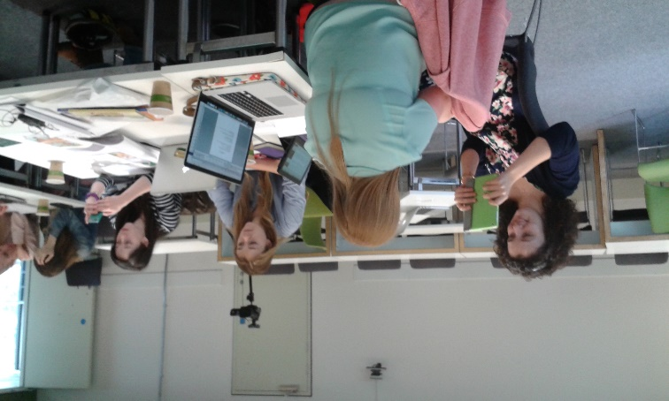
Preparing our new group of volunteers
Training session for outgoing students : using video and resources
Students establish contact with schools/ agree objectives
Students also to source material in new curriculum areas

Slide 16
What now?
Sign up using the form here:
https://docs.google.com/document/d/1oDleeQ7HS1ZnhLIVCVbjcaDPALy5DlWN4izRE_cHv7s/edit?usp=sharing
More information: http://www2.warwick.ac.uk/fac/arts/modernlanguages/undergraduate/yearabroad/yearabroad/aac/

