Slide 1


EDUCATION FOR SUSTAINABLE DEVELOPMENT IN THE ARTS (AND BEYOND!) Dr Joanne Lee Dr Sara Parisi (SMLC)

Slide 2
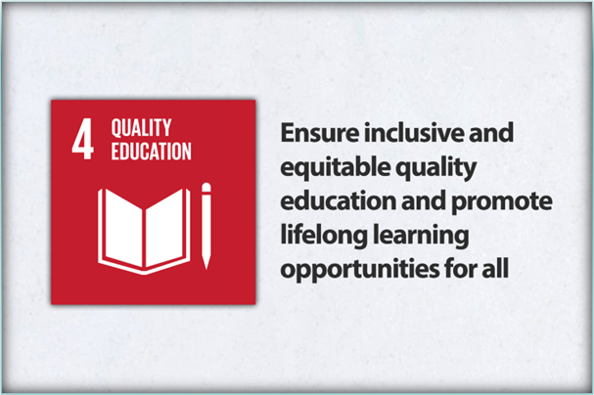
ESD: the wider context
Institutional: ITLR common theme; Climate Emergency Declaration 2019; 2030 strategy; ‘The Way to Sustainable’
National: New subject benchmarks
International commitments: UN 17 Sustainability Goals 2015; UNESCO ESD for 2030

Slide 3
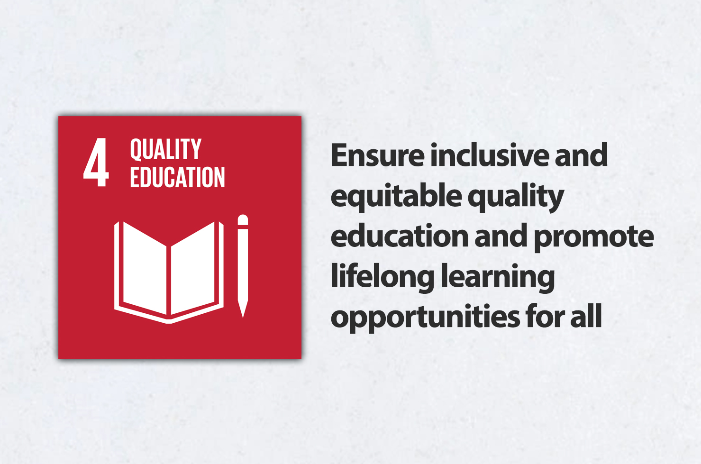
Education for Sustainable Development
SDG4.7 Target: By 2030 ensure all learners acquire knowledge and skills needed to promote sustainable development, including among others through education for sustainable development and sustainable lifestyles, human rights, gender equality, promotion of a culture of peace and non-violence, global citizenship, and appreciation of cultural diversity and of culture’s contribution to sustainable development

Slide 4
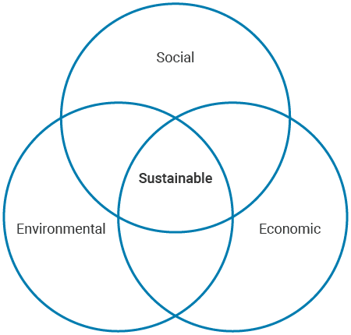
ESD: knowledge, skills, attributes and competencies
“ESD empowers learners to take informed decisions and responsible actions for environmental integrity, economic viability and a just society, for present and future generations, while respecting cultural diversity. It is about lifelong learning, and is an integral part of quality education. ESD is holistic and transformational education which addresses learning content and outcomes, pedagogy and the learning environment. It achieves its purpose by transforming society” (UNESCO 2019).
“ESD is not solely about environmental issues as is commonly misconstrued, but focuses on the connections between economic, social and environmental factors. ESD is an educational change agenda grounded in transformative learning and critical pedagogy. It can be understood as a lens that permits us to look critically at how the world is and to envision how it might be and equips us to deliver that vision” (Advance HE 2021).

Slide 5
ESD in Arts?
Curriculum content
Pedagogical approaches and practices
Forms of assessment
Decolonisation
Inclusivity and widening participation
Cultural diversity / global citizenship
Engagement with local and wider communities
Skills and employability /
interdisciplinarity
Students as co-creators
Lifelong learning skills
Internationalisation

Slide 6

Within the curriculum – modules on:
Feminism, gender and sexuality
Environment and ecology
Ecopoetics, ecocinema
Climate change and climate fictions
Urban reconstruction and development
Social justice, memory and political institutions
Race and racial justice
Postcolonial studies and imperial legacies
Travel and ethics
Mobility and migration
MA Environmental humanities

Slide 7

Pedagogical approaches and skills
Active engagement / experiential learning
Transformative
Problem based learning (PBL)
Systems thinking / Futures thinking
Critical thinking skills
Co-creation (empowerment)
Working with others (group tasks)
Communication and interpersonal skills
Assessment forms: policy briefs, presentations

Slide 8
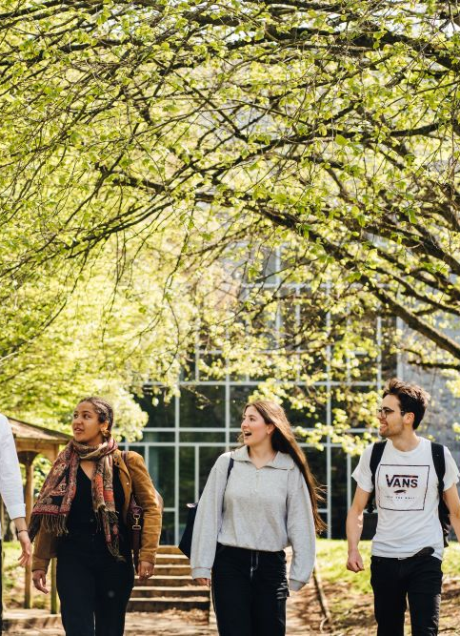
ITLR: opportunities
Make more explicit / increase visibility
Focus on skills and values
Sharing resources
Collaborative networks
Equality and diversity initiatives

Slide 9

Co-creation: IT301 Modern Italian Language III
Encourage students to reflect and talk about their own values in Italian
Explain the role of SDGs in Italy
Introduce the inquiry-based approach
Encourage participation and empowerment
Enhance students’ awareness and engagement with global sustainable issues

Slide 10




IT301 Syllabus
TERM 1
TERM 2
Week 2: Introduction to the UN’s SDG
Week 3: Italy and Climate Change
Week 4: Drought and Water Scarcity in Italy
Week 5-7: Mass Tourism in Italy
Week 8-9: Italy Country of Immigration and Emigration
Week 1-2: Sustainable Production and Consumption: Food
Week 3-4: Sustainable Production and Consumption: Fashion
Week 5-7-8: Italian Culture: Films, Sustainable Art and Architecture
Week 9-10: Language and Neologisms
Week 10:Writing Workshop

Slide 11
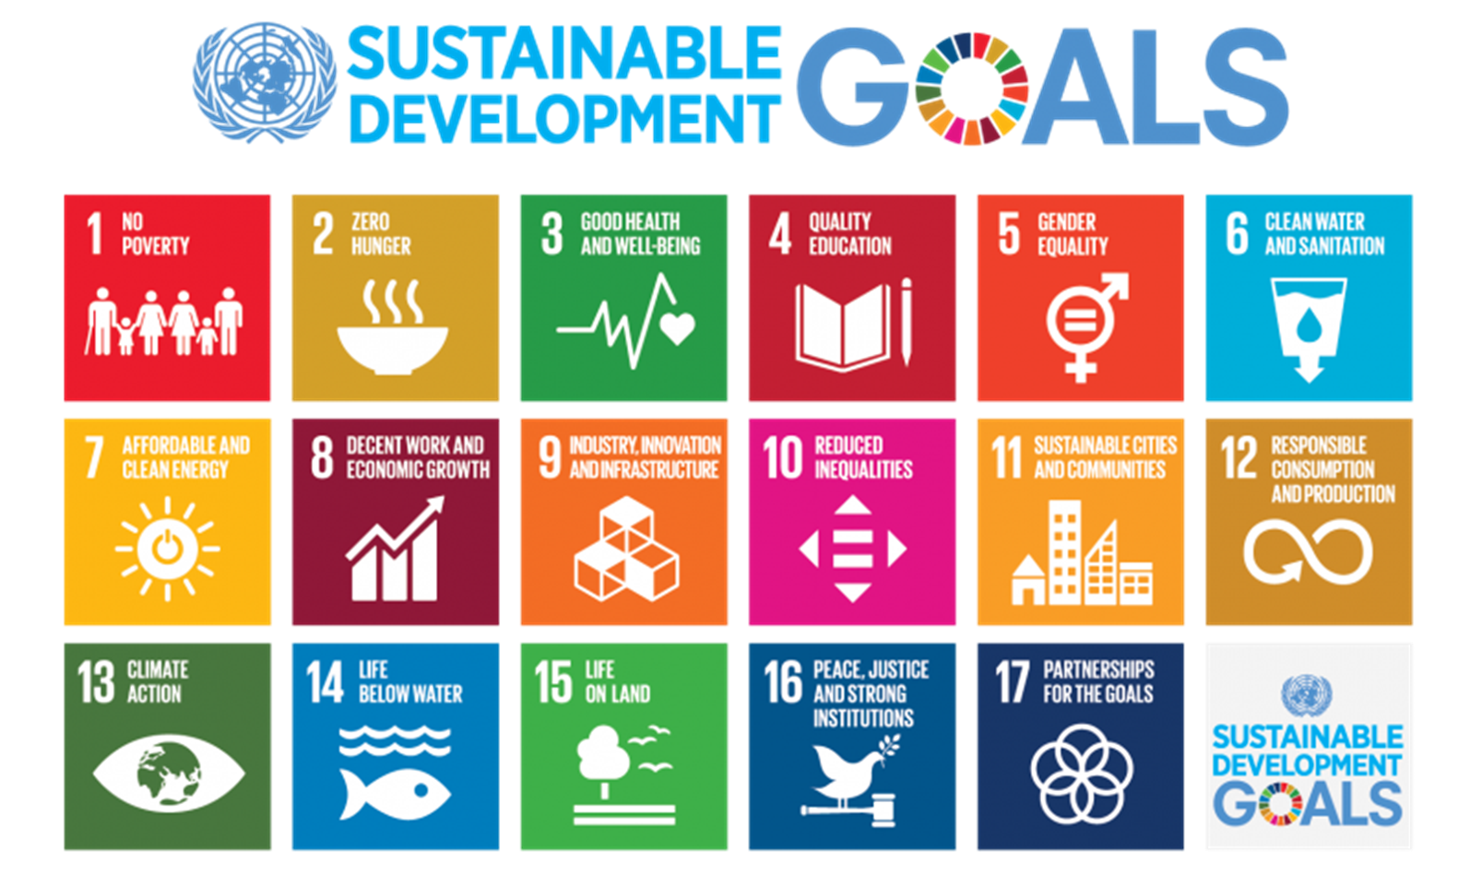

Slide 12
Get involved
Read through QAA / Advance HE Guidance: Education for Sustainable Development Guidance | Advance HE (advance-he.ac.uk)
Look through our webpages: Education for Sustainable Development (warwick.ac.uk)
Join our ESD Network: registration here:
Attend our termly events
Look out for our WIHEA project survey: Evaluating student and staff awareness of Education for Sustainable Development

