Slide 1

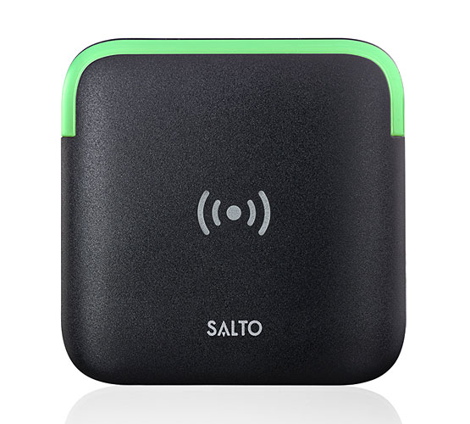
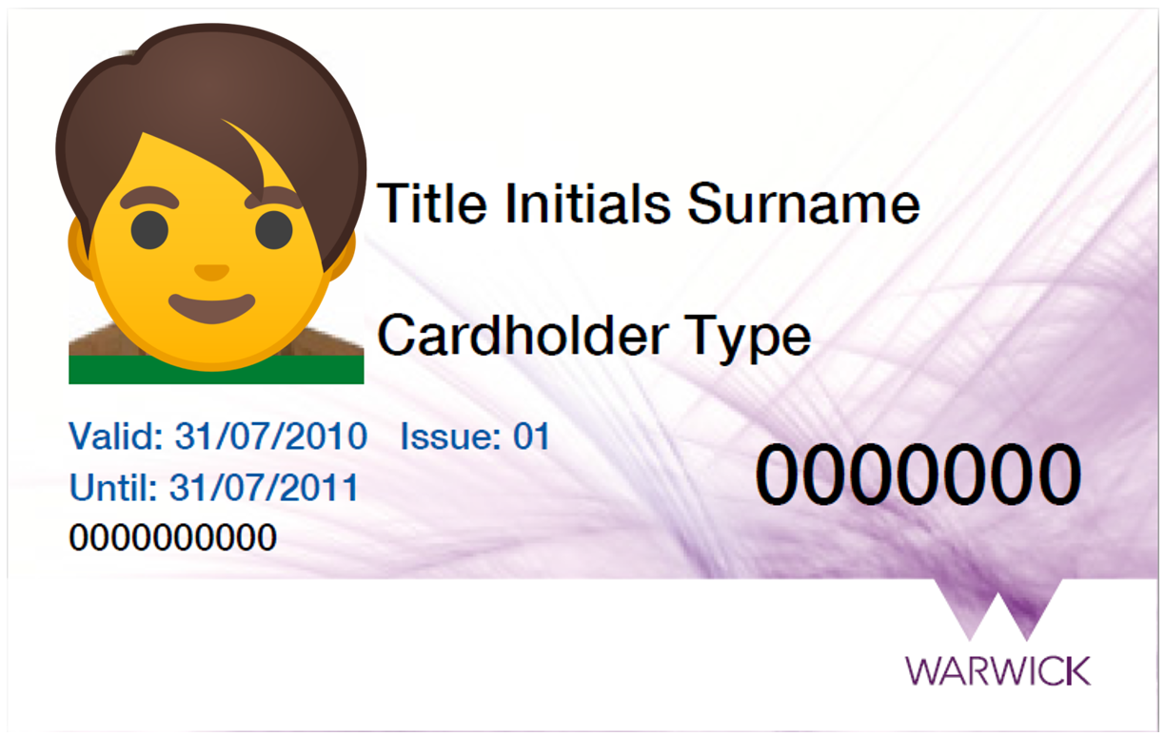
Door Access Changes
We’re updating the door access card readers in your building
What will happen?
The old card reader will be removed and replaced with a new
unit. While the work is carried out access through doors will be
maintained.
Do I need to do anything?
If you have an older issue blue Warwick ID card you should get a
replacement to ensure it will work with the new system.
You can do this by visiting Senate House or University House reception to replace your card from Monday to Friday between 9:30am and 4:30pm.
Once the new readers are installed the first time you use your
card please hold it on the reader for 10-15 seconds so it is
registered on the system after which access should operate as normal.
Will I still have access?
The access you had on the old system will in most cases be carried over to the new system. If you feel you should have access to a certain area that you now do not have please email Cardoffice@warwick.ac.uk and explain where the issue is.

