Slide 1
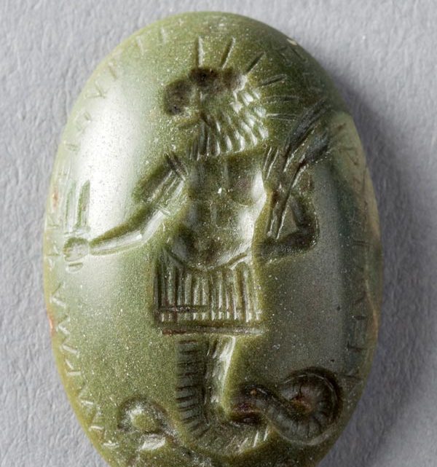

Cultural exchange: medicine
Summer school in Venice
Dr. Caroline Petit, University of Warwick

Slide 2
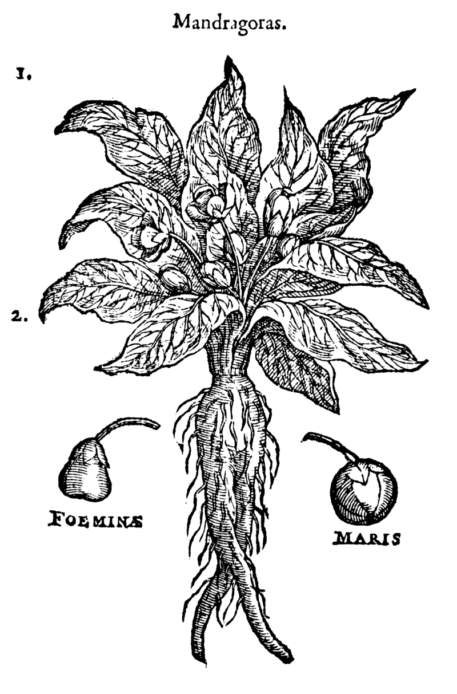
Ancient medicine in one slide?
Practices originating in prehistoric times (evidence from bones, palaeontology, …): trephination, dentistry…
Different ‘families’ of healers: interprets of divine designs, magicians, self-styled ‘rational’ healers in 6th/ 5th c. Greece
Hippocrates, ‘father of medicine’? A convention (and a body of texts by various authors, mid-5th c. BC to early 3rd c. BC)
Among ‘rational’ physicians: rise of several schools through the Hellenistic and Roman periods
Galen (129-216 AD)
Soranus (gynaecology)
Continuation of alternative practices inspired by Egyptian/near Eastern knowledge

Slide 3
An archaeology of cultural transfers? Drugs in antiquity
Antiquity: a useful détour to understand some long-term aspects of the history of drugs
Hippocrates?
Pliny, Dioscorides, Galen (not the only ones; but all play a role long term)
The most successful ancient text on plants and other drugs is Dioscorides’ De Materia Medica
Insight into cultural transfers, appropriation, validation of drugs (Galen)
Setting an example – the archetypal pharmacist

Slide 4

Late antique medicine and Christianity
Temkin, Hippocrates in a World of Pagans and Christians, 1991
Temkin, Galenism. Rise and Decline of a Medical Philosophy 1973 ch. 1-2
Argument = in the face of rising Christianity, medicine had to make itself “neutral”, profane but acceptable
Christianity and hellenism: a long-standing conflict (appropriation and contestation)
Medicine couldn’t be separated from Hellenism, esp. philosophy
Consequences: loss of some texts (deemed inappropriate); persecutions of pagan doctors (Gesius at Alexandria, 5th c. AD; heretics of all kinds, such as the Monophysites, who fled East to Ctesiphon in Persia after the Council of Chalcedon 451)
Alexandria: a place of conflicts, riots, fights between schools and esp. btw Christians and pagans: vivid memories still in 7th c. (Sophronius of Jerusalem, Miracles of Cyrus and John)
Crackdown on philosophy schools in 529
In 7th c. Alexandria however, ancient disciplines remained alive

Slide 5
Late antiquity : medicine & ‘christianization’?
Medicine: practiced and taught in various places but especially in Alexandria
Late antique medicine represented in texts = commentaries, compilations, handbooks
Engaging with classics of medicine: Hippocrates, Galen
Gradual/partial erasing of alternative medical authorities
Selection of most important texts according to criteria of usefulness
Galen: a monumental oeuvre reduced to a canon of 16 works in Alexandria
Transmission of alternative texts through Latin (south Italy, Ravenna, Africa), Syriac (Nisibis, Persia) and, later, Arabic

Slide 6
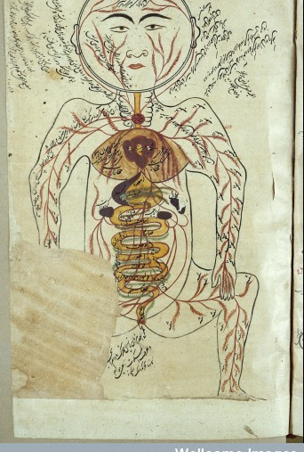
Alexandria under Islamic rule
Continuation of practice/research/ teaching
Paul of Aegina visited the place several times, even after 642
Transfer of Greek to Islamic knowledge (along with Persian, Indian, Armenian…)
In fact transfer via Syriac translation (role of Christians in all this)
9th c. AD: a vast translation enterprise in Baghdad: Al Bitriq, later Hunayn and his school, using Alexandrian collections
Appropriation, not pure transfer: see Pormann/Savage-Smith, Medieval Islamic Medicine

Slide 7
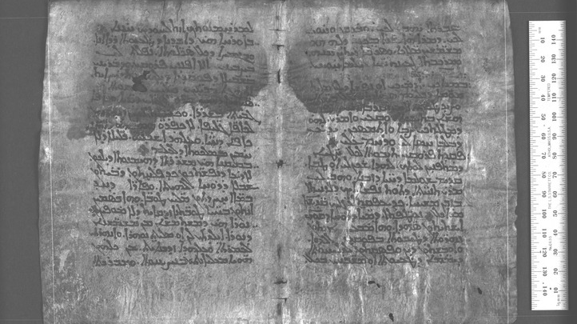
Galen in Syriac: Sergius of Res’haina (6th c AD)

Slide 8
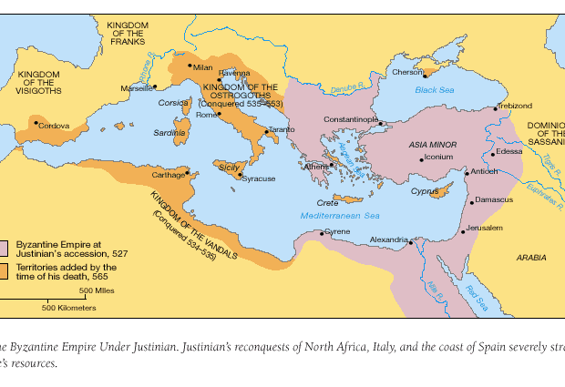
Ravenna and other centres of learning in Latin
Ravenna: imperial court
Agnellus of Ravenna
Translations into Latin beyond Ravenna
Southern Italy (Greek influence)
North Africa
A body of texts making their ways into monastery libraries and courts
Cassiodorus (Vivarium)

Slide 9
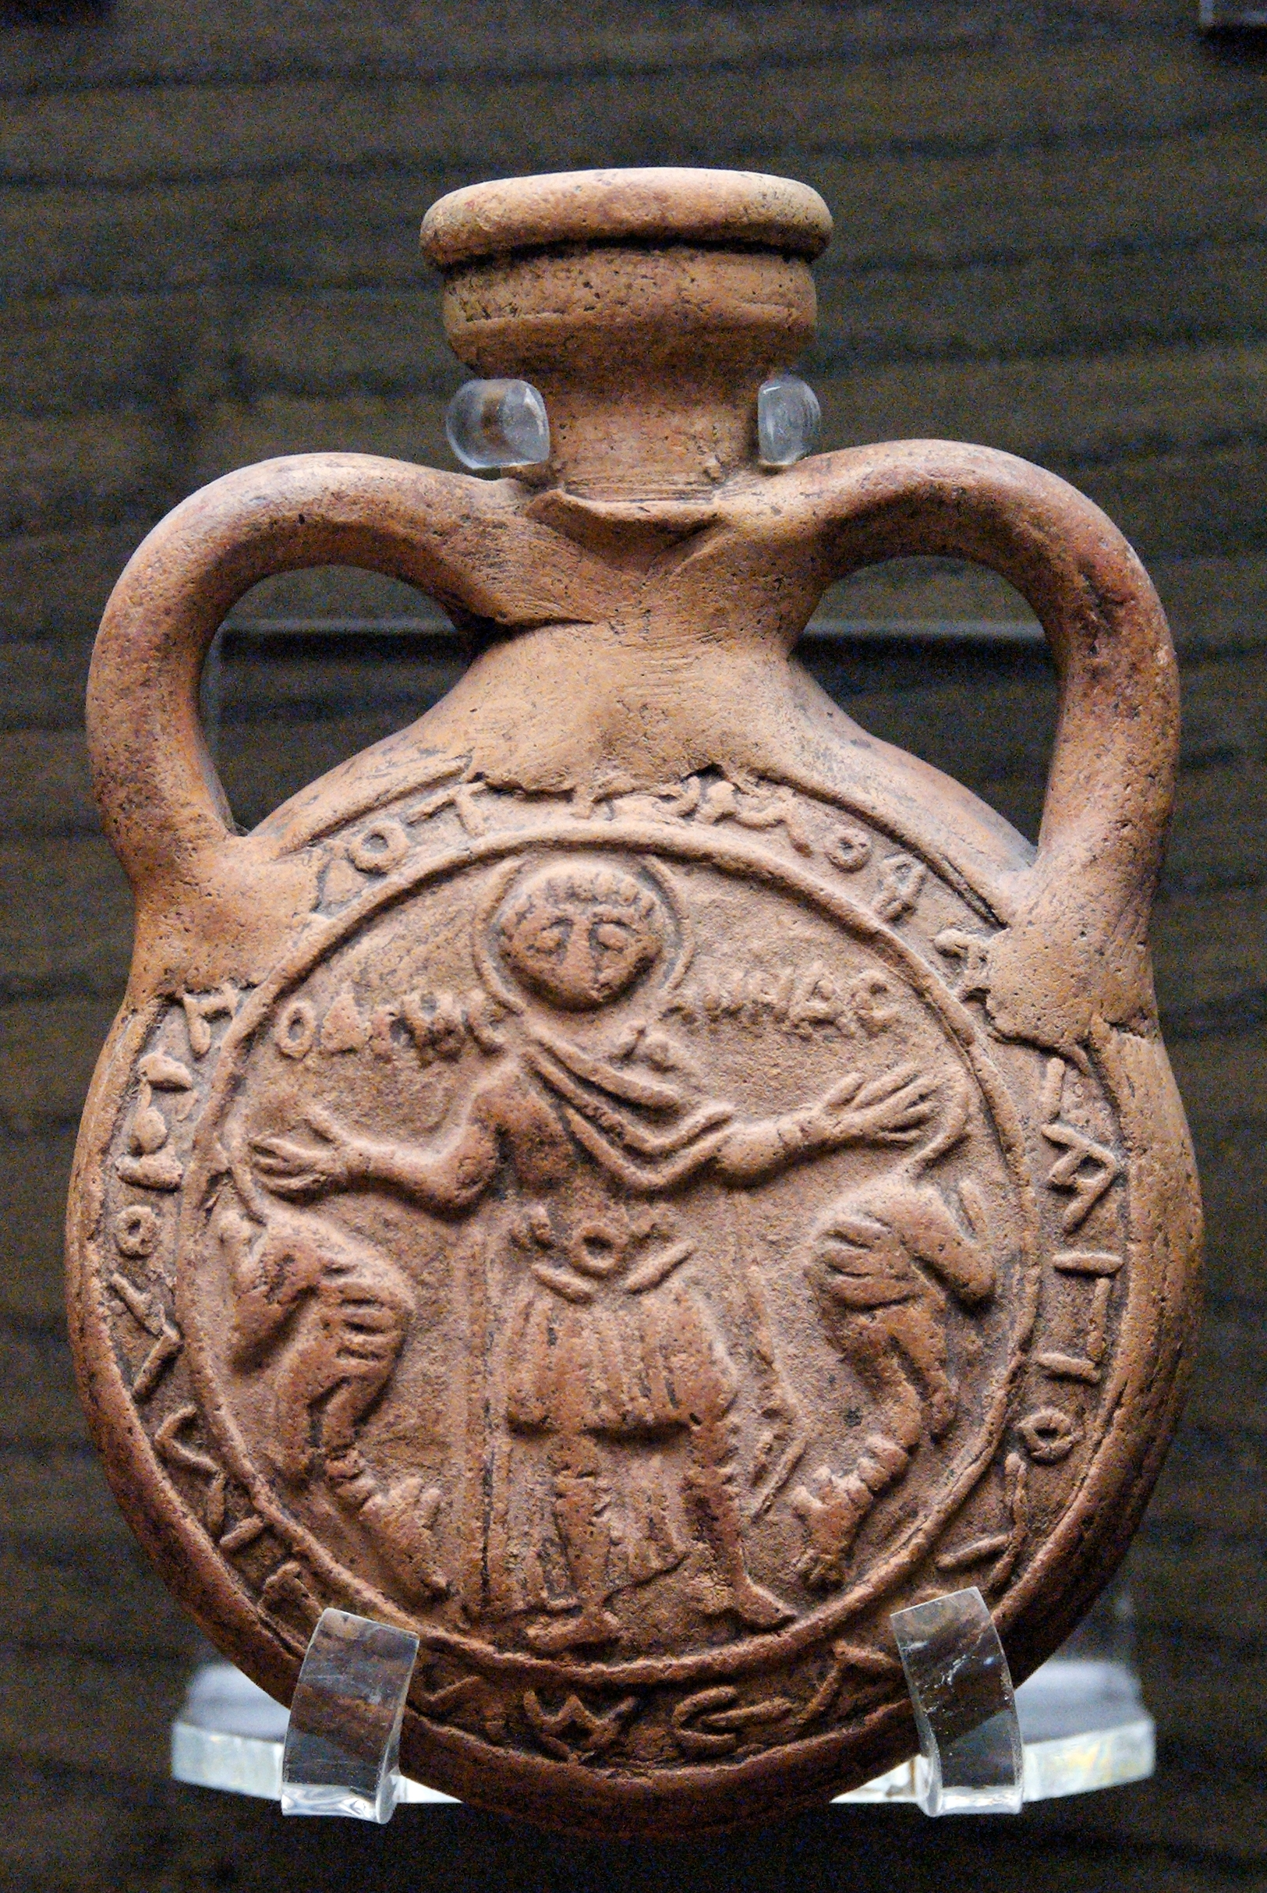
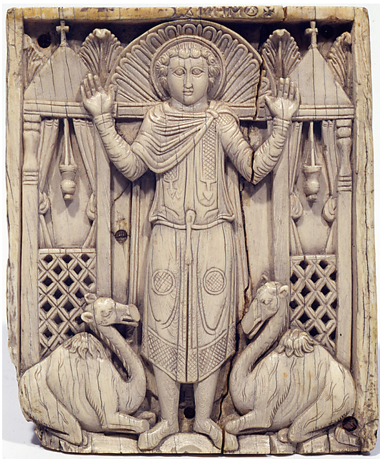
Saint Menas - a popular healing cult of late antique Egypt

Slide 10
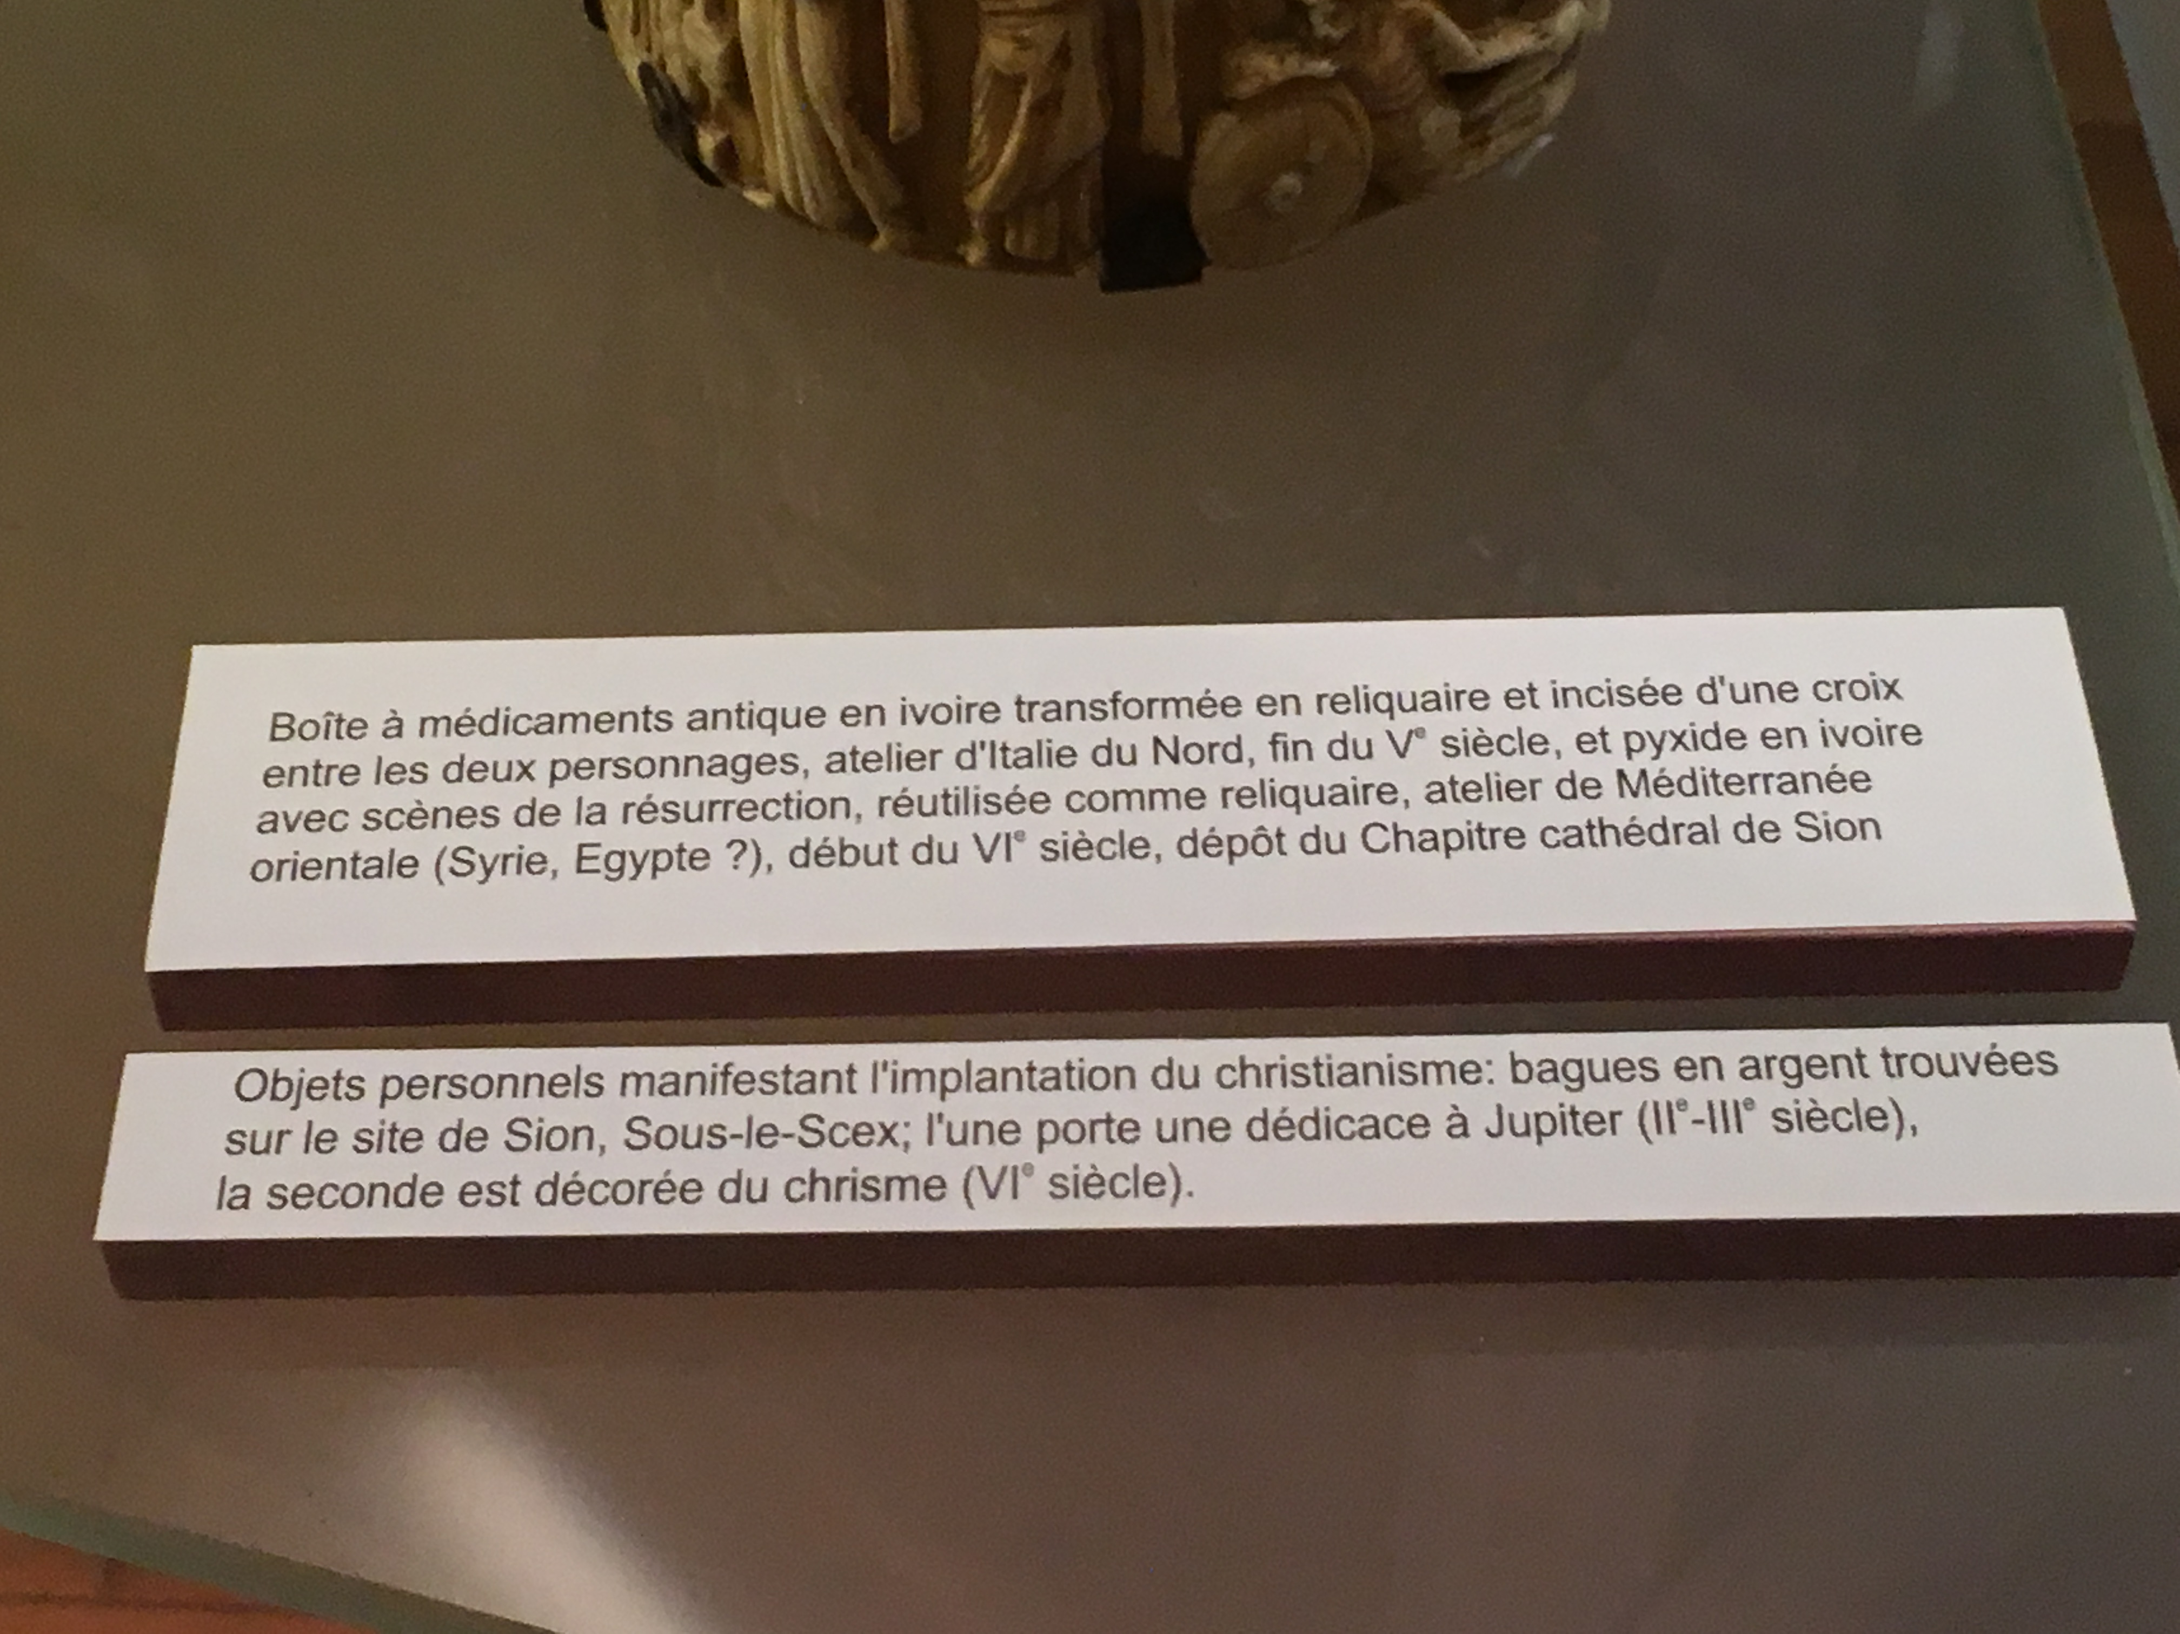
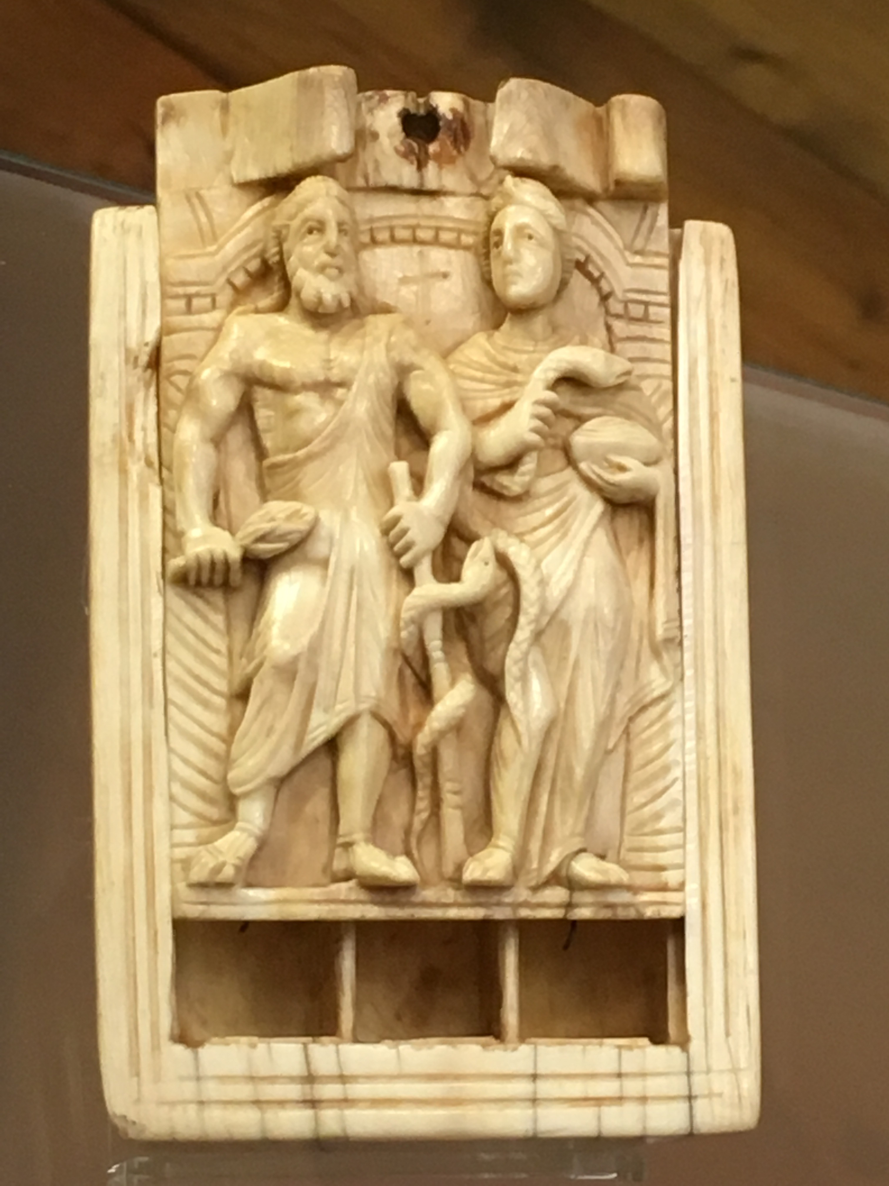
Repurposing ancient medical objects

Slide 11
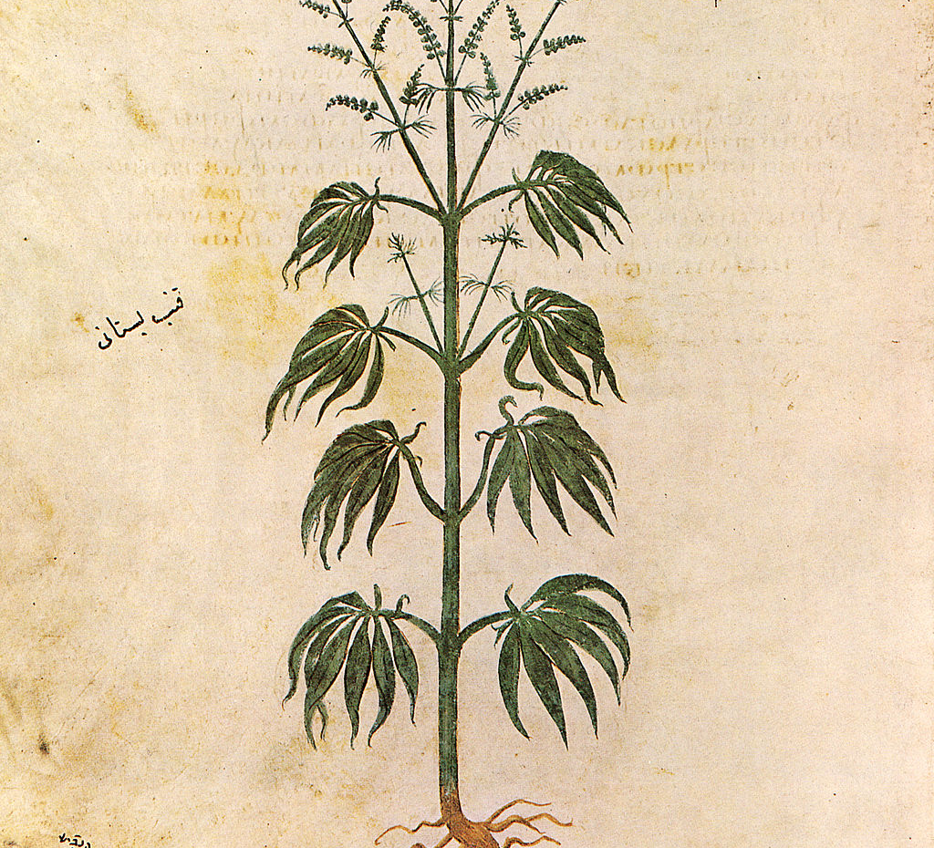
Vienna 1, Dioscorides (cannabis)
5th c AD ms

Slide 12
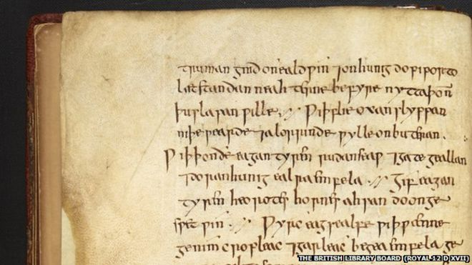
Up north?
Latin knowledge circulates in Gaul and beyond
Anglo-Saxon England
Ancient remedies and modern challenges: Freya Harrison on Bald’s Leechbook
https://www.bbc.co.uk/news/uk-england-nottinghamshire-32117815

Slide 13
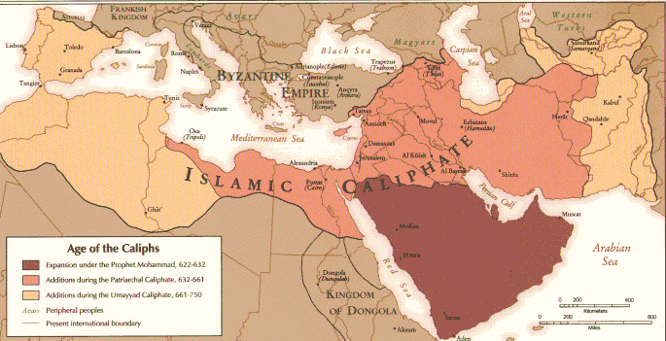
Islamic world in the early medieval period

Slide 14

Medieval medicine in a scholastic context
Aristotelian framework in most intellectual communities in the West
Monastic libraries and the circulation of books
Science, medicine, and the occult: navigating a new religious order
Medicine: transmission of Islamic knowledge into Latin from 12th c. onwards
Avicenna and Galen: continuity? Systematization?
14th to Late 15th c. translations based on Greek manuscripts begin to circulate
Universities: Salerno, Montpellier, Padua, Oxford, Paris…

Slide 15
Byzantium and the preservation of medical texts
Constantinople
Southern Italy (Terra d’Otranto)
Hippocrates: a well-established canon (collectio vaticana/marciana)
Galen: scattered around; open; contaminated
Example of Galen, On simple drugs :
11 books (1-5: theory, 6-11 properties of drugs)
Preservation of books 1-5: a group of scholars around John Argyropoulos in Constantinople in the mid 15th c.

Slide 16
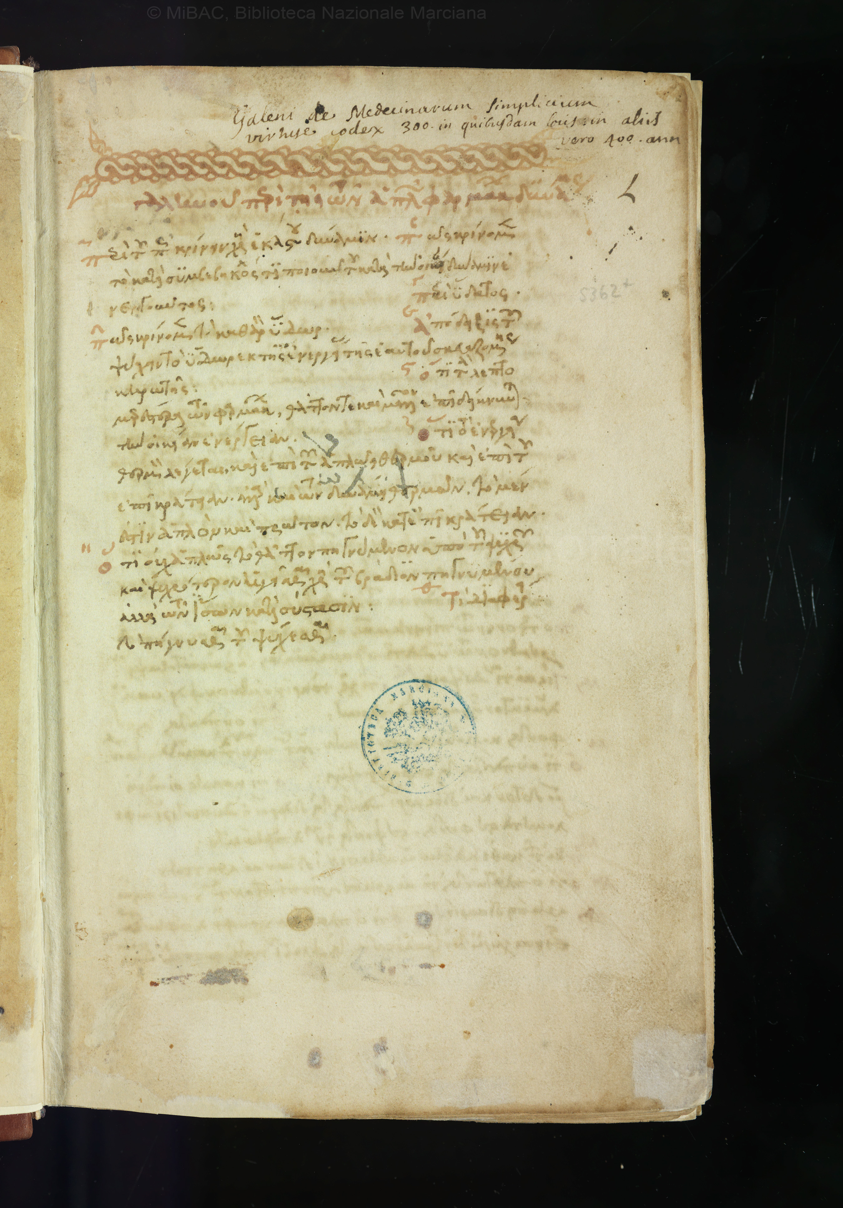
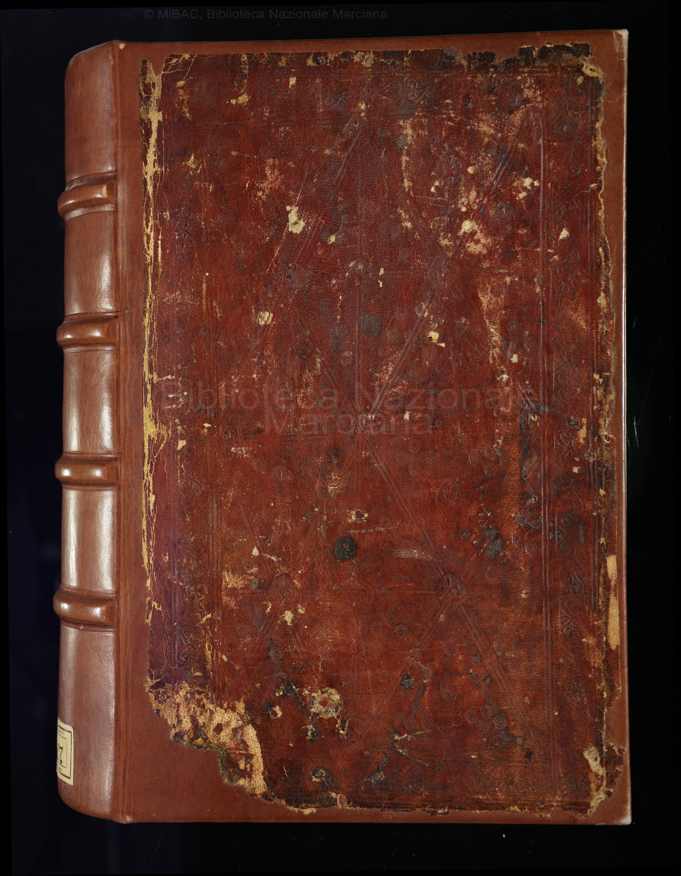
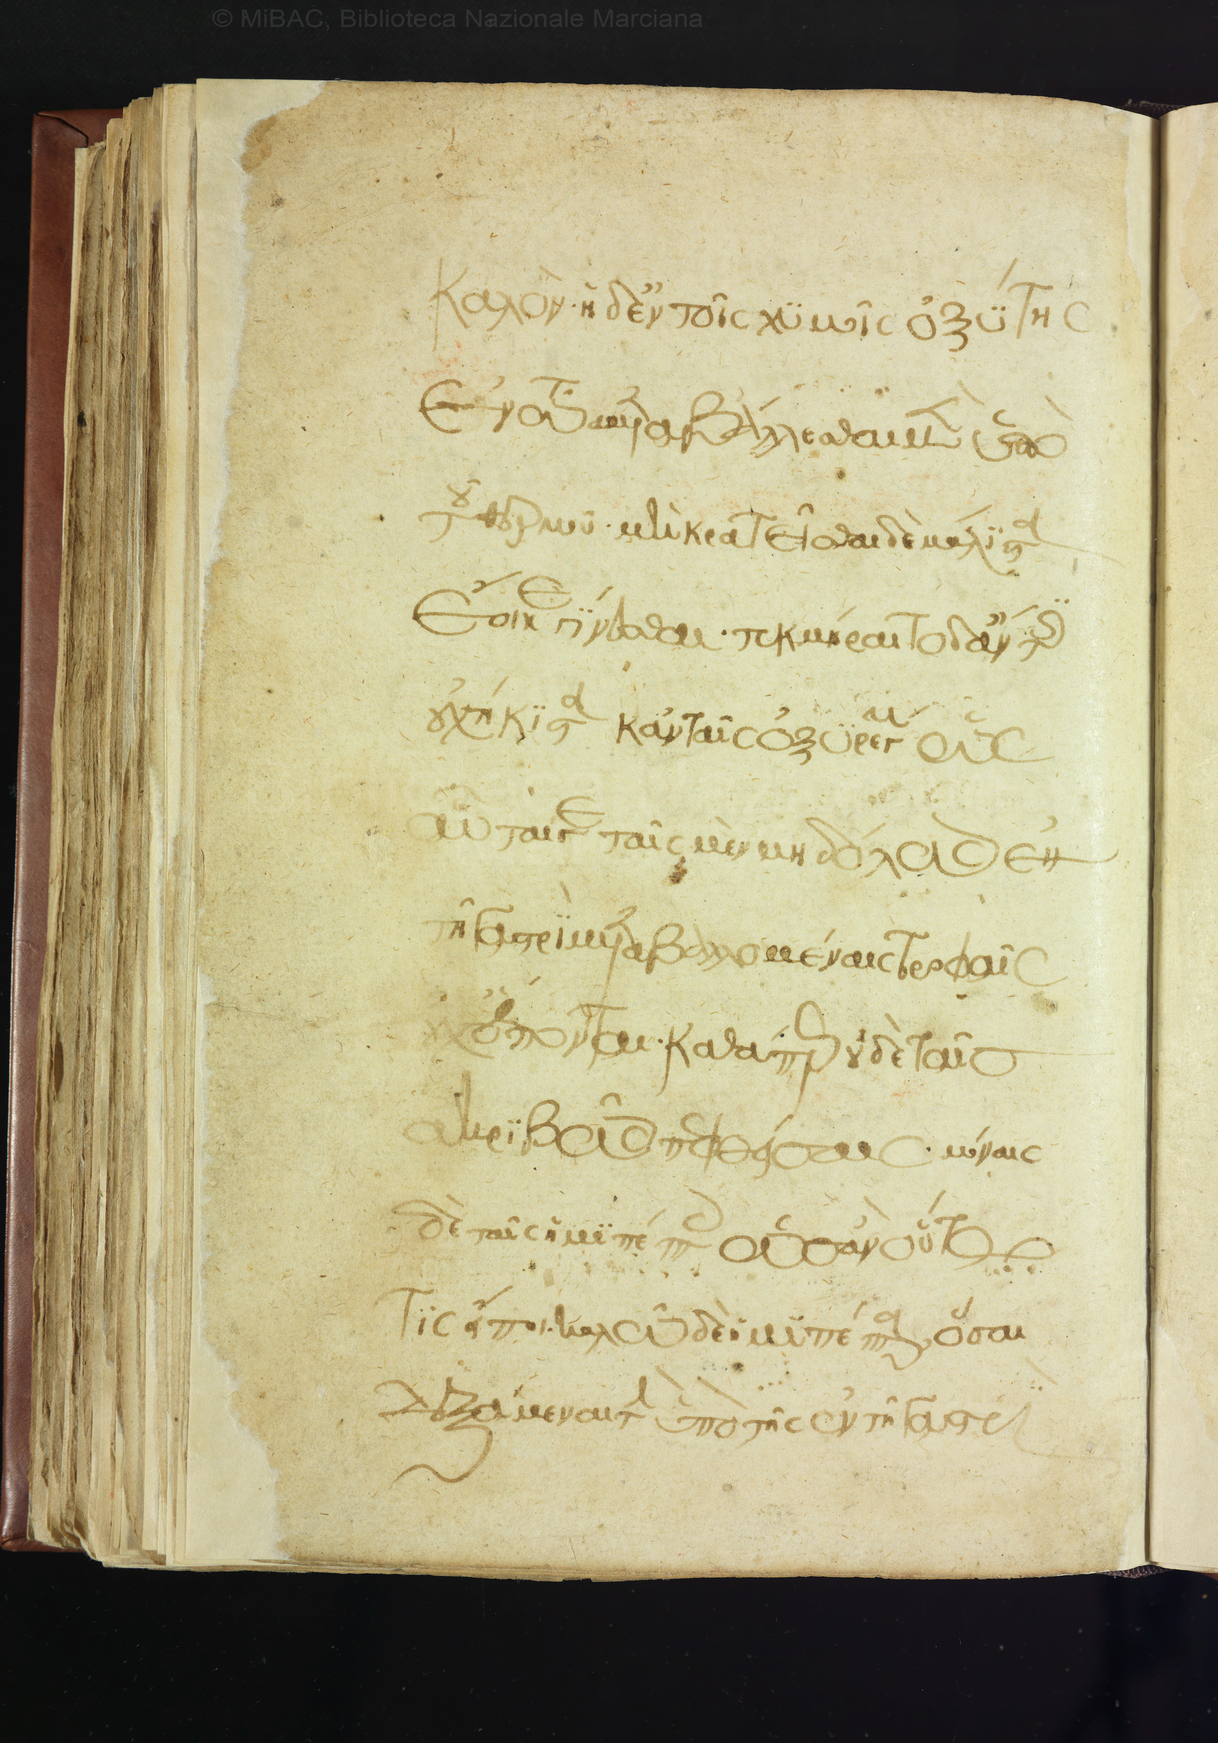
Marcianus V, 6 (simple drugs 1-5)

Slide 17
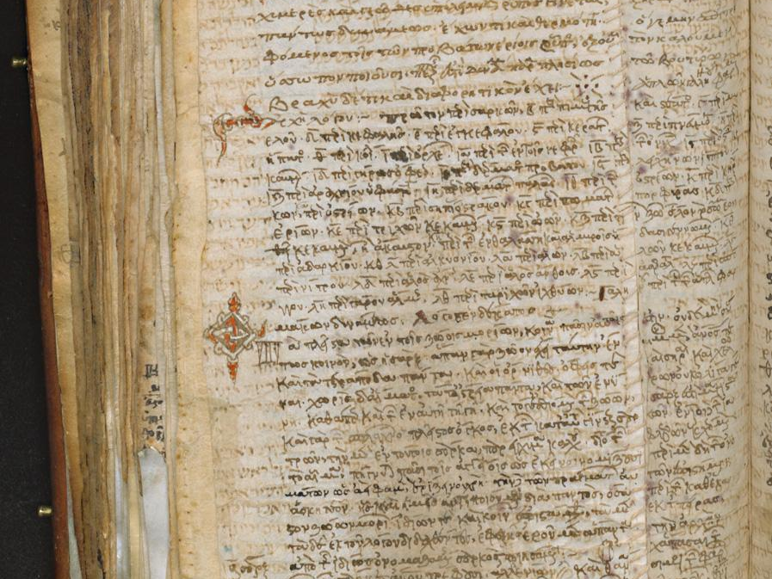
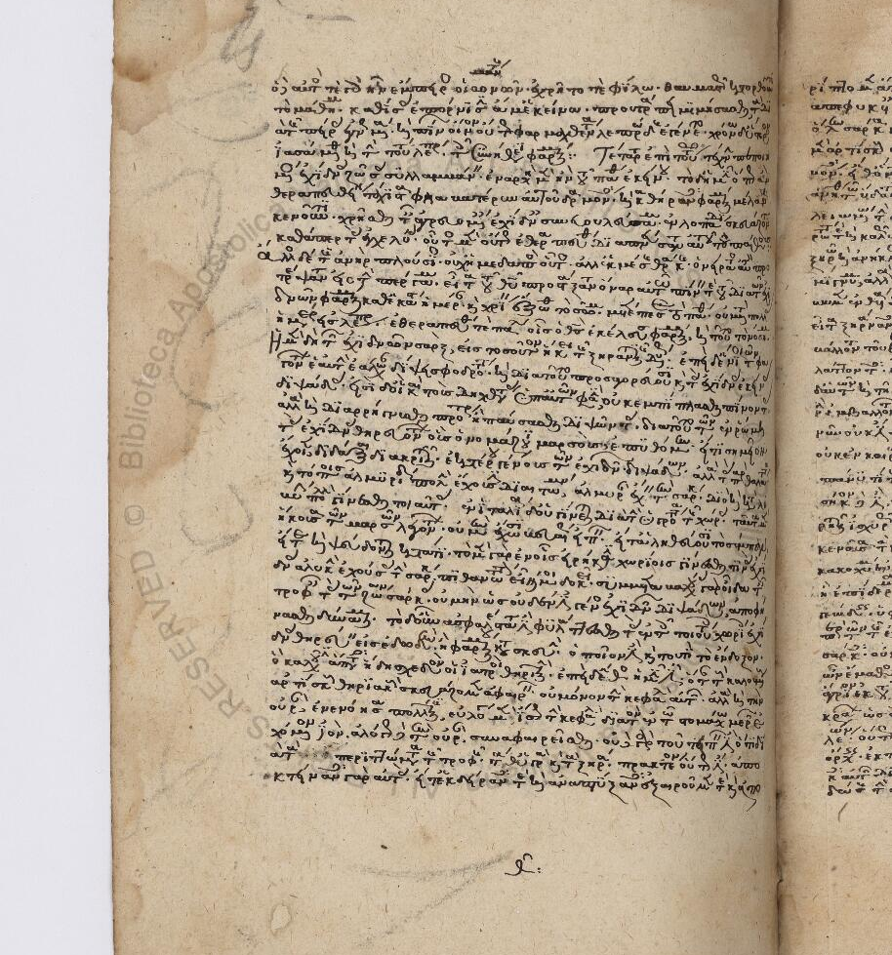
Laur. Plut 74, 17 (palimpsest) and Urbinas gr. 67

Slide 18
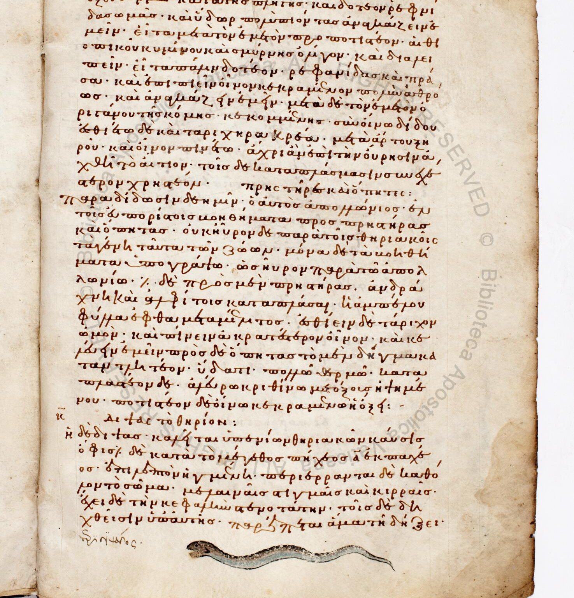
Vaticanus gr. 284
10th c.
Dioscorides + Galen, Ps. Dioscorides, Philumenos
Illustrations added later (animals, plants)
Scribe as editor?
Reflection of earlier reworking of the text?

Slide 19
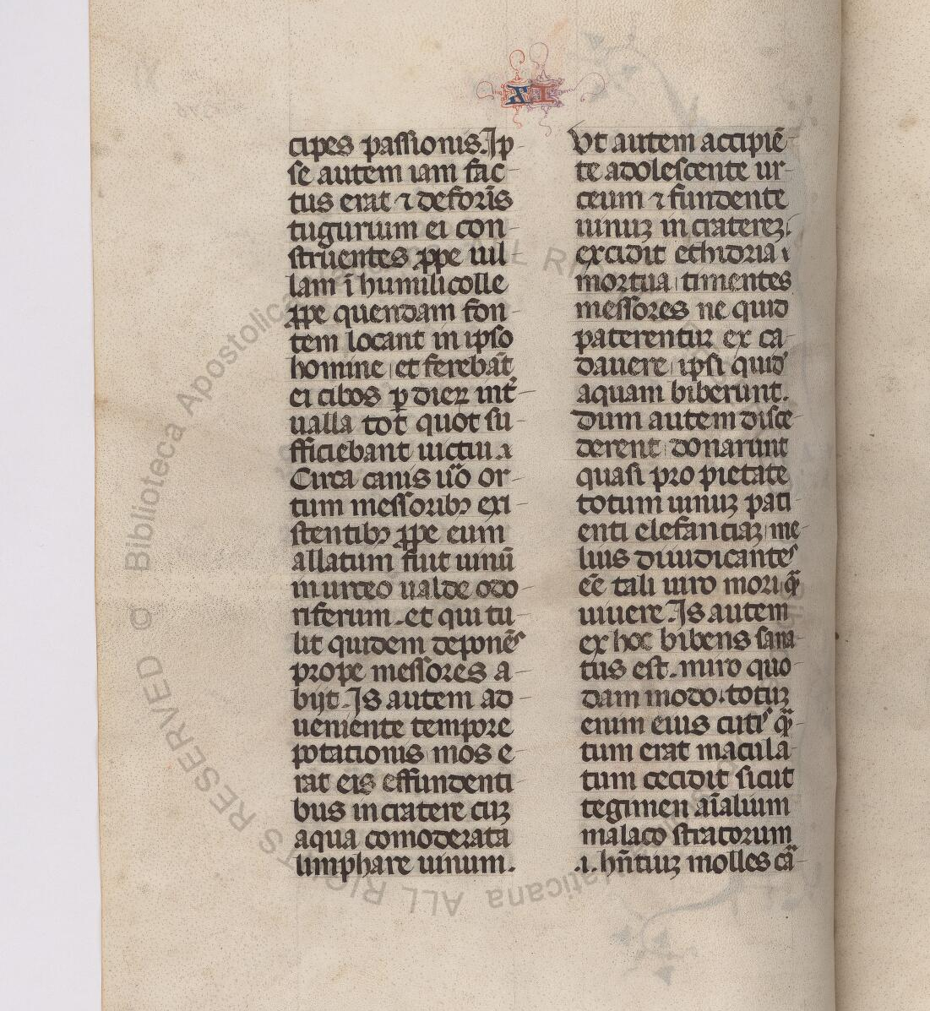
Translating Greek into Latin?
Medieval translations: Burgundio di Pisa and the scriptorium of Ioannikios (Wilson, Degni,…) – 12th c.
Naples 14th c.: Niccolò da Reggio
Galen, Simples: *one* extant copy of Niccolò’s full translation
urbinas lat. 248 (shows evidence of additional material (e.g. from Symeon Seth)
In print (1490, 1502… ): books I-VI from Arabo-Latin translation + books VII-XI from Greco-Arabic translation

Slide 20
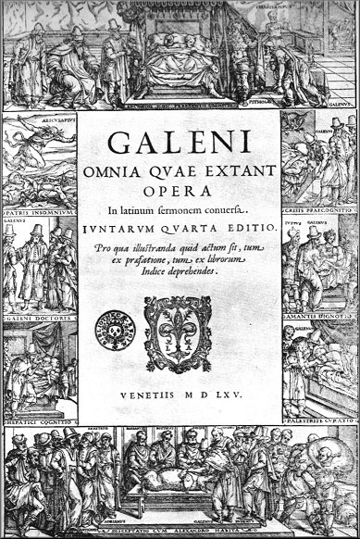
Establishing a medical canon in the Renaissance
The revolution of Print
Complete works in Greek appear in 1525 (Galen) and 1526 (Hippocrates) in Venice (Aldus Manutius)
Rise of new translations into Latin (Winter of Andernach,…)
Alternative medical texts also printed: Aretaeus of Cappadocia, Dioscorides, …
Universities still teaching a syllabus based on Avicenna, a few texts by Hippocrates and Galen (Nancy Siraisi)
Questioning the Arabic heritage (and some of the classics): Niccolò Leoniceno (Italy)
Symphorien Champier (France: Lyon)
Universities of Bologna, Padua, Montpellier, Paris are key centres of medical knowledge

Slide 21
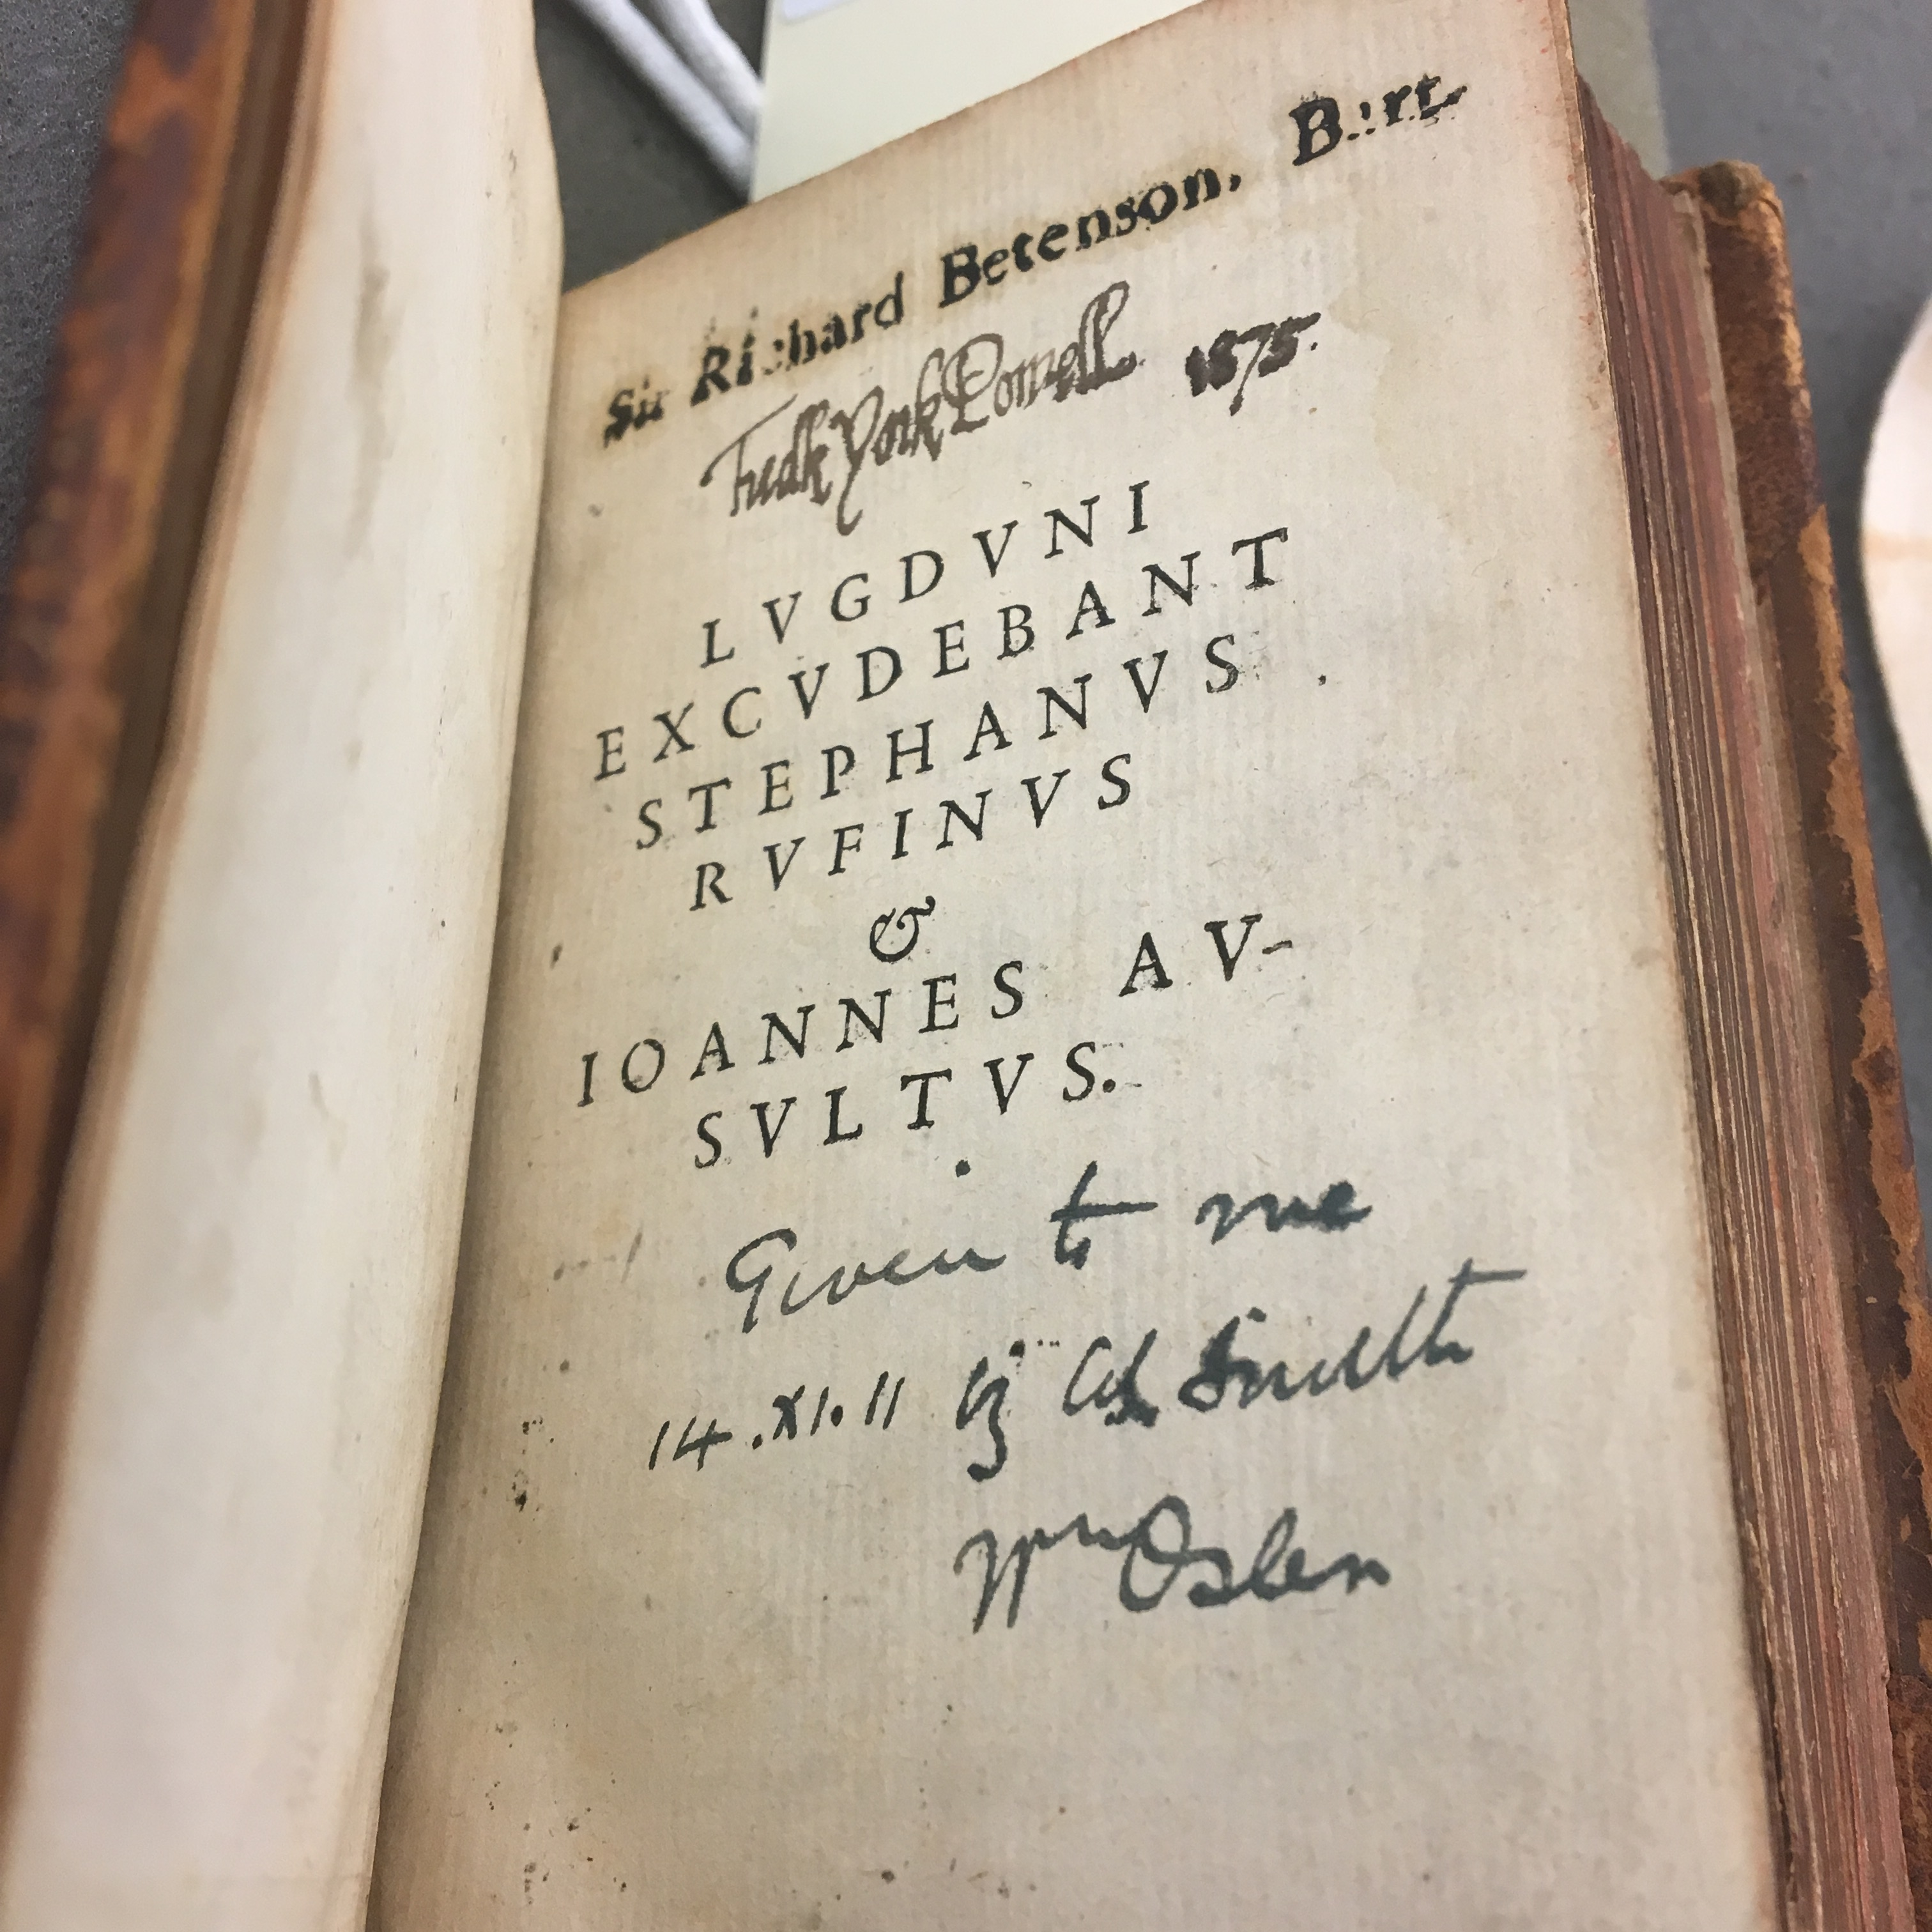
Simples from Bonardus (1490) to the Juntines (1550-)
The partial eclipse of Niccolò’s translation (books I-V never printed)
Ground-breaking translation: Theodoricus Gerardus Gaudanus 1530 (based on Aldine of 1525)
Reprints with corrections but no new translation
French: tr. Of books V and IX by Jean Canappe (for surgeons)
1530’s : a decade with intense debates around simples + theriac (see Champier in France)

Slide 22
Josephus Struthius (1510-1568), a Pole in Italy (Padua)
1535 Galeni de urinis (tr.) + Prognostica de decubitu infirmorum ex mathematica Scientia
(repr. 1550) – see copy from John Dee library
1537 Galeni antidotarius (tr.) = De antidotis

Slide 23
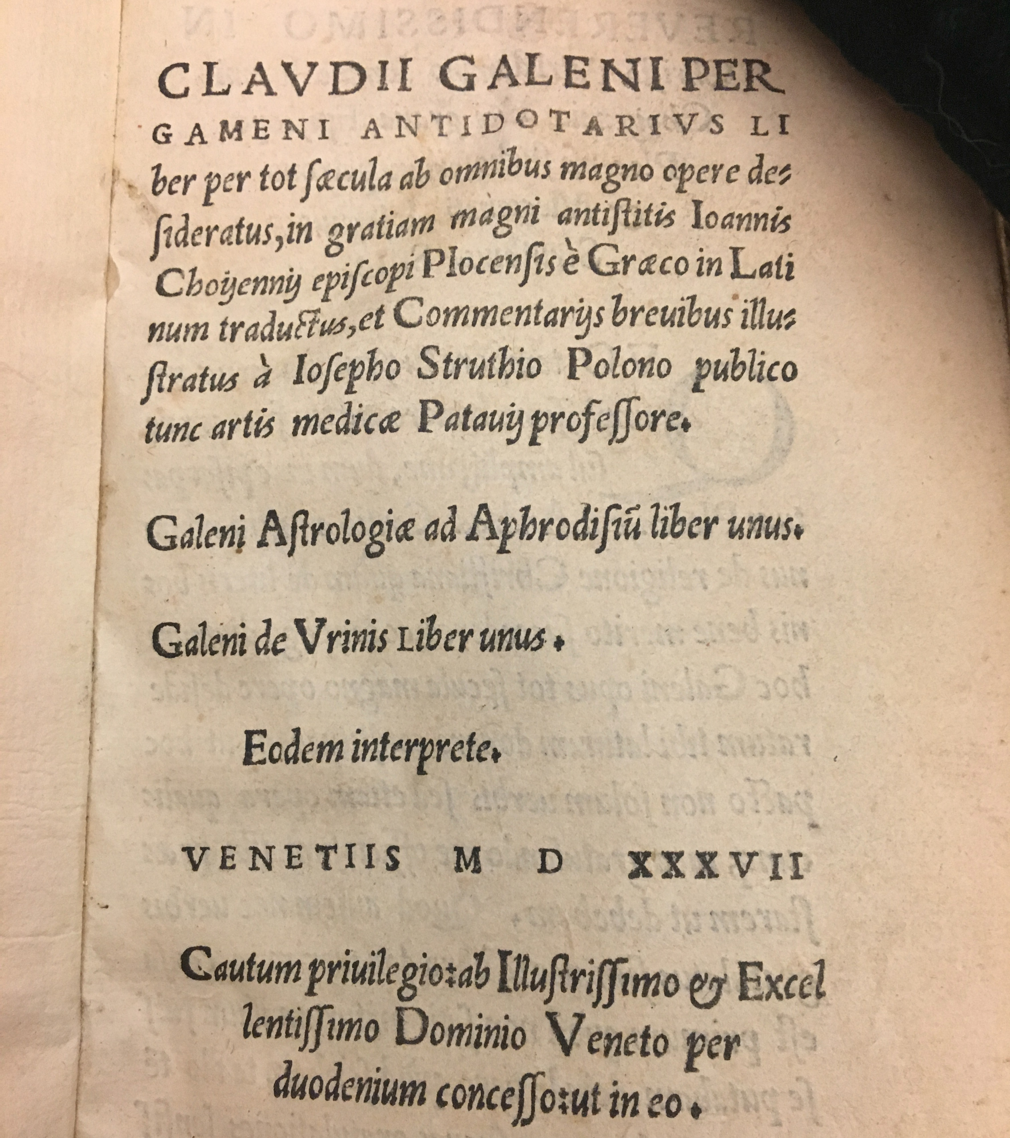
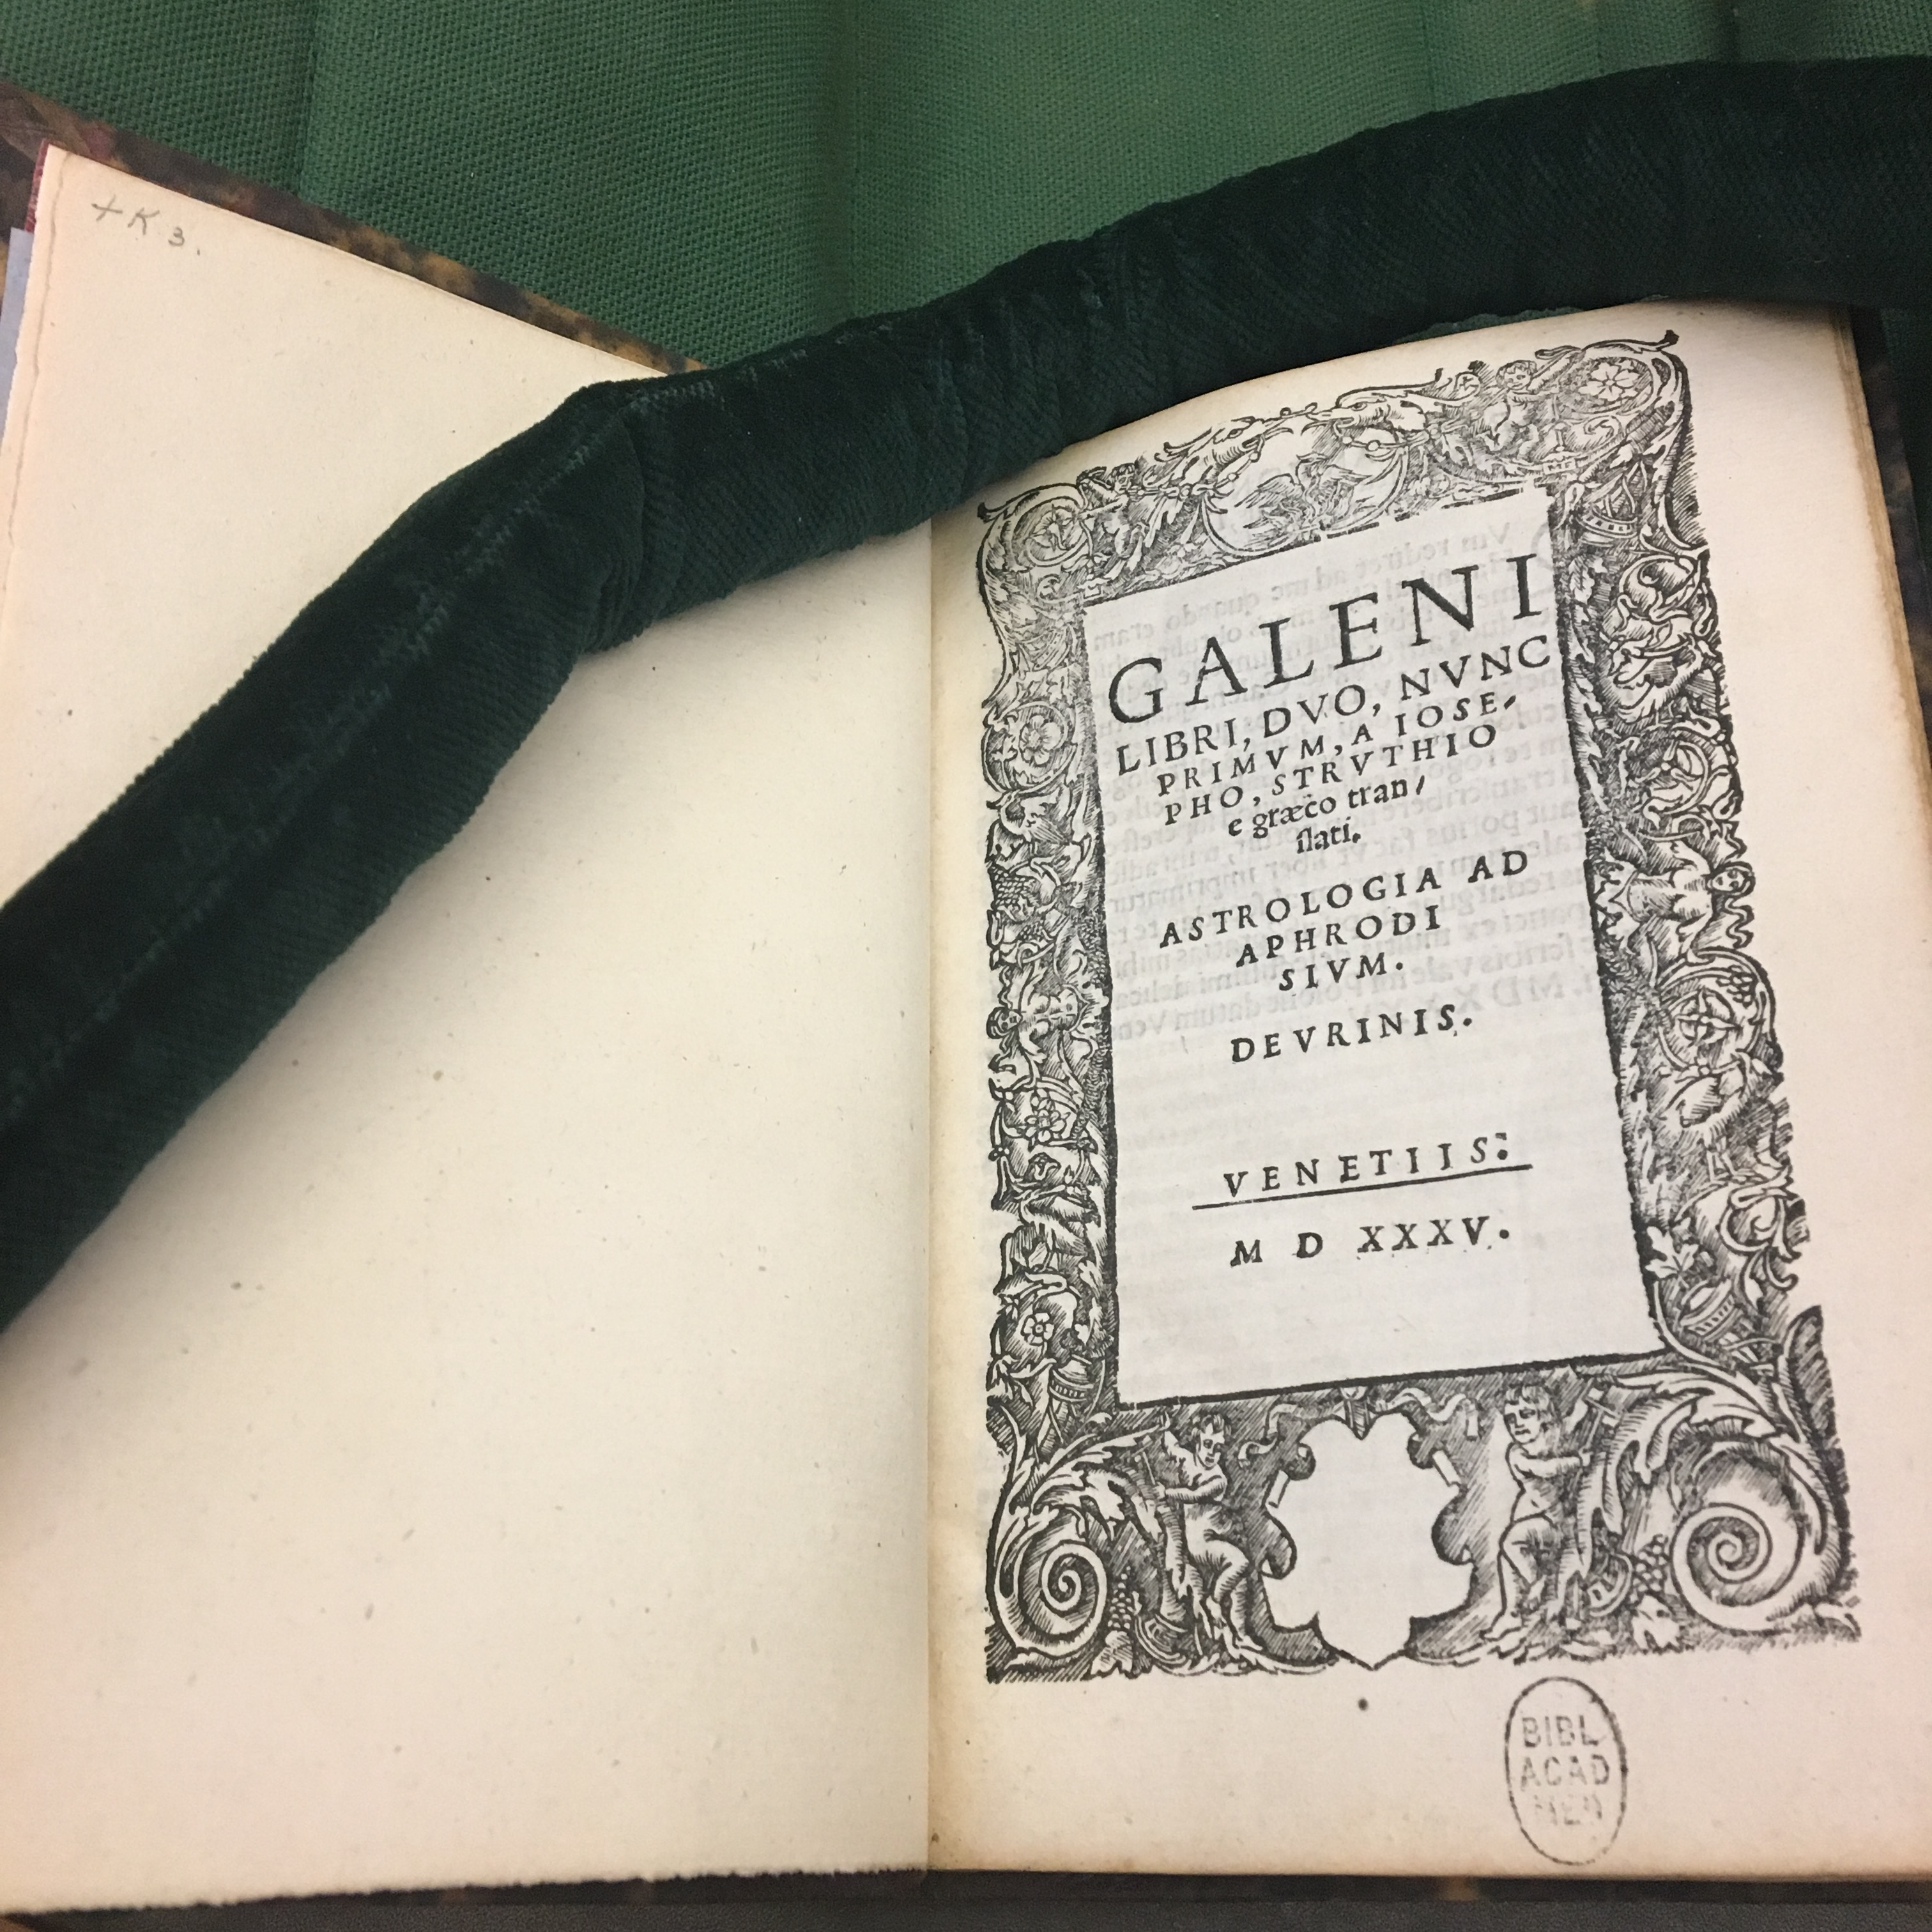
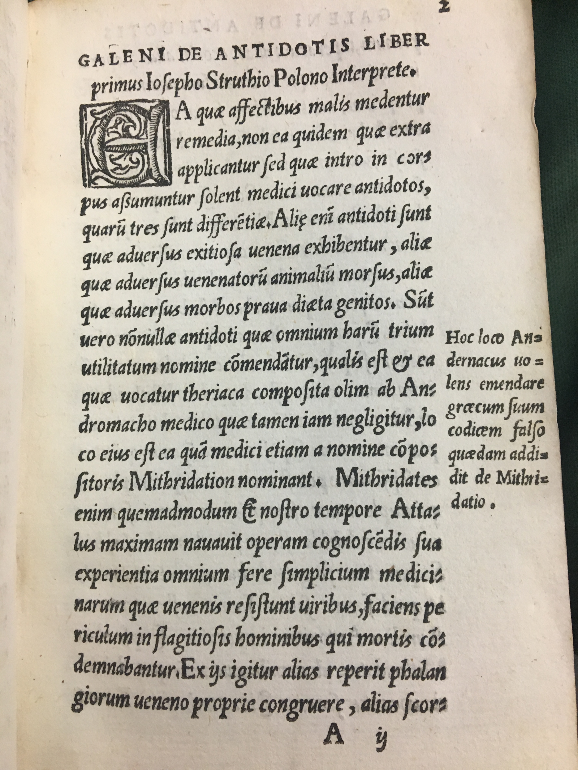
Struth translator of Galen (Antidotes)

Slide 24
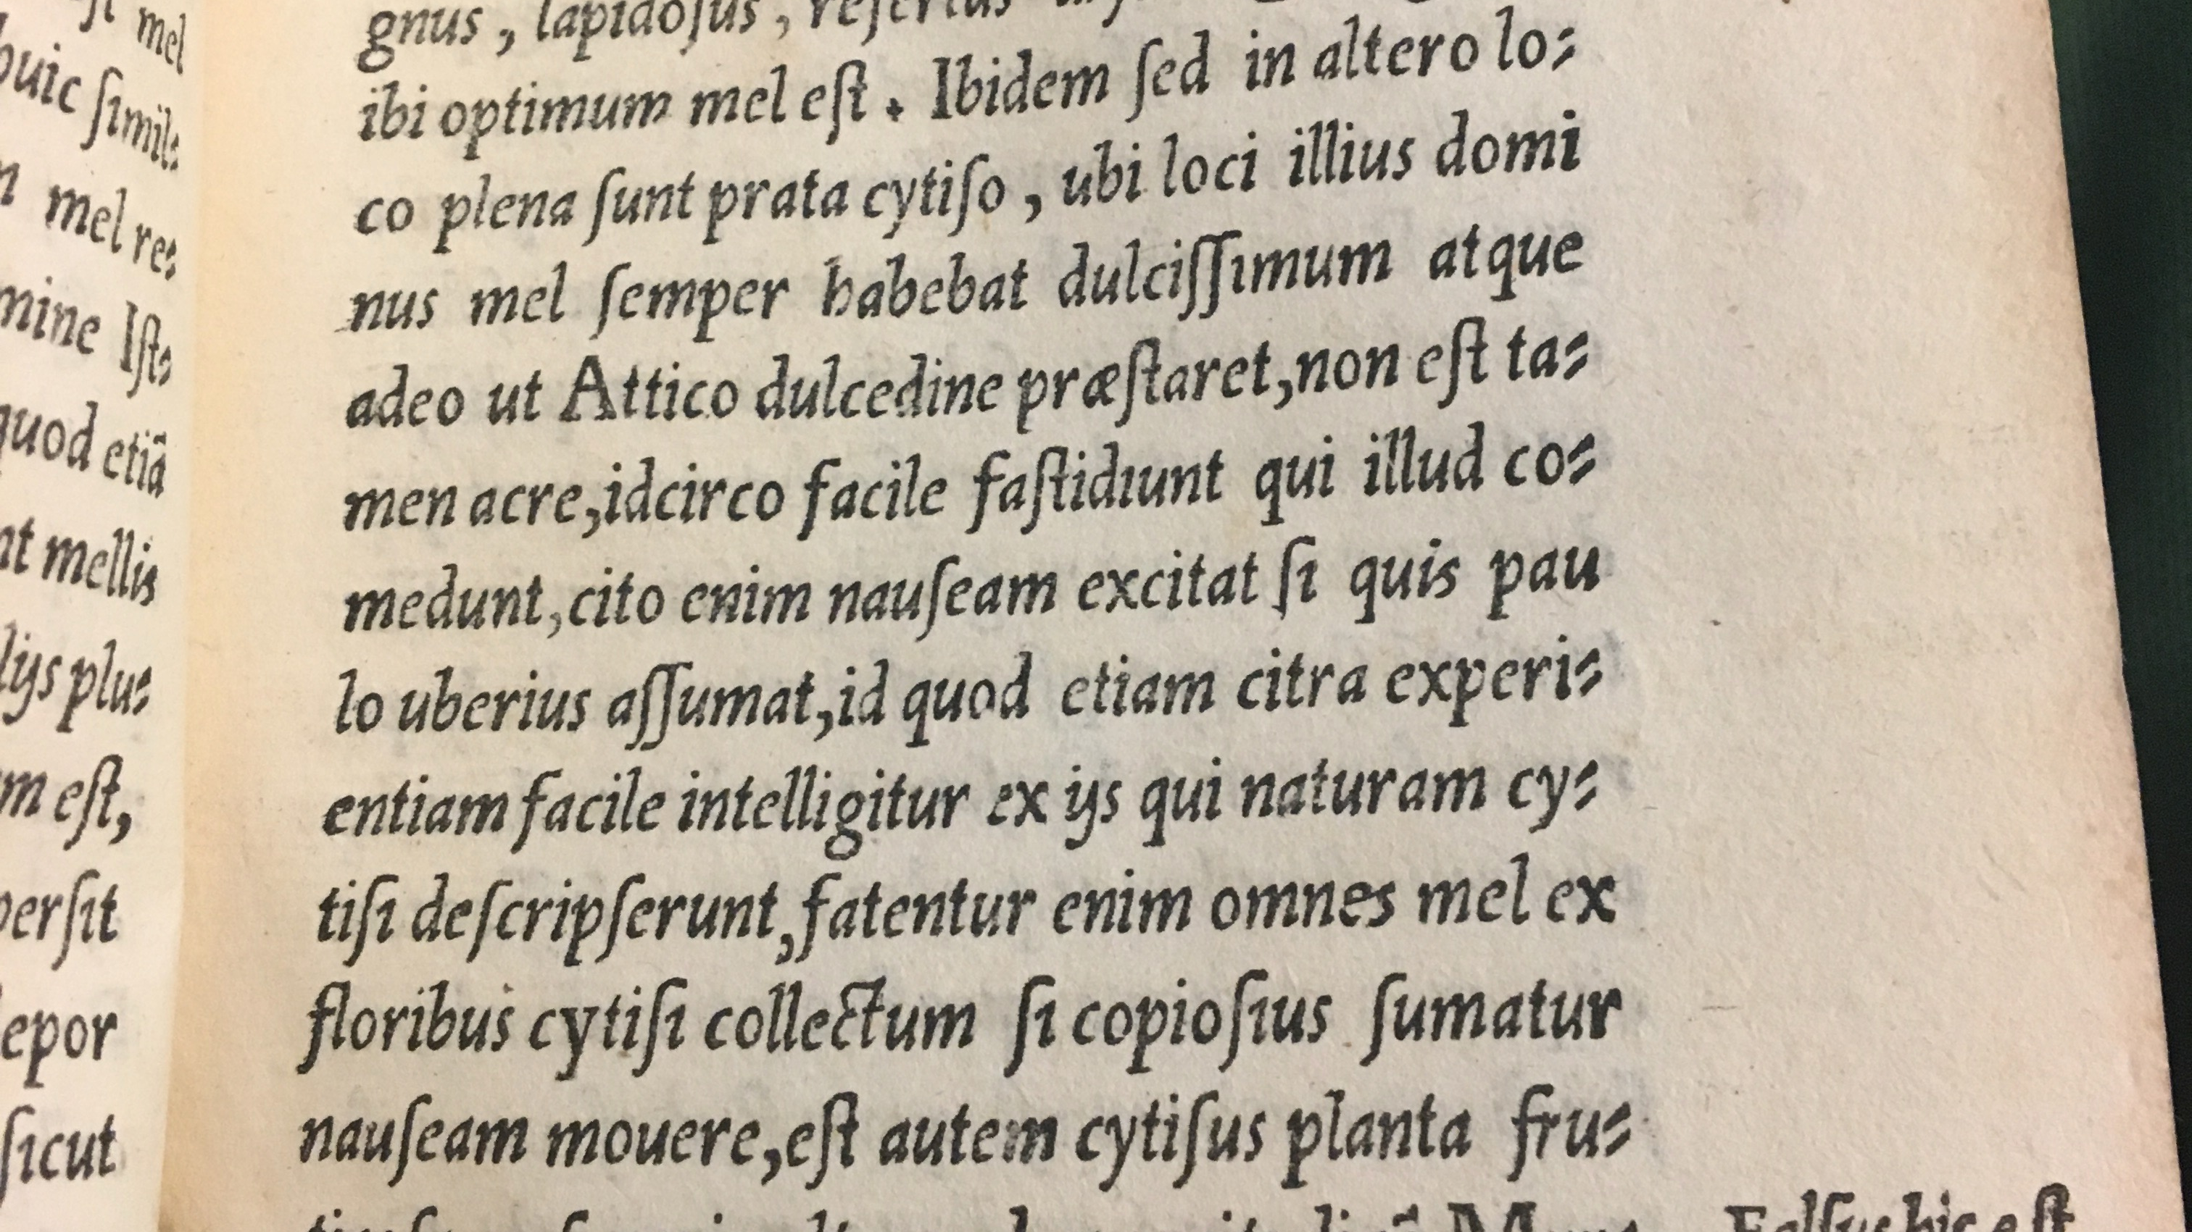
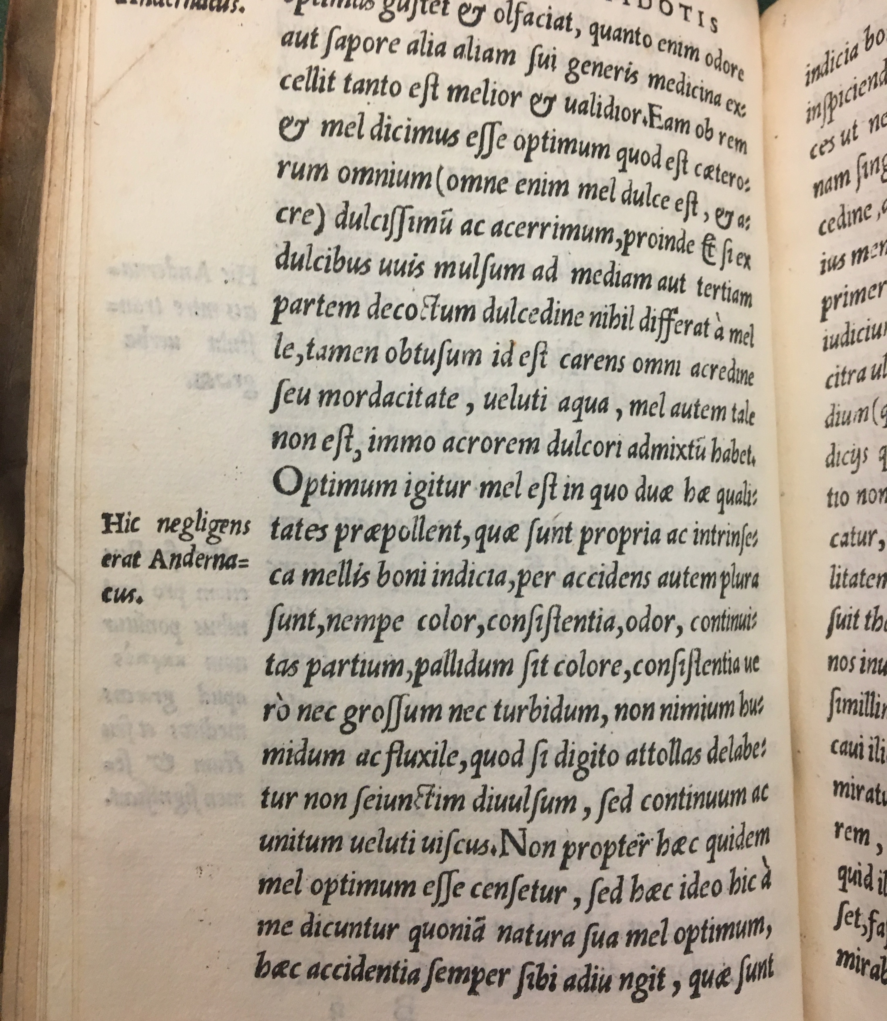
Criticising Andernacus
'hic negligens erat Andernacus’
His falsus est Andernacus’
‘vide num hic poteris intelligere Andernacum, ego certe non intelligo’
‘hic aliud dicit Galenus, aliud Andernacus’

Slide 25
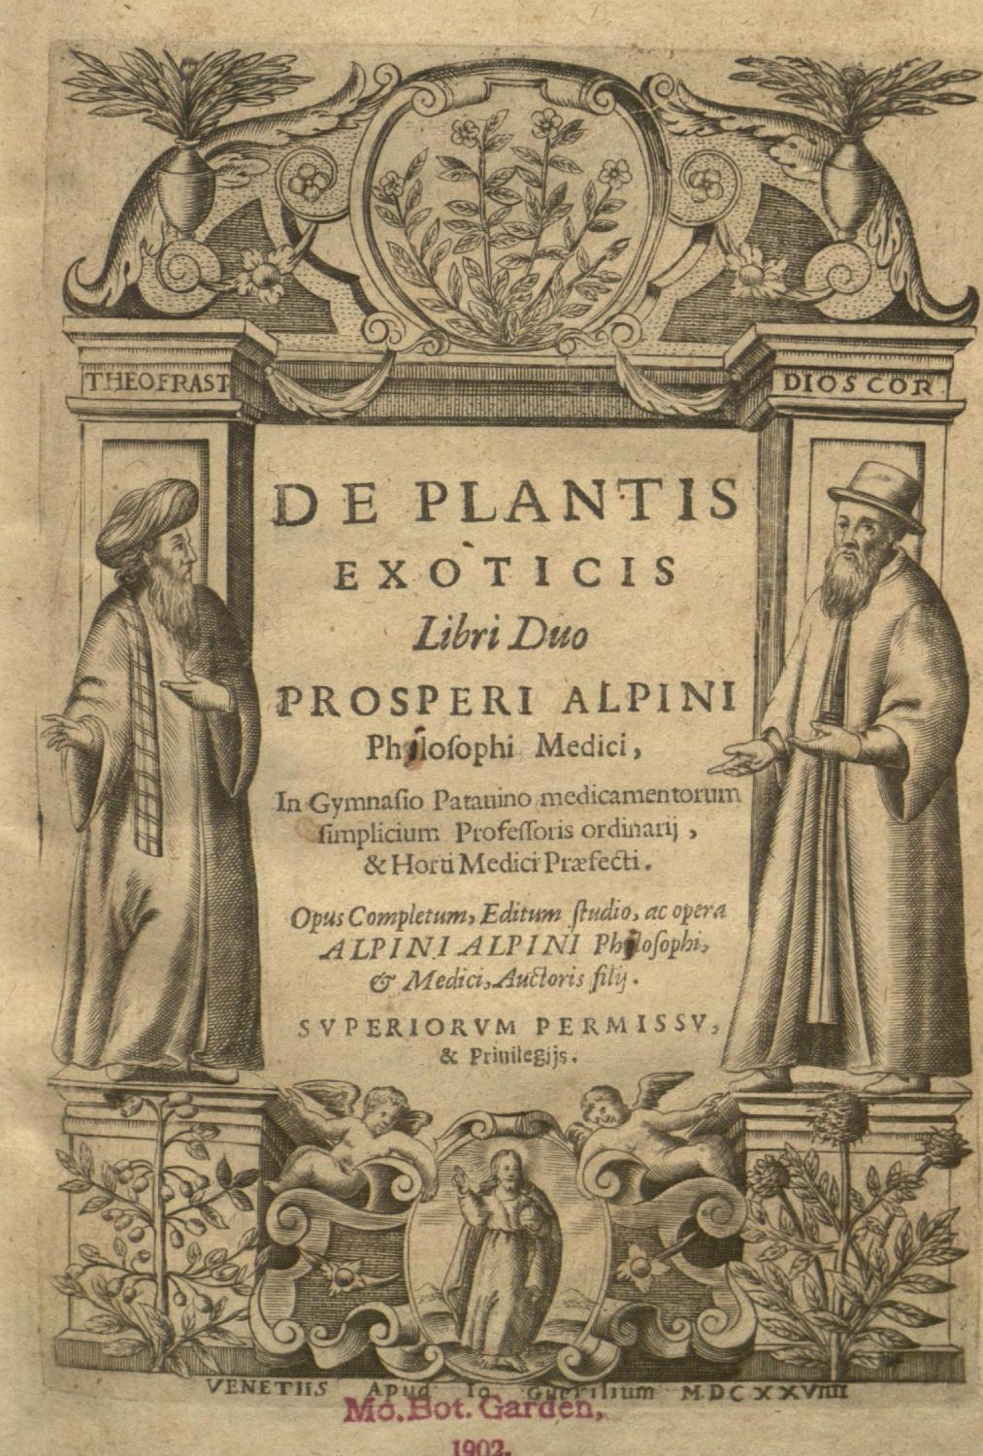
Readerships and contexts
General readers (educated)
Physicians looking to re-establish medicine on sound bases
Greek texts (and their new Latin translations) overtaking Arabic ones in learned circles (see Champier and friends)
Sciences develop new disciplinary boundaries and methods (botany)
New interest in direct observation:
  Of patients
  Of plants, herbs, minerals, animals…
  Of medical practices of others (Egypt: Prospero Alpini; the New World(s) of the Americas; India and the far East)

Slide 26
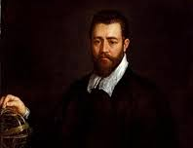
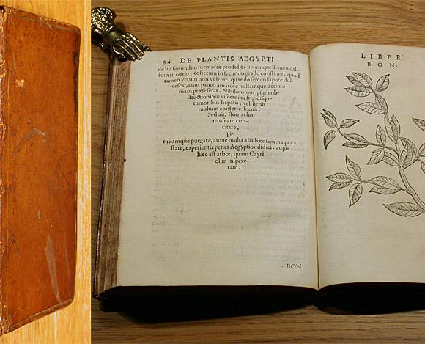
Medicine and plants of the Egyptians
Prospero Alpini (1553-1617)
Physician and professor at Padua (medicine, botany)
Travelled to Egypt and observed local medicine, herbs, remedies, animals…
Published first description of coffee plant
Director (prefect) of the first botanical garden in Europe, Padua (founded 1545)

Slide 27
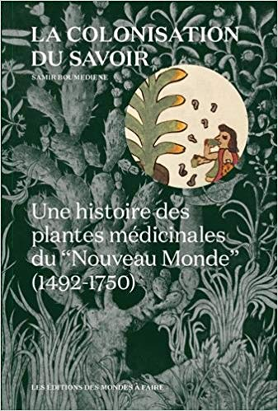
New World, new diseases, new remedies
Samir Boumediene, La colonisation du savoir. Une histoire des plantes médicinales du Nouveau Monde (1492-1750), 2016
Spanish conquest of parts of South America
Backdrop of explorations, military conquest, cultural appropriation, slavery, religious domination (Catholic church; Inquisition)
Angle of Boumediene’s book: colonization of knowledge
Discusses herbs, drugs, their usage (medicinal, ritual, culinary) and the ways they get adopted (or banned) by the colonisers
Role of classical medicine/knowledge: framework, language, power
Scholarship with similar approaches on India (Portuguese explorers/merchants, etc)

Slide 28
Take away points?
Role of print (history of the book)
Exploration/discoveries
‘Colonial’ ventures
Ancients and moderns: complex, evolving dynamics
Medicine & neighbouring fields: astrology, botany, philosophy…

