Slide 1


Beginners’ Latin
Session 3
Adjectives; Time, Place and Space; Questions and Commands
University of Warwick
Centre for the Study of the Renaissance, 2024

Slide 2
Adjective Basics: 1st and 2nd Declensions
1st Declension
2nd Declension
Masculine |  | Feminine |  | Neuter
Singular | Plural | Singular | Plural | Singular | Plural
bonus | boni | bona | bonae | bonum | bona
boni | bonorum | bonae | bonarum | boni | bonorum
bono | bonis | bonae | bonis | bono | bonis
bonum | bonos | bonam | bonas | bonum | bona
bono | bonis | bona | bonis | bono | bonis
Adjectives agree with the nouns in number, gender, and case. The endings, however, could well be different.
There are three declensions, with a majority of adjectives belonging to 1st/2nd declension
1st and 2nd declension adjectives have three distinct genders. Feminine adjectives require the 1st declension, masculine and neuter the 2^{nd.}

Slide 3
Let’s see how it works
Fertur in conviviis vinus, vina, vinum.
Masculinum displicet, placet faemininum,
Sed in neutro genere vinum est amoenum:
Loqui facit clericos optimum latinum.
Puella (pulcher, ra, rum) est. The girl is beautiful.
Puer (beatus, a, um) est. The boy is blessed.
Legenda (aureus, a, um). The Golden Legend.
Locus (sanctus, a, um). A sacred place.
Poeta (bonus, a, um) et (clarus, a, um) est. The poet is good and distinguished.
Insulae (magnus, a, um) et (plenus, a, um) sunt. Islands are big and plentiful.
Glossary
Fertur (3p. pres. passive) – is brought
Convivium (-i, m, 2) – feast, party
Vinum (-i, n, 2) – wine
Displicet (pres.) – displeases
Placet (pres) – pleases
Amoenus (-a, um, 1/2) – pleasant
Loqui (pres.inf., loquor) – to speak
Optimum – the best

Slide 4
Adjective Basics: 3rd Declension
Most third declension adjectives do not have separate masculine and feminine forms.
Those that do, only differ in their Nominative form.
Singular |  |  | Plural
Masc | Fem | Neut | Masc | Fem | Neut
celeber | celebris | celebre | celebres |  | celebria
celebris |  |  | celebrium |  | celebrium
celebri |  |  | celebrius |  | celebrius
celebrem |  | celebre | celebres |  | celebria
celebri | celebri |  | celebribus
Singular |  | Plural
Masc/Fem | Neut | Masc/Fem | Neut
omnis | omne | omnes | omnia
omnis |  | omnium
omni |  | omnibus
omnem | omne | omnes | omnia
omni |  | omnibus

Slide 5
3rd Declension Adjectives
Of tree terminations | Of two terminations | Of one termination
acer (-ris, re), bitter, sour celeber (-bris, bre), famous | brevis, breve, short crudelis, crudele, cruel, bloody fidelis, fidele, faithful gravis, grave, heavy, serious lamentabilis, lamentabile, deplorable omnis, omne, all perennis, perenne, perennial, eternal puerilis, puerile, boyish regalis, regale, royal similis, simile, like terribilis, terribile, terrible tristis, triste, sad, gloomy | audax (-acis), bold, daring discors (discordis), inharmonious felix (felicis), happy, fortunate ferox (ferocis), savage, wild infelix (infelicis), unhappy ingens (ingentis) huge, mighty innocens (innocentis) harmless multiplex (multiplicis) multiple recens (recentis) recent sapiens (sapientis) wise supplex (supplicis) suppliant vetus (veteris) old
Puer innocens; femina celebris; poeta vetus; vita brevis; insula ingens; urbs omnis.
An old man (vir, m); a wild beast (bestia, f); a happy marriage (coniugium, n)

Slide 6
Adjective Basics: Degrees of Comparison
Positive
Longus (a, um)
Pulcher (pulchra, um)
Similis (-e)
Comparative (more)
Long+ior (n. –ius)
Pulchr + ior (n. -ius)
Simil + ior (n. –ius)
+3rd declension endings
Superlative (the most)
Long+issimus (a, um)
Pulcher+rimus (a, um)
Simil+limus (a, um)
+1st/2nd declension endings
Vir gratus (a pleasant man); femina honesta (an honest woman); scriptura nova (a new writing); sapientia rara (a rare wisdom); puer pulcher (a handsome boy)

Slide 7
Adjective Basics: Degrees of Comparison
Latin can use quam (than) to compare two words. If quam is used, the words compared are in the same case:
Puellae diligentiores quam pueri sunt. The girls are more diligent than boys.
If the word to be compared is in the nominative or accusative, quam may be omitted and the second word put in the ablative:
Puellae diligentiores pueris (Abl.) sunt.
Adjectives of the 1st and 2nd declension ending in -eus or -ius form the comparative with magis and the superlative with maxime:
idoneus, -a, -um (suitable) magis idoneus, -a, -um maxime idoneus, -a, -um
Marcus (gratus) quam Gaius est; Tulia (honesta) quam vicina sua est; scriptura tua (idonea) quam sua est.

Slide 8
Adjective Basics: Irregular Adjectives
bonus, -a, -um (good) | melior, melius | optimus, -a, -um
malus, -a, -um (bad) | peior, peius | pessimus, -a, -um
māgnus, -a, -um (big) | maior, maius | maximus, -a, -um
parvus, -a, -um (small) | minor, minus | minimus, -a, -um
multī, -ae, -a (multiple) | plūrēs, plura | plūrimī, -ae, -a
-------- | exterior, exterius | extrēmus, -a, -um
-------- | inferior, inferius | infimus, -a, -um (imus)
-------- | interior, interius | intimus, -a, -um
-------- | prior, prius (previous, earlier) | prīmus, -a, -um
-------- | proprior, propius (close, personal) | proximus, -a, -um
-------- | superior, superius (superior) | summus, -a, -um
-------- | ulterior, ulterius (following, later) | ultimus, -a, -um
multus, -a, -um (plentiful, multiple) | -------- | plūrimus, -a, -um
senex, senis (old) | senior | --------
The smallest boy (puer); This book (iste liber) is worse than (quam) that one (ille); older brother (frater); first day (dies).

Slide 9
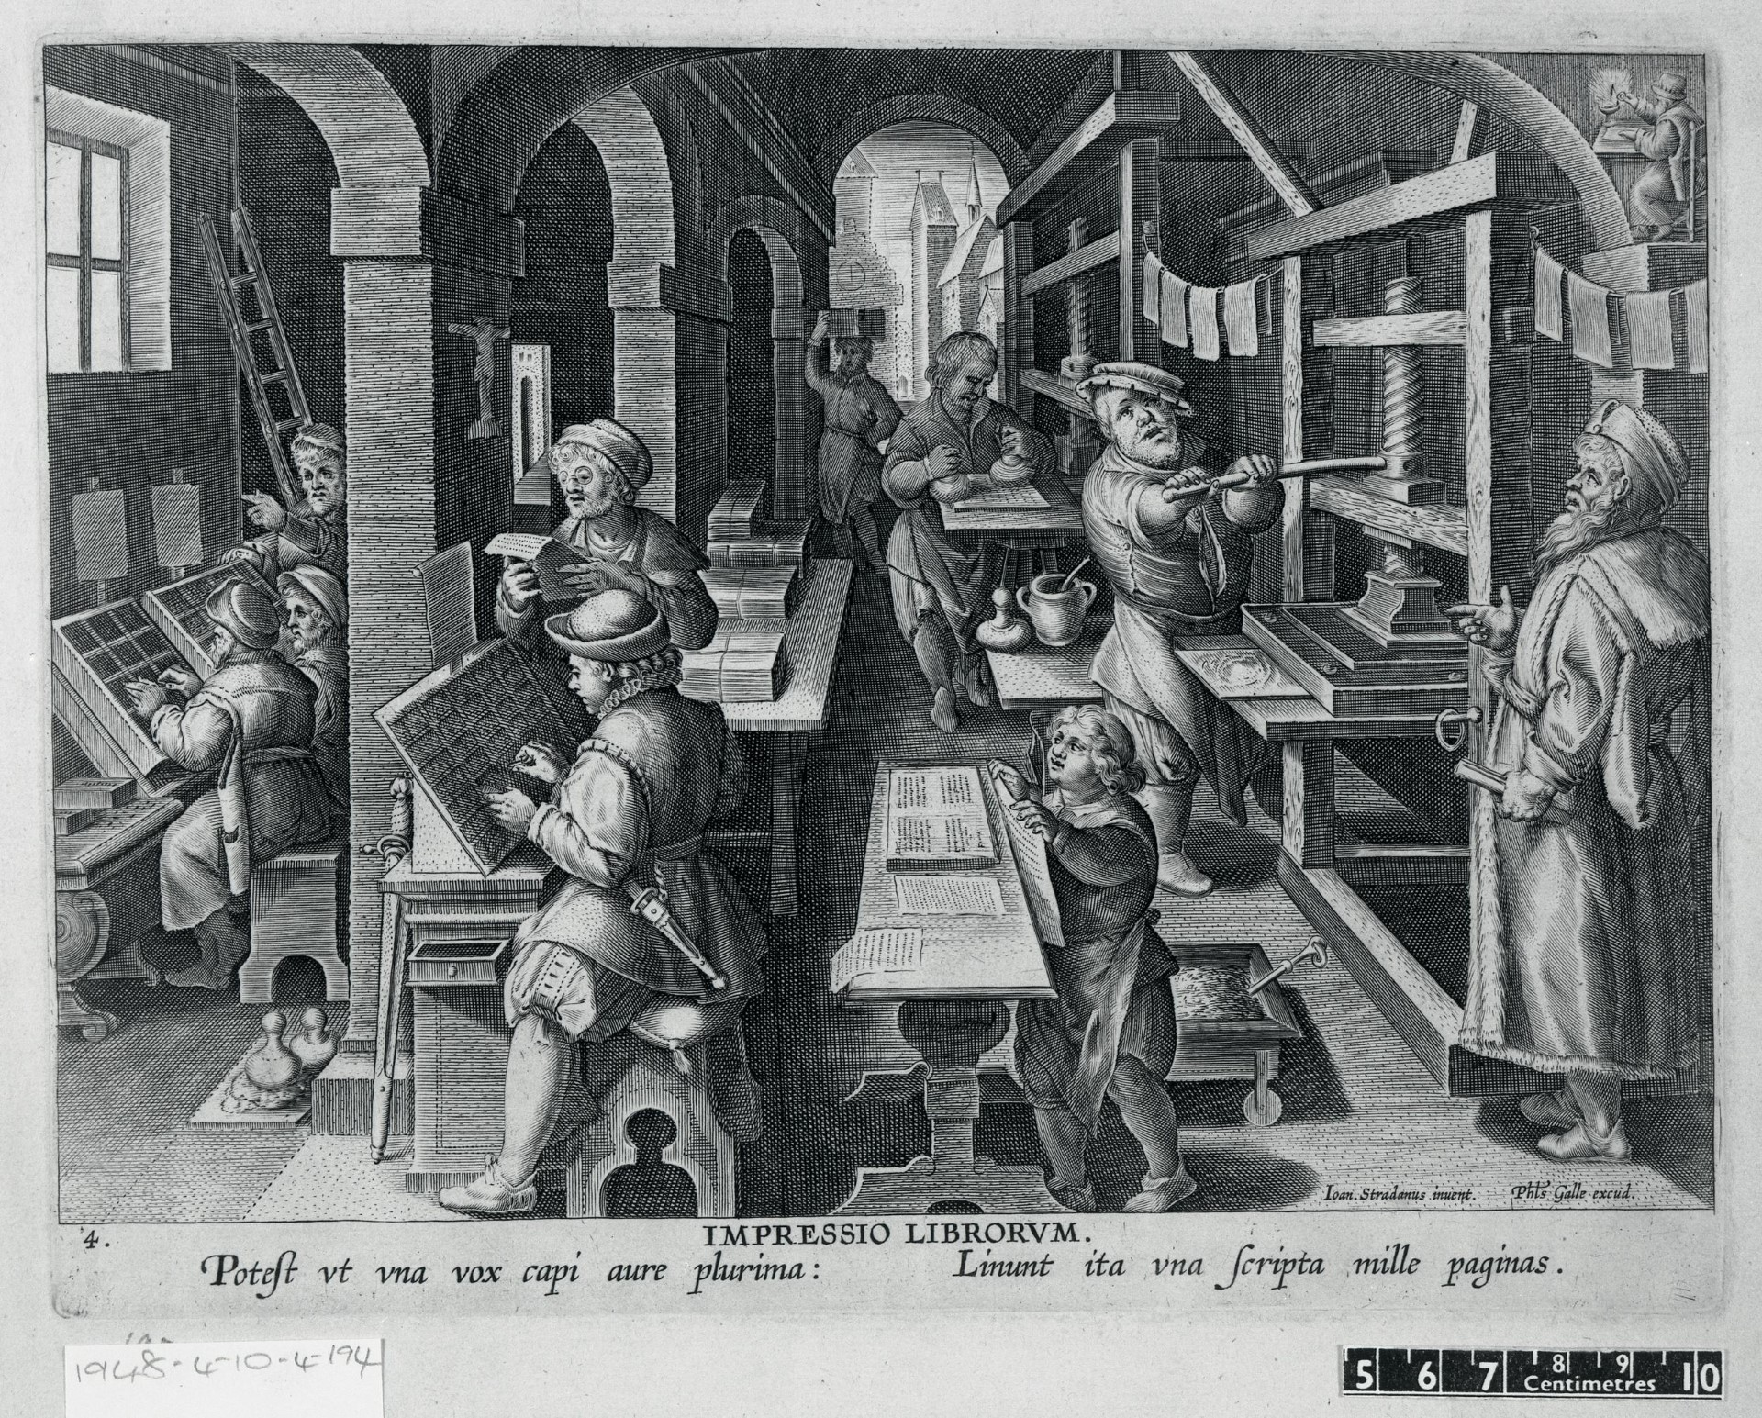
A quick training
Potest ut una vox capi aure plurima: Linunt ita una scripta mille paginas
Glossary:
Potest (3rd person singular) – can
Ut – thus, as
Vox (-cis, f, 3) – voice
Capi (pres. Pass. Inf.) – to be caught, to be held
Auris (-ris, f, 3) – ear
Plurimi (sup. from multi) – the most, the largest number
Linunt (3rd person plur) – line, daub, cover
Scripta (-ae, f, 1) – writing, text
Mille (num.) – thousand
Pagina (-ae, f, 1) – page

Slide 10
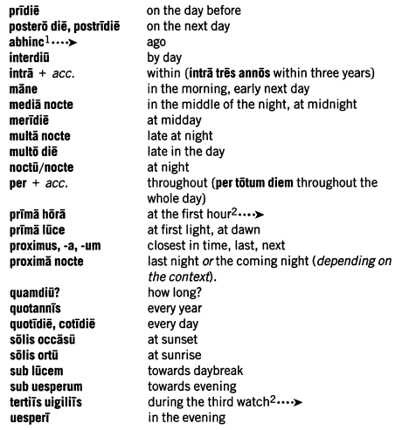
Expressions of Time
In Latin the accusative expresses 'how long’:
Totam noctem dormivi. I slept the whole night.
Puella quinque annos nata, a girl five years old (lit. a girl born for five years)
The ablative expresses 'time when’:
Domum tuam secunda hora ueniam. I shall come to your house at the second hour.
The ablative also expresses 'time within which’:
Tribus diebus Romam reueniam. I shall return to Rome within three days.

Slide 11
Expressions of Place and Space
In Latin the 'place to which' is expressed by in or ad with the accusative:
ad oppidum. to the town
Note that “ad Graeciam navigavi” means I sailed to Greece in the sense of towards Greece, while “in Graeciam ii” means I went to Greece and actually set foot there.
The 'place from which' is expressed by a, ab, e or ex with the ablative:
ex oppido. from the town
The 'place where' is expressed by in with the ablative:
in Britannia. in Britain
However, if the place is a town, city, or small island (Rhodes is the largest small island), the place name is usually put into the appropriate case without the preposition. The same applies to three common nouns, domus, domi, f. (house, home), rus, ruris, n. (country, countryside), and humus, humi, f. (ground).
Athenas nauigauerunt. They sailed to Athens.

Slide 12
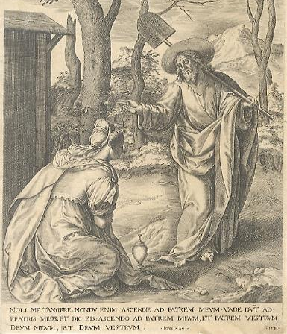
Grammar: Direct Commands
Direct commands are expressed by imperative:
Ama me fideliter. Love me faithfully
Negative direct commands are expressed by noli (singular) and nolite (plural) (= refuse to, be unwilling to) followed by the present infinitive, or ne + present or perfect subjunctive can be used:
Nolite speluncas intrare. Don't go into the caves.
Ne feceris quod times. Don't do something you're frightened of.
Commands in the first and third person are expressed by the present subjunctive.
Amet. Let him love.
Gaudeamus. Let us rejoice.
Noli me tangere

Slide 13
Grammar: Indirect Commands
Commands expressed through commanding/forbidding words are followed by ut or ne + the present or imperfect subjunctive
Tibi impero ut hoc facias. I tell you to (literally, that you should) do this.
Imperator suis imperauit ne progrederentur. The general ordered his men not to (literally, that they should not) advance.
The two exceptions are iubeo (iubere, iussi, iussum) = I order, and its converse veto (vetare, vetui, vetitum) = I forbid. Both are followed by an accusative and infinitive. Iubeo cannot be followed by non.
Me iussit hoc facere. He ordered me to do this.
Me vetuit abire. He told me not (forbade me) to go away.

Slide 14
Grammar: Questions
Direct Question
The exact words of the speaker
Quid est? What is it?
Indirect Question
The substance of the question, quoted in a sentence(depends on a verb or other expression of asking, doubting, knowing)
Rogāvit quid esset. He asked what it was.
Questions in Latin are introduced by special interrogative words.

Slide 15
Yes or No Questions
Are formed by adding –ne to the emphatic word (sometimes can be omitted)
Tūne id veritus es? Did you fear that?
Is tibi mortemne vidētur aut dolōrem timēre? Does he seem to you to fear death or pain?
When -ne is added to a negative word, as in nōnne, an affirmative answer is expected. The particle num suggests a negative answer.
Nōnne animadvertis? Do you not observe?
When -ne often when added to the verb, it sometimes has the force of nōnne:
Meministīne mē in senātū dīcere? Don't you remember me speaking in the Senate?

Slide 16
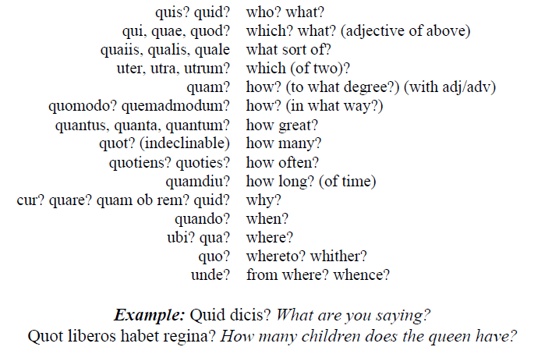
Special and Alternative questions
In Double or Alternative Questions, utrum or -ne, whether, stands in the first part of the sentence and an, anne (or) or annōn, necne (or not) in the second.
Utrum nescīs, an prō nihilō id putās? Is it that you don't know, or do you think nothing of it?
Utrum is often omitted in the first part, and an or -ne (anne, necne) may stand in the second:
Sunt haec tua verba necne? Are these your words or not?
If the second member is omitted or implied, and utrum may ask a question to which there is no alternative:
Utrum est in clārissimīs cīvibus is? Can it be that is he among the noblest citizens?
Special questions are asked with the help of these words

Slide 17
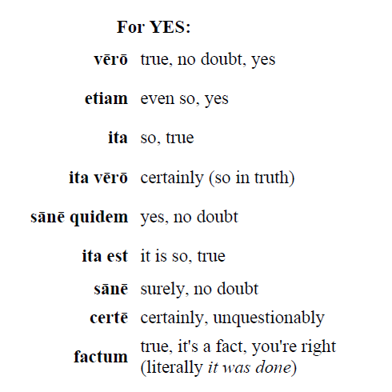
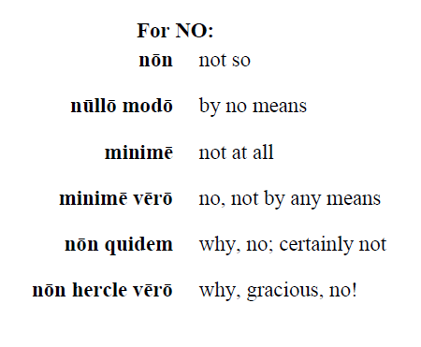
Answering a question
In answering a question affirmatively, the verb or some other emphatic word is generally repeated. In answering negatively, it is repeated with nōn or a similar negative:
— Valetne? Is he well?
— Valet. Yes (he is well).
— Eratne tēcum? Was he with you?
— Nōn erat. No (he was not).
In answering a double question, one member of the alternative, or some part of it, must be repeated:
— Vīdistī an dē audītō nūntiās? Did you see it or are you repeating what you’ve heard?
— Egomet vīdī. I saw it myself.

Slide 18
Reading: Cicero, In Catilinam
Quo usque tandem abutere, Catilina, patientia nostra? quam diu etiam furor iste tuus nos eludet? quem ad finem sese effrenata iactabit audacia? Nihilne te nocturnum praesidium Palati, nihil urbis vigiliae, nihil timor populi, nihil concursus bonorum omnium, nihil hic munitissimus habendi senatus locus, nihil horum ora voltusque moverunt? Patere tua consilia non sentis, constrictam iam horum omnium scientia teneri coniurationem tuam non vides? Quid proxima, quid superiore nocte egeris, ubi fueris, quos convocaveris, quid consilii ceperis, quem nostrum ignorare arbitraris?
How far will you (continue to) abuse our patience, Catiline? For how much longer will that rage of yours make a mockery of us? To what point will your unbridled audacity show itself? Did the nocturnal garrison on the Palatine, the watch patrols of the city, the fear of the people, the assemblies of all the good men, this most fortified place of holding the senate, the faces and expressions of all these people [the senators] not move you at all? Do you not realise that your plans lie revealed? Do you not see that your plot is already held in check by the knowledge of all these people? Do you think that any of us do not know what you did last night, what you did the night before, where you were, who you summoned, and what plans you made?

