Slide 1


Beginners’ Latin
Session 4
Nominative and Accusative Constructions. Clauses.
University of Warwick
Centre for the Study of the Renaissance, 2024

Slide 2
Double Nominative
Is formed by the Nominative of the Subject and Nominative of the Complement.
With verbs of being/becoming, such as esse, to be:
Vesta dea est. Vesta is a goddess.
With verbs of state/mode of existence, such as:
  manêre, to remain
  vivere, to live
Is vixi beatus. He lived happy.
With the passive forms of verbs as:
  fieri to be made, become
  appellâre to name, call
  creâre to appoint
  eligere to choose
  existimâre to value, judge
  habêre to consider, think
  putâre to think, suppose
Translate:
The girl (puella) is good (bonus, -a, um).
The temple (templum) is huge (ingens).
I remain (maneo) happy (felix).
She lives (vivit) alone (solus, -a, -um).
Scipio is called (apellatur) Africanus.
Gaius Valerius is elected (elegitur) consul.
Bernardus is appointed (creatur) abbot (abbas)
Old people (senes) are considered (habentur) wise (sapienti).
The poet is thought (putatur) to be better (melior) than (quam) Catullus.

Slide 3
Nominative and Infinitive
Nominative is used after the infinitives of the aforementioned verbs in constructions, including:
Possum+inf, can
Volo+inf, want
Nolo+inf, don’t want
Malo+inf, prefer
Videor+inf, seem
Translate:
I can be (essere) a good (bonus, -a, um) poet.
Marcus wants (vult) to become abbot (abbas)
I prefer to remain (manere) alone (solus, -a, -um).
She doesn’t seem (videtur) to live (vivere) happy (felix).

Slide 4
Double Accusative
Direct object + Predicate Accusative with verbs of making, choosing, calling and showing:
Appellavitque Deus lucem Diem. And the God called light Day.
Mē hērēdem fēcit. He made me heir.
Verbs of requesting and demanding, such as ōrō, poscō, reposcō, exposcō, flāgitō and such.
  Ōtium dīvōs rogat. He asks the gods for rest.
Verbs of teaching (doceō and its compounds).
  Tē litterās doceō. I teach you your letters.
Verbs of inquiring.
  Tē haec rogo. I ask you this.
Several special verbs: moneō, admoneō, commoneō, cōgō, accūsō, arguō, and a few others:
  hōc tē moneō, I give you this advice;
  mē id accūsās, you bring this accusation against me;
  id cōgit nōs nātūra, nature compels us (to) this.
Verb of concealing, cēlō
  nōn tē cēlāvī sermōnem, I have not concealed the conversation from you.

Slide 5
Double Accusative
In the Passive construction the Accusative of the Person becomes the Subject, and the Accusative of the Thing is retained:
Omnēs artēs ēdoctus est, he was taught all accomplishments;
Rogātus sum sententiam, I was asked my opinion
Transitive compounds of trāns may take two Accusatives, one dependent upon the Verb, the other upon the preposition:
mīlitēs flūmen trānsportat, he leads his soldiers across the river.
1st Declension (-a)
silva | silvae
silvae | silvārum
silvae | silvīs
silvam | silvās
silvā | silvīs
Translate:
I teach (doceo) you (vos) Latin (lingua Latina).
I ask (posco) for your daughter’s (filia tua) hand (mihi uxorem).
Julius called (appellavit) his daughter (filia sua) Julia.

Slide 6
Accusative and Infinitive
A type of indirect clause that is very similar to double accusative, introduced by the verbs of perception like audio (hear), video (see), dico (say), puto (think), credo (believe), scio (know):
Credo Johannem dedisse Matheo terram.
I believe that John has given the land to Matthew. (Literally – I believe John to have given to Matthew the land.)
Solo Croesum felīcem esse non putat.
Solon doesn’t consider Croesus happy.
You will often be able to spot an accusative and infinitive clause coming up from the type of verb which precedes it.
Translate:
I see the girls (puellas) talking (loquier).
Gaius is happy (gaudet) to see you (te) being (esse) well (salvum).
Tullia says that Julia (Juliam) is a good (bonus, -a, um) friend (Acc. - amicam).
It is said (dicitur) that he is stupid (stultum).
Cicero called (dixit) Catilina the enemy (hostem) of the fatherland (patriae).
We know (scimus) that the teacher (magistrum) praises (laudare) a good student (discipulum).

Slide 7
Translation time!
Dicitur Nasīca aliquando Ennium poētam visitavisse. Cui ancilla dixit domĭnum domi non esse et sero domum ventūrum esse. Sed Nasīca ei non credĭdit, nam sensit Ennium domi esse. Postridie poēta Nasīcam visitātum vēnit et ostiarium rogāvit: «Est-ne domi domĭnus tuus?» Tum Nasīca, qui domi erat, clamāvit se domi non esse. Tum Ennius: «Credis me vocem tuam non cognoscĕre?» At Nasīca: «Ego ancillae tuae credĭdi, et tu mihi ipsi non credis me domi non esse?»
Glossary:
Aliquando – once, one time
Visitavisse – perf.inf. of visito
Ancilla (ae, f, 1) – female servant
Dominus (i, m, 2) – lord, master
Domus (i, f, 4) – home
Sero (adj) – late, at late hour
Creo – believe
Sentio – feel, sense
Postridie – the next day
Ostiarius (-i, m, 2) – doorman
Rogo – ask
Clamo – claim
Cognosco – know, recognise

Slide 8
Clauses: Relative
Clauses that are attributed to the noun with the help of the word qui (quae, quod). It agrees in gender and number with its antecedent, but its case depends on its function in the clause which it introduces:
Epistulam accepi quam (acc.) tu mihi miseras. I received the letter which you had sent me.
Ille qui (N.) tibi epistulam misit non te prodet. The man who sent you the letter will not betray you.
Ille est amicus cui (Dat.) epistulam misi. He is the friend to whom I sent the letter.
 | Singular |  |  | Plural
 | Masculine | Feminine | Neuter | Masculine | Feminine | Neuter
Nom | quī | quae | quod | quī | quae
Gen | cuius |  |  | quōrum | quārum | quōrum
Dat | cui |  |  | quibus/quīs
Acc | quem | quam | quod | quōs | quās | quae
Abl | quō | quā | quō | quibus/quīs

Slide 9
Clauses: Purpose
To express purpose Latin uses ut (= in order that) or, in the negative, ne (=to prevent) followed by the present or imperfect subjunctive depending on the sequence of tenses:
Romam accedo ut prlncipem uideam. I am going to Rome so that I may see the emperor, to see the emperor.
Roma excessit ne Antonium uideret. He left Rome in order not to see Antony.
Neu or neue (and not) introduces a second purpose clause if it is negative.
Roma excessit ne Antonium uideret neu contionem audiret. He left Rome in order to avoid seeing Antony and hearing his speech (lit., and so as not to hear).
When the purpose clause contains a comparative adjective or adverb, quo is used instead of ut.
Cucurri quo celerius eo aduenirem. I ran so as to get there faster.
The relative pronoun qui (quae, quod) is used with the subjunctive to express purpose.
legatos misit qui pacem peterent. He sent ambassadors to seek peace (literally, who might seek).
Romani arma rapiunt quibus urbem suam defendant. The Romans seize their arms in order to defend their city (lit., with which they may defend).

Slide 10
Clauses: Result
Ut (= so that, so as to) or ut non (so that...not) + the subjunctive
Tot vulnera accepit ut moriatur. He received so many wounds that he is (now) dying.
Tam clare Marcum de illls rebus certiorem fecit ut omnia intellegeret neque iam esset ignarus. So clearly did he inform Marcus about these things that he understood everything and was no longer in ignorance.
The relative with the subjunctive can be used to express result:
Non tam stulta est Livia quae mendacibus credat. Livia is not so stupid as to trust liars. (Her stupidity is not so great that it leads to the result of her trusting liars)
Quam qui (or quam ut) is used after a comparative:
Fortior est quam qui effugiat. He is too brave to run away (literally, He is braver than the sort of man who runs away/He is too brave for the result to be that he runs away).
Dignus/indignus sum qui (quae, quod) + subjunctive = I am worthy/ unworthy to:
Digna est quae morte puniatur. She deserves to be punished by death. Literally, She is worthy so that (as a result) she should be punished by death

Slide 11
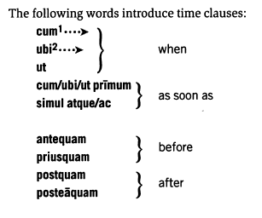
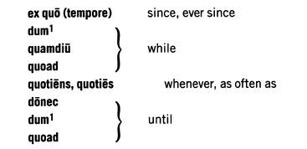
Clauses: Time
Latin uses the indicative in the vast majority of time clauses and the subjunctive in time clauses where the outcome is perceived as less real:
Priusquam Caesar pervenit, obsides poposcit. Before Caesar arrived, he demanded hostages
Collem celeriter priusquam ab hostibus conspiceretur (subj.) commonivit.
He quickly fortified the hill before he could be noticed by the enemy.

Slide 12
Clauses: Time
The words antequam, postquam, and posteaquam are often split in two, the first bit going in the main clause.
Ante ad urbem celeriter redii quam tu Capuam advenisti. I returned quickly to the city before you came to Capua.
If there is any idea of purpose, expectation or waiting for something to happen, the verb in the time clause goes into the subjunctive:
Mus celeriter effugit priusquam feles saliret (subj.). The mouse hurried off before the cat could leap.

Slide 13
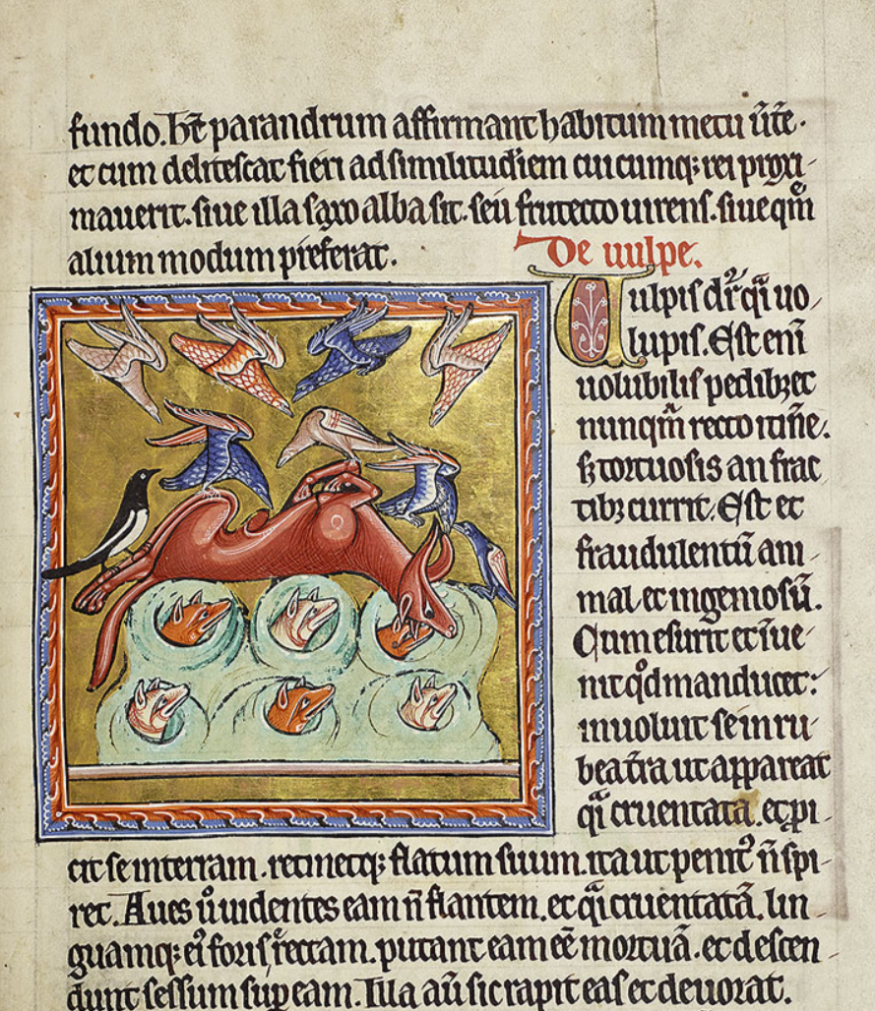
Reading
De vulpe. Est fraudulentum animal et ingeniosum. Cum esurit et [non] invenit quod manducet, involuit se in rubea terra ut appareat quasi cruentata, et proicit se in terram, retinetque flatum suum, ita ut penitus non spiret. Aves vero videntes eam non flantem, et quasi cruentatam, linguamque eius foris erectam, putant eam esse mortuam, et descendunt sessum super eam. Illa autem sic rapit eas et devorat. Istius eiusdemque figuram diabolus possidet. Omnibus enim viventibus secundum carnem vixeritis esse mortuum quoadusque inter guttur suum habeat et puniat. Spiritualibus tamen viris in fide vere mortuus est, et ad nichilum redactus. Qui autem voluit exercere opera eius, moriuntur.
On the fox. It is a clever, crafty animal. When it is hungry and can find nothing to eat, it rolls itself in red earth so that it seems to be stained with blood, lies on the ground and holds it breath, so that it seems scarcely alive. When birds see that it is not breathing, that it is flecked with blood and that its tongue is sticking out of its mouth, they think that it is dead and descend to perch on it. Thus it seizes them and devours them. The Devil is of a similar nature. For to all who live by the flesh he represents himself as dead until he has them in his gullet and punishes them. But to spiritual men, living in the faith, he is truly dead and reduced to nothing. Those who wish to do the Devil's work, die.

