Slide 1
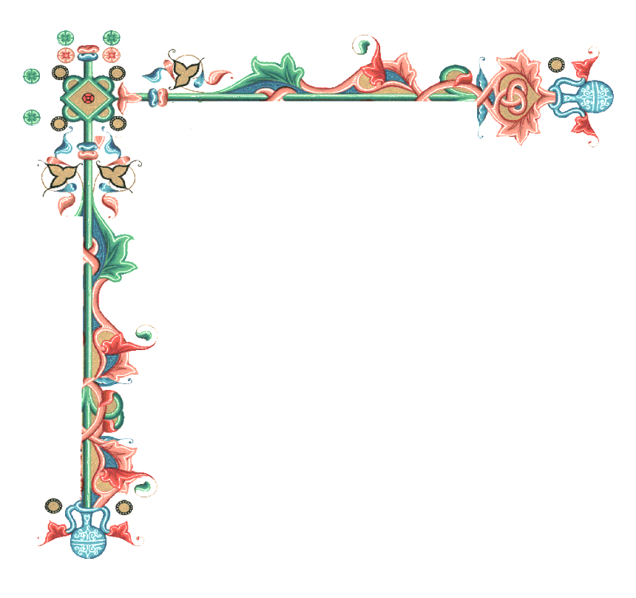

Beginners’ Latin
Session 1
Setting up the expectations, getting the basics
University of Warwick
Centre for the Study of the Renaissance, 2024

Slide 2
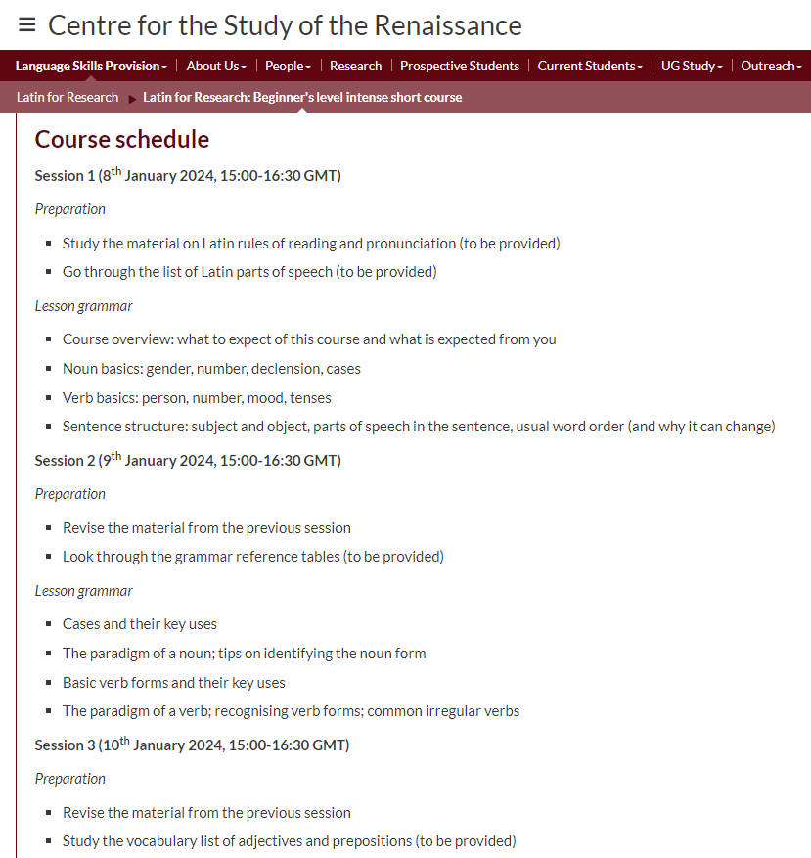
Course overview
The course is designed to help you navigate your personal learning journey according to your research needs
Covers the most important aspects of the language and gives you tools to use it to a certain degree

Slide 3
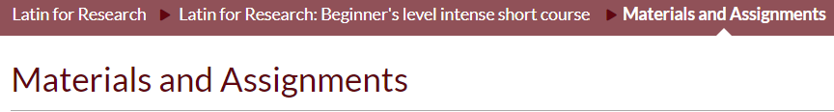

How to get the max results from the course
Identify your learning goal (Grammar? Vocabulary? Reading?)
Go through the course materials at your own pace (e.g. make your own glossaries, train your noun/verb forms…)
Revise the material before each session
Have a go with suggested assignments and email me any questions you get in the process
Explore the additional materials and links keeping your goals in mind
Apply your knowledge in your work (and ask for support if needed)

Slide 4
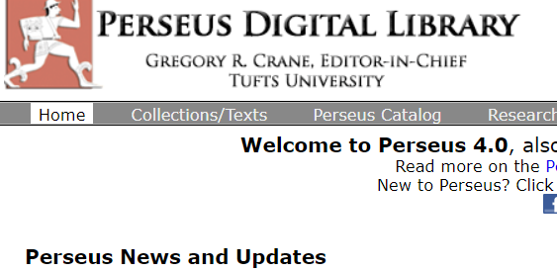
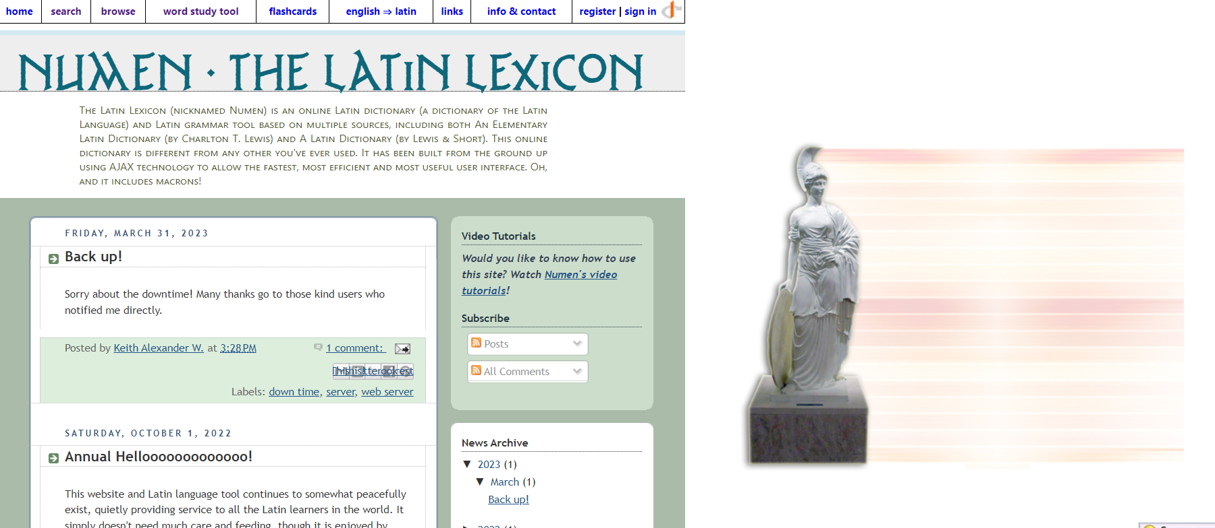
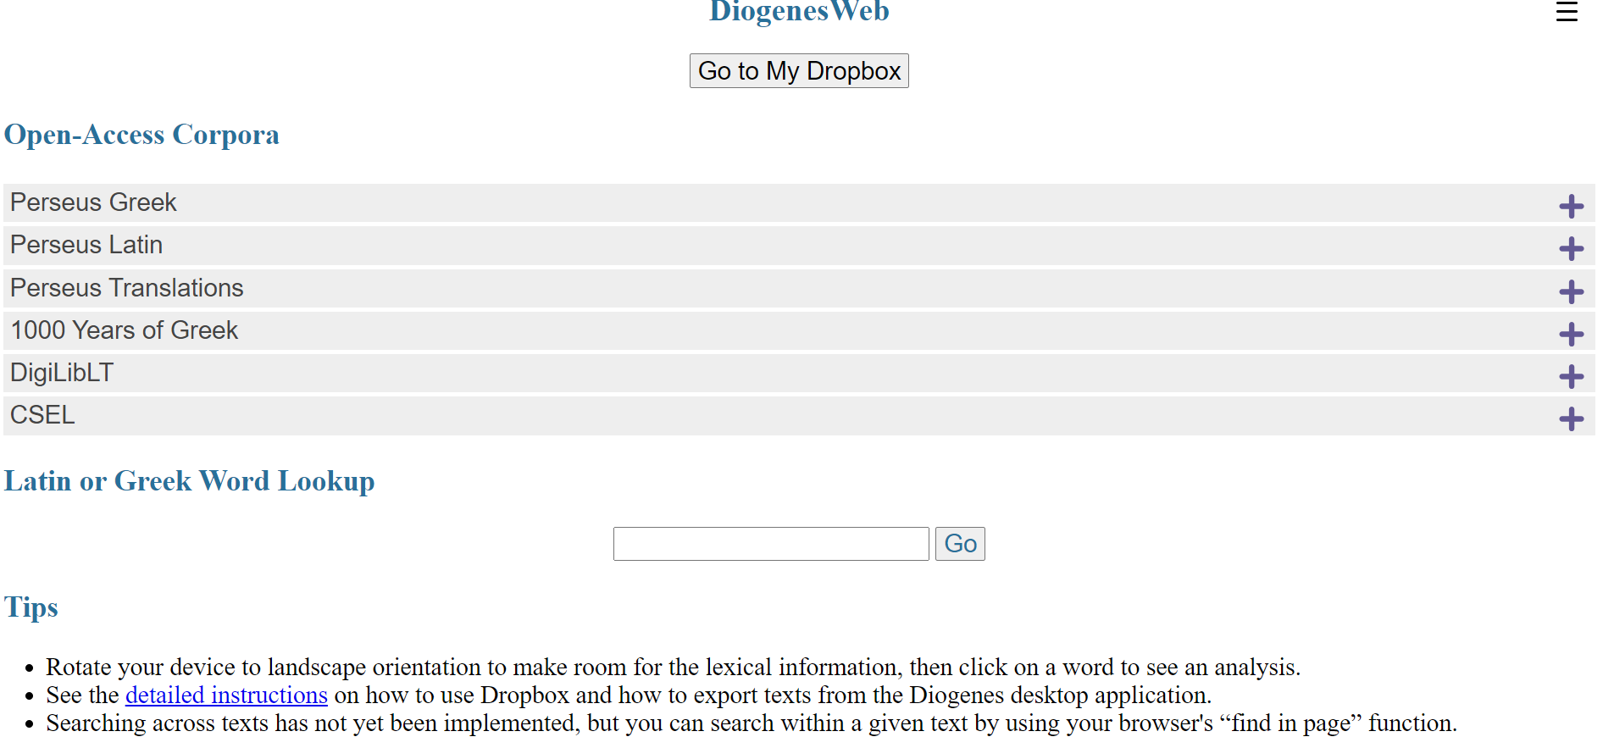
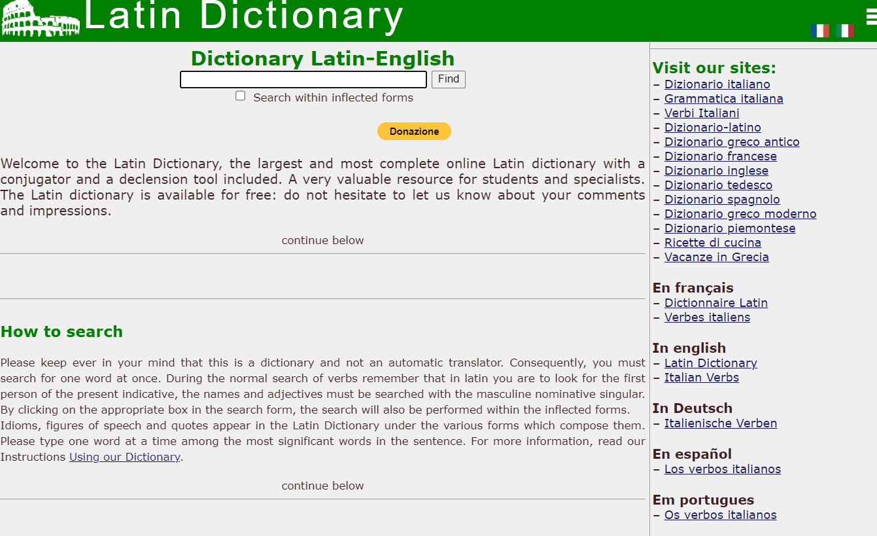
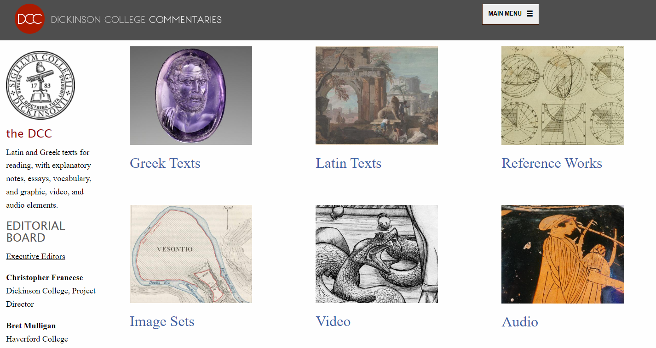
Tools: Grammar
Databases and libraries:
  https://www.thelatinlibrary.com/101/ (a collection of grammar handouts)
  https://linguaclassica.com/LatinGrammarTable.html (grammar tables)
  https://dcc.dickinson.edu/ (various sources and digitised textbooks)
  https://warwick.ac.uk/fac/arts/ren/languages/latin4research/weekly-intermediate/bibliography (a collection of sources and bibliographies)
Online exercisers:
  www.thelatinlibrary.com/decl.html (noun declension drill)
  https://linguaclassica.com/latindrillspage.html (inflection drills)
  students.open.ac.uk/arts/a276/OU_Interactive_Latin (word endings drills)

Slide 5
Tools: Vocabulary
Dictionaries
  https://latinlexicon.org/ (a dictionary with some word learning tools)
  https://d.iogen.es/web (a dictionary with access to several databases)
  https://www.online-latin-dictionary.com/ (a dictionary with inflected forms search)
Vocabulary exercisers:
  www.languagesonline.org.uk/Latin/First_Year_Learning/Section1/Index.htm (basic vocabulary drills)
  sites.hofstra.edu/ilaria-marchesi/self-correcting-exercises-based-on-wheelocks-latin/ (vocabulary and grammar drills)

Slide 6
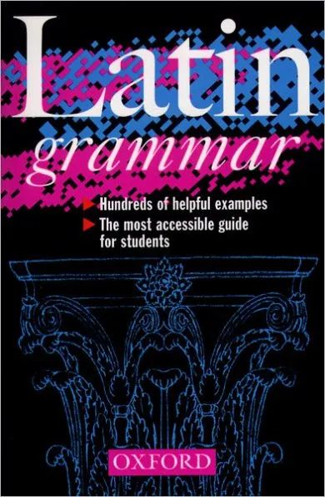
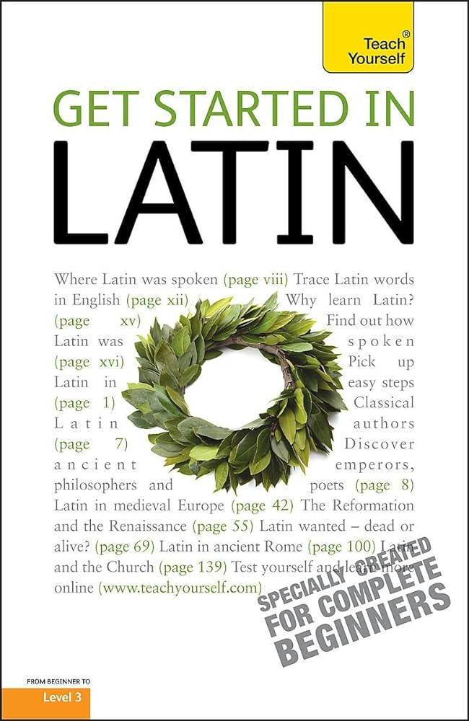

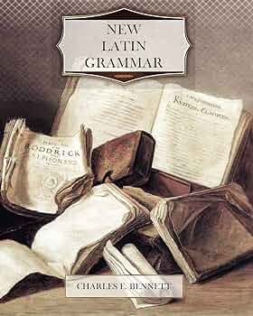
George Sharpley,
Get Started in Latin (London: Hachette UK, 2010 [1999])
►
▲
Bennett, Charles Edwin,
New Latin Grammar
(New York: Ithaca, 1918)
Allen and Greenough’s New Latin Grammar for Schools and Colleges
►
▲
James Morwood, A Latin grammar
(Oxford: Oxford University Press, 1999)

Slide 7
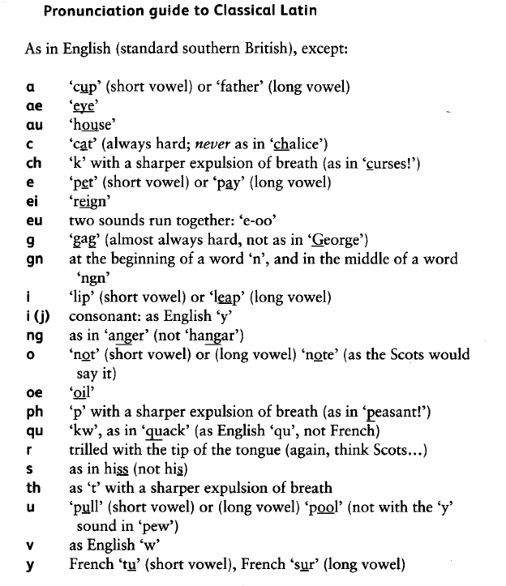
Quick pronunciation recap
Let’s give it a try!
Cane decane, cane! Sing, dean, sing!
Bonum nomen, bonum omen. A good name, a good omen.
Quintus est frater meus. Quintus is my brother.
Verberat nos et lacerat fortuna. Fortune battles and torments us (Seneca, Dial. I, 4, 12)
Si quidem deus est, unde mala? If there is a god, how can there be evil? (Boethius, Consolation of Philosophy, 4)

Slide 8
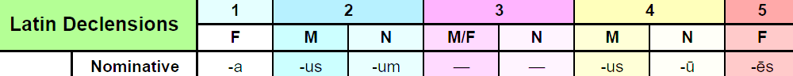
Noun Basics
Expresses the name of a person, place, thing, or idea
Has one of three genders: Masculine, Feminine, or Neuter
NB: all Latin nouns are gendered. You can try and guess the gender by the word endings, but they sometimes coincide:
Puella (fem.) (A, the) Girl
Poeta (masc.) (A, the) Poet
There are five groups of nouns that share the same endings – declensions. You can find them indicated in a dictionary with a number (1-5).

Slide 9
Group the nouns and guess their meaning
1 2
-a (f./m.) -us (m.) /-um (n.)
Aqua, templum, argentum, nātūra, oculus, patria, poēta, signum, terra

Slide 10
Noun basics: Number
Nouns can be of two numbers: Singular or Plural. This is indicated by their ending.
-a
-ae
-us
-i
-um
-a
Make it plural: tenebra (shadow), stella (star), donum (gift), campus (field), aurum (gold), verbum (word), fēmina (woman), dominus (lord, master), ventus (wind)

Slide 11
Word order, sentence structure
The meaning of a Latin sentence depends less on the word order and more on the relationships between words, expressed by cases.
English has some remnants of this system as well:
I looked for my father whom I had lost, but I could not find him.
'Whom’ and 'him’ are the accusative of 'who’ and 'he’.
Indirect object: who/wat the action is performed on? (Needs a preposition)
Predicate: the verb expressing the action
Subject: who performs the action?
Direct object: who/what the action is performed on?
Thanks to the case system, the word order in Latin can change:
est mihi canis = canis est mihi = mihi est canis
The usual word order, however, is S-V-O (Subject – Object –Verb)

Slide 12
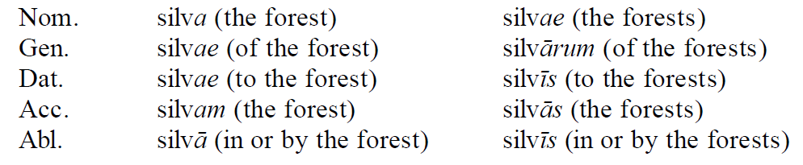
Noun cases
There are six types of relationships between words in a Latin sentence, expressed by six cases:
  Nominative (subject of a sentence, predicate noun)
  Genitive (possession, part of a whole, description of another noun, etc.)
  Dative (indirect object)
  Accusative (direct object)
  Ablative (means of doing something, locations, prepositional constructions)
  Vocative (calling, referring to a person or a thing)
Each noun thus has 10-12 sets of endings (5 cases that sometimes coincide, different endings for singular and plural)

Slide 13
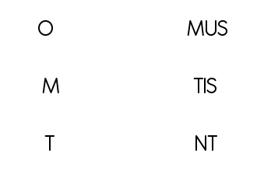
Verb Basics
A verb agrees with its subject in number and person. There are three persons and two numbers, arranged thus:
1st person singular (I) 1st person plural (we)
2nd person singular (you) 2nd person plural (you)
3rd person singular (he, she it) 3rd person plural (they)
In Latin person and number are expressed by the ending of the verb, so pronouns can often be omitted. The present tense endings go as follows:
Sing. Plur.
1
2
3

Slide 14
Verb Basics: Moods
Indicative: The Indicative is used for statements and questions.
Librum flliae meae dedi. I gave a book to my daughter.
Subjunctive: The Subjunctive has many uses, including commands, conditions, wishes, possibility, and dependent clauses.
Si vobis placet, in ecclesiam festinetis. If it pleases you, you could hurry to the church.
Imperative: The Imperative is used to express command or exhortation.
Dīc, Mārce Tullī, sententiam. Marcus Tullius, state your opinion
Infinitive: The Infinitive is chiefly used as an indeclinable noun (To err is human) or as a complementary infinitive to complete the meaning of another verb (I want to go).
Iubeō tē valēre. Be well (lit. I command you to be well)

Slide 15
Verb Basics: Tenses (Indicative)
Continued action | Completed action
Present | Perfect -i, -isti, -it, -imus, -istis, -erunt (add to perfect stem).
Imperfect -ba- | Pluperfect -eram, -eras, -erat, -eramus, -eratis, -erant (add to perfect stem).
Future -bi- for 1st & 2nd conjugations, -e- for 3rd & 4th conjugations | Future Perfect -ero, -eris, -erit, -erimus, -eritis, -erint (add to perfect stem).

Slide 16
Let’s Test It Out!
Gladium mihi rapuit. He snatched my sword from me.
Regina a marito suo occisa est. The queen was killed by her own husband.
Discipulos dimitte tuos! Dismiss your students! (Martial, Epigrams ix, 68, 9-12)
Rem publicam nobis seruauit. He saved the state for us.
Vivamus, mea Lesbia, atque amemus. Come my Lesbia, let's live, let's love (Catullus, Poems, v.1-9)
Beati pauperes, quia vestrum est regnum Dei. Blessed are the poor, for yours is the kingdom of God.

