Slide 1


Beginners’ Latin
Session 2
Cases and their key uses; verb forms and their key uses
University of Warwick
Centre for the Study of the Renaissance, 2024

Slide 2
The Paradigm: Declensions and Cases
1st Declension (-a) |  | 2nd Declension (-us, -er, -ir; -um) |  | 3rd Declension Gen. sing. always ends in –is |  | 4th Declension A characteristic -u-; -ūs in the gen. sing. |  | 5th Declension A characteristic -e-; -eī in the gen. sing.
silva | silvae | vir | viri | pater | patrēs | cursus | cursūs | rēs | rēs
silvae | silvārum | viri | virorum | patris | patrum | cursūs | cursuum | reī | rērum
silvae | silvīs | viro | viris | patrī | patribus | cursuī (ū) | cursibus | reī | rēbus
silvam | silvās | virum | viros | patrem | patrēs | cursum | cursūs | rem | rēs
silvā | silvīs | viro | viris | patre | patribus | cursū | cursibus | rē | rēbus
Nom
Gen
Dat
Acc
Abl

Slide 3
Spotting your Nouns: 1st Declension
Nouns of the first declension are overwhelmingly feminine.
A very few nouns in the first declension are masculine:
Some natural genders such as agricola (farmer), nauta (sailor), pīrāta (pirate),poēta (poet), scrība (scribe or clerk).
Some personal or family names: Catilīna, Mūrēna, Dolābella, Scaevola.
Hadria (the Adriatic).
Even fewer nouns are of common gender: incola (inhabitant) and advena (stranger).
Adjectives will always agree with gender: pīrāta malus (evil pirate), poēta clārus (famous poet).
1st Declension (-a)
silva | silvae
silvae | silvārum
silvae | silvīs
silvam | silvās
silvā | silvīs
Dea and Fīlia: For the dative and ablative plural of dea and fīlia the endings -ābus (deābus and fīliābus) are used
Familiās: An old genitive in -ās is preserved in the word familiās (of the family), often with pater, mater, fīlius, or fīlia. Thus, pater familiās (father of the family = head of the household).

Slide 4
Spotting your Nouns: 2nd Declension
2nd Declension (-us, -er, -ir; -um)
vir | viri
viri | virorum
viro | viris
virum | viros
viro | viris
Nouns of the Second Declension are regularly masculine or neuter. Nouns ending in -us, -er, and -ir are masculine; those ending in -um are neuter.
The following nouns of the second declension are feminine:
Most cities, countries, and islands: Corinthus, Aegyptus, Rhodus, etc.
Most trees and plants: fagus, beech, ficus, fig tree, etc.
The following: alvus, belly; carbasus, linen; humus, ground; and a few others.
The following are neuter: virus, poison; pelagus, sea; vulgus, crowd, rabble. These have no plural, except pelagus.
The Vocative Case is always the same as the nominative in all declensions except
–us nouns of the second declension, which change to -e: O Marce, O Marcus!
Proper names ending in -ius (as well as filius, son; and genius, divine guardian) change to -i, retaining the accent as in the nominative: O Vergili, O Virgil! O fili, O son!
Deus plural has special forms
N.dei, dii, or di
Gen. deorum or deum
Dat. deis, diis, or dis
Acc. deos
Abl. deis, diis, or dis

Slide 5
Spotting your Nouns: 3rd Declension
Third declension nouns have a variety of Nominative endings, but the Genitive singular always ends in -is. Masculine and feminine third declension nouns are declined alike.
The Dative and Ablative plurals are always alike within each declension
The Ablative singular always ends in a vowel.
Tips to guess the gender of the 3rd Declension nouns:
Abstract nouns that end with –tas (Gen. –tatis) are feminine
SOX: if a 3rd declension noun ends with s, o or x, it’s most likely feminine
LANCET: If a 3rd declension noun ends in l, a, n, c, e, or t, it is most likely neuter
Nouns ending with –us (gen. –eris/oris) are neuter.
If the nominative singular of a third declension noun ends in –er or –or, it is most likely masculine
3rd Declension Masculine and Feminine
pater | patrēs
patris | patrum
patrī | patribus
patrem | patrēs
patre | patribus
Neuter nouns declension
nōmen | nōmina
nōminis | nōminum
nōminī | nōminibus
nōmen | nōmina
nōmine | nōminibus

Slide 6
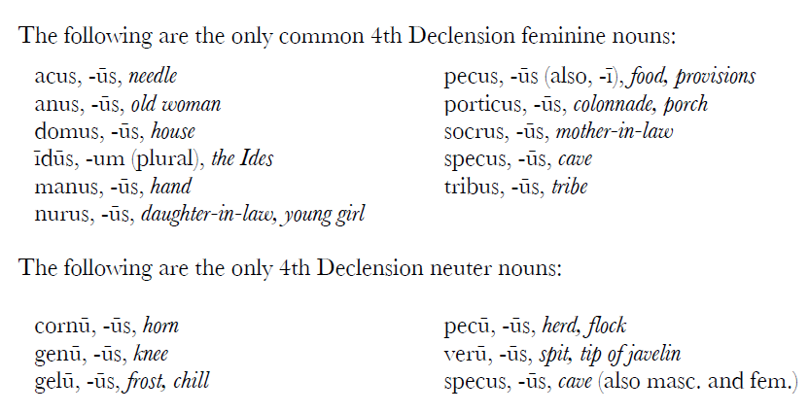
Spotting your Nouns: 4th Declension
4th declension nouns carry a characteristic -u- throughout their declension (except in the dative and ablative plural) and -ūs in the genitive singular
Fourth declension nouns are generally masculine, although a few feminines and even fewer neuters appear. Feminine and masculine nouns are declined alike.
4th Declension A characteristic -u-; -ūs in the gen. sing.
cursus | cursūs
cursūs | cursuum
cursuī (ū) | cursibus
cursum | cursūs
cursū | cursibus

Slide 7
Spotting your Nouns: 5th Declension
Fifth declension nouns carry a characteristic -e- and are identified by the -eī in the genitive singular.
All 5th declension nouns are feminine, except dies, and compounds of dies, which are masculine. Dies, however, can also be feminine when it refers to a specific day: constitūtā diē, on the appointed day.
Of nouns of the fifth declension, only dies and res are declined fully. Most lack plural forms, which are, however, found in the nominative or accusative in acies (sharp edge, battle, steel),effigies (copy, portrait), eluvies (flood, discharge), facies (form, face, beauty), glacies (ice), series (row, series), species (sight), spes (hope).
5th Declension A characteristic -e-; -eī in the gen. sing.
rēs | rēs
reī | rērum
reī | rēbus
rem | rēs
rē | rēbus

Slide 8
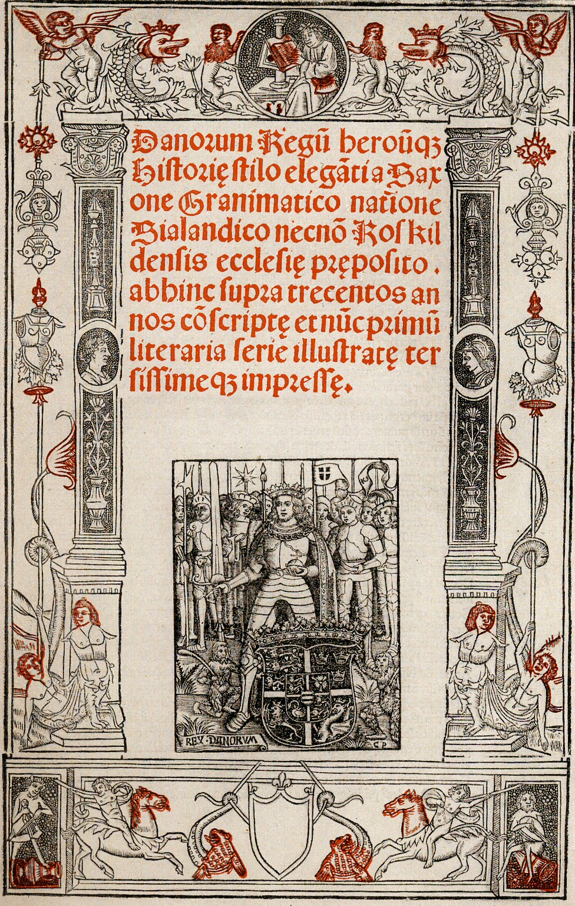
Cases and Their Key Uses: Nominative
Subject of a sentence
Iuppiter circumspectat. Jupiter looks around.
Predicate nominative (with linking verb “to be” “to seem” “to appear,” etc.).
Iuppiter est deus. Jupiter is a god.
Iuppiter erat benignus. Jupiter was kind.
Danorum Regum heroumque Historiae stilo eleganti

Slide 9
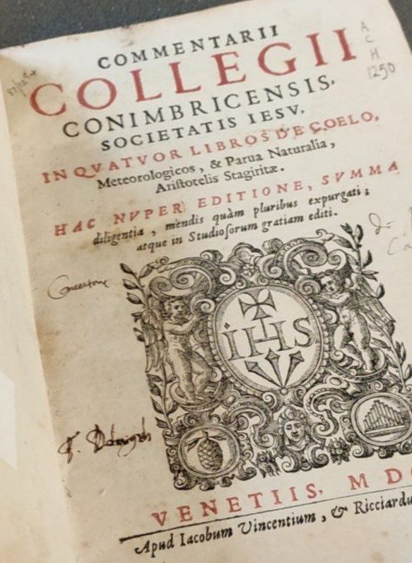
Cases and Their Key Uses: Genitive
Genitive of possession:
Regia reginae magna erat. The palace of the queen was large.
Genitive of description: attributes a quality to a noun. This genitive is normally accompanied by an adjective.
Diana dea magnae sapientiae est. Diana is a goddess of great wisdom.
Genitive with certain adjectives:
dignus, -a, -um + gen. = worthy (of)
Delectamenta sunt pretiosa sed digna pretii. The delights are costly but worth the price.
plenus, -a, -um + gen. = full (of)
Oppidum olim plenum virorum erat. The town was once full of men.
peritus, -a, -um + gen. = skilled (in), expert (in)
Vir peritus sagittarum est. The man is skilled with arrows.
Partitive Genitive: genitive is used to denote the whole to which a part belongs.
Deis partem cibi dederunt : They gave part of the food to the gods.
A page full of genitives

Slide 10
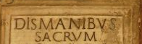
Cases and Their Key Uses: Dative
Dative of indirect object
Dei dona viris dederunt : The gods gave gifts to the men.
Dative of possession (common with pronouns):
Nomen mihi Marcus est : My name is Mark.
Dative with certain verbs:
praesto, -are, -stiti, -stitum + dat. = to surpass
Cur Latona mihi praestat? Why does Latona surpass me?
impero, -are + dat. = to command, order
• Dative with certain adjectives:
benignus, -a, -um + dat. = kind (to)
Iuppiter erat filio benignus : Jupiter was kind to his son.
carus, -a, -um + dat. = dear (to)
Terra deo cara erat : The land was dear to the god.
gratus, -a, -um + dat. = pleasing (to)
Nymphae deis gratae sunt : Nymphs are pleasing to the gods.
idoneus, -a, -um + dat. = suitable (for)
Tempus idoneum poenis exspectavit : She awaited a suitable time for punishment.

Slide 11
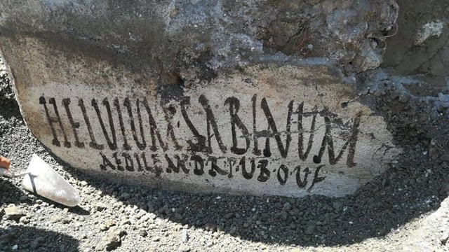
Cases and Their Key Uses: Accusative
Direct Object:
Poeta fabulas narravit. The poet told stories.
Accusative with prepositions:
ad + acc. = to, toward, near
per + acc. = through
prope + acc. = near, close to
trans. + acc. = across
propter + acc. = on account of, because of
post + acc. = after
inter + acc. = between, among
in + acc. = into
Subject Accusative in Indirect Speech (with Infinitive):
Minerva monstrat se deam esse. Minerva shows that she is a
goddess.
Deos appropinquare video. I see that the gods are approaching.
Helvium Sabinum aedilem dignum rei publicae virum bonum oro vos faciatis

Slide 12

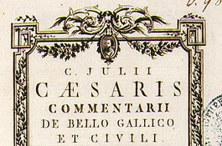
Cases and Their Key Uses: Ablative
Ablative of Means:
Phoebus liberos eius sagittis necavit : Phoebus killed her children with (by means of) arrows.
Ablative with prepositions:
cum + abl. = with
sine + abl. = without
de + abl. = about, concerning
a (ab) + abl. = from, away from, by
pro + abl. = in front of, before
in + abl. = in, on

Slide 13
Identifying Noun Forms: Algorythm
If you already know the noun/declension: identify the case and find what causes this form to appear (e.g. other nouns/verbs/prepositions)
If you can’t spot a noun, try looking at the verbs. They are often easier to spot due to their characteristic endings
Having found the verb, find the noun(s) it corresponds with to know the number and, possibly, case
Either rely on your memory and try to identify the noun’s declension to be completely sure about the case/number, or use a dictionary to get a hint
Reconstruct the meaning of a phrase based on the relationships expressed by cases and verb forms
Temporibus mores sapiens sine crimine mutat.

Slide 14
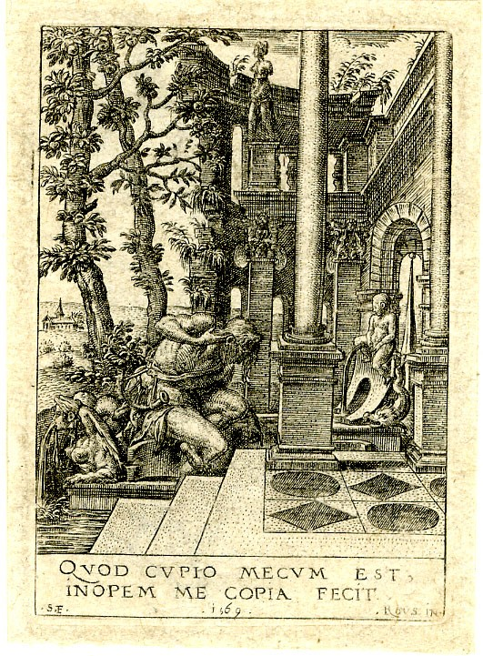
Example
Quod cupio, mecum est: inopem me copia fecit.
(Ovid, Metamorphoses 3.454-73)
Glossary:
Cupiō (cupere, cupīvī or cupiī, cupītum) – to desire
Mecum – with me
Inops (-is, m, 3) – destitute, lacking, weak
Cōpia (-ae, f, 1) – abundance, copiousness

Slide 15
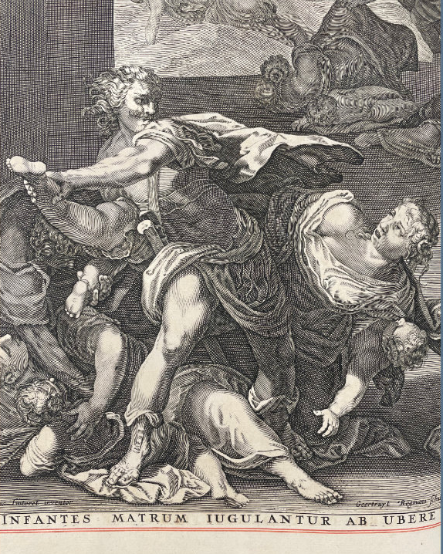
Another Example
Infantes matrum iugulantur ab ubere
Glossary:
Māter (-is, f, 3) – mother
Infāns (-is, m/f, 3) – infant, child
Iugulō (iugulāre, iugulāvī, iugulātum, 1) – slay, kill
Iugulantur – 3rd person plur. pres. passive
Ūber (-is, n, 3) – breast; fruitfulness

Slide 16
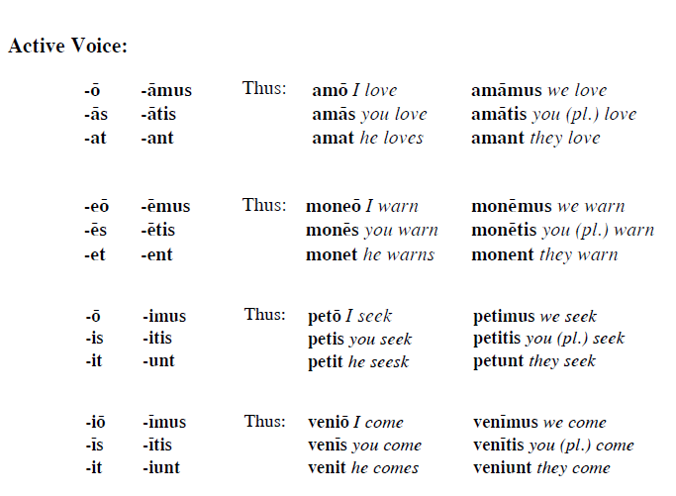
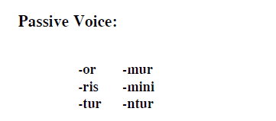
Verb Forms: All Conjugations
1
2
3
4

Slide 17
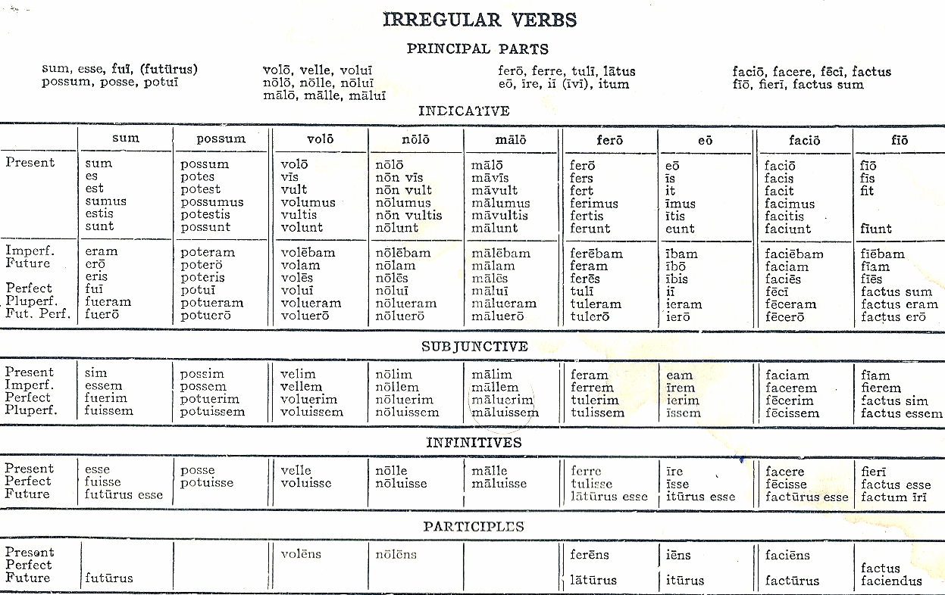
Common irregular verbs

Slide 18
Spot Your Verbs: Tense Indicators
Indicative:
Imperfect: -ba-
Future: -bi- for 1st & 2nd conjugations, -e- for 3rd & 4th conjugations.
Perfect: -i, -isti, -it, -imus, -istis, -erunt (add to perfect stem).
Pluperfect: -eram, -eras, -erat, -eramus, -eratis, -erant (add to perfect stem).
Future Perfect -ero, -eris, -erit, -erimus, -eritis, -erint (add to perfect stem).
Subjunctive:
Present tense: He beat a friar. (Characteristic vowels for the 4 conjugations).
Imperfect: Add personal endings to the infinitive.
Pluperfect: -issem, -isses, -isset, -issemus, -issetis, -issent (add to perfect stem).
Perfect: -erim, -eris, -erit, -erimus, -eritis, -erint (add to perfect stem).

Slide 19
Final Exercise: Reading
In principio creavit Deus caelum et terram. Terra autem erat inanis et vacua, et tenebrae super faciem abyssi, et spiritus Dei ferebatur super aquas. Dixitque Deus: "Fiat lux". Et facta est lux. Et vidit Deus lucem quod esset bona et divisit Deus lucem ac tenebras. Appellavitque Deus lucem Diem et tenebras Noctem. Factumque est vespere et mane, dies unus. Dixit quoque Deus: "Fiat firmamentum in medio aquarum et dividat aquas ab aquis". Et fecit Deus firmamentum divisitque aquas, quae erant sub firmamento, ab his, quae erant super firmamentum. Et factum est ita. Vocavitque Deus firmamentum Caelum. Et factum est vespere et mane, dies secundus.
In the beginning God created the heaven and the earth. And the earth was without form, and void; and darkness was upon the face of the deep. And the Spirit of God moved upon the face of the waters. And God said, Let there be light: and there was light. And God saw the light, that it was good: and God divided the light from the darkness. And God called the light Day, and the darkness he called Night. And the evening and the morning were the first day. And God said, Let there be a firmament in the midst of the waters, and let it divide the waters from the waters. And God made the firmament, and divided the waters which were under the firmament from the waters which were above the firmament: and it was so. And God called the firmament Heaven. And the evening and the morning were the second day.

