Slide 1
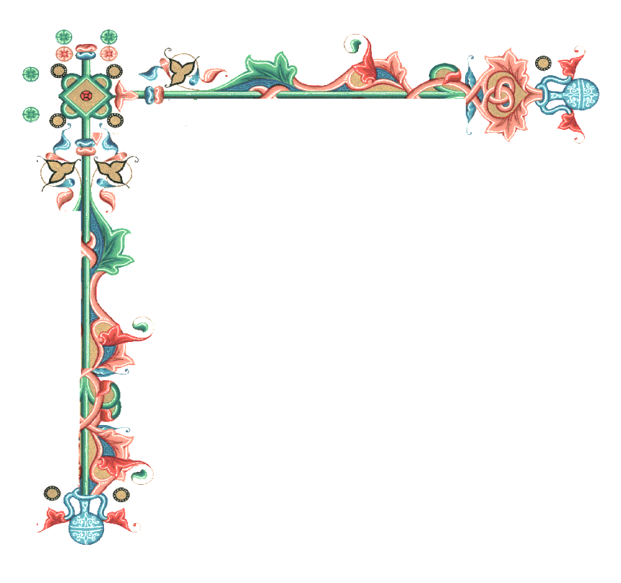

Beginners’ Latin
Session 5
Absolute Ablative. Participles.
University of Warwick
Centre for the Study of the Renaissance, 2024

Slide 2
Participles
The participle may be active or passive, but will always agree in number, case, and gender with the noun that it modifies.
Vidimus Herculem vinum bibentem. We saw Hercules drinking wine.
Present active | Present passive | Future Active | Future Passive
Stem + ns + 3rd decl. adj. endings | Given in a dictionary as the 4th verb form Decline as 1st/2nd decl. adj | Pres.participle + turus (-a, um) | To be found in a dictionary (gerundive)
Doing | Having been done | Sth is going to happen | Sth is to be done
Femina clamans eum vidit. The shouting woman saw him | His verbis dictis, vir discessit. With these words having been said, the man left. | Donum tibi daturus sum I am going to give you gifts | Carthago delenda est. Carthage is to be destroyed

Slide 3
Use of Participles
Active present participle has a meaning of simultaneity with the main action:
Vir equum currentem vidit. The man saw a running horse.
Passive present participle has a meaning of anteriority to the main action:
Vir sclavum captum vidit. The man saw a captured slave.
Active future participle gives active voice of a subsequent action
Femina dictura virum vidit. The woman, about to speak, saw her husband.
Passive future participle gives a passive voice of a subsequent action
Libros legendos in mensa posuit. He placed books (having) to be read on the table.

Slide 4
Symbolum Nicaenum
Credo in unum Deum, Patrem omnipotentem, factorem caeli et terrae, visibilium omnium et invisibilium. Et in unum Dominum Iesum Christum, Filium Dei unigenitum, et ex Patre natum ante omnia saecula. Deum de Deo, Lumen de Lumine, Deum verum de Deo vero, genitum non factum, consubstantialem Patri; per quem omnia facta sunt. […] Et incarnatus est de Spiritu Sancto ex Maria Virgine, et homo factus est. Crucifixus etiam pro nobis sub Pontio Pilato, passus et sepultus est, et resurrexit tertia die, secundum Scripturas, et ascendit in caelum, sedet ad dexteram Patris. Et iterum venturus est cum gloria, iudicare vivos et mortuos, cuius regni non erit finis. Et in Spiritum Sanctum, Dominum et vivificantem, qui ex Patre Filioque procedit. Qui cum Patre et Filio simul adoratur et conglorificatur: qui locutus est per prophetas.
I believe in one God, the Father almighty, Maker of heaven and earth, and of all things visible and invisible. And in one Lord Jesus Christ, the Only-begotten Son of God. Born of the Father before all ages. God of God; Light of Light; true God of true God. Begotten not made; of one being with the Father; by Whom all things were made. […] And was made Flesh by the Holy Spirit of the Virgin Mary: And was made man. He was also crucified for us, suffered under Pontius Pilate and was buried. And on the third day He rose again according to the Scriptures. And ascending into heaven, He sits at the right hand of the Father. And He shall come again in glory to judge the living and the dead; and of His kingdom there shall be no end. And I believe in the Holy Spirit, Lord and Giver of life, Who proceeds from the Father and the Son. Who together with the Father and the Son is no less adored and glorified: Who spoke by the Prophets.

Slide 5
Absolute Ablative
The ablatives of a participle and a noun (or pronoun) are used to define the circumstances or situation in which the action of the main verb occurs.
An Ablative Absolute with a perfect passive participle is widely used in classical Latin to express the cause or time of an action. Equally common is an Ablative Absolute with a present active participle
Hīs verbīs dictīs, Caesar discēdit. With these word having been said, Caesar departs.
Leōne adveniente, fēmina discēssit. With the lion approaching, the woman left.
On occasion, another noun may take the place of the participle:
Caesare duce vincēmus. With Caesar as leader, we shall conquer.
Because the participle in an Ablative Absolute retains its verbal force, it may govern its own direct object:
Duce militēs vocante, hostes fūgērunt. With the general calling his soldiers, the enemy fled.

Slide 6
Caesar omnibus rebus relictis persequendum sibi Pompeium existimavit, quascumque in partes se ex fuga recepisset, ne rursus copias comparare alias et bellum renovare posset. […] Erat edictum Pompei nomine Amphipoli propositum, ut omnes eius provinciae iuniores, Graeci civesque Romani, iurandi causa convenirent. Ipse ad ancoram unam noctem constitit et vocatis ad se Amphipoli hospitibus et pecunia ad necessarios sumptus corrogata, cognito Caesaris adventu, ex eo loco discessit et Mytilenas paucis diebus venit. […]
Ibi cognoscit consensu omnium Antiochensium civiumque Romanorum qui illic negotiarentur, arma capta esse excludendi sui causa nuntiosque dimissos ad eos, qui se ex fuga in finitimas civitates recepisse dicerentur ne Antiochiam adirent. Id si fecissent, magno eorum capitis periculo futurum.
Caesar laying all other thoughts aside, determined to pursue Pompey, whithersoever he should retire, to prevent his drawing together fresh forces, and renewing the war. Pompey had issued a proclamation at Amphipolis, enjoining all the youth of the province, whether Greeks or Romans, to join him in arms. Here he lay one night at anchor, sending to what friends he had in the town, and raising all the money he possibly could. But being informed of Caesar's approach, he departed with all expedition, and came in a few days to Mitylene. […]
There he learns that, by the consent of all the people of Antioch and of the Roman citizens engaged in business there, arms had been taken up for the purpose of excluding him, and that messages had been sent to those who were said to have betaken themselves in flight to the neighbouring townships bidding them not to go to Antioch. If they did so, they were told, it would be at great peril of their lives.
C. Iuli Caesaris Bellum Civile, 3. 102

Slide 7
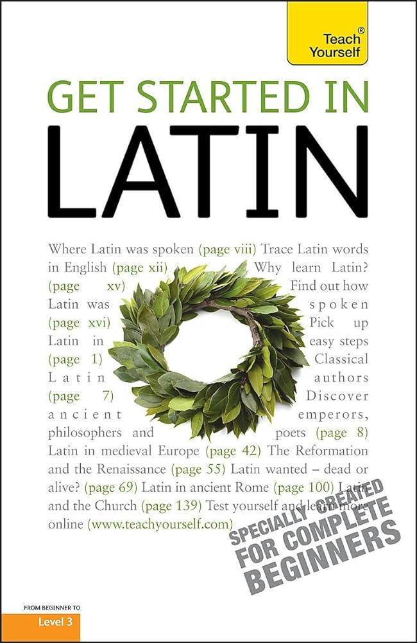

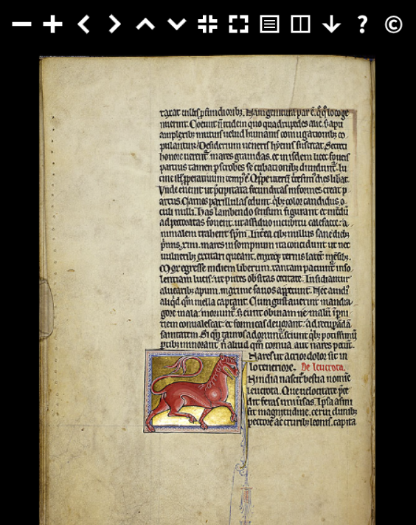
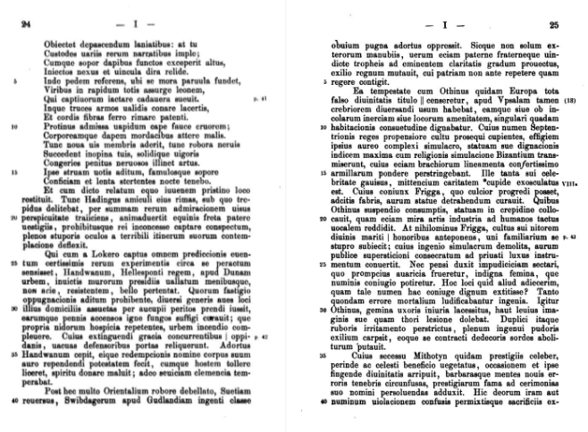
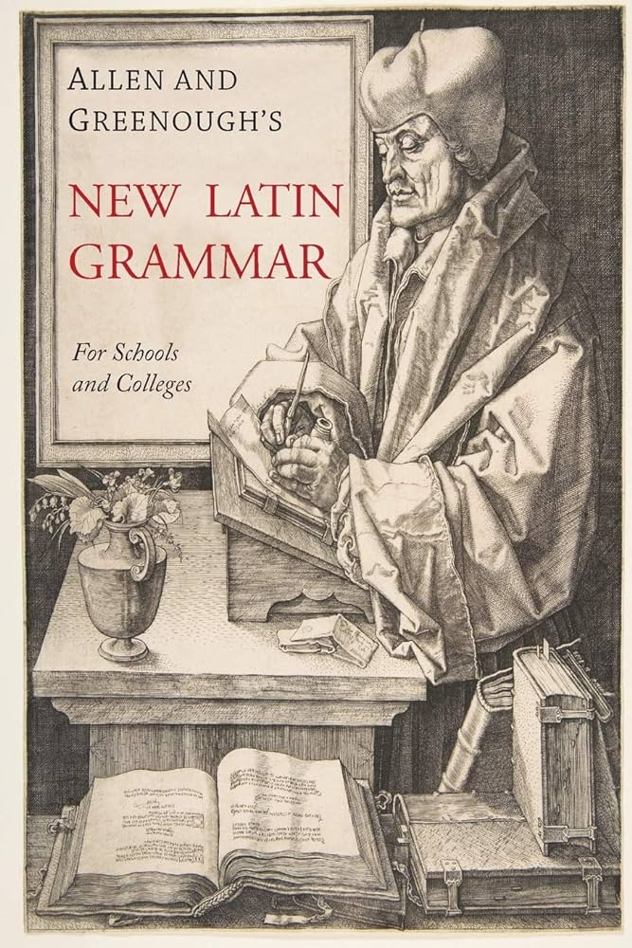
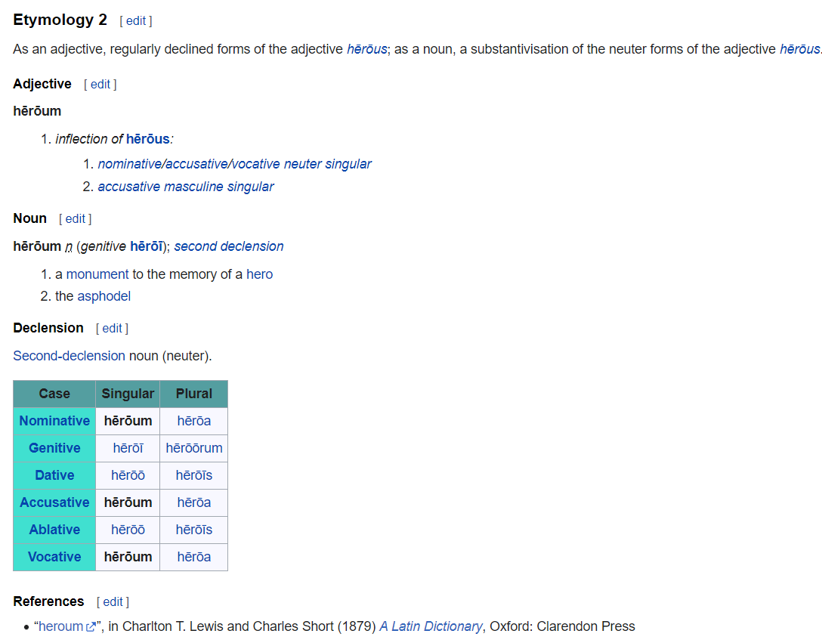
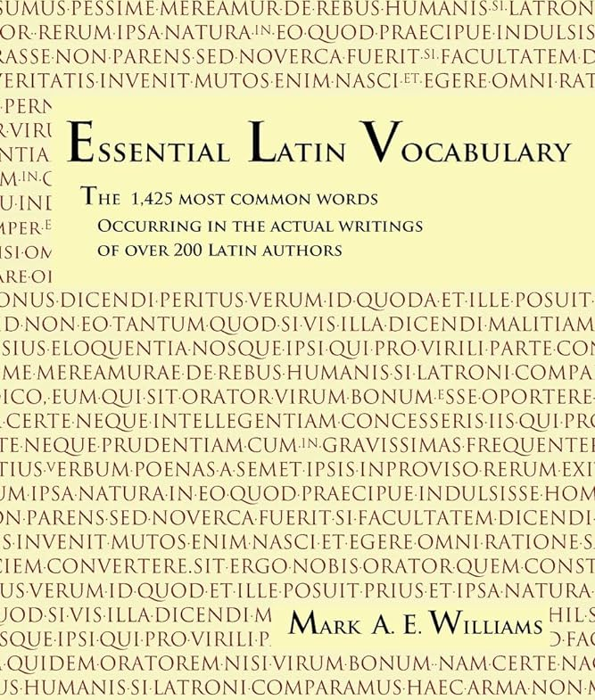
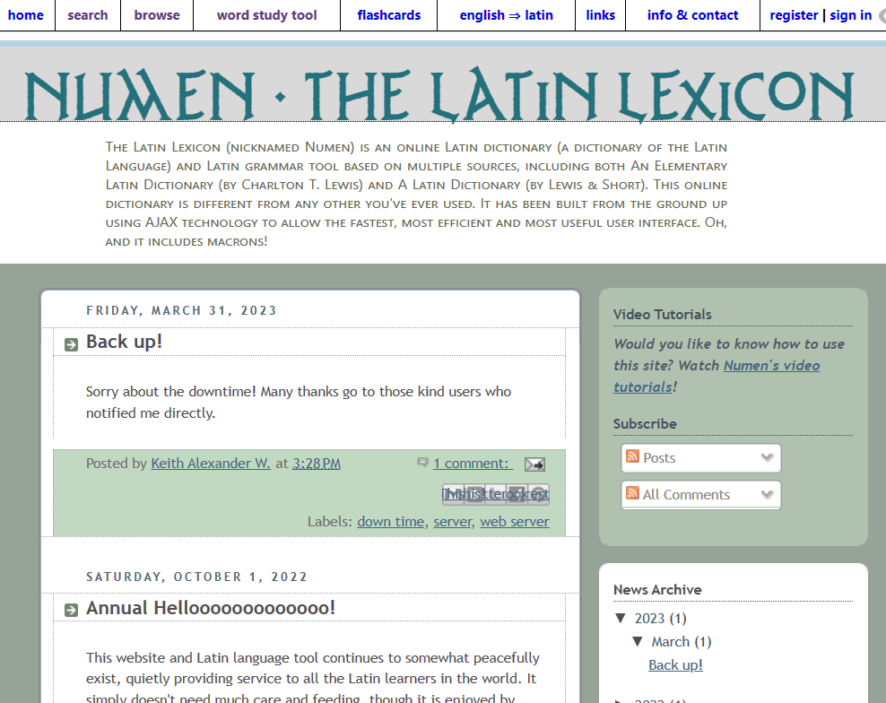
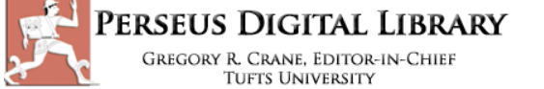
What Now?
Apply your knowledge
Try and translate your own texts
Explore other materials that were previously inaccessible to you
Use all possible tools to ease your work process
Deepen your knowledge
More complex grammar
Reference tables and exercises
Drills practice
Follow-up courses
Widen your knowledge
Vocabulary lists and glossaries
Read more various texts from the period that interests you
Browse dictionaries and literature collections (e.g. Latin corpus)

