Slide 1
Outline of session 3
Check last session
Answers to questions: conditional clauses
how did you consolidate?
Read through last week’s scene
Castellio – Joseph’s dream – using on-line dictionary
Revise formation of indicative of verbs
For session 4
? Transcribe passage
Learn vocabulary
Grammar – as your notes today suggest is necessary!
Read out

Slide 2
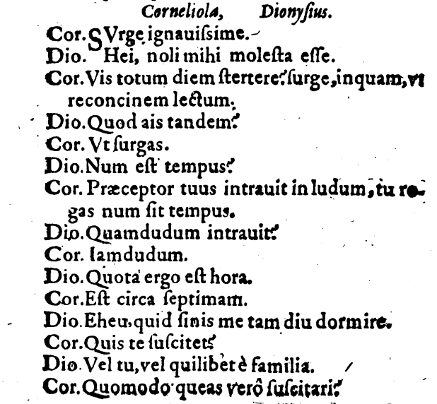
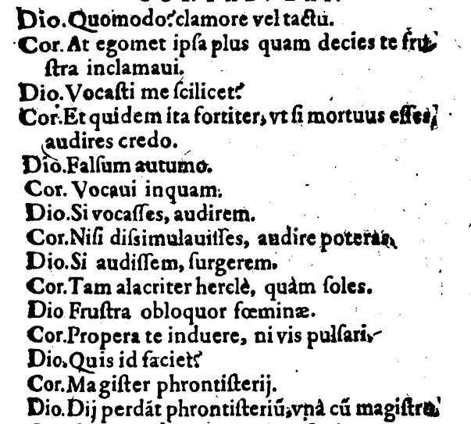

Slide 3
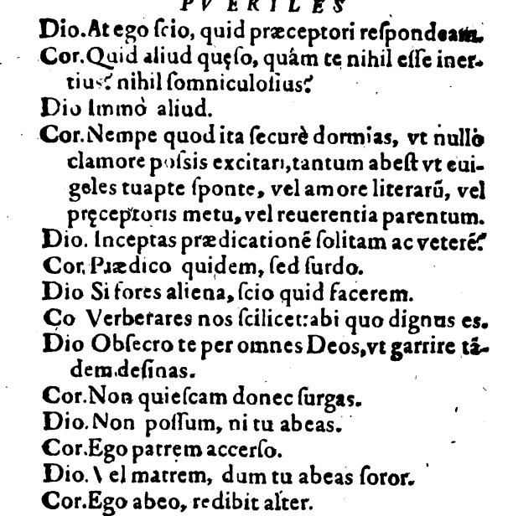

Slide 4
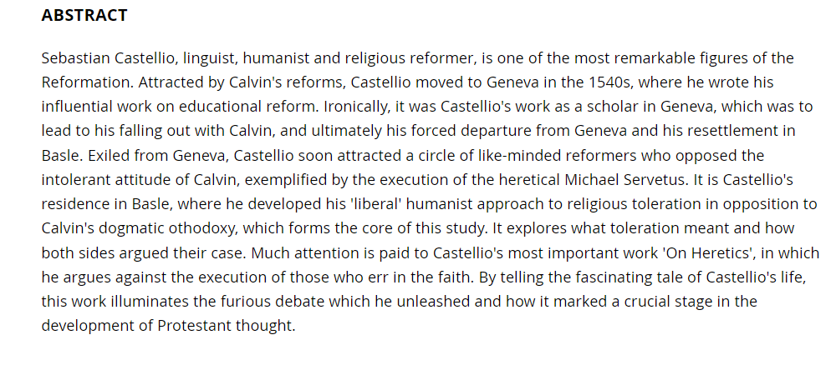
Sebastian Castellio, 1515-1563 Humanist and Defender of Religious Toleration in a Confessional Age By Hans R. Guggisberg, Bruce Gordon https://doi.org/10.4324/9781315243597

Slide 5
Pdf scan page 14
Argumentum (Summary)
Josephus interpretatur Pharaoni duo somnia,
ob eamque causam (= propter)
Pharao praeficit eum toti Aegypto

Slide 6
Conditional sentences
[Si vocasses, audirem: give other subjunctive tenses possible for this conditional sentence and translate into English]
Three tenses of subjunctive possible – not the perfect
Present subjunctive refers to future time
Imperfect subjunctive refers to current time
Pluperfect subjunctive refers to past time

Slide 7
For session 4
? Transcribe passage
Learn vocabulary
Grammar – as your notes today suggest is necessary!
Read out

