Slide 1
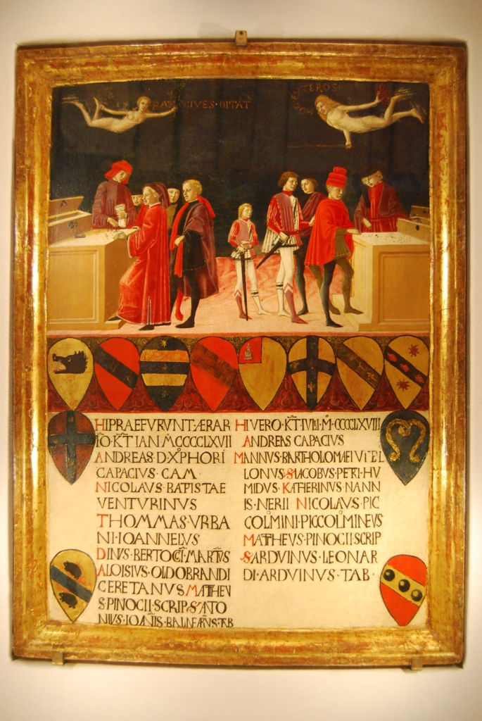
TAXATION IN THE RENAISSANCE
Dr Giorgio Lizzul (giorgio.lizzul@warwick.ac.uk)
Finances of the Comune in War and Peace, Benvenuto di Giovanni, 1468, Tavolette di Biccherna, State Archive Siena.

Slide 2
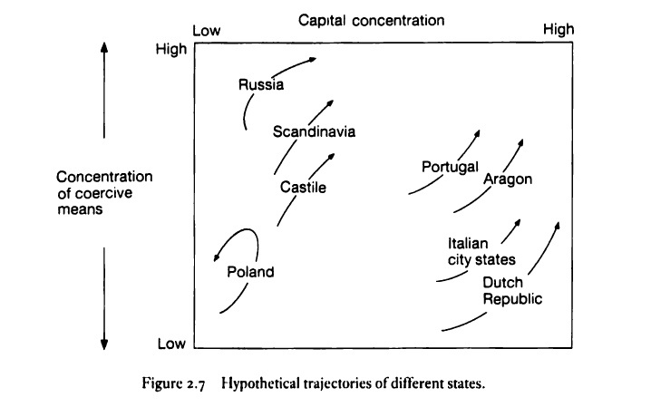
Coercion and Capital
Source: C. Tilly, Coercion and Capital, Fig. 2.7

Slide 3
Fiscal Pressures on the Italian City- States
Political instability
Expansion
Rising Military Costs

Slide 4
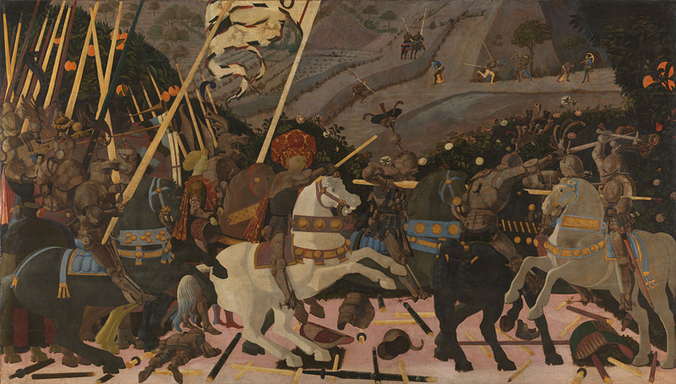
Mercenaries
The Battle of San Romano, Paolo Uccello, (ca. 1438-40), The National Gallery, London.

Slide 5
Ancient Roman Model of Taxation
Tributa vs. Vectigalia
Immunitas - No direct taxation of citizens – Cicero and the definition of the Republic
Corpus Iuris Civilis: Higher power retains right to tax – new tax permissible in extraordinary circumstances only with causa iusta → Communis utilitatis

Slide 6
Public Finances of the City-States
Ordinary and extraordinary taxation
Direct/Indirect Taxes (Gabelle, dazi/dacia/muda)
Property taxes extraordinary.
Bartolus of Saxoferrato civitas sibi princeps
Citizen immunity: Venice, Florence, Genoa
Problem: Revenue shortfall in war

Slide 7
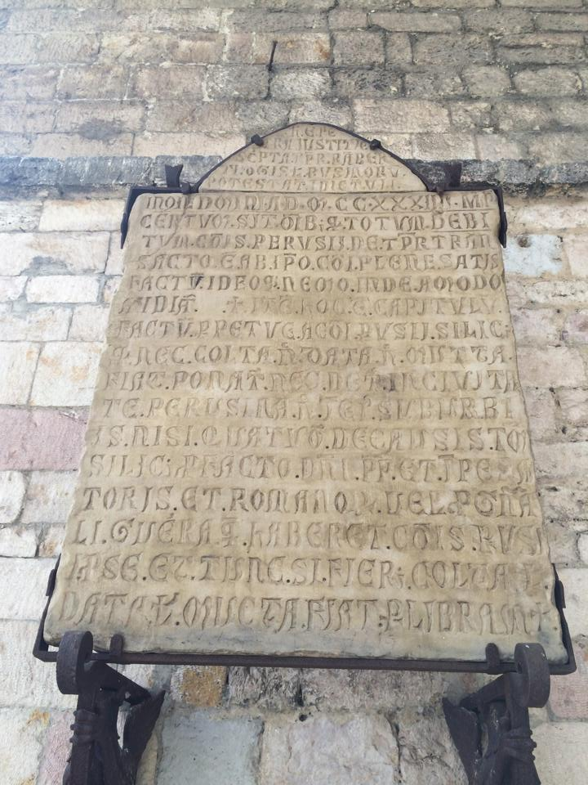
Fig. 1. Pietra di giustizia, 1234, Perugia.

Slide 8
Public Finances of the City-States
Ordinary and extraordinary taxation
Direct/Indirect Taxes (Gabelle, dazi/dacia/muda)
Property taxes extraordinary.
Bartolus of Saxoferrato civitas sibi princeps
Citizen immunity: Venice, Florence, Genoa
Problem: Revenue shortfall in war

Slide 9
Credit Solutions?
Debt/Credit
Forced Loans
Voluntary Loans
Differences between Republics and Principalities
Funded Public Debt – Debt Consolidation – hypothecation of income streams

Slide 10
Consolidated Public Debt
Funded Public Debt – Debt Consolidation hypothecation of income streams
Venice: Camera degli imprestiti
Genoa: Luoghi and the Casa di S. Giorgio
Florence: Monte comune

Slide 11
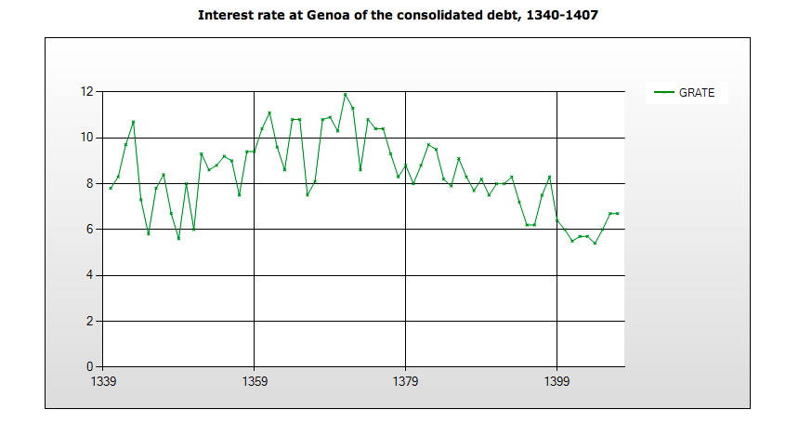
Public Debt: Genoa

Slide 13
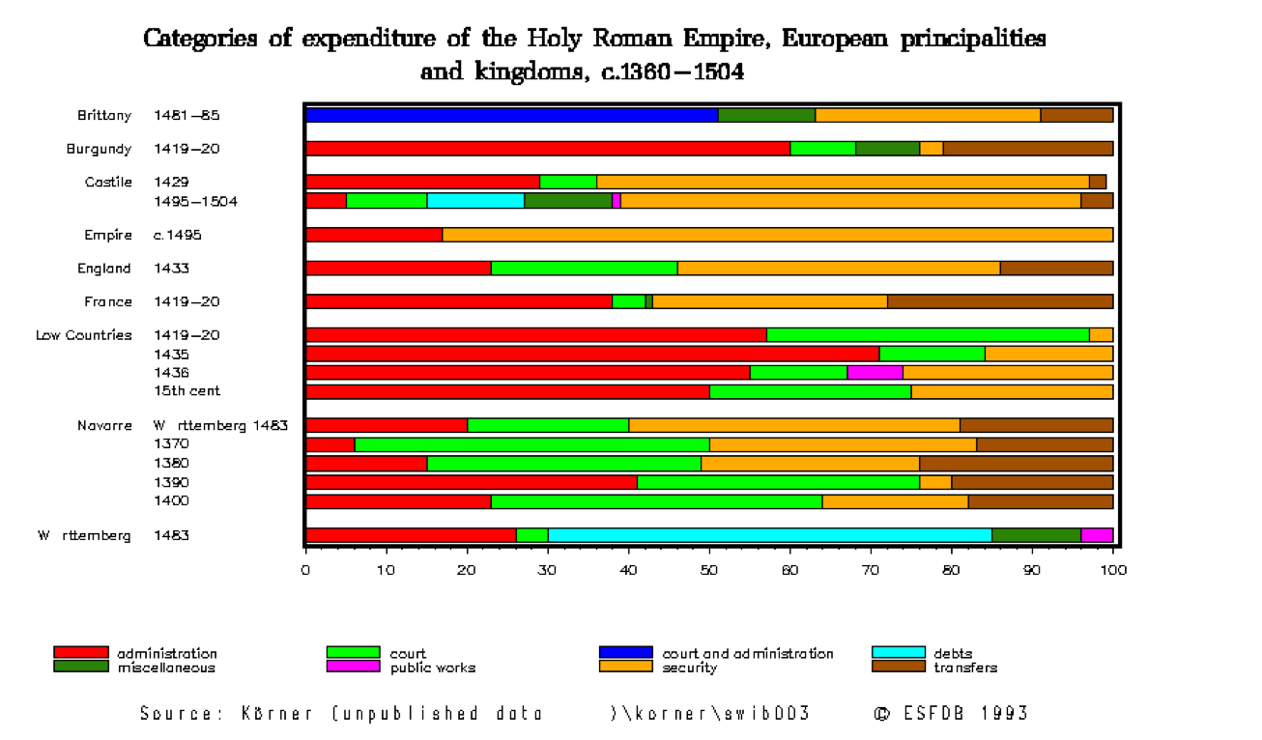
State Expenditure
1360-1504

Slide 14
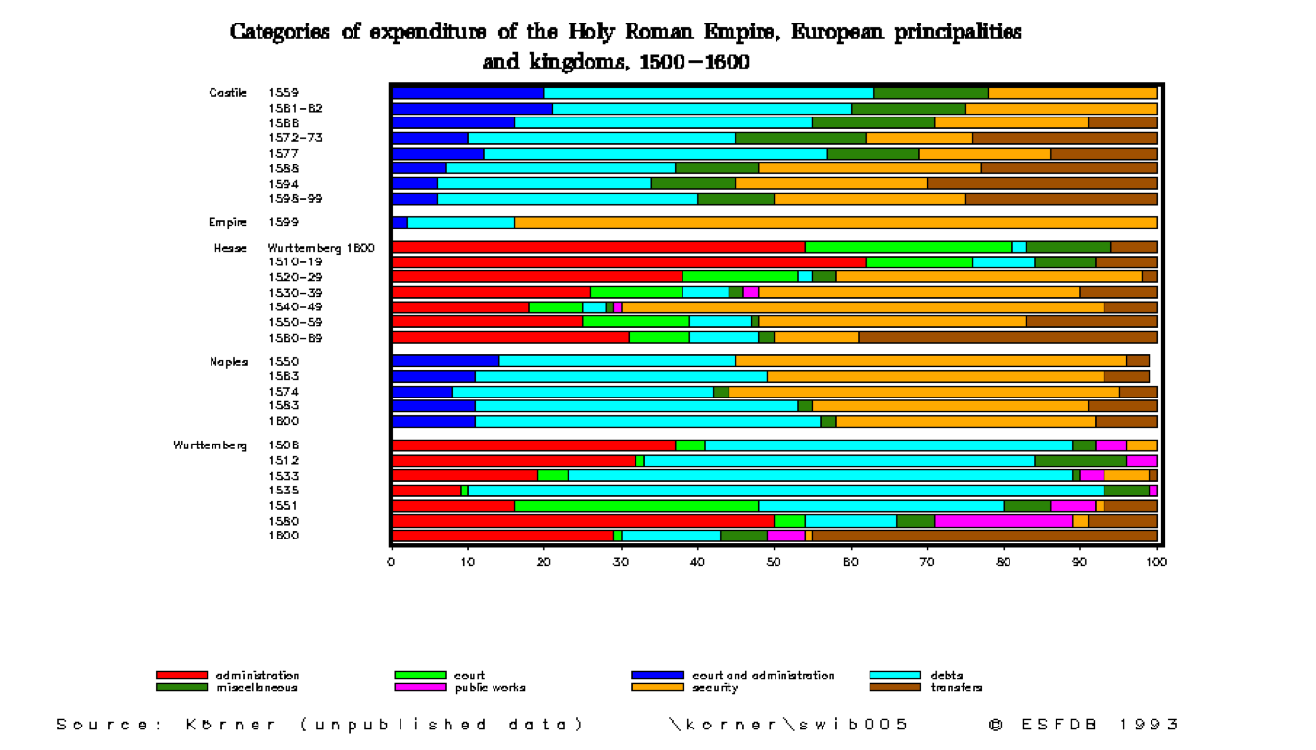
State Expenditure
1500-1600

Slide 15
Fiscal Thought
Theologians/Jurists and casuistry.
Public Debt and Usury - Luke: ‘lend, expecting nothing in return’ (Lc. 6.35) .
Humanists – Creditors’ liberality; civic militia vs mercenaries; moral philosophy and tax justice.

Slide 16
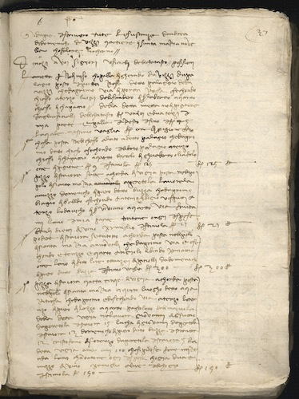
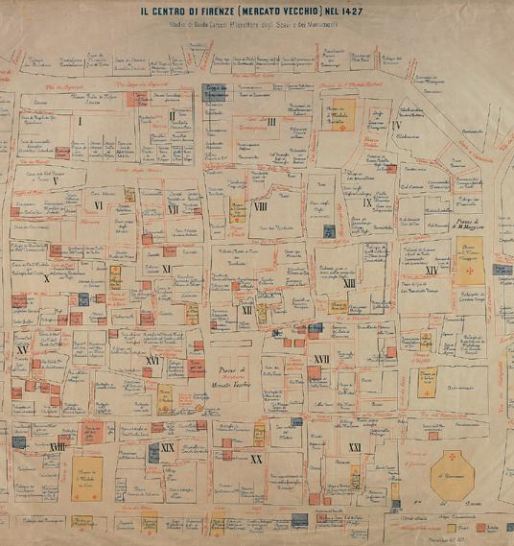
The Florentine Catasto of 1427

Slide 17
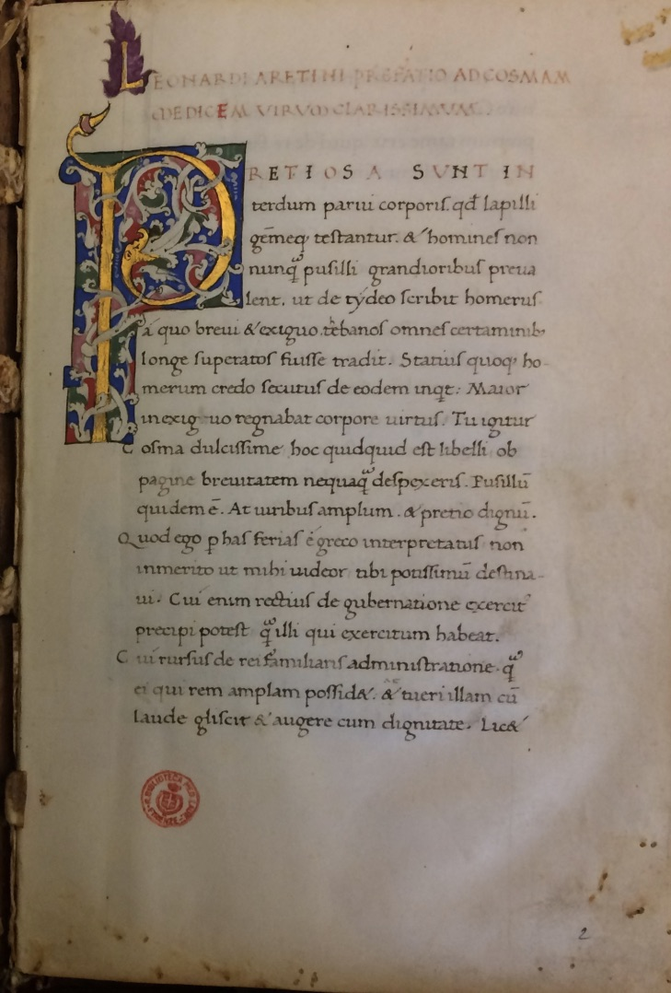
Leonardo Bruni and the Oeconomica 1420
Dedication to Cosimo de’ Medici:
‘Wealth is indeed useful (utiles), since it is both an embellishment (ornamentum) for those who possess it, and the means by which they may exercise their virtue.’ Oeconomica, Preface.
Thus for our own sake and even more for the love of our children, we ought to strive as far as we honourably can to increase our wealth, since it is included by the philosophers among the things that are good (bonum), and considered to be related to happiness (felicitas).’ Ibid.
‘Money was invented to give aid, it is a necessary thing for holding the civitas together and defending the social life’, Oeconomica, Commentary on Book I.

Slide 18
Poggio Bracciolini, De avaritia
Loschi: ‘avarice is not against nature but instilled in us and imprinted on us by nature itself.’
‘Everything we undertake is for the sake of money, and we are all led by the desire for gain, and not a small profit either’
‘everyone in every age, condition, rank or estate is dominated by the desire for gold, that is, avarice,’ even the most honourable: kings, lawyers, soldiers and philosophers’
‘If you were to remove that profit, all business and work would entirely cease’
‘I think they should be invited into the city as a sustaining support for the people,’ given that their money is advantageous for the common welfare, provides for the poor, and subsidises the city’

