Slide 1
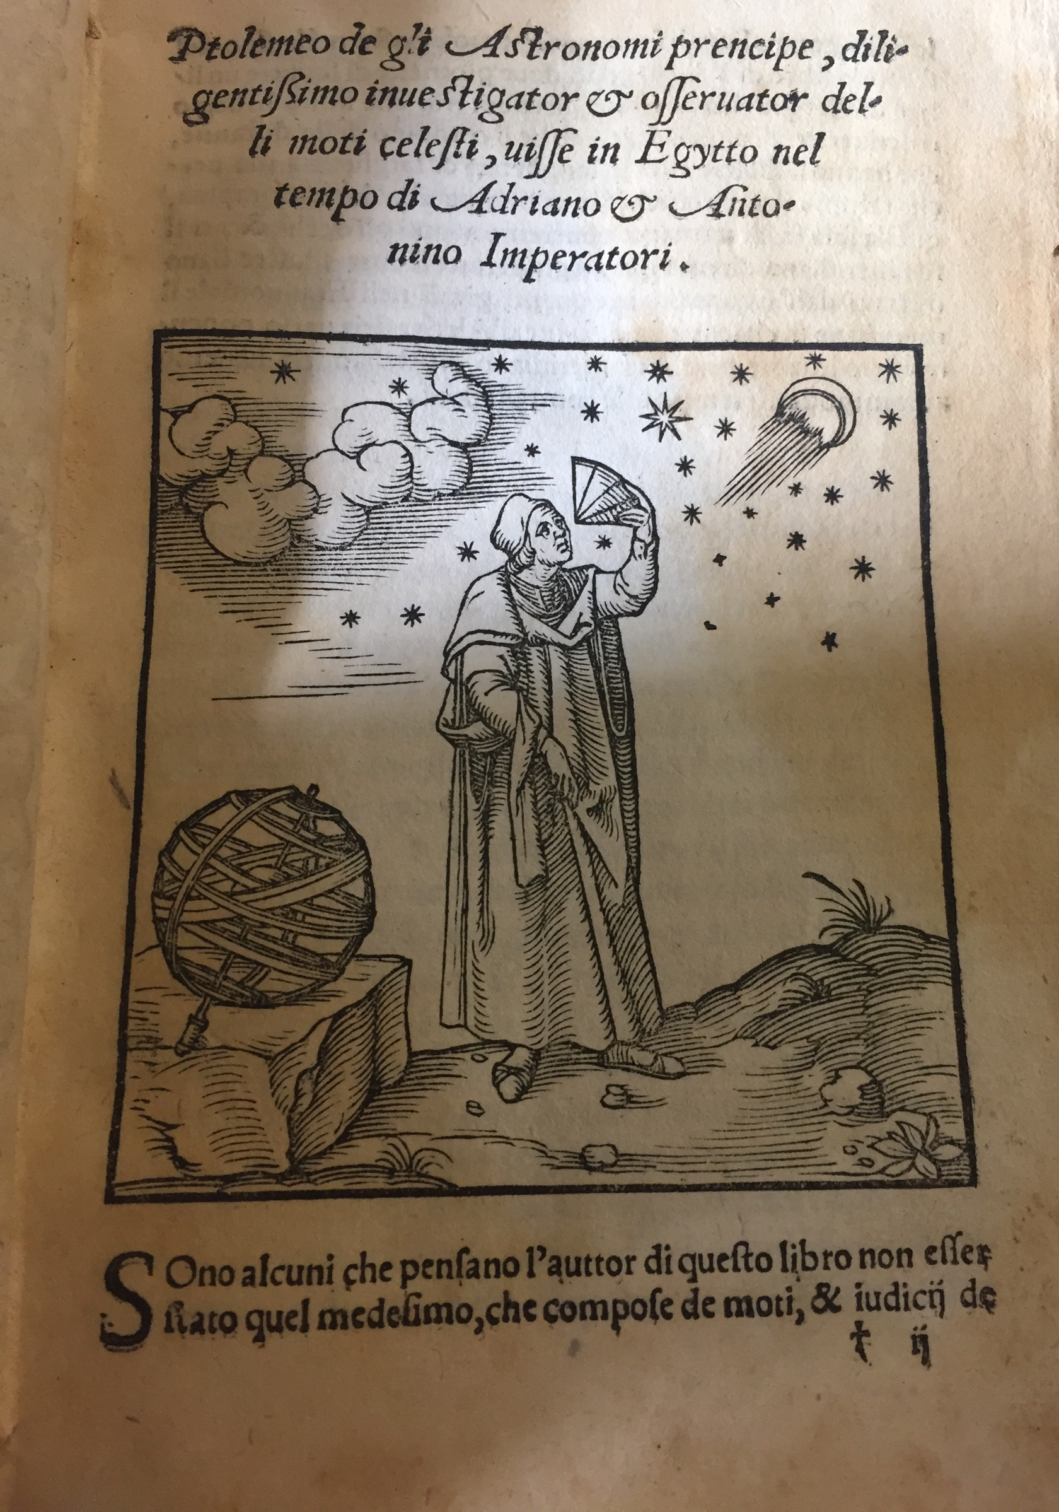

Art and Cartography in the Renaissance:
The Influence of Ptolemy's Geography
Gloria Moorman
Centre for the Study of the Renaissance,
University of Warwick
g.moorman@warwick.ac.uk

Slide 2
Approaching Early Modern Maps
- What questions do we ask of maps?
- How does our mode of interaction (looking at a single-sheet map, leafing through atlas books, or looking up at wall maps) influence our expectations, and the answers potentially provided?
- What kinds of messages are conveyed through cartographic content and its carrier?
- To what extent may two-dimensional maps allow the individual viewer to grasp the global or the local,
the natural and the cultural, the ancient versus the modern?
‘Maps are often thought of as records of facts and terrain rather than actors in history. [Yet] a map does not merely illustrate the lie of the land […]. It is also an instrument of persuasion.’
The Economist, November 24th 2018

Slide 3
‘Geography is different from chorography, because the latter, dividing particular places, exposes them separately, and each according to itself; and together it describes almost all the things […] contained [within them], like the harbours, the towns, the peoples, […] rivers, and other, similar things.
Where it is proper to Geography to show all in one […], the objective of chorography is to represent a sole part, just like it would imitate or paint a single ear, or an eye.’
Giovanni Antonio Magini,
Geografia cioè descrittione universale della terra [...] di Claudio Tolomeo, nuouvamente con singolare studio rincontrati, & corretti dall'eccell.mo sig. Gio. Ant. Magini padovano Pubblico Matematico nello Studio di Bologna
(Venice: Gio. Battista & Giorgio Galignani, 1598).

Slide 4
'[The] science of cosmography is of use not just to philosophers, theologists, astronomers, medics, legal scholars, orators, poets, and other men learned in any science, to better themselves with the truth of those things of the world that relate to their sciences. But it [cosmography] is also necessary to Princes, to rulers of Republics, to leaders of armed men, to Captains and Admirals of armies at sea, to privateers, to soldiers, to merchants, to gentlemen and the most gentle women, to travellers and pilgrims, and finally to each gentle spirit that […] wants to know what that this world of ours is.
With this knowledge one knows not only the world as a whole, but in particular the regions, the provinces, […] the islands, the seas, […] the lakes, the mountains, the forests, the cities, […] the peoples, the habits, […] and laws one finds there. Additionally, one may with this noble science promptly know under what climate, and […] province or city any part of the world [lies], and what the distance […] is from one place to another.
In this way, with the science of geography, anyone can be like an eagle, or a falcon, [which] soared into the upper regions of the sky, circles there thanks to one of nature’s special gifts and surveys all parts of the world. […] So we conclude that without any risk and without the effort of long journeys, [the reader] can with the sciences of both cosmography and geography know clearly every single detail of the entire universe.’
Pietro Andrea Mattioli,
La geografia di Claudio Ptolemeo alessandrino […] con le tavole non solamente antiche & moderne solite di stamparsi, ma altre nuove aggiuntevi di messer Iacopo Gastaldo piamontese cosmographo, ridotta in volgare italiano
(Venice: Gio. Baptista Pedrezano, 1548).

Slide 5
‘We wander through and visit the entire world […], at no cost, and swiftly move, without any trouble or discomfort, from east to west, from south to north, at the speed of our eyes and thoughts. And yet what is more fun and entertaining than to see before one’s eyes, from [mere] images and descriptions of the world, the great empires and far-flung countries of so many Kings and Sovereigns? than to know the differences between so many landscapes, cities, and villages? how, and how far, they are positioned in respect of one another? than to note the situation of waters, coves, and promontories? to understand, moreover, the diverse nature and cities of so many peoples, and what such a land produces and renders?’
Willem & Joan Blaeu,
Toonneel des aerdriicx, ofte nieuwe Atlas, dat is beschryving van alle landen /
Theatrum orbis terrarum
(Amsterdam: Blaeu, 1635).

Slide 6
‘Therefore, the maps help the student whose main interest lies in the study of history, who have what they intended to buy, or would willingly spend money on them, were it not that because of limited space, large charts cannot be opened and inspected easily because of their size. For to speak the truth, those large geographical maps and charts which are folded or rolled up are not so commodious, nor, when they are being read, are they easy to inspect. And whoever wants to hang them on a wall will not only need a very large house, but even a king’s gallery or a theatre. Since I have often experienced this, I began to wonder whether it is possible to redress these inconveniences or possibly remove them altogether. And finally, it seemed that this might be accomplished by what we have done in this book of ours, which I earnestly wish that every student will include among his books.’
Abraham Ortelius,
Theatrum orbis terrarum
(Antwerp, 1570 onwards).
[translation in Marcel van den Broecke, ‘Abraham Ortelius’ Library Reconstructed’, Imago Mundi, 66:1 (2014), 25-50 (27).]

Slide 7
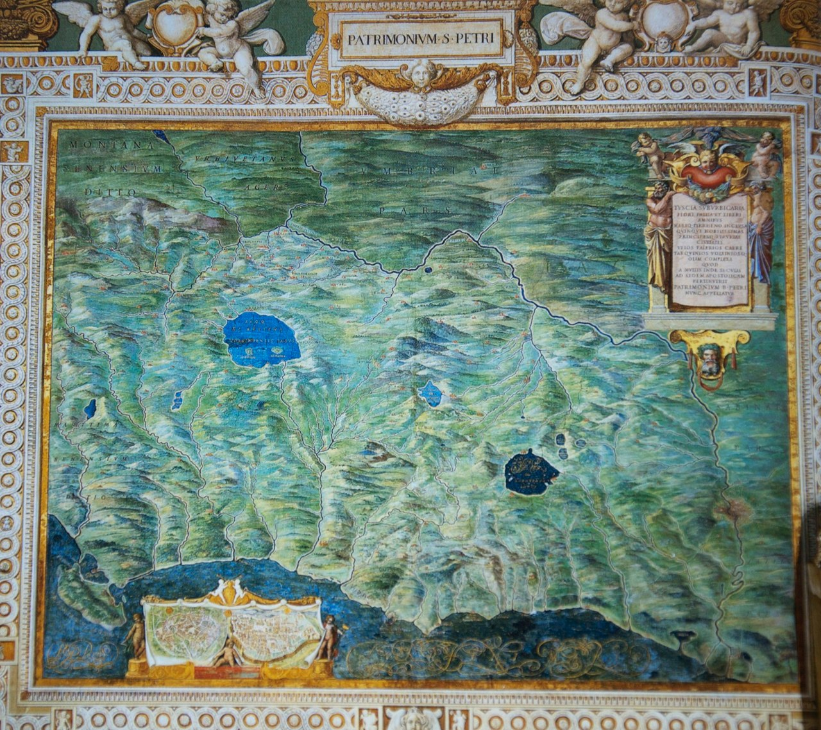
Philip van Winghe, drawing after Patrimonium San Petri and Latium et Sabina (attached to letter, 1592), in Vatican Galleria di carte geografiche.
[Bijzondere Collecties: BPL 2766, Universiteitsbibliotheek Leiden.]

Slide 8
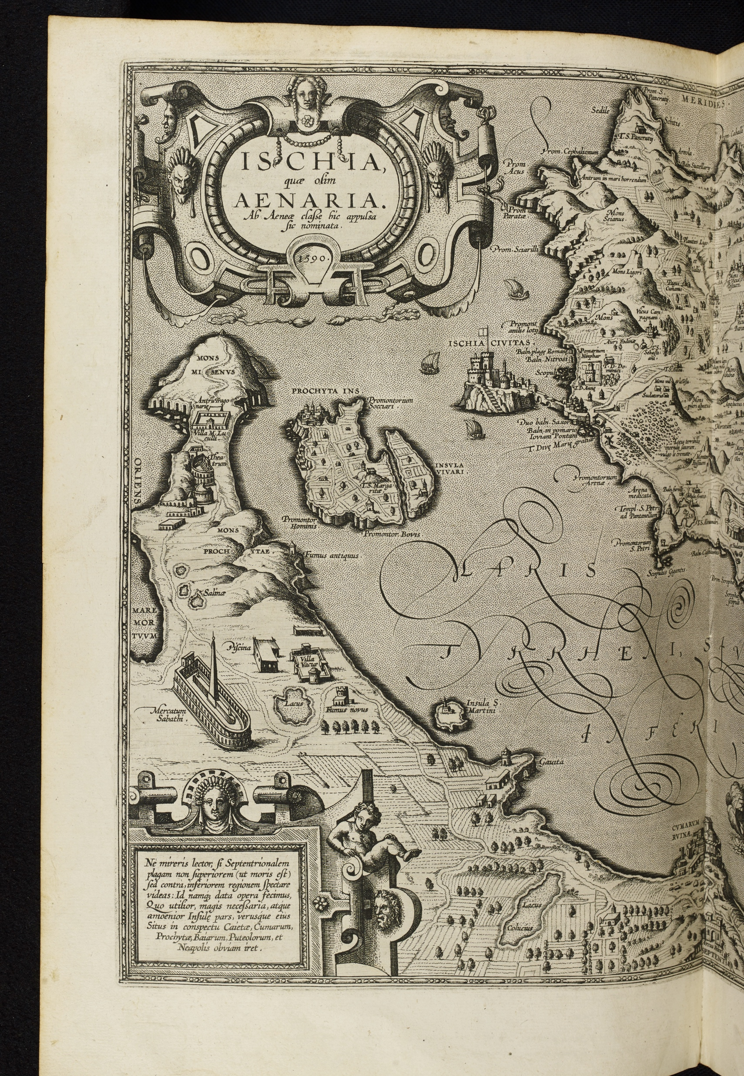
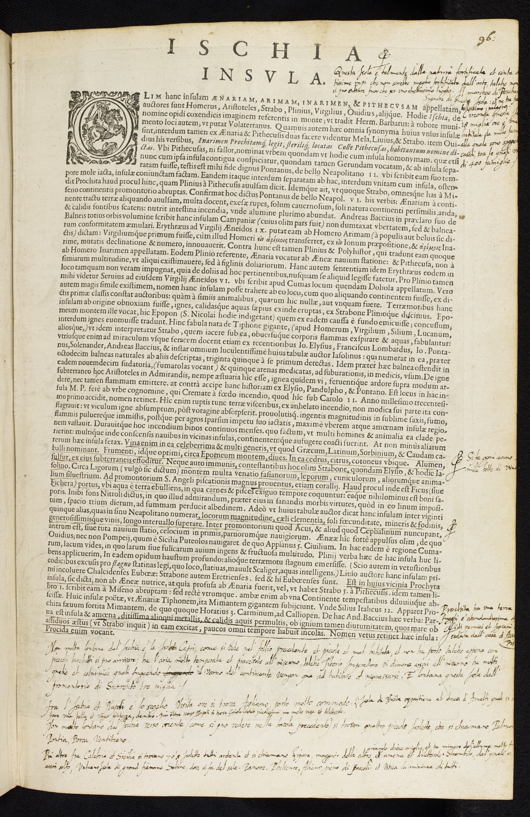
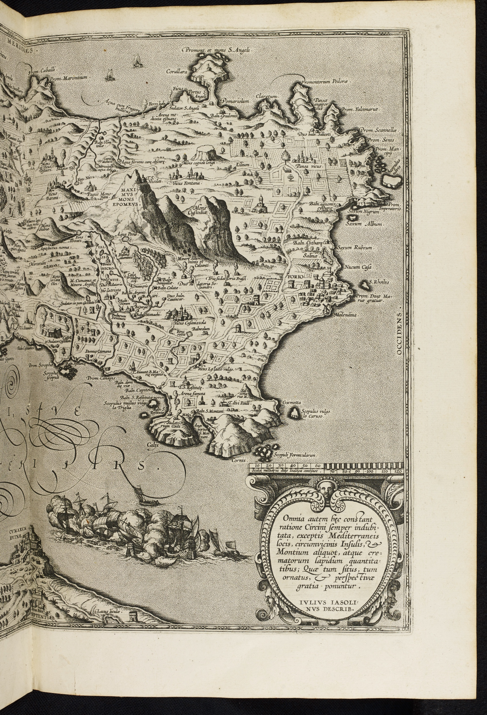
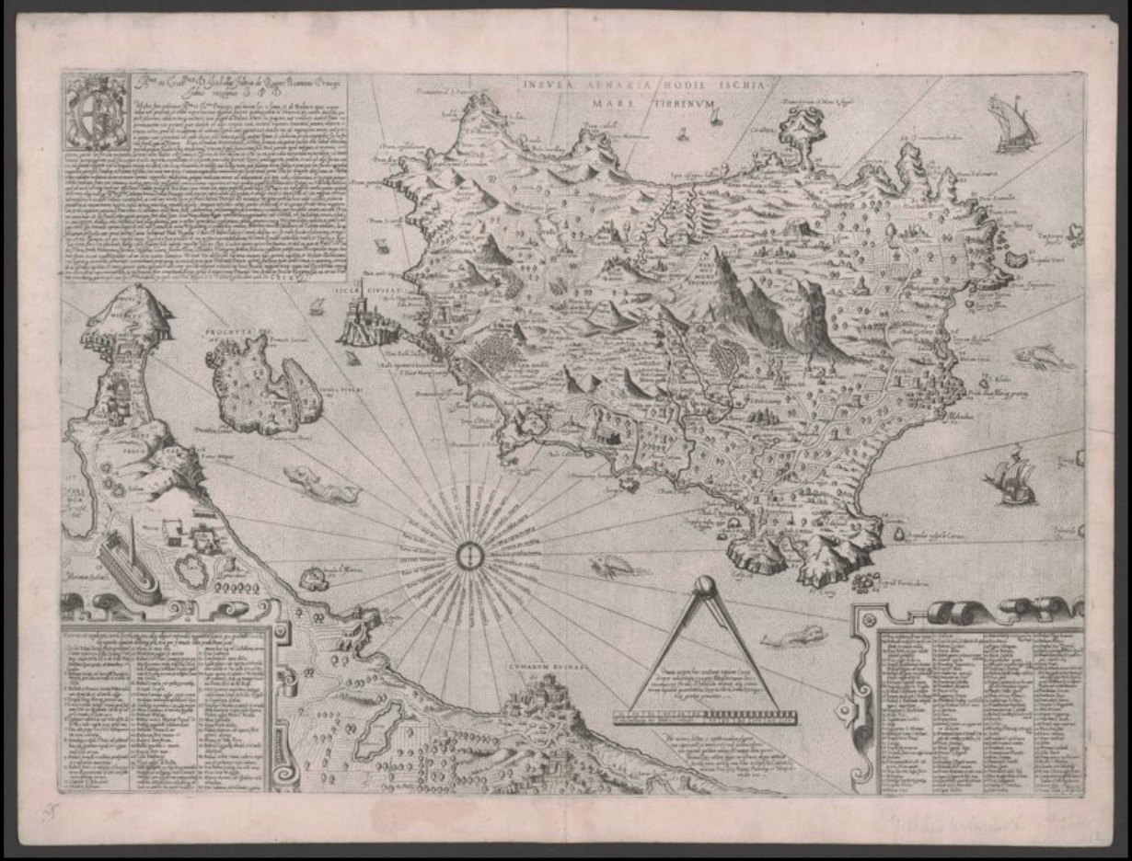
Mario Cartaro and Giulio Iasolino, Insula Aenaria hodie Ischia (1586).

Slide 9
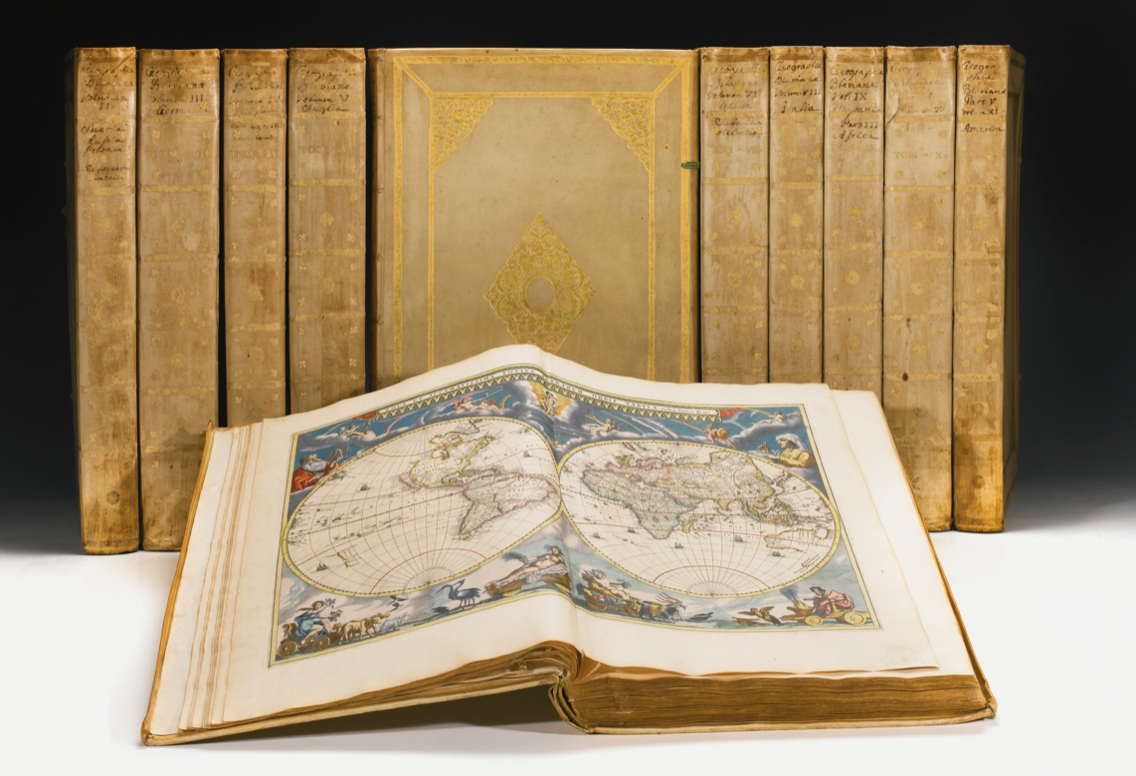
Joan Blaeu,
Atlas Maior, sive Cosmographia Blaviana, qua solum, salum, coelum, accuratissime describuntur
(Amsterdam: Blaeu, 1662 onwards).

Slide 10
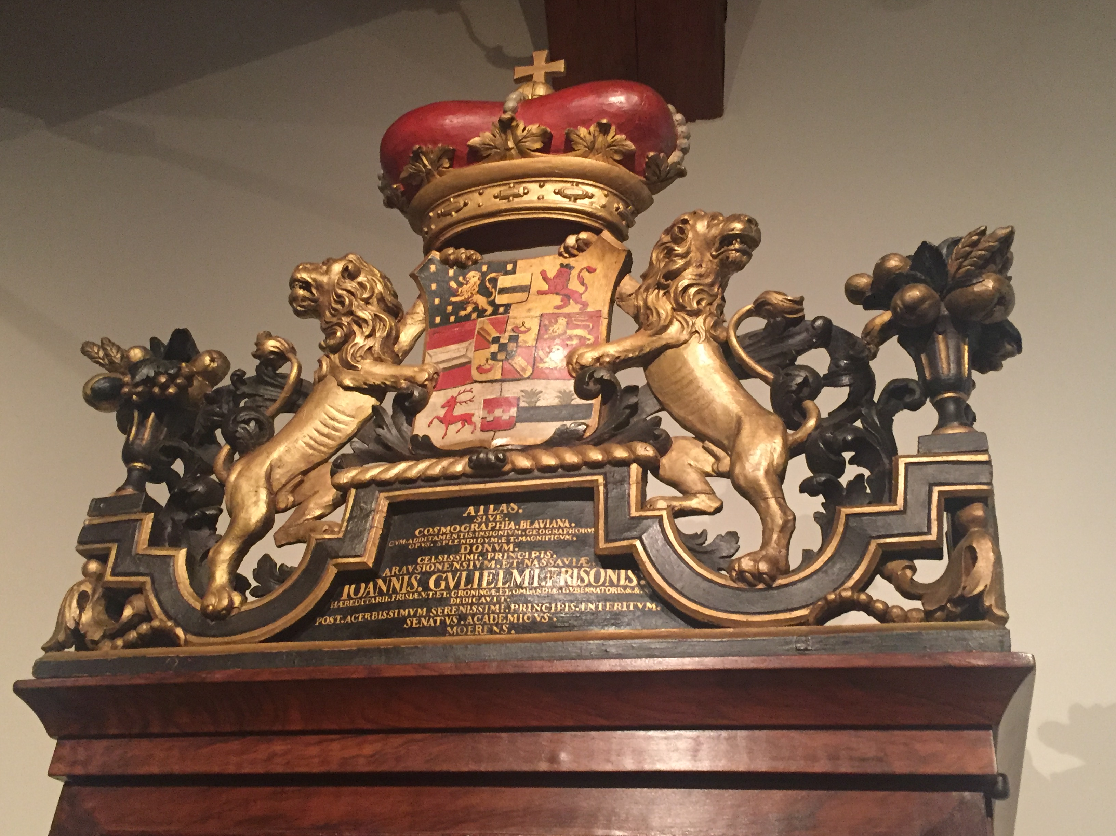
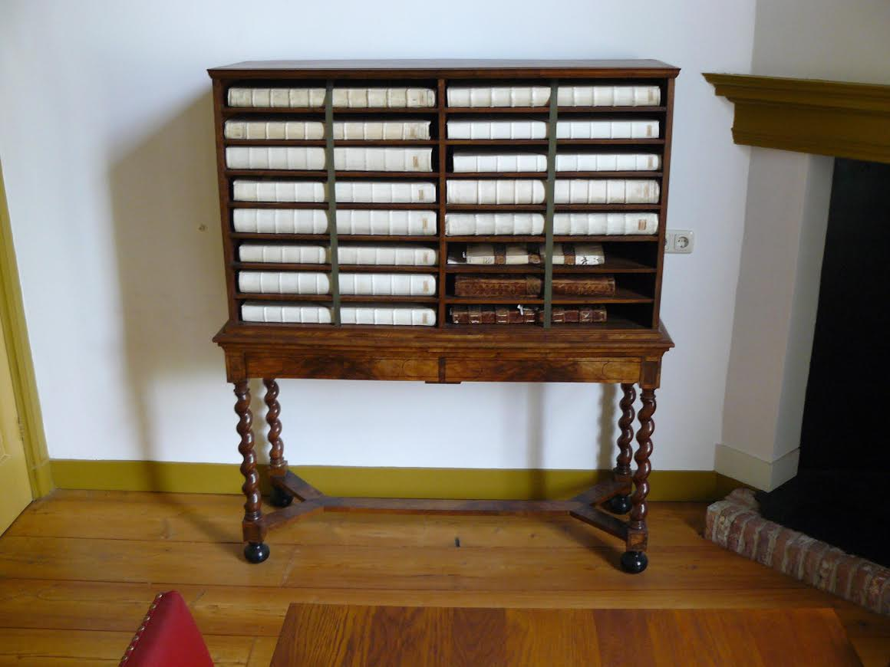
Biblioteca Thysiana, Leiden.
(Former) Franeker universiteit, now Tresoar library, Leeuwarden.

Slide 11
Joan Blaeu,
Atlas Maior, sive Cosmographia Blaviana, qua solum, salum, coelum, accuratissime describuntur
(Amsterdam: Blaeu, 1662 onwards).

Slide 12
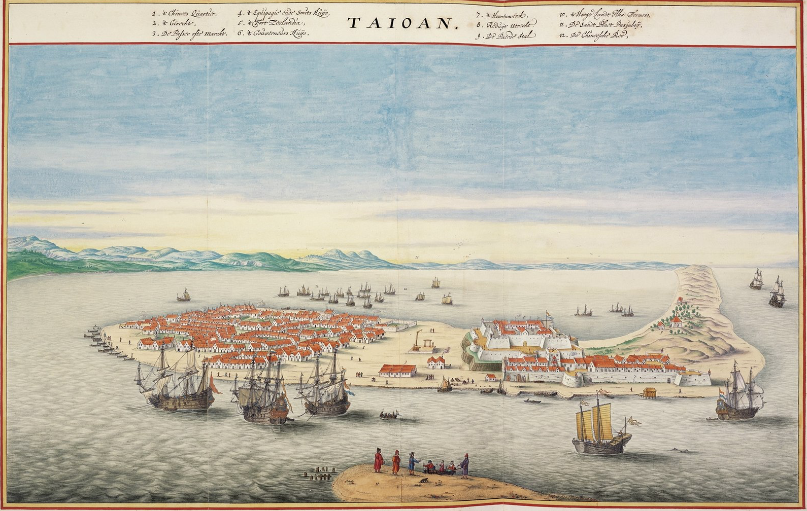
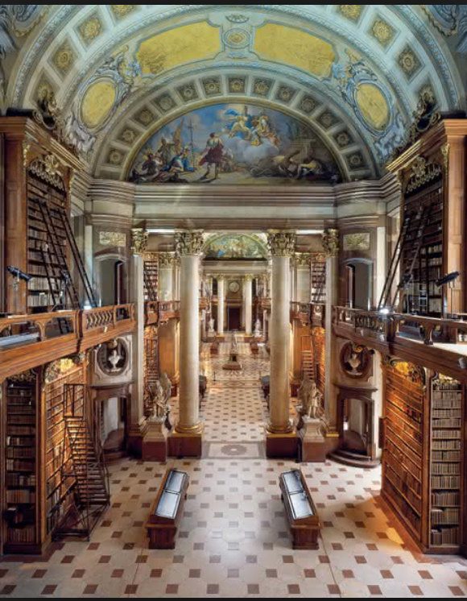
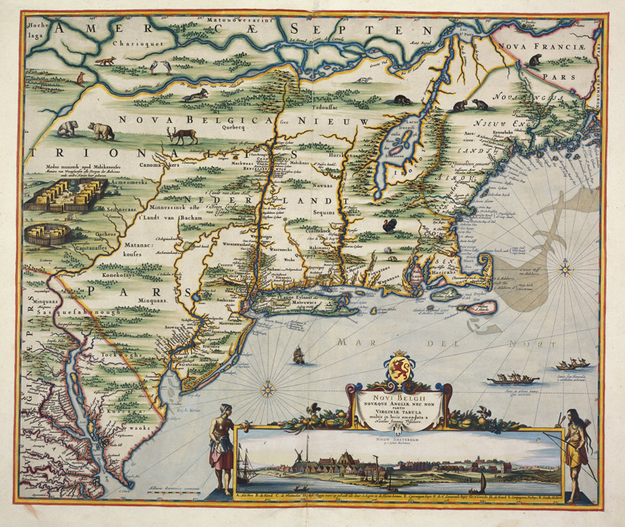

Slide 13
‘The distinctions of class and power are engineered, reified and legitimated in the map by means of cartographic signs. The rule seems to be: the more powerful, the more prominent.
To those who have strength in the world shall be added strength in the map. Using all the tricks of the cartographic trade – size of symbol, thickness of line, height of lettering, hatching and shading, the addition of colour – we can trace this reinforcing tendency in innumerable European maps.
We can begin to see how maps, like art, become a mechanism for defining social relationships, sustaining social rules and strengthening social values. […] Rather than being inconsequential marginalia, […] emblems in cartouches and decorative title pages can be regarded as basic to the way they convey their cultural meaning […], and they help to demolish the claim of cartography to produce an impartial graphic science.’
J.B. Harley, ‘Deconstructing the Map’,
in The Map Reader: Theories of Mapping Practice and Cartographic Representation
(2011), pp. 58-59.

