Slide 1
‘John Milton and the Ancient World’
Renaissance Reinterpretations of the Ancient World
Dr. Katie Forsyth
Teaching Fellow in Medieval and Early Modern Literature
K.Forsyth@warwick.ac.uk

Slide 2
Structure of Lecture
1. Biography of John Milton
2. Introduction to Milton’s earlier poetry – L’Allegro and Il Penseroso
3. Paradise Lost and the Epic Tradition

Slide 3
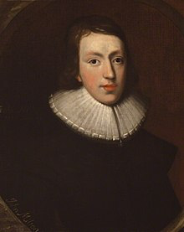
John Milton
b. 9th December, 1608. Bread Street, London.
Affluent family.
Childhood filled with music and learning.
Education began at home with private tutor.
Then moved to St. Paul’s School.
  Principal goal: “the preparation of young men for public life through the study of classical languages and literature.” (Chaplin, p.282)
  “boys must be instructed in…Greek, of course, and Latin…because almost everything worth learning is set forth in these two languages.” Erasmus.

Slide 4
John Milton
Age 11 – built on Latin grammar. Started conversational Latin via Erasmus and Comedies of Terrence. Also read Ovid’s Tristia.
Age 12 – more poetry. Started to read history. Works such as Ovid’s Metamorphoses and Caesar for history.
Age 13 – Sallust’s Histories and Virgil’s Eclogues. Began study of Greek.
Age 14 – Biblical Greek of New Testament. Cicero, Martial, Virgil.
Age 15 – Additional Greek dialects added to repertoire and relevant literature from those dialects.
Age 16 – Studied Hebrew. Read more widely in Greek Literature (Homer, Euripides, Isocrates, Demosthenes). Latin satirists. History reading in Greek.

Slide 5
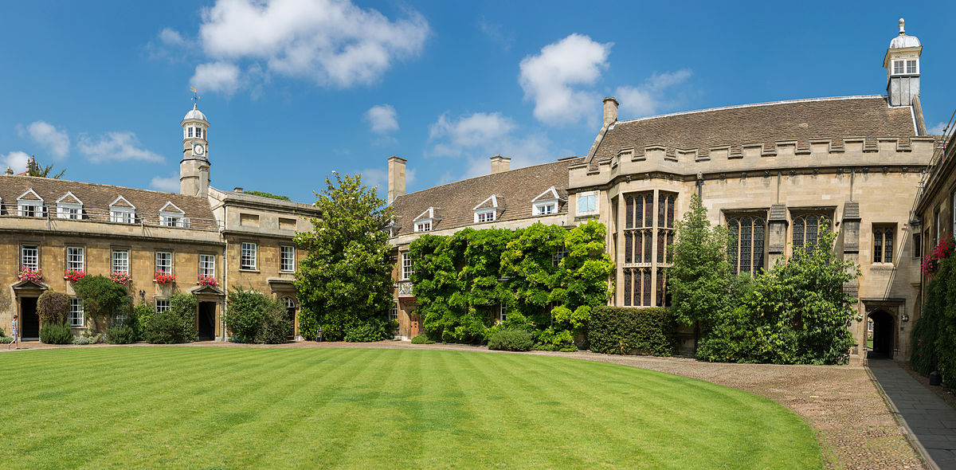
John Milton
Christ’s College, Cambridge

Slide 6
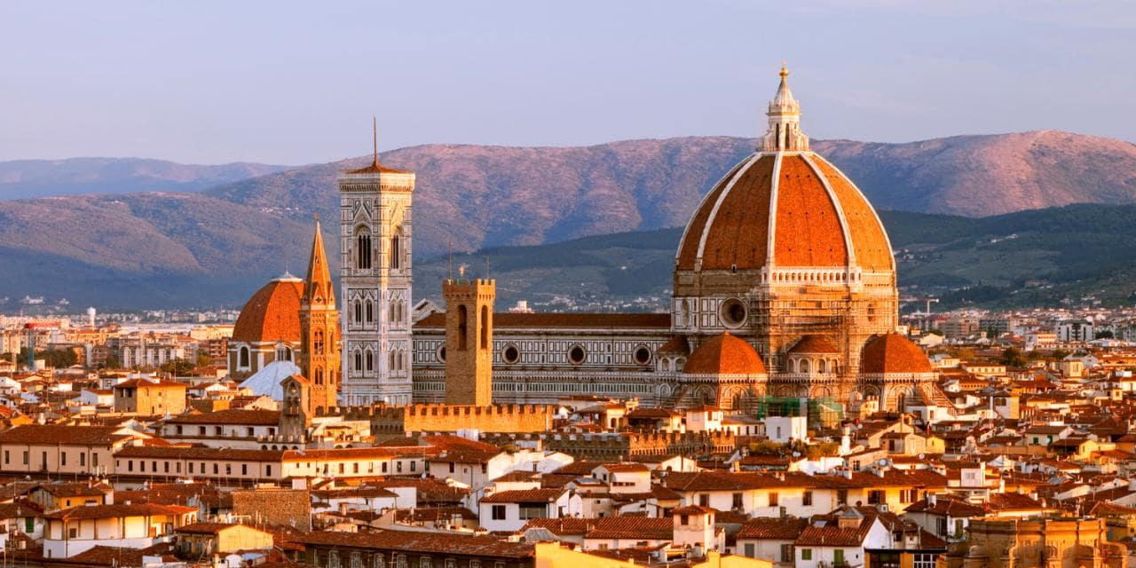
John Milton
Florence

Slide 7
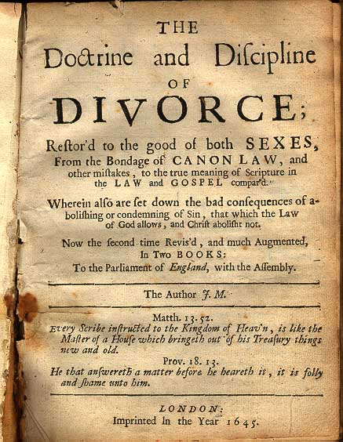
John Milton

Slide 8
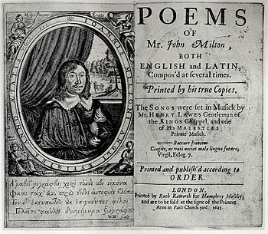
John Milton

Slide 9
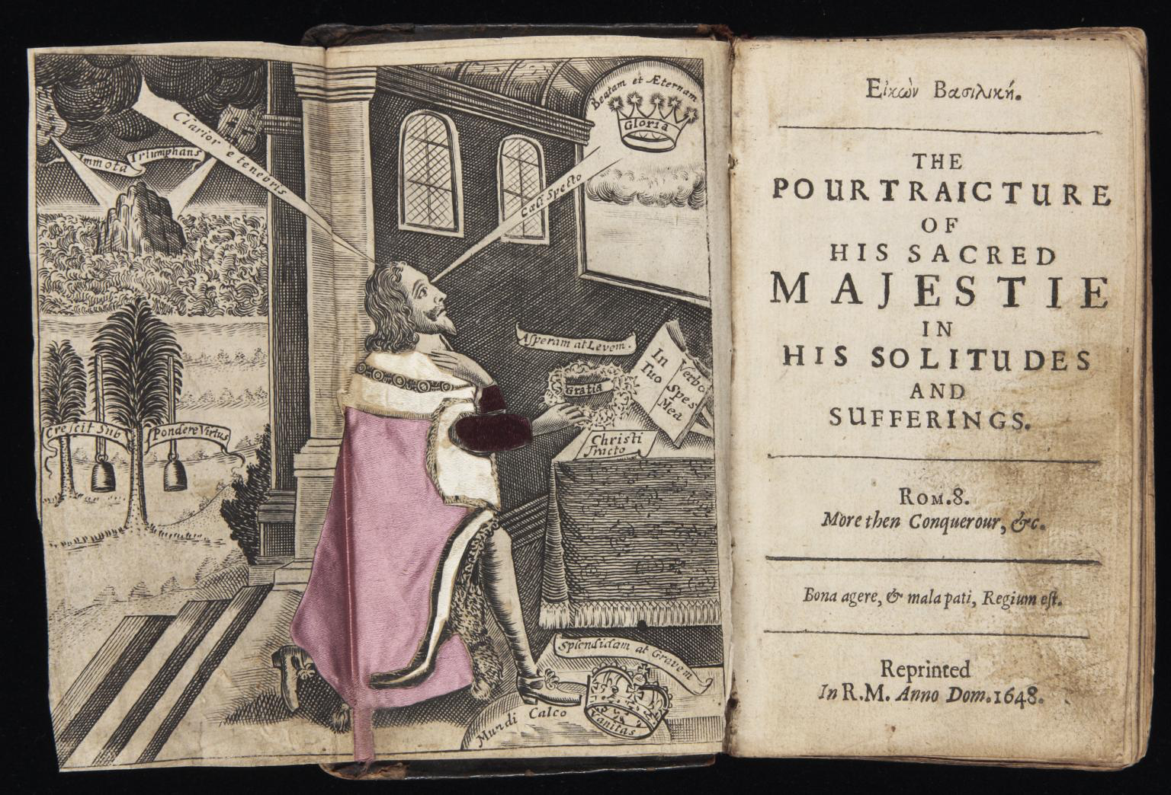
John Milton

Slide 10
Milton’s Early Poetry
Up to 1629 – clear preference for poems in languages other than English:
  1 poem in Greek
  6 in Italian
  19 in Latin
  7 in English (3 translations)
  Then after 1629, a clear move towards vernacular poetry. Just one poem in Latin between 1629 and 1637-38.

Slide 11
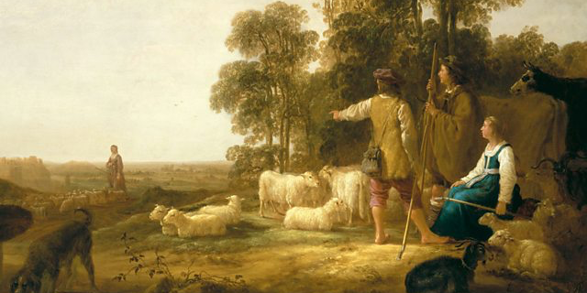
Milton’s Early Poetry

Slide 12
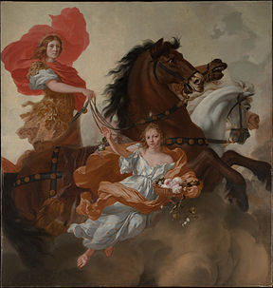
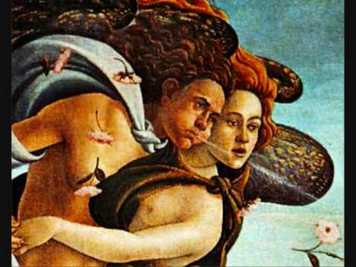
Milton’s Early Poetry
Aurora
Zephyr

Slide 13
Paradise Lost
Book 1 – we start in media res – in the middle of things – I will come back to this term shortly - and we meet Satan and the fallen rebel angels in Hell.
Book 2 – Satan assembles a council of rebel angels and they decide their next step. They decide Satan should go to explore the newly-created Earth.
Book 3 – We meet God and the Son for the first time and God prophesizes the fall of man, but explains to the Son that he gave Adam and Eve free will to stand or fall as they choose. The son then offers himself to save mankind. Satan reaches Earth.
Book 4 – Satan enters Eden and we see Adam and Eve for the first time. Satan spies on them – and interestingly expresses strong emotions, particularly jealousy when watching them together. However, Satan is caught and expelled from Eden
Book 5- the angel, Raphael, goes to Eden to warn Adam and Eve of Satan. Raphael relates the story of the war in Heaven between Satan (then Lucifer) and God to Adam.
Book 6 – Raphael continues to recount the war in Heaven.

Slide 14
Paradise Lost
Book 7 – He describes the creation of the world to Adam.
Book 8 – He describes the creation of Adam and then Eve.
Book 9 – The Fall. Satan returns to Eden disguised as a serpent and tempts Eve with the apple from the tree of knowledge – he tempts her with knowledge. She eats the apple and falls and Adam quickly follows.
Book 10 – God judges Adam and Eve and the allegorical figures of Sin and Death who have been gatekeepers to Hell until now build a bridge between Earth and Hell and enter Earth for the first time. Satan returns to Hell and informs the rebel angels of his success, but God punishes them by turning them into snakes.
Book 11 – Michael is sent to Eden to expel Adam and Eve but he does show Adam the future (up until the Flood and Noah).
Book 12 – Michael shows Adam more of the future before Adam and Eve leave Paradise for ever hand-in-hand.

Slide 15
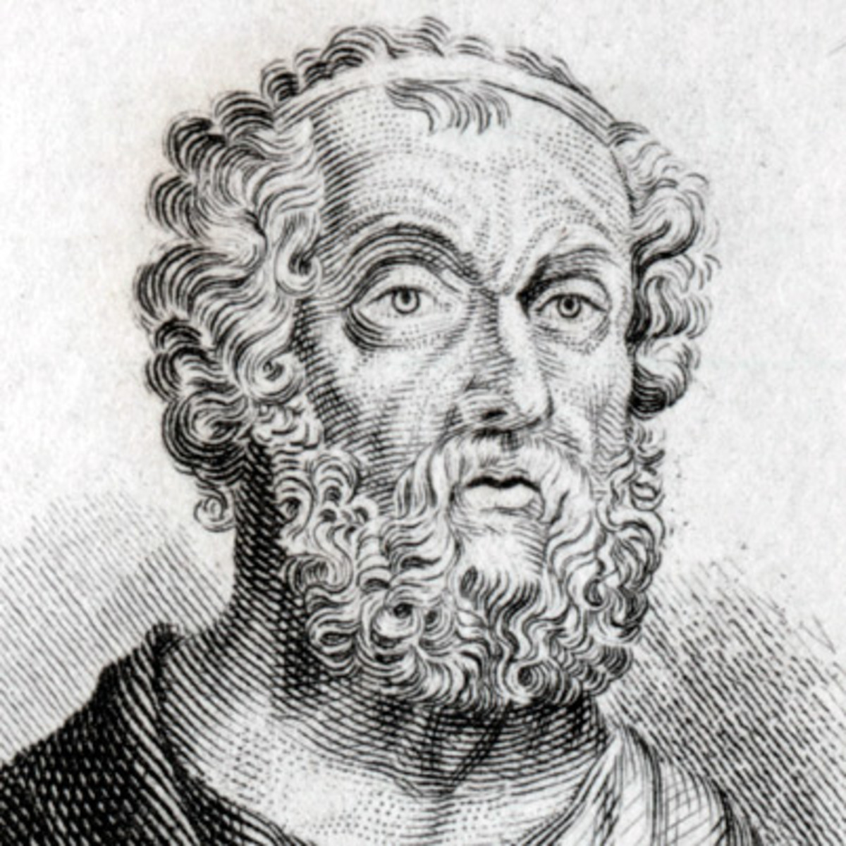
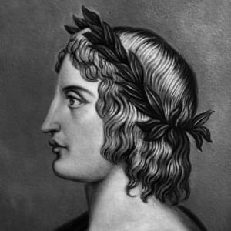
Paradise Lost
Homer
Virgil

Slide 16
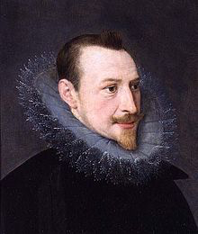
Paradise Lost
Edmund
Spenser

Slide 17
Paradise Lost
Long narrative poem
Usually of national or universal importance
Elevated and dignified style
Makes use of extensive and detailed description – ‘catalogues’
Extensive and detailed description of objects – ‘ekphrasis’
Epic similes:
  “a detailed, often complex poetic comparison that unfolds over the course of several lines.” poetryfoundation.org

Slide 18
Paradise Lost
Epic simile – rebel angels as bees:
“As bees
in springtime, when the sun with Taurus rides,
Pour forth their populous youth above the hive
In clusters; they among fresh dews and flowers
Fly to and fro, or on the smoothed plank,
The suburb of their straw-built citadel,
New rubbed with balm, expatiate and confer
Their state affairs.” (1.752-766)

Slide 19
Paradise Lost
Invocation of the muse:
“Sing, goddess, the anger of Peleus’ son Achilles and its devastation, which put pains thousandfold upon the Achaians.” The Iliad
“Tell me, Muse, of the man of many ways, who was driven far journeys, after he had sacked Troy’s sacred citadel.”
The Odyssey
“Tell me the causes now, O Muse, how galled in her divine pride, and how sore at heart from her old wound, the queen of Gods compelled him – a man apart, devoted to his mission- to undergo so many perilous days and enter on so many trials.”
The Aeneid

Slide 20
Paradise Lost
“Of man’s first disobedience and the fruit of that forbidden tree, whose mortal taste brought death into the world, and all our woe, with loss of Eden, till one greater man restore us, and regain the blissful seat, sing heavenly muse, that on the secret top of Oreb, or of Sinai, didst inspire that shepherd, who first taught the chosen seed, in the beginning how the heavens and earth rose out of Chaos..” (1. 1-10)

