Slide 1
Renaissance Reinterpretations of the Ancient World
Ariosto and the ancient world
Dr Maria Pavlova
Maria.Pavlova@warwick.ac.uk

Slide 2
Palma il Vecchio, Portrait of a Poet
(1516), National Gallery

Slide 3
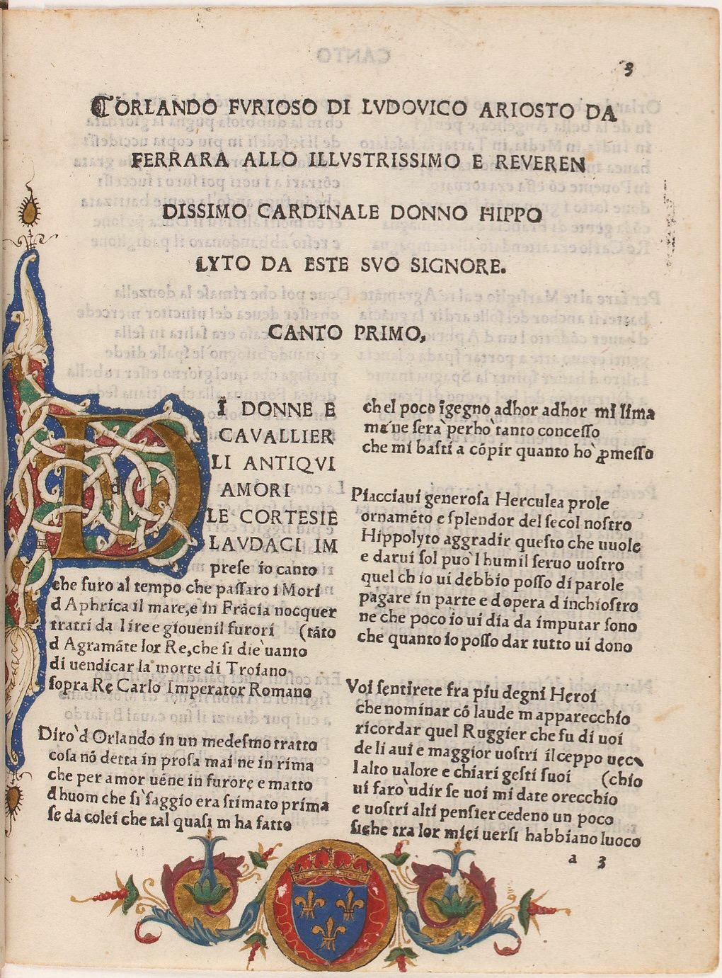
1516 edition of Orlando furioso
Francis I’s copy
Bibliothèque nationale de France

Slide 4
Of ladies, cavaliers, of love and war,
Of courtesies and of brave deeds I sing,
In times of high endeavour when the Moor
Had crossed the sea from Africa to bring
Great harm to France, when Agramante swore
In wrath, being now the youthful Moorish king
To avenge Troiano, who was lately slain,
Upon the Roman Emperor Charlemagne.
And of Orlando I will also tell
Things unattempted yet in prose or rhyme,
Of the mad frenzy that for love befell
One who so wise was held in former time,
If she who my poor talent by her spell
Has so reduced that I resemble him,
Will grant me now sufficient for my task:
The wit to reach the end is all I ask.
Most generous and Herculean son,
The ornament and splendour of our age,
Ippolito, pray take as for your own
Your humble servant’s gift, that men may gauge
The debt I owe to you, which words alone
Cannot repay, nor ink upon the page.
And let it not be said my gift is small,
For giving this, my lord, I give my all.
Among the heroes most deserving praise
Whose catalogue of names I now prepare,
Ruggiero I will bring before your gaze,
The founder of the lineage you bear.
His valiant deeds which time cannot erase
I will make known to you if you’ll lend ear
And from your lofty thoughts your mind incline
To grant admittance to this tale of mine.
Orlando furioso, I 1-4

Slide 5
Chanson de Roland
MS Digby 23
Bodleian Libraries
University of Oxford

Slide 6
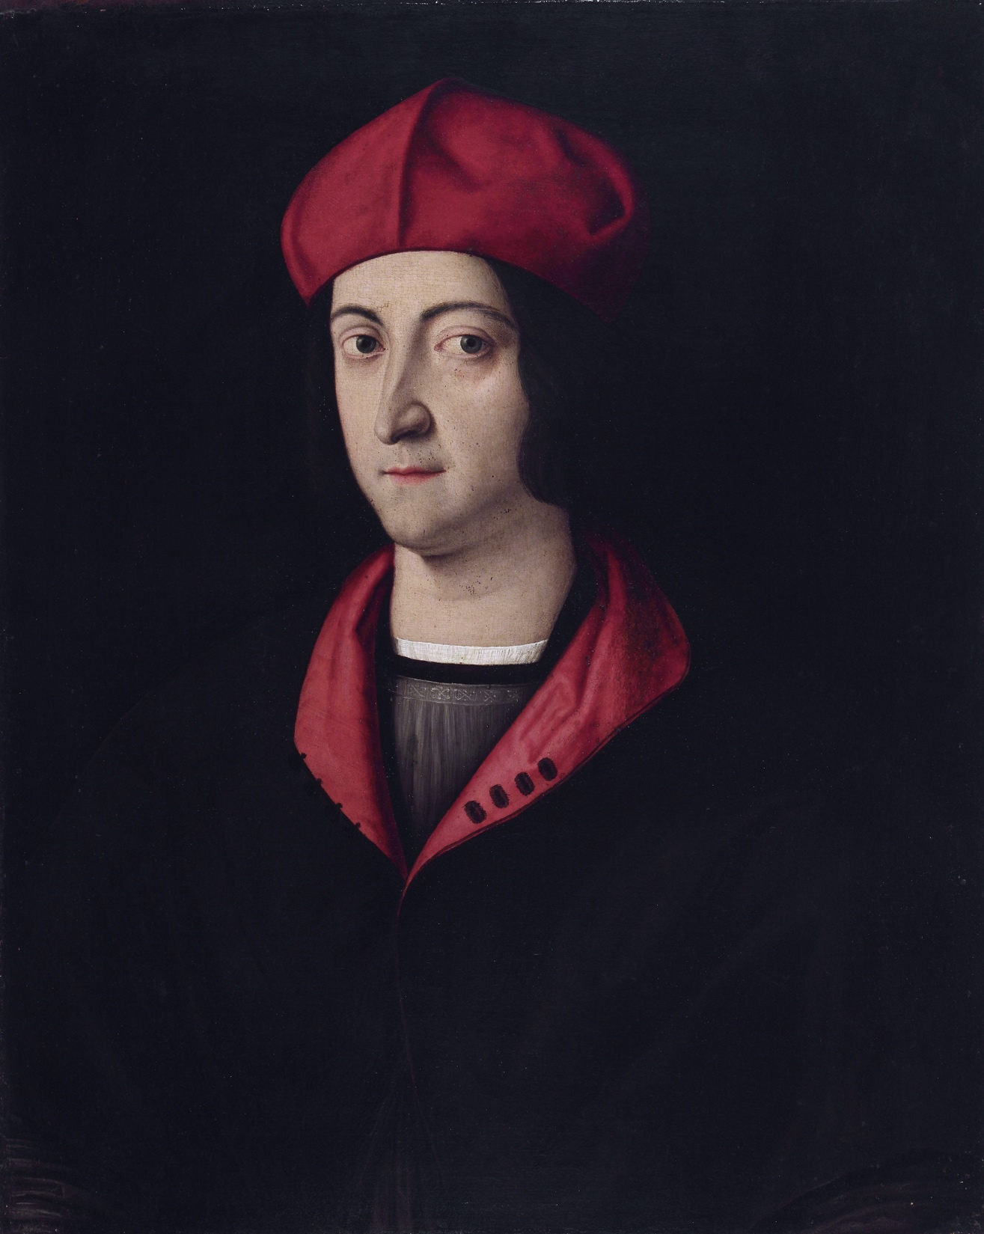
Bartolomeo Veneto Ippolito d’Este, private collection

Slide 7
Renaissance translations of the Metamorphoses
Giovanni Bonsignori, Ovidio metamorphoseos vulgare (1497).
Nicolò degli Agostini, Tutti li libri de Ovidio Metamorphoseo, in verso vulgar con le sue allegorie in prosa et istoriato (1522)
Ludovico Dolce, Le Trasformationi (1553).
Giovanni Andrea dell’Anguillara, Le Metamorfosi di Ovidio (1561)

Slide 8
Piero di Cosimo, Perseus freeing Andromeda, Uffizi

