Slide 1
Visual Culture of the Renaissance and the Classical Tradition
Kenilworth Community Course “Renaissance Reinterpretations of the Ancient World”
01 February 2019
Centre for the Study of the Renaissance

Slide 2
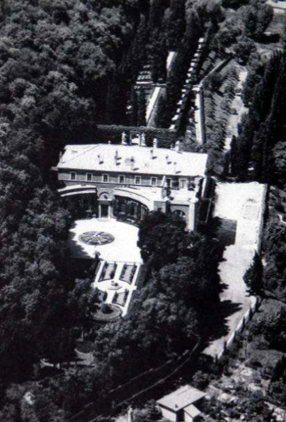
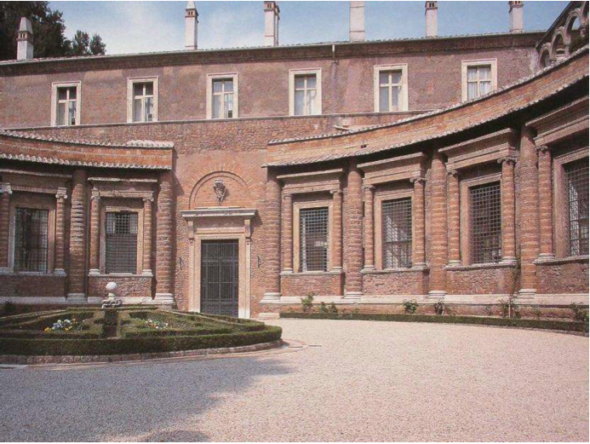
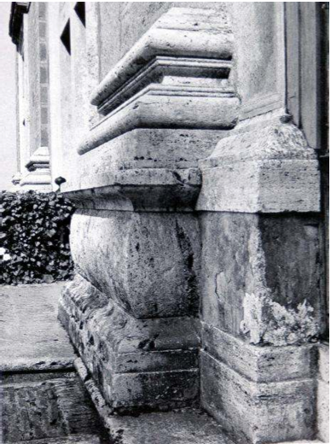
Raphael, Villa Madama, 1519-’20, Rome

Slide 3
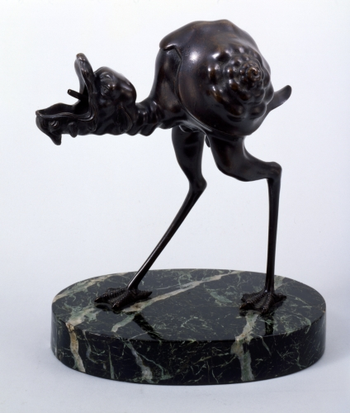
Arent van Bolten (1573-1633), bronze lamp in the form of a grotesque bird, c.1620, Amsterdam http://barber.org.uk/bolten-arent-van-about-1573-1633/

Slide 4
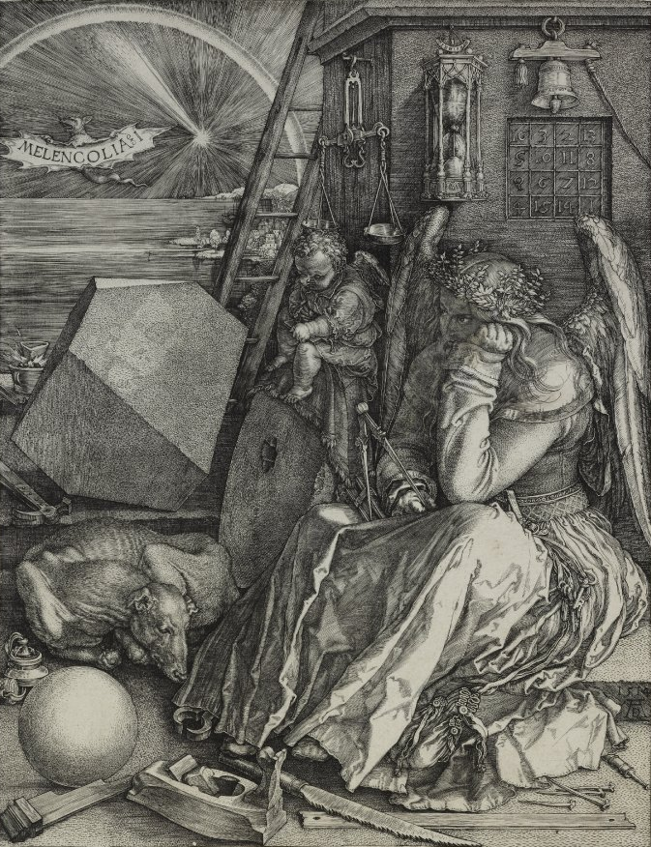
Albrecht Dürer,
Melencolia I, 1516,
Bartsch VII. 87. 74
Albrecht Dürer, Melancholia I, engraving, 1514

Slide 5
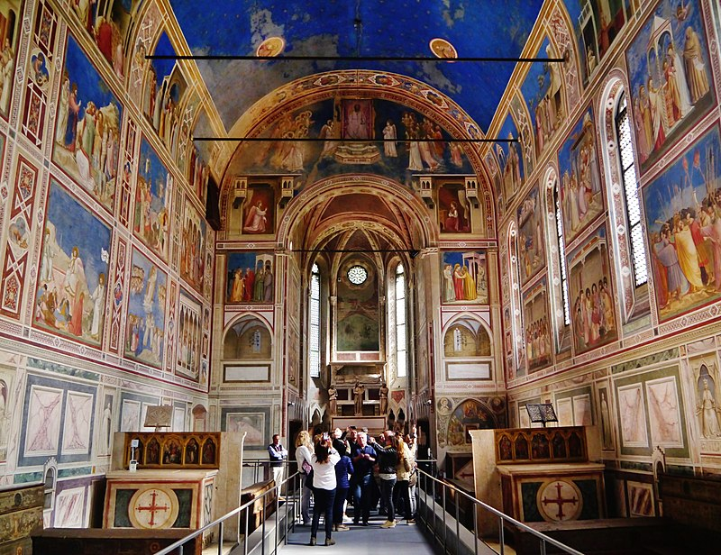
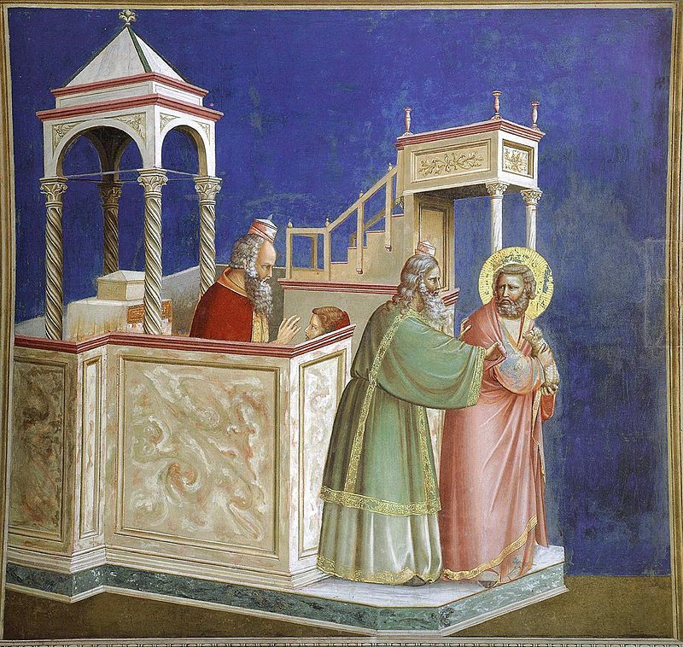
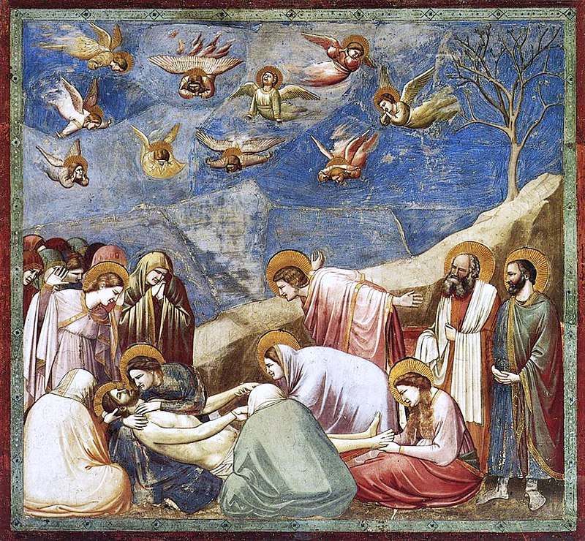
Giotto, Scrovegni Chapel, frescoes, Padua 1304-’06

Slide 6
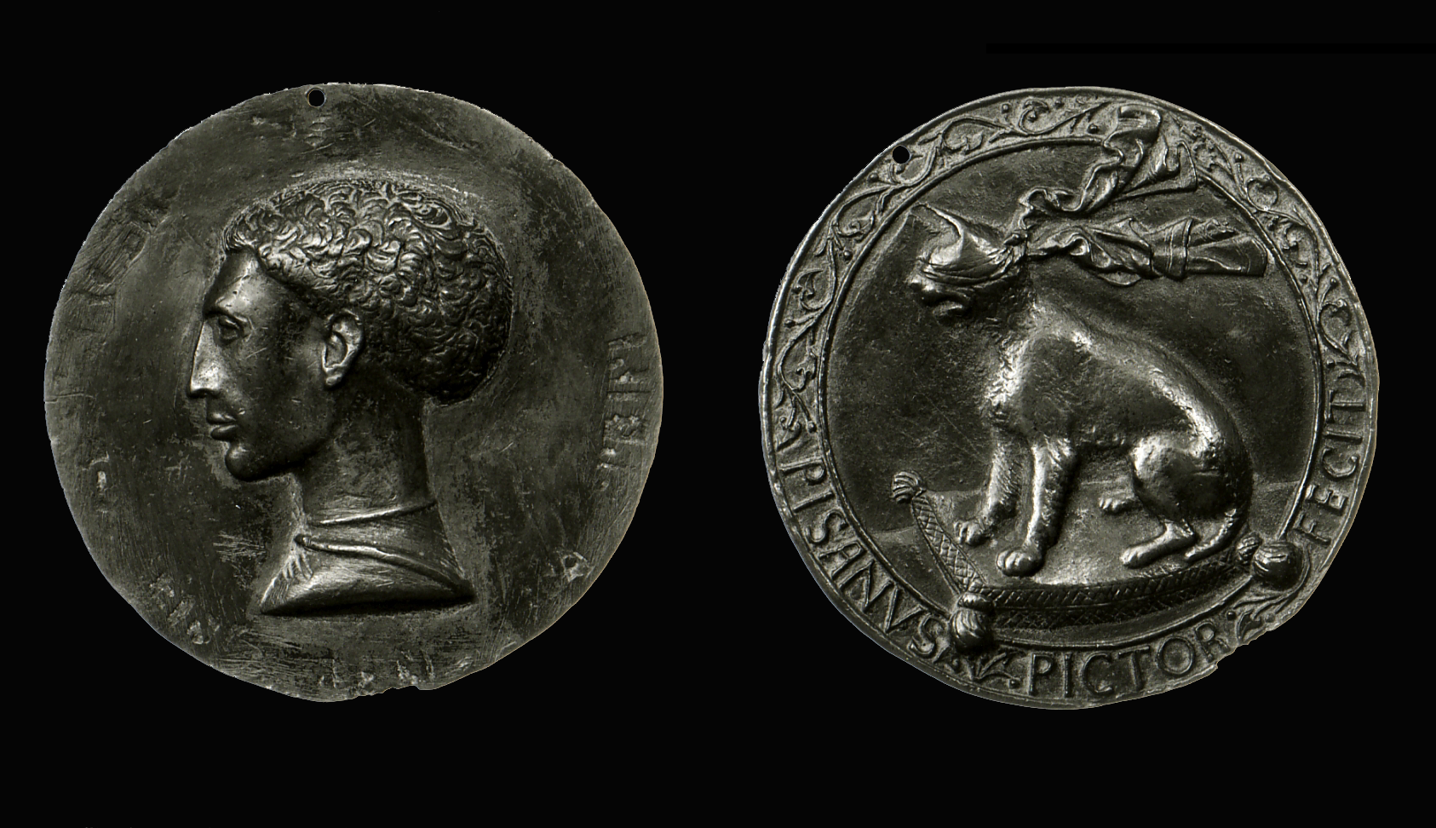
Pisanello, Lionello d’Este with device of blindfold lynx, 1449, British Museum, London

Slide 7
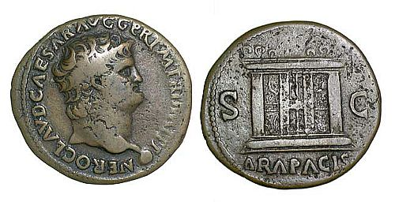
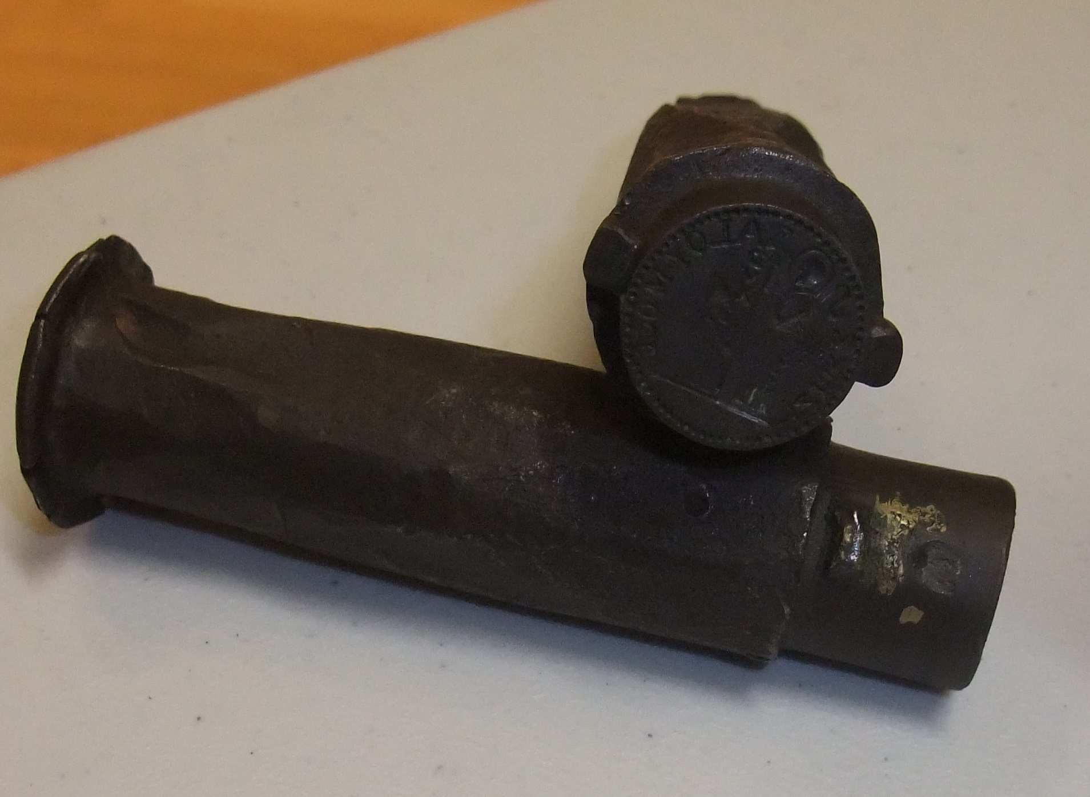
coin of Nero’s time, 54-68 http://barber.org.uk/roman-coins/
http://barber.org.uk/anthony-cleopatra/
http://barber.org.uk/miscellaneous/

Slide 8
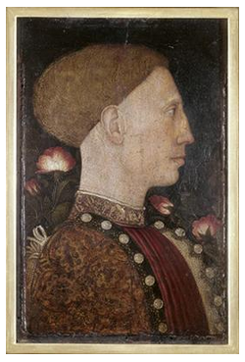
Pisanello, Portrait of Lionello d’Este, 1441, Accademia Carrara, Bergamo

Slide 9
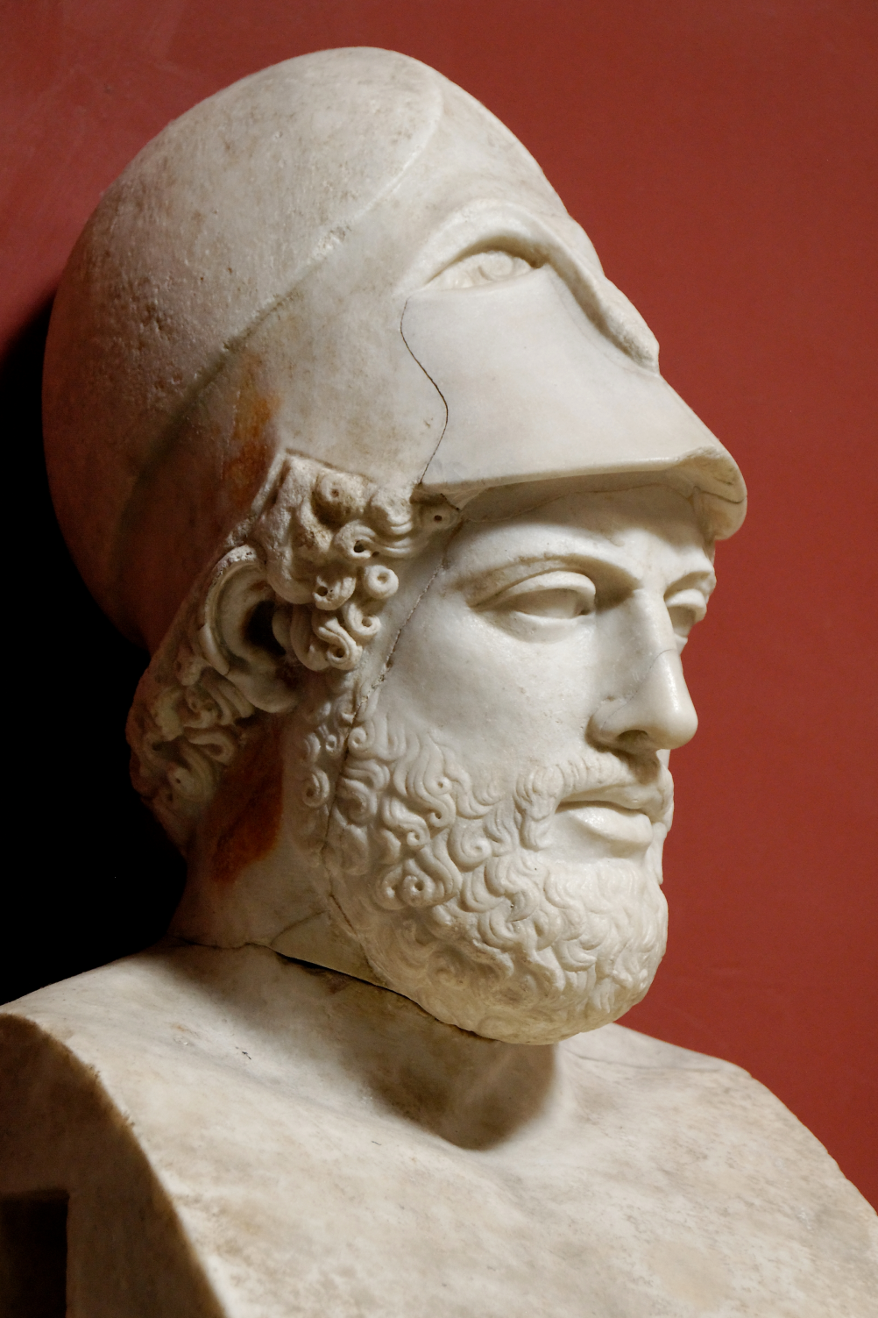
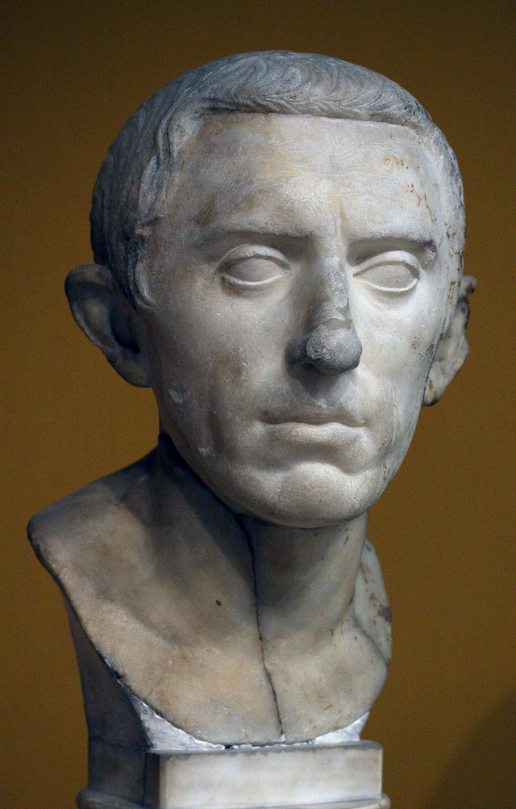
Pericles, 1st century copy of Greek 5th century BC bust,
Museo Pio-Clementino, Rome
Anon. Roman, 1st century BC-
AC, Museum of Fine Arts, Boston

Slide 10
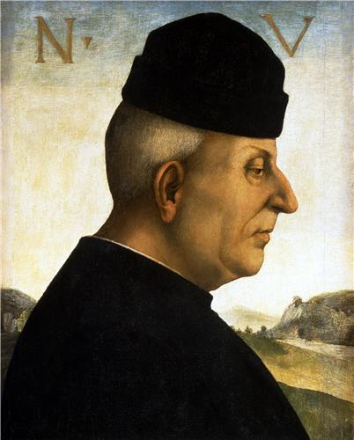
Luca Signorelli, A Portrait of Niccolò Vitelli, 1492-’93, oil on wood
http://barber.org.uk/luca-signorelli-about-1441-1523/

Slide 11
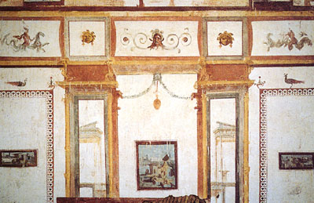
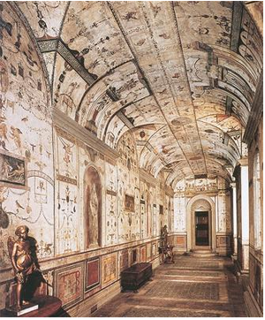
Grotesques, Domus Aurea, middle of 1st century AD
Raphael and workshop – Giovanni da Udine, Grotesques, Loggetta of Cardinal Bibbiena, fresco, 1516-’17, Vatican Palace

Slide 12
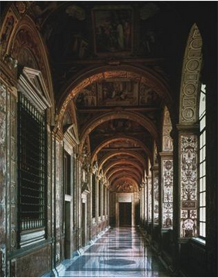
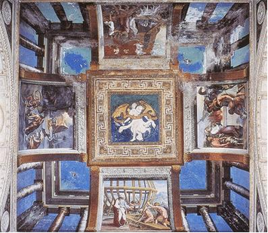
Raphael and workshop, Loggia with biblical scenes, frescoes, 1517-’20, Vatican Palace

Slide 13
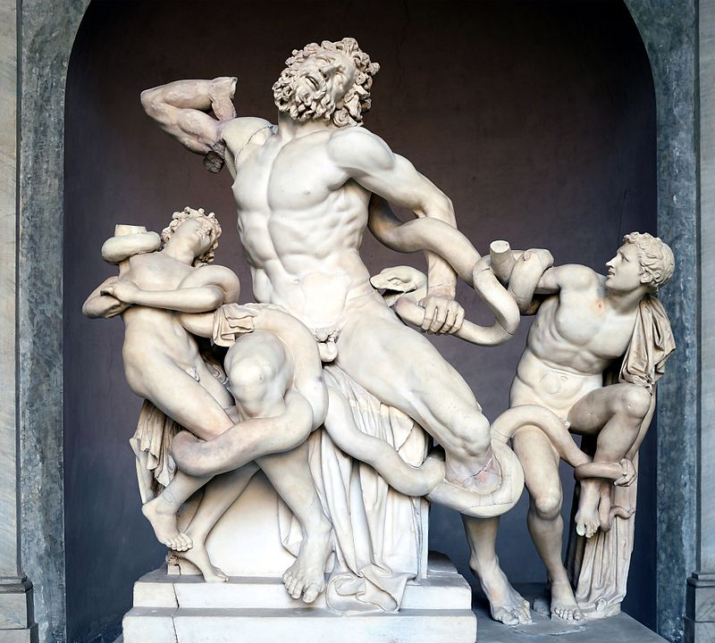
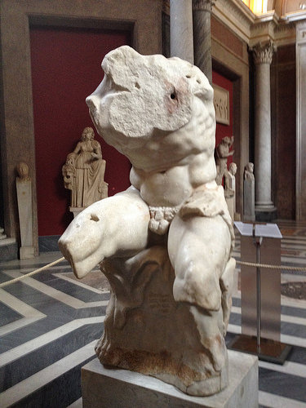
Hagesandros, Polydoros, and Athanadoros from Rhodos, Laocoön and his sons, Roman copy from 2nd century BC original, Vatican Palace
Apollonios from Athens, Torso Belvedere, Roman copy from 2nd century BC original, Vatican Museums

Slide 14
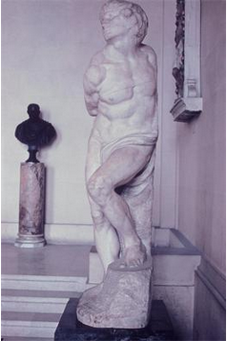
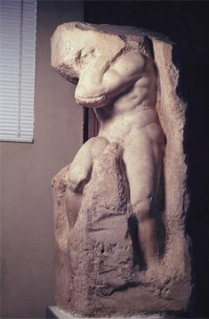
Michelangelo, Slaves – Rebellious c.1513 & Atlas c. 1530-’34, Tomb of Julius II 1505-’45, marble, Louvre, Paris

Slide 15
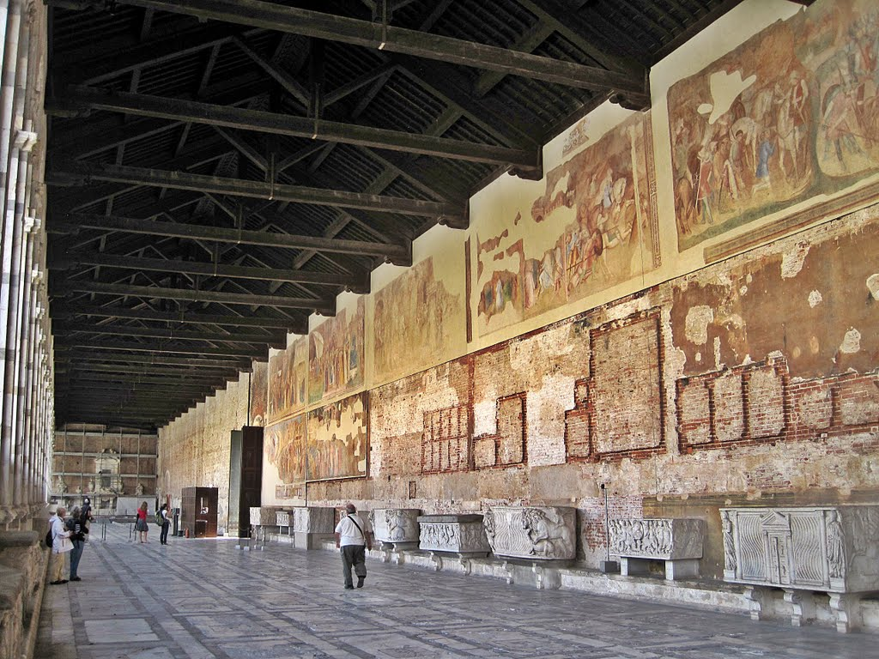
Pisa, Campo Santo

Slide 16
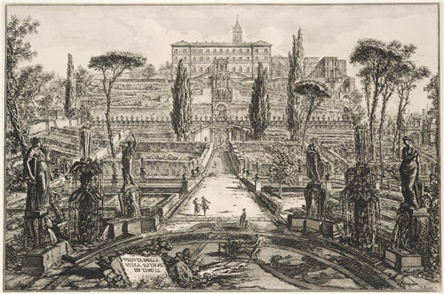
Giovan Battista Piranesi, Villa d’Este in Tivoli, etching, 1773 http://barber.org.uk/giovanni-battista-piranesi-1720-1778/

Slide 17
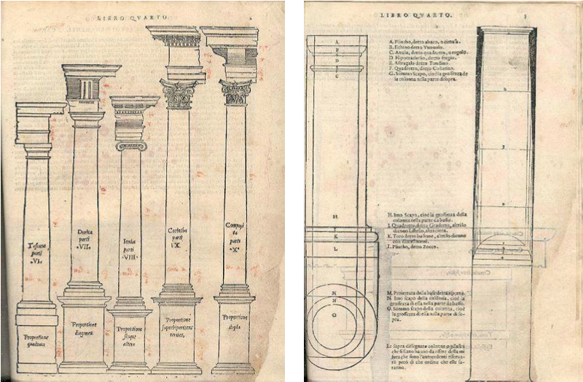
Sebastiano Serlio, Libro quarto de l’architettura, Venice 1537

Slide 18
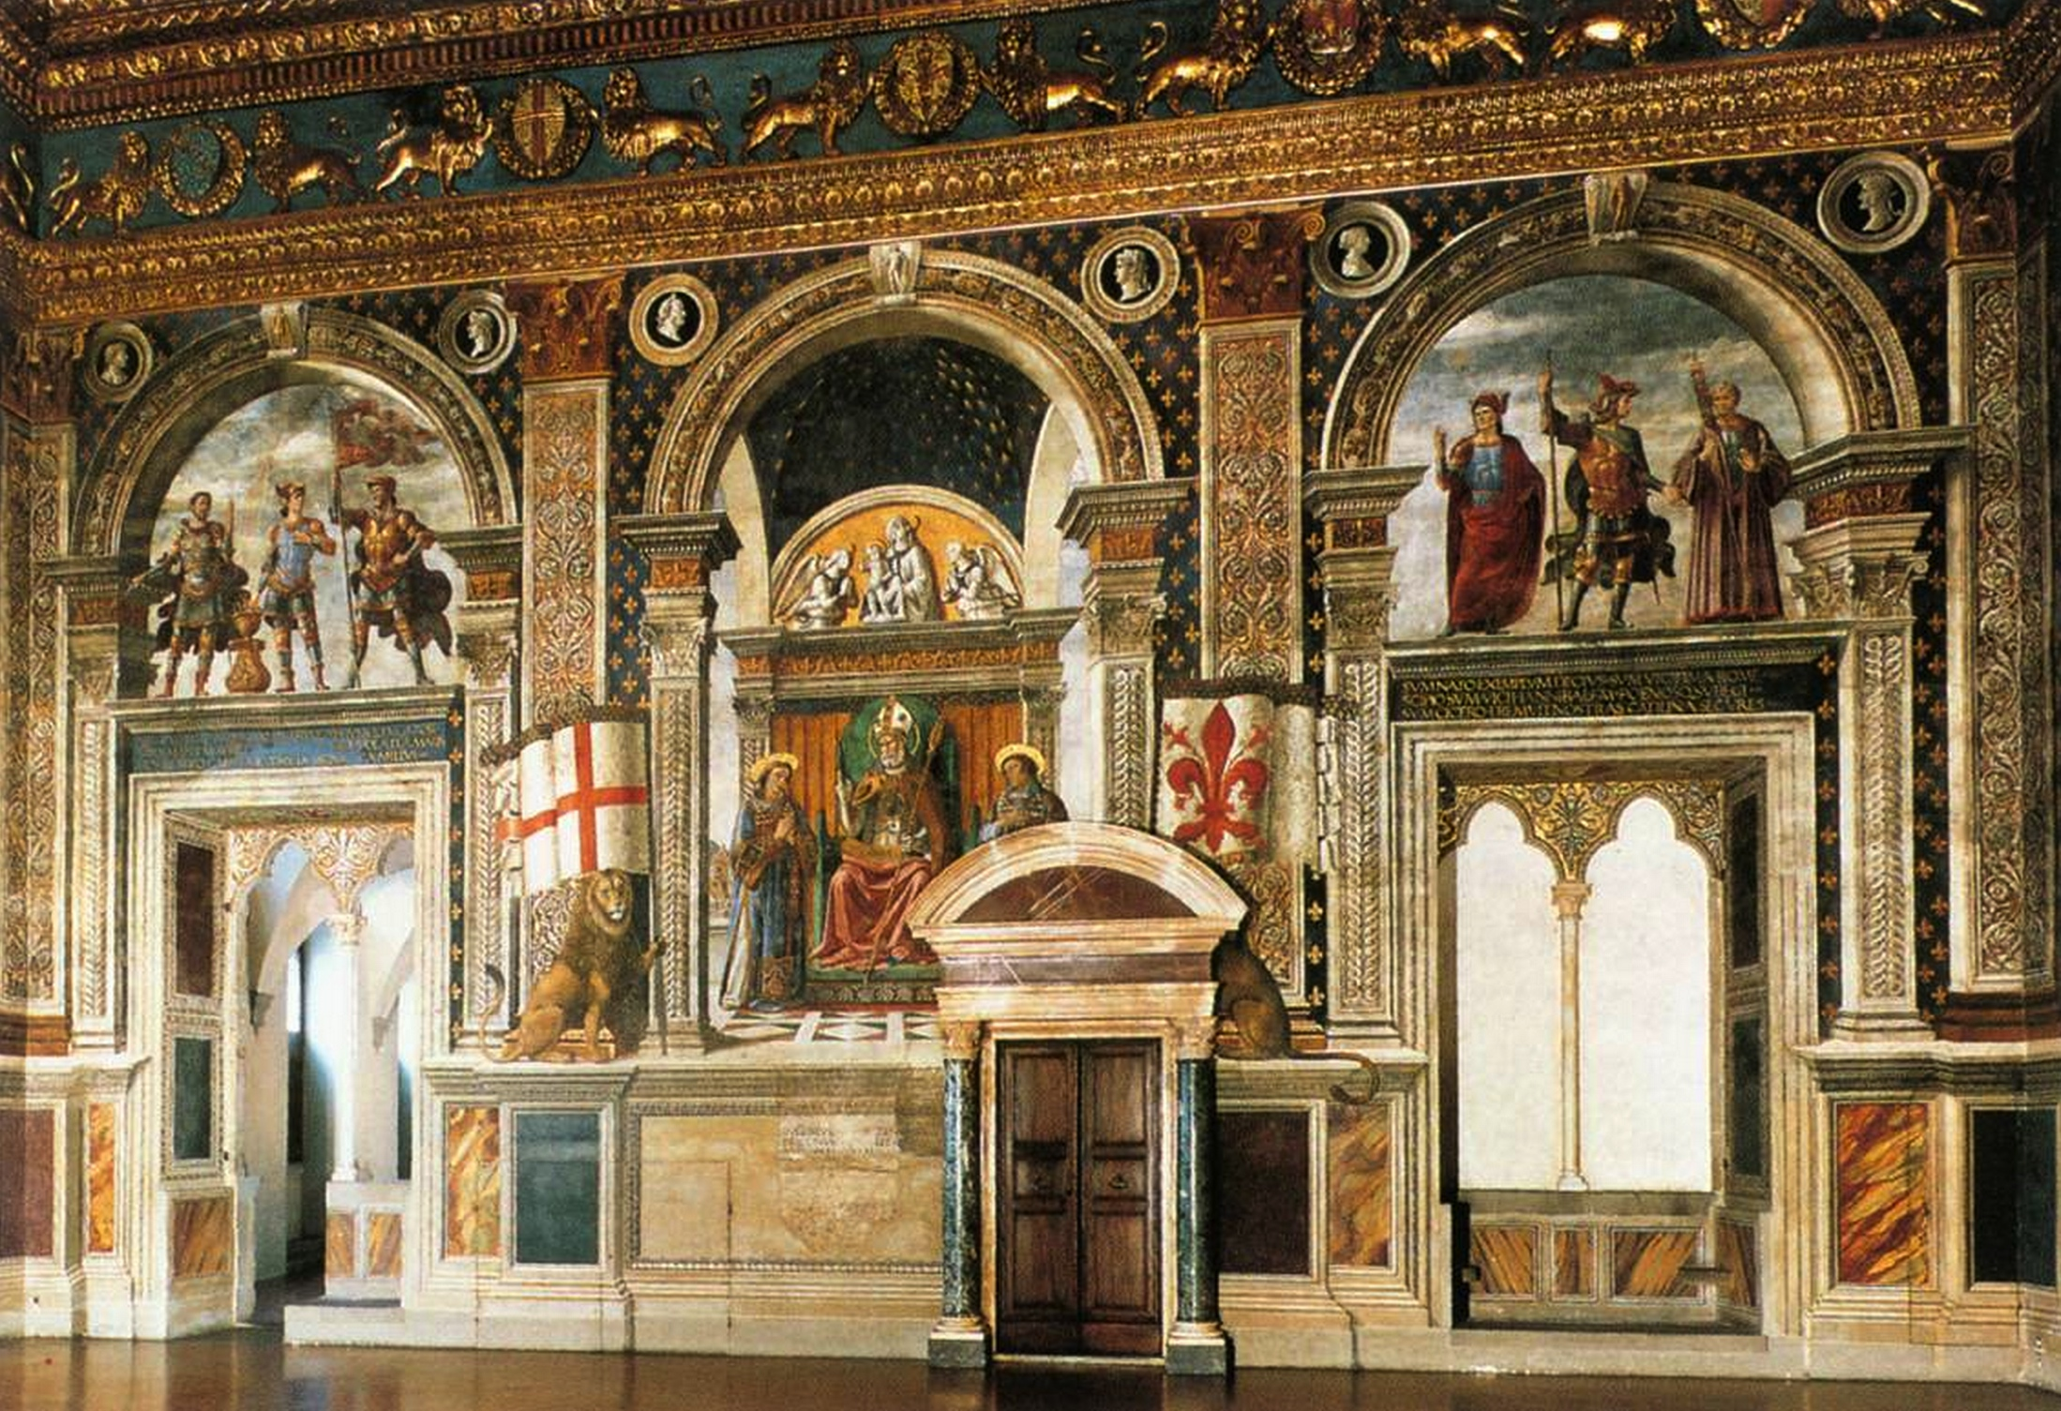
Domenico Ghirlandaio, Republican Romans, Sala dei Gigli, 1482-’85, frescoes, Palazzo Vecchio, Florence

Slide 19
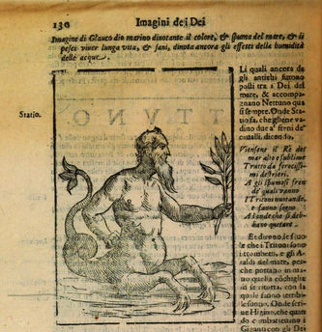
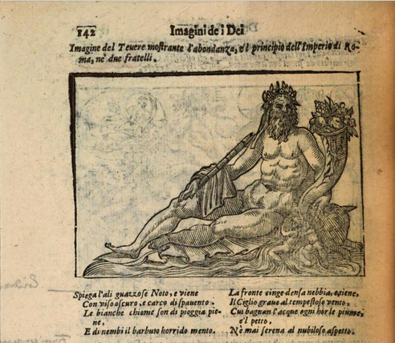
Vincenzo Cartari, Imagini colla sposizione degli dei degli antichi, Venice 1617

Slide 20
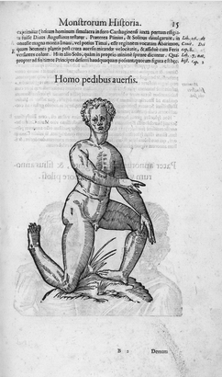
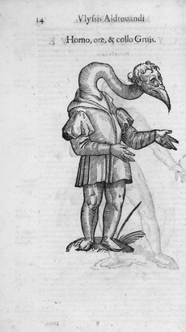
Ulisse Aldrovandi, Monstrorum Historia, Bologna 1642

Slide 21
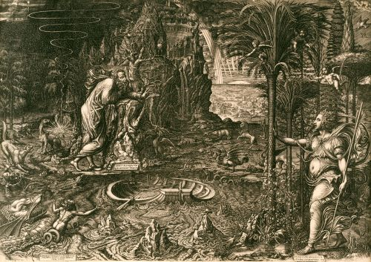
Giorgio Ghisi, An allegory of life (‘The dream of Raphael’), 1561, engraving
http://barber.org.uk/giorgio-ghisi-1520-4-1582/

Slide 22
Albrecht Dürer,
Melencolia I, 1516,
Bartsch VII. 87. 74
Albrecht Dürer, Melancholia I, engraving, 1514

Slide 23
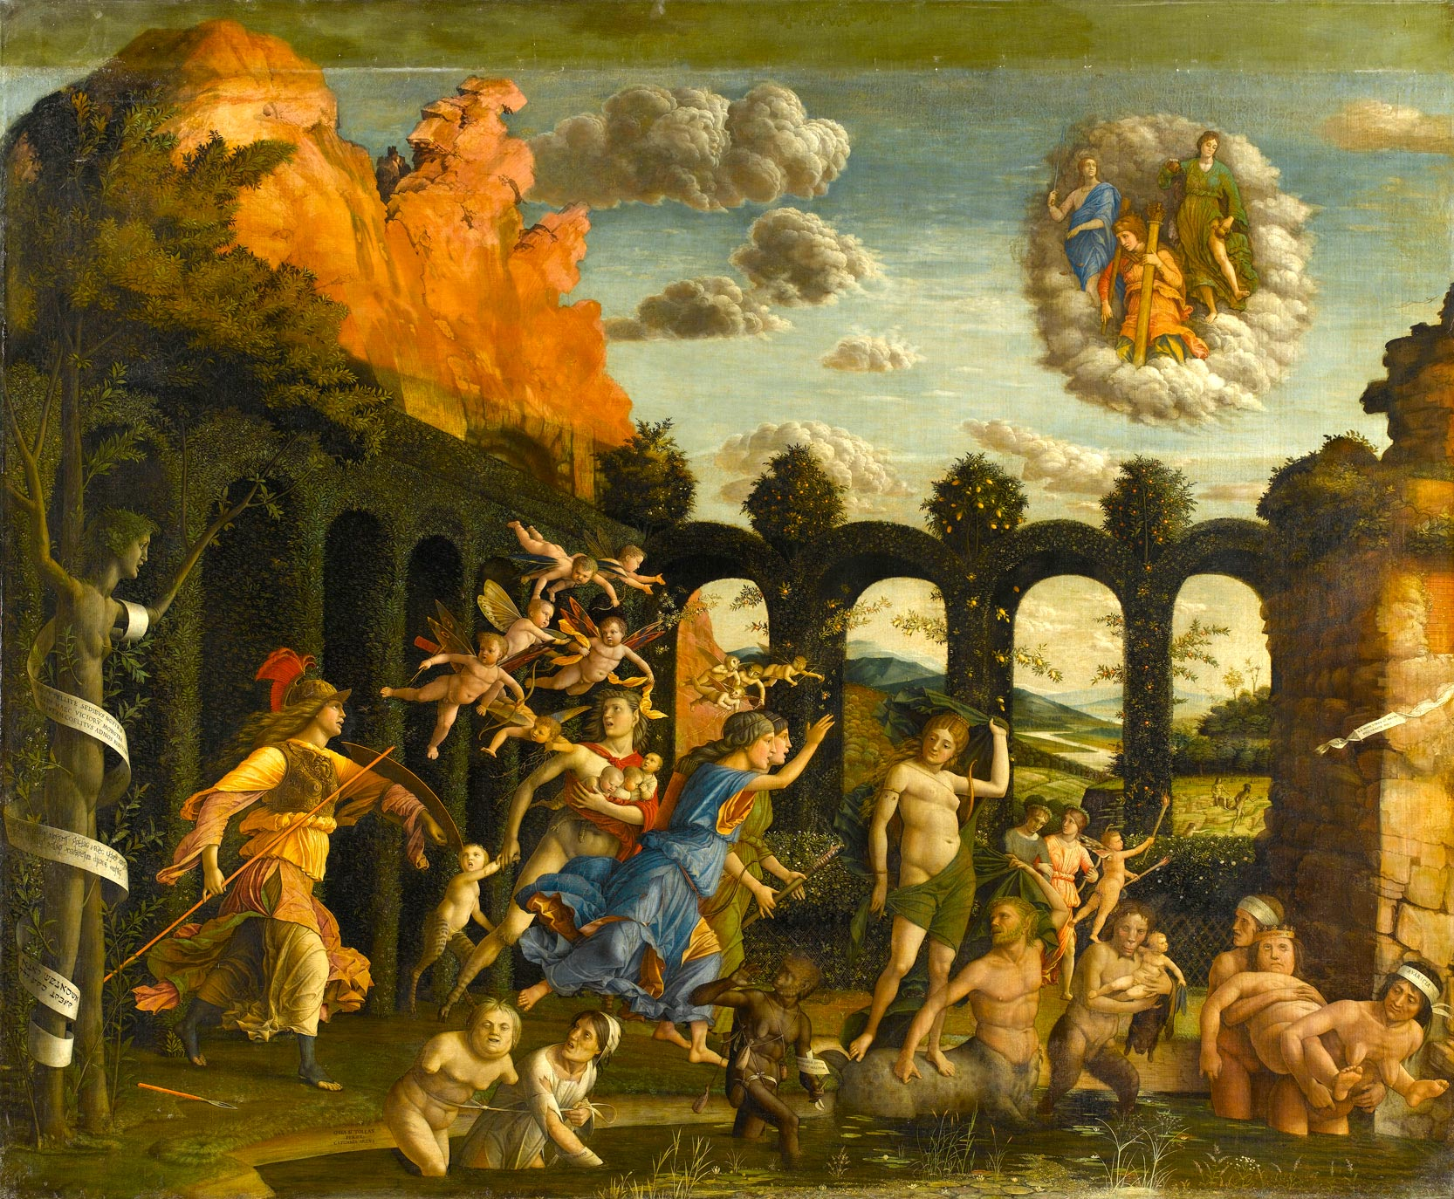
Andrea Mantegna, Expulsion of the Vices from the Garden of Virtue, 1502, tempera on canvas, Louvre, Paris

Slide 24
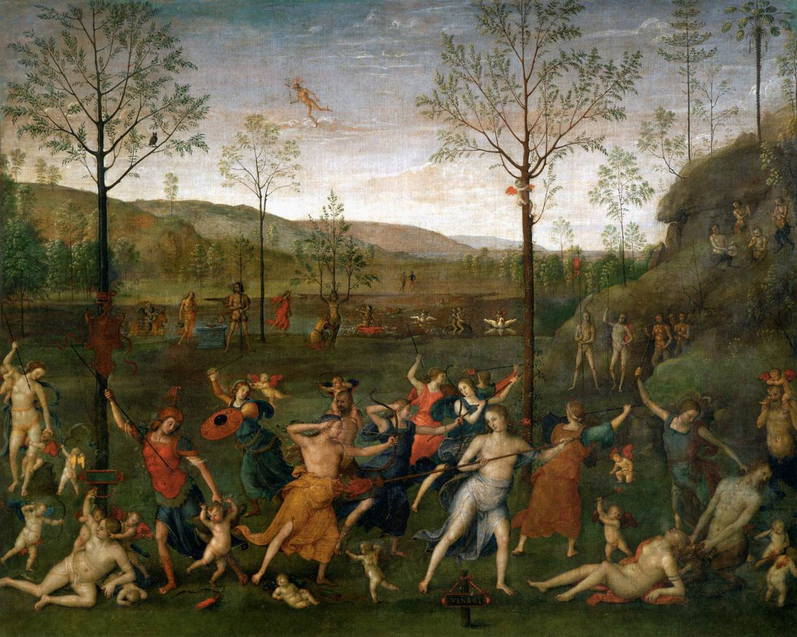
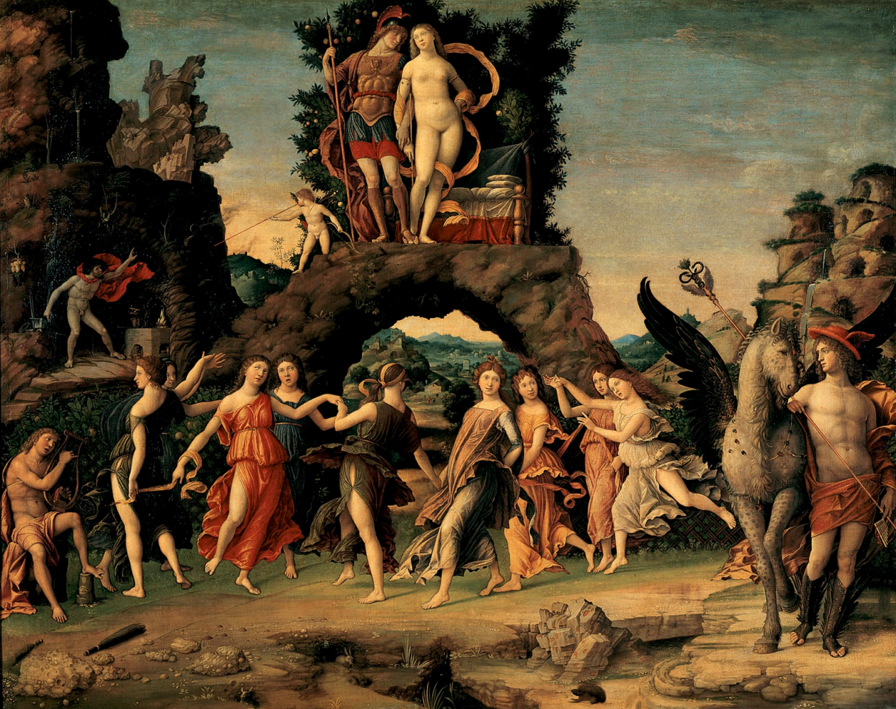
Mantegna, Parnassus, 1497, tempera and gold on canvas, Louvre, Paris
Perugino, Battle of Love and Chastity, 1504,tempera on canvas, Louvre, Paris

Slide 25
http://en.wikipedia.org/wiki/Triumphs_of_Caesar_%28Mantegna%29
https://www.rct.uk/collection/search#

Slide 26
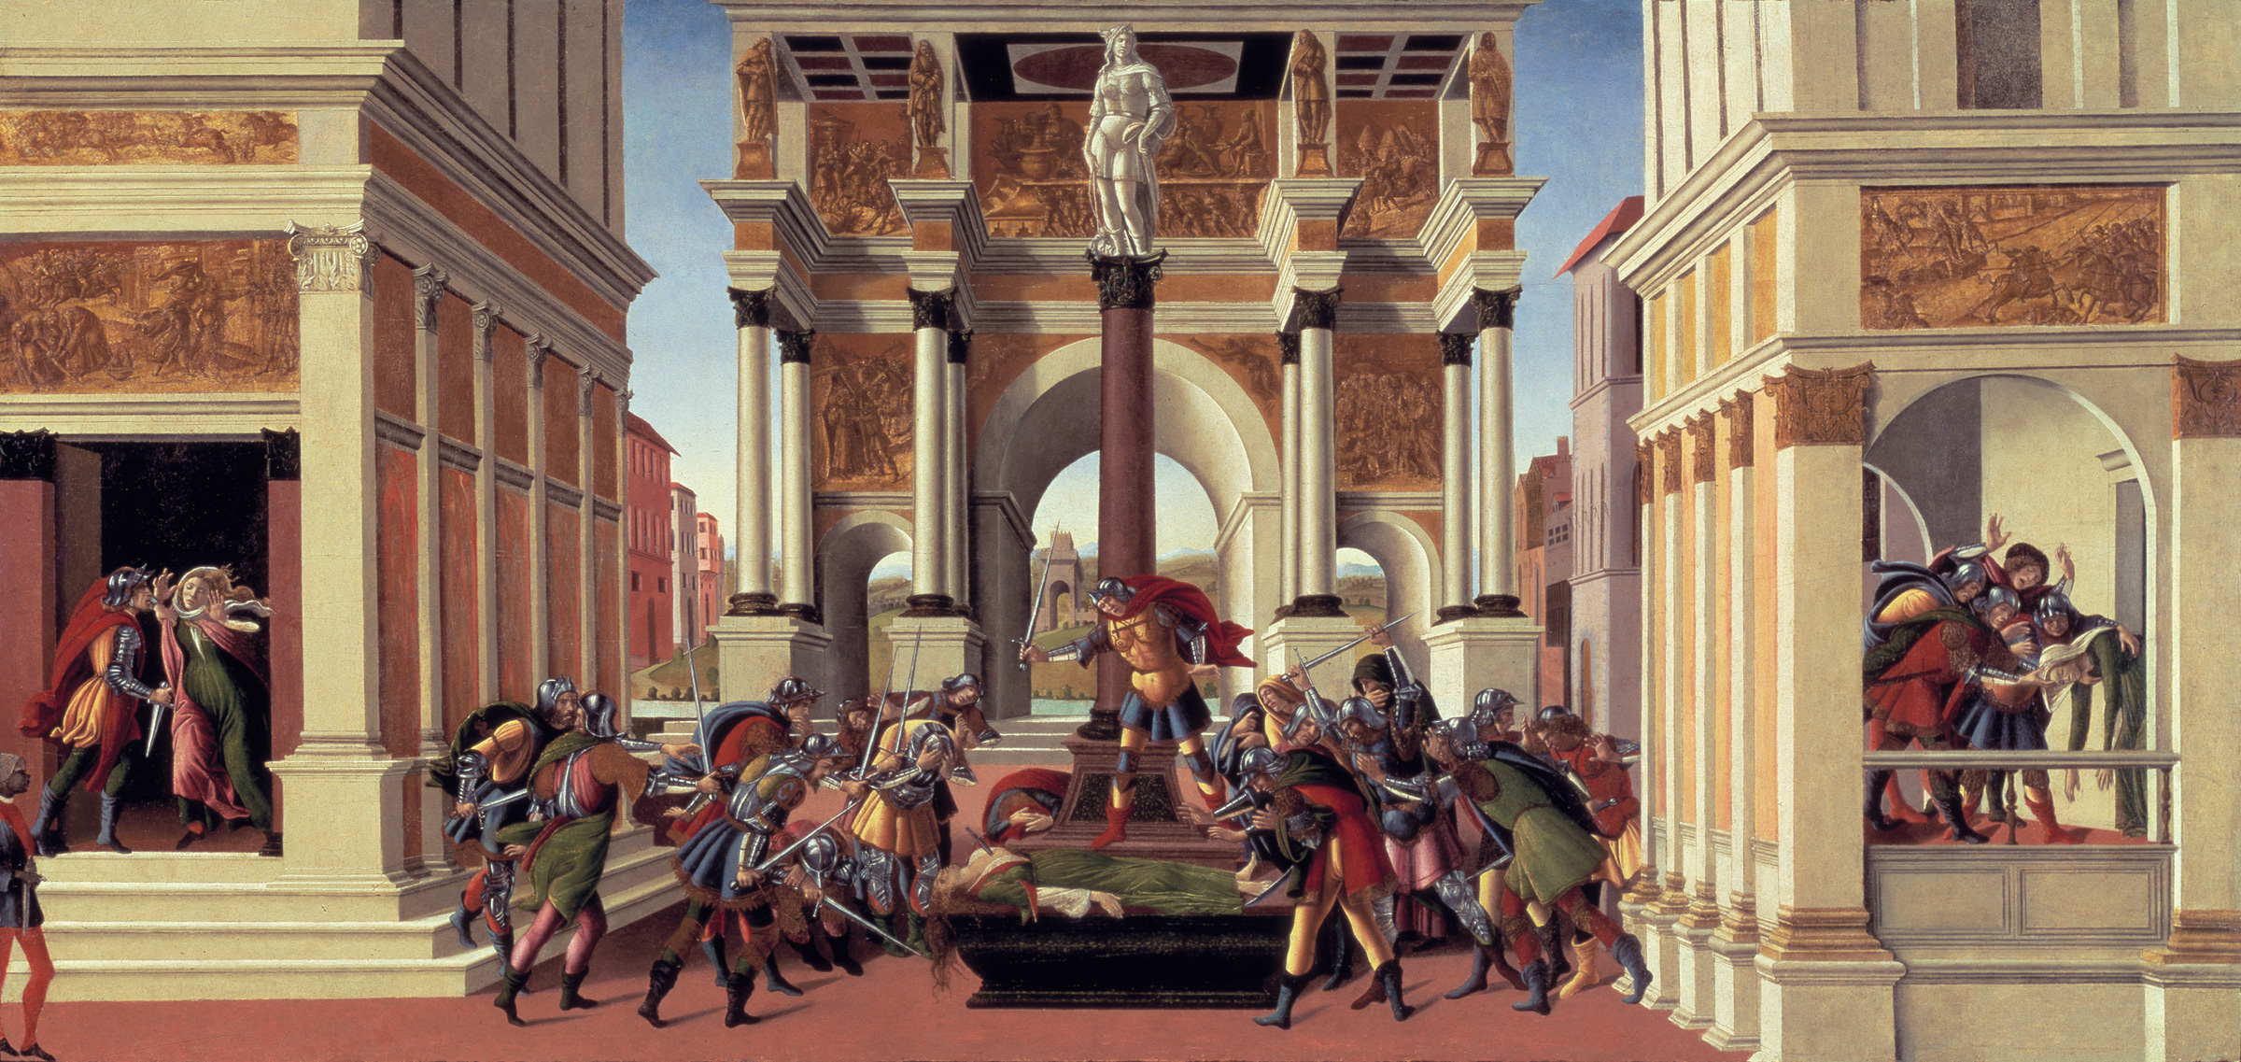
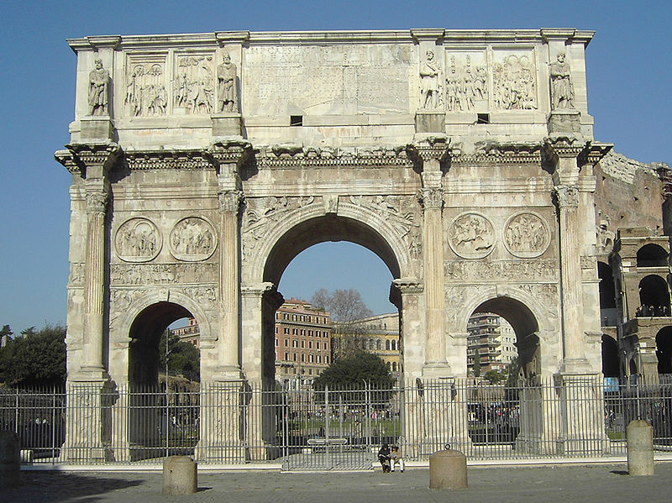
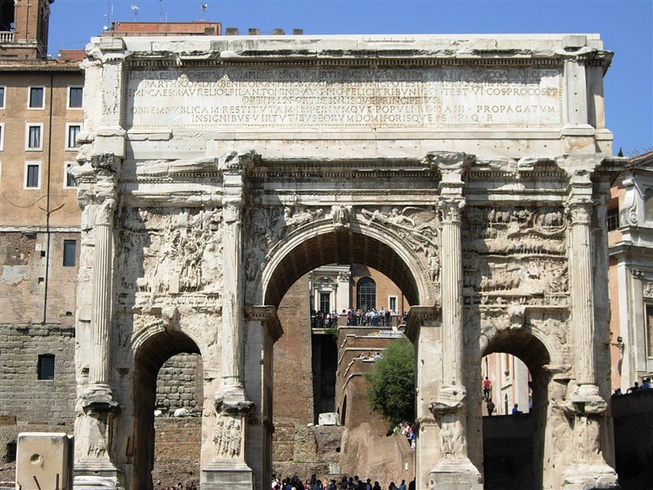
Botticelli, Story of Lucretia, 1490, tempera & oil on wood, Gardner Museum, Boston

Slide 27
Raphael, Villa Madama, 1519-’20, Rome

Slide 28
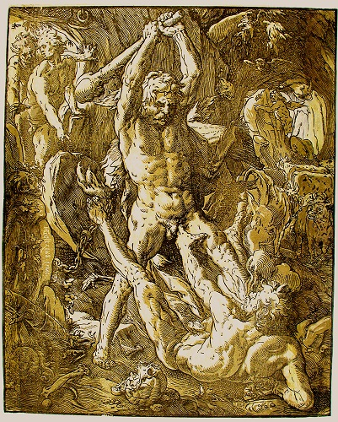
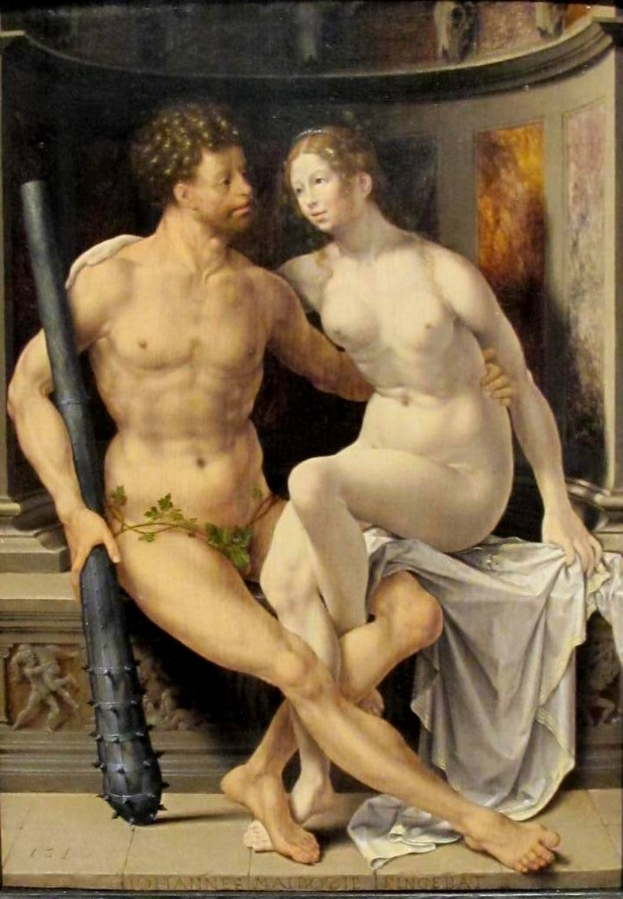
Jan Gossaert, Hercules and Deianira, 1517, oil on wood http://barber.org.uk/jan-gossaert-about-1478-1532/
Hendrik Goltzius, Hercules and Cacus, chiaroscuro woodcut, 1588 http://barber.org.uk/hendrick-goltzius-1558-1617-2/

Slide 29
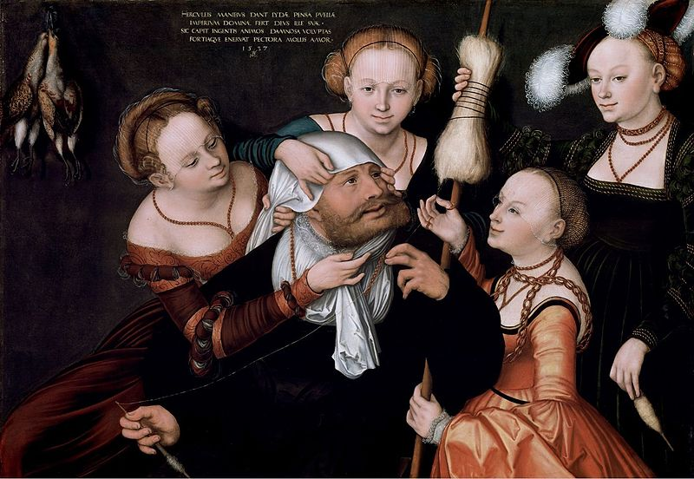
Lucas Cranach The Elder, Hercules and Omphale’s maids, oil on canvas, 1537, Herzog Anton Ulrich Museum, Braunschweig

Slide 30
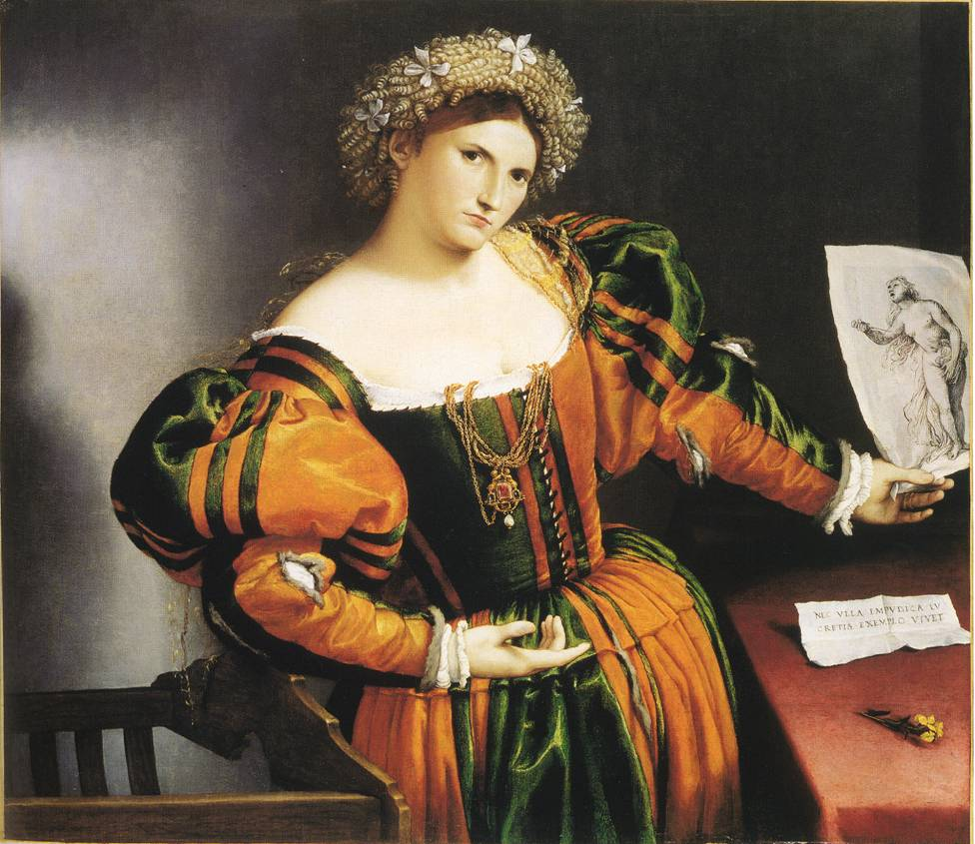
Lorenzo Lotto, Woman with drawing of Lucretia, c.1530, oil on canvas, London, National Gallery
Notes:
‘Lest any unchaste woman live by Lucretia's example‘
Livy 1. 58

Slide 31
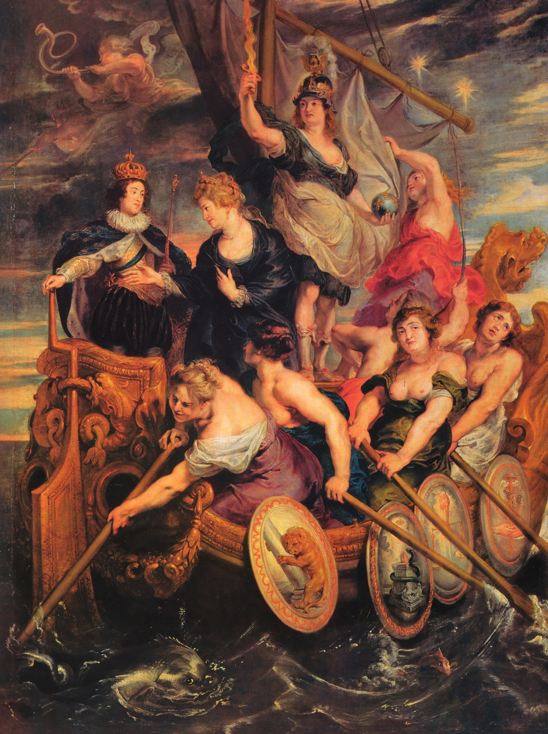
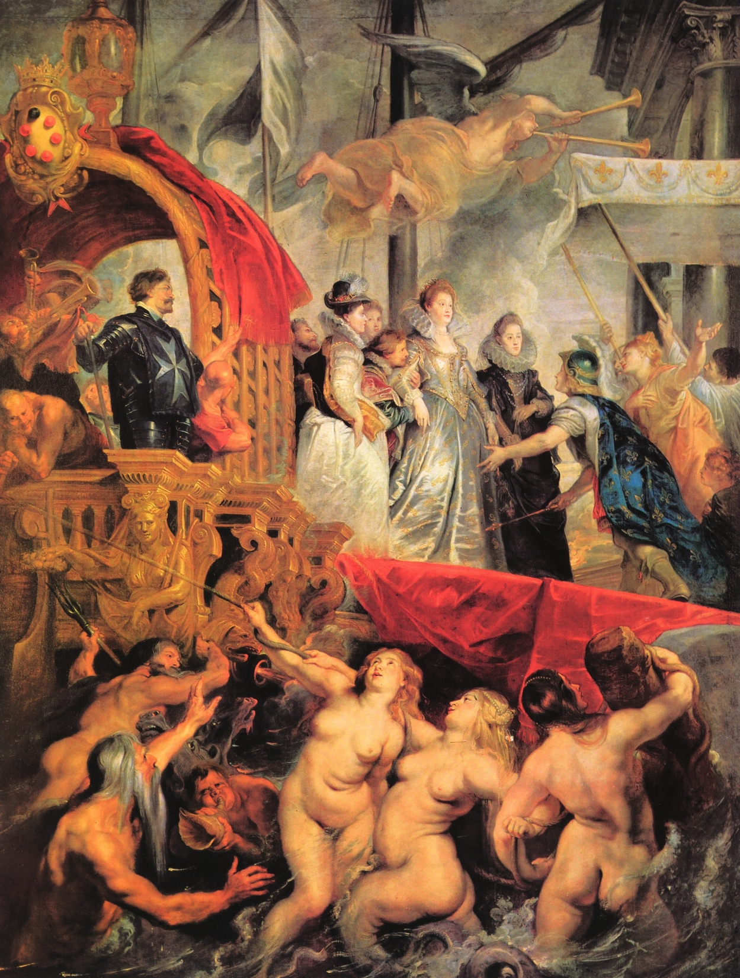
Marie handing over
the rudder of the Ship of State
to Louis XIII
Marie arriving in Marseilles

Slide 32
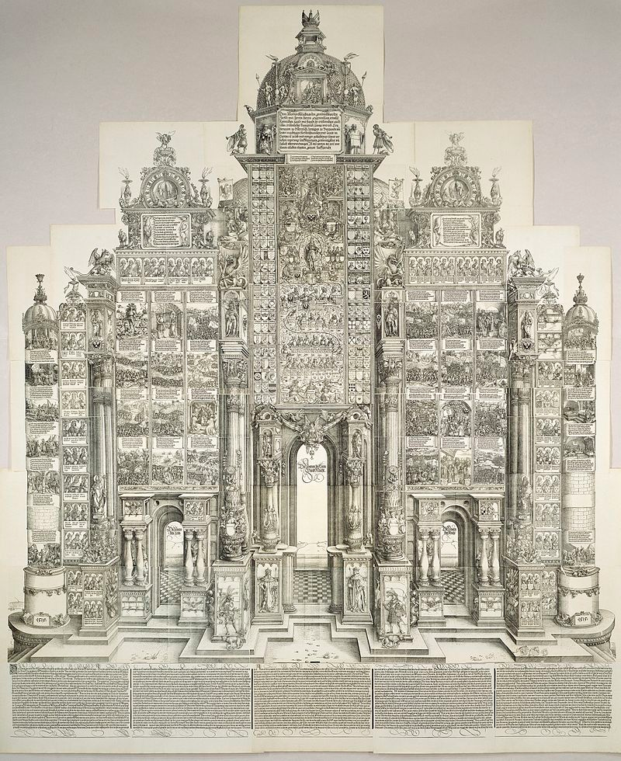
Triumphal Arch of Maximilian I, 1515, woodcut https://www.britishmuseum.org/whats_on/exhibitions/d%C3%BCrers_paper_triumph.aspx

Slide 34
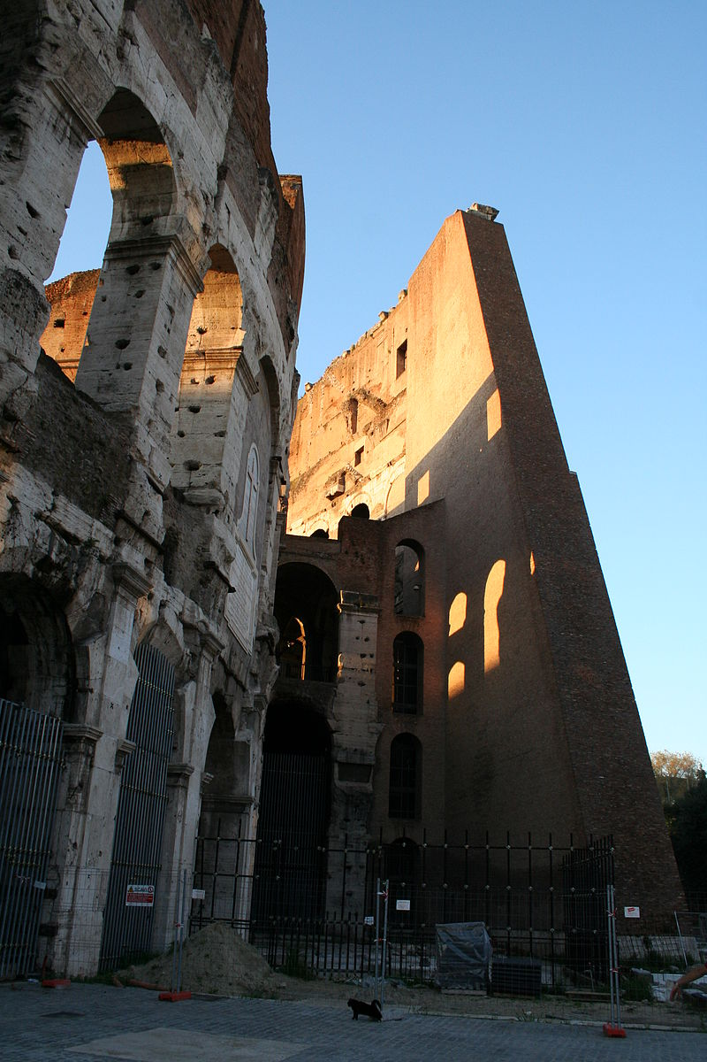
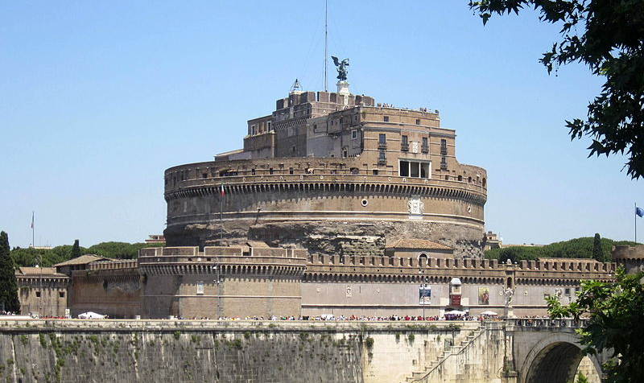
Castel Sant’Angelo, formerly Tomb of Hadrien the Emperor
Coliseum

Slide 35
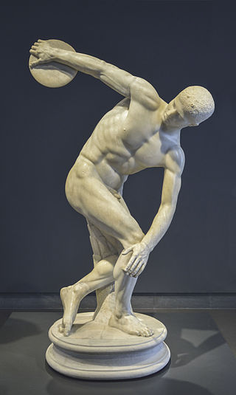
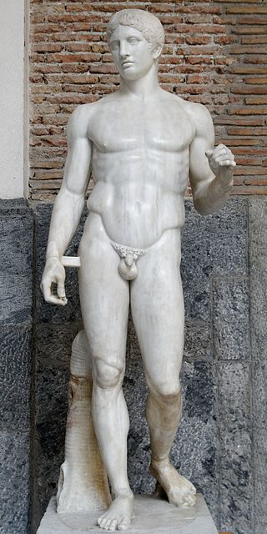
Diskobolos by Myron, Museo Nazionale Romano
Doruphoros by Polykleitos, Museo Archeologico of Naples

Slide 36
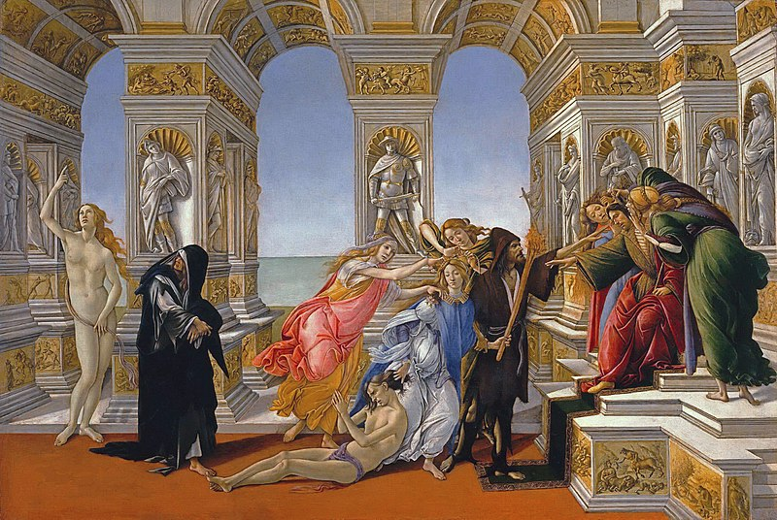
Botticelli, Calunnia d’Apelle, 1495, tempera on woodpanel, Uffizi

Slide 37

Giotto’s Campanile, Santa Maria del Fiore in Florence, 1259-1358

Slide 38



Pantheon — Dome of S.ta Maria del Fiore, 1418-’36 Dome of St. Peter, 1506-’64

Slide 39

Masaccio, Trinità, 1425-’27, fresco, S.ta Maria Novella in Florence

Slide 40


Slide 41


Sacrifice of Isaac, North Door of the Baptistery of St. Maria del Fiore in Florence
Ghiberti Brunelleschi

Slide 42




Slide 43



Slide 44

Leonardo, Profile of soldier all’antico, drawing, c.1472, Uffizi

Slide 45

Giorgione, Sleeping Venus, 1507-’10, oil on canvas, Gemaldgalerie of Dresden

Slide 46


Raphael, Transfiguration, 1520, oil on canvas, Pinacoteca Vaticana
Raphael, Wedding of the Virgin, 1502, oil on panel, Pinacoteca di Brera of Milan

Slide 47


Michelangelo, Dome of St. Peter, 1546-’64
Baccus, 1497, marble, Museo Nazionale del Bargello of Florence

