Slide 1
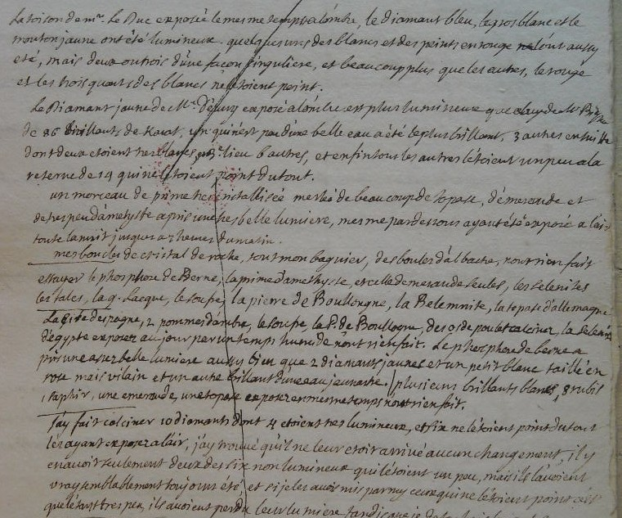
Notes:
1
[Don't read out French!]
1. On location, seems unlikely that DF transported
2. Very expensive stones from important people.
3. Not just items from a cabinet but personal jewellery.
Did not shy away from using other people's.
4. Intrusive tests.
Truly aristocratic science!
Nor was it just research on l of diamonds

Slide 2
1. Transparent and colourless
Diamond
2. Transparent and coloured
Ruby > balais ruby, spinel ruby, garnet, almadine**, hyacinth, amethyst
Pearl
Sapphire, opal
Emerald > prase
Chrysoprase > chrysolite, topaz, beryl
Rock crystal
Girasole*
Cat’s eye
BOODT (1644 [1609])
3. Semi-transparent
Carnelian, sardonix, chalcedony, onyx, agate, agate-like cat’s eye*, jasper, heliotrope, jade*, malachite
4. Opaque and used in gold/silver rings
Turquoise, lapis lazuli, Armenian stone**, aventurine*, star-stone, toad-stone
5. Opaque and not used in gold/silver rings
Coral, amber, marble, alabaster
...
Notes:
2
2

Slide 3
HAÜY (1801)
1. Acidic: marble, turquoise, chalk...
2. Earthy
Quartz
I. Water-quartz: rock crystal, amethyst, sand, sand-stone
II. Agate-quartz: carnelian, sardony, cat's eye, onyx...
III. Resin-quartz: opal, girasol, hydrophane...
IV. Jasper-quartz
Zircon: jargon diamond, hyacinth ...
Corundum: ruby, sapphire, topaz ...
Cymophane: chrysolite
Spinel: ruby balais, ruby spinel, vermillion ...
Topaz: topaz, Brazilian ruby, chrysolite
Emerald: Siberian aqua-marine, Peruvian emerald, chrysolite
3. Combustible: diamond, amber, bitumen
Notes:
3
3
Divided minerals into acidic, earthy, combustible, metallic.
Criteria were chemical but especially geometrical.
Gems disappeared in the sense that:
1. no category called ‘pierres precieuses’ or ‘pierres fines.’
Did use the terms ‘pierres précieuses’ and ‘gemmes’,
but did not correspond to any formal categories in his mineralogy.
2. did not just move gem species from one genus to another
but also revised the species themselves.
Eg. ruby, sapphire, topaz = differently coloured varieties of same kind of stuff.
Chrysolite: previously single kind of stuff, now three different kinds of stuff

Slide 4
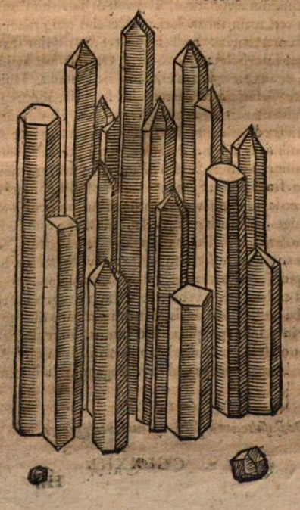
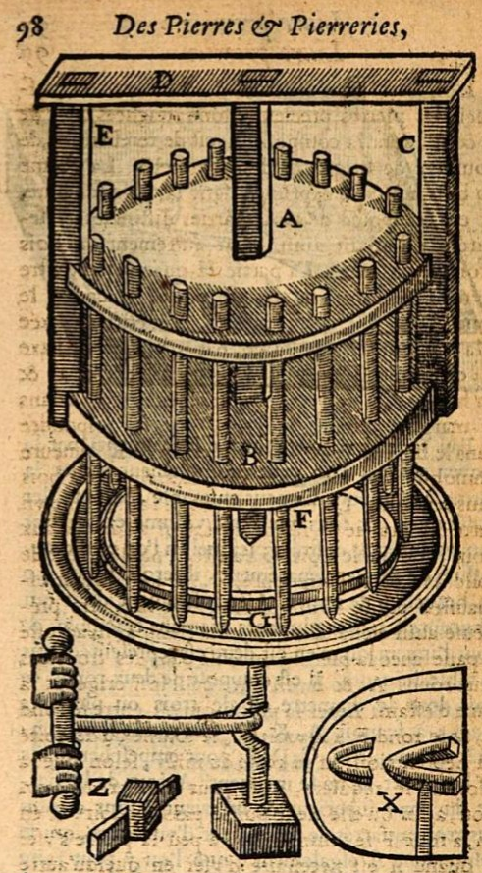
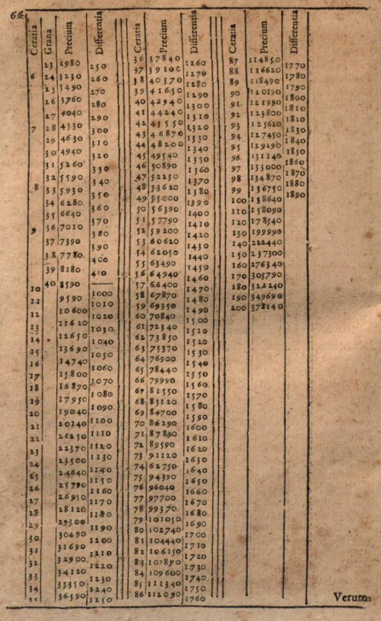
Boodt, Parfait joaillier

Slide 5
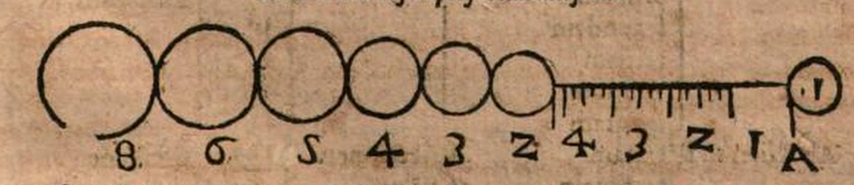

Slide 6
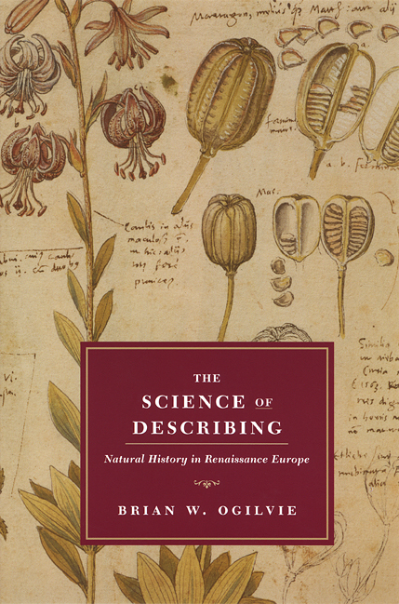
‘Natural history was invented in the Renaissance’

Slide 7
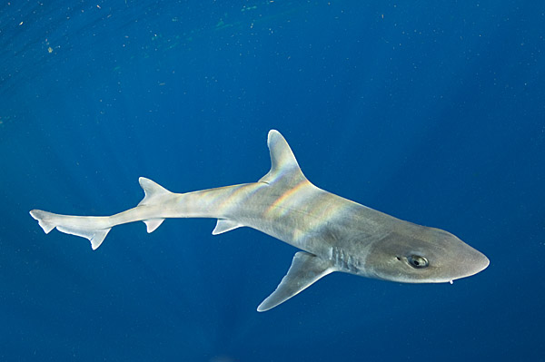
Smooth dogfish
externally viviparous = rears young first as egg inside body, then gives birth to live young

Slide 8
The smooth dogfish has its eggs in between the wombs..
these eggs shift into each of the two horns of the womb and descend
And the young develop with the navel-string attached to the womb, so that, as the egg-substance gets used up, the embryo is sustained to all appearance just as in the case of quadrupeds.
The navel-string is long and adheres to the under part of the womb (each navel-string being attached as it were by a sucker)
-- Aristotle, History of Animals

Slide 9
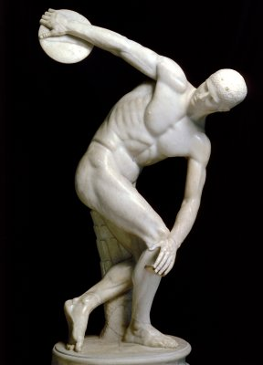
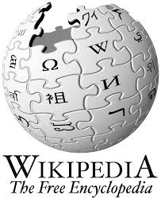
Pliny’s Historia naturalis, 1st century AD
Discus thrower, 2cad, copied from lost Greek bronze

Slide 10
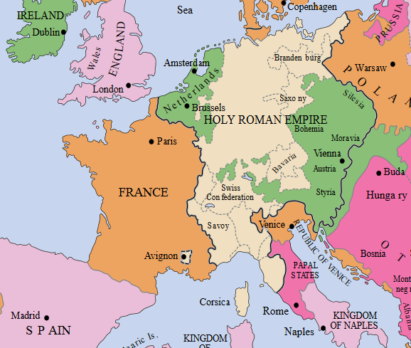
Niccola Leoniceno (Ferrara)
Luca Ghini (Pisa, Bologna)
Pietro Mattioli (Sienna)
Andrea Cesalpino (Pisa)
Ulisse Aldrovandi (Bologna)
Euricius Cordus (Marburg)
Valerius Cordus (Wittenberg)
Otto Brunfels (Strasbourg)
Hieronymous Bock (Hornbach)
Leonhart Fuchs (Tubingen)
Rembert Dodoens (Vienna, Leiden)
Carolus Clusius (ibid.)
Conrad Gessner (Zurich)
Caspar Bauhin (Basel)

Slide 11
Niccola Leoniceno (Ferrara)
Luca Ghini (Pisa, Bologna)
Pietro Mattioli (Sienna)
Andrea Cesalpino (Pisa)
Ulisse Aldrovandi (Bologna)
Euricius Cordus (Marburg)
Valerius Cordus (Wittenberg)
Otto Brunfels (Strasbourg)
Hieronymous Bock (Hornbach)
Leonhart Fuchs (Tubingen)
Rembert Dodoens (Vienna, Leiden)
Carolus Clusius (ibid.)
Conrad Gessner (Zurich)
Caspar Bauhin (Basel)

Slide 12
Niccola Leoniceno (Ferrara)
Luca Ghini (Pisa, Bologna)
Pietro Mattioli (Sienna)
Andrea Cesalpino (Pisa)
Ulisse Aldrovandi (Bologna)
Euricius Cordus (Marburg)
Valerius Cordus (Wittenberg)
Otto Brunfels (Strasbourg)
Hieronymous Bock (Hornbach)
Leonhart Fuchs (Tubingen)
Rembert Dodoens (Vienna, Leiden)
Carolus Clusius (ibid.)
Conrad Gessner (Zurich)
Caspar Bauhin (Basel)

Slide 13
Niccola Leoniceno (Ferrara)
Luca Ghini (Pisa, Bologna)
Pietro Mattioli (Sienna)
Andrea Cesalpino (Pisa)
Ulisse Aldrovandi (Bologna)
Euricius Cordus (Marburg)
Valerius Cordus (Wittenberg)
Otto Brunfels (Strasbourg)
Hieronymous Bock (Hornbach)
Leonhart Fuchs (Tubingen)
Rembert Dodoens (Vienna, Leiden)
Carolus Clusius (ibid.)
Conrad Gessner (Zurich)
Caspar Bauhin (Basel)

Slide 14
Compare different versions of same text
Compare text with a plant
Compare text with new plant

Slide 15
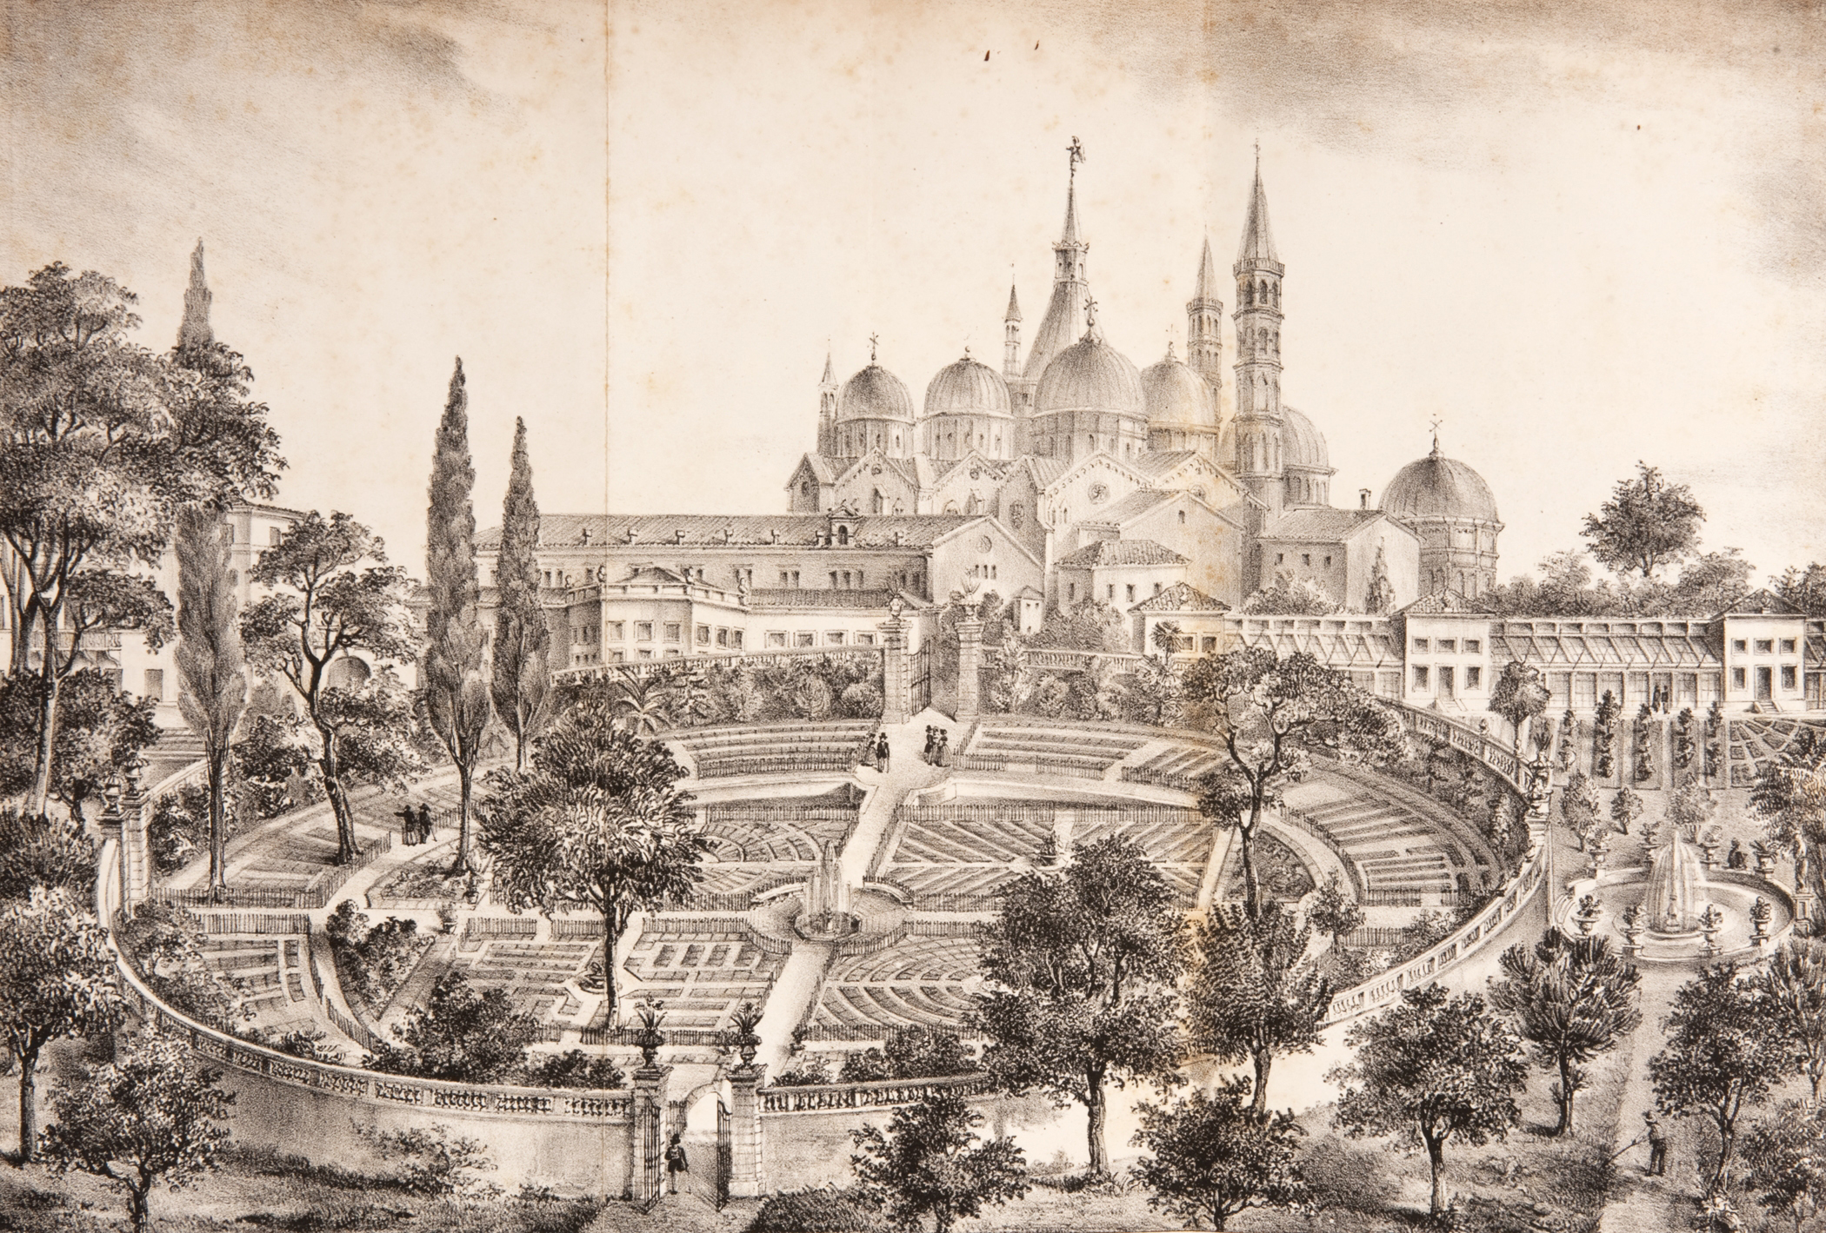
Botanical garden of the University of Padua, 1545
(19th-century print)

Slide 16
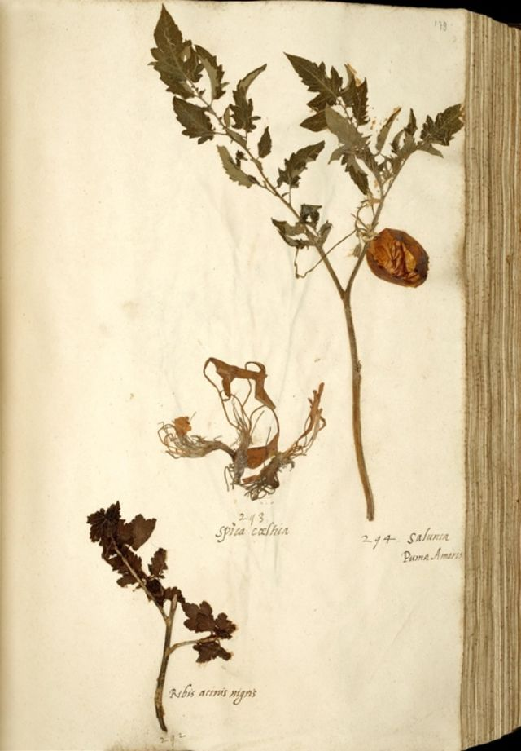
Dried specimen from oldest tomato collection in Europe (1540s)

Slide 17
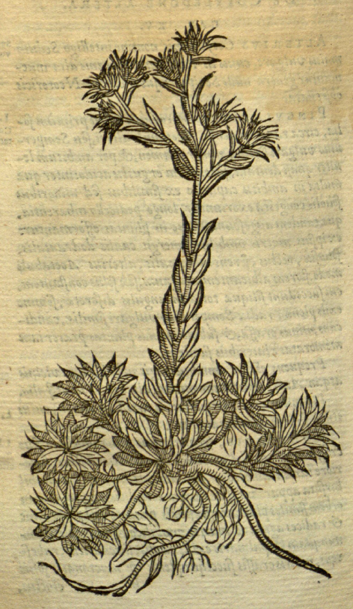
[it has] broad, fat leaves, like little tongues, thick about the root, describing as it were an eye in the middle, like the greater Sempervivum, and is binding to the taste
a little thin stalk, and upon it flowers, and seeds like to Hypericum, but the root greater.
It is good for the same uses as the Sempervivum is.
-- Dioscorides and Mattioli, on the plant Cotyledon altera Matthioli

Slide 18
This plant has numerous, densely-packed leaves, similar to oblong little tongues, rather thick, pointed, somewhat toothed on the edges, with an acid and somewhat astringent taste.
From the centre of the leaves rises up a stem eighteen inches long, or sometimes only a foot, hairy on the upper part, with shorter leaves here and there.
At the top of the stem, it puts out little pedicules between the leaves, on which rest two or three white flowers composed of five petals, which on the inside appear to be spotted with drops of blood…
-- C. Clusius on Cotyledon altera Matthioli

Slide 19
Precious stones, and of various kinds, are found in plenty in this island, namely, rubies, sapphires, jacinths, zircons, yellow sapphires, chrysoberyls and cat’s eyes, all highly-prized by the Indians [i.e. the local Sinhalese], of which the king takes all to himself and are sold on his behalf.
[The island] has men which plough and sift on the hillslopes and riverbeds, and many lapidaries who are skilled to such an extent, that if one should bring one of them a handful, or two or three of gravel he would say at once: you will find such in this one, and sapphires in that one, and of all sorts of gemstones.

Slide 20
The rubies that grow in Ceylon have such a perfect colour that among the Indians they are valued more and deemed finer than those from Pegu; and to enhance their colour they throw them into the fire.
The said rubies, sapphires, yellow sapphires and cat’s eyes are all the same kind of gemstone, as all four are hard, cold and heavy and Nature gives them their colour, and some are half ruby and half sapphire, and others half sapphire and half yellow sapphire; and also cat’s eyes have the colour of sapphire and of yellow sapphires.

Slide 21
From work by Peder Månsson, d. 1534

Slide 22
Benvenuto Cellini on goldsmithery and sculpture (Italy, 1568)
Konrad Keyser on instruments of warfare (Germany, 1405)
Roberto Valturio on military machines (Italy, 1472)
Albrecht Durer on descriptive geometry and fortifications (Germany, 1525 and 1527)
Nicola Tartaglia on ballistics ie. trajectories of cannons (Italy, 1537)
Georg Agricola on mining and metallurgy (Germany, 1546 and 1556)
Vannoccio Biringuccio on metals and metallurgy (Italy, 1570)
Simon Stevin on machines, eg windmills and drainage systems (Low Countries, 1586)
Pedro Nunes on navigation (Portugal, 1530s and 1540s)
Robert Norman on navigating with a magnet (England, 1581)
Thomas Harriot on navigation (England, 1594)

Slide 23
Benvenuto Cellini on goldsmithery and sculpture (Italy, 1568)
Konrad Keyser on instruments of warfare (Germany, 1405)
Roberto Valturio on military machines (Italy, 1472)
Albrecht Durer on descriptive geometry and fortifications (Germany, 1525 and 1527)
Nicola Tartaglia on ballistics ie. trajectories of cannons (Italy, 1537)
Georg Agricola on mining and metallurgy (Germany, 1546 and 1556)
Vannoccio Biringuccio on metals and metallurgy (Italy, 1570)
Simon Stevin on machines, eg windmills and drainage systems
Pedro Nunes on navigation (Portugal, 1530s and 1540s)
Robert Norman on navigating with a magnet (England, 1581)
Thomas Harriot on navigation (England, 1594)

