Slide 1
Political Thought, Conspiracies, and Tyranny
in the Italian Renaissance
Marta Celati
Marta.Celati@warwick.ac.uk

Slide 2
CONSPIRACIES IN THE FIFTEENTH CENTURY
1)
Second half of the fifteenth century
Conspiracies were very frequent in Italian states
2)
Considerable diffusion of literary works that deal with the topic of conspiracy
Histories of the cities (Histories of Florence, histories of Milan, etc.)
Specific works devoted to the narrative of a political plot

Slide 3
HISTORICAL CONTEXT
The development of this literary theme is closely connected with the emergence of a centralized political ideology in most Italian states.
This age is characterized by a substantial concentration of political power in the hand of newly established leaders.
Now most Italian states are “signorie”, states ruled by a singore, a lord, or more in general by a prince, or a king.

Slide 4
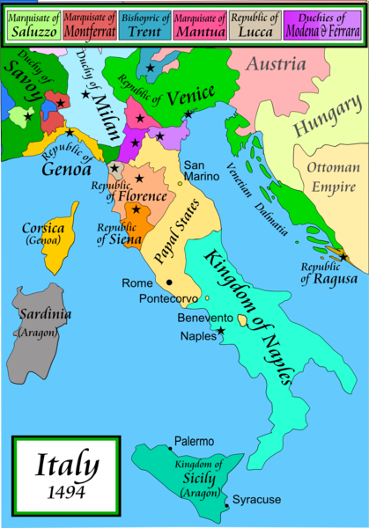
Italian States in the Fifteenth Century
Duchy of Milan => Ruled by the Visconti and then by the Sforza
Florence => Oligarchic Republic
Papal State: Territories in central Italy
Kingdom of Naples: Monarchy of the Aragonese family (1442-1494)

Slide 5
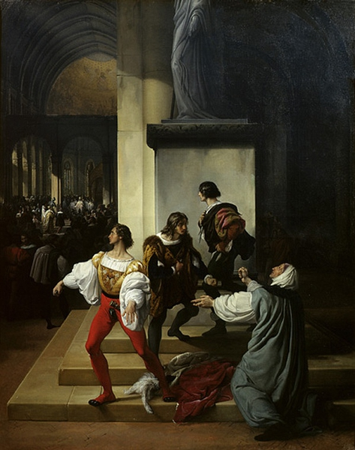
Francesco Hayez, La congiura dei Lampugnani, 1826-1829 (Milan, Pinacoteca di Brera)

Slide 6
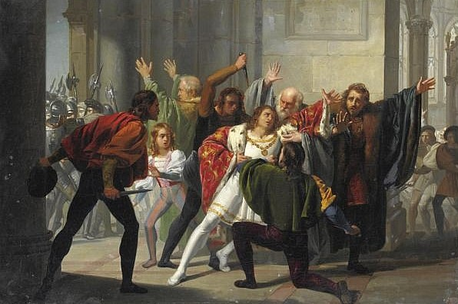
Stefano Ussi, La congiura dei Pazzi, 19th Century. (Private Collection)

Slide 7
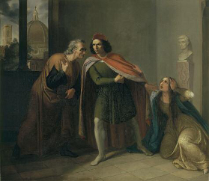
Giulio Piatti, Raimondo de’ Pazzi lascia la moglie per unirsi agli altri congiurati, 1837. (Pistoia, Museo Civico)

Slide 8
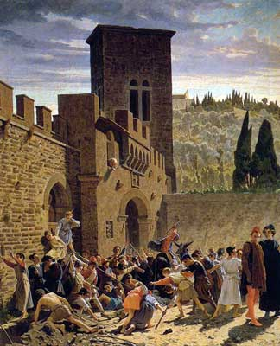
Odoardo Borrani, Disseppellimento del cadavere di Iacopo Pazzi, 1859-1864. (Florence, Palazzo Pitti, Galleria d’Arte Moderna)

Slide 9
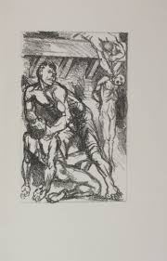
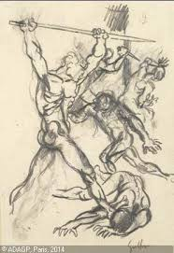
Renato Guttuso, The Pazzi conspiracy: Lithographies in the edition of Angelo Poliziano, Coniurationis commentarium, ed. by Alessandro Perosa, 1958.

Slide 10
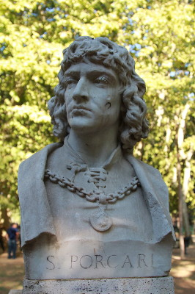
AGE OF CONSPIRACIES
ROME
Stefano Porcari’s plot against pope Nicholas V in 1453
Leon Battista Alberti, Porcaria coniuratio (epistle)
Orazio Romano, Porcaria (poem)
CLASSICAL MODEL: Sallust’s De coniuratione Catilinae
Thematic motifs / Style / Political perspective in the narrative

Slide 11
AGE OF CONSPIRACIES
FLORENCE
Pazzi conspiracy against the Medici brothers on 26th April 1478
Angelo Poliziano, Coniurationis commentarium
Lorenzo de’ Medici’s system of propaganda
was successful in strengthening his power

Slide 12
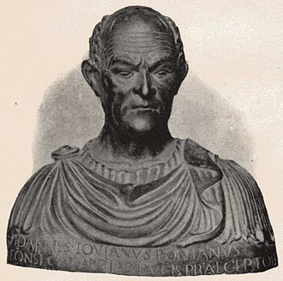
AGE OF CONSPIRACIES
NAPLES
‘First conspiracy of the barons’ against Ferdinando of Aragon, king of Naples, 1459-1465
Giovanni Pontano’s De bello Neapolitano (On the Neapolitan war)
Connection with the Pontano’s major political treatises:
De principe (On the prince)
De obedientia (On obedience)

Slide 13
AGE OF CONSPIRACIES
MILAN
Murder of the Duke of Milan, Galeazzo Maria Sforza
26th December 1476
=> Conspirators presented themselves as followers of the anti-tyrannical tradition
=> The standpoint that generally prevailed condemned the plot as a subversive despotic threat against a legitimate government

Slide 14
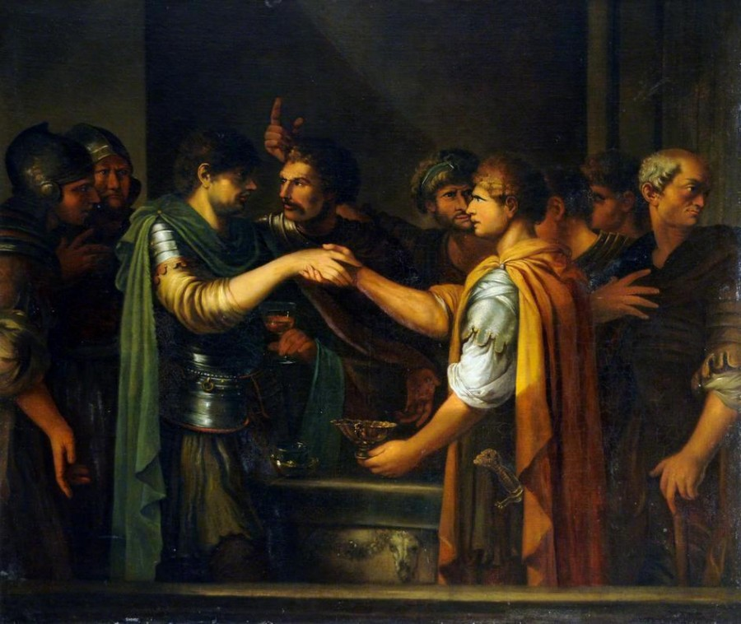
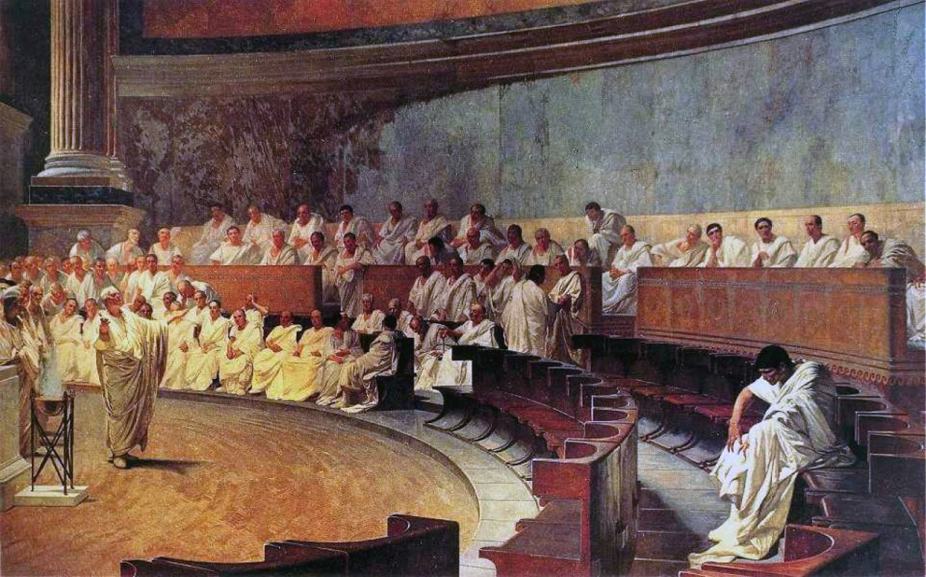
Classical interpretation of the idea of ‘conspiracy’
CONSPIRATIO = ‘an act of taking an oath’
After Cicero’s denunciation of Catiline’s conspiracy
CONSPIRATIO = sedition, insubordination

Slide 15
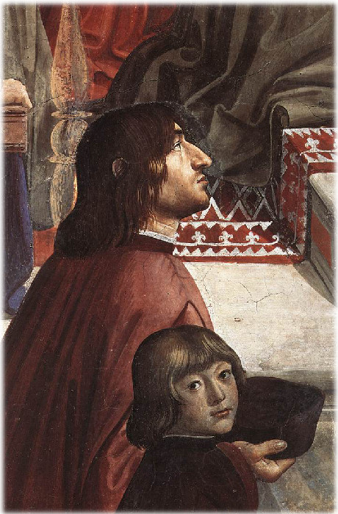
POLIZIANO (1454-1494)
Poet, Historian, Philologist, Professor
Poliziano was born in Montepulciano in 1454
He moved to Florence in 1469
Officially appointed by the Medici to write poems on for special events (The Stanze per la Giostra di Giuliano de’ Medici 1475)
Commentary on the Pazzi conspiracy 1478
Angelo Poliziano e Giuliano di Lorenzo de’ Medici,
Domenico Ghirlandaio, Chiesa Santa Trinità, Firenze

Slide 16
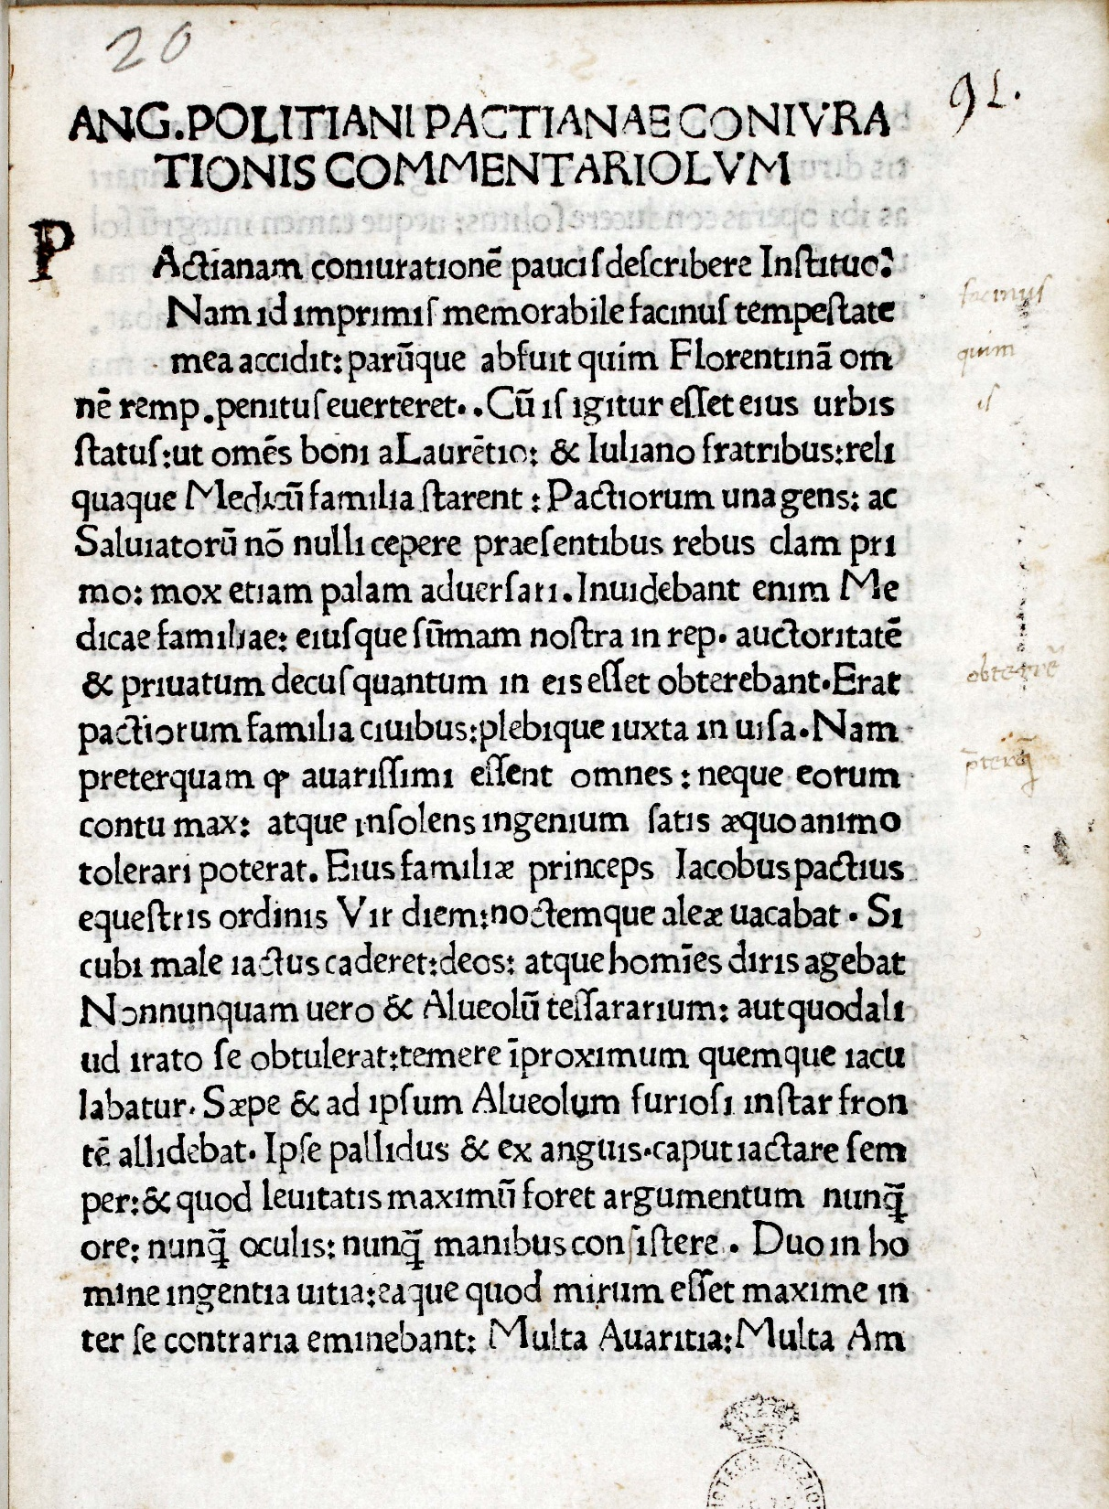
Angelo Poliziano
Commentary on the Pazzi conspiracy
First Printed Edition 1478

Slide 17
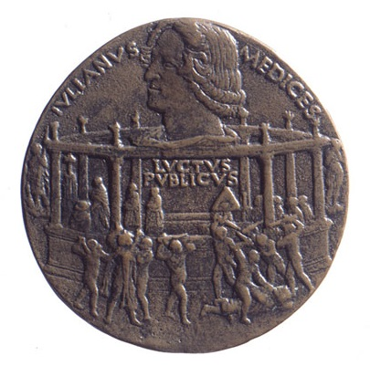
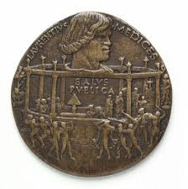
BERTOLDO DI GIOVANNI, Medal of the Pazzi conspiracy, 1478
Giuliano de’ Medici - Luctus Publicus (Public Grief)
Lorenzo de’ Mecici - Salus Publica (Public Safety)

