Slide 1
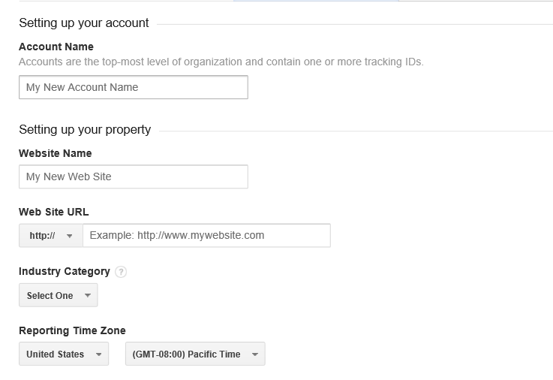
We will start around 12:15
If you have not used google analytics before please visit www.google.com/analytics/
Click on “create an account” in the top-right, then:
If you have a google account, sign in
If you don’t, click on “sign up” in the top-right, enter the information requested (I’d suggest using your Warwick e-mail address). You’ll then have to wait for an e-mail to arrive, click on the link within it to “verify”, then go back to www.google.com/analytics/, click on “create an account” and then sign in using your new details!!
When you hit sign up on the following screen, you’ll see a long page including the details on the right. Fill in the boxes and submit, then leave your browser open on the next page.
Note when you are filling this in that an “Account” can contain several “properties” (each property is a code, e.g. for a website or set of pages thereon).

Slide 2

Getting the most from your Google Analytics
David Beck, 11-Oct 2013
Slides adapted from Netskills workshop, full version and further information available at:
http://googleanalytics.netskills.biz

Slide 3
Getting the most from your Google Analytics
What is Google Analytics
• Service provided by Google for generating statistics about the visits to a web site
• Aimed at marketers
• Available since August 2006 to anyone free of charge
• Paid for premium version also available
• New features and functionality being added constantly
• Works by loading and executing tracking code on the visitor’s device then saving information gathered by this code on Google servers in a Google Analytics account
http://support.google.com/analytics/bin/answer.py?topic=1008008&ctx=topic&answer=1008065

Slide 4
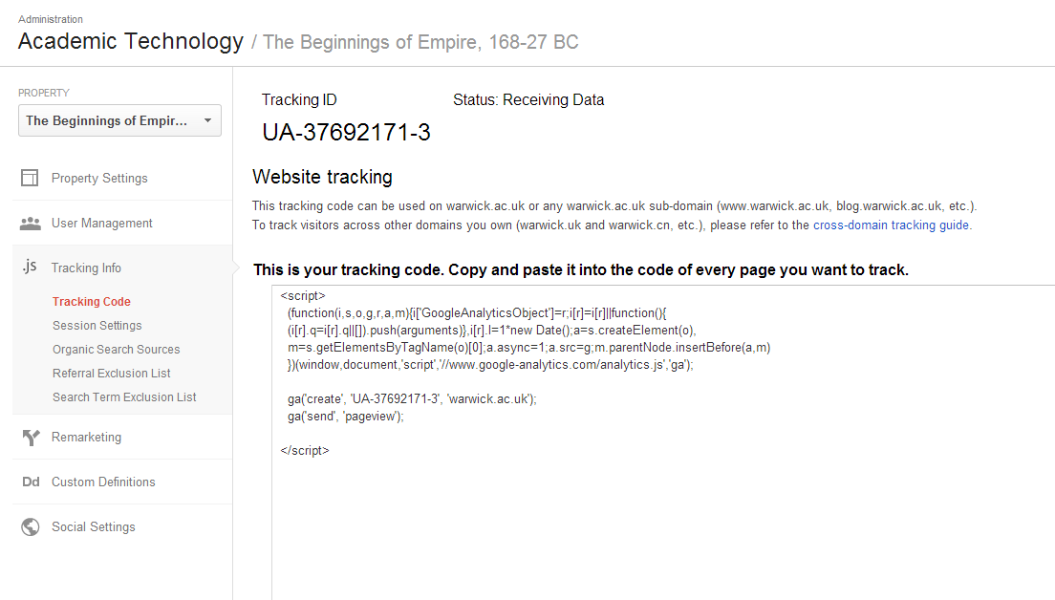
Getting the most from your Google Analytics
Getting started—tracking code
Admin / property – “tracking info”

Slide 5
Getting the most from your Google Analytics
Getting started
EITHER: Copy and paste tracking code into the pages you want tracked (using raw editor on sitebuilder, before </head>
OR: Put the Tracking ID in the appropriate box within sitebuilders “site properties” section- which installs it on all sub-pages.
• Confirm tracking code has been verified
data starts to gather (real time report displayed immediately, others may take <24 hours)
http://support.google.com/analytics/bin/answer.py?hl=en-GB&answer=1008080

Slide 6
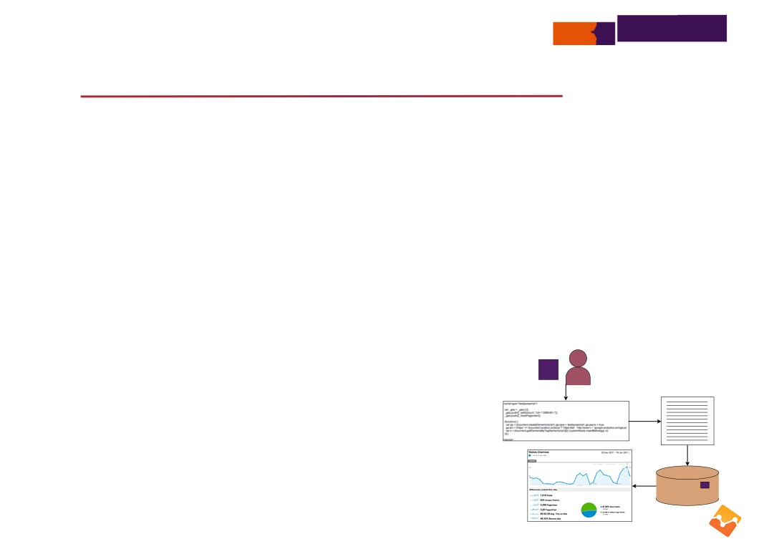
Getting the most from your Google Analytics
How Google Analytics works
• Process
when a page is displayed by the browser, the inserted JavaScript executes this code loads the ga.js script from a Google server
this script stores data about the visit in cookies on the user’s machine
this cookie data is sent in a query string to a secure GA reporting server
the cookie data, relating to the page visit, is then extracted from the access logs of the
Google secure server and stored in the corresponding GA account for use in compiling reports
• Note
JavaScript is required on the user’s machine cookies must be enabled
data is recorded when cached and reloaded pages are viewed
https://developers.google.com/analytics/resources/concepts/gaConceptsTrackingOverview

Slide 7
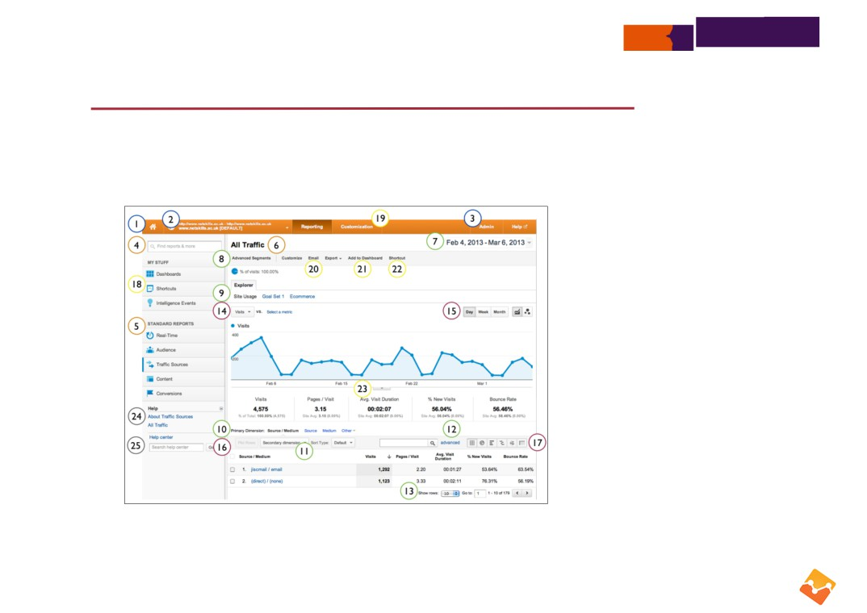
Getting the most from your Google Analytics
The interface
Account Controls
1. Property list
2. Account/Profile Selector
3. Administrative Settings
Report Navigation
4. Report Finder
5. Directory of Reports
6. Report Title
Data Inclusion Controls
7. Date Selector
8. Advanced Segments
9. Metric Group Selector
10. Primary Dimension Selector
11. Secondary Dimension Selector
12. Table Filter
13. Table Controls
Graph & Visualisation Controls
14. Metric View Selector
15. Graph Increment Selector
16. Plot Rows
17. Data View Selector
Report Sharing,Dashboards, and Downloading
18. Dashboards, Realtime, Intelligence
19. Custom Reporting
20. Customize, Email, Export
21. Add to Dashboard
22. Shortcuts
23. Annotations
Help Resources
24. Contextual Help
25. Help Search Box

Slide 8
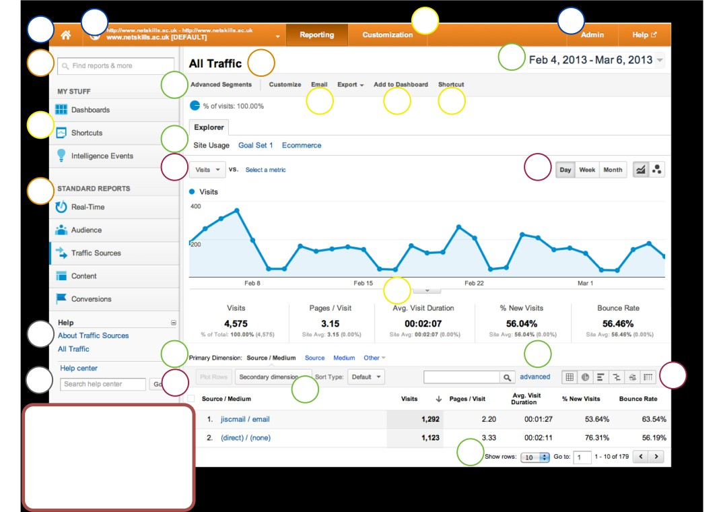
1
2
19
3
4
6
7
8
20 21
22
18
9
14
15
5
23
24
10
12
25
16
17
11
Help Resources
24. Contextual Help
25. Help Search Box
13
19. Custom Reporting
20. Customize, Email, Export
21. Add to Dashboard
22. Shortcuts
23. Annotations

Slide 9

Getting the most from your Google Analytics
Getting the helicopter view
• Google account
• Analytics account
• Property
• Profile
• Administrator *
• User
* http://analytics.blogspot.ie/2013/03/enhancing-google-analytics-access.html

Slide 10
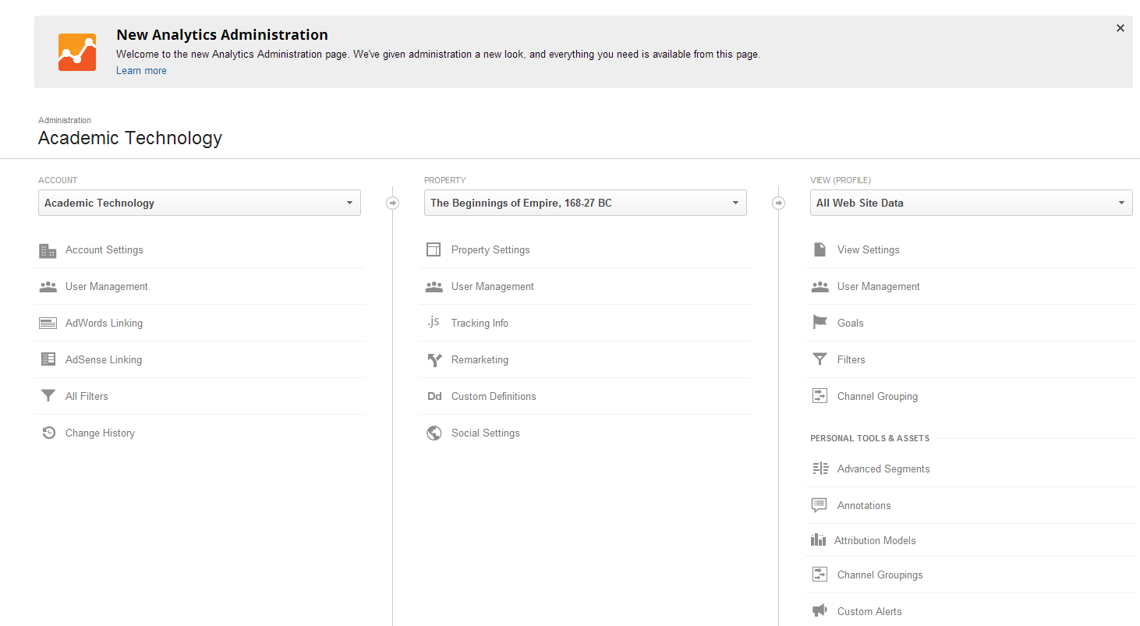
Click on “admin” in the top right corner of google analytics, and the relationship of account to property to view becomes a little clearer…

Slide 11

Getting the most from your Google Analytics
Getting the helicopter view
• Standard report
• Custom report
• Dashboard
• Widget

Slide 12
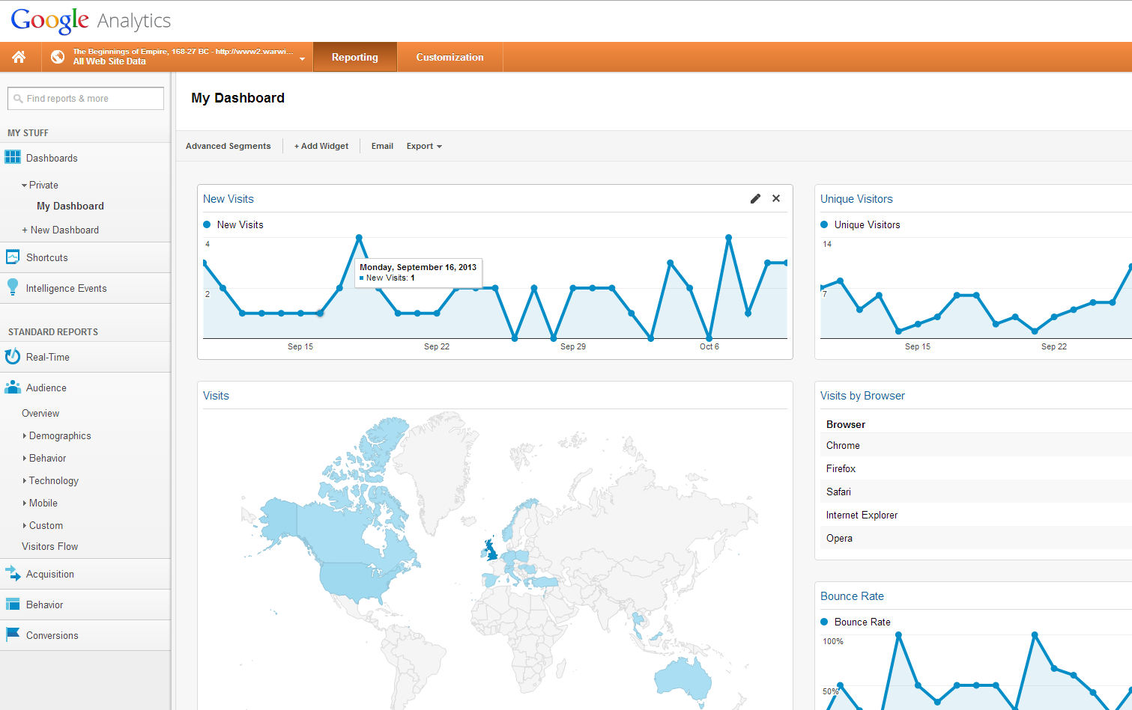

Slide 13
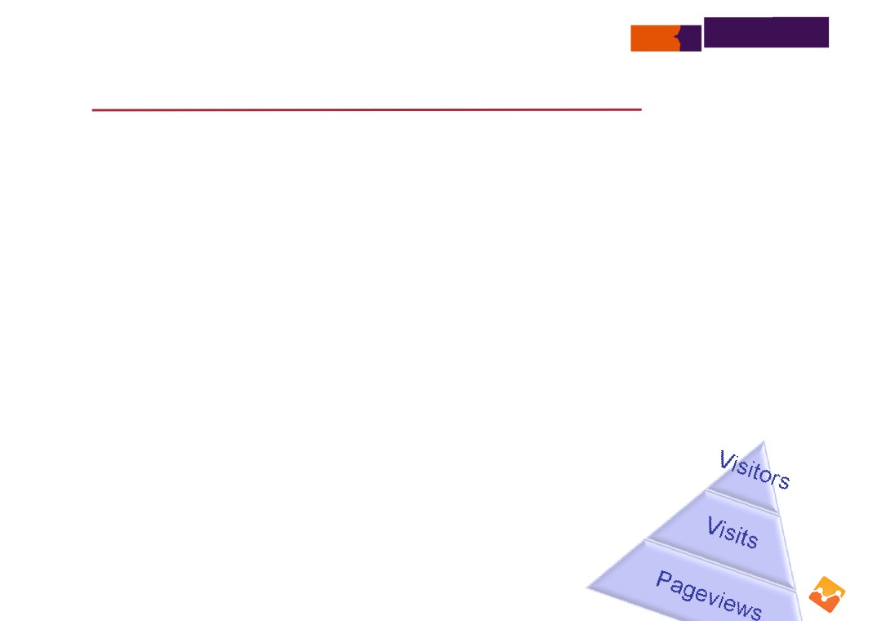
Getting the most from your Google Analytics
Common metrics
• Visits
a period of interaction between a web browser and a web site
closing the browser or staying inactive for >30 minutes ends the visit
• Unique Visitors
counts each visitor only once during the selected date range
uniquely identified by a GA visitor cookie, assigns a random visitor ID to the user, combines it with timestamp of the visitor’s first visit
if visitor A views a site 4 times during the selected date range, visitor B views the same site once, that’s 2 unique visitors
• Pageviews
counts every time a page on a site loads

Slide 14

Getting the most from your Google Analytics
Common metrics
• Unique pageviews
represents the number of visits during which that page was viewed
if visitor views page A 4 times during one visit, it is 4 pageviews, 1 unique pageview
• Bounce
calculated as a single-page view or single-event trigger in a visit or session—these qualify as bounces:
a visitor clicks on a URL sent by a friend, reads the content on the page and closes the browser
a visitor comes to your home page reads for a minute or two and immediately leaves
a visitor comes directly to a page referred from a search, leaves the page available in the browser while completing other tasks in other browser windows and the session times out
• Bounce rate
percentage of visitors that view only one page during a visit to your site

Slide 15
Getting the most from your Google Analytics
Common metrics
• Pages/Visit (pages per visit)
displays average number of pages viewed per visit to a site
repeated views of a single page are counted in this calculation
this metric is useful as a total as well as when it is viewed with other dimensions, such as country, visitor type or mobile operating system
bounces are excluded
• Average Time on Site
divides the total time for all visits by the number of visits—classifies each visit as coming from either a new or a returning visitor
bounces remain a part of the calculation
• New Visits
percentage of all visits from first-time visits

Slide 16
Getting the most from your Google Analytics
Real-Time reports
• Measuring activity as it happens
how many people viewing content right now pageviews per second/minute
the location of the visitors
what traffic sources referred them to your site what pages visitors are viewing
• Verify tracking code is working
• Check the traffic when a social media post has been made
• Monitor the effects of an email campaign

Slide 17
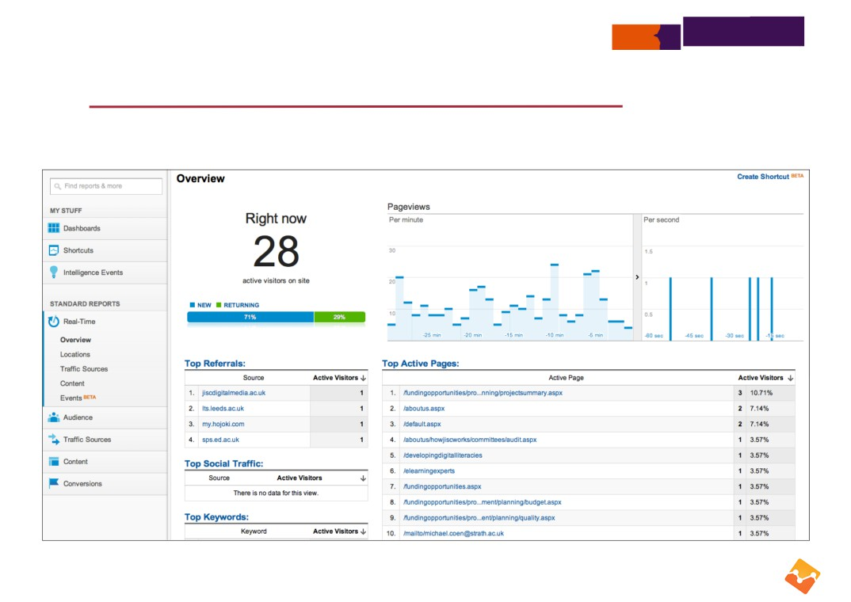
Getting the most from your Google Analytics
Real-Time reports

Slide 18
Getting the most from your Google Analytics
Audience reports
• Overview reports gives an at-a-glance view of visitor metrics
Visits (total number of visits to your site)
Unique Visitors (total number of unique visitors to your site) Pageviews (total number of pages viewed on your site) Pages per Visit (average number of pages viewed per visit) Average Visit Duration (average visit length of all visitors) Bounce Rate (percent of single-page visits)
New Visitors (percent of total visitors who visited your site for the first time)

Slide 19
Getting the most from your Google Analytics
Audience reports
• Demographics—where audience comes from by language and location
• Behavior—type of visitor, their loyalty and engagement
• Technology—what browser and network they’ve used to access your site
• Mobile—accesses via mobile and the devices they’ve used
• Visitors flow—traces the route that visitors took through your site and left

Slide 20
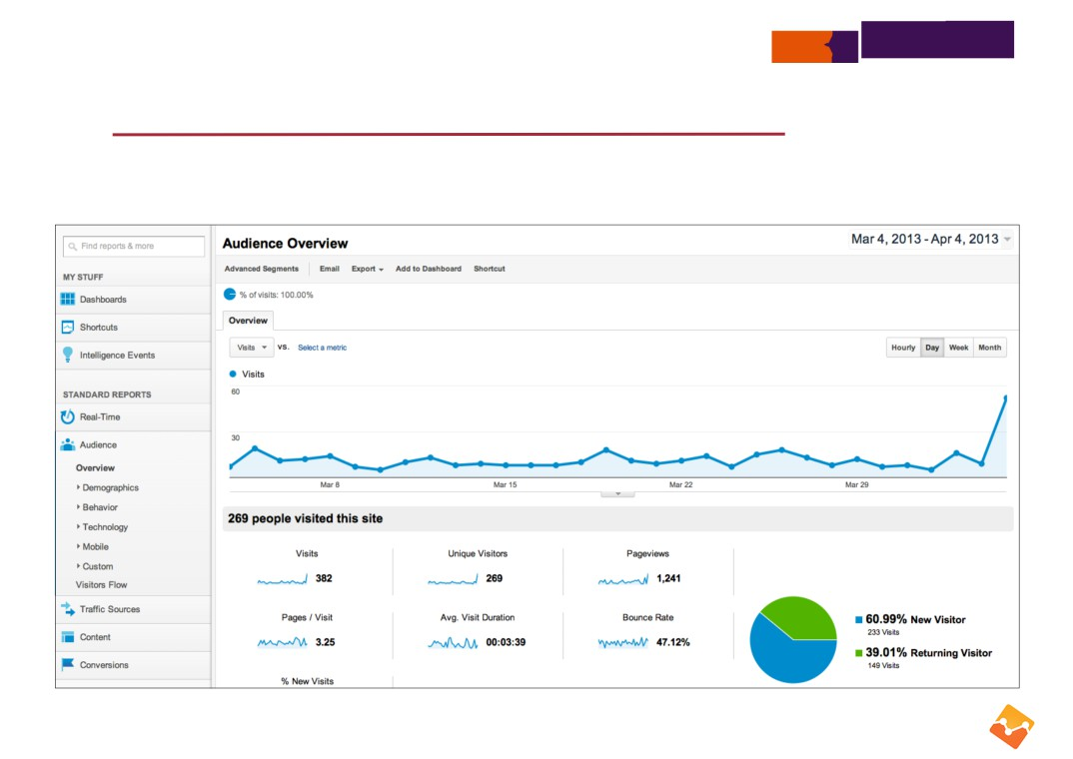
Getting the most from your Google Analytics
Audience overview report

Slide 21
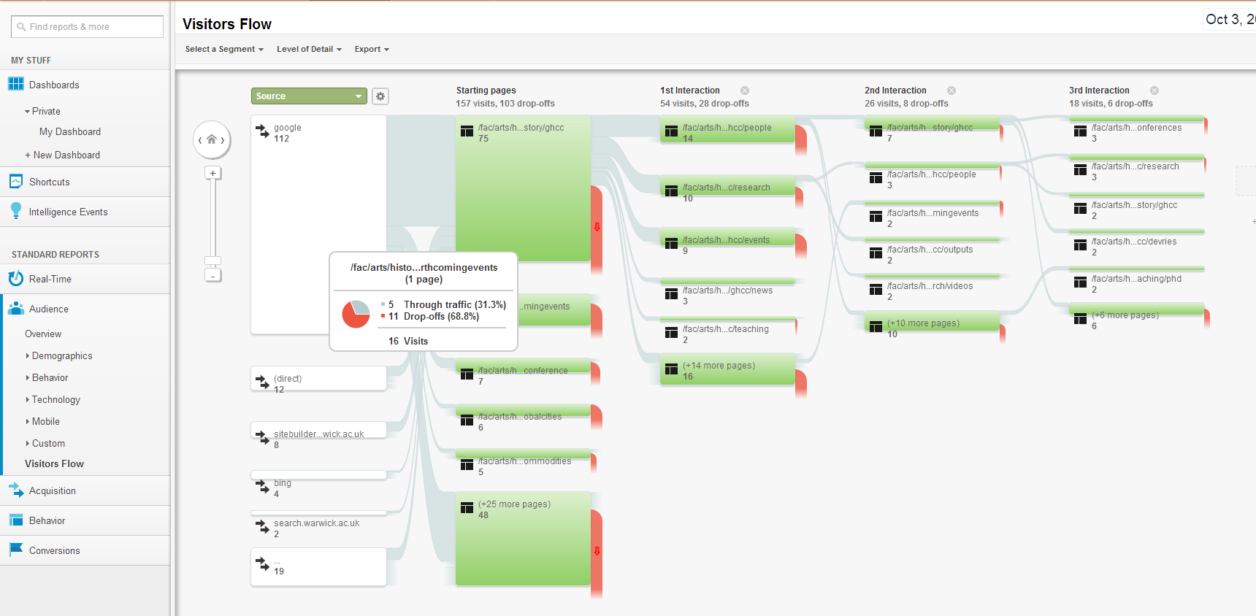
In the Reports view, click on “audience”, “visitors flow”…

Slide 22
Getting the most from your Google Analytics
Traffic Sources reports
• Overview reports gives an at-a-glance view of traffic sources
• Sources—offers you insights into how people are finding your site through:
referrals
direct traffic
organic (unpaid) search keywords custom campaigns
advertising (Adwords)
• helps you evaluate the effectiveness of social media
https://support.google.com/analytics/bin/answer.py?hl=en&answer=1006930&topic=1631856&rd=1

Slide 23
Getting the most from your Google Analytics
Custom campaigns
• Helps you collect information about traffic coming to your site and identify what are the most effective ways to drive more visitors
• By adding parameters to the end of a web address, allows Analytics to record metrics which you can monitor
• Simple URL builder builds the URL which you can add to e.g. a tweet, email or within a web page
http://support.google.com/analytics/answer/1033867?hl=en

Slide 24
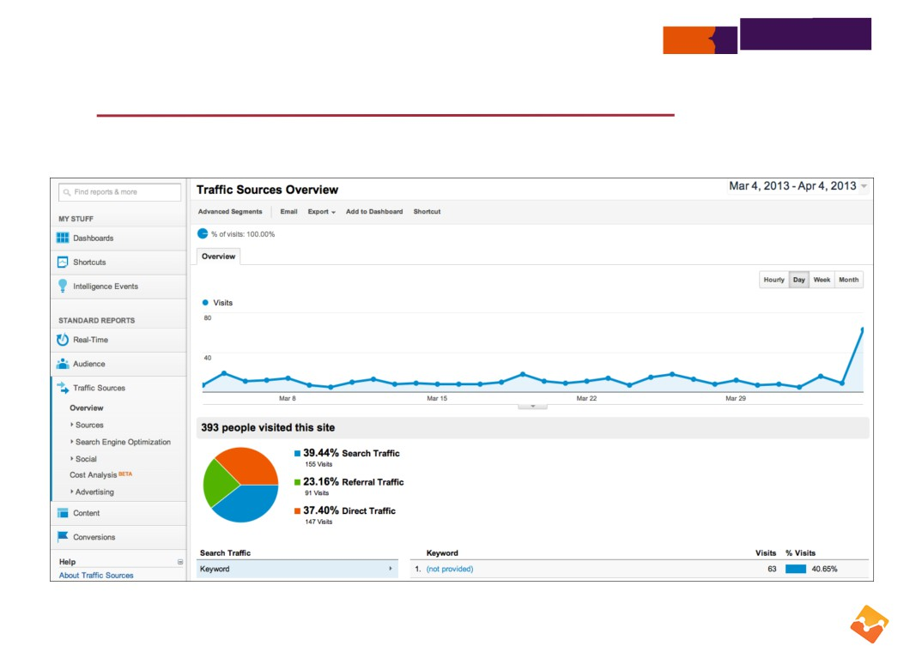
Getting the most from your Google Analytics
Traffic Sources overview report

Slide 25
Getting the most from your Google Analytics
Traffic Sources—Social
• Overview—shows at-a-glance conversions generated from social channels
• Network referrals—list of social media sources
• Data Hub activity—those that share data with Google
displays what visitors have done within social network (so it tracks off-site traffic) such as sharing a URL, making a favourite, saved
• Landing pages—metrics associated with pages linked from social networks
• Trackbacks—URL they’ve come from, the page on your site, how many visits
http://www.google.com/analytics/features/social.html https://developers.google.com/analytics/devguides/socialdata/

Slide 26
Getting the most from your Google Analytics
Traffic Sources—Social
• Conversions—measures success of campaigns aligning with pre-defined goals
• Plugins—displays metrics of social buttons visitors select and what they ‘share’, ‘like’
• Visitors flow
view a flow diagram of the path visitors took through site from social networks
• In all, helps you measure the impact and effectiveness of your social initiatives

Slide 27
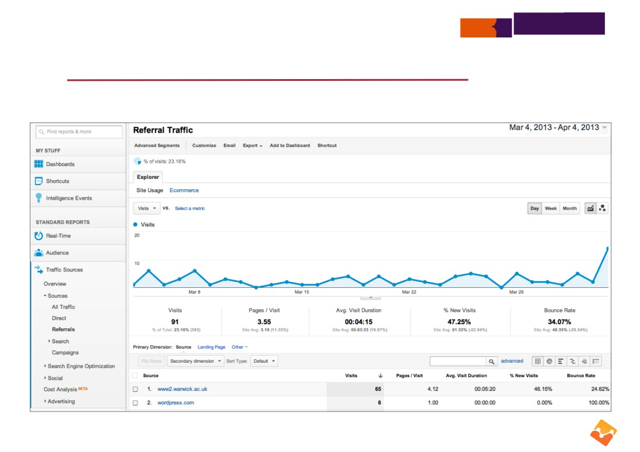
Getting the most from your Google Analytics
Traffic Sources referrals report

Slide 28
Getting the most from your Google Analytics
Content reports
• Overview reports gives an at-a-glance view of pageview metrics—designed to help you improve content
• Site Content—how frequently each page is viewed
observe how visitors view pages e.g. in Landing page report identify those with high bounce rates, may need rewritten to be more effective
• Site Speed—page load times
observe how any page that is excessively slow when being downloaded
• Site Search—metrics if Analytics tracking internal searches
observe search terms visitors are using and relevance
• In-Page Analytics—visualise how users interact with your web pages

Slide 29
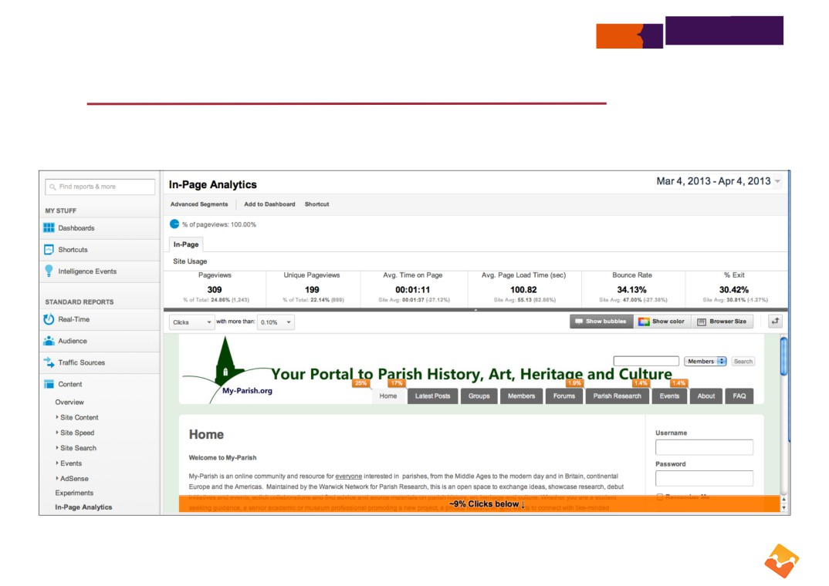
Getting the most from your Google Analytics
Content In-Page Analytics report

Slide 30

Getting the most from your Google Analytics
Reference material
• Overview on wikipedia:
http://en.wikipedia.org/wiki/Google_analytics
• Official Google site:
http://www.google.com/analytics/
• Google support:
http://support.google.com/analytics/
• Google analytics blog—official blog for Google Analytics tips, tricks and news:
http://analytics.blogspot.co.uk/
• Google analytics youtube channel:
http://www.youtube.com/user/googleanalytics/videos
http://www.google.com/search?q=Google+Analytics

Slide 31

Getting the most from your Google Analytics
Getting the most out of Google Analytics
• What do you want visitors to achieve on your site
• Set your goals
• Once set, they enable GA to track all traffic data into information you can quickly monitor and take action

Slide 32
Getting the most from your Google Analytics
Set your goals
• Request for admissions information
• How engaged visitors are around feature stories and other areas that require significant investment to create and maintain
• Visits to information pages about an event promotion
• Registrations to advertised events
• Alumni engagement via an online giving form
• Students signing up for a text alert service or paying a deposit online

Slide 33

Getting the most from your Google Analytics
Admin—Goals
• Set up a goal within Admin, choose the Profile you want to add the goal, select Goals, select +Goals
• Within each profile, can create 4 sets of goals, each containing up to 5 goals
if more goals required, an additional profile will need to be created
• Specify a name for the goal and choose to make that goal active or inactive
• Four different types of goals
http://support.google.com/analytics/bin/answer.py?hl=en&answer=1032415

Slide 34
Getting the most from your Google Analytics
Admin—Goals
• URL destination—see how frequently visitors abandon their way and where they go to
specify the goal page—could be a thank you page when a donation received
match type menu—Exact Match, Head Match, Regular Expression Match
optional—set up a Goal funnel that represents a path (a series of pages) you expect a visitor to take on their way to a goal
note: within a goal set, it is possible to set up multiple paths to same destination—see which path is the most successful or highest bounce rate
http://support.google.com/analytics/bin/answer.py?hl=en&answer=1116091

Slide 35
Getting the most from your Google Analytics
Admin—Goals
• Visit duration
specify hours, minutes, seconds that occurs for a time lapsed on a visit
• Pages/Visit
specify a number of pages visited
• Event
used with Event tracking to track activity such as a file download
configure a combination of one or more event conditions (category, action, label, value)
http://support.google.com/analytics/bin/answer.py?hl=en&answer=1033068

Slide 36
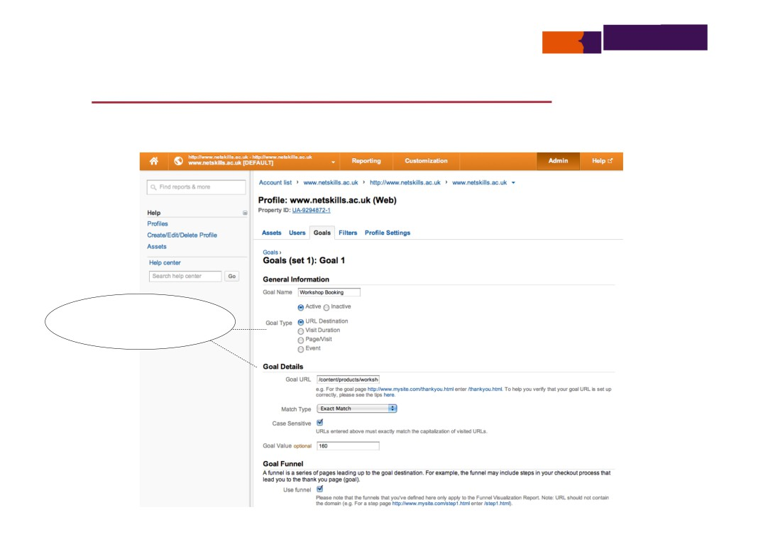
Getting the most from your Google Analytics
Admin—Goals
depending on goal
type selected, different goal details to be supplied

Slide 37
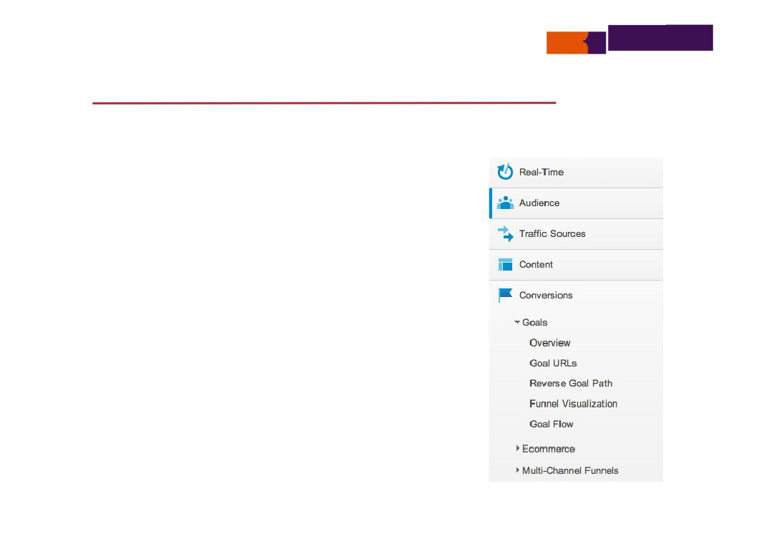
Getting the most from your Google Analytics
Reporting—Conversions
When goal is reached, GA calls this a
conversion
Monitor your goals—view path to each goal, visualise funnel conversion rate, goal flow
Ability to optimise value of ecommerce activity
View impact of all online marketing
activities including search, social, email in multi-channel funnels reports
http://www.google.com/analytics/features/conversion-suite.html

Slide 38
Getting the most from your Google Analytics
Conversions > Goals
• Overview—default report, shows number of goals and value
• Goal URLs
view graph of all completed goals and table displays URL when goal completed
• Reverse goal path
shows URLs of three previous steps that visitors used before conversion
• Funnel Visualisation
funnel showing the route of all traffic to conversion—displays URLs visitors took when abandoning route to goal and percentage of those who progressed to conversion
• Goal flow
flow visualises the path from where visitors came from, through different pages towards the conversion and table displays percentage from source

Slide 39
Getting the most from your Google Analytics
Reporting—Conversions
• Added benefit—Google measures what has brought traffic
to your site from other sources during last 30 days Detects channels that send traffic to your site
•
all search engines
referrals (like from social media sources) visits that people have previously bookmarked direct—types site’s URL into the browser social media traffic
custom campaigns you’ve previously setup
http://support.google.com/analytics/bin/answer.py?hl=en&answer=1033867
https://support.google.com/analytics/bin/answer.py?hl=en&answer=1191180&topic=1191164

Slide 40
Getting the most from your Google Analytics
Suggested actions
• Identity what you want visitors to achieve
• Set up corresponding goals
• If you’ve set up paths, check effectiveness of the pages visitors took through goal funnel
• View channels visitors are taking to make a conversion

Slide 41
Getting the most from your Google Analytics
Getting the most out of Google Analytics
• Analyse and refine your reports
make use of advanced segments
visualise data differently
add annotations to remind you of key reasons for traffic changes or changes made to the site use profiles to filter data e.g. remove your internal network traffic from the rest of the data check up on change history

Slide 42
Getting the most from your Google Analytics
Analyse your traffic—advanced segments
• Analyse specific kinds of traffic as you go through reports
view data only for a particular segment or compare data side-by-side with data from other segments e.g. ‘New Visitors’ with ‘Returning Visitors’
• Create a custom segment for you to analyse your traffic
identify the dimensions and metrics you want to select e.g. only traffic for a certain region
• Select up to four segments to compare
displays results within graph, examine historical data (even if segment just created)
• Adjust sample size tool—controls the subset of data to be used when building a report
slider used to select less for faster processing or more for higher precision
http://www.google.com/analytics/features/advanced-segments.html

Slide 43
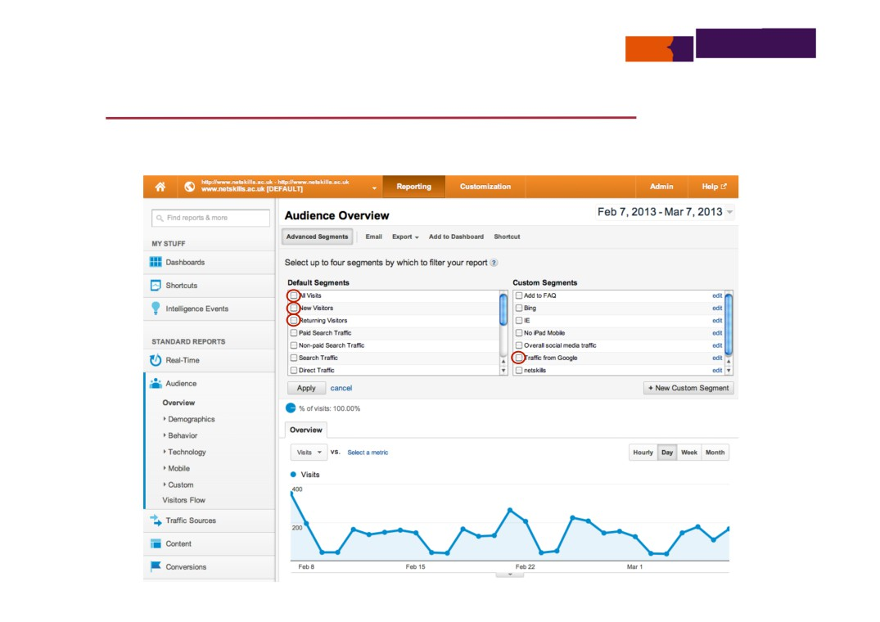
Getting the most from your Google Analytics
Analyse your traffic—advanced segments

Slide 44
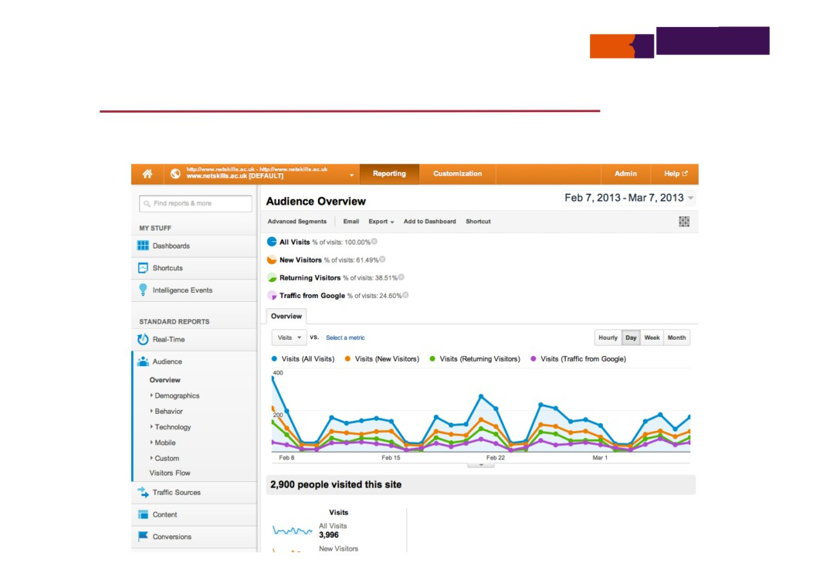
Getting the most from your Google Analytics
Analyse your traffic—advanced segments

Slide 45
Getting the most from your Google Analytics
Visualise data
• Within tables of data—select other dimensions, add second dimension to compare with same metrics
search the table for a particular word and continue with more advanced search
• Use different selectors
Percentage—displays data in percentage and in a pie chart
Performance—displays data in bar chart against a different metric
Comparison—shows an at-a-glance view of what outperform/underperforms site average
e.g. in Audience > Location, select City, select comparison and compare visits with bounce rate (with site average)
Pivot—rearrange data in a table to compare groups of data against each other e.g. to find
out the bounce rate and pageviews for each keyword in Traffic > Search > Organic, select Pivot selector, pivot by source, from Pivot metrics menus select Bounce rate and Pages/Visit Term cloud—only available in some reports showing a keyword cloud
https://support.google.com/analytics/bin/answer.py?hl=en&answer=1010052&topic=1009682

Slide 46
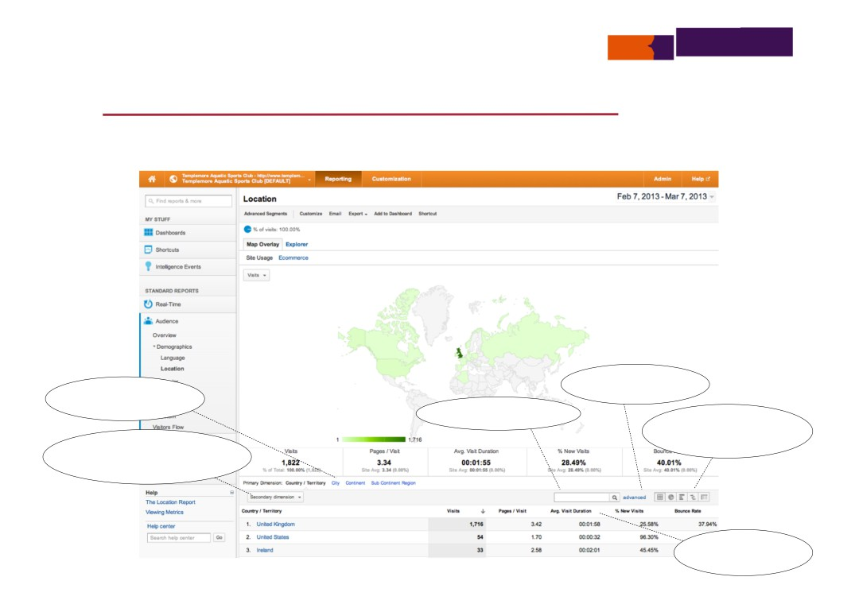
Getting the most from your Google Analytics
Visualise data
filter search results
view other dimensions
search data
select view from different selectors
add second dimension to compare with other metrics
select heading to sort

Slide 47
Getting the most from your Google Analytics
Annotations
• easily add personalised notes to record anything of interest against a specified date
reason for an increase in traffic
when a new section added
a specific blog item published
when marketing campaign was started

Slide 48
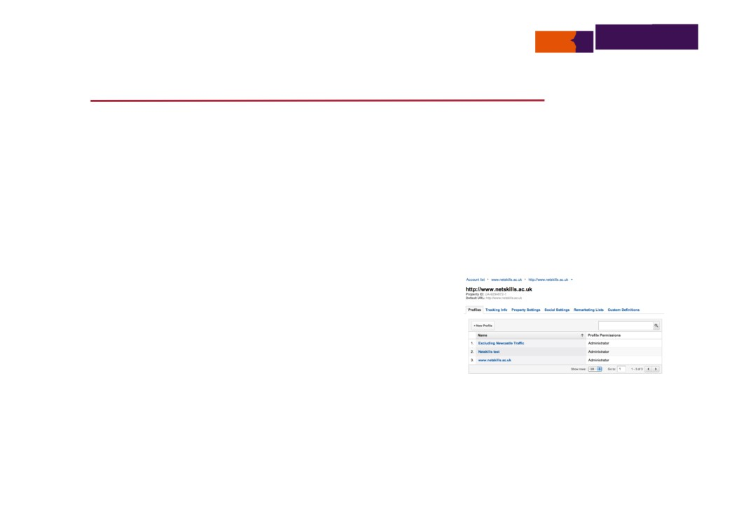
Getting the most from your Google Analytics
Profiles—filtering data
Set up new profiles to filter data for a web property (e.g. for a set of pages)
Manage profiles from within Admin
http://support.google.com/analytics/bin/topic.py?hl=en&topic=1032939&parent=1726911

Slide 49
Getting the most from your Google Analytics
Profiles—filtering data
• Always keep one unfiltered profile so that all data is available for a web property
• Create a new profile for the property
• Set up a new filter—using pre-defined or your own custom
pre-defined—allows you to exclude (or include only)
traffic from the domain
traffic from the IP addresses traffic to the subdirectories traffic to the hostname
custom—select your own filter field
http://support.google.com/analytics/bin/answer.py?hl=en&answer=1033162

Slide 50
Getting the most from your Google Analytics
Suggested actions
• Use advanced (or set up your own) segments to compare data side-by-side
• Make use of selectors to visualise data better
• Add annotations to remind you of variations of activity or site enhancements
• Use profiles to filter traffic (esp. for administrators, so that academics can see their own pages)

Slide 51
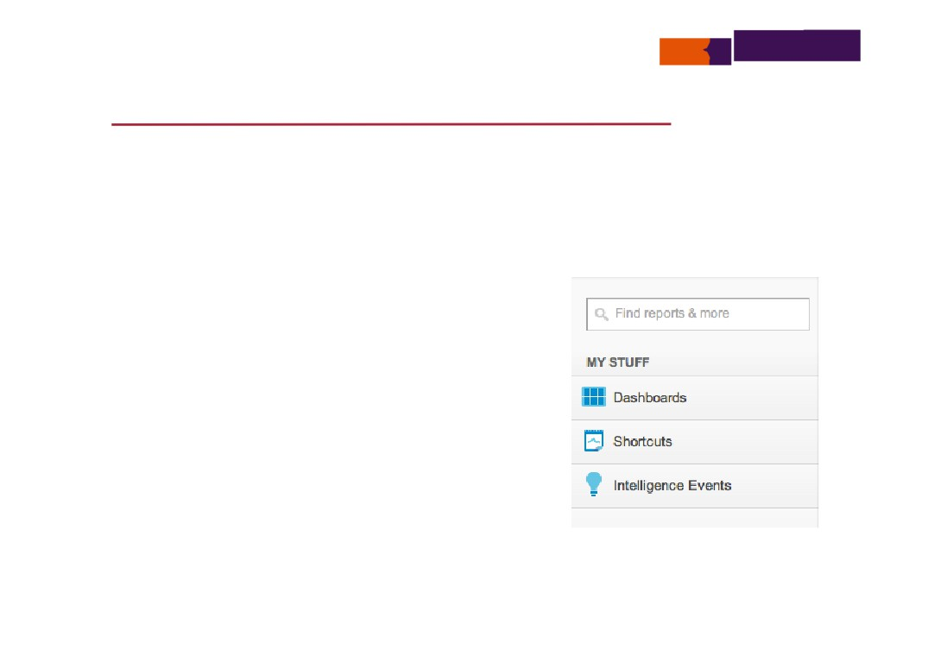
Getting the most from your Google Analytics
Getting the most out of Google Analytics
• Minimise effort
Use the dashboards to group together relevant reports Schedule emails to key staff
Create your own reports Use shortcuts
Consider using Share Assets

Slide 52
Getting the most from your Google Analytics
Dashboards
• Lets you display various statistics on a single page
allowing you to monitor a number of different areas at once
• Default dashboard consists of seven widgets
displays dimensions and metrics e.g. Daily visits, Average time on site, Total goal conversion rate, Traffic types, Time on site by country, Conversion rate by source, Mobile visits
• Add/edit/delete a widget in a format and data of your choice
Metric—select individual metric
Pie chart—select metric, dimension and number of slices
Timeline—select primary metric and optional comparative metric Table—select dimensions, up to two metric & number of rows
https://support.google.com/analytics/bin/answer.py?hl=en&answer=1068216&topic=1068215&rd=1

Slide 53
Getting the most from your Google Analytics
Dashboards
• Use ‘ADD TO DASHBOARD’ at the top of any report to add it to a specific report
• When dashboard is created, only visible in the user account in which it was created
• Can email dashboard configuration with others—to be used on data for other web properties
social media dashboard
site performance
http://www.google.com/analytics/learn/solutions-gallery.html

Slide 54
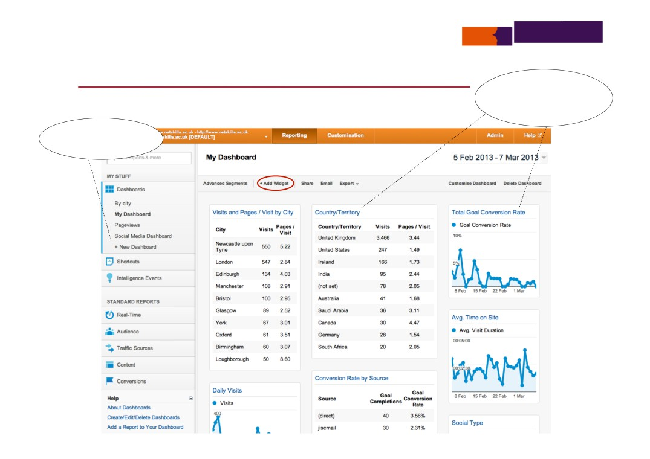
Getting the most from your Google Analytics
Dashboards
select title to go to
report, hover over title to see icons to edit or delete
create and customise a dashboard

Slide 55
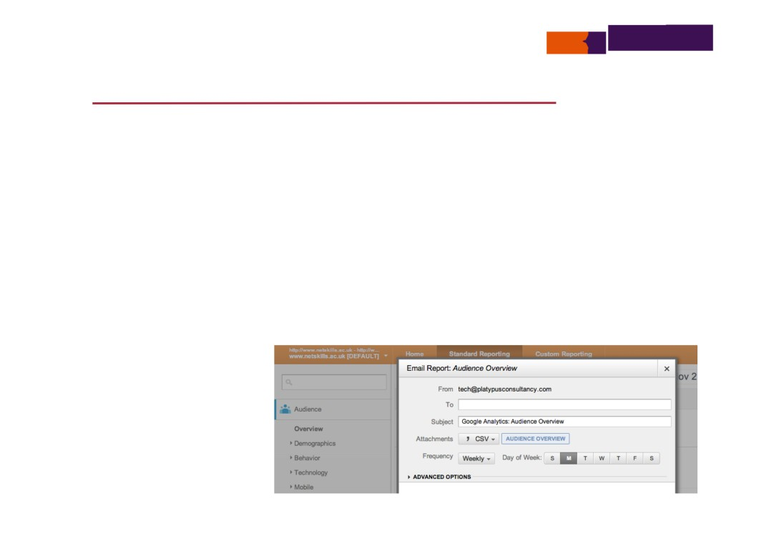
Getting the most from your Google Analytics
Schedule emails
• Schedule emails containing attachments of reports to go to key staff once, daily, weekly, monthly, quarterly
• Different formats—CSV, TSV, Excel, PDF
• Select the day for report delivery
• Maintain scheduled emails in Admin
http://support.google.com/analytics/bin/answer.py?hl=en&answer=1038573

Slide 56
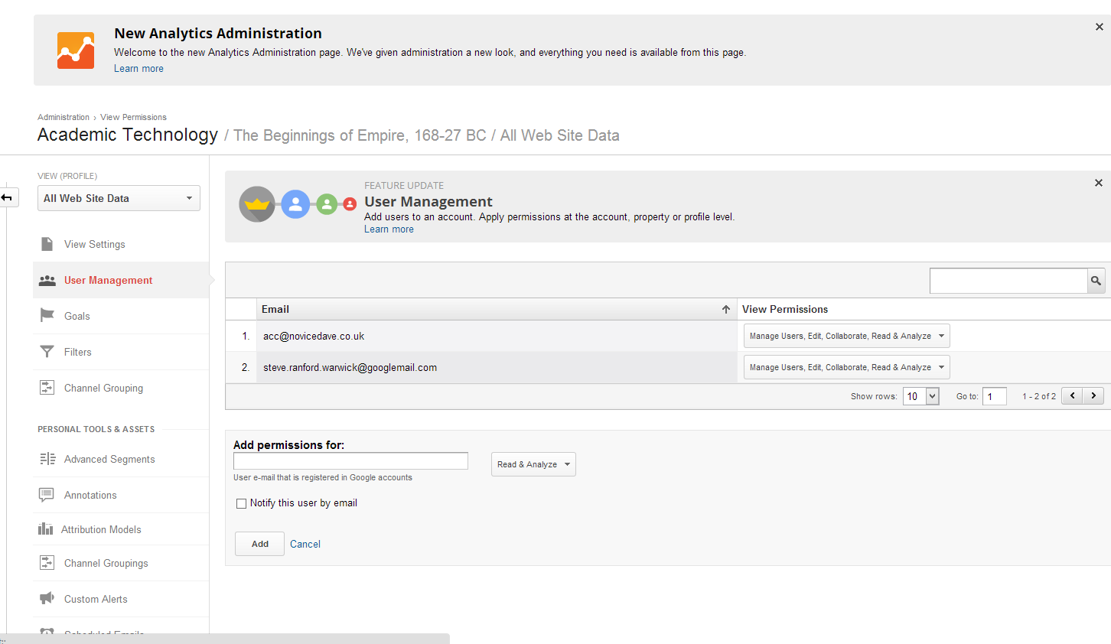
Getting the most from your Google Analytics
Create users
http://support.google.com/analytics/bin/answer.py?hl=en&answer=1699665&topic=1009690&ctx=topic

Slide 57
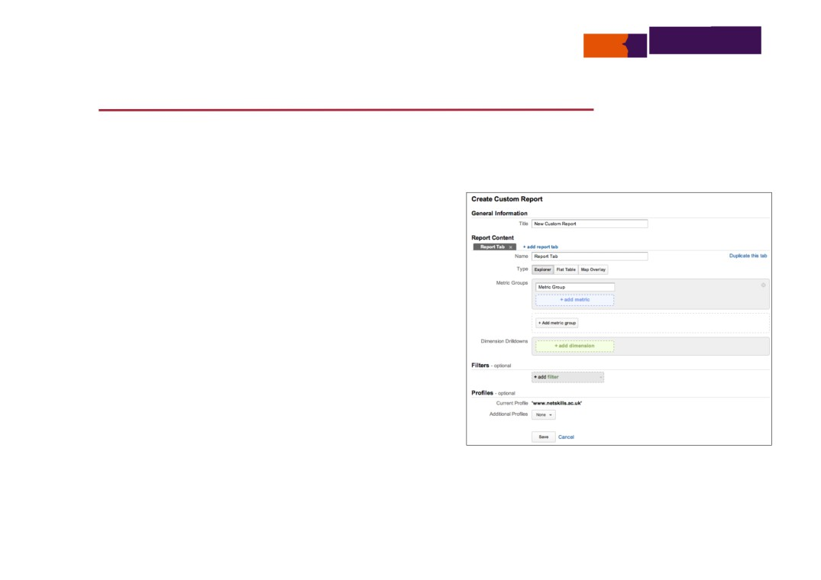
Getting the most from your Google Analytics
Customisation—creating your own reports
• Ability to create your own custom
reports and categorise
• Select appropriate metrics and dimensions to display report
https://support.google.com/analytics/bin/answer.py?hl=en-GB&topic=1012046&answer=1033013&rd=1

Slide 58
Getting the most from your Google Analytics
Customisation—creating your own reports
• General information
enter a name for the custom report
• Report content
name report tab of either type Explorer or Flat table
Explorer—contains a hierarchy of data tables linked by clickable rows (name and select Metric group and Dimension drilldowns)
Flat table—a single table showing all the data (add up to 5 dimensions and 25 metrics)
• Filters—optional, to limit report to subset of data
• Profiles—optional, add other profiles that this report is also available
https://support.google.com/analytics/bin/answer.py?hl=en-GB&answer=1151300&topic=1012046

Slide 59
Getting the most from your Google Analytics
Suggested actions
• Make a start with dashboards—import a relevant dashboard configuration and customise
• Set up scheduled emails to to deliver reports to key staff
• Create your own reports

Slide 60
Getting the most from your Google Analytics
Summary
• Plan—set your goals to see what visitors achieve (or not)
• Analyse—filter traffic, refine your reports
• Minimise effort—dashboards, email reports, use shortcuts
• Monitor traffic—real time, intelligence events, social media

Slide 61

Getting the most from your Google Analytics
Getting more out of Google Analytics
There is a wealth of information that can be extracted about a web site (or app) use from a Google Analytics account interface and often the issue will be deciding what subset of the possible is most useful and forming the discipline to routinely utilise and act on that quintessential report data.

Slide 62

Getting the most from your Google Analytics
Using Google Analytics effectively
5 ways you can effectively use web
analytics to your advantage
ManageWP, Tom Ewer, May 2012
1. Set goals—conversions matter more than anything else
2. Check for problem pages—check exit rates on key pages and try to determine reasons for unusually high values
3. Consider your target audience—ensure compatibility across multiple platforms etc.
4. Leverage top traffic sources—80% of the effects come from 20% of the causes, so identify your top traffic sources and ensure that you are leveraging them to their maximum capacity
5. Curb your addiction—checking your analytics regularly is a bad habit, plain and simple: there is no apparent benefit, in my opinion, to checking your analytics on a daily basis
http://managewp.com/effectively-use-web-analytics-to-your-advantage

Slide 63

Getting the most from your Google Analytics
Using Google Analytics effectively
Five awesome tips to extract valuable SEO secrets from Google Analytics data
SocialMediaToday, David Mercer, May 2012
1. Segment analytics data for today—you can derive deeper SEO insights by splitting data into segments: day, week, month, year, historical
2. Exclude erroneous traffic spikes from analytical data—exceptional traffic spikes, if they're large enough, can warp your data and skew your SEO strategy as a result
3. Use content navigation to analyse traffic patterns—it helps to
understand exactly how people are navigating your site in order to make intelligent decisions about how to improve the conversion rate
4. Use secondary dimensions—the secondary dimension can help provide drill-down information about the primary dimension's data
5. Segmented visitor flow view—looking at lists of statistical SEO data is one thing, but being able to actually visualise the flow of traffic into and around your website is a very powerful feature
http://socialmediatoday.com/siteprebuilder/501747/five-awesome-tips-extract-valuable-seo-secrets-google-analytics-data

Slide 64

Getting the most from your Google Analytics
A range of APIs and options
• Collection API relates to web tracking using the ga.js set of JavaScript functions for tracking user interaction with websites or web applications and Android or iOS apps
• The Management API allows access to Google Analytics
configuration data for accounts, properties, profiles, goals, segments, for use in other applications
• The Core reporting or data export API allows querying of data stored in a Google Analytics account to produce special reports
• The Social data hub allows social networks and other social platforms to integrate social data with Google Analytics
https://developers.google.com/analytics/devguides/

Slide 65

Getting the most from your Google Analytics
Application programmers interface (API)
There are occasions when it is desirable to monitor, measure, or analyse, something quite specific to a particular web site— something that cannot be accomplished using the Google Analytics default interface.
On such occasions the Google Analytics data collection API can be used to programme additional data collection which can then be used in standard or custom reports.
https://developers.google.com/analytics/devguides/collection/

Slide 66
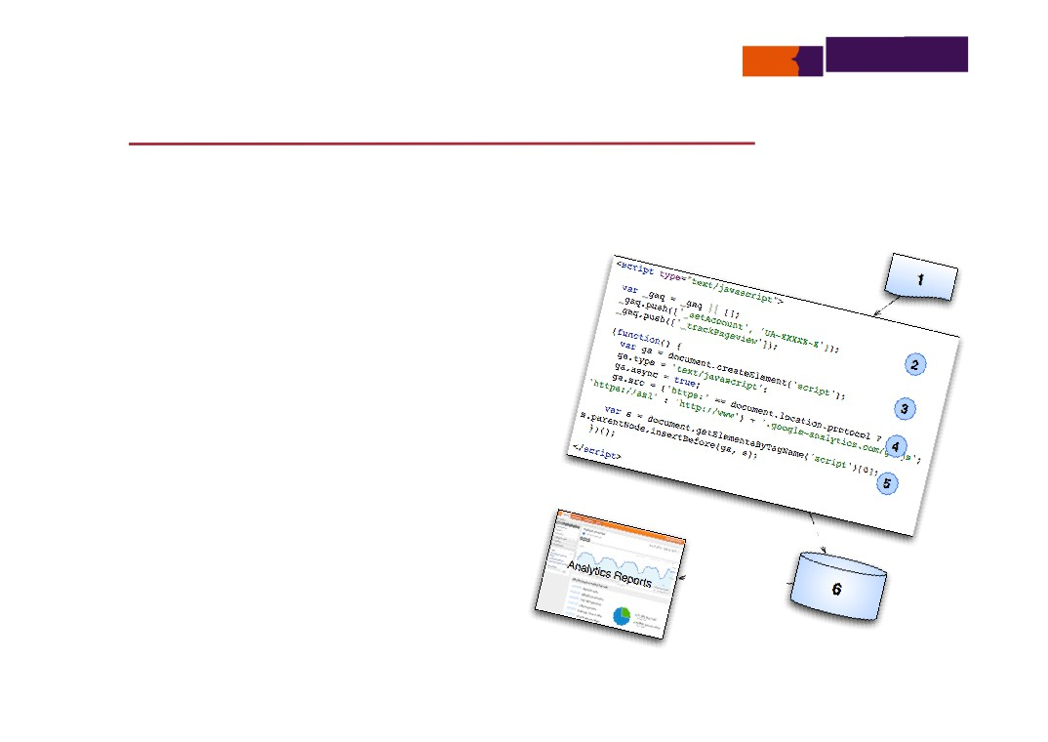
Getting the most from your Google Analytics
Implementing the collection API
var _gaq = _gaq || [];
_gaq.push (['_setAccount', 'UA-11066040-24']); _gaq.push (['_trackPageview']);
(function () {
var ga = document.createElement ('script'); ga.type = 'text/javascript';
ga.async = true;
ga.src = ('https:' == document.location.protocol ? 'https://ssl' :
'http://www') + '.google-analytics.com/ga.js';
var s = document.getElementsByTagName ('script')[0]; s.parentNode.insertBefore (ga, s);
}) ();
https://developers.google.com/analytics/devguides/collection/gajs/

Slide 67
Getting the most from your Google Analytics
What’s in the ga.js file?
• The ga.js file contains JavaScript that:
• Defines JavaScript objects
• Provides the code of method scripts associated with the defined objects
• Two primary objects are defined:
1.
_gat is used to create and retrieve tracker objects, from which other tracking related
methods are invoked
2. _gaq is used directly for asynchronous page tracking, acting as a queue, a first-in, first-
out data structure that collects instructions until ga.js is ready to execute them—the _gaq.push () method adds something to the queue
• A wide range of method scripts included in ga.js enable cookie management and updating, detection or setting of system variables... and, most importantly, tracking
https://developers.google.com/analytics/devguides/collection/gajs/methods/

Slide 68
Getting the most from your Google Analytics
Calling Google Analytics method scripts
• A default tracker object is always defined and implied in calls of methods that don’t specify an alternative tracker
• A method may be called by pushing an array of the method name and parameters (to the Google Analytics queue object that allows efficient asynchronous JavaScript execution):
_gaq.push (['_setAccount', 'UA-XXXXX-X']);
• Or call method by pushing a function that calls the method:
_gaq.push (function () {
var pageTracker = _gat._getTrackerByName (); var accountId = pageTracker._getAccount (); });
• The approach used depends on whether or not a return value is required from the call to the method
https://developers.google.com/analytics/devguides/collection/gajs/methods/

Slide 69

Getting the most from your Google Analytics
Google Analytics cookies
• Google Analytics cookies act as local data collectors on the visitors device as the visitor interacts with a web page
• They uniquely define the visitor and gather information from page to page during a visitor's session
• Data about the browser being used, computer type, network location etc. are also stored in these cookies
• Google Analytics cookies do not collect personal data about a web page visitor
• At critical points of a visit cookie information is dumped to Google Analytics servers
https://developers.google.com/analytics/resources/concepts/gaConceptsCookies

Slide 70
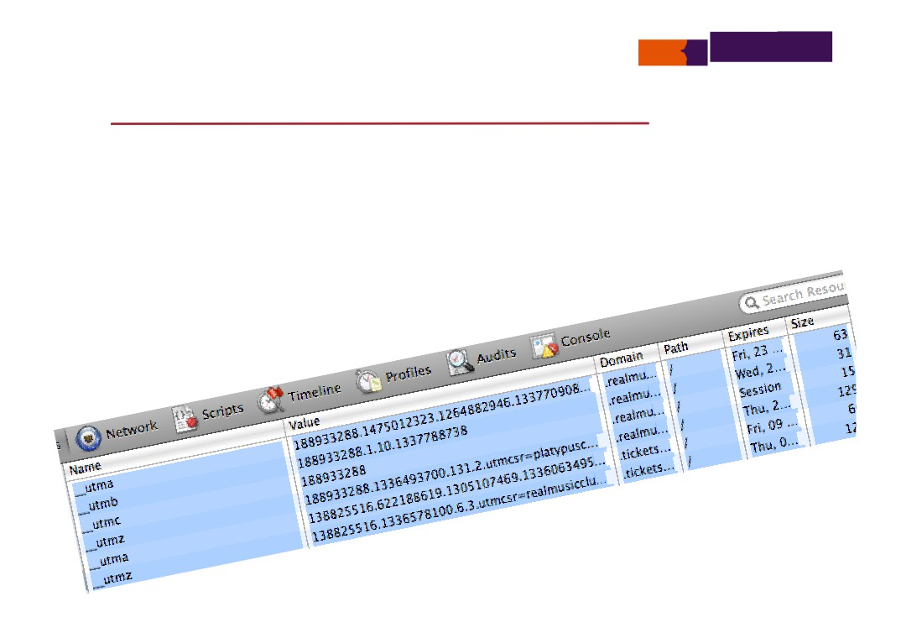
Getting the most from your Google Analytics
Google Analytics cookies
• Each cookie in a set of 6 has a specific data collection
purpose and its data are always ready for transfer to Google
• Determining visitor session, cookies:
_utmb, _utmc
• Identifying unique visitors, cookie:
_utma
• Tracking traffic sources and navigation, cookie:
_utmz
• Custom variables, cookies:
_utmv, _utmx
• These cookies can be seen on the visitor browser device and have different expiry periods depending on their purpose
https://developers.google.com/analytics/resources/concepts/gaConceptsCookies

Slide 71

Getting the most from your Google Analytics
Review of how data collection works
• JavaScript file ga.js loaded in any page being tracked
• This contains definitions of Google Analytics objects with associated methods (specific scripts)
• Some of these are called by the standard install code insert, or other JavaScript in a page, and these update Google Analytics cookies with information about the page visit or initiate transfer of cookie information to Google
• Information stored in Google Analytics cookies, including relevant information determined from the environment, is transferred to Google servers using the _utm.gif method
• This information is then processed at Google and stored in the Google Analytics account identified in the tracking code
https://developers.google.com/analytics/resources/concepts/gaConceptsTrackingOverview#trackingCodeExecution

Slide 72
Getting the most from your Google Analytics
The _utm.gif technique
• This is a simple HTTP request from the visitor’s browsing
device to the Google Analytics servers for a one pixel gif file
• The requested URL contains a long series of query
parameters (query string) that together specify all of the data (from Google Analytics cookies) to be tracked at the corresponding Google Analytics account
• The exact data transferred on the query string is defined by the particular request type made (initiated by the specific tracking method that was called)
https://developers.google.com/analytics/resources/concepts/gaConceptsTrackingOverview#gifParameters

Slide 73
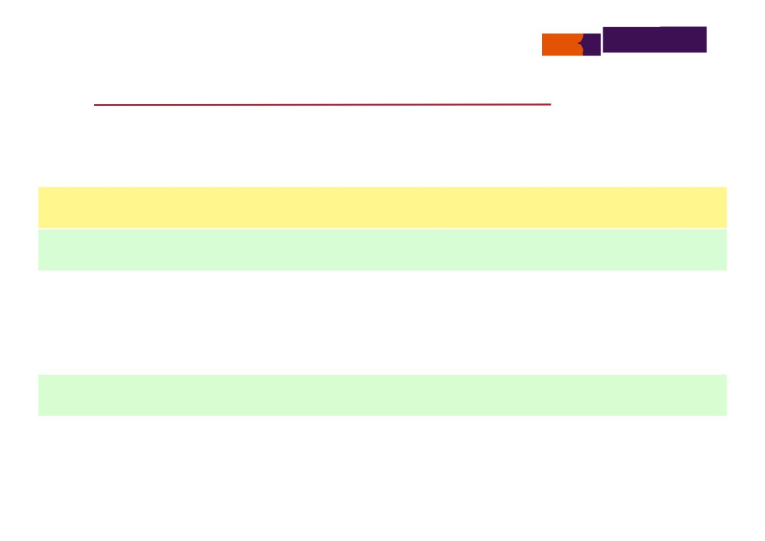
Getting the most from your Google Analytics
When is cookie information transferred to Google?
• When tracking occurs—i.e. one of 5 request types is made:
1.
A web page is requested—using trackPageView method
Page request type
2.
An event is triggered—using trackEvent method
Event request type
3.
A purchase transaction occurs—using trackTrans method
Transaction request type
4.
An item in a purchase transaction is recorded—using addItem method preceding a
trackTrans call which sends both transaction and item data to Google
Item request type
5.
A custom user variable is set and triggered by a visitor—using setCustomVar method
Var request type
• To get required data recorded one of above methods must be called at an appropriate point when web page visited
https://developers.google.com/analytics/resources/concepts/gaConceptsTrackingOverview#trackingCodeExecution

Slide 74
Getting the most from your Google Analytics
Tracking a page visit using _trackPageview
• The most basic tracking of a web page visit is enabled using an initial call to _trackPageview with an optional page URL parameter, e.g.
_gaq.push (['_trackPageview']);
or
_gaq.push (['_trackPageview', ‘/home/startPage’]);
https://developers.google.com/analytics/devguides/collection/gajs/methods/gaJSApiBasicConfiguration

Slide 75
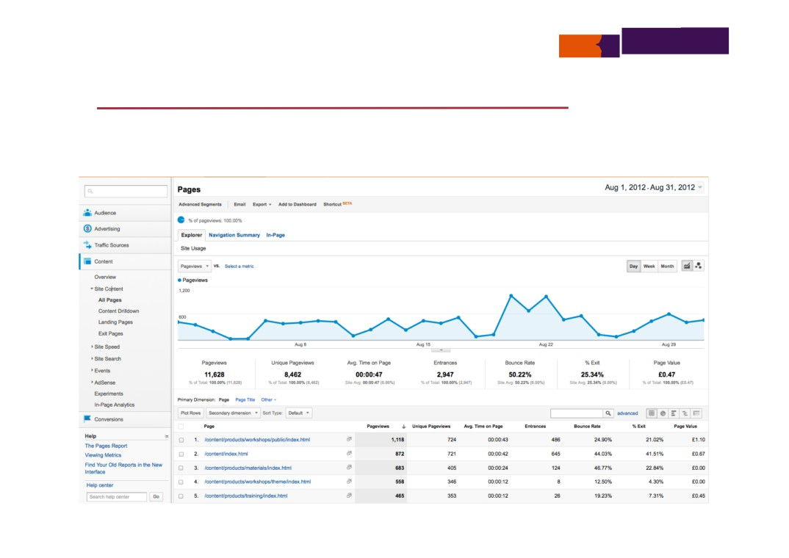
Getting the most from your Google Analytics
Tracking a page visit using _trackPageview

Slide 76
Getting the most from your Google Analytics
Tracking a file downloads using _trackPageview
• File downloads from a web page are not automatically tracked by Google Analytics—it is normally necessary to code tracking in each link, e.g.
<a href="http://www.example.com/files/myfile01.pdf"
onClick="_gaq.push (['_trackPageview', '/download/file01']);"> myfile01
</a>
https://developers.google.com/analytics/devguides/collection/gajs/methods/gaJSApiBasicConfiguration

Slide 77

Getting the most from your Google Analytics
Tracking all file downloads using entourage.js
• Avoiding the tedium of adding JavaScript code to every file link by using another piece of JavaScript to do it for you!
• By loading the entourage.js JavaScript code at the start of the page, all document links will have necessary tracking JavaScript code added automatically so that the downloads appear in the usual Content reports
http://techoctave.com/c7/posts/58-entourage-js-automatic-download-tracking-for-asynchronous-google-analytics

Slide 78
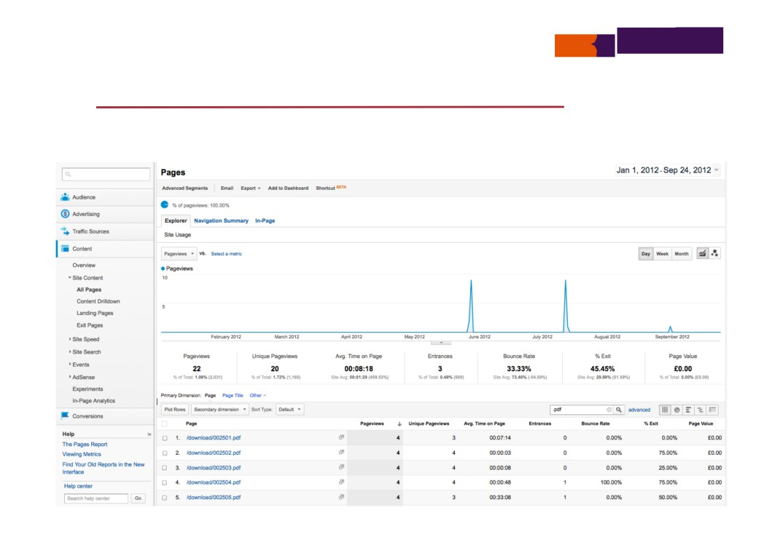
Getting the most from your Google Analytics
Tracking all file downloads using entourage.js

Slide 79
Getting the most from your Google Analytics
Event tracking
• Particular visitor activity on a web page is recorded and displayed as an event in the Analytics reporting interface using the _trackEvent method:
_trackEvent (category, action, opt_label, opt_value, opt_noninteraction) category—(required) the name you supply for the group of objects you want to track action—(required) a string that is uniquely paired with each category, and commonly used to define the type of user interaction for the web object
label—(optional) an optional string to provide additional dimensions to the event data
value—(optional) an integer used to provide numerical data about the user event
non-interaction—(optional) a boolean that when set to true, indicates that the event hit will not be used in bounce-rate calculation
https://developers.google.com/analytics/devguides/collection/gajs/eventTrackerGuide

Slide 80
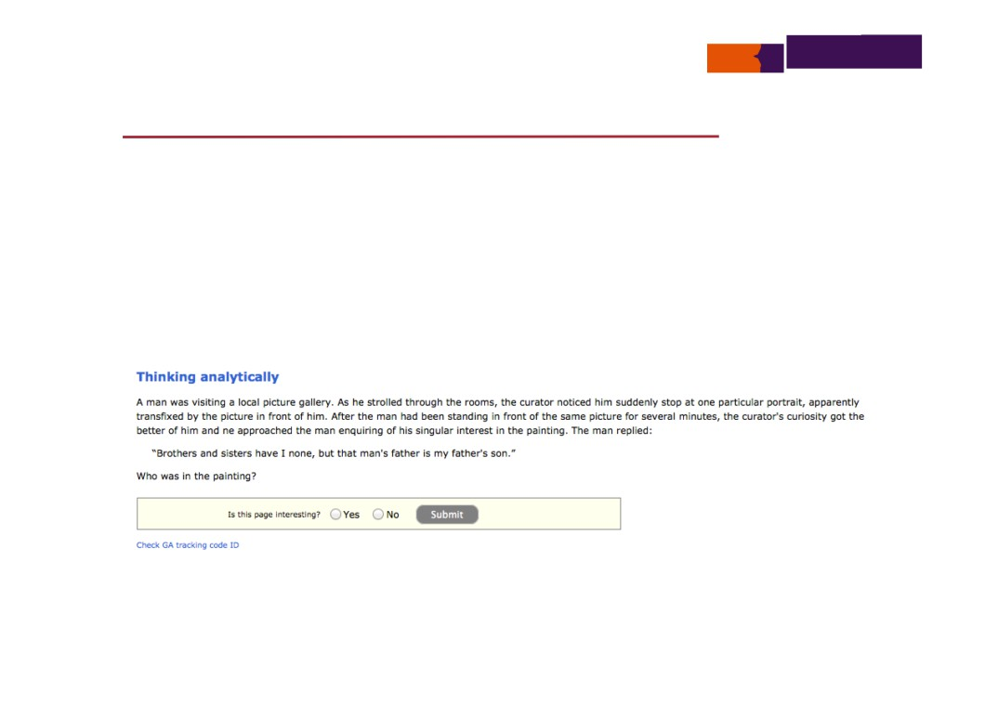
Getting the most from your Google Analytics
Event tracking example
• Track visitor expressed preference in a simple poll form
http://googleanalytics.netskills.biz/cgi-bin/generic?instanceID=1

Slide 81

Getting the most from your Google Analytics
Event tracking example
<input type="submit" class="submit" style="float: none;" value="Submit" onclick="
var vVote = document.getElementById ('vV1').checked ? document.getElementById ('vV1').value :
(document.getElementById ('vV0').checked ? document.getElementById ('vV0').value : 0); var vValue = (vVote == 'positive') ? 1 : 0; if (vVote) {
alert ('thanks for the useful ' + vVote + ' feedback!');
_gaq.push (['_trackEvent', 'feedback',
'indication of page interest given', vVote, vValue, 0]);
}
">
http://googleanalytics.netskills.biz/cgi-bin/generic?instanceID=1

Slide 82
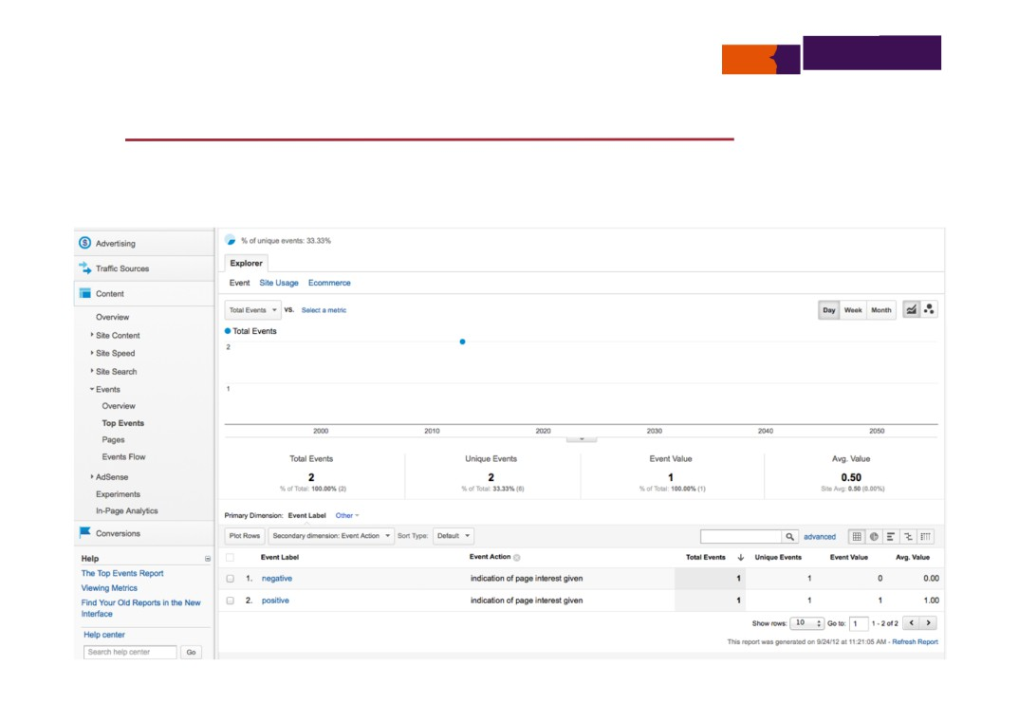
Getting the most from your Google Analytics
Event tracking report

Slide 83
Getting the most from your Google Analytics
Custom variables
• You can set up a variety of custom variables to track user
activity for your site, managed by your own JavaScript using:
_setCustomVar (index, name, value, opt_scope)
index—the slot for the custom variable (required), this is a number whose value can range from 1 - 5, inclusive— a custom variable should be placed in one slot only and not be re-used across different slots
name—the name for the custom variable (required), this is a string that identifies the custom variable and appears in the top-level Custom Variables report
value—the value for the custom variable (required), this is a string that is paired with the name, you can pair a number of values with a custom variable name—typically, you will have two or more values for a given name, for example, you might define a custom variable name gender and supply male and female as two possible values
opt_scope—the scope for the custom variable (optional), the scope defines the level of user engagement with your site—it is a number whose possible values are 1 (visitor-level), 2 (session-level), or 3 (page-level) and when left undefined, the custom variable scope defaults to page-level interaction
https://developers.google.com/analytics/devguides/collection/gajs/gaTrackingCustomVariables

Slide 84

Getting the most from your Google Analytics
Custom variables example
• Record logged in user ID, if a visitor has logged in, and review logins over a period of time
!
<script type="text/JavaScript">
!
var _gaq = _gaq || [];
!
_gaq.push (['_setAccount', 'UA-11066040-24']);
!
_gaq.push (['_setCustomVar', 5, 'visitorUserID', 5, 1]);
!
_gaq.push (['_trackPageview']);
!
</script>
http://googleanalytics.netskills.biz/

Slide 85
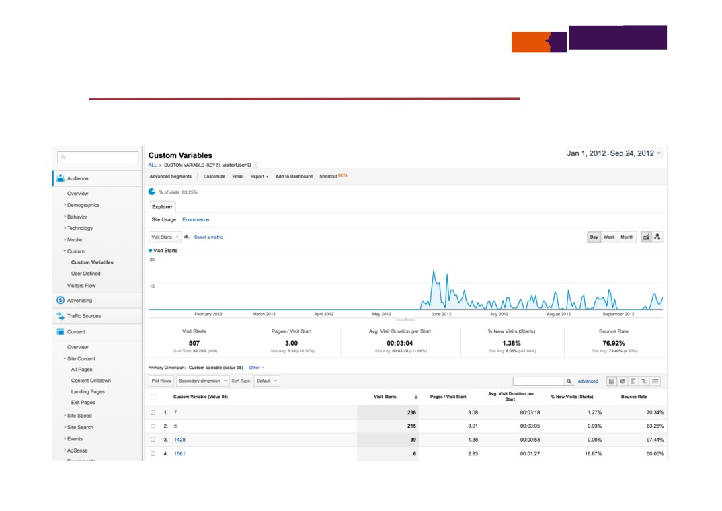
Getting the most from your Google Analytics
Custom variables example

Slide 86
Getting the most from your Google Analytics
Summary
• Google Analytics collection API
• ga.js JavaScript file
• Objects and script methods
• Google Analytics cookies
• The _utm.gif data transfer technique
• Different script methods related to tracking
• Examples using _trackPageview, _trackEvent and _setCustomVar
• Custom embedding of Google Analytics JavaScript methods in a web page to provide rich tailored collection of data available for analysis

