Slide 1


Room 50B: Inside the Church Evaluation - The Chancel (Santa Chiara Chapel)
October 2013

Slide 2
Table of Contents
Evaluation Objectives
Methodology
Executive summary
Visitor observations
Visitor experience survey

Slide 3
Mission & OBJECTIVES

Slide 4
Project Mission
Evaluate the V&A’s Chancel display (and the Santa Chiara Chapel) in Room 50B: Inside the Church –to assess visitor behaviour, impact of displays and compare to key Medieval & Renaissance gallery benchmarks.

Slide 5
Study Objectives
The objective of the Inside the Church/Chancel display evaluation is to assess visitor behaviour across five key elements:
1. Attracting and holding power of The Chancel and key display components including the Santa Chiara Chapel
2. Awareness and motives for visiting The Chancel display
3. Attitudes toward the Church and Religion
4. Usage of gallery touch screen interactives and audio points associated with the Santa Chiara Chapel
5. Access to and impact of the Santa Chiara Chapel in the Chancel display

Slide 6
Desired Outcomes
Evaluate gallery performance and compare to benchmarks
Assess visitor expectations, behaviors and preferences
Assess display area features/placements that drive engagement
Measure how visitors interact and engage with key display components/features
Identify display features/placements that drive engagement and compare to original gallery design objectives
Assess how visitor traffic flow impacts engagement
Evaluate gallery performance (e.g. engagement, interaction and impact) and compare to key benchmarks and original gallery design objectives
Clearly identify “Best Practice Insights” to be applied to similar exhibits to maximize the visitor experience and ultimate impact
Illustrate the benefits of specific display features/placement to future exhibits

Slide 7
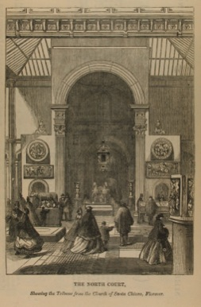
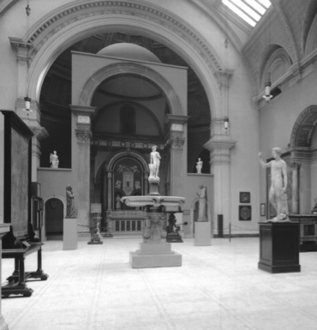
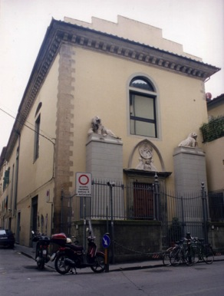
Background
The Santa Chiara Chapel was built in the 1490s as the high altar chapel of the nunnery church of Santa Chiara, in the Oltrarno district of Florence. The Chapel was purchased by the V&A (then the South Kensington Museum) in 1860-61 and transported piece by piece to London where it has been reconstructed in several displays (upper left and centre). The nave remains in situ in Florence (upper right). The Chapel was purchased as an example of Renaissance design. The new Medieval and Renaissance Galleries (opened 2009) sought to present a more rounded interpretation of the Chapel, acknowledging its status as a liturgical space and devotional focus for its viewers. This evaluation assesses the visitor response to the new display.

Slide 8
Methodology

Slide 9

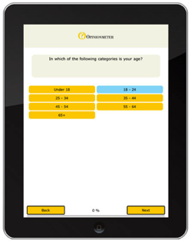
Evaluation Methodology
Observations and exit surveys were conducted from 1th April through 12th May 2013.
GALLERY OBSERVATIONS
VISITOR SURVEYS
N=822
N=203

Slide 10
Executive Summary

Slide 11
Executive Summary
Visitor Observations
Overall, the Chancel display average dwell time was 3.2 minutes and the average number of items engaged with was 9.2 (or 27% of all gallery items).
Chancel dwell time and average number of items engaged was higher than the adjacent Inside the Church gallery (Sculpted Altarpieces & Saints) with average dwell time of 2.2 minutes and the average number of items engaged was 5.8 (or 24% of all gallery items).
The Santa Chiara Chapel within the Chancel display clearly drove visitors deeper into the gallery as evidenced by three out of four visitors entering one of the two side Chapel rooms at the back of the Room 50B.

Slide 12
Executive Summary
Visitor Observations (Continued)
Visitor individual object engagement was highest among wall display and cases located in the Chapel rooms.
Visitor interaction with the video interactive and audio units was low - with less than one in ten visitors engaging.
Similar low engagement was found for elevated objects (e.g. the Chapel cross).
Visitors entering the ground floor walkway between the Chancel and Inside the Church were more likely to enter the Chancel display when entering through Entrance A than B.
The first floor passageway captured nearly half of visitor attention, with one-fifth stopping and reading the Chancel panel.

Slide 13
Executive Summary
Visitor Characteristics
Chancel visitors represented a diverse audience:
Nearly half had visited the V&A before.
One-third of visitors lived outside the UK.
Represented young and older visitors.
A majority of The Chancel visitors were at least somewhat interested in the Renaissance Church.
A large majority of visitors came across The Chancel while browsing the museum.
Visitors who did have something specific they wanted to see focused on the Renaissance period.

Slide 14
Executive Summary
Visitor Experience
About a quarter of visitors saw an object of interest in Room 50B: Inside the Church that motivated their visit.
What Chancel visitors liked best about the display centered around three key themes:
Interpretation
Space/Atmosphere
Chapel/Objects
What Chancel visitors thought could be improved focused on three components:
Signage/Context
Navigation
Labeling

Slide 15
Executive Summary
Visitor Experience (continued)
Primary words to describe the Chancel display experience included:
Calming
Relaxing
Inspiring
Spacious
Enlightening
A large majority of visitors read gallery interpretation content. For many, interpretation did provide some object and contextual information.
Only a quarter of visitors stepped up into the Chapel.
For the majority who didn’t enter the Chapel– few were aware that they could walk onto the tiled pavement.

Slide 16
Executive Summary
Visitor Experience (continued)
One quarter of visitors used the video interactives.
For those that did – a majority reported that the interactive had at least somewhat enhanced their enjoyment.
Non interactive users reported they did not use the interactive because of lack of time, desire or interest.
A majority of video interactive users looked more closely at the chapel after engaging with the interactive.
Only about one in ten visitors used the gallery audio unit.
Amongst those who did use the audio – more than half reported that the audio experience significantly enhanced their experience.
Similar to non-interactive users, non-audio users’ reasons for not accessing the audio unit included a lack of time, desire or interest.

Slide 17
Visitor Observations

Slide 18

Room 50 Gallery Plan – Area Definitions
Collectively all of Room 50 is Medieval & Renaissance Europe 1350-1600
Room 50a is Cityscape and Villa 1350-1600
The focus of our study is Room 50B: Inside the Church 1350-1600 (Incorporating 2 areas: The Chancel Display/the Santa Chiara Chapel and Sculpted Altarpieces & Saints)
Room 50c The Treasury – Metalwork 1350-1600
Room 50d The Treasury – Textiles 1350-1600

Slide 19
Observation Methodology
The Santa Chiara Chapel in Room 50B was evaluated from three separate vantage points:
The Chancel (N=309)
The ground floor corridor between The Chancel and the rest of Room 50B: Sculpted Altarpieces & Saints (N=191)
The first floor corridor overlooking The Chancel (N=168)
The adjacent gallery (Room 50B: Sculpted Altarpieces & Saints) located next to The Chancel was used as a comparison gallery (N=191)
Gallery observations were carried out by University of Warwick students. Observation training was provided by Fusion Research + Analytics.
Visitor observations captured visitor dwell time, engagement with individual gallery objects, visible presence of mobile device and gender.

Slide 20
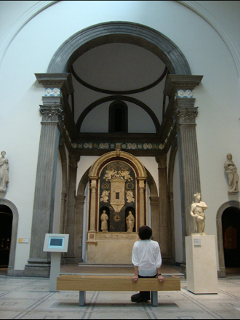
Gallery Areas – Study Focus - 1
Room 50B: Inside the Church, 1350-1600, The Chancel Display/Santa Chiara Chapel

Slide 21
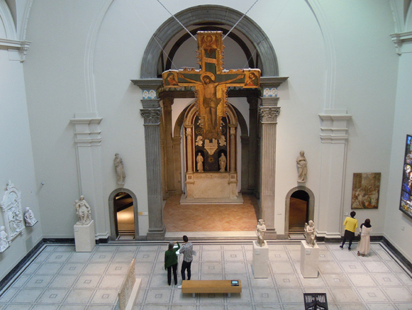
Gallery Areas – Study Focus - 2
Room 50B: View of The Chancel Display/Santa Chiara Chapel from the balcony

Slide 22
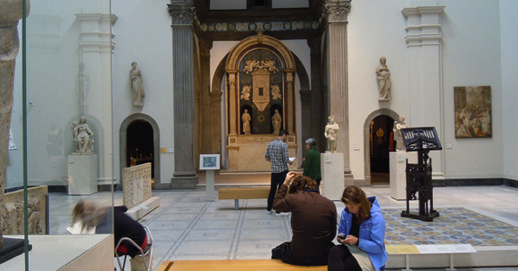
Gallery Areas – Study Focus - 3
Room 50B: Inside the Church, 1350-1600, The Chancel Display/Santa Chiara Chapel

Slide 23
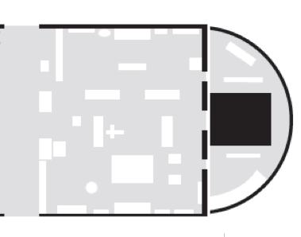
Room 50B: Inside the Church, Attracting Power of The Chancel display
Statue/Ceramic
Case display
Gold Panel
*
Painting
3%
Iron
7%
23%
21%
31%
19%
25%
Platform
3%
47%
Bench
18%
Elevated object
16%
Interactive
25%
23%
13%
Santa Chiara
Chapel
37%
35%
5%
9%
The Chancel Display
8%
6%
40% Viewed
4%
4% Enter
23%
33%
22%
22%
9%
18%
25%
41%
15%
73% entered one of the side Chapel rooms
30%
29%
32%
29%
15%
*Please note the Gold Panel explains 'The Chancel' display.

Slide 24
The Chancel – Engagement Heat Map
40%+
Gold Panel
1.5
30% to <40%
20% to < 30%
10% to < 20%
< 10%
Santa Chiara
Chapel
Viewed
Enter
73% entered one of the side Chapel rooms

Slide 25
The Chancel: Dwell Time And Items Engaged
The Chancel display average dwell time was 3.2 minutes and the average number of items engaged with was 9.2 (or 27% of all gallery items*).
*Percentage of gallery items engaged was based on the average (9.2) items divided by the number of gallery objects (34).
Please Note: high and low dwell time ranges represent the range of time spent/items in the gallery (i.e. one standard deviation from the average dwell time).

Slide 26
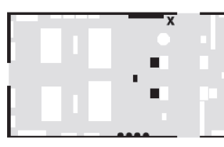
Comparison - Room 50B: Inside the Church (Sculpted Altarpieces & Saints)
Statue/Ceramic
Object
12%
17%
14%
10%
Bench
18%
18%
Interactive
11%
16%
41%
50%
8%
27%
31%
9%
The Chancel
34%
39%
6%
43%
26%
17%
41%
19%
15%
5%
12%
26%
15%
12%

Slide 27
Comparison - Room 50B: Inside the Church (Sculpted Altarpieces & Saints)
40%+
30% to <40%
20% to < 30%
10% to < 20%
< 10%
9%
The Chancel
5%

Slide 28
Comparison - Room 50B: Inside the Church (Sculpted Altarpieces & Saints)
Inside the Church (Sculpted Altarpieces & Saints) average dwell time was 2.2 minutes and the average number of items engaged was 5.8 (or 24% of all gallery items*).
*Percentage of gallery items engaged was based on the average (5.8) items divided by the number of gallery objects (24).
Please Note: high and low dwell time ranges represent the range of time spent/items in the gallery (i.e. one standard deviation from the average dwell time).

Slide 29
Ground Floor Gallery Visitor Flow: Entrance A
40%+
30% to <40%
Entrance A
20% to < 30%
10% to < 20%
< 10%
32%
34%
Inside the Church
(The Chancel)
(Room 50b)
Inside the Church (Sculpted Altarpieces)
(Room 50b)
29%
4%
Entered both galleries

Slide 30
Ground Floor Gallery Visitor Flow: Entrance B
40%+
30% to <40%
20% to < 30%
Pass through only
10% to < 20%
23%
< 10%
53%
17%
Inside the Church
(The Chancel)
(Room 50b)
Inside the Church (Sculpted Altarpieces)
(Room 50b)
7%
Entrance B
Entered both galleries

Slide 31
First Floor Gallery Visitor Flow
40%+
Pass through only (Did not engage with the display)
30% to <40%
Stopped and read Chancel display panel
20% to < 30%
10% to < 20%
< 10%
58%
42%
21%
Engagement items | Entrance A | Entrance B
Viewed Santa Chiara Chapel | 51% | 49%
Read Santa Chiara Chapel panel | 17% | 24%
Viewed Santa Chiara Chapel/The Chancel

Slide 32
Visitor Experience survey

Slide 33
Visitor Characteristics: Visitation & Residence
The Chancel visitors represented a diverse V&A audience.
Q. Which of these statements best describes you?/Where do you live?

Slide 34
Visitor Characteristics: Age
The Chancel visitors represented a wide range of young and older visitors. Visitor gender distribution fell within expected museum range.
Gender
Male | 40%
Female | 60%
Q. What is your age?

Slide 35
Visitor Characteristics: Religion
A majority of The Chancel visitors were Christian – although one-quarter of visitors had no religious affiliation.
Q. Please tell us which of the following best describes your religion. Tick all that apply:

Slide 36
Visitor Characteristics: Smartphone Ownership
Consistent with general consumer trends, the majority of The Chancel visitors own and brought a smartphone with them to the museum.
Q. Do you own a smartphone?/Do you have it with you today?

Slide 37
Visitor Characteristics: Church Interest
A majority of The Chancel visitors are at least somewhat interested in the Renaissance Church.
Q. How interested are you in the Renaissance Church as a subject?

Slide 38

The Chancel: Gallery Visit
A large majority of visitors came across The Chancel (in Room 50B) while browsing the museum. Visitors who did have something specific they wanted to see focused on the Renaissance period.
Objects Wanted To See
Q. Which statement best describes your visit to this part of the Museum today?

Slide 39
Inside the Church: Visit Motives
About a quarter of visitors saw an object of interest in Room 50B: Inside the Church that motivated their visit.
See next slide for objects of interest
Q. What motivated you to enter this gallery today?

Slide 40

Inside the Church: Objects of Interest
Q. What was the object(s) that interested you?

Slide 41
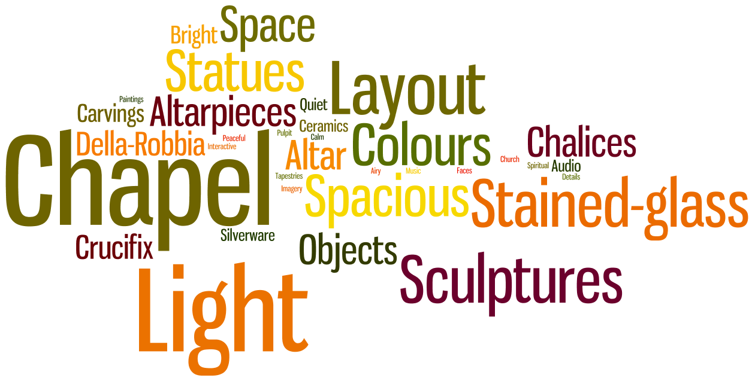
Inside the Church: What Liked Best
Q. What did you like best about the Santa Chiara Gallery?

Slide 42
Inside the Church: What Liked Best – Themes & Quotes
Interpretation
Lots of information on labels with dates. Easy to read and understand.
Space/Atmosphere
Nice large space. Interesting layout for a gallery.
Chapel/Objects
The fact that the chapel has been reconstructed with as much attention to historical accuracy as possible.
Informative labels.
The interactive information.
Benches with audio.
The light, spacious atmosphere.
The open space and lighting.
Calm and not too busy. Nice to sit and look.
Everything is perfect. The objects are beautiful in the passage behind the chapel, and the sculptures too.
Lots of interesting objects, lots of space to view them.
Different artifacts sit harmoniously within gallery.
Q. What did you like best about the Inside the Church gallery?

Slide 43

Inside the Church: What Could Be Improved
Q. What do you think could be improved?

Slide 44
Inside the Church: What Could Be Improved – Themes & Quotes
Signage-Context
A big sign to introduce the area. Thought it was just more of the space before.
Navigation
More of a path to follow through the exhibit.
Labeling
Clear labels specifying how objects in room relate.
Bigger signs, more explanation of area.
Guidebook companion.
Leaflets for young people
More contextual information.
Labels in other languages.
Some of the text on the interpretation panels is a bit small.
Q. What do you think could be improved?

Slide 45

Inside the Church: Words To Describe The Chancel Display Experience
Q. What Words Would You Use To Describe Your Experience In This Gallery?

Slide 46

Inside the Church: Engagement With Text
A large majority of visitors read gallery interpretation content. For many interpretation did provide object and contextual information.
Engaging Interpretation
Q. Did you read any of the gallery interpretation text/labels/panels?/Was there an aspect of the gallery interpretation/panels that you found engaging?

Slide 47
The Chancel: The Santa Chiara Chapel
Only a quarter of visitors stepped up into the Chapel. For the majority who didn’t enter the Chapel– few were aware that they could walk onto the tiled pavement.
No
Q. Did you step up into the Chapel (i.e. the raised floor directly underneath the chapel)?/Were you aware that you could step into the Chapel/(inside the Chapel)?

Slide 48
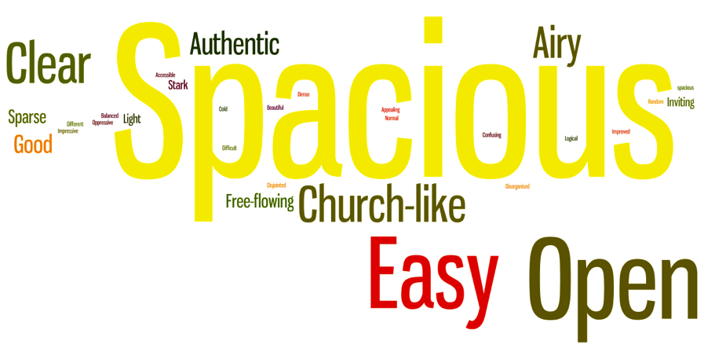
Inside the Church: Gallery Layout
Q. How would you describe the gallery layout?

Slide 49
Santa Chiara Chapel: Awareness of 3D Digital Interactive
Only a quarter of visitors used the video interactives. For those that did – a majority reported that the interactive had at least somewhat enhanced their enjoyment.
Q. Did you notice the touchscreen interactive display (standing video display) in the gallery?/Did the touch screen interactive...

Slide 50
Santa Chiara Chapel: Awareness of 3D Digital Interactive & Outcome
A majority of video interactive users looked more closely at the chapel after engaging with the interactive.
Q. Did you notice the touchscreen interactive display (standing video display) in the gallery?/After you used the touch screen interactive did you…

Slide 51

Santa Chiara Chapel: Reasons For Not Using 3D Digital Interactive
Q. Why did you not use the touch screen interactive?

Slide 52
Awareness of Santa Chiara Chapel Audio Unit and Impact on Enjoyment
Only about one in ten visitors used the gallery audio unit. Amongst those who did use the audio – more than half reported that the audio experience significantly enhanced their experience.
Q. Did you notice the audio unit embedded in the gallery bench (video and audio) in the gallery?/Did the audio unit…

Slide 53
Awareness of Santa Chiara Chapel Audio Unit and Impact on Enjoyment
Amongst audio unit users – about one third looked at the chapel more closely, about half of the rate of video interactive users.
Q. Did you notice the audio unit embedded in the gallery bench (video and audio) in the gallery?/After you used the audio unit did you…

Slide 54

Inside the Church: Santa Chiara Audio Unit Recall
Q. Do you remember what you heard on the audio unit?

Slide 55

Inside the Church – Santa Chiara Chapel: Reasons For Not Using Audio Unit
Q. Why did you not use the audio unit?

Slide 56
General V&A Visitor Audio Unit Usage
The audio unit usage in Inside the Church (Room 50B) appears to be on par with usage of audio units throughout the museum.
Q. Have you used other audio units in any of the other Medieval & Renaissance Galleries today?

Slide 57
Inside the Church: Gallery Information Evaluation
The design and atmosphere of the gallery rated the highest while the presentation of gallery information rated lowest. That said, overall gallery ratings are relatively high across all attributes.
Q. Thinking about the way the gallery information was presented, how satisfied were you with...?

Slide 58

Inside the Church: General Comments
Q. Do you have any general comments?

Slide 59
Notable Quotes:
General Impressions:
“Delighted to come back – it makes your life richer – I will bring all my family.”
“Want to come again, love the range and ability to see such wonderful objects brought to life.”
“Very nice display. Unsure of the actual theme. Is it meant to be a church?”

Slide 60
Notable Quotes:
Gallery Layout:
“Love the idea of reconstructing the chapel. Gives an interesting perspective. Better for viewing the pieces in context.”
“Didn't enter the chapel area due to expectation that you wouldn't be allowed. Have more emphasis on chapel itself and make it clear people can walk up to it.”
“Amazing how they got it here! It’s an immense labyrinth and you could easily get lost - which is quite nice really!”

Slide 61
Notable Quotes:
Gallery Interpretation:
“Larger thematic headings would be good and deeper explanation of some of the iconography.”
“Would like more info but if too much then you can’t read it all. Maybe some actors or music to get an idea of the medieval times a bit more.”
“Very impressive and my child was having a lot of fun with audio.”
“Interactive panel was slow.”

Slide 62
Recommendations
Add a clearer invitation to visitors to step up into the Chancel chapel to help increase awareness and uptake. The text panel introducing the Chancel subject is only read by a small number of visitors (3%). Consider replicating the panel in other locations, or delivering more of the information included in the Chancel subject text at object label level.
The Chapel is a dominant object in terms of attracting visitors and would be a logical place to introduce (or reinforce) the Chancel subject. It is an ideal ‘gateway’ for visitors into the subject. A text panel within the Chapel could achieve this and have the added benefit of drawing visitors into the space.
Consider making improvements to gallery text in any future refreshment – promote large print books, increase font size on labels, introduce bolder section headings and repeat subject panels.

Slide 63
Recommendations (continued)
The high ownership of smartphones and other mobile devices indicates that there is potential to create mobile enabled versions of the 3D interactive and the audio / music content.
Consider adding a reference to the audio point / 3D interactive on the Santa Chiara object label to increase awareness of the connection between the two.

Slide 64
Acknowledgements
This evaluation was made possible with the support of the University of Warwick.
We’d also like to thank the University of Warwick students who participated in the data gathering.
Special thanks to:
Donal Cooper –University of Warwick
Stuart Frost – The British Museum
The Victoria & Albert Museum

Slide 65
Select Bibliography
Meghan Callahan & Donal Cooper, ‘Sacred Space in the Modern Museum: Researching and Redisplaying the Santa Chiara Chapel in the V&A’s Medieval & Renaissance Galleries,’ V&A Online Journal, Issue no. 5, Autumn 2013
http://www.vam.ac.uk/content/journals/research-journal/onlinejournal/sacred-space-in-the-modern-museum-researching-and-redisplaying-the-santa-chiara-chapel-in-the-v-and-as-medieval-and-renaissance-galleries/
Stuart Frost, ‘Reinterpreting a Florentine Chapel at the V&A,’ in Social History and Museums – Journal of the Social History Curators Group 37, ed. Helen McConnell (summer, 2013).
http://www.shcg.org.uk/journal (volume 37 online from 2014)
Peta Motture, ‘Inspire, Engage, Preserve, Connect, Transform: meeting the aims for the new Medieval & Renaissance Galleries at the Victoria and Albert Museum,’ in Museum Narrative & Storytelling: engaging visitors, empowering discovery and igniting debate, ed. Gregory Chamberlain, Museum Identity, 2011: 15-32

