Slide 1
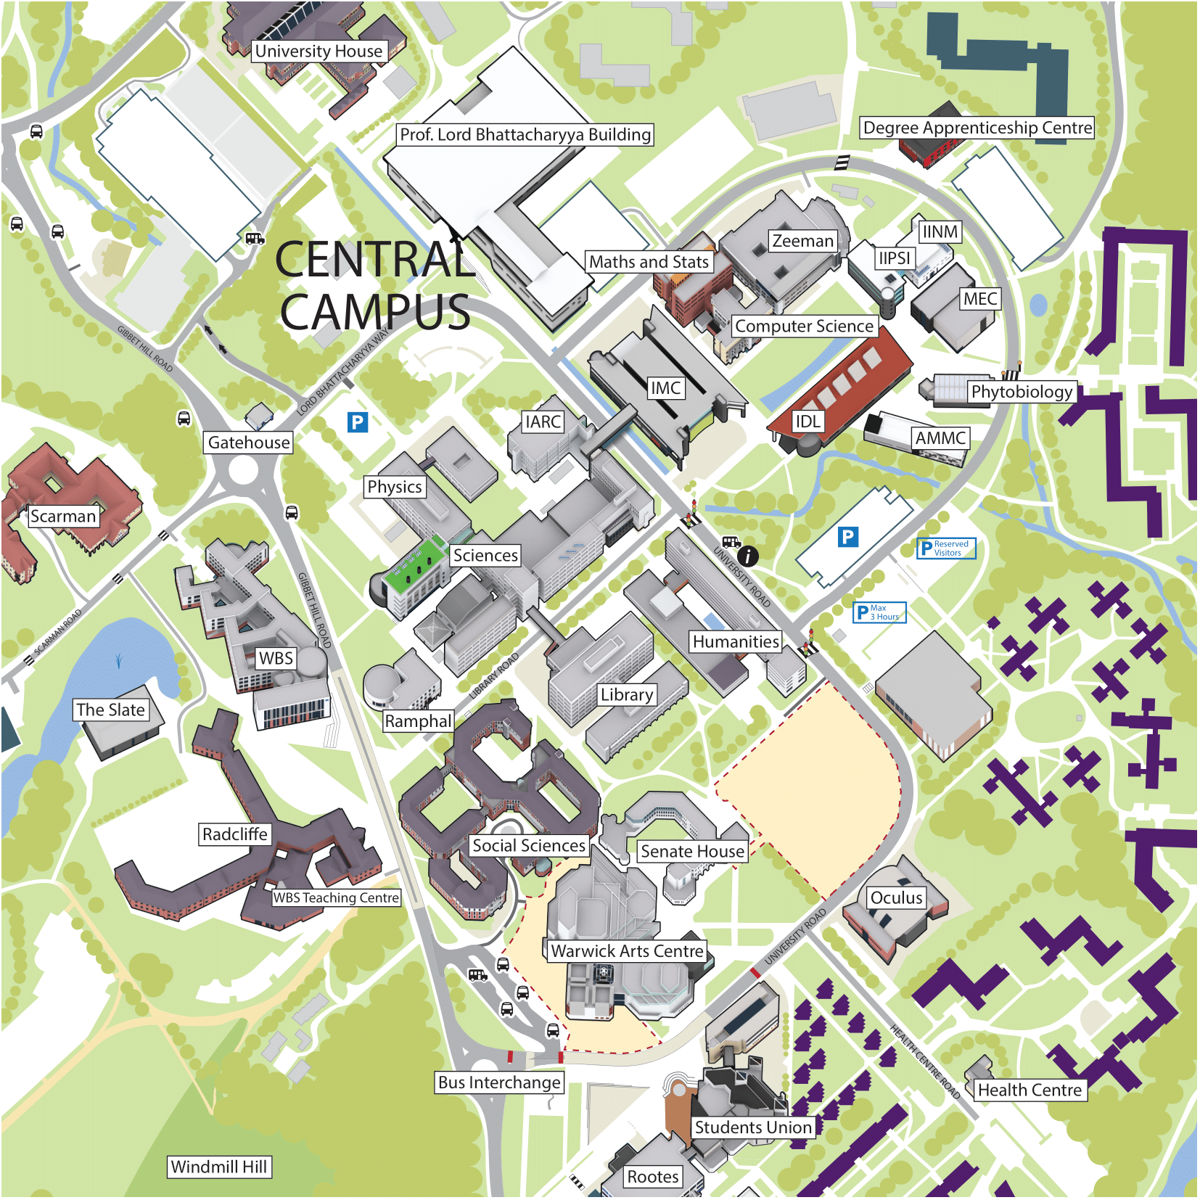
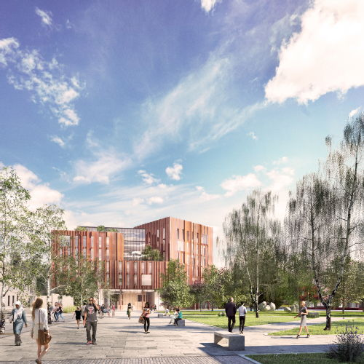
Warwick Interactive Map
Our university creates a new memory for 25,000 students and over 5,000 staff members everyday. Every place on campus holds these memories over generations of attendees. These reflections are influenced by the change in time and the innovativeness of our campus, as can be seen in the experiences shared in different this student experience map of different areas on campus.

Slide 2
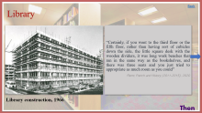
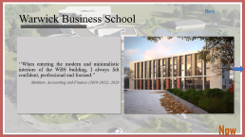
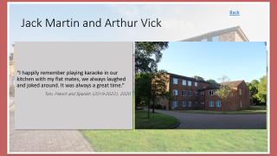
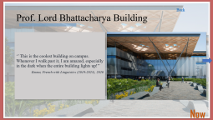
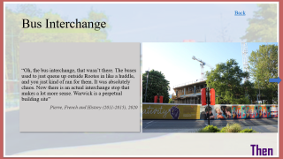
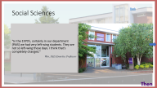
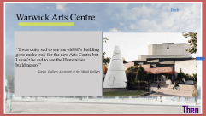
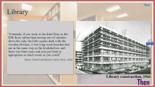
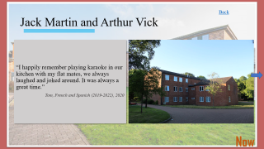
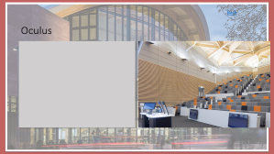
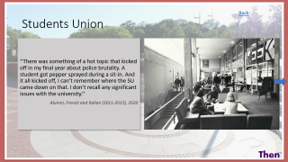
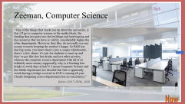
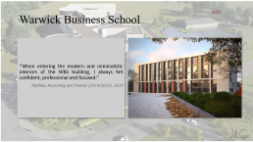
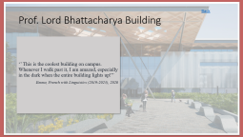
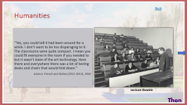
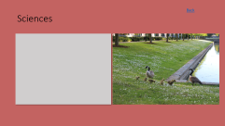
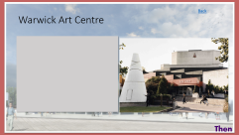
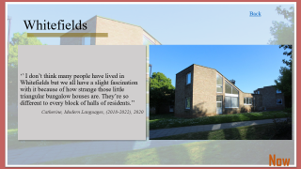
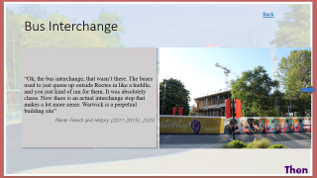
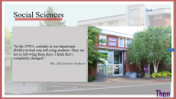
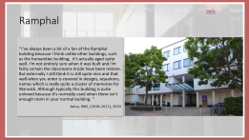
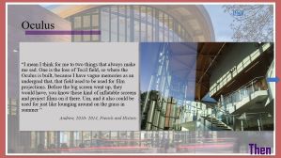
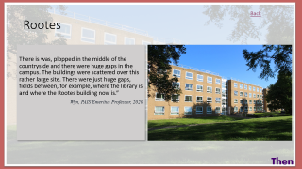
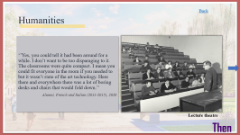
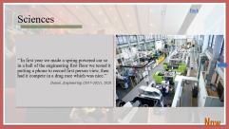

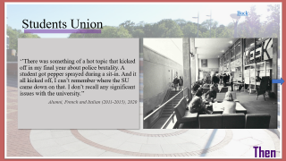
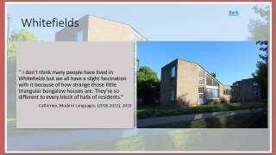
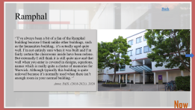
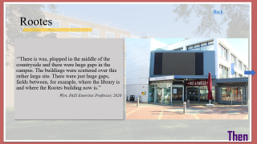
Central campus

Slide 3
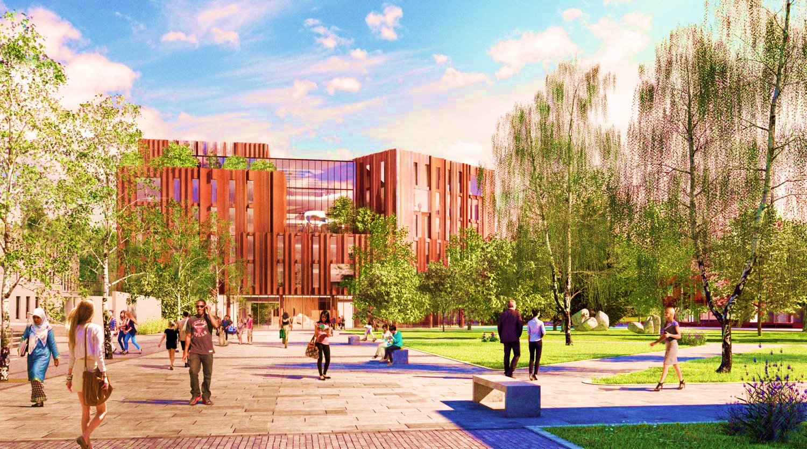
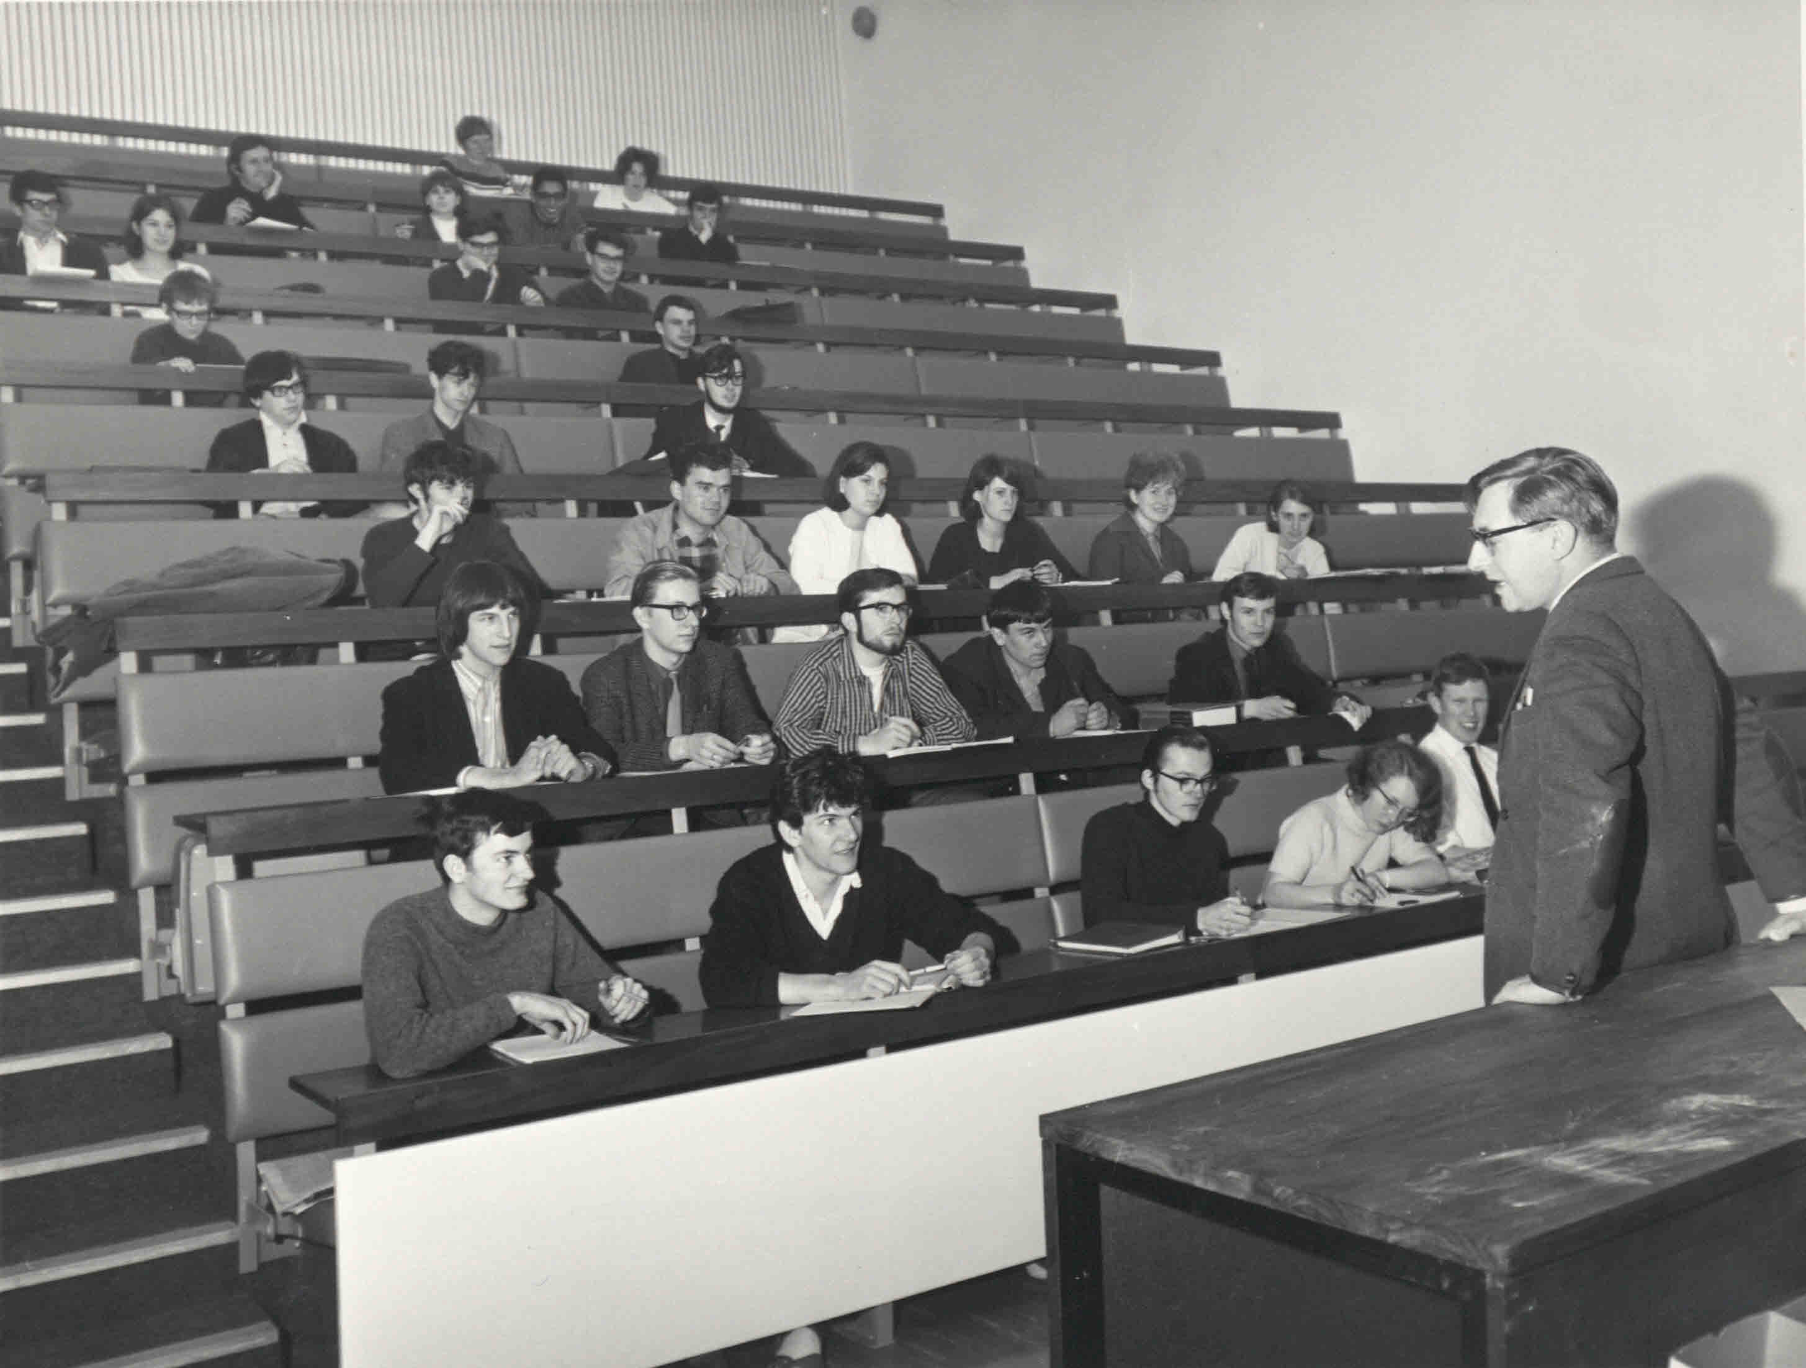
Humanities
Back
‘’Yes, you could tell it had been around for a while. I don’t want to be too disparaging to it. The classrooms were quite compact. I mean you could fit everyone in the room if you needed to but it wasn’t state of the art technology. Here there and everywhere there was a lot of boring desks and chairs that would fold down.’’
Alumni, French and Italian (2011-2015), 2020
Lecture theatre
Then

Slide 4
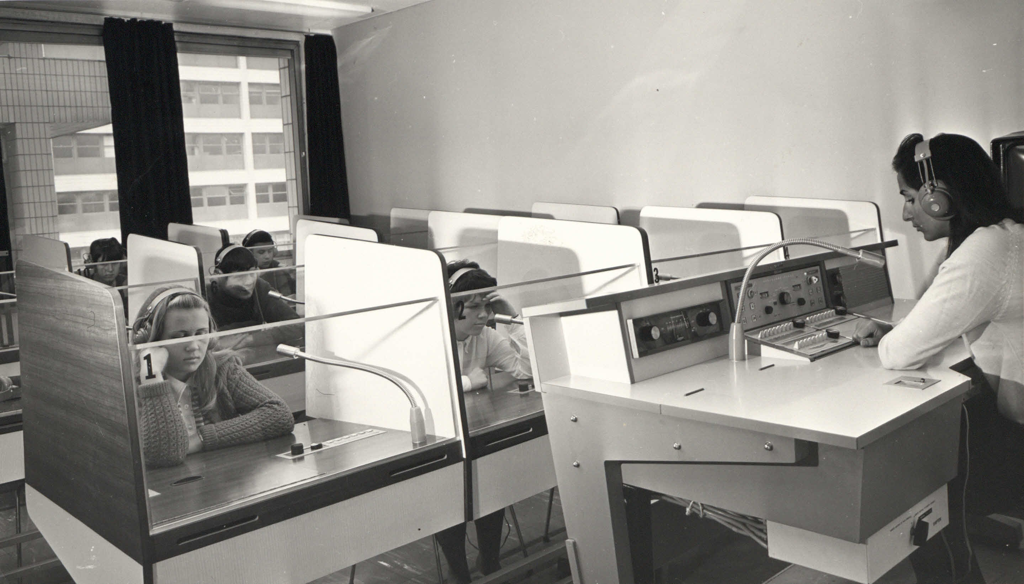
Humanities
Back
‘’The Arts Faculty can be found in one of the ugliest buildings at Warwick. It is a huge five floored building with all rooms and corridors exactly the same shape and size. All the Arts departments are housed in this building so there is no problem with it being scattered around in different sites.’’
Alternative Student Prospectus, 1985
Language class
Then

Slide 5
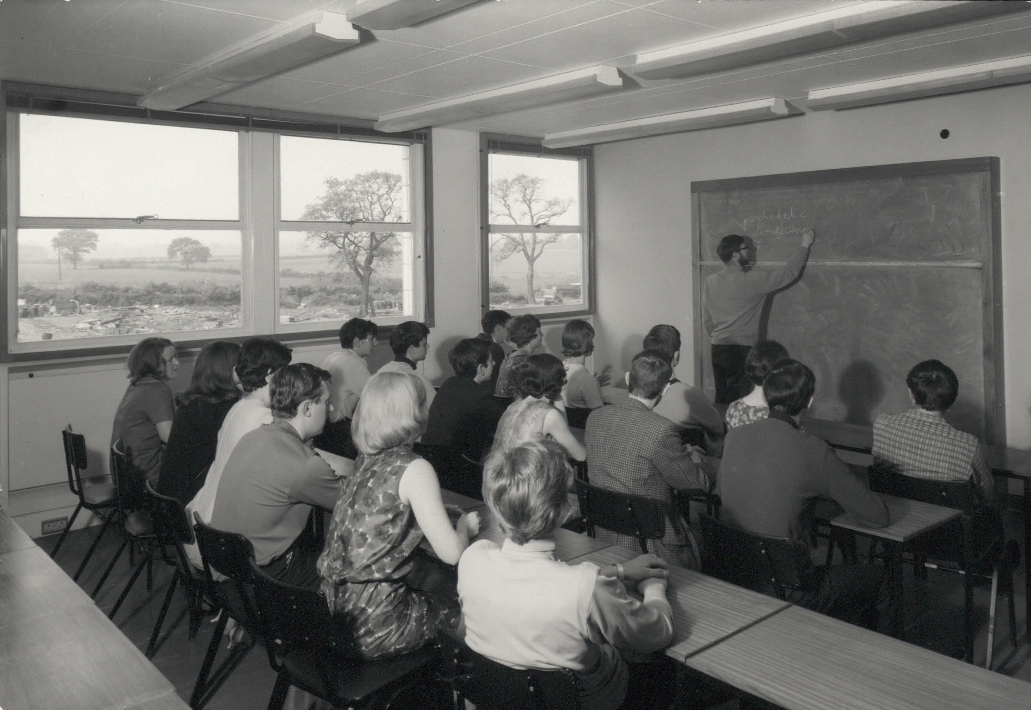
Humanities
Back
“I’ll be really sad when the Humanities Building is demolished. It’s my building, like all my classes almost were in there, it’s where I have done most of my PhD work. You can sit in the garden at lunch time, it’s really pleasant. No other building has that really”
Pierre, French and History (2011-2015), 2020
Then

Slide 6
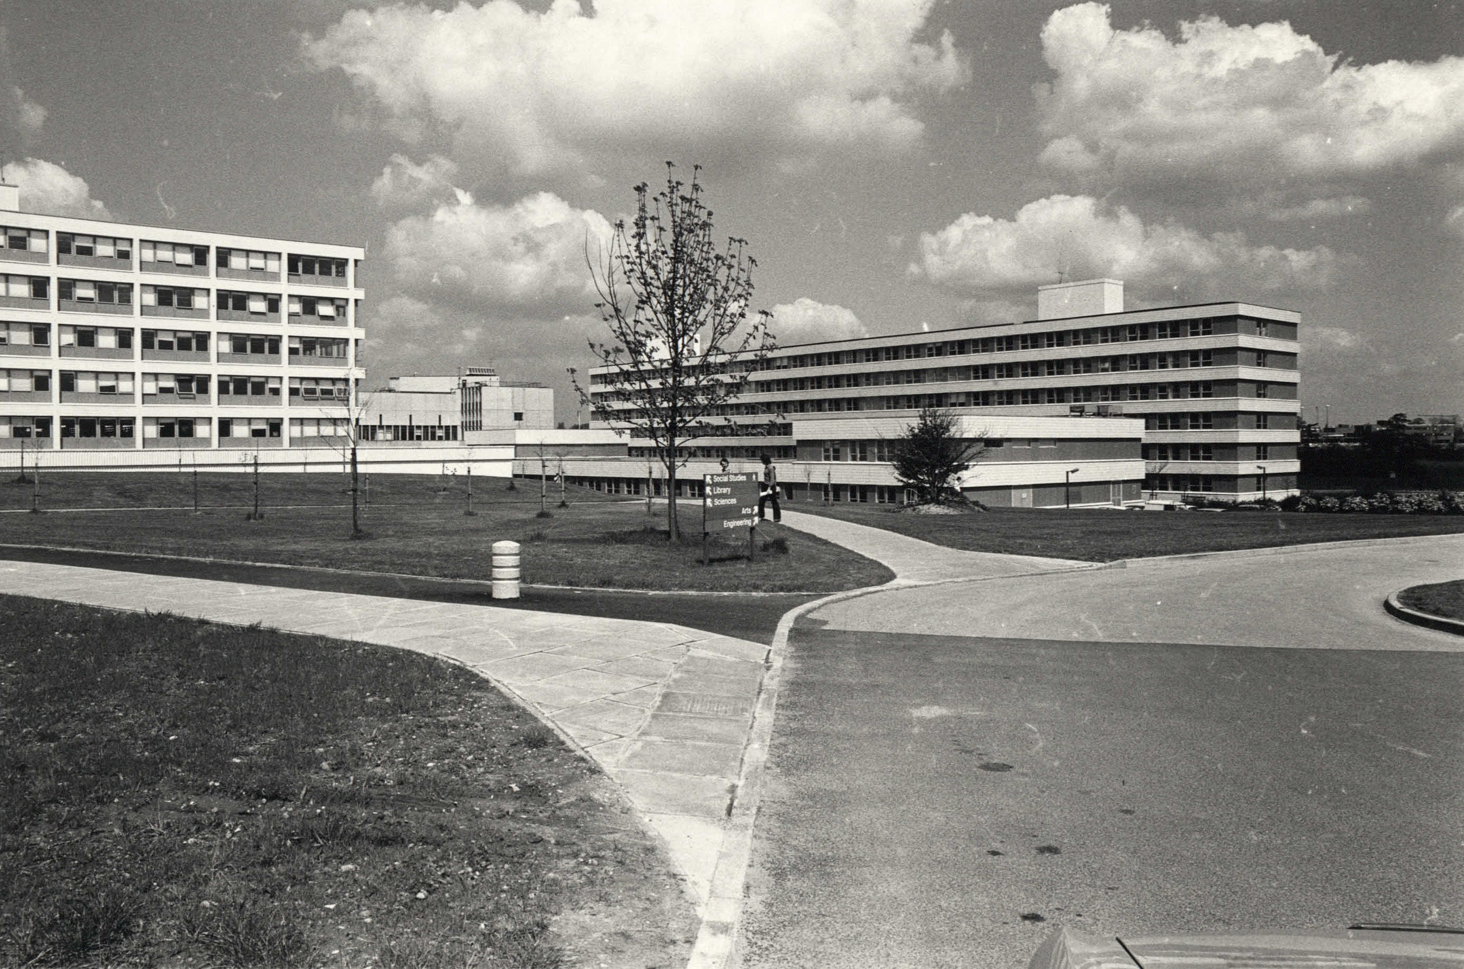
Humanities
Back
‘’I remember, I was really struggling with one of the literature modules and he basically said what can I do, what am I not doing essentially and he sat down and said here are some books to help you, here’s what we’re looking at. Look at that and you’ll be fine essentially. ‘’
Alumni, French with Italian (2011-2015), 2020
Then

Slide 7
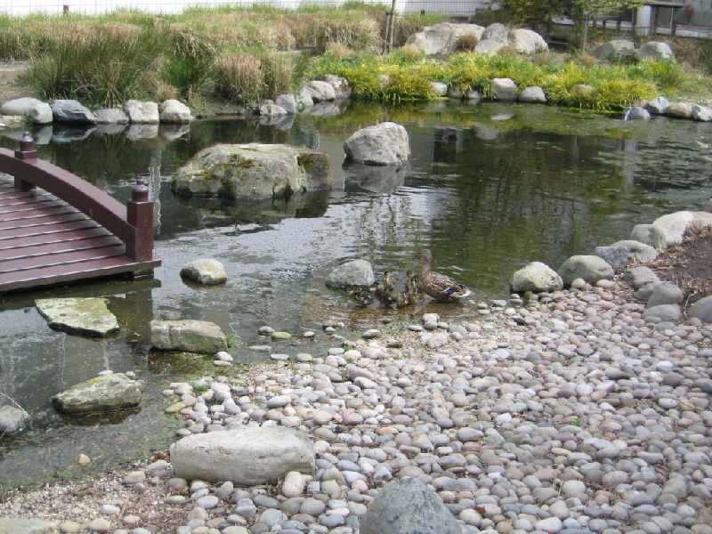
Humanities
Back
‘’There are little moments of charm in it, perhaps the garden in the centre with the pond and the geese on a summer’s day in comparison with the greyness on the actual building itself, its just a real jepst of position. I think that’s what makes it quite special. ‘’
Anna, PAIS (2018-2021), 2020
Now

Slide 8
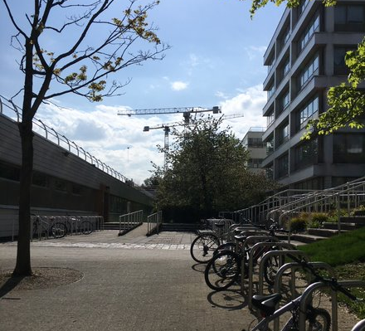
Humanities
Back
‘’It’s quite an old building, I think it’s one of the oldest buildings actually on campus. But for some reason it feels really comfy and homey to me, especially the Humanities café, which is my favourite place to get coffee on campus. Other than that, it’s quite a big building but in its way it’s quite nice, not to modern, so it doesn’t feel too threatening. It has a nice little patio in the middle which feels really zen.’’
Anna, PAIS (2018-2021), 2020
Now

Slide 9
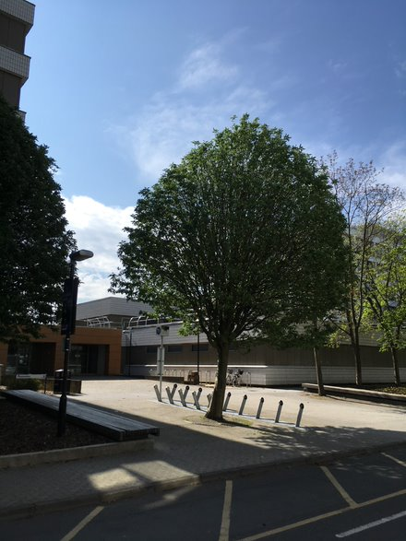
Humanities
Back
‘’For me, this is the ugliest building on campus and that’s saying something because I’m quite critical of Warwick architecture. I think a lot of people complain that all the arts students have been thrown into one building and mashed together but I think that gives it its charm.’’
Catherine, Modern Languages (2018-2022), 2020
Now

Slide 10
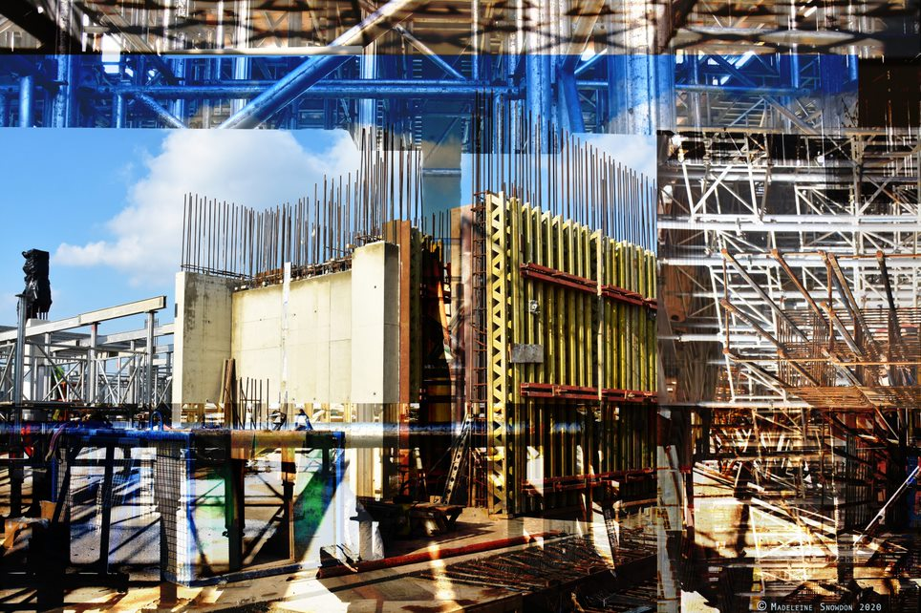
Humanities
Back
‘’The building will house departmental offices and a variety of spaces for teaching and learning. Larger more public spaces are located on the lower levels; these include a large open plan multi-purpose engagement space, a café, two lecture theatres, and a variety of spaces for social learning.’’
Warwick Community Engagement Proposal, 2020
New Humanities Building Being Built
Now

Slide 11
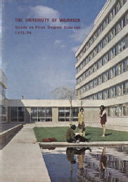
Humanities
Back
Now
Design of New Humanities Building

Slide 12
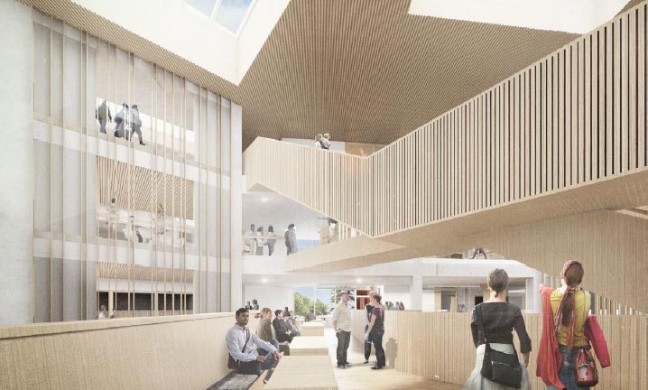
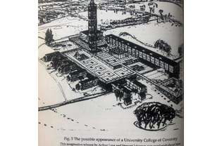
Humanities
Back
New Humanities Building’s Predicted Interior
First Blueprint of The University of Warwick’s campus
Now

Slide 13
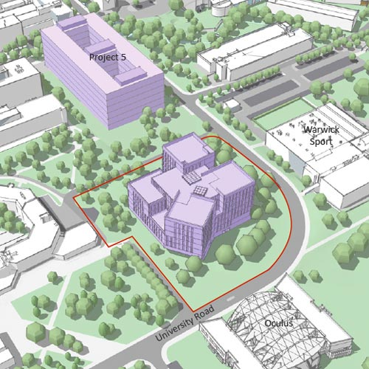
Humanities
Back
“It’s difficult to remember a time when there hasn’t been building going on in the university even in the 1980’s when finances were constrained.”
Wyn, PAIS Emeritus Professor, 2020
Now

Slide 14
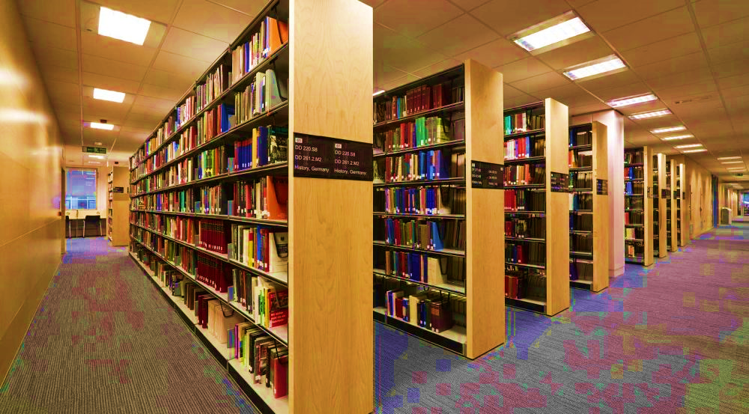
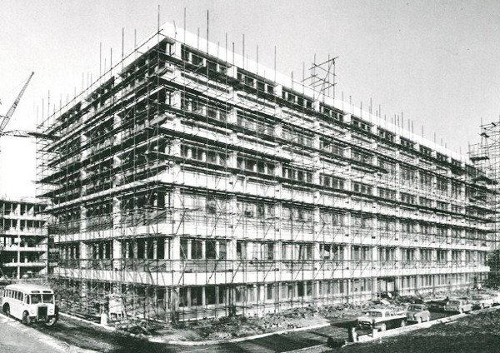
Library
Back
“Certainly, if you went to the third floor or the fifth floor, rather than having sort of cubicles down the side, the little square desk with the wooden dividers, it was long work benches that ran in the same way as the bookshelves, and there was three seats and you just tried to appropriate as much room as you could”
Pierre, French and History (2011-2015), 2020
Library construction, 1966
Then

Slide 15
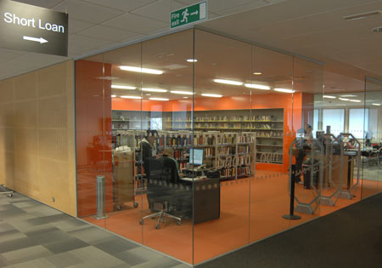
Library
Back
‘’ …probably shouldn’t quote me on this. We were thinking somewhere between 6 to 10 years before the whole coronavirus thing. And now I imagine that will be pushed back a bit more, but we definitely need a new library. There will be at some point.’’
Kate, English and Latin (1999-2002) ,2020; current Academic Library Advisor
Now

Slide 16
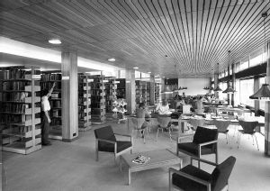
Library
Back
‘’I also really remember that kind of thing where you go to the lecture and they’d recommend some books. Your reading lists were kind of scrappy. You get bits and pieces and you go to the library and it would always be out, but they’d said you must, everyone must go read this. Somebody else would always get there first and the book would never be there, and so there was a lot of just wandering up and down the shelves looking. And going, that looks like it might be quite good, I'll read that. I quite liked that actually, because it meant that you found all kinds of interesting things and you sort of had the feeling that maybe what you were reading and writing about wasn't the same as everybody else’s’’
Kate, English and Latin (1999-2002) ,2020; current Academic Library Advisor
Then

Slide 17
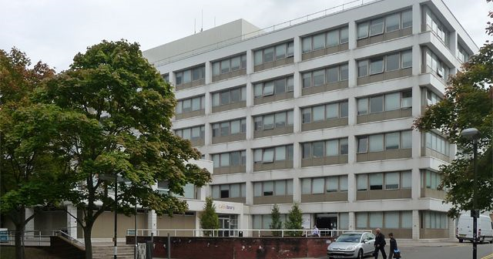
Library
Back
‘’I went to the library very often in my first year because my computer broke down in term 1. The E-books available on the website are really useful for assignments. The only problem is that it is often too busy to find a space to study ! Because it is open 24/7, I did find myself working there with my flatmates one Friday night - slightly less fun than having a night out ...’’
Laura, GSD (2019-2022), 2020
Library, 2018
Now

Slide 18
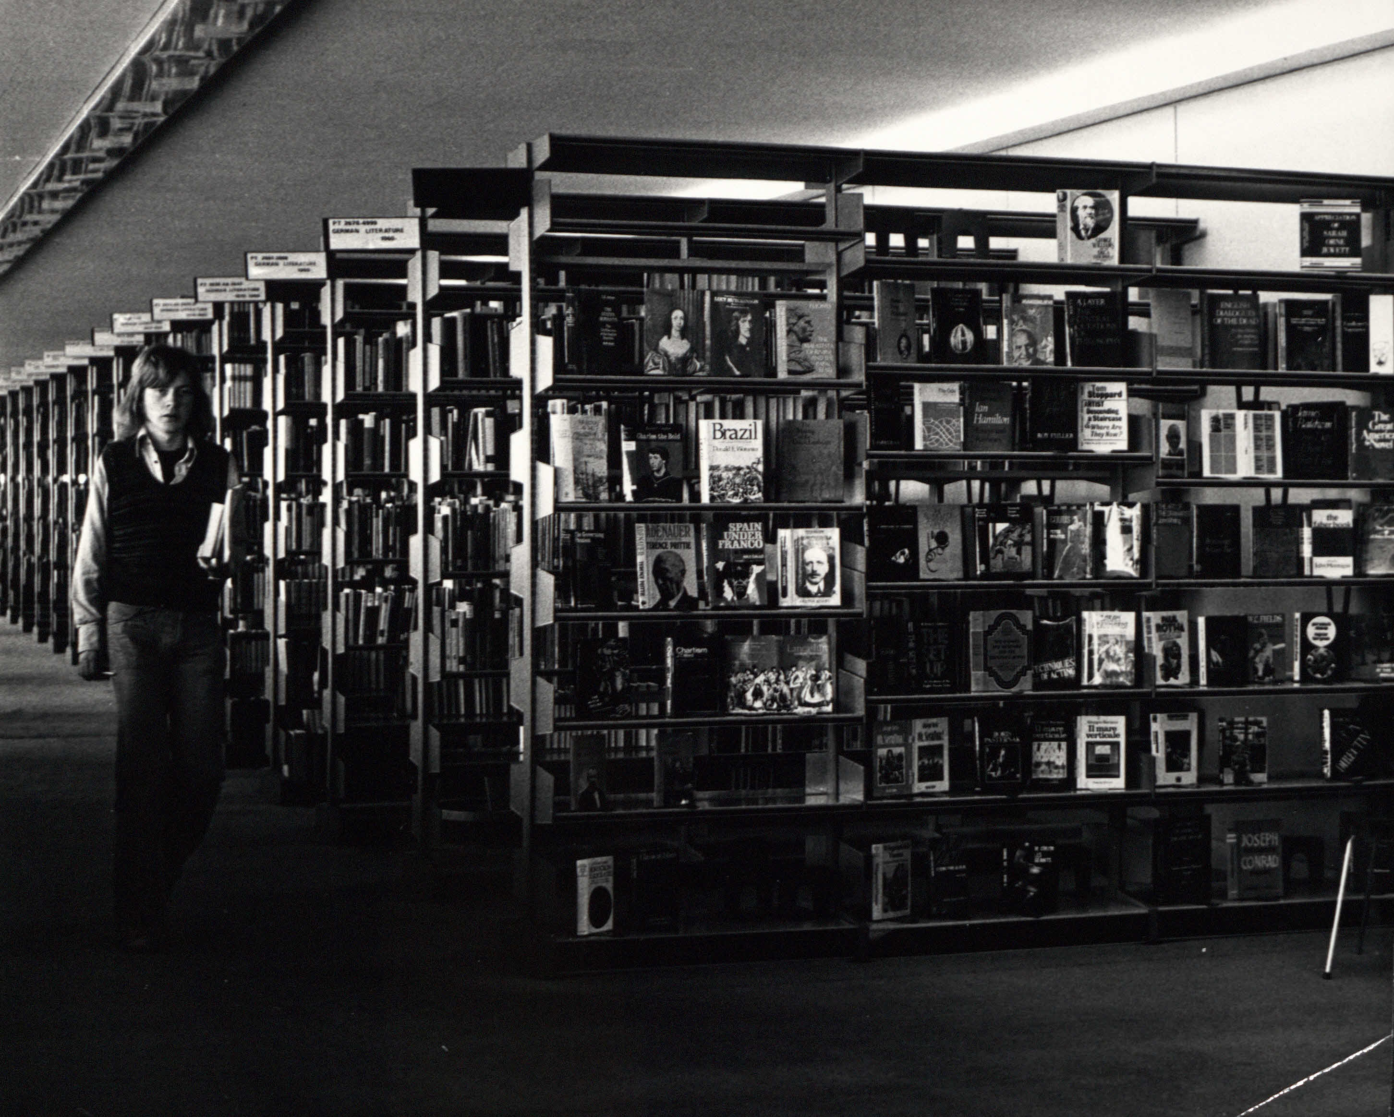

Library
Back
Library, 1968
Library, 2020

Slide 19


Warwick Business School
Back
‘’When entering the modern and minimalistic interiors of the WBS building, I always felt confident, professional and focused.’’
Matthew, Accounting and Finance (2019-2022), 2020
Now

Slide 20


Warwick Business School
Back
‘’WBS likes to promote intercultural awareness and knowledge and I really liked that because there is a wallpaper of pictures from places around the world in one of its floors and its really surprising that there is a picture of my hometown too.’’
Loizos, Accounting and Finance (2019-2022), 2020
Now

Slide 21


Social Sciences
Back
"In the 1970’s, certainly in our department (PAIS) we had very left-wing students. They are not so left-wing these days. I think that’s completely changed.”
Wyn, PAIS Emeritus Professor
Then

Slide 22

Social Sciences
Back
“When we get to the 1990’s, there’s a greater expansion both in the university and the department (PAIS) which gives the opportunity to recruit new sorts of people, and also the recognition of the fact that there was also an imbalance in the composition of the department.”
Wyn, PAIS Emeritus Professor
Then

Slide 23
Social Sciences
Back
‘’The social sciences building is literally a maze. You walk down one corridor on floor, and somehow come out in a completely different building on a different floor. After 3 years of having lessons in the Social science building, I still don’t know how to get around most of it. After getting lost one time, I don’t stray from the café or beyond the main lecture halls.’’
Lauren, PAIS and History (2017-2020), 2020
Now

Slide 24


Students Union
Back
‘’There was something of a hot topic that kicked off in my final year about police brutality. A student got pepper sprayed during a sit-in. And it all kicked off, I can’t remember where the SU came down on that. I don’t recall any significant issues with the university.’’
Alumni, French and Italian (2011-2015), 2020
Then

Slide 25

Students Union
Back
‘’My favourite part of the SU is in the HQ where there’s a timeline of all the events that have impacted the organisation and its history perhaps most famously when Pink Floyd performed there. ‘’
Anna, PAIS, (2018-2021), 2020
Airport Lounge, 1975
Then

Slide 26


Students Union
Back
‘’OK, there was big party I don’t know if it's still going on now, called Metamorphosis and then I think still exist anymore. But they used to spend quite a lot of the budget on this big event. It was mainly dance music and house music. And so, I DJ at one of those parties which was great fun. ‘’
Benjamin, French with Film Studies (2001-2005), 2020
Then

Slide 27


Students Union
Back
‘’It was awful, it was called Top Banana, that happened every Monday, right? It was a terrible, terrible event, it was like very, very cheesy pop music. Wasn't really my scene, but it did happen regularly. ‘’
Benjamin, French with Film Studies (2001-2005), 2020
Then

Slide 28
Student Union
Back
“I think the piazza makes Warwick Warwick. I think it brings together community. I love it not even on an event day but when it’s summer and everyone goes there and sits there to eat. I think it is such a nice focal point and atmosphere.”
Ellie, History (2017-2018), 2020
Then

Slide 29

Students Union
Back
‘’I think this is one of the few buildings I remember really well from my open day, but that’s mainly because it has a hairdressers that I have yet to visit. It’s a really dynamic busy place and that’s not just because of the mass of rooms there which includes a night club, a British tea room, a sandwich shop, a travel agency and a pharmacy but also just all the different students, there’s usually something different everyday. An indoor market in there a second hand clothes store and no matter how grey it is or dirty the building is this kind of make ups for it all and you feel like Warwick students belong there. ‘’
Catherine, Modern Languages (2019-2022), 2020
Now

Slide 30

Students Union
Back
‘’I think when I go inside (the SU) I can always smell the purple because they never clean it properly after circling which is not nice but when I go in on Tuesday, there is the market. You can buy these organic fruits which is really nice. So that gives it a bit of a better environment inside.”
Jakab, PAIS (2018-2021), 2020
Now

Slide 31


Bus Interchange
Back
“Oh, the bus interchange, that wasn’t there. The buses used to just queue up outside Rootes in like a huddle, and you just kind of ran for them. It was absolutely chaos. Now there is an actual interchange stop that makes a lot more sense. Warwick is a perpetual building site”
Pierre, French and History (2011-2015), 2020
Then

Slide 32

Bus Interchange
Back
‘’We didn’t have a bus interchange, so the getting busses was a nightmare. It used to be outside of Rootes Grocery Store which used to be “Costcutter” but no one remembers that. The busses used to leap around down by Library Road. There’s a bus stop by the old sports centre, it (the bus) used to pick up people there, as well.’’
Ellie, History (2017-2018), 2020
Then

Slide 33

Bus Interchange
Back
‘’The bus interchange is almost like a portal to another world. You don't realise how much of bubble Warwick campus is until you hop on a bus and see what the outside world is actually like.’’
Lea, Modern Languages with Linguistics (2019-2023), 2020
Now

Slide 34

Bus Interchange
Back
“Warwick was quite an attractive location.”
“Transport around the university was very poor in those days.”
“It’s always been separate from its surrounding communities.”
Wyn, Emeritus Professor (PAIS), 2020
Then

Slide 35


Oculus
Back
‘’Best waffles ever.’’
Ross, Computer Science (2019-2022), 2020
“Oculus didn’t exist when I was an undergrad, they started building that my final year. That used to just be a big field, it was quite nice in the summer people would play frisbee or cricket, used to do film screenings on there in the summer”
Pierre, French and History (2011-2015), 2020
“I mean I think for me to two things that always make me sad. One is the loss of Tocil field, so where the Oculus is built, because I have vague memories as an undergrad that, that field used to be used for film projections. Before the big screen went up, they would have, you know those kind of inflatable screens and project films on it there. Um, and it also could be used for just like lounging around on the grass in summer “
Andrew, 2010- 2014, French and History
Then

Slide 36

Oculus
Back
‘’Best waffles ever.’’
Ross, Computer Science (2019-2022), 2020
“Oculus didn’t exist when I was an undergrad, they started building that my final year. That used to just be a big field, it was quite nice in the summer people would play frisbee or cricket, used to do film screenings on there in the summer”
Pierre, French and History (2011-2015), 2020
‘’Best waffles ever.’’
Ross, Computer Science (2019-2022), 2020
Now

Slide 37

Oculus
Back
“Oculus didn’t exist when I was an undergrad, they started building that my final year. That used to just be a big field, it was quite nice in the summer people would play frisbee or cricket, used to do film screenings on there in the summer”
Pierre, French and History (2011-2015), 2020
Then

Slide 38

Oculus
Back
‘’Best waffles ever.’’
Ross, Computer Science (2019-2022), 2020
“Oculus didn’t exist when I was an undergrad, they started building that my final year. That used to just be a big field, it was quite nice in the summer people would play frisbee or cricket, used to do film screenings on there in the summer”
Pierre, French and History (2011-2015), 2020
‘’I’m sure we need it, I know Stuart Croft was saying when Oculus opened, it opened literally just in time because we just didn’t have the capacity for the students. Whether that will continue, post-coronavirus, we won’t have as many students, of course. I think it will look very different in the future. It certainly feels different as a campus.”
Karen, Alumni and Mead Gallery Assistant, 2020
Then

Slide 39


Whitefields
Back
‘’ I don’t think many people have lived in Whitefields but we all have a slight fascination with it because of how strange those little triangular bungalow houses are. They’re so different to every block of halls of residents.’’
Catherine, Modern Languages, (2018-2022), 2020
Now

Slide 40


Jack Martin and Arthur Vick
Back
“I happily remember playing karaoke in our kitchen with my flat mates, we always laughed and joked around. It was always a great time.”
Tom, French and Spanish (2019-2022), 2020
Now

Slide 41

Jack Martin and Arthur Vick
Back
“I remember when we were in their it was the year before Bluebell had opened, at that point Arthur Vick was kind of the pinnacle. It was the Bluebell so everyone you met would slowly, you could see them silently judging you because you lived in that particular hall. In the way that now everyone automatically judges everyone who lives in Bluebell”
Andrew, French and History (2010-2014), 2020
Then

Slide 42


Rootes
Back
‘’There is was, plopped in the middle of the countryside and there were huge gaps in the campus. The buildings were scattered over this rather large site. There were just huge gaps, fields between, for example, where the library is and where the Rootes building now is.”
Wyn, PAIS Emeritus Professor, 2020
Then

Slide 43
Rootes
Back
“It’s really interesting because I was living in J block and every time I told somebody I was living in J block, they told me “Oh my god! You must be living in the party place of Rootes because I heard that J block is such as good place” and everything, and I told them that I was living on the ground floor and that the ground floor was not at all a party block. The second and third floor of J block were where people actually had fun.”
Jakab, PAIS (2018-2021), 2020
Then

Slide 44
Rootes
Back
‘’When I think of Rootes, the only thing I think about are the fire alarms - we had them several times per week.’’
Joanne, PAIS (2019-2022), 2020
Then

Slide 45


Ramphal
Back
‘’I’ve always been a bit of a fan of the Ramphal building because I think unlike other buildings, such as the humanities building, it’s actually aged quite well. I’m not entirely sure when it was built and I’m fairly certain the classrooms inside have been redone. But externally I still think it is still quite nice and that wall when you enter is covered in designs, equations, names which is really quite a cluster of memories for Warwick. Although typically this building is quite unloved because it’s normally used when there isn’t enough room in your normal building. ‘’
Anna, PAIS, (2018-2021), 2020
Now

Slide 46
Ramphal
Back
‘’I feel like the Ramphal building is like notoriously a disliked lecture hall. I think it is cause it is kind of dark, always warm and the seats are really comfy, that you have to battle to stay awake in a morning lecture. There is one lecture I went to in the first couple of weeks of First Year where I had made the bad decision to go out the night before, I was sat in the 9am the next day and honestly I didn’t really write anything, I was too busy trying to stay awake. Also the fact there was no table to lean on was super frustrating and was the main reason I started taking notes on a laptop.’’
Lauren, History and PAIS (2017-2020), 2020
Now

Slide 47


Warwick Arts Centre
Back
‘’I was quite sad to see the old 80’s building go to make way for the new Arts Centre but I shan’t be sad to see the Humanities building go.’’
Karen, Gallery Assistant at the Mead Gallery
Then

Slide 48

Warwick Arts Centre
Back
‘’ I’ve always thought the building looked a bit like a swimming pool or a leisure centre from the 1970’s, I don’t know why, I think it might be because of the blue terracings on the ceiling.’’
Catherine, Modern Languages (2018-2022), 2020
Now

Slide 49

Warwick Arts Centre
Back
‘’I think it represents how dynamic and special this place is, ever changing, but at the heart it will always be the Warwick Arts Centre for students and the local community.’’
Anna, PAIS (2018-2021), 2020
Now

Slide 50

Prof. Lord Bhattacharya Building
Back
‘’ This is the coolest building on campus. Whenever I walk past it, I am amazed, especially in the dark when the entire building lights up!’’
Emma, French with Linguistics (2019-2023), 2020
Now

Slide 51

Prof. Lord Bhattacharya Building
Back
“And then the other one is the field where…. The Lord Bhattacharyya Building [now is]… because that used to be a big open field and again it used to be where the SU would hold its summer party, complete with stage and acts, but obviously that is no more there. A friend and I always used to have this joke that at some point we would release like an album of photos of various buildings on Warwick and call the whole thing ‘That used to be such a lovely field’, cause it does feel like that is kind of how it is going now”
Andrew, 2010- 2014, French and History
Then

Slide 52
Prof. Lord Bhattacharya Building
Back
‘’Yeah it has changed. I personally feel a bit sad that so many of the green spaces have been filled in since I was a student. I like the NIKE, NAIC, I don’t know how to pronounce it, you know that was an enormous green field. ‘’ ‘’ The what sorry? The Nike?‘’ ‘’ The big automated thing that was like a cheese grater. ‘’
Kate, English and Latin (1999-2002), 2020; current Academic Library Advisor (Interviewee Emma)
Now

Slide 53


Sciences
Back
‘’In first year we made a spring powered car so in a hall of the engineering first floor we tested it putting a phone to record first person view, then had it compete in a drag race which was nice.’’
Daniel, Engineering (2017-2021), 2020
Now

Slide 54


Sciences
Back
‘’The building itself is very boring. But there was a vending machine which was nice.‘’
Pranav, Engineering (2019-2022), 2020
Now

Slide 55


Zeeman, Computer Science
Back
‘’One of the things that cracks me up about the university, is that if I go to computer science or the maths block, the funding that just goes into the buildings and landscaping and the resources that we have is visibly, considerably higher the other departments. However, they like, do not really use any money towards keeping the student’s happy. So PAIS has that big room, you know there’s just a couple whiteboards, there’s a few chairs, it’s just for students to meet up and they’ve got like free hot drinks and just other niceties, whereas the computer science department with all of its infinitely more money supposedly, why is it limiting free drinks to week days at half 9. I mean Computer Science and the Maths department has decided that this is apparently worth having a bridge covered in LED’s running all year. Clearly budgeting across departments has no consistency.’’
Kurtis (2017-2020), 2020
Now

Slide 56
Zeeman, Computer Science
Back
‘’ The department of computer science is incredible, or so I’ve been told, it’s so small we don’t have lectures in there.’’
Ross, Computer science (2019-2022), 2020
Now

Slide 57









West

Slide 58


Lakeside
Back
‘’Lakeside became my home during first year. It’s where I met the friends I talk to the most and where I had the most enjoyable moments- kitchen paper aeroplane competitions, Christmas dinner and trying to throw a tomato at someone but missing.’’
Emma, French with Linguistics (2019-2023)
Now

Slide 59

Lakeside
Back
‘’I had a few come at me, but I was able to escape them, but I know a few people had some run ins with the geese, nothing serious, just the charging at them and pecking.’’
Alumni, French and Italian (2011-2015)
Then

Slide 60


Heronbank
Back
‘’ One of my fondest memories at university was standing in Heronbank courtyard at 6:30 am after almost having a heart attack because of being woken up by a fire drill.’’
Sam, Computer Science (2019-2023), 2020
Now

Slide 61


Sherbourne
Back
‘’I will always remember the happy times I shared with my flatmates in Sherbourne 7. I was lucky to live with some lovely people and even though it's one of the furthest accommodation blocks from central campus, it was well worth the trek to lectures everyday. Nicest kitchens, nicest rooms and the nicest people.’’
Lea, Modern Languages with Linguistics (2019-2023), 2020
Now

Slide 62


Sports centre
Back
‘’I bought a gym membership for the year and I only visited the gym 4 times. I’m blaming it on my degree.’’
Student, Computer Science (2019-2023), 2020
Now

Slide 63

Sports centre
Back
‘’ I won my first ever trophy playing at the squash inter-uni tournament on these courts. And played against other unis, including Loughbrough.’’
Emma, French with Linguistics (2019-2023), 2020
Now

Slide 64







East

Slide 65


Gibbet Hill Campus
Back
‘’I used to stay late in life sciences quite a lot and the walks/cycles back were so peaceful, especially early evening in the spring because the bluebells were out and the sun would be coming through the trees. Was very serene after a full day's work.’’
Lara, Bio-med (2017-2020), 2020
Now

Slide 66

Gibbet Hill Campus
Back
“I think a lot of people think that about Gibbet Hill, that’s it’s a mystical no man’s land.”
Chris, PAIS with Hispanic studies (2018-2022), 2020
Now

Slide 67


Bluebell
Back
‘’We used to be able to get into any single given apartment with a coat hanger because the locks on the doors, the bits of them were exposed so, we used to hook it. We used to play pranks on a few friends of mine who were living in the block. Harmless, we clingfilmed someone’s door. So, when they tried to leave they couldn’t. Harmless things like that.’’
Alumni, French with Italian (2011-2015), 2020
Then

Slide 68


Tocil Woods
Back
‘’I like to think that I'm one of the students who knows Tocil Woods the most. I went there for one of my modules to lay animal footprint traps, to map out the local ecosystems and to analyse water samples. My fondest memory was certainly being filmed jumping up and down in one of its rivers to Whitney Huston.’’
Laura, GSD (2019-2022), 2020
Now

Slide 69

Tocil Woods
Back
‘’My favourite place on campus is a bench by the lakes at the edge of Tocil wood and nature reserve. It was and continues to be my favourite spot to read, think, and sometimes cry. It was always so serene, a welcome break from the intensity of campus life.’’
Kaleigh, Bio-Med (2017-2020), 2020
Now

Slide 70





Westwood

Slide 71

Westwood campus
Back
“It looks the same every time I go past, I think there’s one extra building, and that’s it, and I don’t know, they changed the education course over and over, so before I went you used to do a Bed, bachelor of education, when I went it was BA, it was QTS. Now I think it’s something else entirely but aimed still towards teaching because way back in the 60s I think, Westwood was Coventry Education College, it wasn’t part of the university, but separate. Coventry Education college, and I met lots of older teachers or retired teachers, a lot of them now, who say um, oh yeah I studied at Coventry Educational College, and they mean Westwood.”
Kathryn, Education (1990-1994), 2020
Then

Slide 72

Westwood campus
Back
‘’Well, actually at Westwood they had like a can, like a diner canteen thingy. You had this card that gave you credit for the term where you could get food.‘’
Benjamin, French with Film Studies (2001-2005), 2020
Then

Slide 73

Westwood campus
Back
“There was a cafeteria and I remember going there, cause I remember having my handbag stolen in the cafeteria. Never since then have I carried a big handbag with my whole life in it, I learnt a lesson there.”
Kathryn, Education (1990-1994), 2020
Then

Slide 74


Westwood Sport’s Ground
Back
‘’Umm, I can’t even say winning Varsity’s significant because that’s just a given isn’t it.’’
Alumni, French and Italian (2011-2015), 2020
Then

Slide 75

Westwood Sport’s Ground
Back
‘’ I was in the Westwood or Westfield halls of residents in the first year. So, we were really close to the football pitches, so I genuinely think I played football everyday in the first year, which was absolutely wonderful. ‘’
Benjamin, French with Film Studies (2001-2005), 2020
Then

Slide 76

Westwood Sport’s Ground
Back
‘’ The pitches at Warwick were a fundamental part of my first year, I spent countless hours there socialising and playing the sports I’m passionate about. The facilities are second to none. ‘’
Finley, MORSE (2019-2023), 2020
Now

