Slide 1
THE POLITICISATION OF MUSEUMS: A GAME OF TWO HALVES
Clive Gray
University of Warwick
c.j.gray@warwick.ac.uk

Slide 2
POLITICS AND MUSEUMS (1)
Can talk about three distinct forms of politics as they affect museums:
Politics IN museums: the politics of how things are done inside museums
Politics OF museums: the politics of what things are done inside museums
Politics ABOUT museums: the politics of why things are done inside museums

Slide 3
POLITICS AND MUSEUMS (2)
In more general usage ‘politics’ also refers to:
The exercise of power
By particular individuals/groups/organisations/institutions
For particular ideological purposes
With the exercise of power being accepted as legitimate
On the basis of justificatory rationalities

Slide 4
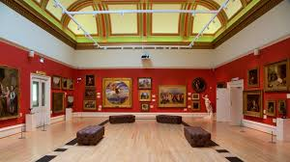
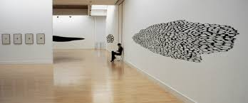
POLITICS AND MUSEUMS (3)
So politics in museums could involve:
The exercise of power by museum professionals

Slide 5
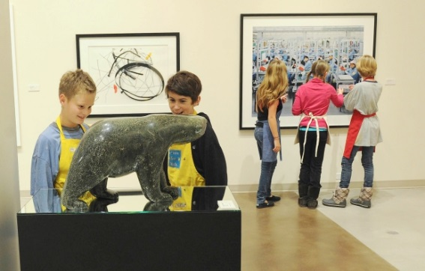
POLITICS AND MUSEUMS (3)
For the purposes of social engagement through public participation in museum activities

Slide 6
POLITICS AND MUSEUMS (3)
With this being legitimised by reference to professional values, ethics and judgements
With these being justified on the basis of technical and instrumental forms of rationality

Slide 7
POLITICS AND MUSEUMS (4)
Reality is messy
There are overlaps between forms of politics in everyday practice
For example, deciding to spend a greater proportion of a museum budget on conservation rather than on display has
Implications for what the museum can afford to do
Implications for how the museum will undertake all of its functions
And there will be:
Deliberate intentions about why this change has been introduced
And unintended consequences as the change is implemented

Slide 8
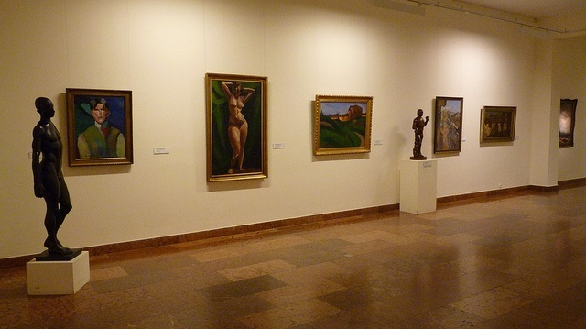
THE POLITICISATION OF MUSEUMS (1)
If museums are inherently political institutions what does the ‘politicisation of museums’ mean?
Can address this by considering politicisation as:
A simple expression of political and/or policy preference

Slide 9
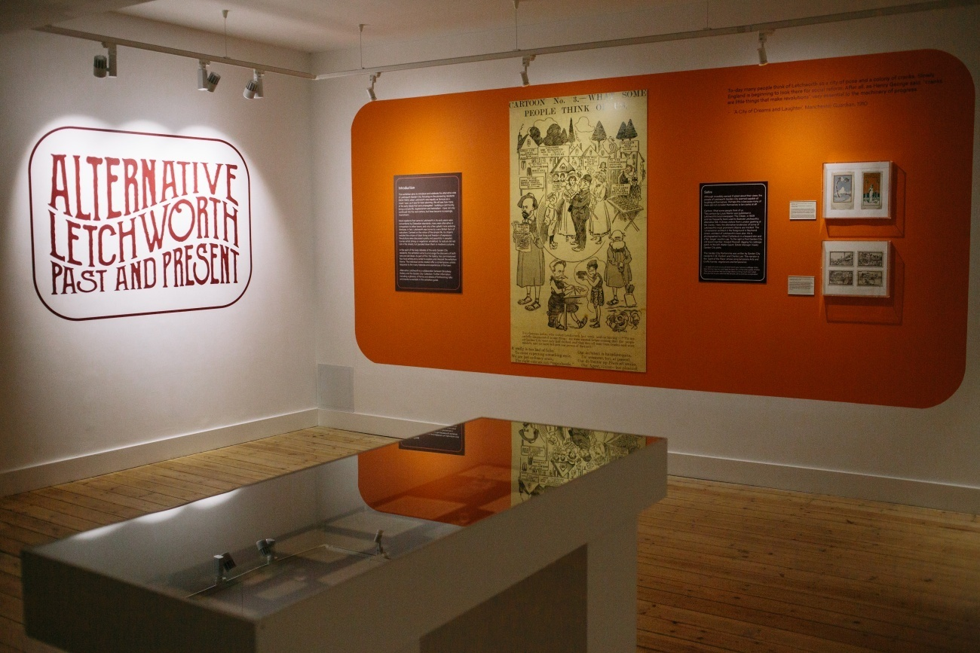
THE POLITICISATION OF MUSEUMS (1)
A more complicated expression of ideological preference
An intention to shift the balance of power within museums between individuals/groups/organisations/institutions
Or as a consequence of changing perceptions of museums

Slide 10
WHO DRIVES MUSEUM POLITICISATION?
In crude terms four sets of potential actors can be identified:
Internal actors in a managerial and/or professional capacity
External actors in positions of systemic power and authority
Members of civil society
(At the risk of reification) Museums themselves as particular institutional forms

Slide 11
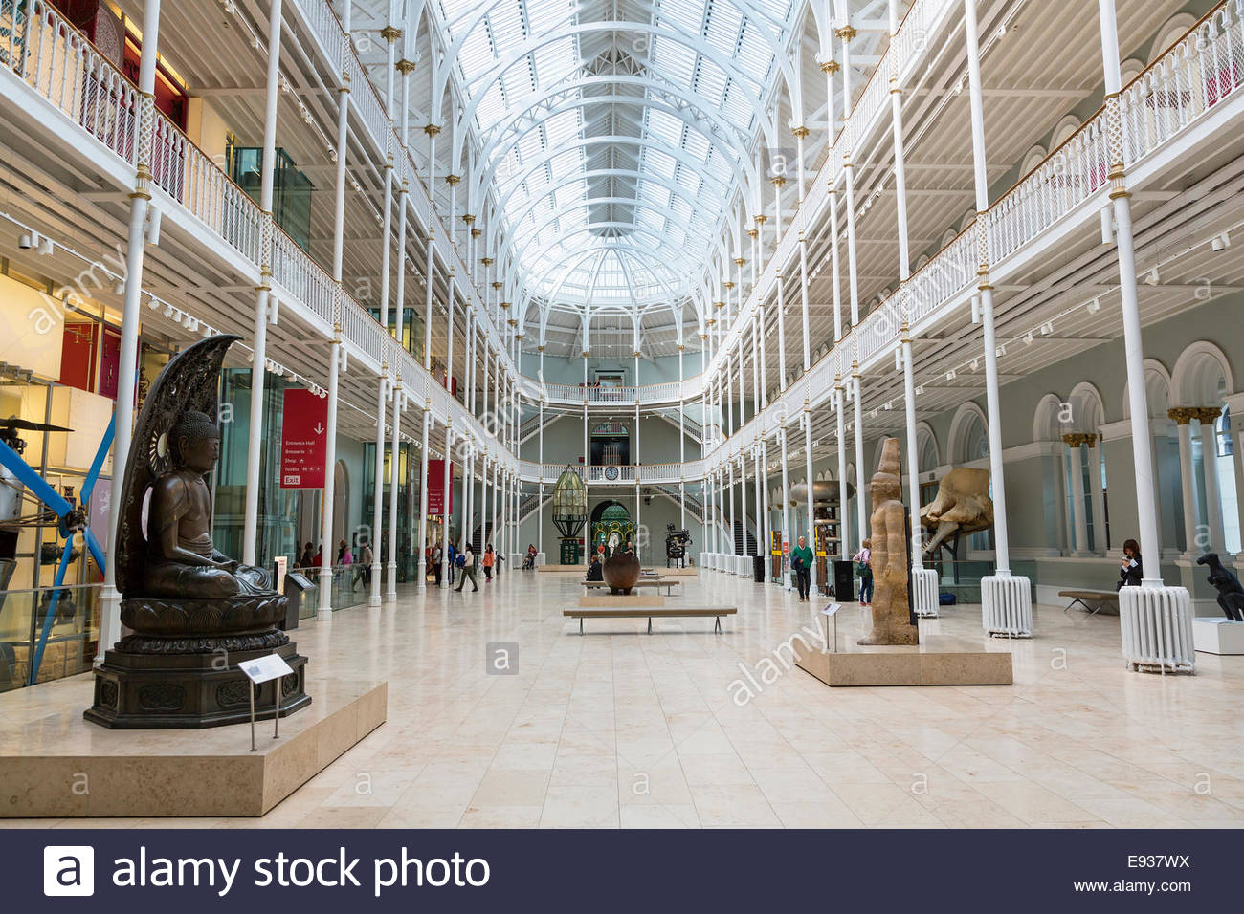
WHY POLITICISE MUSEUMS? (1)
This is closely related to the meaning of politicisation in the first place
Can identify four clear reasons for why politicisation is seen as being worthwhile:
Ideological preference

Slide 12
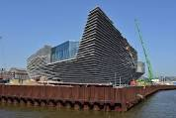
WHY POLITICISE MUSEUMS (1)
2. Political advantage

Slide 13
WHY POLITICISE MUSEUMS (1)
Because it can be done
The political weaknesses of museums making them relatively easy to manipulate by organised sets of political interests

Slide 14
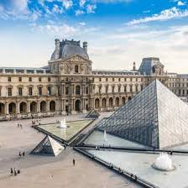
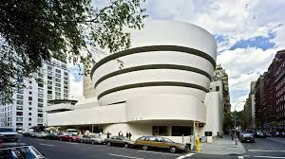
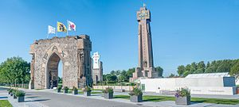
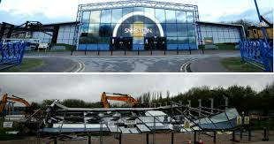
WHY ARE MUSEUMS POLITICALLY WEAK?
The overwhelming majority of museums are in a weak financial position

Slide 15
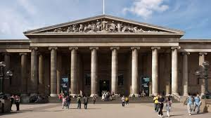
WHY ARE MUSEUMS POLITICALLY WEAK?
Museums have limited political capital
Museums have limited social capital
Their perceived status as neutral sites of knowledge and meaning creation limits their ability to be brazenly ‘political’ in their actions unless they are willing to lose this symbolic status

Slide 16
THE SECOND HALF
So, if museums are liable to being politicised by a variety of actors for a variety of reasons what, if anything, can they do about it?
Museums can appeal to their perceived politically neutral status to mobilise resistance.
Museums can change the nature of the argument.
Museums can appeal to their technical expertise to evade demands for change or to manage change

Slide 17
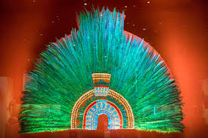
THE SECOND HALF
Museums can appeal to international agreements and standards to resist demands for change or to manipulate what changes are feasible
Less proactively, museums can simply sit still and hope that the politicisers will simply give up and go and do something else

Slide 18
IN CONCLUSION (1)
Museums are always, and have always been, political institutions

Slide 19
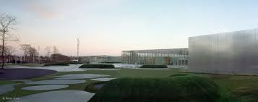
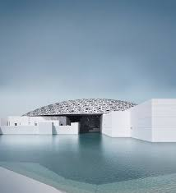
IN CONCLUSION (1)
This has always been recognised by authoritative power-holders

Slide 20

IN CONCLUSION (1)
Recently, however, this has become a basis for much more overt attempts to politicise what museums are, what they do, and how they do it
While much of this has been externally-driven by ‘political’ actors, a great deal has also been internally-driven through the changing perceptions of museum staff and professionals about the roles and functions of museums in societies

Slide 21
IN CONCLUSION (2)
There is no point to hoping that politicisation will go away – it won’t
Instead, developing overt mechanisms to manage politicising pressures, to evade the intentions of politicisation, and to manipulate the process of politicisation are necessary
Museums have been doing these things since they were established so they have a wealth of experience to refer back to
In the conditions where power-holders of various persuasions have become increasingly interventionist into the activities of museums…

Slide 22
IN CONCLUSION (3)
…A shift in position away from the idea that museums are politically-neutral exemplars of the ‘public sphere’ and towards an acceptance of their political nature will probably be of greater utility to museums than the loss of symbolic status will cost them

