Slide 1

AI and Academic Integrity
An update
13 June 2023 / FSS Lunch and Learn

Slide 2
Agenda
The concerns
Why students ‘cheat’
A model for Academic Integrity

Slide 3
Concerns
Students will simply feed assessments into an AI and submit the answer
Colleagues may not spot this
Work submitted and given credit is therefore not the student’s
plus ça change, plus c'est la même chose

Slide 4
Why cheat?
Opportunity
Rationalisation
Motivation
Based roughly on Donald R. Cressey, Other People’s Money (Montclair: Patterson Smith, 1973) p. 30.

Slide 5
Why cheat?
Opportunity
Rationalisation
Motivation
Based roughly on Donald R. Cressey, Other People’s Money (Montclair: Patterson Smith, 1973) p. 30.

Slide 6
Why cheat?
Opportunity
Rationalisation
Motivation
Based roughly on Donald R. Cressey, Other People’s Money (Montclair: Patterson Smith, 1973) p. 30.

Slide 7
Why cheat?
Opportunity
Rationalisation
Motivation
EXAMS ONLY!
DETECTION TOOLS!
Based roughly on Donald R. Cressey, Other People’s Money (Montclair: Patterson Smith, 1973) p. 30.

Slide 8
Why cheat?
Opportunity
Rationalisation
Motivation
?
?
Based roughly on Donald R. Cressey, Other People’s Money (Montclair: Patterson Smith, 1973) p. 30.

Slide 9
Why cheat?
Opportunity
Rationalisation
Motivation
?
Stress
Time
Panic
Fear
Outcome
Based roughly on Donald R. Cressey, Other People’s Money (Montclair: Patterson Smith, 1973) p. 30.

Slide 10
Why cheat?
Opportunity
Rationalisation
Motivation
Stress
Time
Panic
Fear
Outcome..?
Whether studying, teaching or researching, we’re all taking part in an expert conversation which must meet standards of academic integrity. When we all meet these standards, we can take pride in our own academic achievements, as individuals and as an academic community.
Based roughly on Donald R. Cressey, Other People’s Money (Montclair: Patterson Smith, 1973) p. 30.

Slide 11
DESIGN
DELIVERY
DETECTION
Model
Support, culture

Slide 12
Design
WIHEA Learning circle – principles of design – now on ADC
https://warwick.ac.uk/fac/cross_fac/academic-development/assessmentdesign/assessmentdesignprinciples/
Examples to follow this month

Slide 13
Delivery
Flows from design, follows the same principles:
  Needs to be fair/equitable (note AI help for some specific needs)
  Consider online risks
  Interaction with students, can we see the answer ‘build’

Slide 14
Detection
This is NOT the whole answer, but is part of it
Risks are very similar to essay-mill risks, a third party produces the work a student presents as their own

Slide 15
Detection framework
There are three parts here:
  Central guidance and general principles for staff and students
  Translated at the department level, then course, module and component, and restated in student handbook
  Student declaration for all submissions referring back to guidance to remove ‘I didn’t know that wasn’t acceptable’ excuse

Slide 16
Detection
Currently NO to TurnitIn’s built in detection tools:
Unsure on process
Unsure on data handling
Unsure on efficacy – specifically false positive rates
No testing, can’t train colleagues
Pricing is opaque

Slide 17
BUT…

Slide 18
We now have a test environment
We are testing the detection tool for false positives and failures to detect.
Any test material you wish me to try please send to me
There are limited numbers of test accounts

Slide 19
Detection
The single best tool we have sits between the marker’s ears

Slide 20
Example
Essay question to ‘design and defend a costing process for a product’

Slide 21
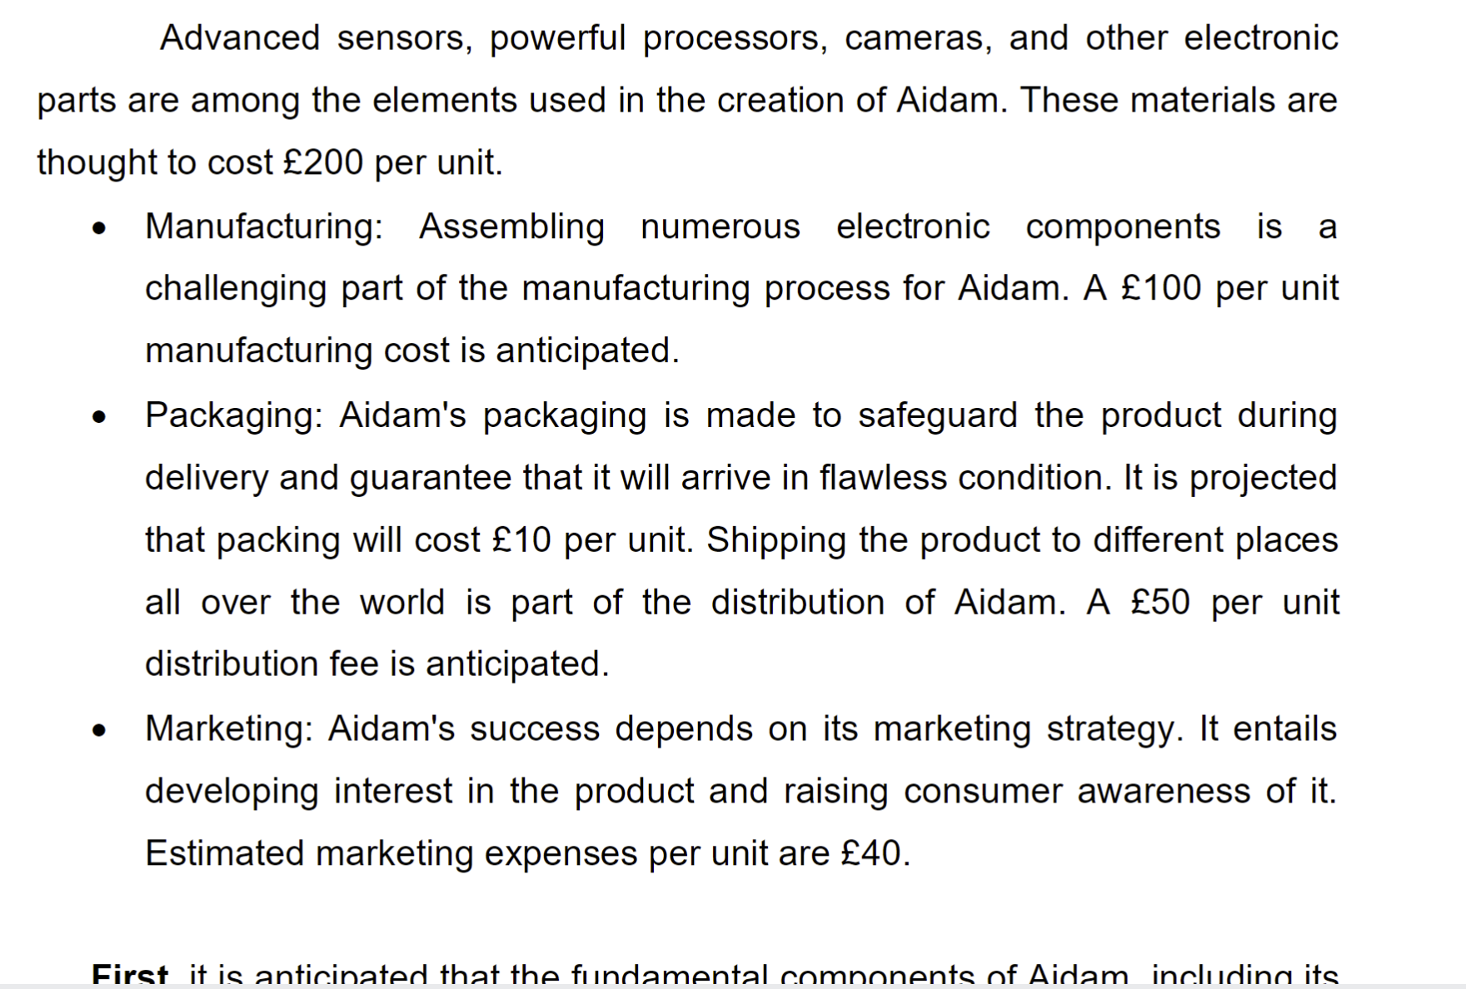
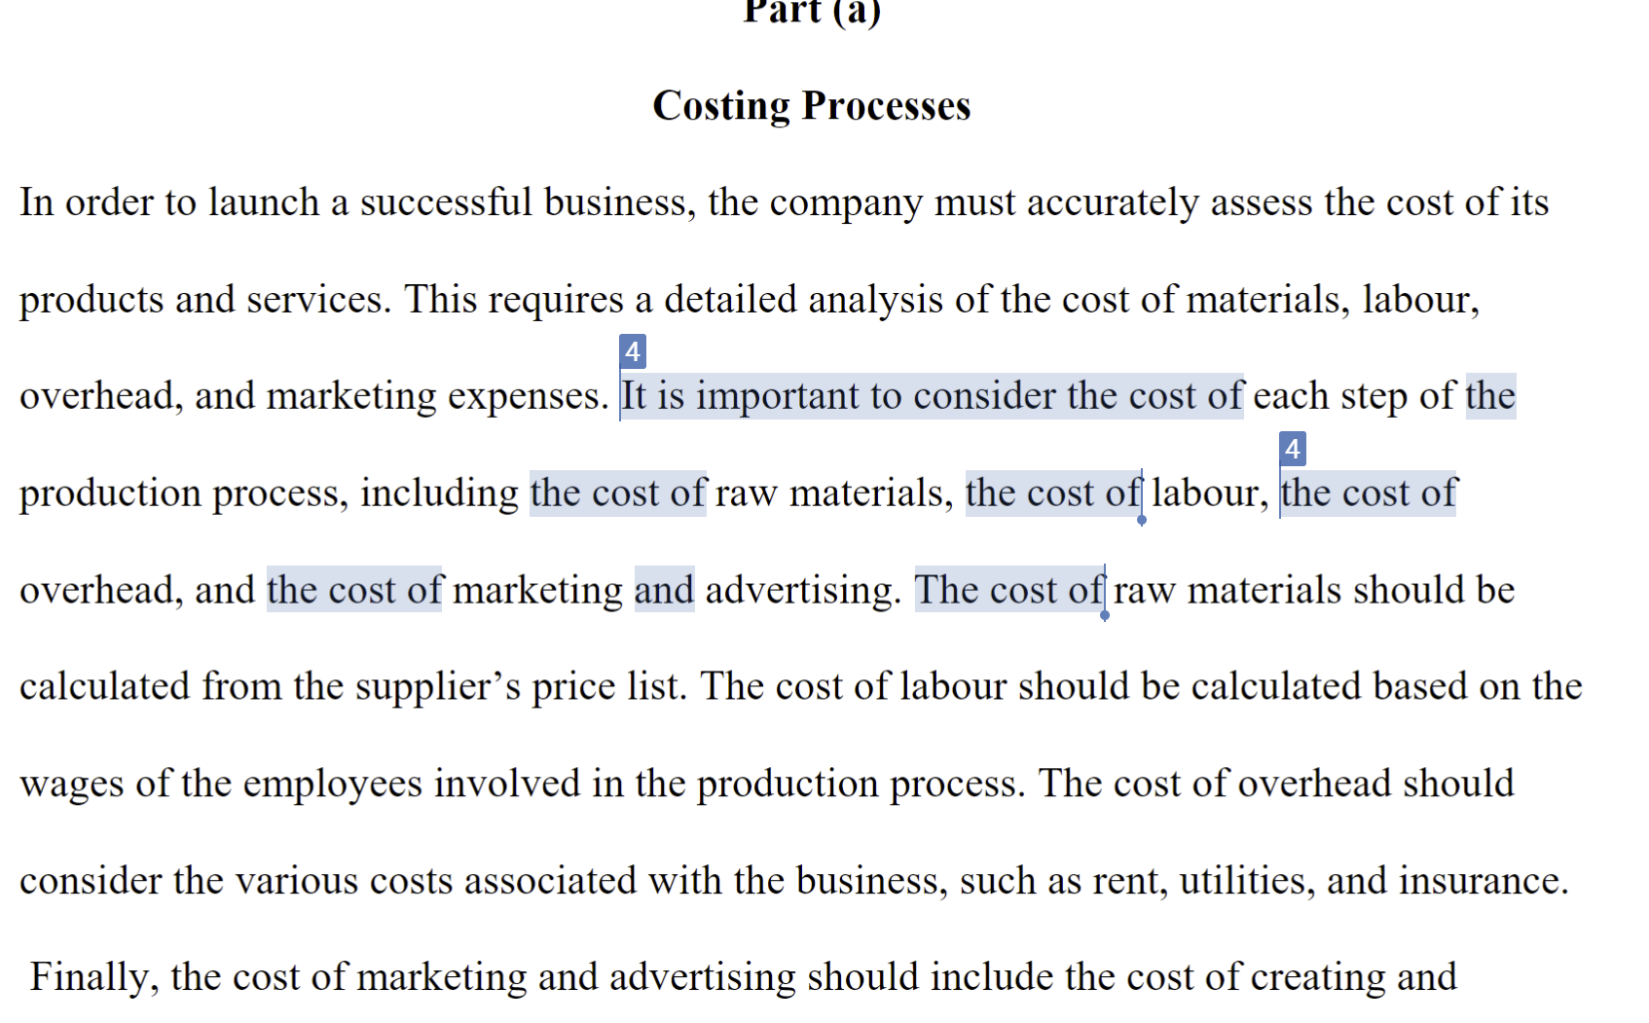
Both fail, but which one is the human?

Slide 22
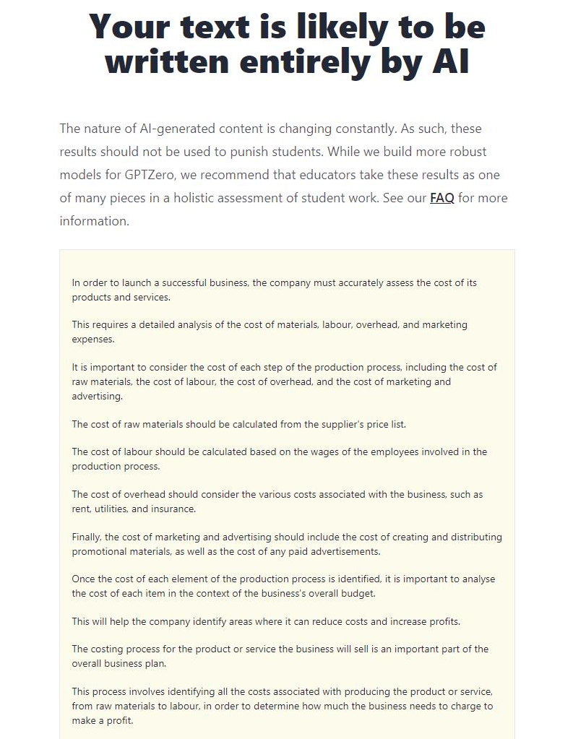

Slide 23
GOOD NEWS!
Not much has changed, it’s the same risk as an essay-mill
It’s easier to spot
Answers tend to be weak, leading to either minimal pass or more often failure as the question not addressed

Slide 24
Detection tips:
Largely accurate but generic content;
Coding and maths can be excellent
Hallucinated references (look sensible, but don’t exist)
Descriptive, repetitive
Likely to gain low marks

Slide 25
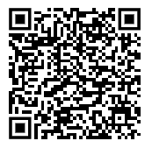
The following is from here:
https://www.jcq.org.uk/wp-content/uploads/2023/03/JCQ-AI-Use-in-Assessments-Protecting-the-Integrity-of-Qualifications.pdf

Slide 26
A default use of American spelling, currency, terms and other localisations.
A default use of language or vocabulary which might not appropriate to qualification level.
A lack of direct quotations and/or use of references where these are required/ expected.
Inclusion of references which cannot be found or verified (some AI tools have provided false references to books or articles by real authors).
A lack of reference to events occurring after a certain date (reflecting when an AI tool’s data source was compiled), which might be notable for some subjects.

Slide 27
Instances of incorrect/inconsistent use of first-person and third-person perspective where generated text is left unaltered.
A difference in the language style used when compared to that used by a student in the classroom or in other previously submitted work.
A variation in the style of language evidenced in a piece of work, if a student has taken significant portions of text from AI and then amended this

Slide 28
A lack of graphs/data tables/visual aids where these would normally be expected.
A lack of specific local or topical knowledge.
Content being more generic in nature rather than relating to the student themself, or a specialised task or scenario, if this is required or expected.
The inadvertent inclusion by students of warnings or provisos produced by AI to highlight the limits of its ability, or the hypothetical nature of its output.

Slide 29
The submission of student work in a typed format, where their normal output is handwritten.
The unusual use of several concluding statements throughout the text, or several repetitions of an overarching essay structure within a single lengthy essay, which can be a result of AI being asked to produce an essay several times to add depth, variety or to overcome its output limit.

Slide 30
The inclusion of strongly stated illogical conclusions and statements or confidently incorrect statements within otherwise cohesive content.
Overly verbose or hyperbolic language that may not be in keeping with the candidate’s usual style.

Slide 31
Next steps
Finalisation of guidance;
Development of policy – NOTE timetables here for policy v guidance
Colleague training – probably over the summer
Continued engagement with QAA, other institutions and TurnitIn

