Slide 1

MA FILM AND TELEVISION STUDIES
2026-2027

Slide 2

MASTER OF ARTS
FILM AND TELEVISION STUDIES
Film and Television Studies at Warwick is internationally recognised as one of the leading programmes in the field, offering an unparalleled training in the study of audio-visual media as cultural, historical, and aesthetic forms.
You will learn from leading scholars in the field through exciting modules that explore film theory, history, style, genre, representation, and film culture.
The programme provides a rigorous training in textual analysis alongside the historical and methodological study of film and television. Through research-led teaching and specialised skills training, students develop competencies including critical analysis, interpretation, creative thinking, and effective problem-solving. In the final phase, students hone these skills through an independent dissertation under supervision, allowing for in-depth exploration of a specialised area of interest.
The course equips students with a solid foundation in film and television studies and fosters critical thinking and advanced research and analytical skills essential for careers in media and cultural sectors, or for those preparing for further academic study.

Slide 3
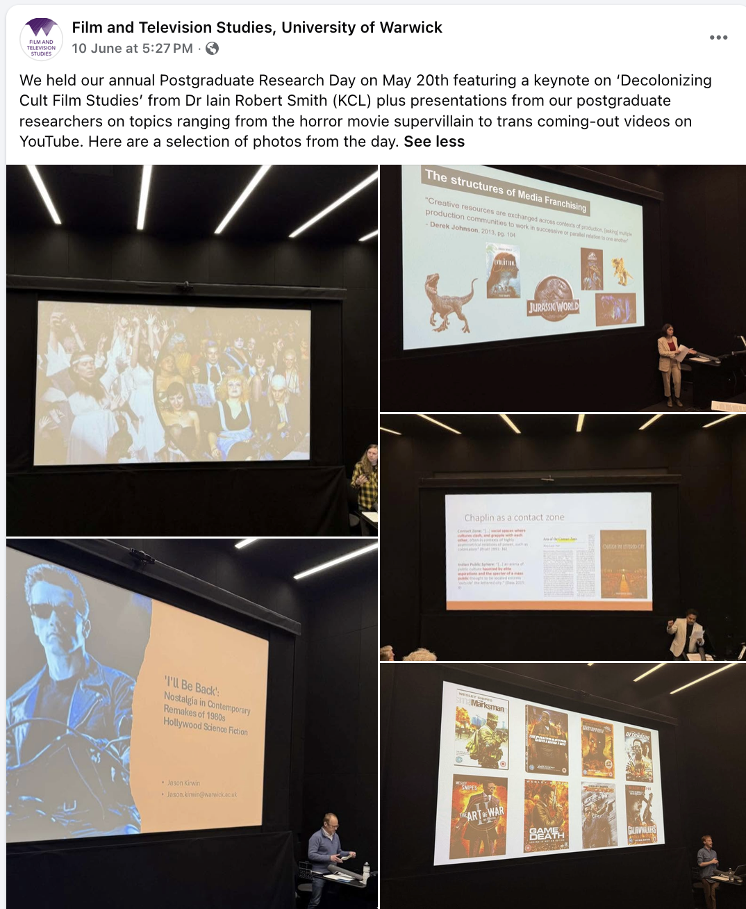
RESEARCH COMMUNITY/CULTURE
In addition to your modules, as postgraduate students, you are an important part of our research community. Listed below are examples of skills sessions and seminars that frequently take place in the department.
Our MA students recently took part in the work-in-progress day, which included topics ranging from the horror movie supervillain to trans coming-out videos on YouTube. This came one week after our Department Research Day where PhD students and staff members shared their developing research.
Please visit our social media for reports on these yearly research events: Facebook- Film and Television, University of Warwick; Instagram: warwickfilmtv

Slide 4
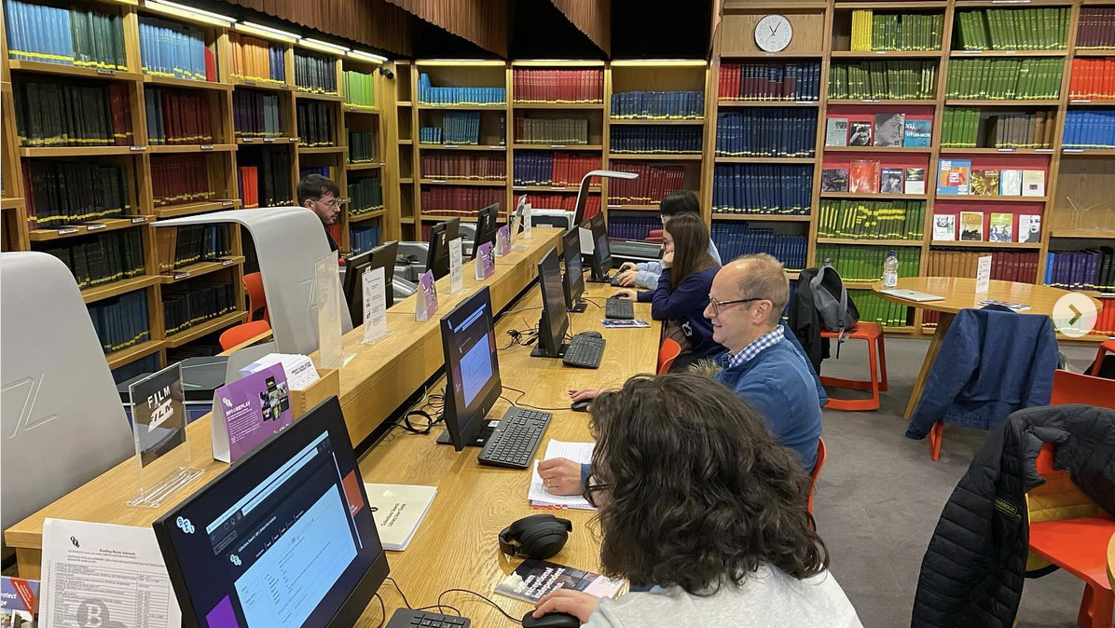
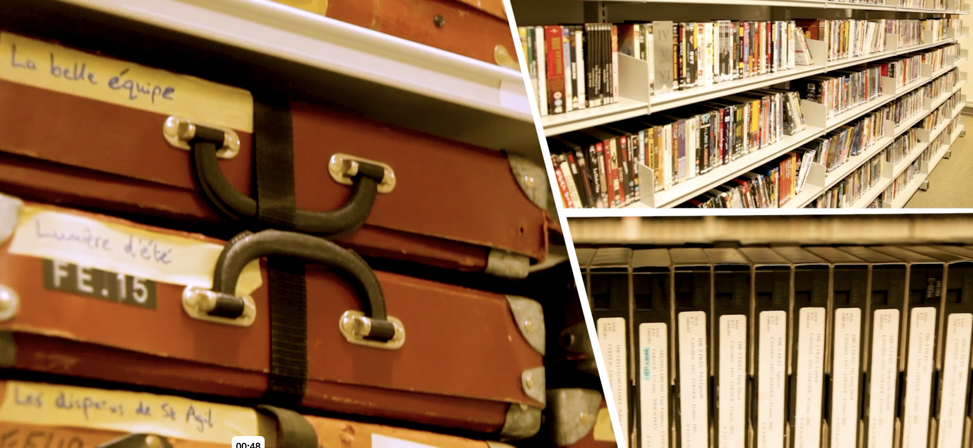
RESEARCH COMMUNITY/CULTURE
Graduate skills classes (may include): Introduction to the technical and archival facilities of F&TV; Image Capture and Scholarly Presentation; Choosing a Topic and Organising a Dissertation; Doing a Literature Review; Writing a PhD Proposal and Applying for Funding
MA Students also regularly take part in:
Postgraduate Reading Groups
Reel Talk Blog (for UG and PG students)
Centre for Television Histories meetings: TV Club and TV Histories in Development group

Slide 5
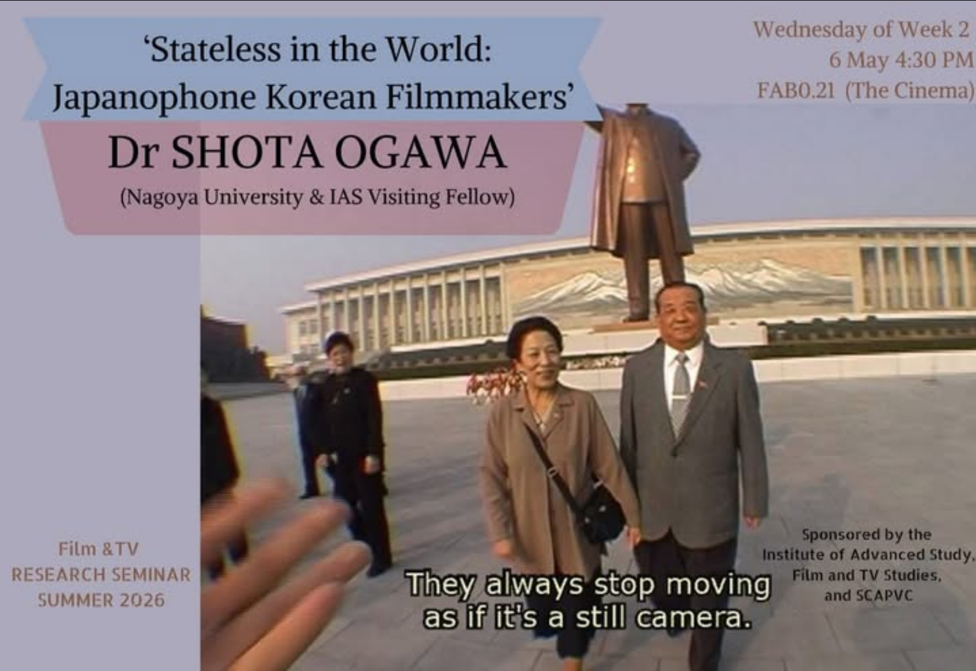
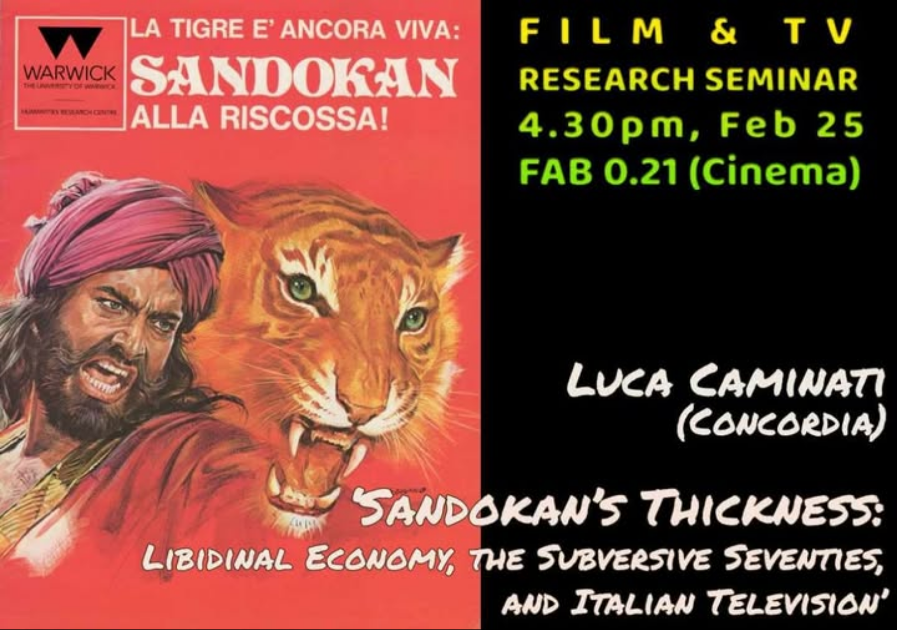
RESEARCH SEMINARS
Research seminars led by departmental staff, PhD students and a range of distinguished visiting speakers (Recent talks and events have included: Prof Luca Caminati (Concordia) ‘Sandokan’s Thickness: Libidinal Economy, the Subversive Seventies, and Italian Television’; Dr Shota Ogawa of Nagoya University: ‘Stateless in the World: Japanophone Korean Filmmakers’; Nike Del Quercio (University of Bologna): ‘From “Pink Pages” to the Silver Screen: Intersections between Photoromance Magazines and Cinema in Postwar Italy’; Films from the UK’s Student Encampments, a series of shorts made by and with activists from the Gaza encampments in the UK, including at Warwick.

Slide 6
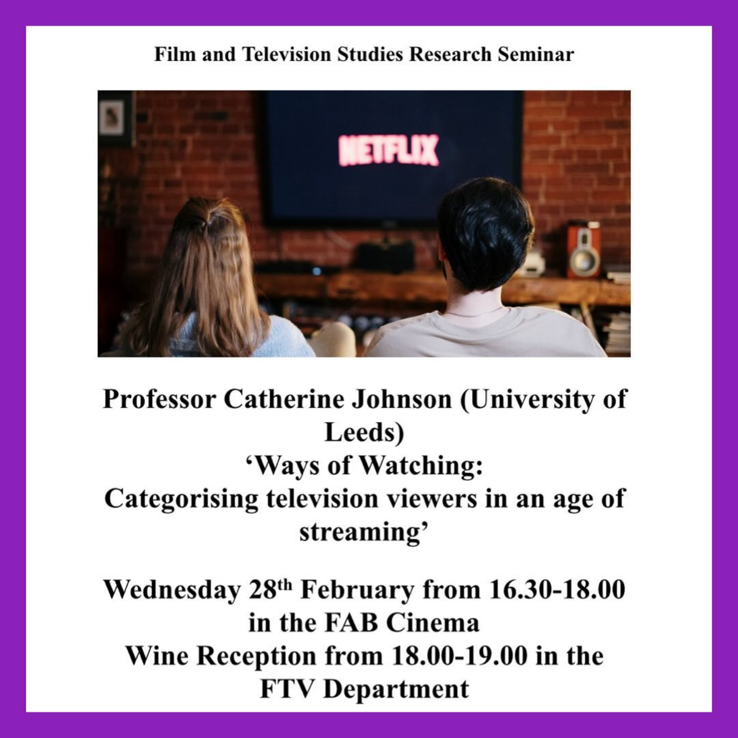
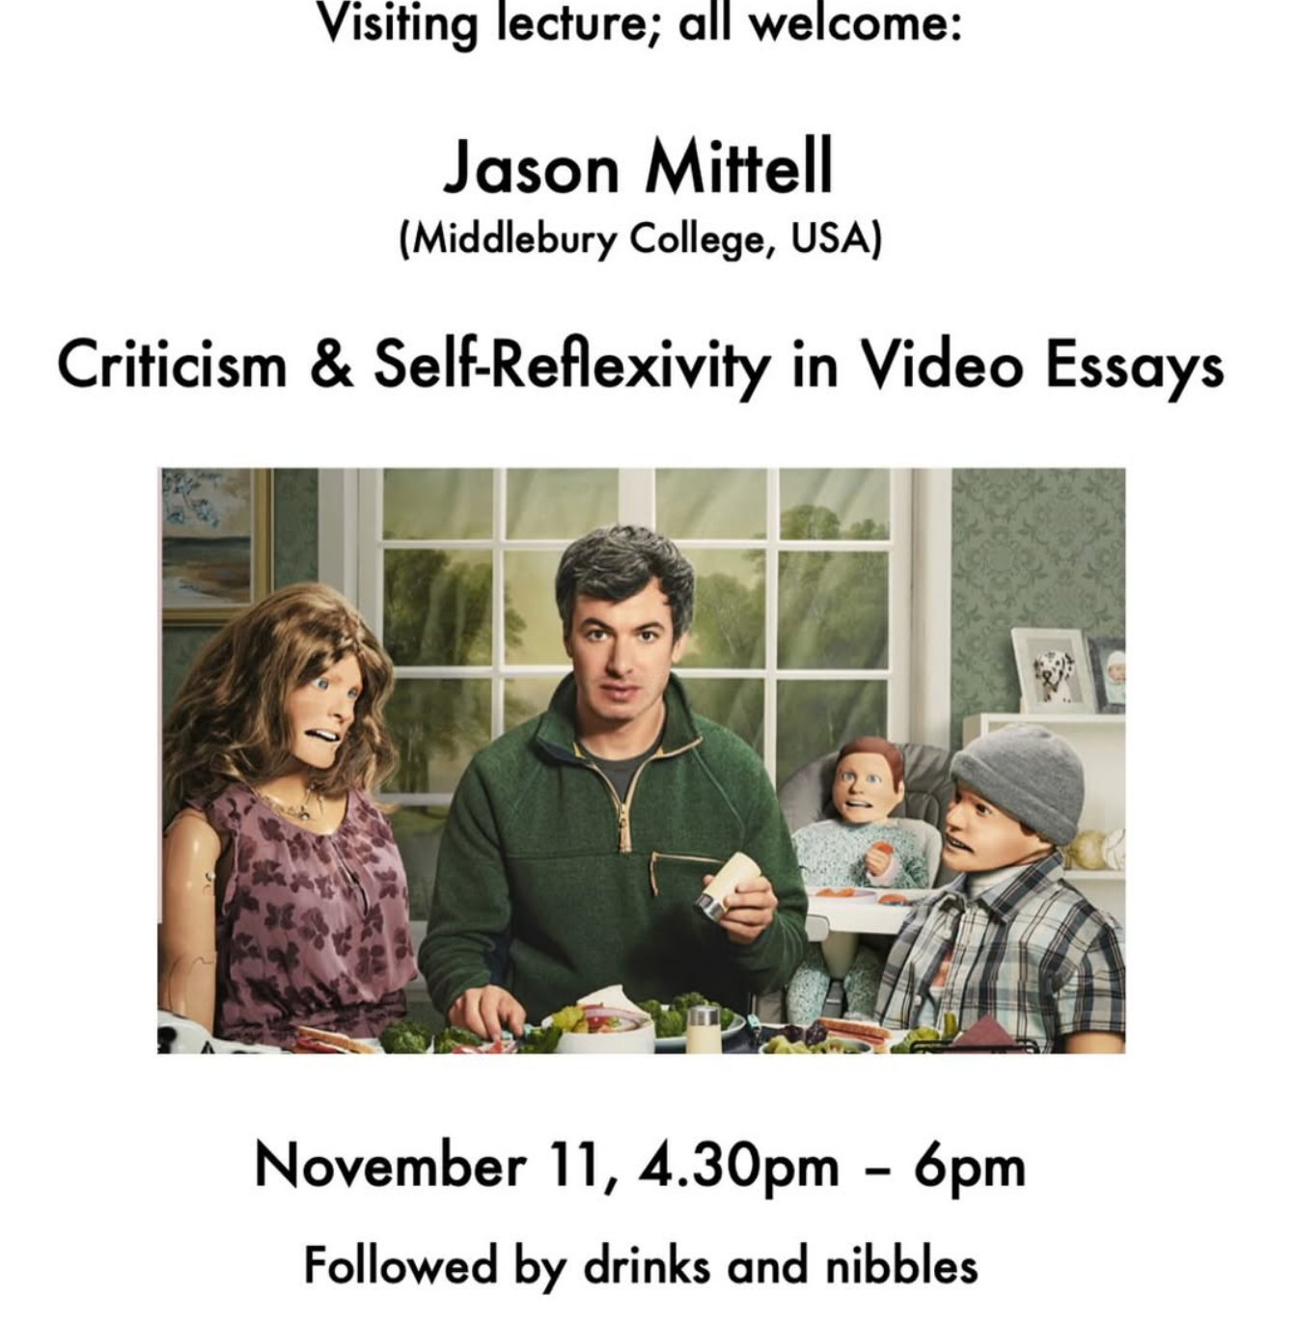

Slide 7
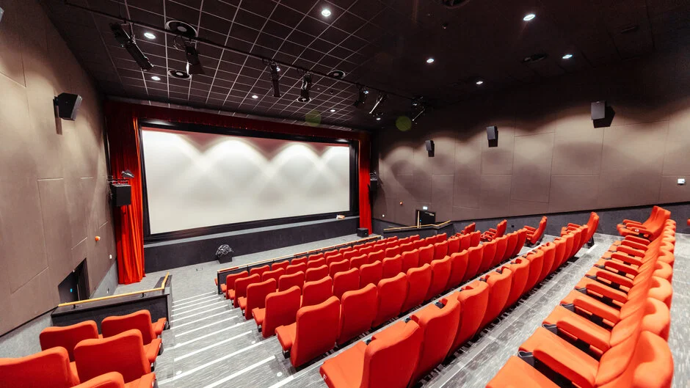

Slide 8
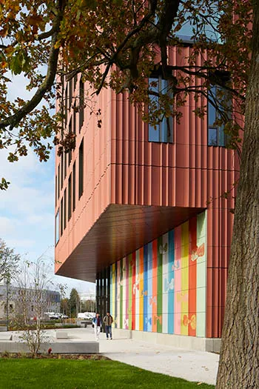
Information from the University of Warwick
If you have queries about:
Fees and Financing https://warwick.ac.uk/study/postgraduate/funding/
Accommodation https://warwick.ac.uk/study/postgraduate/whywarwick/accommodation/
Immigration https://warwick.ac.uk/study/international/immigration/
Campus Life https://warwick.ac.uk/study/postgraduate/whywarwick/campuslife/
Take a virtual tour of Warwick https://warwick.ac.uk/study/undergraduate/virtualtour/
And learn more about our new Faculty of Arts building

Slide 9
MA MODULES

Slide 10
MA MODULES 2026-2027
AUTUMN TERM
SPRING TERM
PICK ONE OF LIST A:
Screening Bodies
Queer + Trans Theories for Film and TV
AND PICK ONE OF LIST B:
Screening Bodies
Queer + Trans Theories for Film and TV
Almodovar
Indian Cinema
CORE MODULE: Advanced Methods in Screen Studies
AND PICK ONE OF:
Screening the Antihero(ine)
Eco-Cinema
US Comedy Television

Slide 11
AUTUMN
FI908 ADVANCED SCREEN CULTURES AND METHODS
FI929 ECOCINEMA
FI942 US COMEDY TELEVISION
FI931 SCREENING THE ANTIHERO(INE)

Slide 12
SPRING
FI944 SCREENING BODIES
FI943 QUEER AND TRANS THEORIES FOR FILM AND TELEVISION
FI968 INDIAN CINEMA
FI-939 PEDRO ALMODÓVAR

Slide 13
AUTUMN TERM MODULE INFORMATION

Slide 14
FI908 ADVANCED SCREEN CULTURES AND METHODS
CORE MODULE
MODULE OUTLINE
MODULE AIMS
This core module aims to explore significant methodologies and conceptual frameworks which are central to the study of audio-visual media. The module will introduce aspects of textual analysis, historiography, and theoretical and conceptual paradigms, across film and television. The module provides a grounding in key concepts and methods, but it will also encourage an advanced level of reflection on the key areas addressed. It is taught through a combination of screenings, presentations, reading and discussion.
The module aims to explore important methodologies and conceptual frameworks which are central to the study of audio-visual media. The module will address three main aspects, each usually taught over a three-week period: (i) textual analysis; (ii) historiography; (iii) theoretical paradigms. The module is intended to offer a grounding in key concepts and methods for MA students who have never studied film and television before, but it is also designed to stimulate an advanced level of reflection on the topics covered for students with an undergraduate qualification in the discipline. To suit the needs of both types of students, the module has a distinctive team-taught format, drawing on the range of expertise from academic staff in the department, who will contribute to the teaching of topics that directly relate to their own research. The aim is thus to offer a broad range of coverage of key issues and methodologies in the field while also familiarising students with the specific strengths and distinctive features of the research culture in the department.

Slide 15
FI908 ADVANCED SCREEN CULTURES AND METHODS
CORE MODULE
OUTLINE SYLLABUS
LEARNING OUTCOMES
It is expected that the the exploration of key methodologies and conceptual frameworks essential to the study of audio-visual media will be divided into the following three sections, each taught over a three week period. The specific topics to be taught will depend on the research interests of the module teaching team.
Part I. Textual Analysis
Part II. Historiography
Part III. Theories of the Moving Image
Undertake, and understand the methodological specificities of, close textual analysis of film and television texts.
Demonstrate knowledge of how audio-visual texts can be interpreted with reference to historical contexts of production and reception
Identify, locate and analyse archival documents relevant to the historical study of film and television
Demonstrate understanding of a range of important conceptual paradigms central to current thinking in film and television studies, and make critical judgements on the validity and usefulness of particular theoretical approaches.
Articulate arguments about film and television texts with an enhanced ability to support them with precise and compelling evidence drawn from a range of sources

Slide 16
FI908 ADVANCED SCREEN CULTURES AND METHODS
CORE MODULE
PREPARATORY READINGS
Preparatory Readings (note to students: the following list contains useful and introductory sources – including books, articles and lectures – for the three main strands of the module: textual analysis, historiography and theories of the moving image).
André Bazin, What is Cinema? Volumes 1 & 2 (University of California Press, 2004)
Catherine Wheatley (2011) Caché (London: BFI Publishing)
Helen Wheatley, Reviewing Television History (IB Tauris, 2007) - particularly the introduction and first section of the book.
Jane M. Gaines, ‘Film History and the Two Presents of Feminist Film Theory’ in Cinema Journal, 44:1, pp. 113-19
Jonathan Bignell and Faye Woods, An Introduction to Television Studies, 4th edition (London: Routledge, 2022), download a preview PDF of the introduction to the book here: https://www.taylorfrancis.com/books/mono/10.4324/9781315619675/introduction-television-studies-jonathan-bignell-faye-woods.
Karen Lury, Interpreting Television (Hodder Arnold, 2005).
Richard Dyer, The Persistence of Textual Analysis (video-lecture): https://www.kracauer-lectures.de/en/winter-2015-2016/richard-dyer/
Thomas Elsaesser and Malte Hagener, Film Theory: An Introduction through the Senses (Routledge, 2010)
V.F. Perkins (2006) ‘Moments of Choice’, Rouge 9, http://www.rouge.com.au/9/moments_choice.html

Slide 17

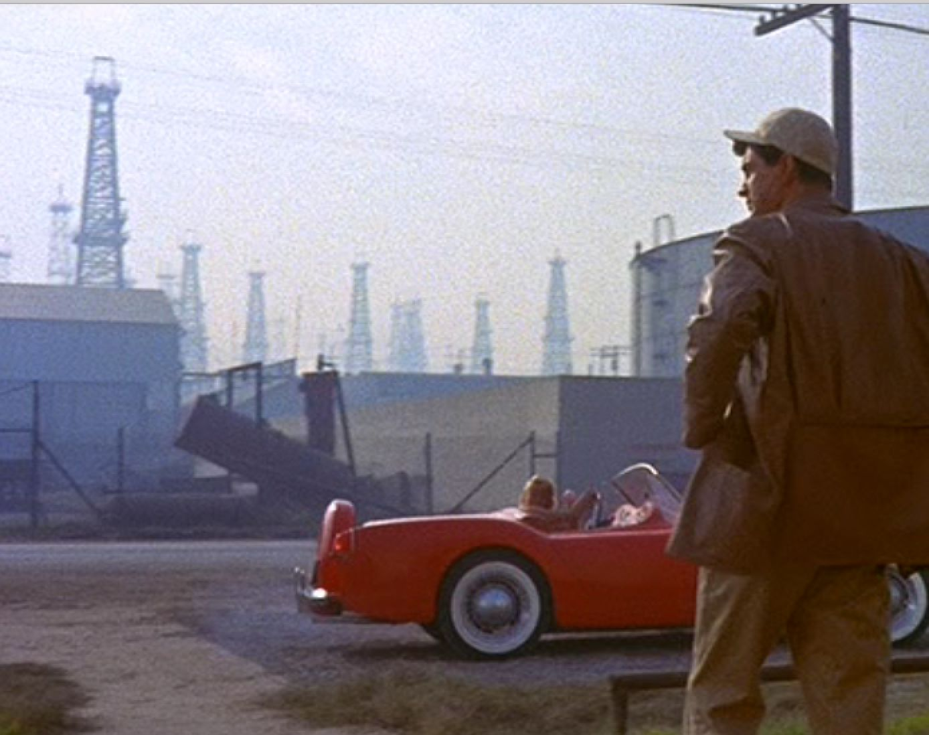
FI929 ECOCINEMA
Tiago de Luca / Karl Schoonover
MODULE OUTLINE
This module examines the rise of eco film theory alongside a wide range of fiction feature films and documentaries. It aims to provoke debate about representing ecology, petroleum dependence, pollution and sustainability. The module will explore a wide variety of (often conflicting) concepts for understanding the relationship between the human and the nonhuman, including ideas of environment, nature, the elemental, animals, and the Anthropocene, among others. The module does not advocate for specific political dogma; rather, it encourages students to develop their own rigorous political perspectives in relation to representations of the environment and to come away with a systematic knowledge of the key paradigms for understanding environmentalism and the environmental crisis.

Slide 18
FI929 ECOCINEMA
MODULE AIMS
PREPARATORY READINGS
By the end of the module, students should be able to articulate the complex relation of cinema to the ecological, aware not only of the environmental impact of a large¬-scale production, but also the capacities and liabilities of representing the natural world on screen. Students should also be able to demonstrate knowledge of how the environment and ecological concerns are depicted in cinema, across a range of genres and periods. Students will have also developed investigatory models of their own through which they will be able to evaluate how cinema engages with or occludes pressing ecological challenges posed by the Anthropocene.
(note to students: the following books provide a good overview of the field, and you may want to focus particularly on their introductions)
Anat Pick and Guinevere Narraway, eds. Screening Nature: Cinema Beyond the Human. Berghahn Books, 2013.
Nadia Bozak, The Cinematic Footprint: Lights, Camera, Natural Resources. Rutgers University Press, 2012.
Stephen Rust, Salma Monani, and Sean Cubitt, eds. Ecocinema Theory and Practice. Routledge, 2013.
Stephen Rust, Salma Monani, and Sean Cubitt, eds. Ecocinema Theory and Practice 2. Routledge, 2022.

Slide 19
FI931 SCREENING THE ANTIHERO(INE)
Michelle Devereaux
MODULE OUTLINE
MODULE AIMS
What do we mean when we call a fictional character an ‘antihero’? The popularity and perception of the antihero has grown and changed over the history of film and television, but it remains an enduring symbol of social and cultural rebellion on our screens. Why do these mediums seem so well-suited to its expression? And what does the recent rise of the female antihero, or ‘antiheroine’, say about changing gender dynamics and the state of contemporary society more generally? This module will explore these questions through a selection of film and TV that articulates the concept of the modern antihero, which traces its roots back to nineteenth-century Romanticism. We will consider the antihero(ine)’s evolution and meaning through historical and contemporary film and television from the UK, US and Europe.
By the end of this module you will be able to
use historical and critical frameworks to understand the antihero’s ongoing cultural importance to film and television
critically evaluate and analyse film and television texts both ideologically and formally through their portrayals of antihero(ine)
INDICATIVE VIEWING LIST: Double Indemnity,Five Easy Pieces, Vagabond/Sans toit ni lo, Le Samouraï, The Power of the Dog, Mad Men, Succession

Slide 20
FI931 SCREENING THE ANTIHERO(INE)
Michelle Devereaux
INDICATIVE READING LIST
INDICATIVE READING LIST
Kelley Conway (2015), ‘Improvisation and Formal Patterning: Vagabond’ in Agnes Varda, University of Illinois Press: 56–71.
Ginette Vincendeau (2003), “The Delon Trilogy: Le Samouraï (1967), Le Cercle rouge (1970), Un flic (1972)” in Jean-Pierre Melville ‘An American in Paris’, London: BFI: 175–216.
Andrew Spicer (2007) “Problems of Memory and Identity in Neo-Noir’s Existentialist Antihero” in The Philosophy of Neo-Noir, Mark T. Conard, ed., Lexington: University of Kentucky Press: 47–66
Michele Aaron (2004) “New Queer Cinema, an Introduction” in New Queer Cinema Reader, Edinburgh: Edinburgh University Press: 3–14.
Sarah Cooper (2022), ‘Paper Flowers: Jane Campion, Plant Life, and The Power of the Dog (2021)’ Philosophies 2022, 7(6), 143
Michael Mario Albrecht (2015), Chapter 3: “Mad Men and Nostalgic Masculinity” in Masculinity in Contemporary Quality Television, New York: Routledge: 47-64.
Margrethe Bruun Vaage (2016), Chapter 4: “Why so Many Television Series with Antiheroes? in The Antihero in American Television, New York: Routledge
Gaylyn Studlar (2013) ‘“The Corpse on Reprieve”: Film Noir’s Cautionary Tales of “Tough Guy” Masculinity”’ in A Companion to Film Noir, Andrew Spicer and Helen Hanson, eds., London: Wiley: 369-386.
Theresa Varney Kennedy (2014), ‘No Exit’ in Racine’s "Phèdre": The Making of the Anti-Hero’, The French Review, Vol. 88, No. 1 (October 2014): 165-178
Lillian Furst (1976), “The Romantic Hero, Or Is He an Anti-Hero?,” Studies in the Literary Imagination 9, no. 1: 53–67.
Thomas Elsaesser (2004), “The Pathos of Failure: American Films in the 1970s: Notes on the Unmotivated Hero” in The Last Great American Picture Show: New Hollywood Cinema in the 1970s, Amsterdam: Amsterdam University Press, 279–292.
Thomas Elsaesser (2019), ‘A Cinema of Abjection?’ in European Cinema and Continental Philosophy: Film as Thought Experiment, London: Bloomsbury Academic: 129–161.

Slide 21
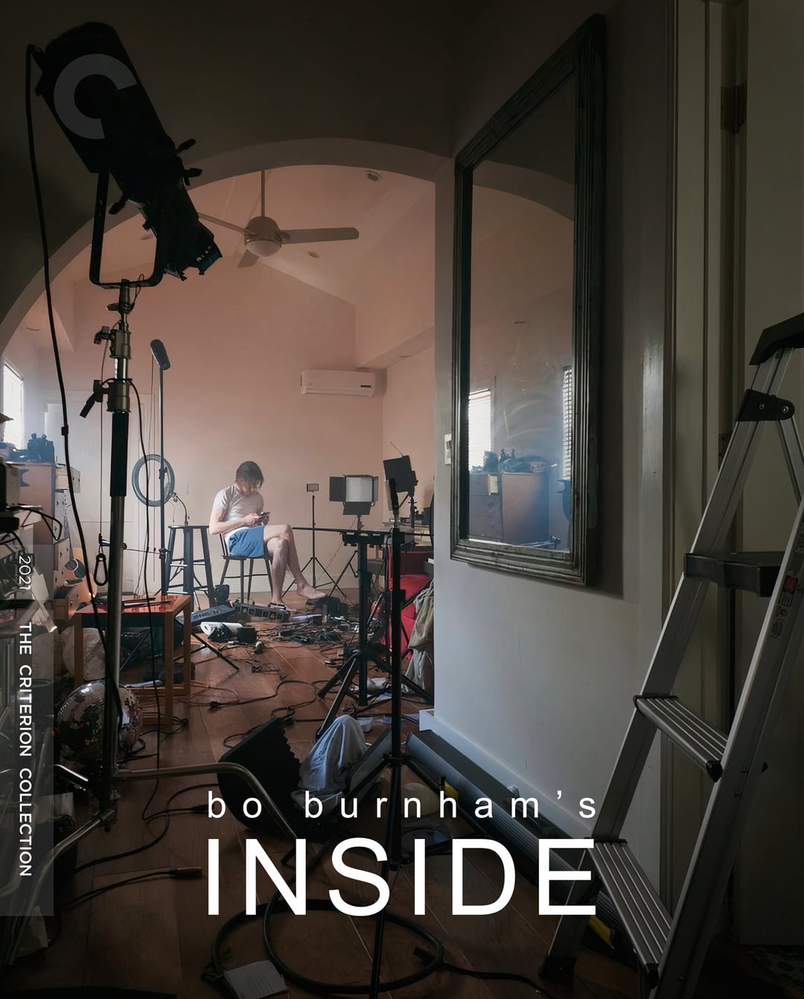
FI942 US COMEDY TELEVISION
TOM HEMINGWAY
MODULE OUTLINE
This module will explore U.S. comedy television from one of the earliest televised sitcoms, I Love Lucy (CBS, 1951 – 1957), to present-day post-broadcast shows such as the stand-up special, Bo Burnham: Inside (Netflix, 2021). Taking a roughly chronological approach, each week will focus on different popular sub-genres such as the network sitcom, the late-night show, the ‘dramedy’, the adult animation, and the stand-up special. Lectures will situate the programmes within a historical context while seminars will allow students to discuss the texts more closely, with an emphasis on close analysis.

Slide 22
FI942-30 US COMEDY TELEVISION
LEARNING OUTCOMES
PREPARATORY READINGS/VIEWINGS
By the end of the module, students should be able to:
Demonstrate an ability to closely analyse comedy texts and be able to discuss their significance within the genre.
Demonstrate a detailed understanding of one or more comedy sub-genres and the key debates surrounding them.
Use precise and engaging language to describe and analyse comedic moments from the texts.
Develop research questions with the module leader that intervene in or develop existing debates surrounding US comedy television.
WHY TAKE THIS MODULE?
This module helps develop the following skills:
critical and analytical thinking in relation • independent research skills • teamwork • clarity and effectiveness of communication, oral and written • accurate, concise and persuasive writing • audio-visual literacy
No pre-viewing or reading is required but some key texts will be:
The Sitcom by Brett Mills (2009)
Popular Film and Television Comedy by Steve Neale and Frank Krutnik (1990)
Module viewing will include:
•I Love Lucy (CBS, 1951 - 1957)
•Seinfeld (NBC, 1989 - 1998)
•Arrested Development (FOX, 2003 - 2006)
•Saturday Night Live (NBC, 1975 - )
•The Simpsons (FOX, 1989 - )
•Jackass (MTV, 2000 - 2001)
•Bo Burnham: Inside (Netflix, 2021)

Slide 23
SPRING TERM
MODULE INFORMATION

Slide 24
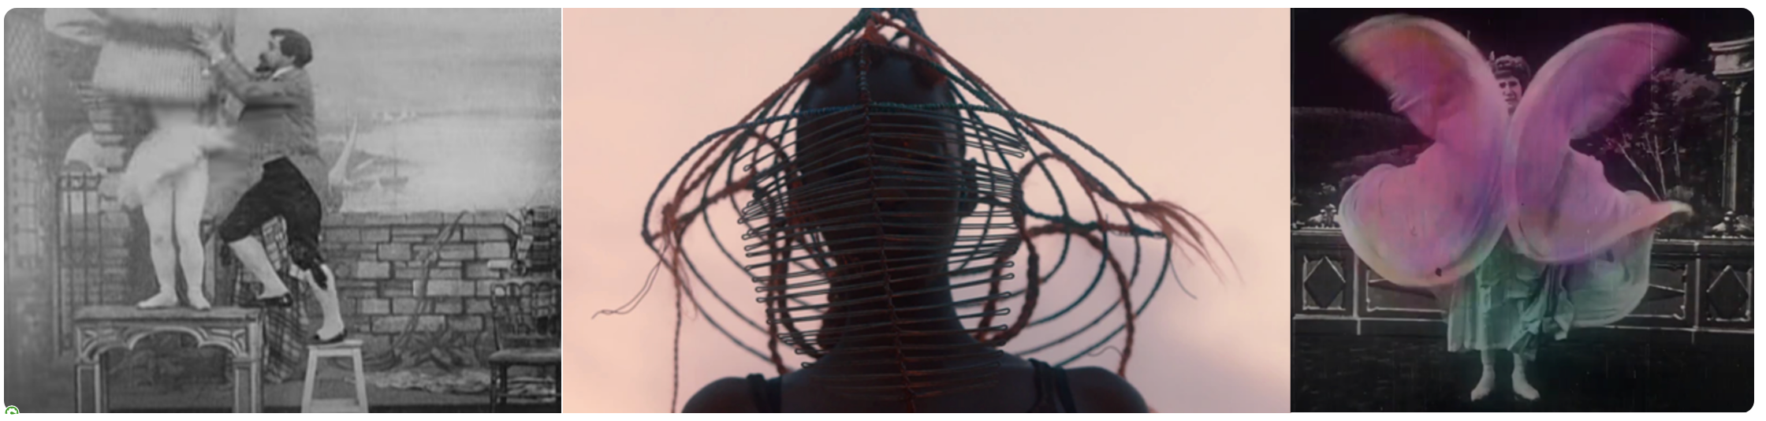
FI943 QUEER AND TRANS THEORIES FOR FILM AND TELEVISION
Karl Schoonover
INDICATIVE SCREENING LIST
Bound (Lana and Lily Wachowski, USA, 1996)
Neptune Frost (Anisia Uzeyman and Saul Williams, 2021)
A Deal with the Universe (Jason Barker, UK, 2018)
Dakan (Destiny, Mohamed Camara, Guinea, 1997)
Open Door: Transex Liberation Group (BBC Two, UK, 1973).
•Horak, Laura, ‘Introduction’, Trans Cinema: Making Communities, Identities, and Worlds. University of California Press, 2026. EBOOK
•Samer, Rox, ‘Trans Chaplin’, JCMS: Journal of cinema and media studies, 2022, 61: 2: 175-180. DOI: 10.1353/cj.2022.0002
•Steinbock, Eliza. ‘Towards Trans Cinema’. In The Routledge Companion to Cinema and Gender, edited by Kristin Lené Hole, Dijana Jelača, E. Ann Kaplan, and Patrice Petro. New York: Routledge, 2017. EBOOK
•Leung, Helen Hok-sze. ‘Film’, TSQ 1 May 2014; 1 (1-2): 86–89 DOI: https://doi.org/10.1215/23289252-2399686
•Horak, Laura, ‘Trans Studies’, Feminist Media Histories 1 April 2018; 4 (2): 201–206. doi: https://doi.org/10.1525/fmh.2018.4.2.201
MODULE OUTLINE
READINGS FOR WEEK 1
This module explores current queer and trans theories of the moving image. We will ask how these theories contribute to our understandings of historical identity, politics, community and audiences. The module covers debates around global queer liberation, trans identity in silent cinema, LGBTQI+ representation in contemporary African cinema, the queer child, bad objects, and early trans television.
Assessment:
- Presentation (10%)
- 5000-word essay (90%)

Slide 25
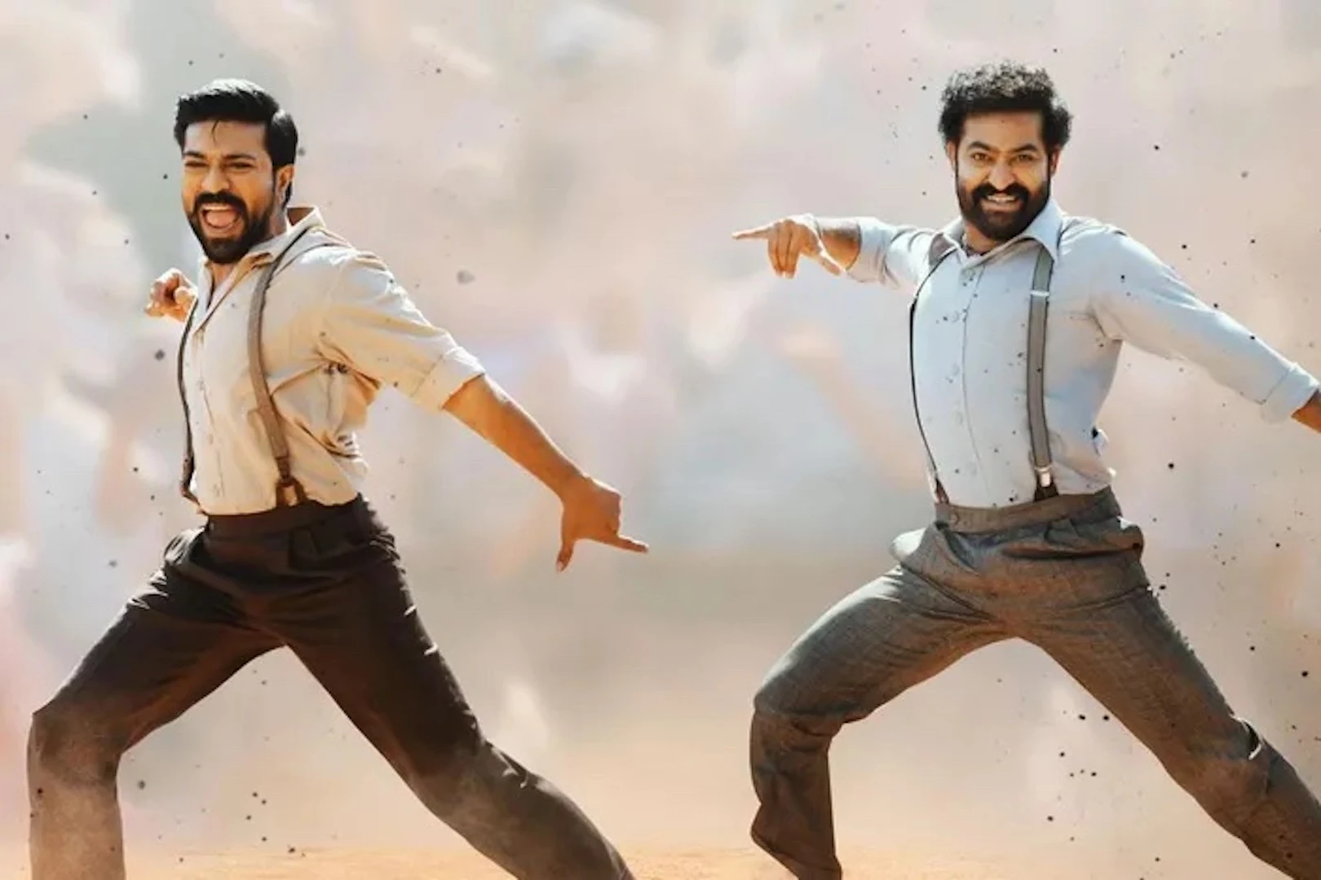
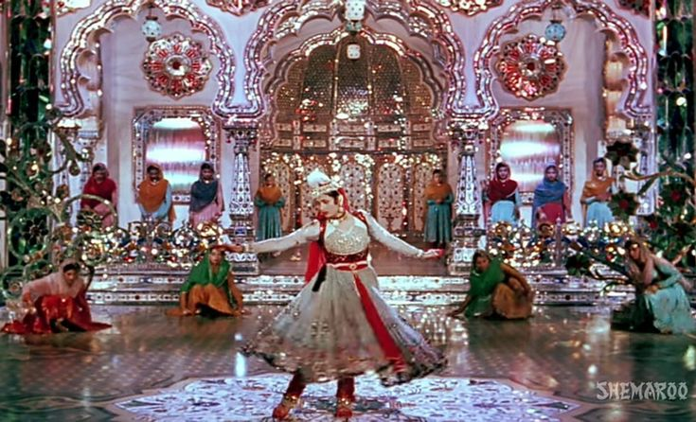
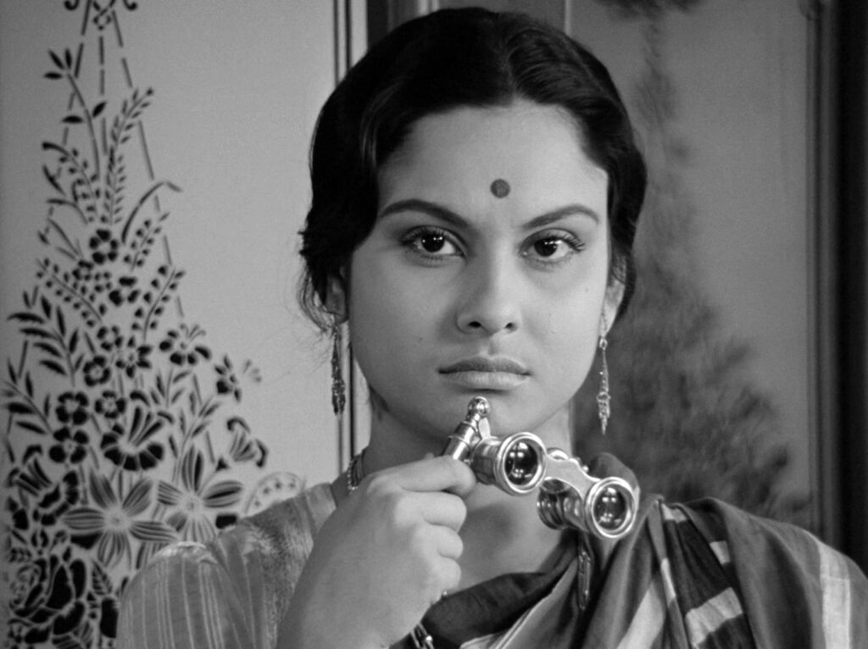
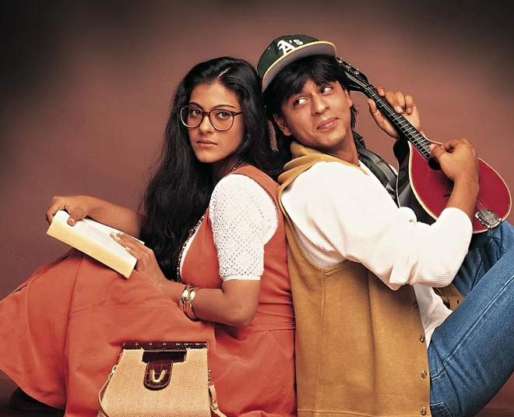
FI968 INDIAN CINEMA
RITIKA KAUSHIK
MODULE OUTLINE
This module will introduce students to the aesthetic and historical developments in the multiple film industries of India. It will look at Indian cinema through multiple lenses including national, regional, and transnational networks of circulation; specific genres; song and dance sequences; stardom and fan cultures; censorship; and technologies and materiality.
Apart from the Hindi-centric films commonly known as “Bollywood,” the module will explore regional film industries as well as the more marginal experimental and non-fiction practices. Students will read both foundational and new approaches on Indian cinema and watch films in several languages which may include Bengali, Telugu, Malayalam, Marathi, and Tamil, as well as films from different historical eras.
The module will enable students to make video essays on Indian cinema for the module's assessment. No previous practical experience is necessary.

Slide 26
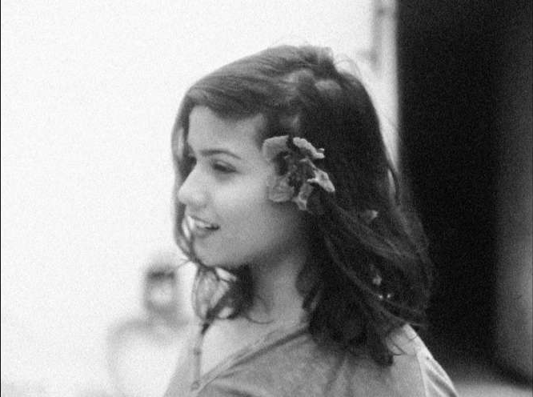
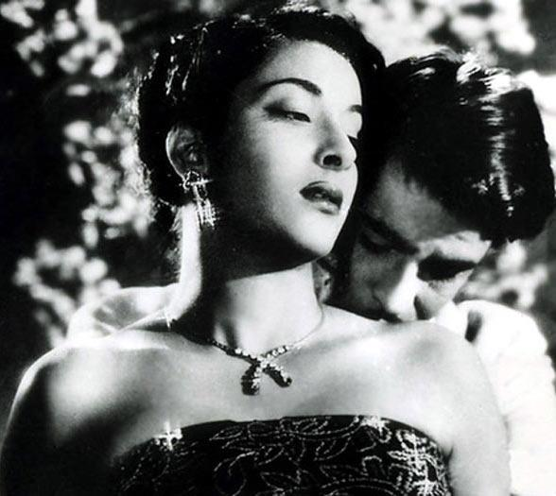
FI968 INDIAN CINEMA
RITIKA KAUSHIK
PREPARATORY VIEWING
There is no other reading or viewing requirement that students need to do before joining the module. If you do wish to prepare in advance, it will be helpful to familiarize yourself with some of the titles from the following list that are likely to come up frequently in class discussions in addition to those screened in class.
List:
Awara (1951, Raj Kapoor) (Available in the Library)
Pather Panchali (1955, Satyajit Ray) (Available in the Library)
Mother India (1957, Mehboob Khan) (Available in the Library)
Pyaasa (1957, Guru Dutt) (Available in the Library)
Meghe Dhaka Tara (1960, Ritwik Ghatak) (Available in the Library)
I am 20 (1967, S.N.S. Sastry) (Youtube)
Mirch Masala (1987, Ketan Mehta) (Youtube)
Lagaan (2001, Ashutosh Gowarikar) (Youtube)
Kabhi Khushi Kabhi Gham (2001, Karan Johar) (Available on Netflix)
Baahubali: The Beginning (2015, S.S. Rajamouli) (Available on Einthusan Telugu)
Karnan (2021, Mari Selvaraj) (Available on Einthusan Tamil)

Slide 27
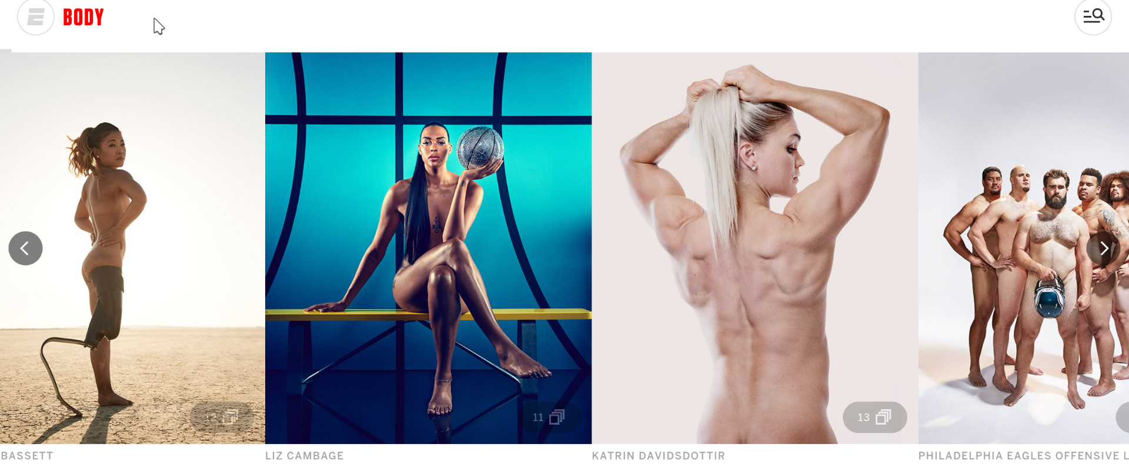
FI944 SCREENING BODIES
Matt Denny
MODULE OUTLINE
The body is a central yet often overlooked aspect of mise-en-scene. The centring of the body in this module encourages students to critically investigate the relationship between the representation s of bodies alongside consideration of cultural and production contexts. Students will learn how analyse the body on screen using a variety of methods, frameworks and approaches. Furthermore, it will engage with questions relating to affect, audiences, abstraction, and theorisations of the corporeal. This detailed discussion of the body will also enable the exploration of its relation to the politics and language of representation. Students will have opportunities to demonstrate knowledge of the various cultural, technological, social and artistic influences and impacts on the representation of the body on screen
Furthermore, as a module that critically investigates obscene, explicit, and/or censored screened material, ethical skills will be developed in seminars in terms of respect and responsibility. This module provides students a framework to engage with challenging materials and content.
Screening Bodies is an optional module available to MA students in Film and Television Studies in the Spring Term. The module will examine the body in various screen examples and through a multitude of frameworks. The module is team-taught and explores a variety of topics drawn from the research expertise of co-convenors

Slide 28
FI944 SCREENING BODIES
Matt Denny
CONTENT NOTE
This module engages with issues of consent, obscenity, sexuality, gender, race, and other challenging issues of bodily identity and experience. The module engages with a range of historical and philosophical conceptualisations of the body, some of which are exclusionary or discriminatory. Inclusion of these frameworks reflect the cultural influence of these conceptualisations of the body rather than endorsement by the module convenors.
PREPARATORY READING
This reading will be our frame of reference in week 1, but also serves well as introduction to some of the concerns of the module:
Brian, Bergen-Aurand "Screened Bodies". Screen Bodies 1.1 (2016) pp.1-10. < https://doi.org/10.3167/screen.2016.010101> accessed 30 Jun. 2026

Slide 29

FI-939 PEDRO ALMODÓVAR
Jose Arroyo
MODULE OUTLINE
A module designed to build on previous undergraduate work, particularly Hollywood and World Cinema but allow in-depth exploration of the work of one director, Pedro Almodóvar. The module will explore the oeuvre through a mix of theoretical approaches and textual analysis, thus honing skills in highly detailed textual analysis but always in relation to the conceptual methods or theories highlighted in any given week with the aim of illuminating the richness and complexity of the work.
This module aims to introduce students to an incredibly rich oeuvre, periodise it through various paradigms (from the political to the authorial), chart its development, and broach the following questions: What does the work owe to the culture it arises from? How is it queer? What does it mean, to whom and in what contexts? What does Almodóvar’s owe to Hollywood cinema in general and melodramatic and noir variants in particular. What is the inter-relationship of representations of gender, sexuality and nation in his work? How does the oeuvre fit into a history of Spanish Cinema, Queer Cinema but also broader contexts and histories of art, design, fashion, advertising cultures? The focus will be largely on the work of one director but seen through various contexts (social and historical; national variants of films studies concepts such as genre, stars, style, authorship) and concepts (camp, postmodernism, metamodernism) so as to also explore and interrogate the meaning and significance of the oeuvre.

Slide 30
FI-939 PEDRO ALMODÓVAR
Jose Arroyo
MODULE AIMS
to enrich our understanding of the work of Pedro Almodóvar. -to understand the different contexts in which it circulated (Spanish Cinema, European Art Cinema, International Queer Circuits) and their effects on production and reception).
to sharpen traditional film studies concepts in relation to this work (genre -- particularly in relation to noir and melodrama -- stars, style, authorship, national cinema).
to learn and apply concepts made pertinent by the work itself (camp, postmodernism, metamodernism) in order to better enable an analysis of the work's aesthetics and cultural significance.
Demonstrate a knowledge of the work of Pedro Almodóvar
Be able to discuss concepts such as genre, authorship, stars, style, queer, camp, postmodernism and metamodernism in relation to the work of Almodóvar
Be able to discuss Almodóvar’s work as part of different histories of cinema (national and international cinemas; social and political; mainstream and queer; aesthetics and style) variously inter-relating; and also as metacinema, as works commenting on cinema itself
Further refine and improve skills of textual analysis.
Further improve skills in the construction of argument , expression, and presentation of evidence.
LEARNING OUTCOMES

Slide 31
FI-939 PEDRO ALMODÓVAR
SUMMER READING
Mark Allinson, ‘Mimesis and Diegesis: Almodóvar and The Limits of Melodrama’ in All About Almodóvar: A Passion for Cinema, edited by Brad Epps and Despina Kakoudaki, pp. 141-165.
José Arroyo, ‘La ley del deseo: a gay seduction’ in Richard Dyer and Ginette Vincendeau eds. Popular European Cinema, London: Routledge 1992, pp.31-46.
José Arroyo, ‘Pedro Almodóvar’ in Yvonne Tasker ed., Fifty Contemporary Directors, Taylor and Rancis, 2010, pp. 7-17.
Leo Bersani and Ulyse Dutoit, ‘Almodóvar’s Girls’ in All About Almodóvar: A Passion for Cinema, edited by Brad Epps and Despina Kakoudaki, pp. 241-266
Marvin D’Lugo, ‘Women on the Verge of a Nervous Breakdown’ and ‘Transnational Repositioning after Women on the Verge’ in Pedro Almodóvar, University of Illinois Press, 2006, pp. 59-85.
Santiago Fouz-Hernandez and Alfredo Martínez-Expósito, ‘Almodóvar’s Approach to Disability’Live Flesh: The Male Body in Contemporary Spanish Cinema, London: I. B. Tauris 2007, pp. 203-210Peter Evans, ‘Back to the Future: Cinema and Democracy’ in Helen Graham and Jo Labanyi eds. Spanish Cultural Studies: An Introduction Oxford: Oxford University Press, 1995, pp. 326-330.
Barry Jordan and Mark Allinson, ‘Authorship – The Auteurist Tradition in Spain’, Spanish Cinema: A Student’s Guide, New York: Hodder Arnold, 2005, pp. 70-92
Marsha Kinder, ‘Almodóvar’s Brain Dead Trilogy’, Film Quarterly, vol 58, pp, 9-25, 2005.
Alberto Mira, ‘All About My Mother’, in Alberto Mira, The Cinema of Spain and Portugal, London: Wallflower, 2005, pp. 229-239
Ana María Sánchez-Arce, ‘Afterword: Dolor y Gloria’ in The Cinema of Pedro Almodóvar Manchester University Press, 2020, pp. 292-309.
Paul Julien Smith, Desire Unlimited: The Cinema of Pedro Almodóvar Verso: 1994, pp. 9-21.
Tom Whittaker, Introduction, The Spanish quinqui Film: Delinquency, Sound, Sensation, Machester University Press, 2020, pp. 1-25.- Fredric Strauss, Almodóvar on Almodóvar (Revised Edition) London: Faber and Faber.
Kathleen M. Vernon, ‘Melodrama Against Itself: Pedro Almodóvar's "What Have I Done to Deserve This?" Film Quarterly, Vol. 46, No. 3 (Spring, 1993), pp. 28-40 Published by: University of California Press . Stable URL: http://www.jstor.org/stable/1212901 .
Jose Arroyo
PREPARATORY READINGS/VIEWINGS
Try to see as many Almodóvar films as possible.
I would expect you to have seen all of his work by the end of the module and we will only have the opportunity of seeing nine during the module. If you get a chance do also try and see Victor Erice’s Spirit of the Beehive (1973) or Eloy de la Iglesia’s ‘Quinci’ Films, Navajeros, El Pico, El Pico 2.

Slide 32

