Slide 1
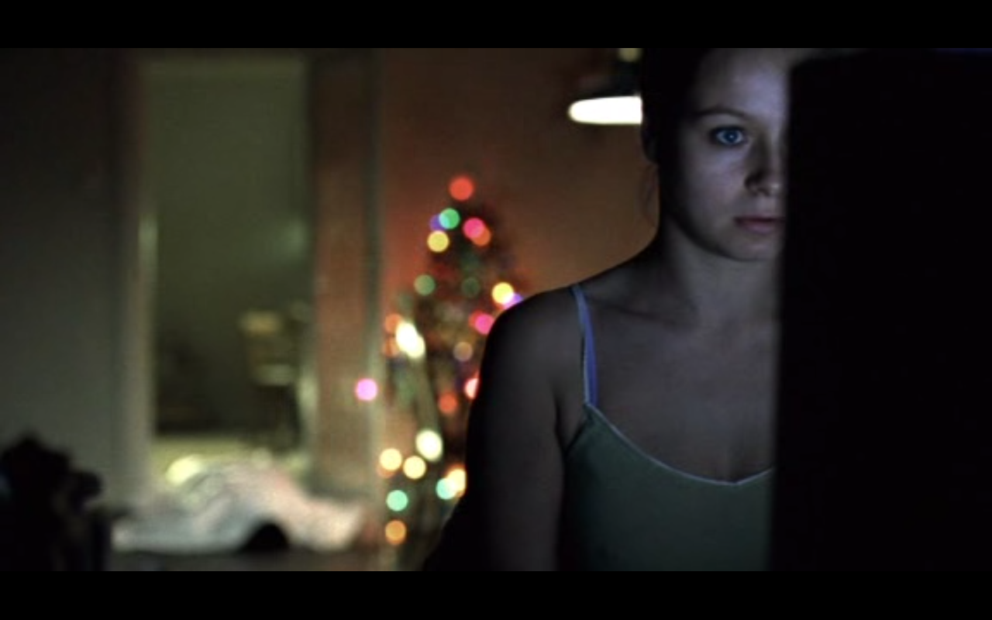
Film Aesthetics 1
Week 8: Aesthetic Value & Moral Judgements
Morvern Callar (Lynne Ramsay, 2002)
Song: ‘Folsom Prison Blues’ – Johnny Cash…

Slide 2

Film Aesthetics 1

Slide 3
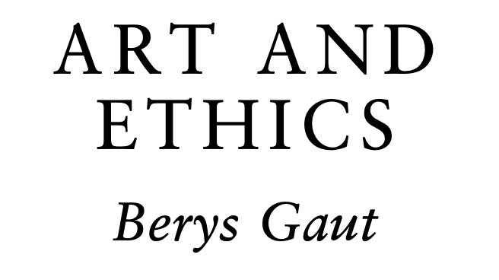
The relationship between aesthetic + moral judgements
…

Slide 4
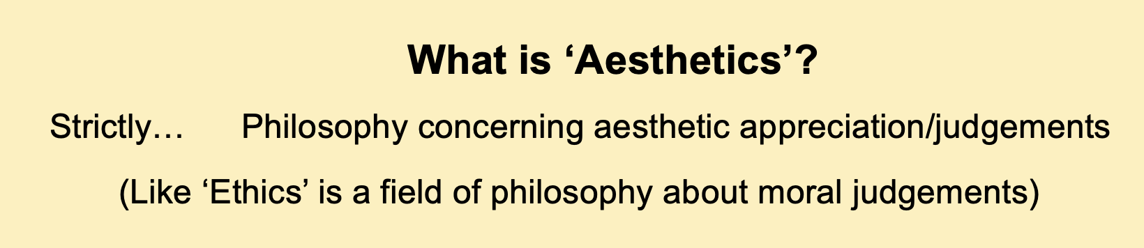
The relationship between aesthetic + moral judgements
…

Slide 5
The relationship between aesthetic + moral judgements
…
An unsettled issue:
‘Aesthetic evaluation cannot always be clearly distinguished from moral evaluation. Whether these two things ought to be kept distinct is [a] […] still-disputed issue of aesthetics.’
(Freeland, 2006: 158)

Slide 6
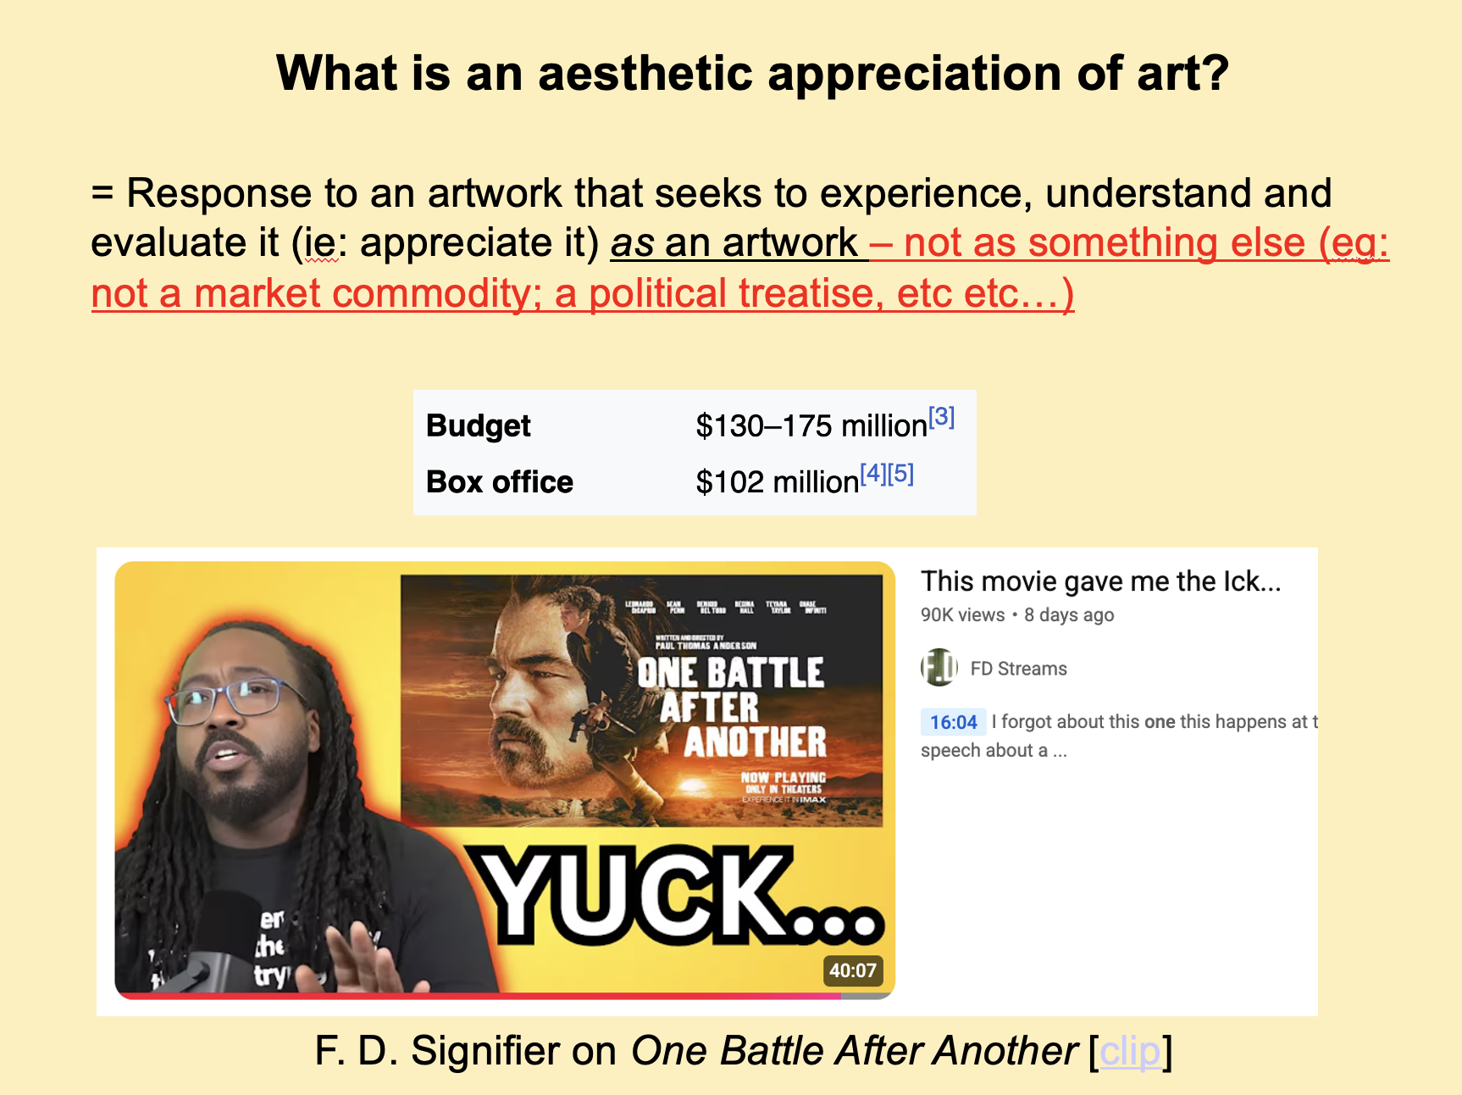
The relationship between aesthetic + moral judgements
…
An unsettled issue:
‘Aesthetic evaluation cannot always be clearly distinguished from moral evaluation. Whether these two things ought to be kept distinct is [a] […] still-disputed issue of aesthetics.’
(Freeland, 2006: 158)

Slide 7
The relationship between aesthetic + moral judgements
…
Whatever moral/political principles we hold, the question is:
What role should they play in evaluating artworks?
An unsettled issue:
‘Aesthetic evaluation cannot always be clearly distinguished from moral evaluation. Whether these two things ought to be kept distinct is [a] […] still-disputed issue of aesthetics.’
(Freeland, 2006: 158)

Slide 8
The relationship between aesthetic + moral judgements
‘The general issue of the relation of art to ethics admits of several distinct questions’ (Gaut, 2013: 421) – not all relate to aesthetics…

Slide 9
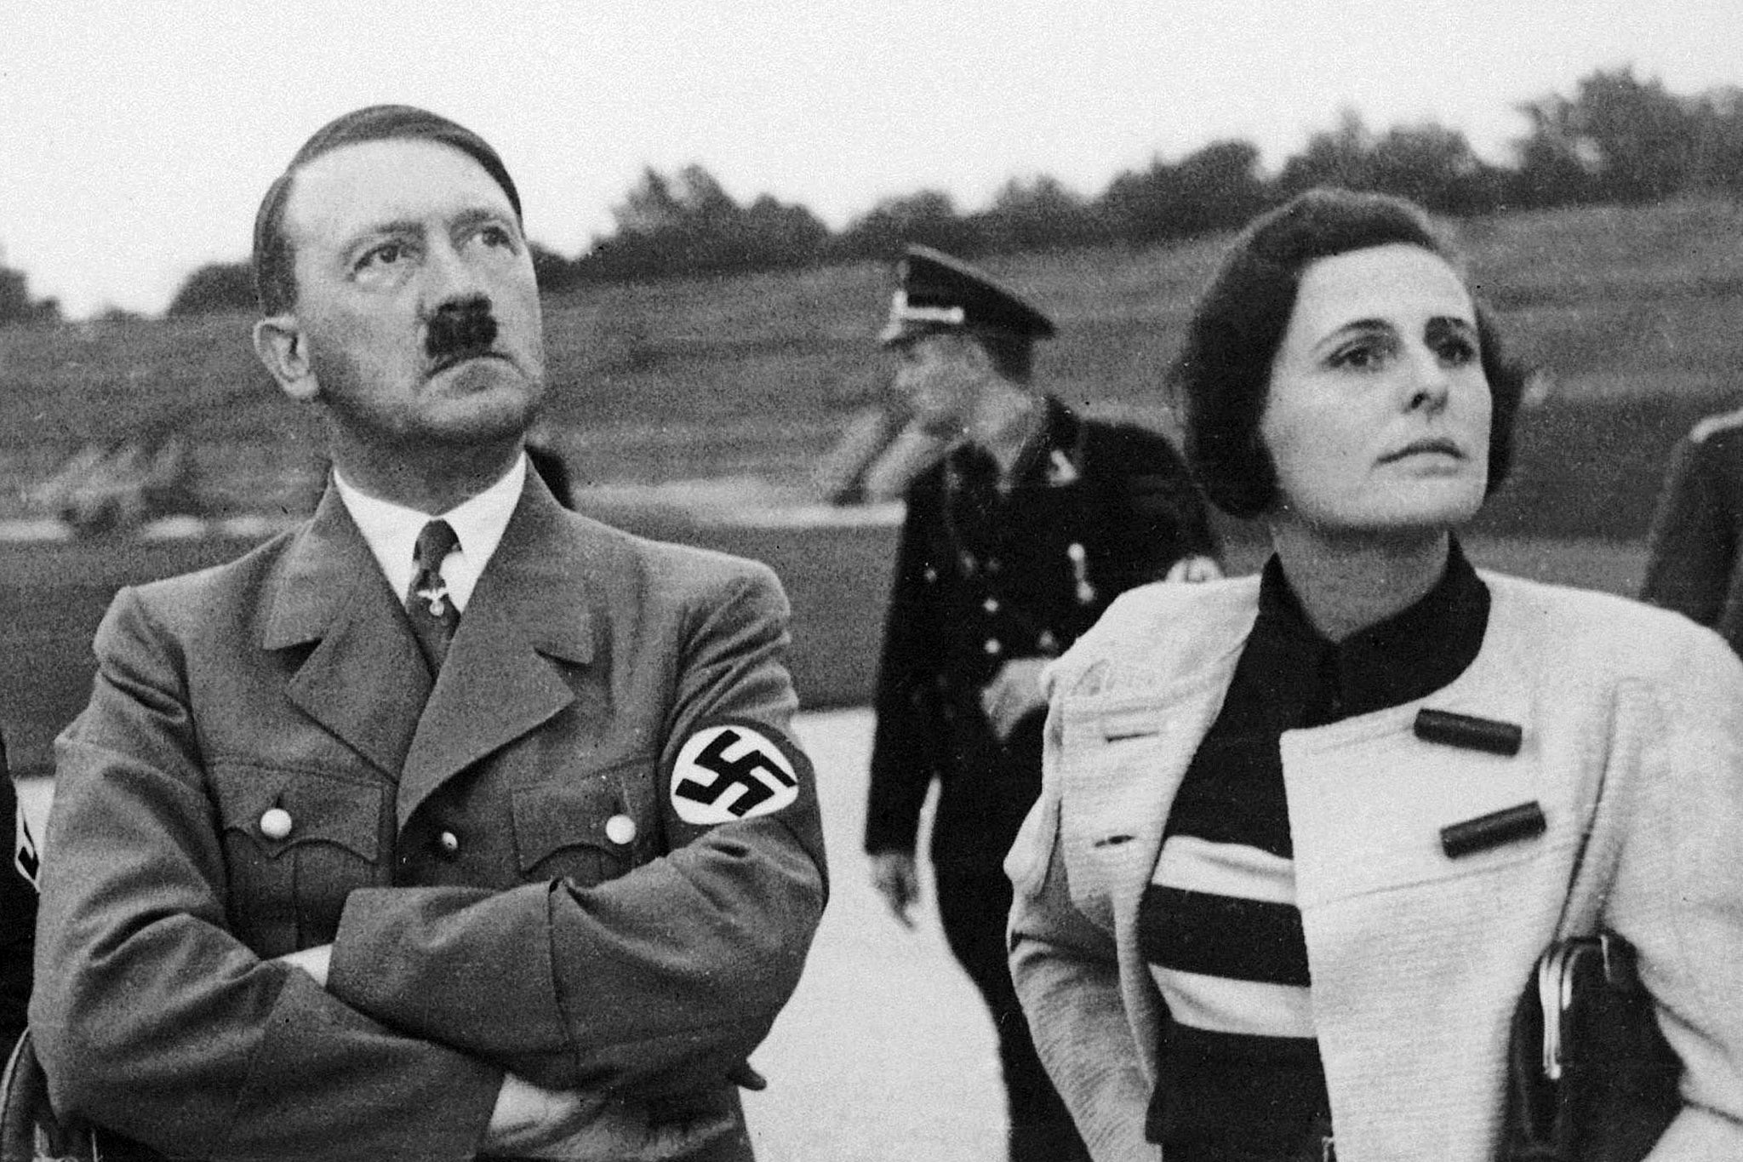
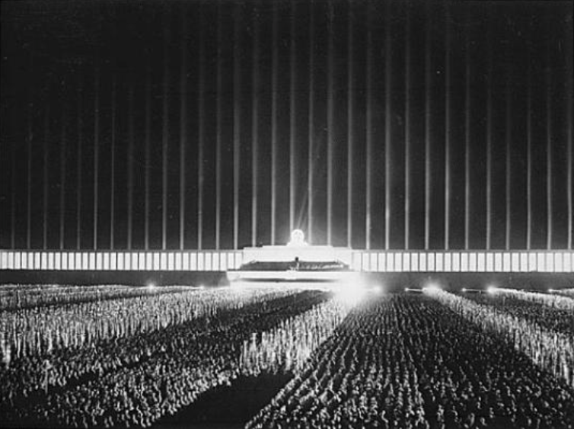
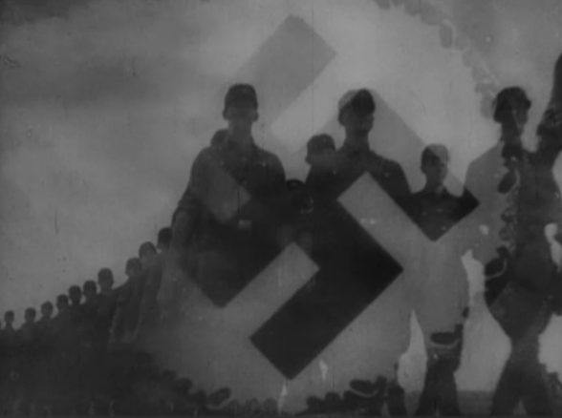
The relationship between aesthetic + moral judgements
‘The general issue of the relation of art to ethics admits of several distinct questions’ (Gaut, 2013: 421) – not all relate to aesthetics…
Way may judge a work’s author immoral / or its effects immoral…
Triumph of the Will (Riefenstahl, 1935)

Slide 10
The relationship between aesthetic + moral judgements
‘Are the ethical flaws (or merits) of works of art also aesthetic flaws (or merits) in them? […] We should understand [aesthetic] flaws in terms of the intrinsic properties of works.’ (Gaut, 2013: 432)
Triumph of the Will (Riefenstahl, 1935)

Slide 11
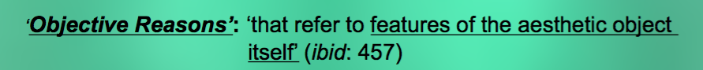
The relationship between aesthetic + moral judgements
‘Are the ethical flaws (or merits) of works of art also aesthetic flaws (or merits) in them? […] We should understand [aesthetic] flaws in terms of the intrinsic properties of works.’ (Gaut, 2013: 432)
Triumph of the Will (Riefenstahl, 1935)

Slide 12
The relationship between aesthetic + moral judgements
‘Are the ethical flaws (or merits) of works of art also aesthetic flaws (or merits) in them? […] We should understand [aesthetic] flaws in terms of the intrinsic properties of works.’ (Gaut, 2013: 432)
‘Aesthetics has been marked in many circles by a drive to free aesthetic value of any dependence on the moral.’ (Eaton, 2001: 58)
Triumph of the Will (Riefenstahl, 1935)

Slide 13
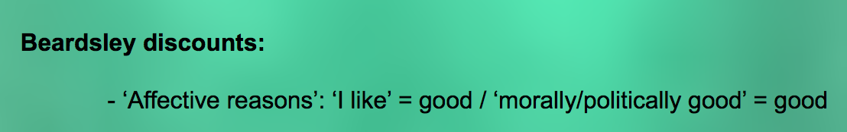
The relationship between aesthetic + moral judgements
‘Are the ethical flaws (or merits) of works of art also aesthetic flaws (or merits) in them? […] We should understand [aesthetic] flaws in terms of the intrinsic properties of works.’ (Gaut, 2013: 432)
‘Aesthetics has been marked in many circles by a drive to free aesthetic value of any dependence on the moral.’ (Eaton, 2001: 58)

Slide 14
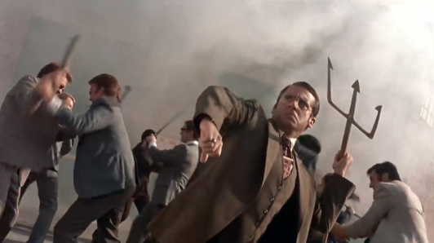
The relation between aesthetic + moral value
‘Aesthetic evaluation cannot always be clearly distinguished from moral evaluation. Whether these two things ought to be kept distinct is [a] […] still-disputed issue of aesthetics.’ (Freeland, 2006: 158)
‘Aesthetics has been marked in many circles by a drive to free aesthetic value of any dependence on the moral.’ (Eaton, 2001: 58)
[…]
[6.52]
Anchorman (2004)

Slide 15
The relation between aesthetic + moral value
‘Extreme moralism’:
‘Moral merits are the only kind of aesthetic merits that there are’ (ibid: 433)
E.g, arguing
:
‘Morally good’ = ‘aesthetically good’
‘Morally bad’ = ‘aesthetically bad’

Slide 16
The relation between aesthetic + moral value
‘Extreme moralism’:
‘Moral merits are the only kind of aesthetic merits that there are’ (ibid: 433)
E.g, arguing
:
‘Morally good’ = ‘aesthetically good’
‘Morally bad’ = ‘aesthetically bad’
‘Extreme moralism […] is highly implausible: we praise [and critique] works for a wide variety of features, […] which may have no necessary relation to morality’ (Gaut, 2013: 433)

Slide 17
The relation between aesthetic + moral value
The other extreme: ‘Aestheticism’ / ‘Autonomism’ / ‘formalism’
‘The idea of art for art’s sake…’ ‘A work’s being valued for its own sake [means] that it be valued on account of its intrinsic properties and not on its relationship to anything external, such as […] moral and political systems.’ (Whewhell, 2009: 128 / 129)
‘Extreme moralism […] is highly implausible: we praise [and critique] works for a wide variety of features, […] which may have no necessary relation to morality’ (Gaut, 2013: 433)

Slide 18
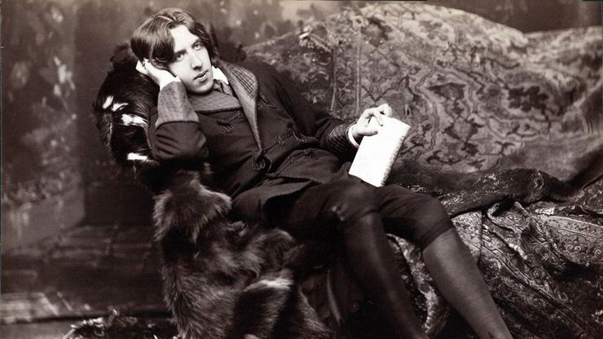
The relation between aesthetic + moral value
The other extreme: ‘Aestheticism’ / ‘Autonomism’ / ‘formalism’
‘The idea of art for art’s sake…’ ‘A work’s being valued for its own sake [means] that it be valued on account of its intrinsic properties and not on its relationship to anything external, such as […] moral and political systems.’ (Whewhell, 2009: 128 / 129)
'There is no such thing as a moral or an immoral book. Books are well written, or badly written. That is all' (Wilde, 1998 [1895]: 266)

Slide 19
The relation between aesthetic + moral value
The other extreme: ‘Aestheticism’ / ‘Autonomism’ / ‘formalism’
‘The idea of art for art’s sake…’ ‘A work’s being valued for its own sake [means] that it be valued on account of its intrinsic properties and not on its relationship to anything external, such as […] moral and political systems.’ (Whewhell, 2009: 128 / 129)
'There is no such thing as a moral or an immoral book. Books are well written, or badly written. That is all' (Wilde, 1998 [1895]: 266)
    Some convincing arguments, e.g: ‘It is not the function of [most] art to produce certain moral consequences.’
    (Carroll, 2001: 133)

Slide 20
The relation between aesthetic + moral value
The other extreme: ‘Aestheticism’ / ‘Autonomism’ / ‘formalism’
‘The idea of art for art’s sake…’ ‘A work’s being valued for its own sake [means] that it be valued on account of its intrinsic properties and not on its relationship to anything external, such as […] moral and political systems.’ (Whewhell, 2009: 128 / 129)
'There is no such thing as a moral or an immoral book. Books are well written, or badly written. That is all' (Wilde, 1998 [1895]: 266)
    Some convincing arguments, e.g: ‘It is not the function of [most] art to produce certain moral consequences.’
    (Carroll, 2001: 133)

Slide 21
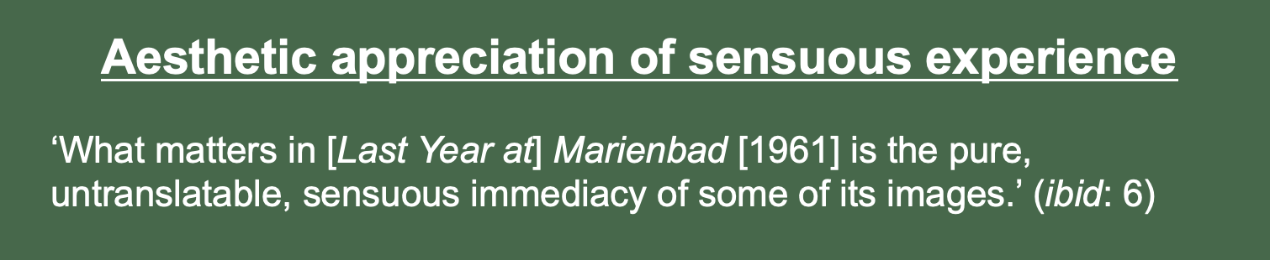
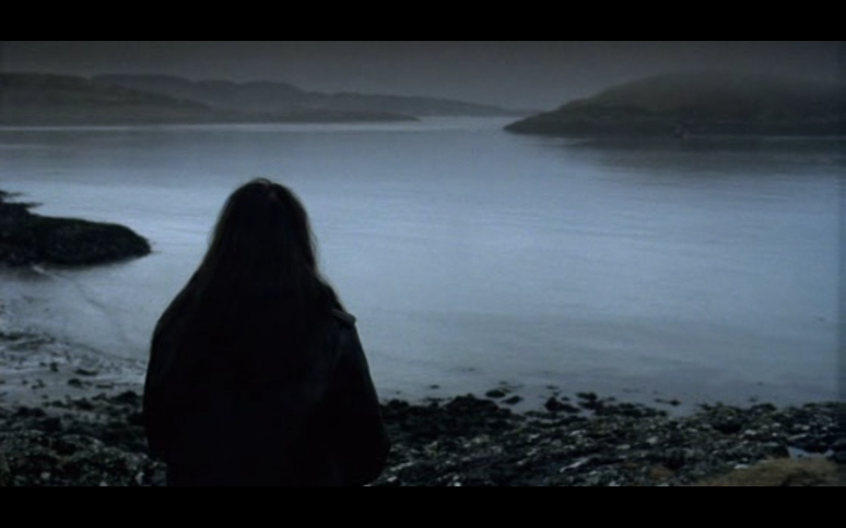
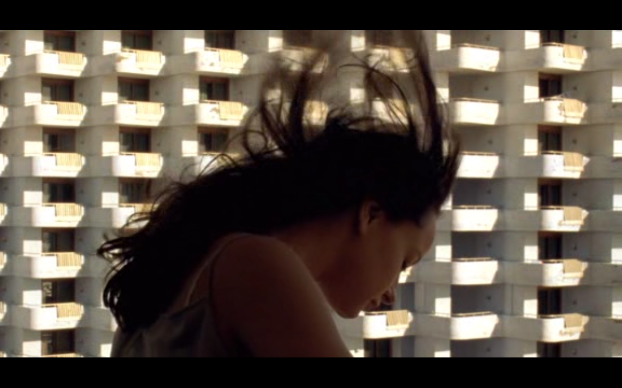
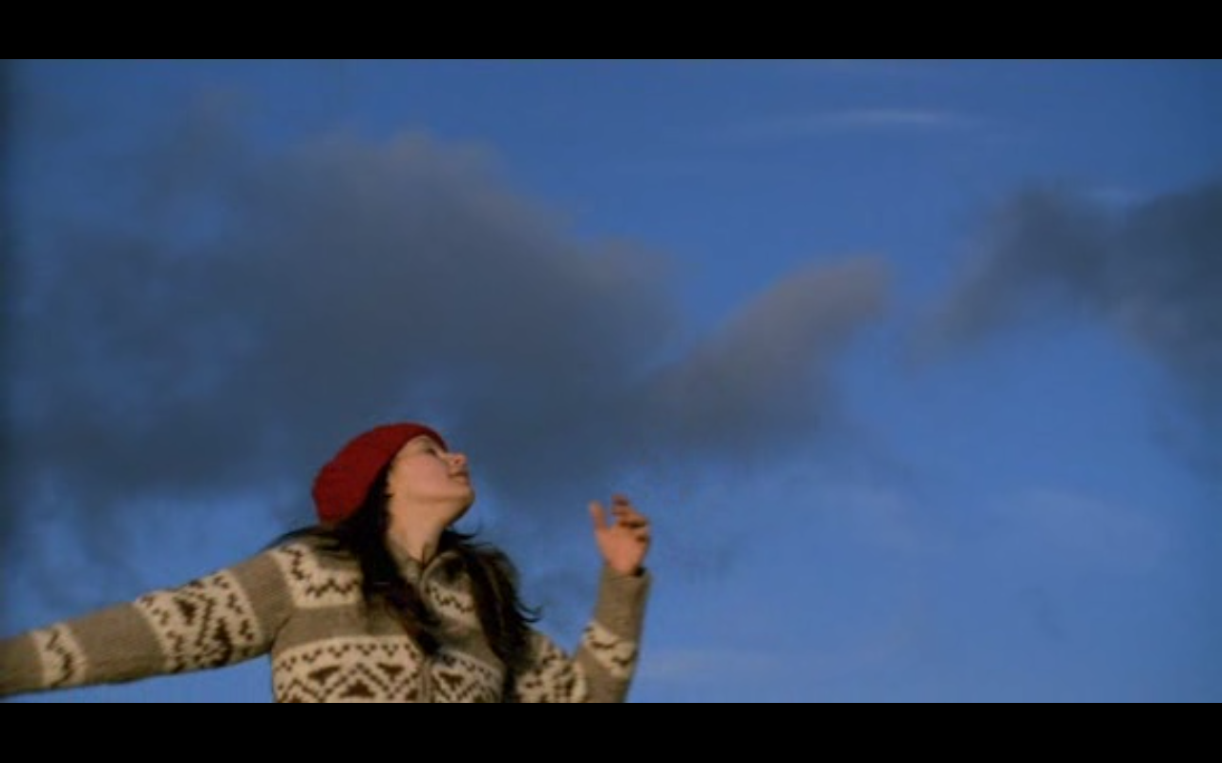
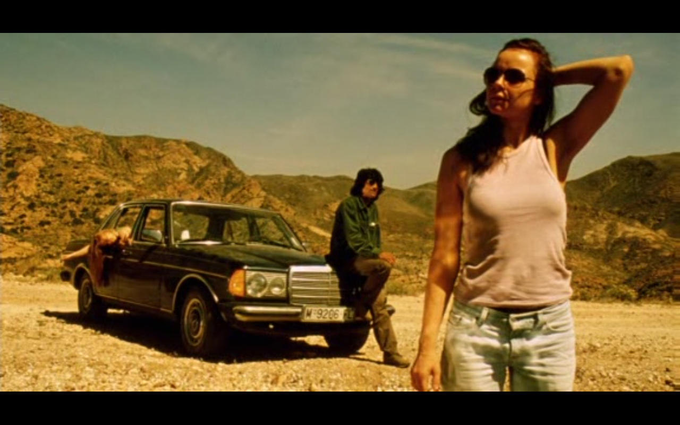
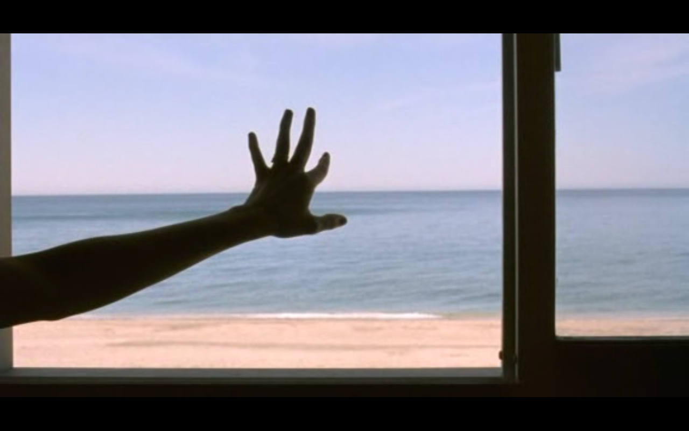
The relation between aesthetic + moral value
The other extreme: ‘Aestheticism’ / ‘Autonomism’ / ‘formalism’
Cf: Sontag
on form/
affect…

Slide 22
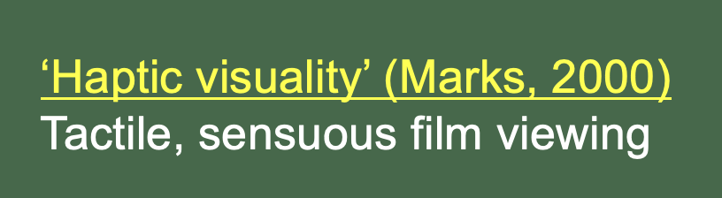
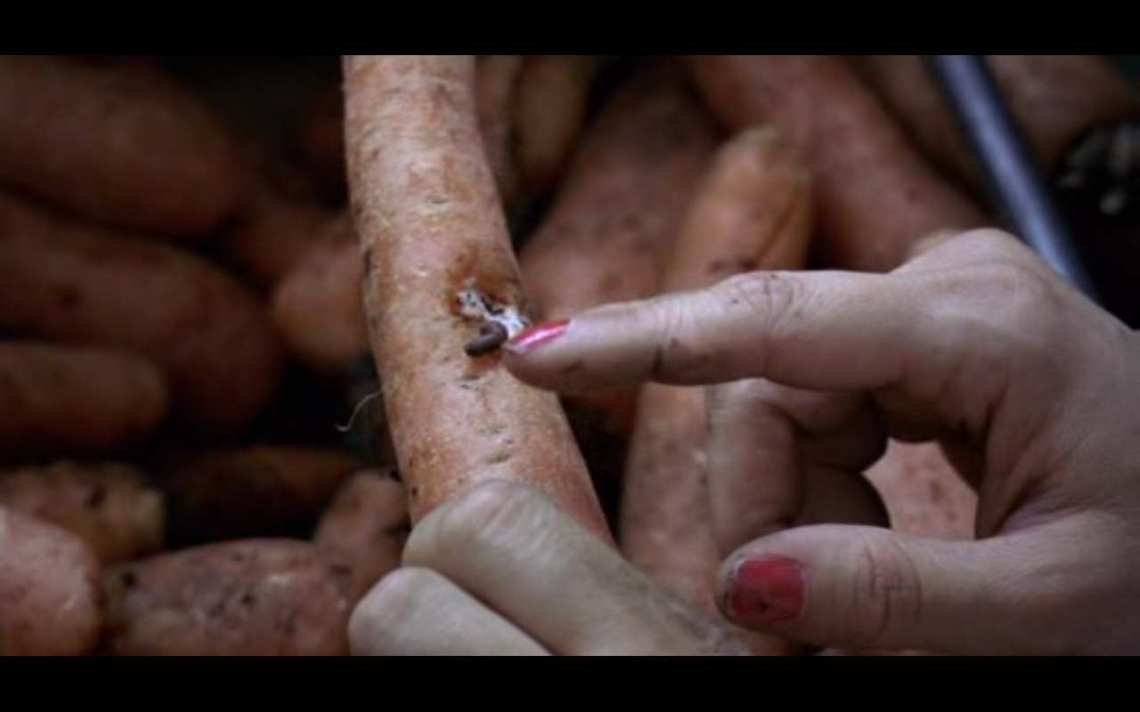
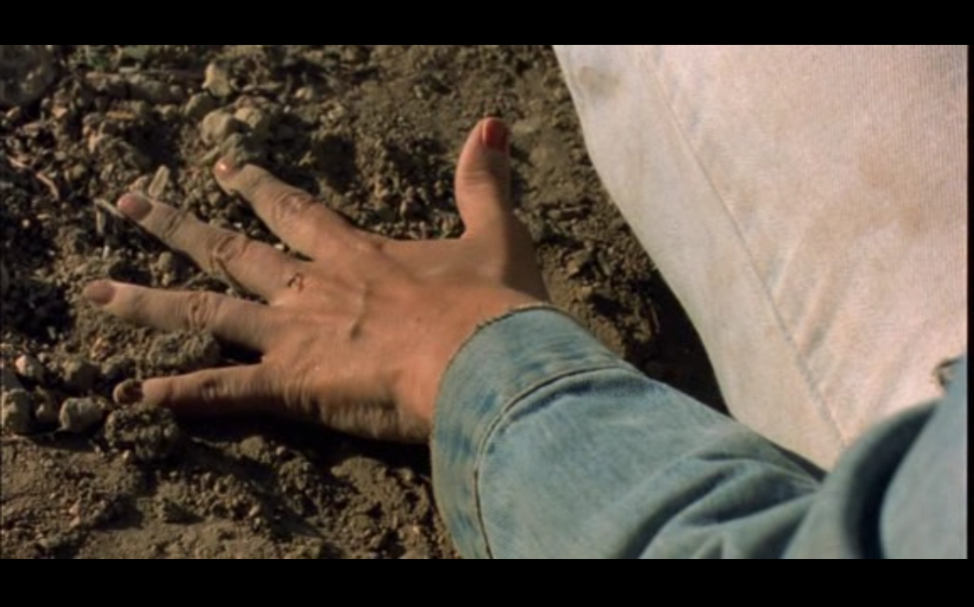
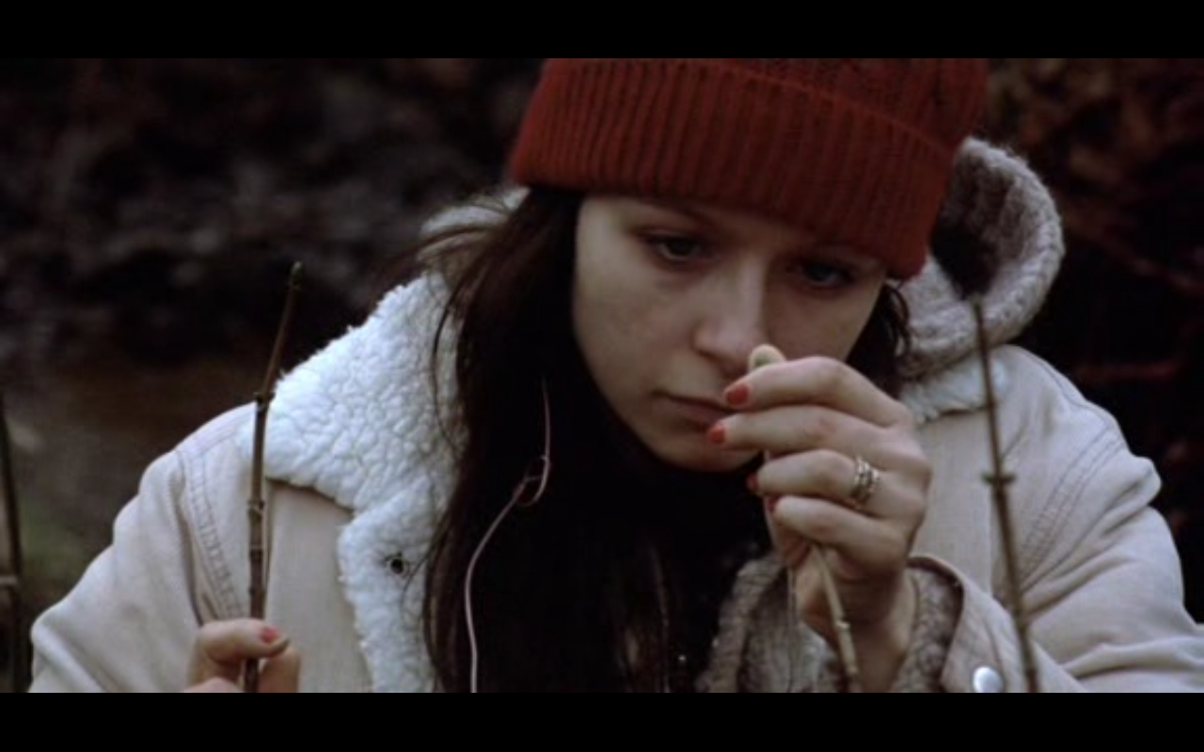
The relation between aesthetic + moral value
The other extreme: ‘Aestheticism’ / ‘Autonomism’ / ‘formalism’
Cf: Sontag
on form/
affect…

Slide 23
The relation between aesthetic + moral value
The other extreme: ‘Aestheticism’ / ‘Autonomism’ / ‘formalism’
Cf: Sontag
on form/
affect…

Slide 24
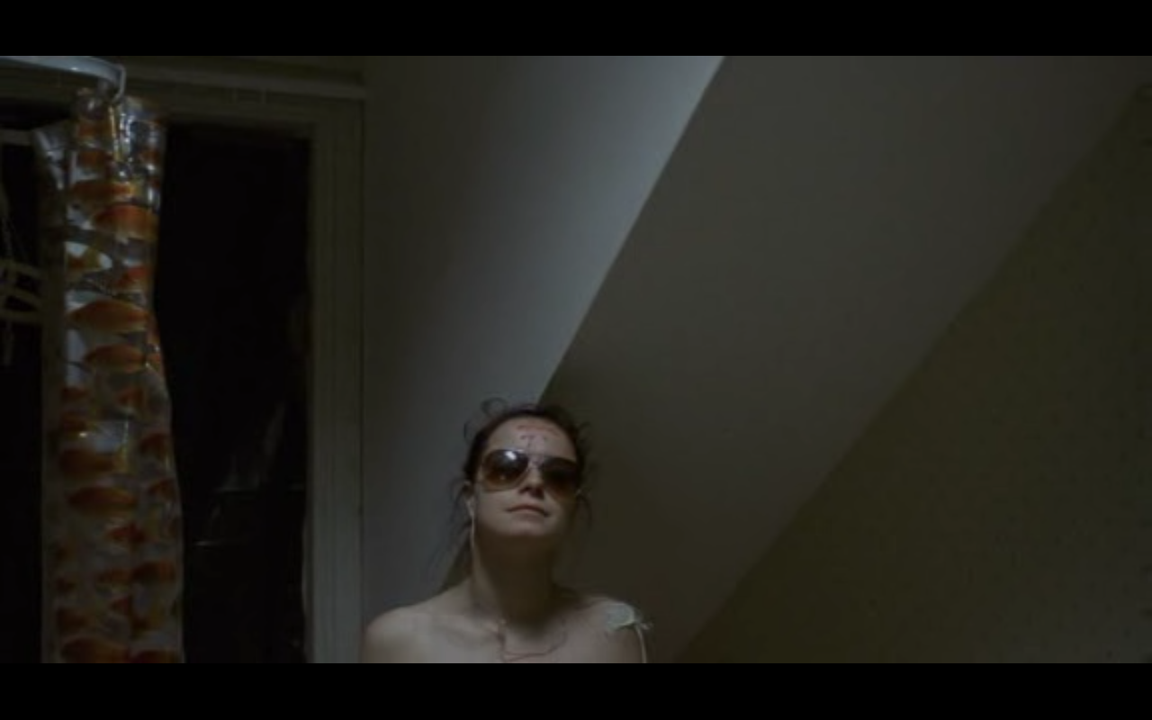
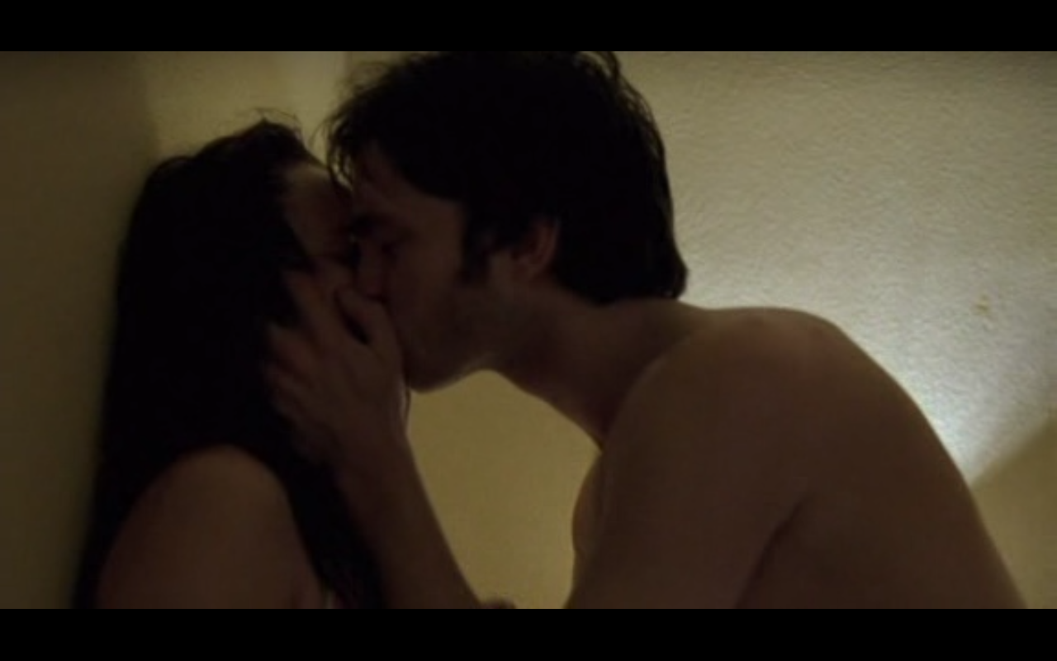
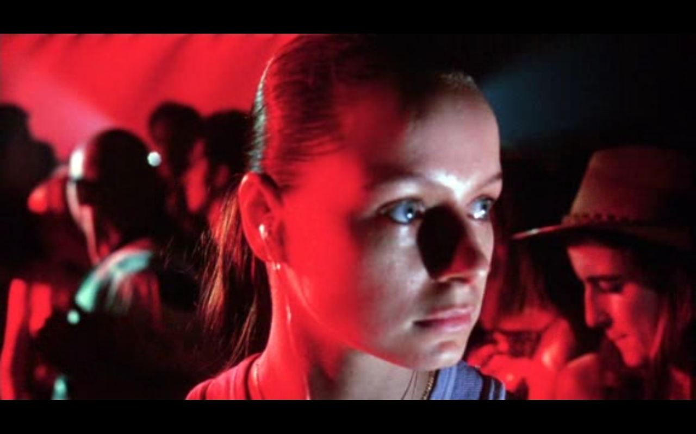
The relation between aesthetic + moral value
The other extreme: ‘Aestheticism’ / ‘Autonomism’ / ‘formalism’

Slide 25
The relation between aesthetic + moral value
The other extreme: ‘Aestheticism’ / ‘Autonomism’ / ‘formalism’
    Some convincing arguments, e.g: ‘It is not the function of [most] art to produce certain moral consequences.’
    (Carroll, 2001: 133)

Slide 26
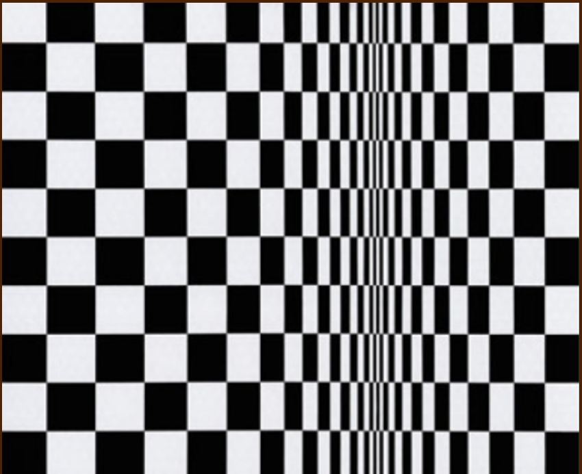
The relation between aesthetic + moral value
The other extreme: ‘Aestheticism’ / ‘Autonomism’ / ‘formalism’
    Some convincing arguments, e.g: ‘It is not the function of [most] art to produce certain moral consequences.’ + ‘Not all artworks [even] have a moral dimension.’ (Carroll, 2001: 133)

Slide 27
The relation between aesthetic + moral value
The other extreme: ‘Aestheticism’ / ‘Autonomism’ / ‘formalism’
    Some convincing arguments, e.g: ‘It is not the function of [most] art to produce certain moral consequences.’ + ‘Not all artworks [even] have a moral dimension.’ (Carroll, 2001: 133)
    ‘Extreme autonomism’:
    ‘Artworks cannot be morally evaluated’ (Gaut, 2001: 433)

Slide 28
The relation between aesthetic + moral value
The other extreme: ‘Aestheticism’ / ‘Autonomism’ / ‘formalism’
    Some convincing arguments, e.g: ‘It is not the function of [most] art to produce certain moral consequences.’ + ‘Not all artworks [even] have a moral dimension.’ (Carroll, 2001: 133)
    ‘Extreme autonomism’:
    ‘Artworks cannot be morally evaluated’. […]. [T]here is little to recommend this view.’ (Gaut, 2001: 433)

Slide 29
The relation between aesthetic + moral value
    How aesthetic form interacts with moral content:
‘Our aesthetic interest is directed not just at lines and colors, but also at how the artwork presents a certain subject-matter – the […] attitudes it manifests toward its subject.’ (Gaut, 2013: 434)

Slide 30
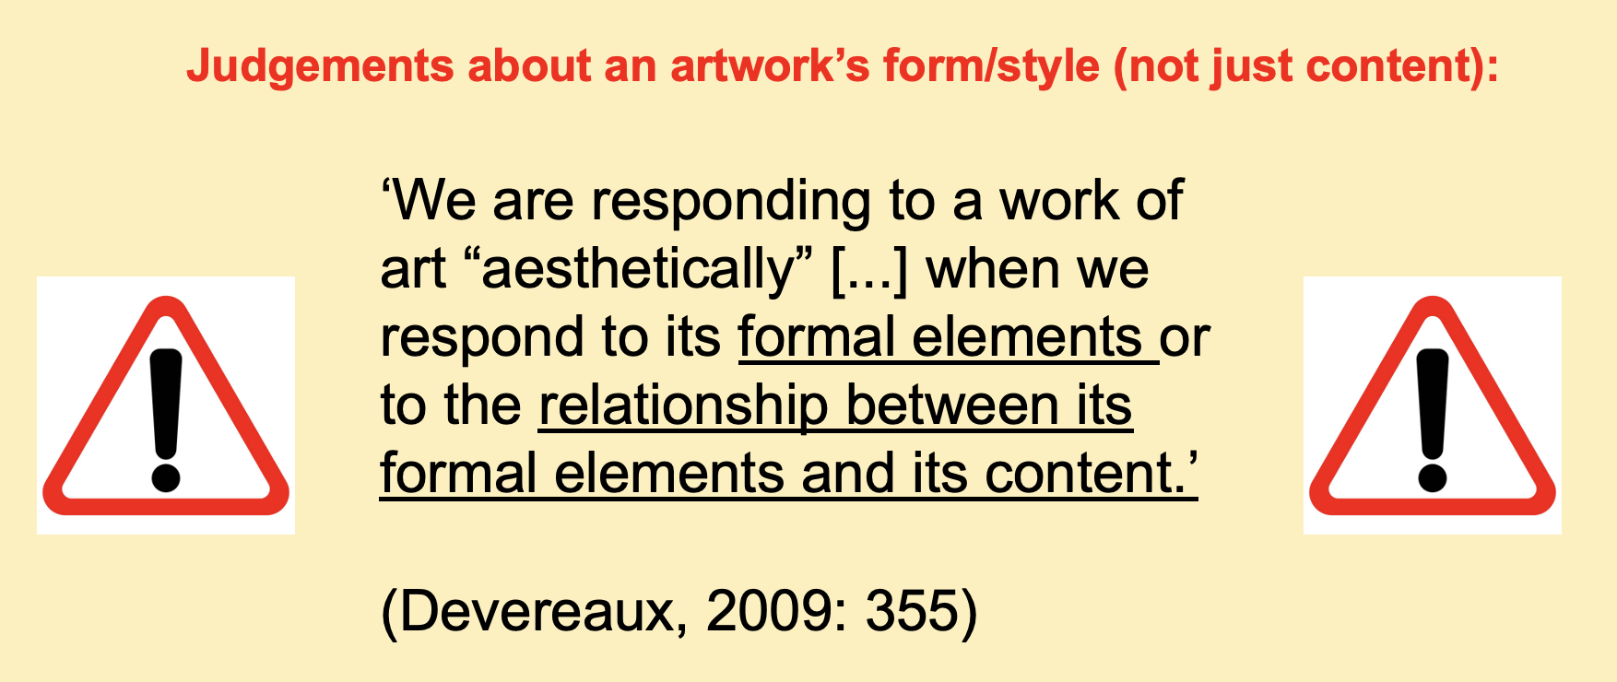
The relation between aesthetic + moral value
    How aesthetic form interacts with moral content:
‘Our aesthetic interest is directed not just at lines and colors, but also at how the artwork presents a certain subject-matter – the […] attitudes it manifests toward its subject.’ (Gaut, 2013: 434)

Slide 31
The relation between aesthetic + moral value
    How aesthetic form interacts with moral content:
‘Our aesthetic interest is directed not just at lines and colors, but also at how the artwork presents a certain subject-matter – the […] attitudes it manifests toward its subject.’ (Gaut, 2013: 434)

Slide 32
Interpreting/evaluating artworks’ moral attitudes
    How aesthetic form interacts with moral content:
‘Our aesthetic interest is directed not just at lines and colors, but also at how the artwork presents a certain subject-matter – the […] attitudes it manifests toward its subject.’ (Gaut, 2013: 434)

Slide 33
Interpreting/evaluating artworks’ moral attitudes
‘Consider how you might likely react to the following newspaper headlines:
Wife-killing paedophile kidnaps
young step-daughter
Suburban homeowner is
psychopathic mafia boss
Beethoven lover rapes wife
of respected author
(Kieran, 2009: 94)

Slide 34
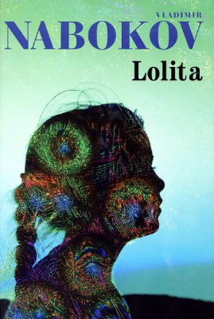


Interpreting/evaluating artworks’ moral attitudes
‘Consider how you might likely react to the following newspaper headlines:
Wife-killing paedophile kidnaps
young step-daughter
Suburban homeowner is
psychopathic mafia boss
Beethoven lover rapes wife
of respected author
(Kieran, 2009: 94)

Slide 35
Interpreting/evaluating artworks’ moral attitudes
‘Consider how you might likely react to the following newspaper headlines:
Wife-killing paedophile kidnaps
young step-daughter
Suburban homeowner is
psychopathic mafia boss
‘Of course, […] [it would not be appropriate] for us to have a moral response to [the mere contents of] a work of art in the same sense that we do to an act in real life. […] The point may seem obvious, but the prevalence of […] moralistic judgments in […] criticism makes it worth repeating.’ (Sontag, 1965: 1)

Slide 36
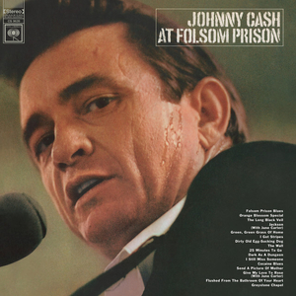
Interpreting/evaluating artworks’ moral attitudes
Prisoner KILLED Man in Reno,
Just to WATCH HIM DIE!
‘Of course, […] [it would not be appropriate] for us to have a moral response to [the mere contents of] a work of art in the same sense that we do to an act in real life. […] The point may seem obvious, but the prevalence of […] moralistic judgments in contemporary literary (and film) criticism makes it worth repeating a number of times.’ (Sontag, 1965: 1)

Slide 37
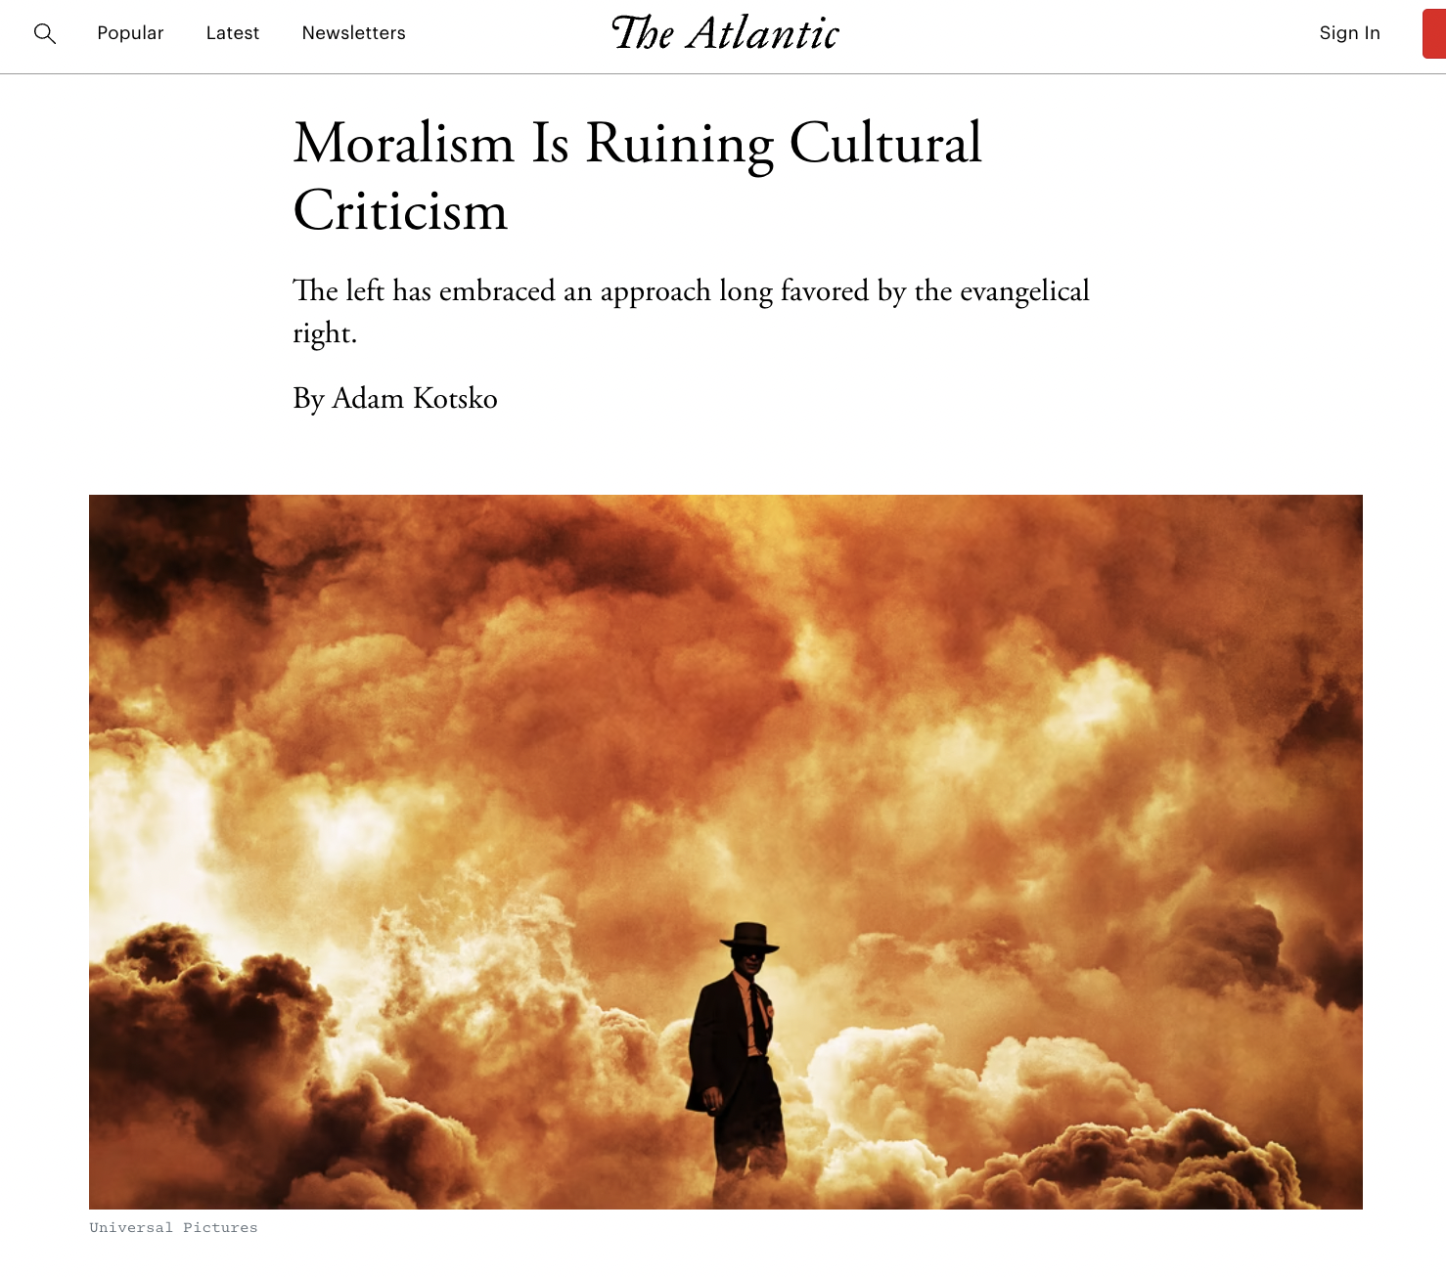
Interpreting/evaluating artworks’ moral attitudes
Prisoner KILLED Man in Reno,
Just to WATCH HIM DIE!
‘Of course, […] [it would not be appropriate] for us to have a moral response to [the mere contents of] a work of art in the same sense that we do to an act in real life. […] The point may seem obvious, but the prevalence of […] moralistic judgments in contemporary literary (and film) criticism makes it worth repeating a number of times.’ (Sontag, 1965: 1)

Slide 38

Interpreting/evaluating artworks’ moral attitudes
‘[though immoral attitudes may be] represented in the play, it does not follow that these attitudes are shared by the play itself’ (Gaut, 2013: 436)
‘Of course, […] [it would not be appropriate] for us to have a moral response to [the mere contents of] a work of art in the same sense that we do to an act in real life. […] The point may seem obvious, but the prevalence of […] moralistic judgments in contemporary literary (and film) criticism makes it worth repeating a number of times.’ (Sontag, 1965: 1)

Slide 39
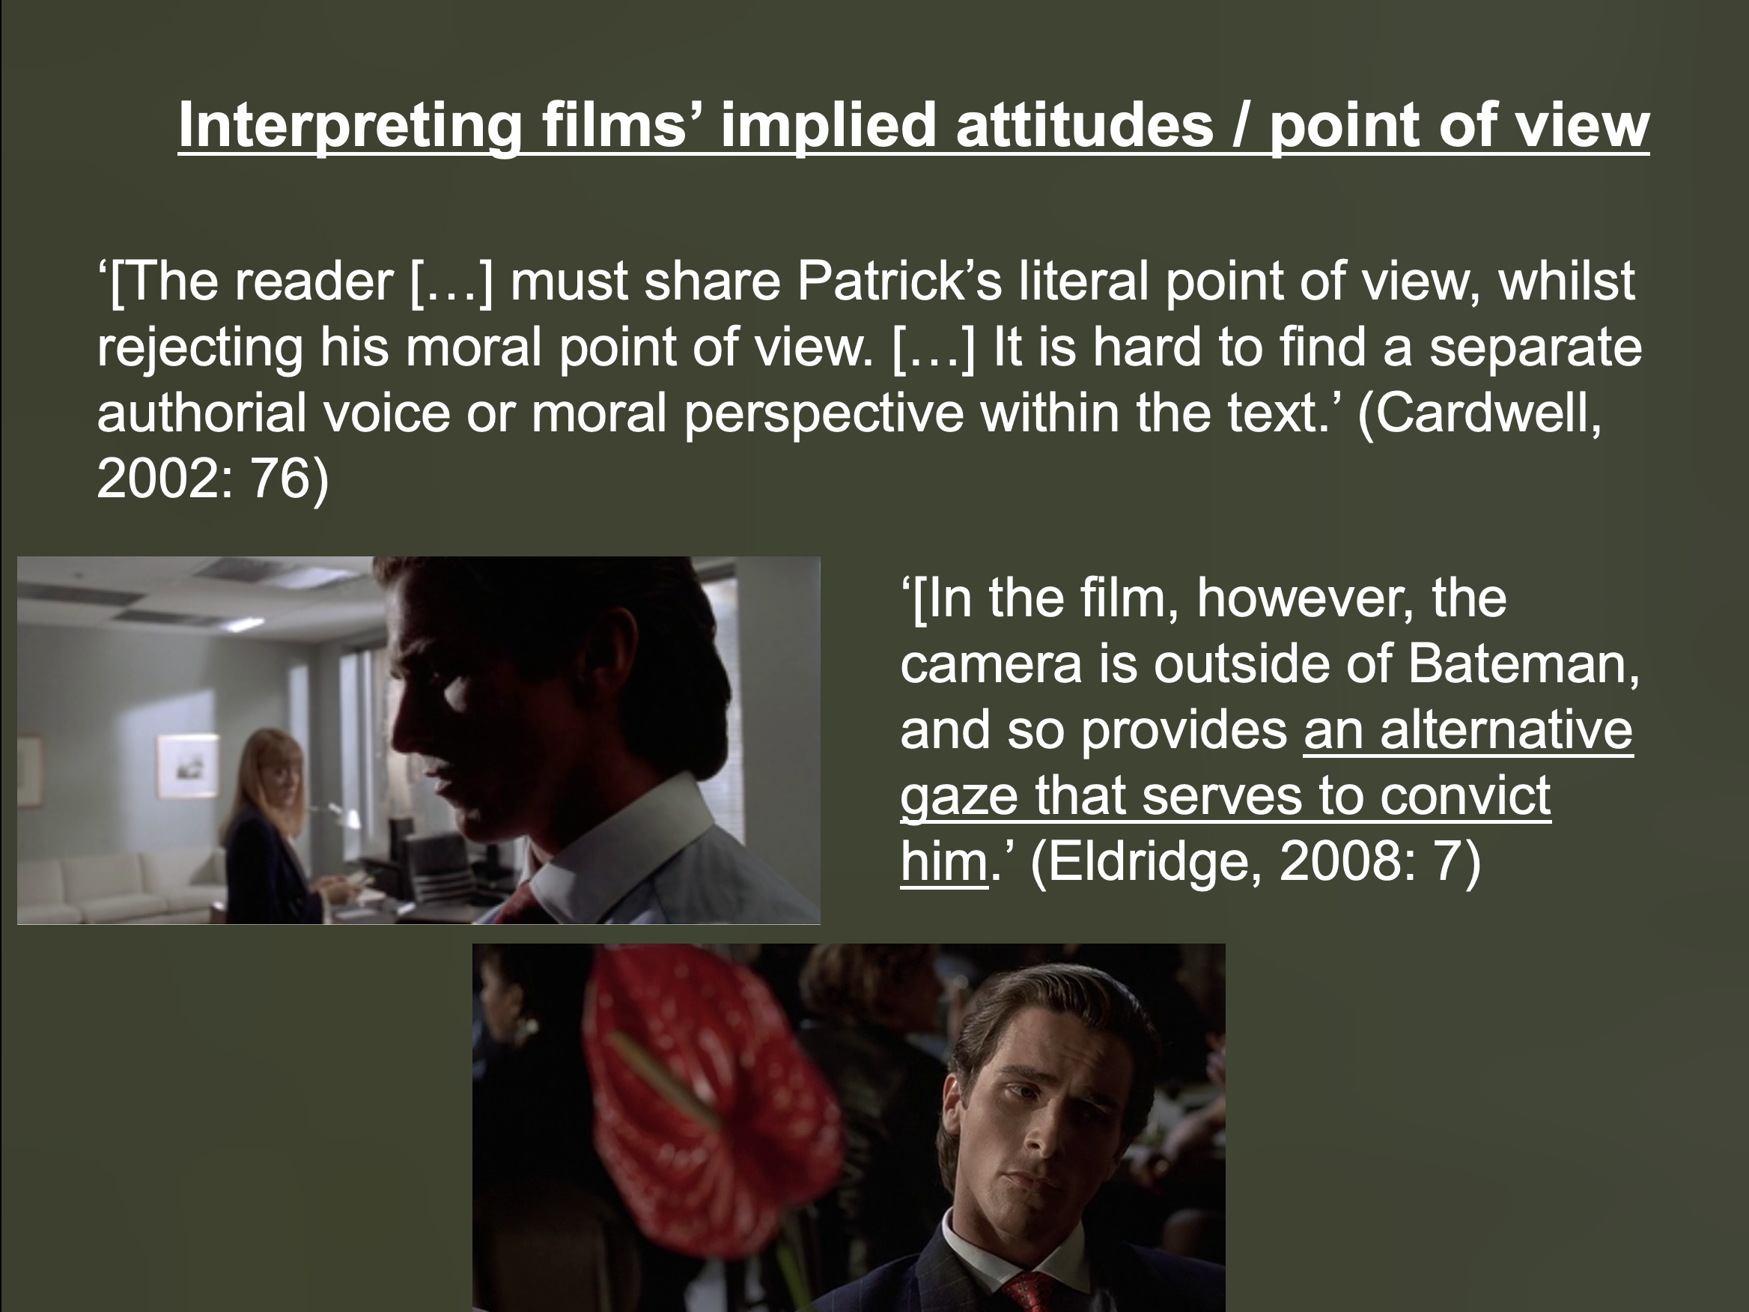
Interpreting/evaluating artworks’ moral attitudes
‘[though immoral attitudes may be] represented in the play, it does not follow that these attitudes are shared by the play itself’ (Gaut, 2013: 436)

Slide 40
Interpreting/evaluating artworks’ moral attitudes
‘Merited response argument’ (Gaut’s ‘ethicism’)
‘When works manifest attitudes, they do so by prescribing or inviting their audiences to have certain responses. […] Responses that works prescribe are not always merited [because of a failing in the work] […]. (ibid: 440-1)

Slide 41
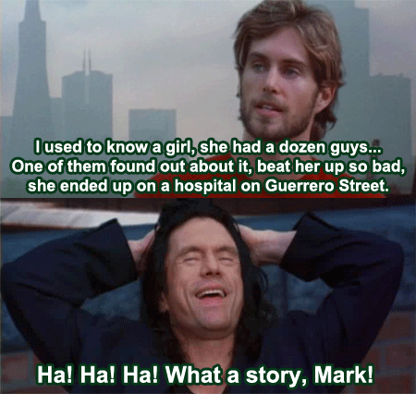
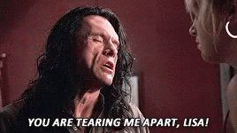
Interpreting/evaluating artworks’ moral attitudes
‘Merited response argument’ (Gaut’s ‘ethicism’)
‘When works manifest attitudes, they do so by prescribing or inviting their audiences to have certain responses. […] Responses that works prescribe are not always merited [because of a failing in the work] […]. (ibid: 440-1)

Slide 42
Interpreting/evaluating artworks’ moral attitudes
‘Merited response argument’ (Gaut’s ‘ethicism’)
‘When works manifest attitudes, they do so by prescribing or inviting their audiences to have certain responses. […] Responses that works prescribe are not always merited […]. One ground for holding a response to be unmerited is that it is unethical: for instance, sexual torture is not erotic and amusing, it is plain evil and does not merit amusement or an erotic response. If an artwork prescribes [moral] responses that it does not merit, then that is a failure in the work. And it is an aesthetic failure in the work.’ (ibid: 440-1)

Slide 43
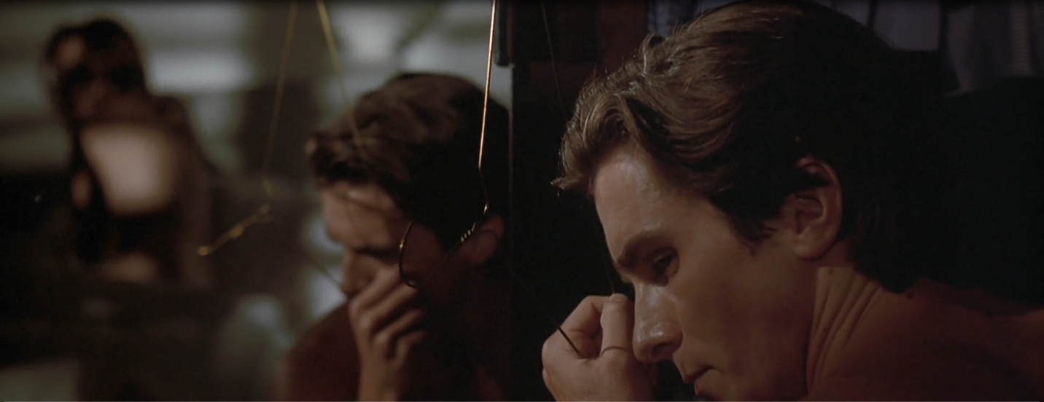
Interpreting/evaluating artworks’ moral attitudes
‘Merited response argument’ (Gaut’s ‘ethicism’)
‘When works manifest attitudes, they do so by prescribing or inviting their audiences to have certain responses. […] Responses that works prescribe are not always merited […]. One ground for holding a response to be unmerited is that it is unethical: for instance, sexual torture is not erotic and amusing, it is plain evil and does not merit amusement or an erotic response. If an artwork prescribes [moral] responses that it does not merit, then that is a failure in the work. And it is an aesthetic failure in the work.’ (ibid: 440-1)

Slide 44
Interpreting/evaluating artworks’ moral attitudes
‘Merited response argument’ (Gaut’s ‘ethicism’)
‘When works manifest attitudes, they do so by prescribing or inviting their audiences to have certain responses. […] Responses that works prescribe are not always merited […]. One ground for holding a response to be unmerited is that it is unethical: for instance, sexual torture is not erotic and amusing, it is plain evil and does not merit amusement or an erotic response. If an artwork prescribes [moral] responses that it does not merit, then that is a failure in the work. And it is an aesthetic failure in the work.’ (ibid: 440-1)

Slide 45
Interpreting/evaluating artworks’ moral attitudes
‘Merited response argument’ (Gaut’s ‘ethicism’)
‘When works manifest attitudes, they do so by prescribing or inviting their audiences to have certain responses. […] Responses that works prescribe are not always merited […]. One ground for holding a response to be unmerited is that it is unethical: for instance, sexual torture is not erotic and amusing, it is plain evil and does not merit amusement or an erotic response. If an artwork prescribes [moral] responses that it does not merit, then that is a failure in the work. And it is an aesthetic failure in the work.’ (ibid: 440-1)
‘Works of art have moral content […] only under an interpretation.’
(Coplan, 1997: 23)

Slide 46
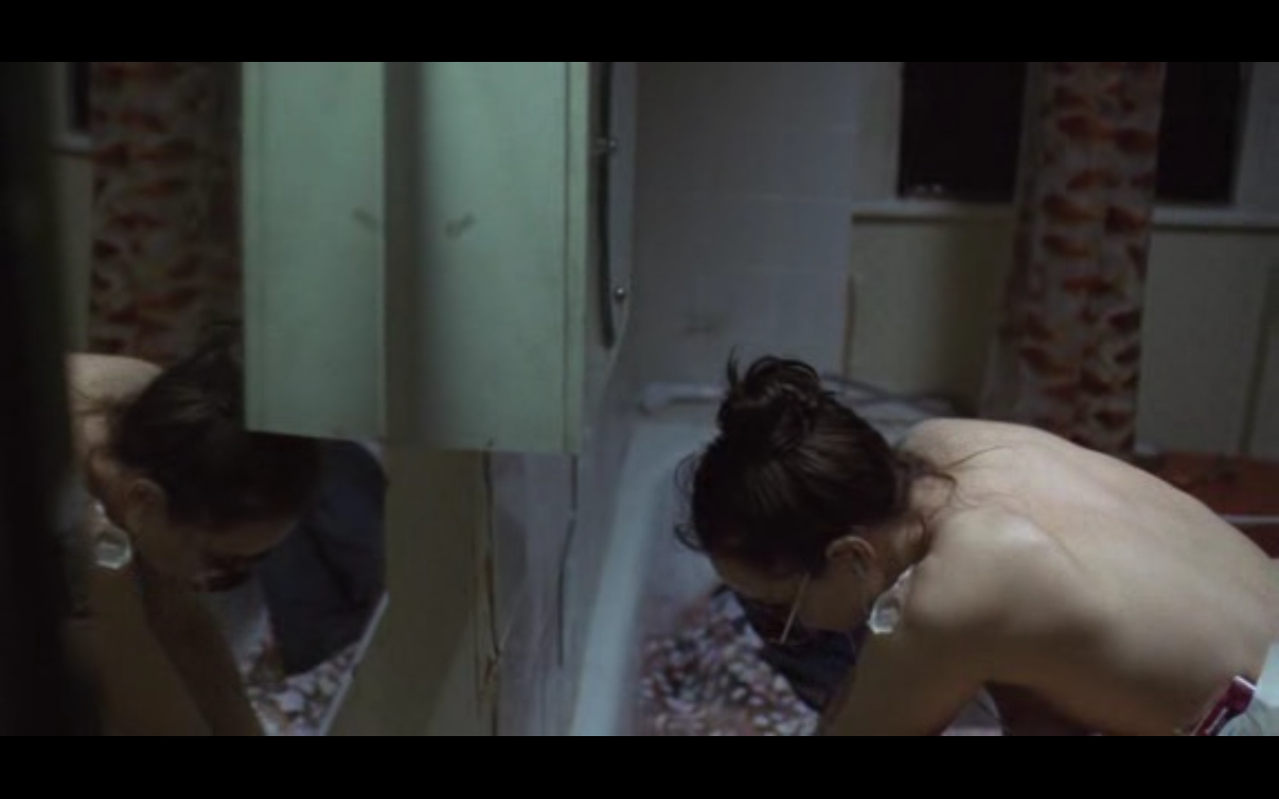
Interpreting/evaluating artworks’ moral attitudes
‘Works of art have moral content […] only under an interpretation.’
(Coplan, 1997: 23)

Slide 47
Interpreting/evaluating artworks’ moral attitudes
Young Raver DISMEMBERS Boyfriend’s Body,
Then STEALS His Work – for £100,000!
‘Works of art have moral content […] only under an interpretation.’
(Coplan, 1997: 23)

Slide 48
Interpreting/evaluating artworks’ moral attitudes
Young Raver DISMEMBERS Boyfriend’s Body,
Then STEALS His Work – for £100,000!
‘It is easy to imagine that such a scenario would bring a system of […] moral judgments into play. However, Morvern Callar is an unusually non-judgmental film.’ (Rizzo, 2014: 255)
‘Works of art have moral content […] only under an interpretation.’
(Coplan, 1997: 23)

Slide 49
Interpreting/evaluating artworks’ moral attitudes
Young Raver DISMEMBERS Boyfriend’s Body,
Then STEALS His Work – for £100,000!
‘If a work manifests unethical attitudes in its prescribed responses, then the work has an aesthetic flaw.’ (Gaut, 2009: 430)
‘It is easy to imagine that such a scenario would bring a system of […] moral judgments into play. However, Morvern Callar is an unusually non-judgmental film.’ (Rizzo, 2014: 255)
‘Works of art have moral content […] only under an interpretation.’
(Coplan, 1997: 23)

Slide 50
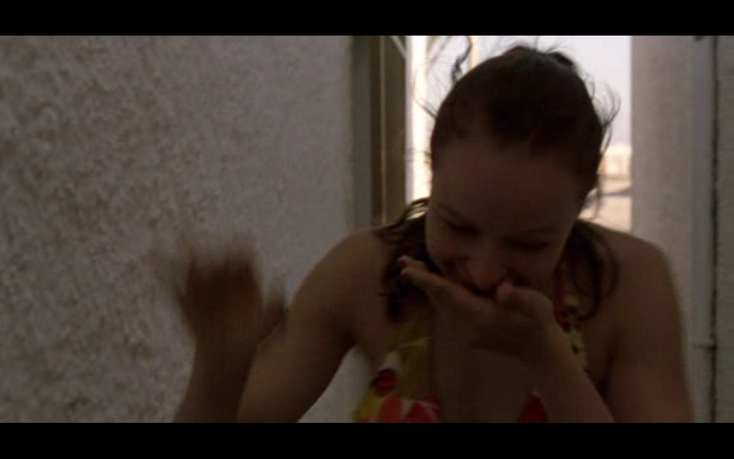
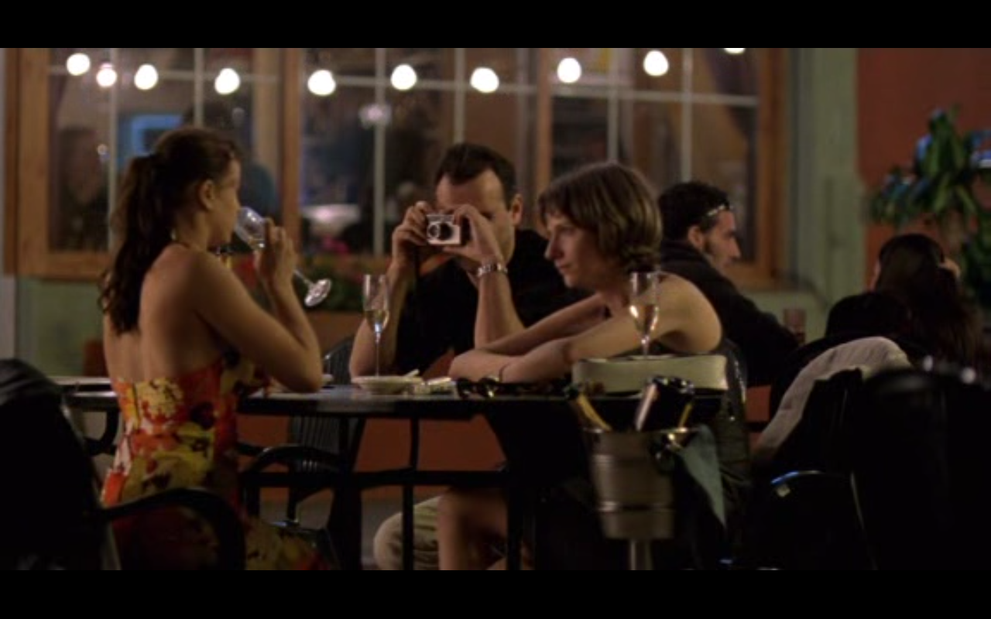
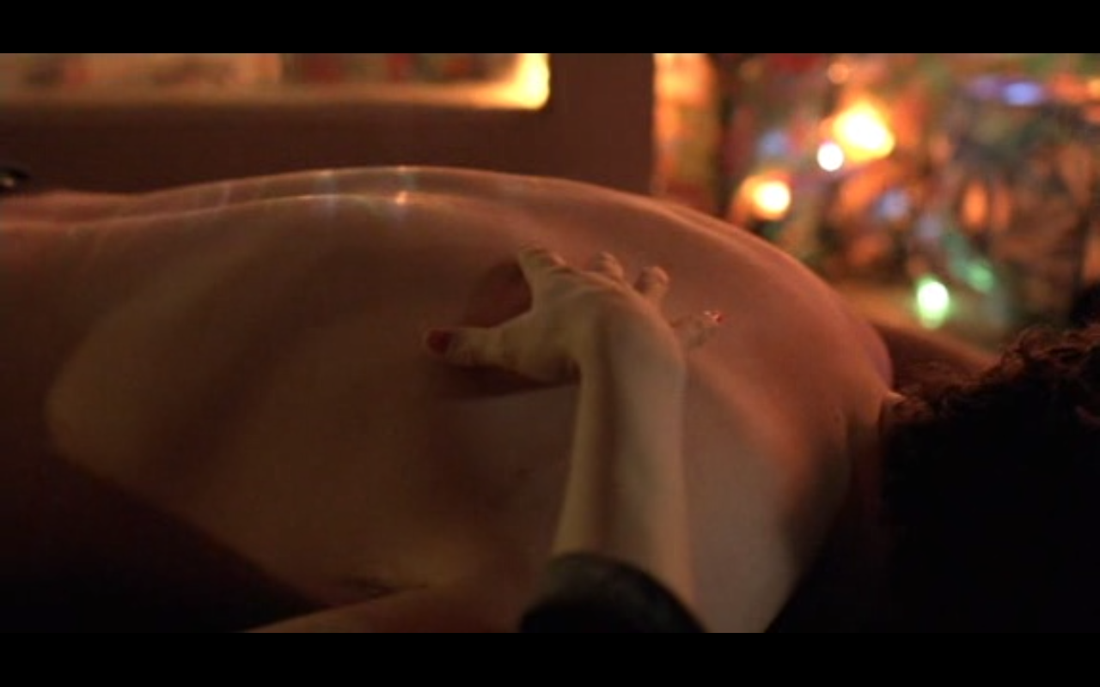
Interpreting/evaluating artworks’ moral attitudes
‘If a work manifests unethical attitudes in its prescribed responses, then the work has an aesthetic flaw.’ (Gaut, 2009: 430)

Slide 51
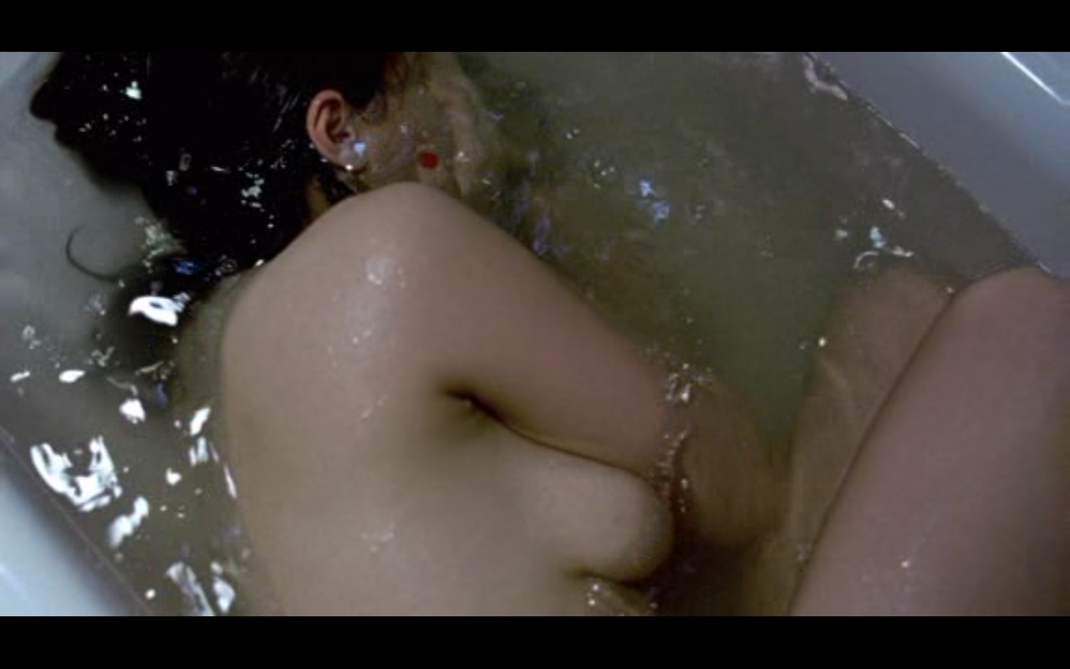
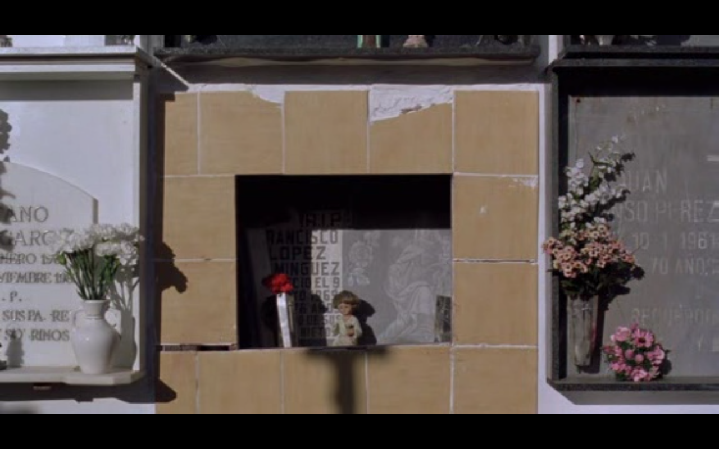
Interpreting/evaluating artworks’ moral attitudes
‘If a work manifests unethical attitudes in its prescribed responses, then the work has an aesthetic flaw.’ (Gaut, 2009: 430)

Slide 52
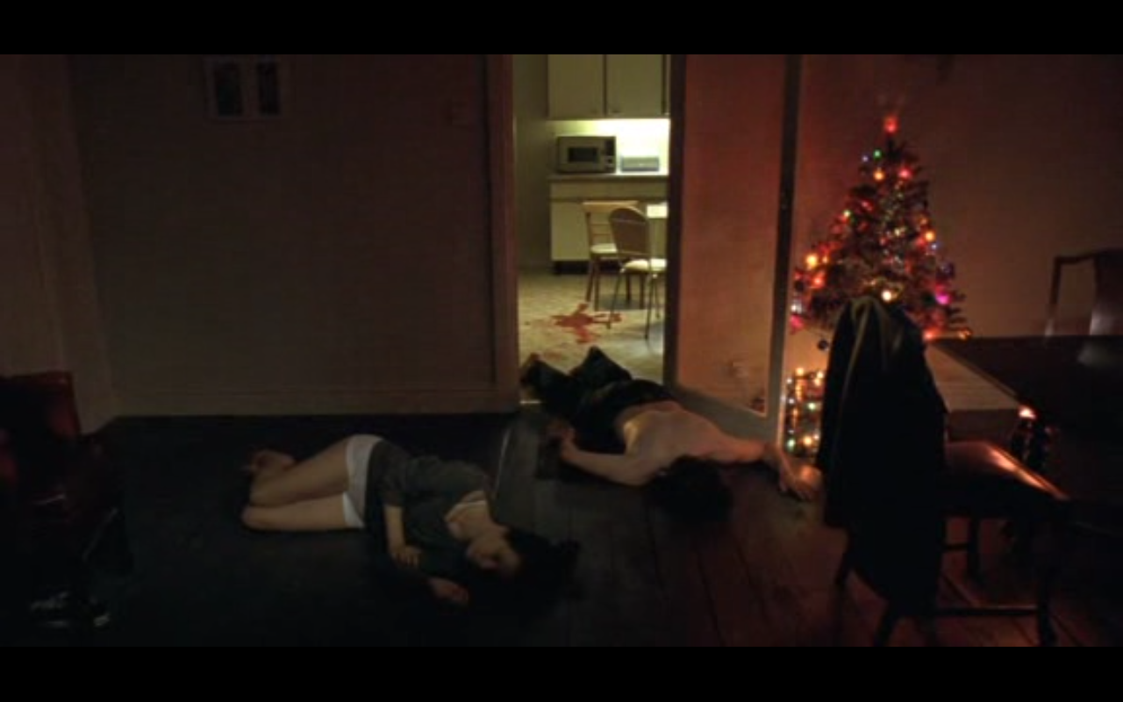
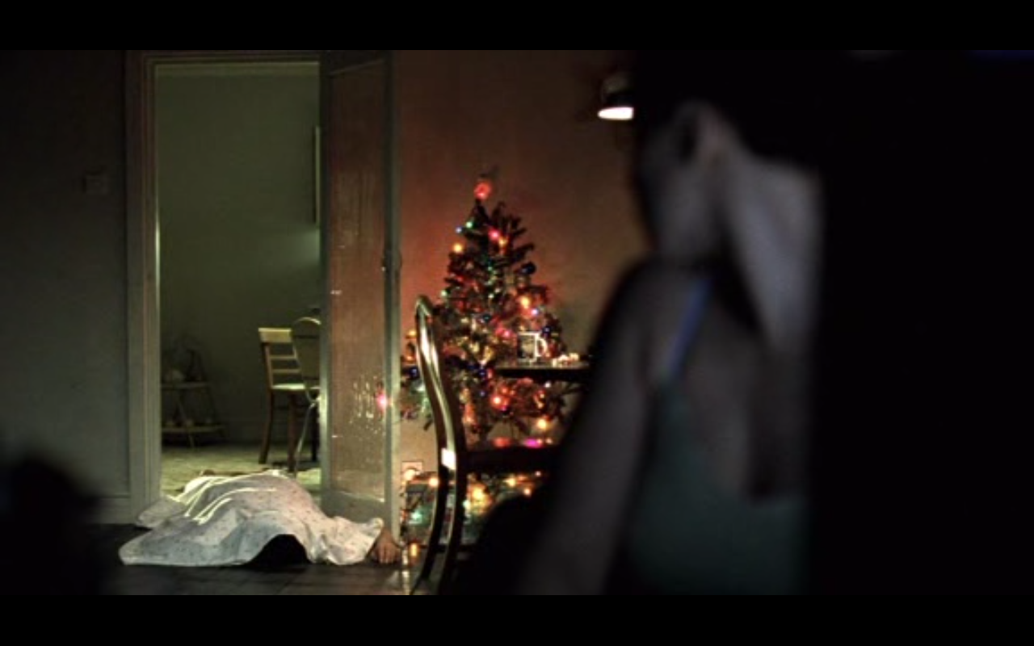
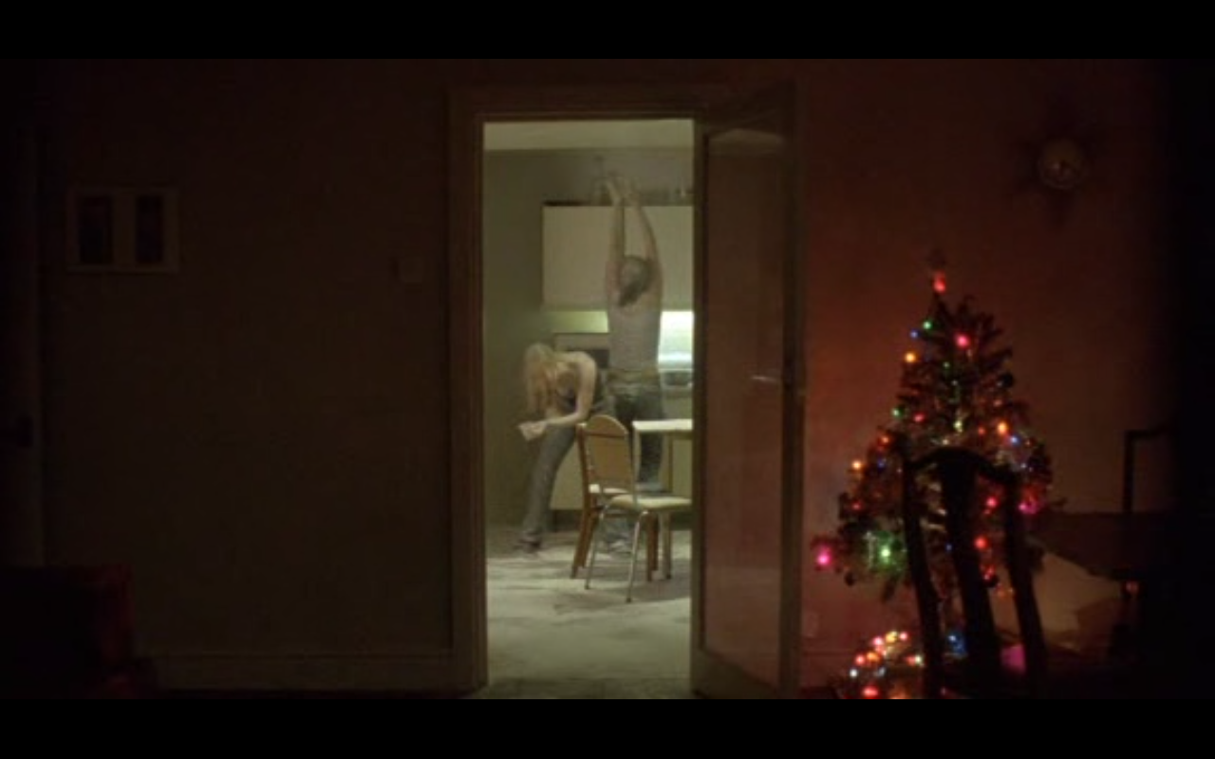
Interpreting/evaluating artworks’ moral attitudes
‘If a work manifests unethical attitudes in its prescribed responses, then the work has an aesthetic flaw.’ (Gaut, 2009: 430)
‘Works of art have moral content […] only under an interpretation.’
(Coplan, 1997: 23)

Slide 53
Interpreting/evaluating artworks’ moral attitudes
‘Works of art have moral content […] only under an interpretation.’
(Coplan, 1997: 23)

Slide 54
Interpreting/evaluating artworks’ moral attitudes
‘Works of art have moral content […] only under an interpretation.’
(Coplan, 1997: 23)

Slide 55
Interpreting/evaluating artworks’ moral attitudes
‘It is easy to imagine that such a scenario would bring a system of […] moral judgments into play. However, Morvern Callar is an unusually non-judgmental film.’ (Rizzo, 2014: 255)
‘Works of art have moral content […] only under an interpretation.’
(Coplan, 1997: 23)

Slide 56

Interpreting/evaluating artworks’ moral attitudes
Moral ambiguity:
one route to aesthetic
complexity…?
‘It is easy to imagine that such a scenario would bring a system of […] moral judgments into play. However, Morvern Callar is an unusually non-judgmental film.’ (Rizzo, 2014: 255)

Slide 57
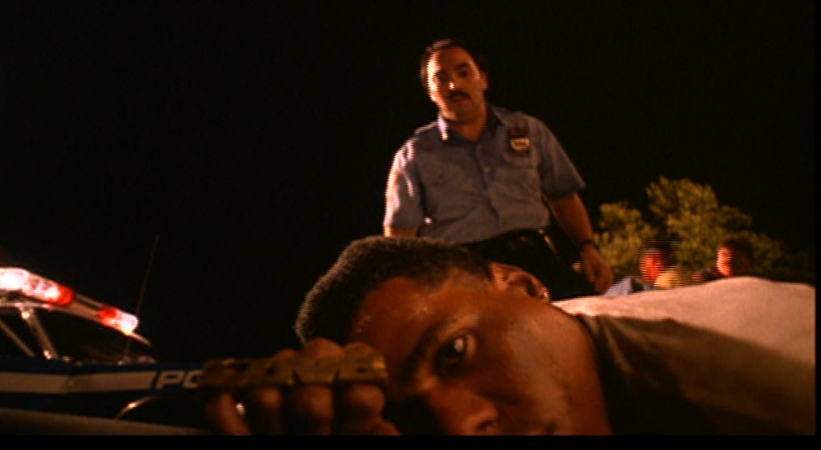
Interpreting/evaluating artworks’ moral attitudes
Limits to this view, depending on moral content…?
Moral ambiguity:
one route to aesthetic
complexity…?
‘It is easy to imagine that such a scenario would bring a system of […] moral judgments into play. However, Morvern Callar is an unusually non-judgmental film.’ (Rizzo, 2014: 255)

Slide 58
Interpreting/evaluating artworks’ moral attitudes
Questions:
- What is an example of a film that you think is aesthetically good, despite implying moral attitudes you consider dubious?
- What is your moral assessment of Morvern Callar, the character?
- What moral attitudes do you interpret Morvern Callar, the film, inviting towards Morvern’s actions? Are they morally merited, according to your moral assessment of her?

Slide 59

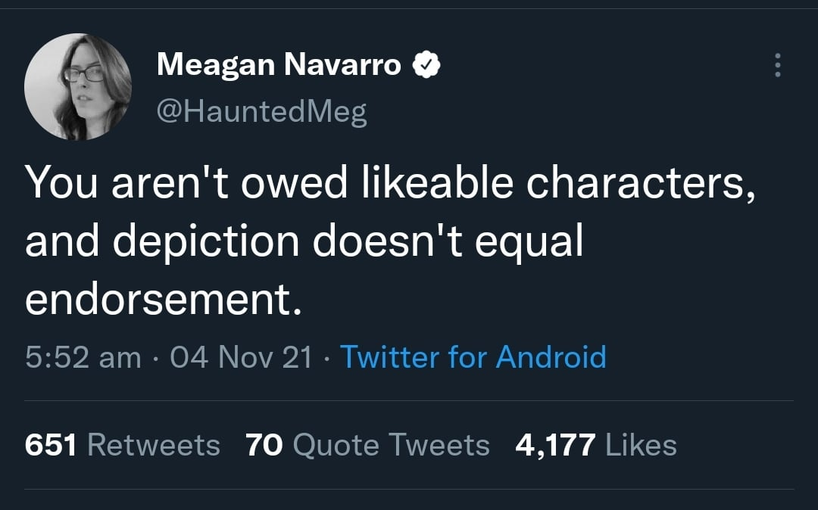
‘Portrayal of the complexity of the human condition requires an integration of aesthetic properties and moral subject matter that is itself complex.’ (Eaton, 2001: 143)
‘The preservation of [moral] indeterminacy in storytelling is not the highest possible […] good. [I]n the case of stories about slavery, genocide, racism, rape, and murder, for example, failing to provide a firm moral perspective could in some cases be seen as a dereliction of ethical duty.’ (Plantinga, 2018: 214)

Slide 60
Bibliography
- Carroll, Noel (2001) ‘Art, Narrative, and Moral Understanding’, in Aesthetics and Ethics: Essays at the intersection, Jerrold Levinson (ed), Cambridge: Cambridge University Press, 126-60.
- Eaton, Marcia Muelder. (2001) Merit, Aesthetic and Ethical, Oxford: Oxford University Press.
- Freeland, Cynthia. (1997) ‘Art and Moral Knowledge’, Philosophical Topics 25: 1, 11-36.
- Gaut, Berys (2013) ‘Art and Ethics’, in The Routledge Companion to Aesthetics (3rd Edition), ed. Berys Gaut and Dominic McIver Lopes, New York: Routledge, 341-352.
- Kieran, Matthew (2006) 'Art, morality and ethics: On the (im)moral character of art works and inter-relations to artistic value', Philosophy Compass 1(2): 129–143.
- Plantinga, Carl (2018) Screen Stories: Emotion and the Ethics of Engagement, Oxford: Oxford University Press.
- Rizzo, Teresa (2014) ‘Without Judgment: A Feminist Reading of the Immanent Ethics and Aesthetics in Morvern Callar’, in A Critique of Judgment in Film and Television, Silke Panse and Dennis Rothermel (eds), London: Palgrave MacMillan, 255-68.
- Sontag, Susan (1965) ‘On Style’, PARTISAN REVIEW 31 (Fall), 545-60. Available online here: http://www.coldbacon.com/writing/sontag-onstyle.html
- Wilde, Oscar (1895) [1998] The Picture of Dorian Gray, The Electric Book Company; version free online: https://bit.ly/3dmL5x3

Slide 61
…
Song: ‘Folsom Prison Blues’ – Johnny Cash…
https://livewarwickac-my.sharepoint.com/personal/fssmab_live_warwick_ac_uk/_layouts/15/stream.aspx?UniqueId=8c8d74ab%2Ddf24%2D5c92%2Ddf7c%2D2e39ffc92646&Translate=false&referrer=StreamWebApp%2EWeb&referrerScenario=AddressBarCopied%2Eview%2Ee1e6c44c%2D6860%2D493d%2Dbaca%2D4f3770a21073
100.23: https://learningonscreen.ac.uk/ondemand/index.php/prog/006FDBBD?bcast=124008056#
41.11
https://learningonscreen.ac.uk/ondemand/index.php/prog/00801333?bcast=132551262

Slide 62
Interpreting/evaluating artworks’ moral attitudes
Local News Anchor SLAUGHTERS Rival Presenter With TRIDENT and Goes UNPUNISHED!
What attitude are we encouraged
to take towards this?!

Slide 63

Interpreting/evaluating artworks’ moral attitudes
Felon KILLED Man in Reno,
Just to WATCH HIM DIE!
What attitude are we encouraged
to take towards this?!

Slide 64
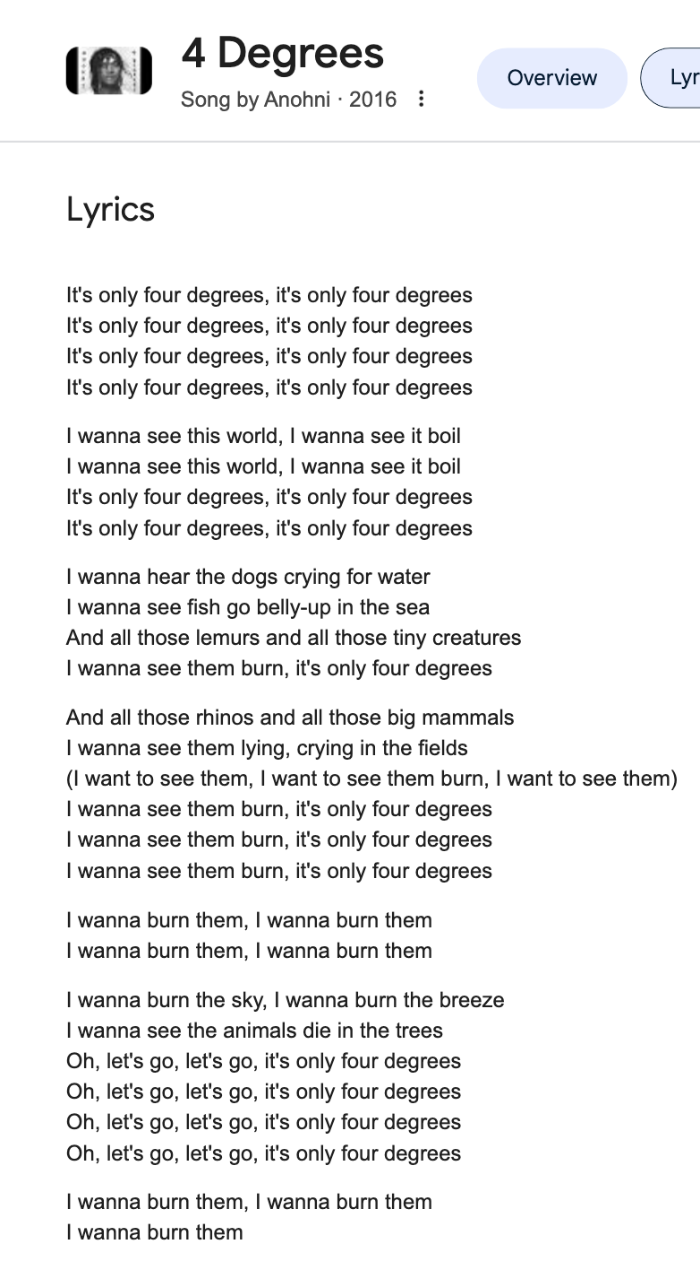
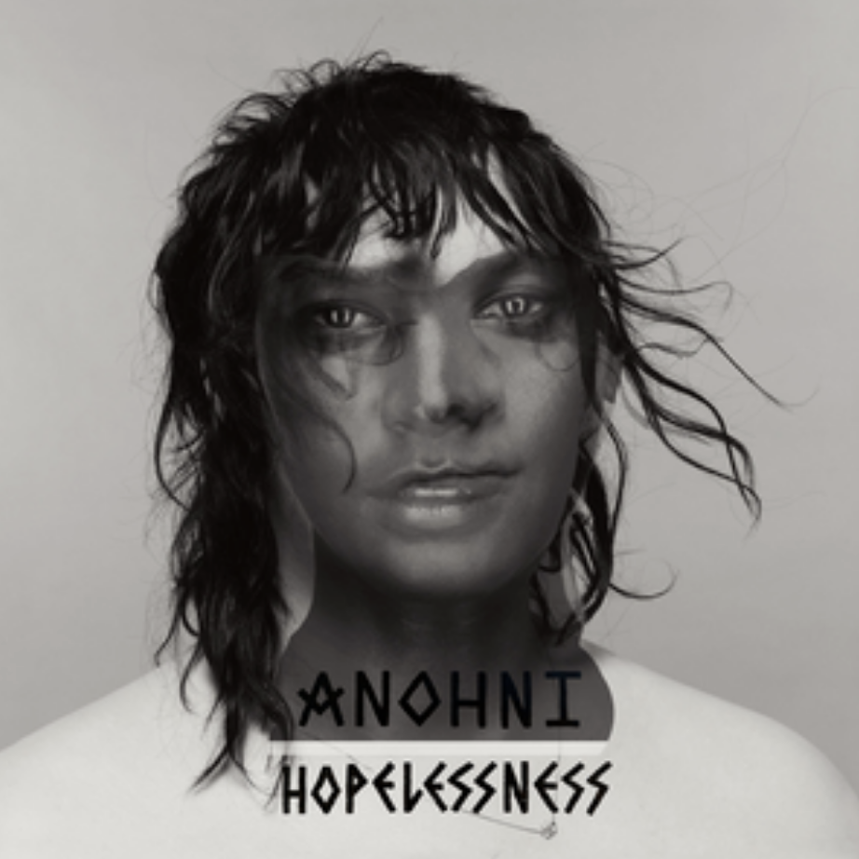
Interpreting/evaluating artworks’ moral attitudes
Woman LONGS for DESTRUCTION
Of ALL EARTH’S CREATURES!
What attitude are we encouraged
to take towards this?!

