Slide 1
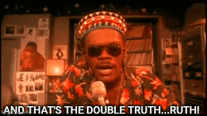
Film Aesthetics 1
Week 7
Aesthetic Appreciation vs ‘Messages’?
Do the Right Thing (Spike Lee, 1989)
[Song: ‘Can It All Be So Simple?’ – Wu-Tang Clan]…

Slide 2
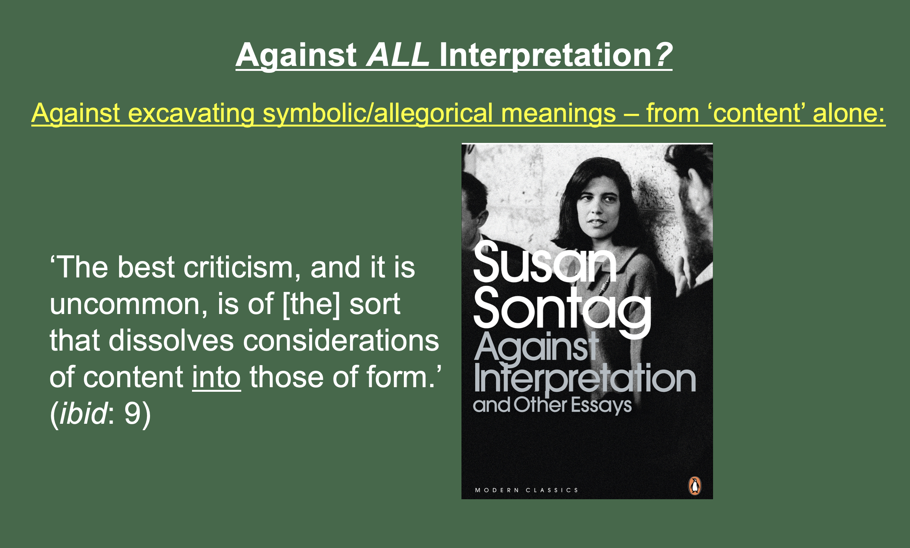
Film Aesthetics 1
Week 7
Aesthetic Appreciation vs ‘Messages’?
(The ‘Heresy of Paraphrase’)

Slide 3
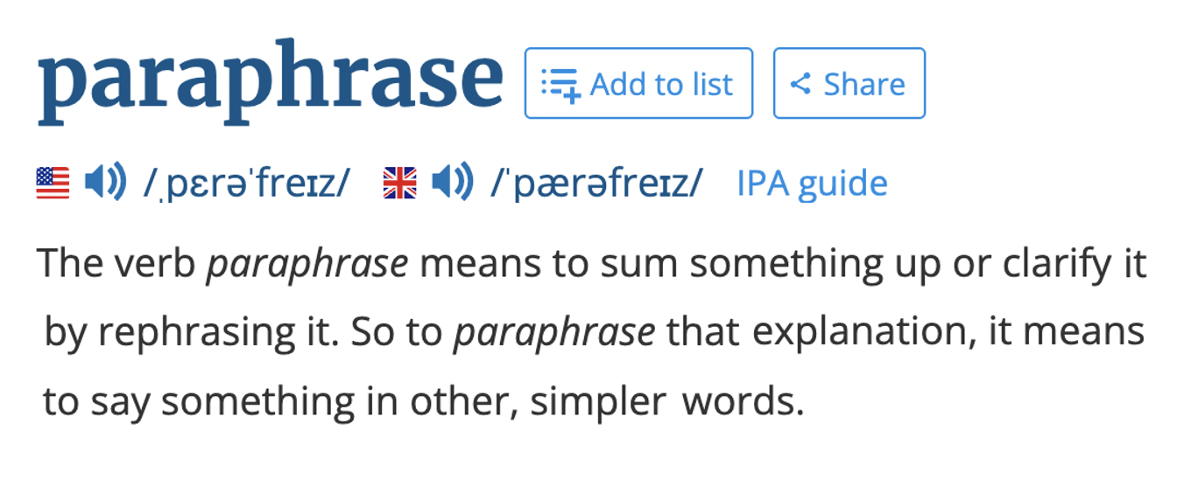
Film Aesthetics 1
Week 7
Aesthetic Appreciation vs ‘Messages’?
(The ‘Heresy of Paraphrase’)

Slide 4
Can / should artworks be paraphrased?

Slide 5
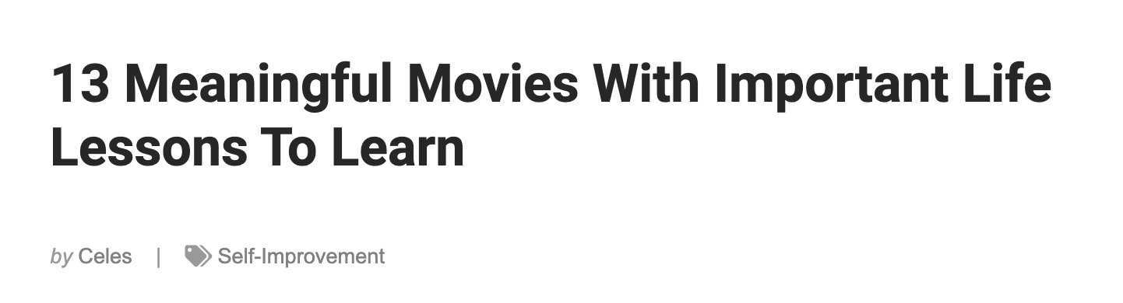
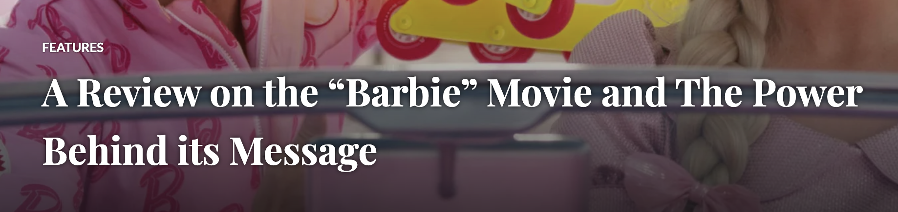
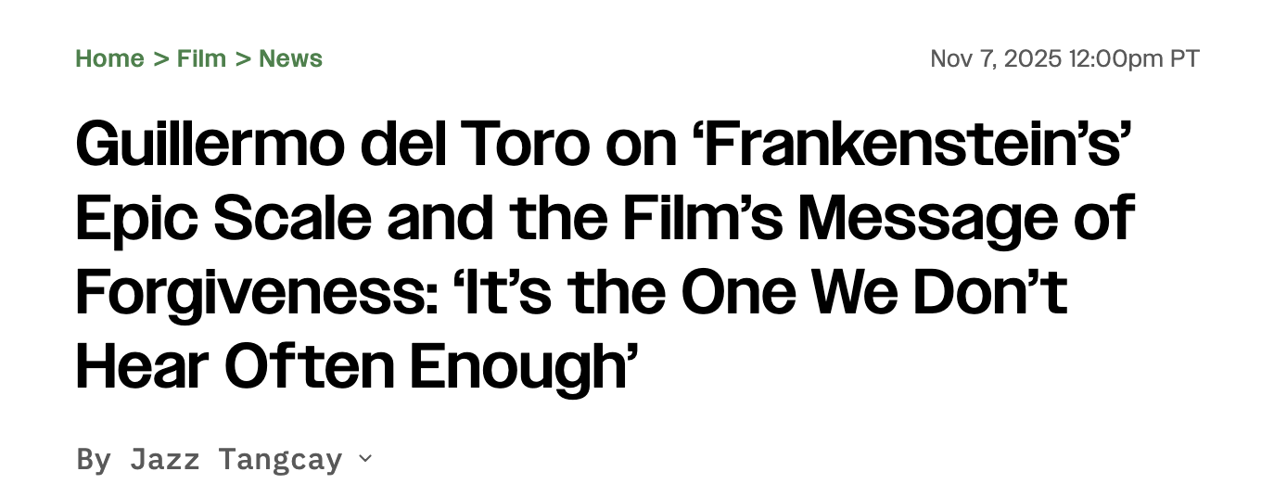
Can / should artworks be paraphrased?

Slide 6
Can / should artworks be paraphrased?
Paraphrase is common/useful in many contexts;
e.g: paraphrased meanings of political speech...

Slide 7
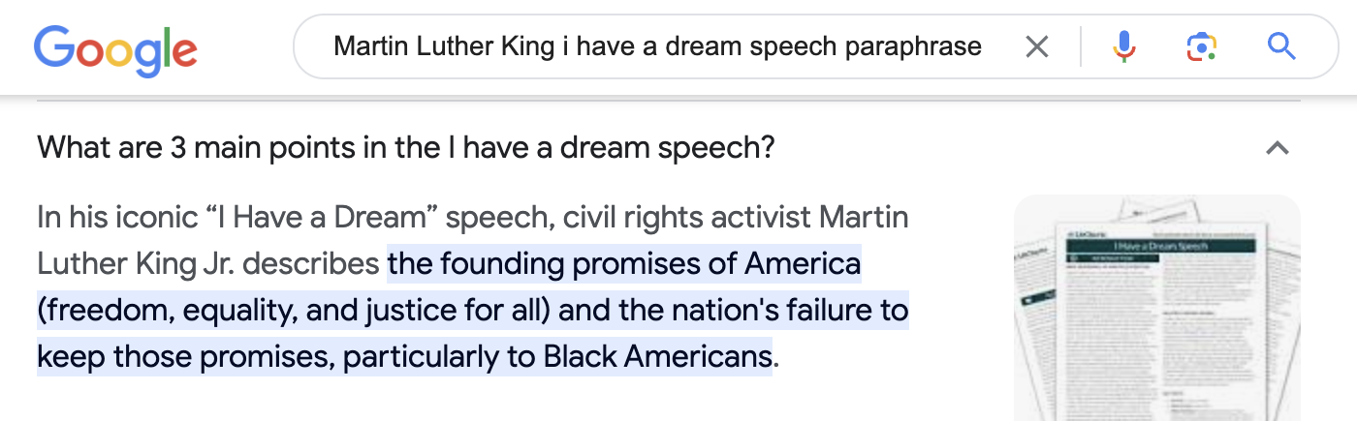
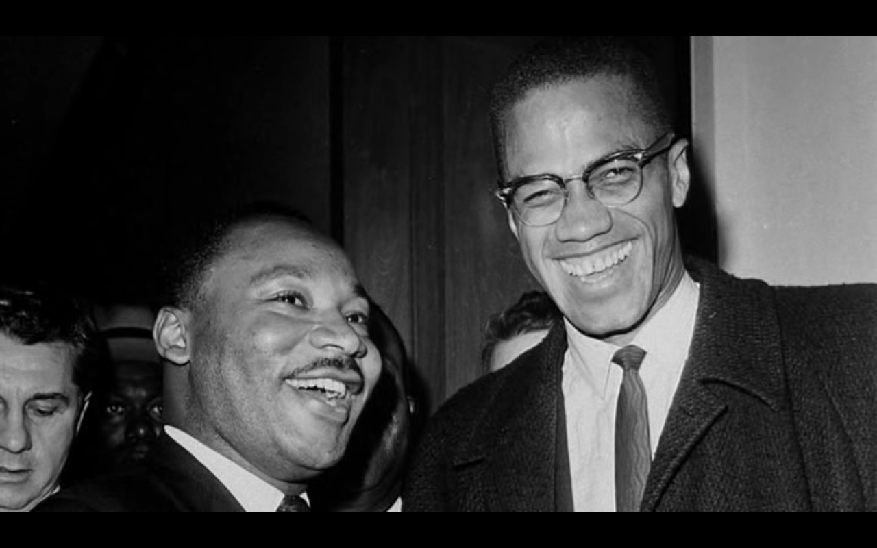
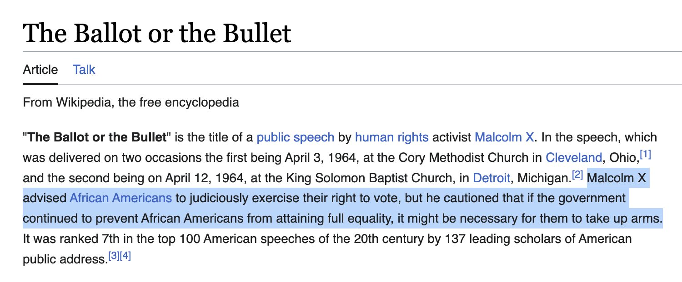
Can / should artworks be paraphrased?
Paraphrase is common/useful in many contexts;
e.g: paraphrased meanings of political speech...

Slide 8
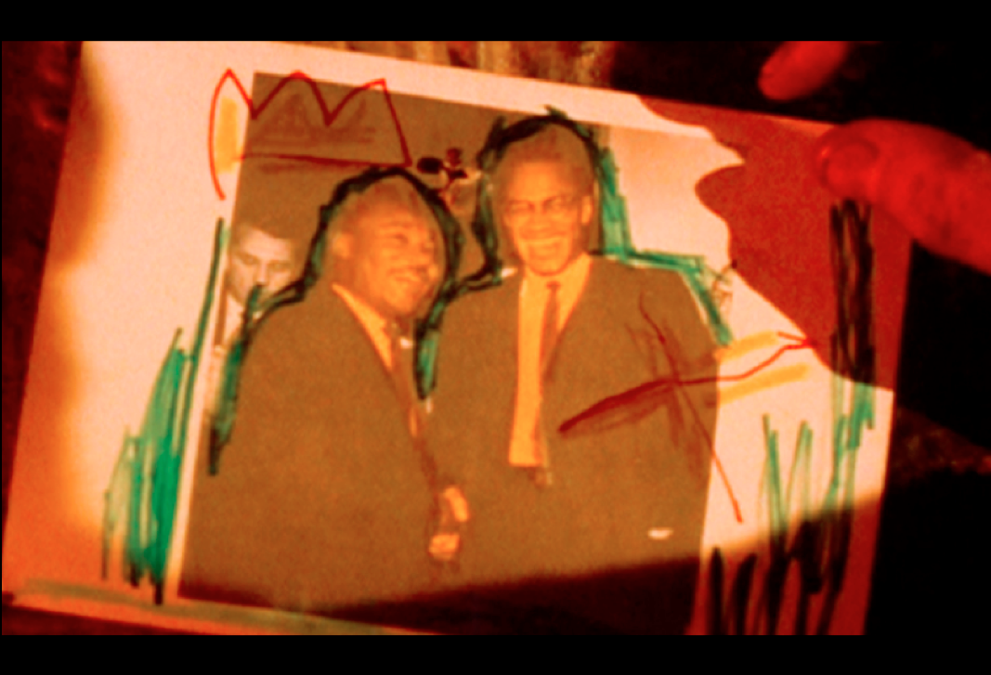
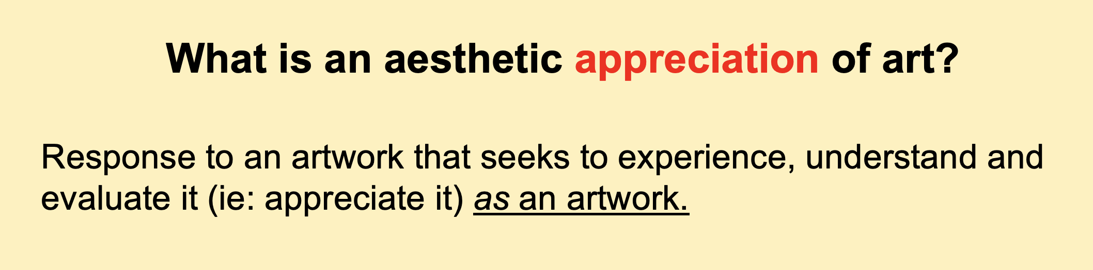
Can / should artworks be paraphrased?
Paraphrase is common/useful in many contexts;
e.g: paraphrased meanings of political speech...

Slide 9
Can / should artworks be paraphrased?
Brooks Rejects: …‘[the] implication that the poem constitutes a “statement” of some sort.’ (Brooks, 1947: 196)

Slide 10
Can / should artworks be paraphrased?
Brooks Rejects: …‘[the] implication that the poem constitutes a “statement” of some sort.’ (Brooks, 1947: 196)
‘If we allow ourselves to be misled by [the heresy of paraphrase] [...] we bring [poetry] into an unreal competition with science or philosophy or theology.’ (Brooks, 1947: 201)

Slide 11
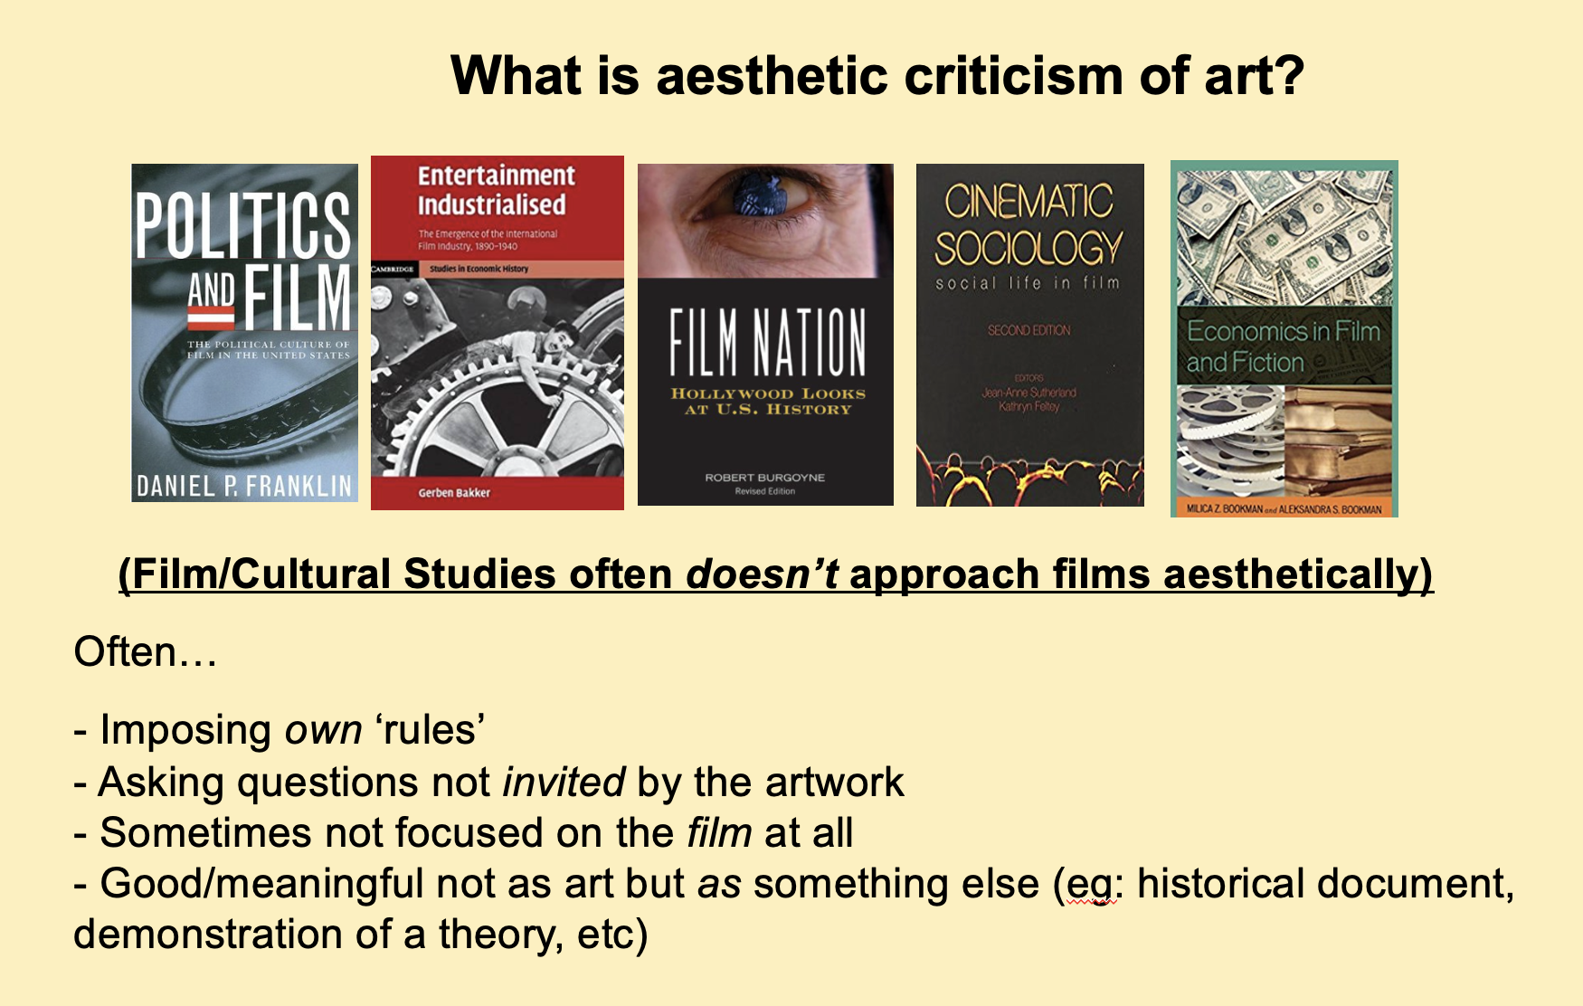
Can / should artworks be paraphrased?
Brooks Rejects: …‘[the] implication that the poem constitutes a “statement” of some sort.’ (Brooks, 1947: 196)
‘If we allow ourselves to be misled by [the heresy of paraphrase] [...] we bring [poetry] into an unreal competition with science or philosophy or theology.’ (Brooks, 1947: 201) Or politics…

Slide 12
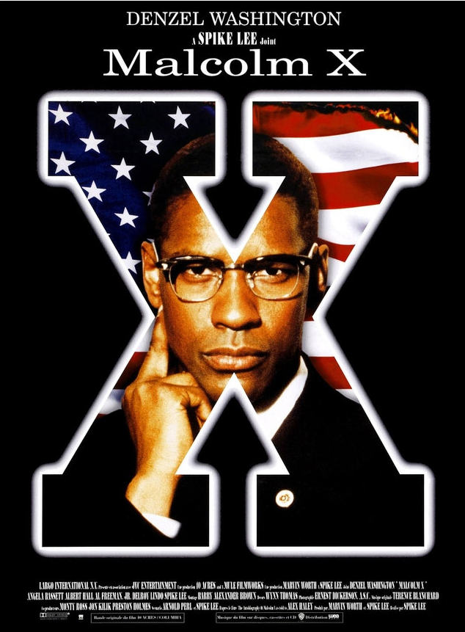

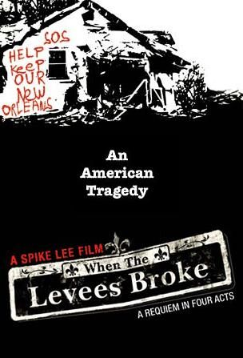

Can / should artworks be paraphrased?
Brooks Rejects: …‘[the] implication that the poem constitutes a “statement” of some sort.’ (Brooks, 1947: 196)
‘If we allow ourselves to be misled by [the heresy of paraphrase] [...] we bring [poetry] into an unreal competition with science or philosophy or theology.’ (Brooks, 1947: 201) Or politics…

Slide 13
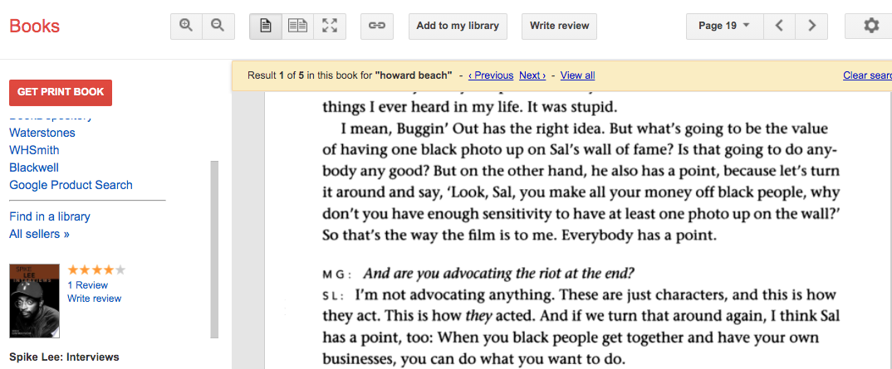
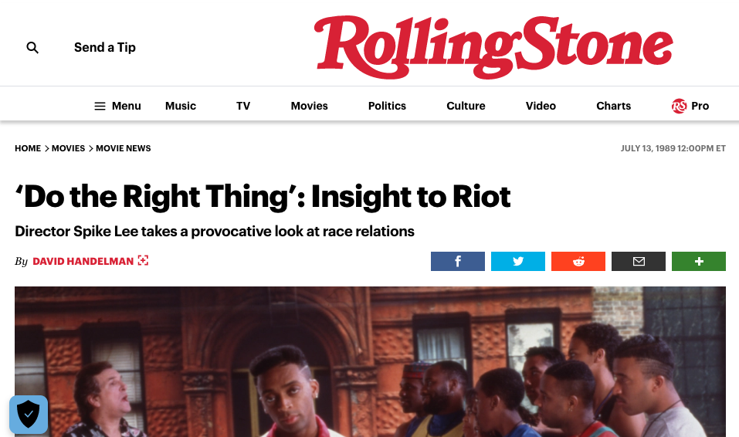
Can / should artworks be paraphrased?
Brooks Rejects: …‘[the] implication that the poem constitutes a “statement” of some sort.’ (Brooks, 1947: 196)
‘If we allow ourselves to be misled by [the heresy of paraphrase] [...] we bring [poetry] into an unreal competition with science or philosophy or theology.’ (Brooks, 1947: 201) Or politics…

Slide 14
Can / should artworks be paraphrased?
‘[Do the Right Thing] graphically portrays the racism we know without suggesting what can be done to bring about change.’ (hooks, 1990: 185)

Slide 15
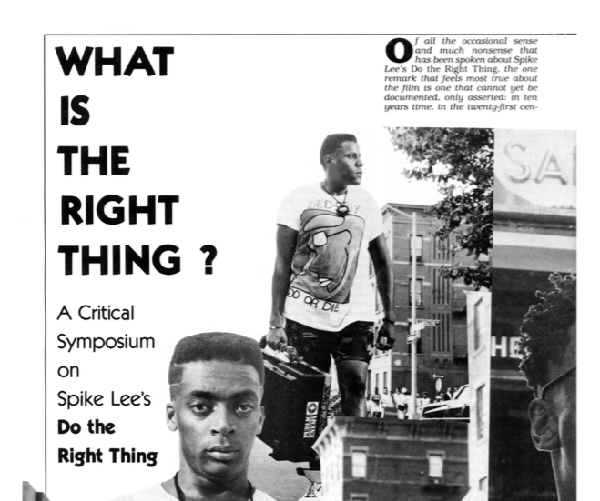
Can / should artworks be paraphrased?
‘[Do the Right Thing] graphically portrays the racism we know without suggesting what can be done to bring about change.’ (hooks, 1990: 185)
On Do the Right Thing: ‘I think its political “message” (if it has one) is probably incoherent.’ (Mitchell, 2017: 106)

Slide 16
Can / should artworks be paraphrased?
Despite Lee’s courageous attempt to mix politics and art, […] [Do the Right Thing] graphically portrays the racism we know without suggesting what can be done to bring about change.’ (hooks, 1990: 185)
On Do the Right Thing: ‘I think its political “message” (if it has one) is probably incoherent.’ (Mitchell, 2017: 106)

Slide 17
Can / should artworks be paraphrased?
On Do the Right Thing: ‘I think its political “message” (if it has one) is probably incoherent.’ (Mitchell, 2017: 106)
The ‘heresy of paraphrase’:
‘It is the scientist [or politician?] whose truth requires a language purged of every trace of paradox; [...] the "truth" which the poet utters can be approached only in terms paradox.’ (Brooks, 1947: 3)

Slide 18
Paraphrase type (1): Statements in a work

Slide 19
Paraphrase type (1): Statements in a work
‘Whatever statement we may seize upon as incorporating the “meaning” of the poem, immediately the imagery and the rhythm seem to set up tensions within it, warping and twisting it, qualifying and revising it.’ (Brooks, 1947: 197)

Slide 20
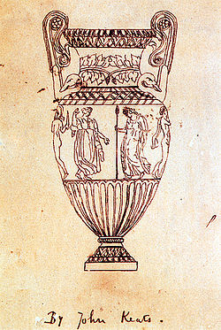


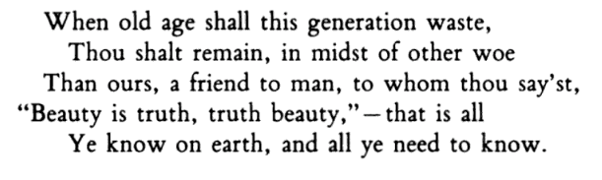
Paraphrase type (1): Statements in a work
‘Whatever statement we may seize upon as incorporating the “meaning” of the poem, immediately the imagery and the rhythm seem to set up tensions within it, warping and twisting it, qualifying and revising it.’ (Brooks, 1947: 197)

Slide 21
Paraphrase type (1): Statements in a work
‘Whatever statement we may seize upon as incorporating the “meaning” of the poem, immediately the imagery and the rhythm seem to set up tensions within it, warping and twisting it, qualifying and revising it.’ (Brooks, 1947: 197)

Slide 22
Paraphrase type (1): Statements in a work
‘[It is not a] generalization, unqualified and to be taken literally. […] “Beauty is truth, truth beauty” […] is a speech "in character" and supported by a dramatic context.' (Brooks, 1947: 165)

Slide 23
Paraphrase type (1): Statements in a work
‘[It is not a] generalization, unqualified and to be taken literally. […] “Beauty is truth, truth beauty” […] is a speech "in character" and supported by a dramatic context.' (Brooks, 1947: 165)
‘If we take it on the level of statement, [this] is a paradox. […] The Urn must, in its role as historian, assert that myth is truer than history.’ (ibid: 213)

Slide 24
Paraphrase type (1): Statements in a work
All ‘statements’ in artworks receive tensions
from aesthetic form/structures:
‘If we take it on the level of statement, [this] is a paradox. […] The Urn must, in its role as historian, assert that myth is truer than history.’ (ibid: 213)

Slide 25
Paraphrase type (1): Statements in a work
All ‘statements’ in artworks receive tensions
from aesthetic form/structures:
‘Irony is the most general term that we have for the kind of qualification which the various elements in a context receive from the context.’ (Brooks, 1947: 209)

Slide 26
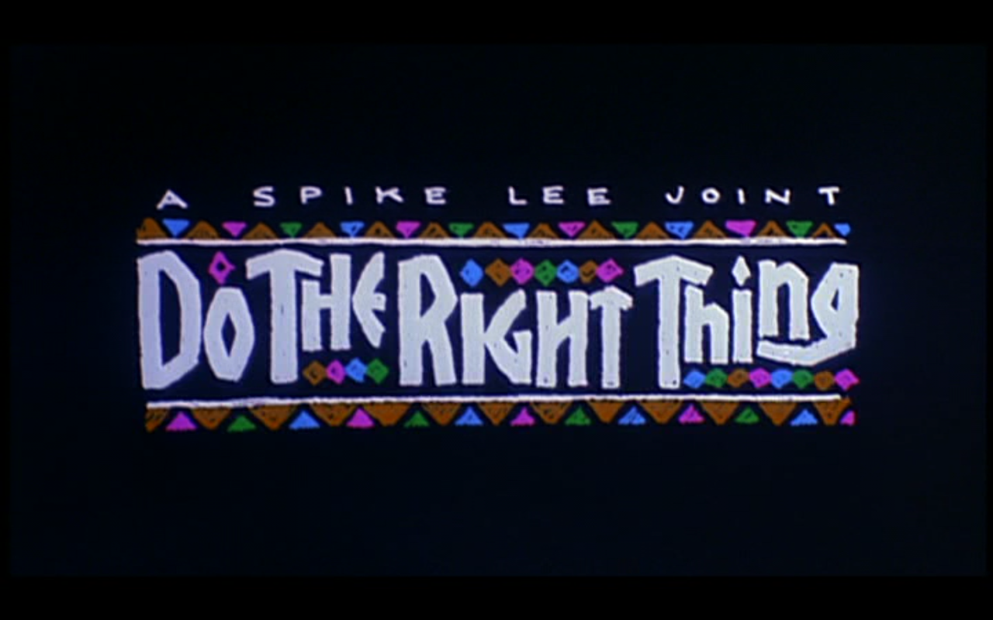
Paraphrase type (1): Statements in a work
All ‘statements’ in artworks receive tensions
from aesthetic form/structures:
A film filled with ‘statements’/slogans/‘messages’…
‘Irony is the most general term that we have for the kind of qualification which the various elements in a context receive from the context.’ (Brooks, 1947: 209)

Slide 27
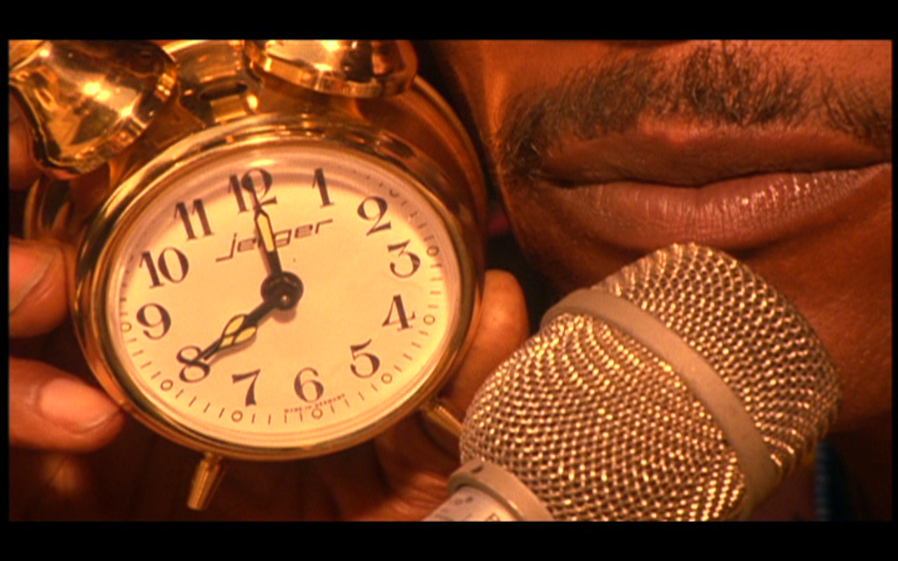
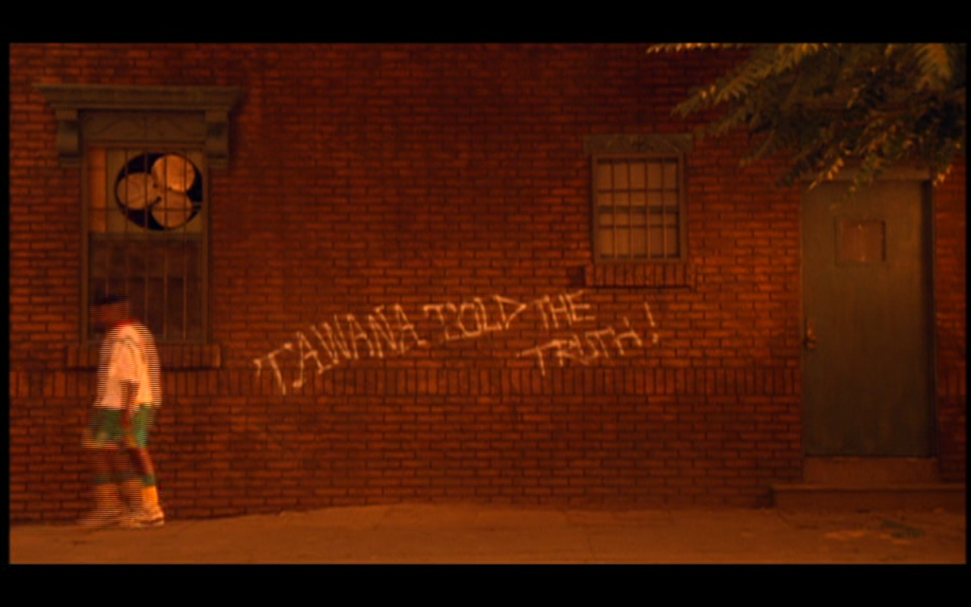
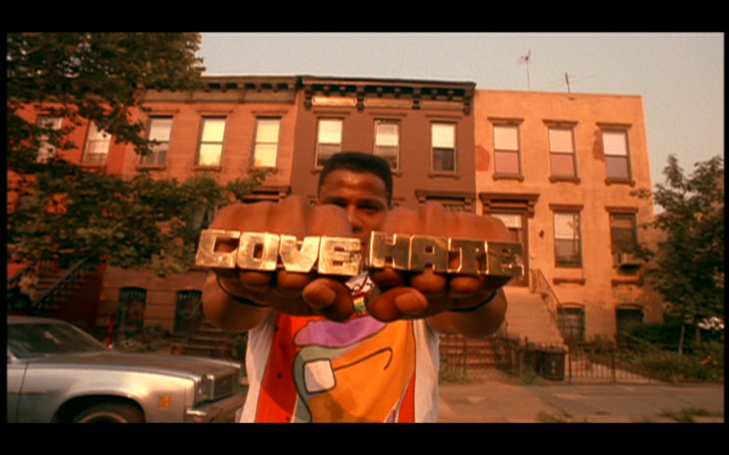
Paraphrase type (1): Statements in a work
All ‘statements’ in artworks receive tensions
from aesthetic form/structures:
A film filled with ‘statements’/slogans/‘messages’…

Slide 28
Paraphrase type (1): Statements in a work
‘Whatever statement we may seize upon as incorporating the “meaning” of the poem, immediately the imagery and the rhythm seem to set up tensions within it, warping and twisting it, qualifying and revising it.’
A film filled with ‘statements’/slogans/‘messages’…

Slide 29

Paraphrase type (1): Statements in a work
‘Whatever statement we may seize upon as incorporating the “meaning” of the poem, immediately the imagery and the rhythm seem to set up tensions within it, warping and twisting it, qualifying and revising it.’

Slide 30

Paraphrase type (1): Statements in a work
‘Whatever statement we may seize upon as incorporating the “meaning” of the poem, immediately the imagery and the rhythm seem to set up tensions within it, warping and twisting it, qualifying and revising it.’

Slide 31
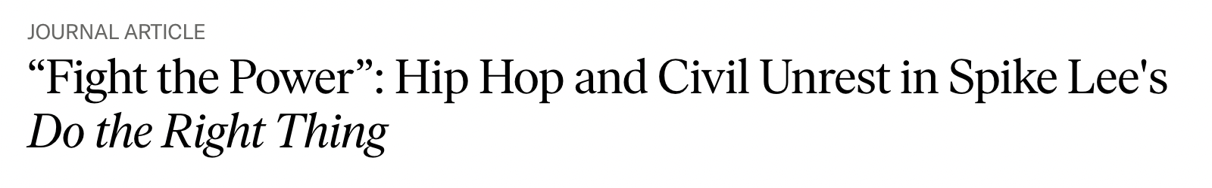

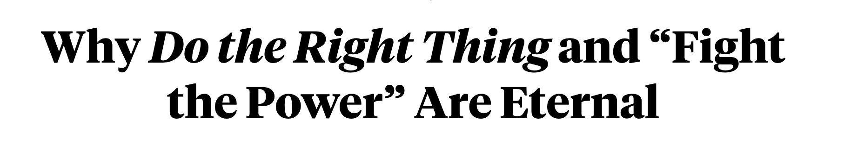
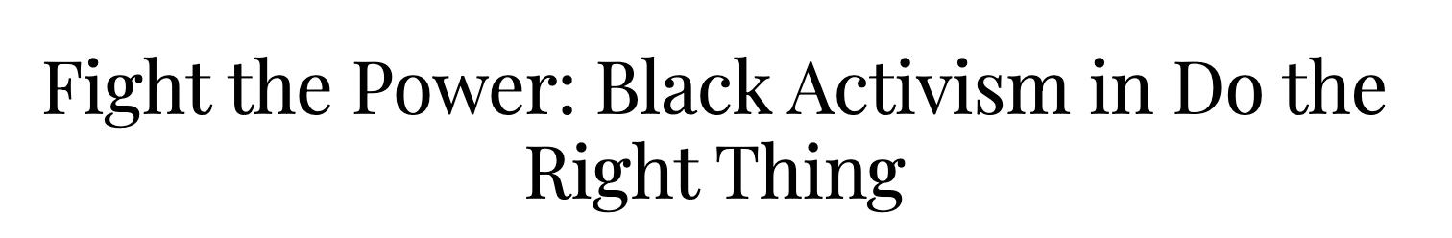
Paraphrase type (1): Statements in a work
‘Whatever statement we may seize upon as incorporating the “meaning” of the poem, immediately the imagery and the rhythm seem to set up tensions within it, warping and twisting it, qualifying and revising it.’

Slide 32
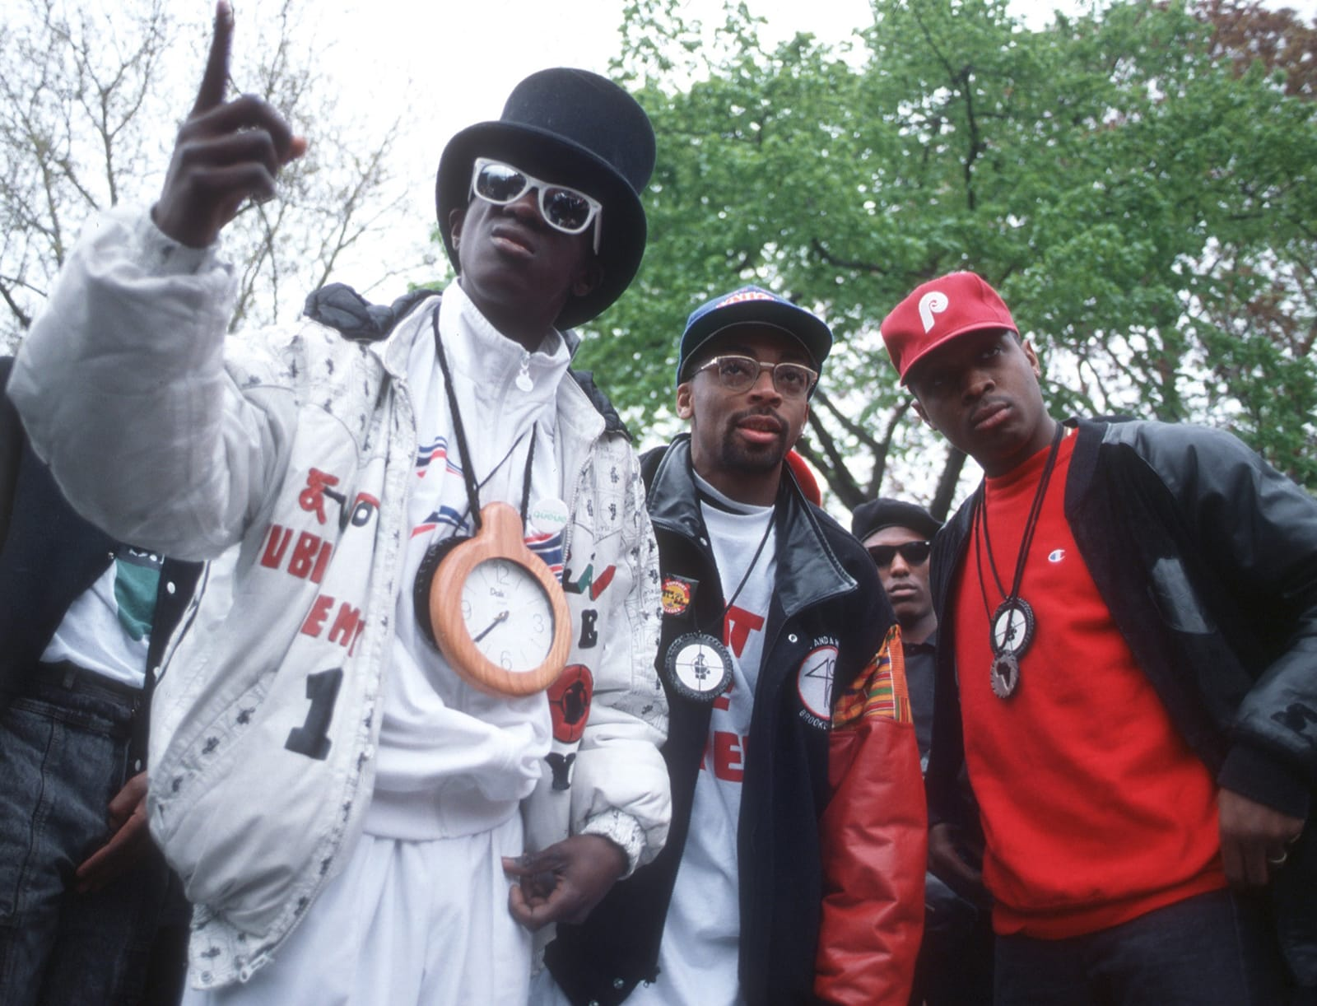
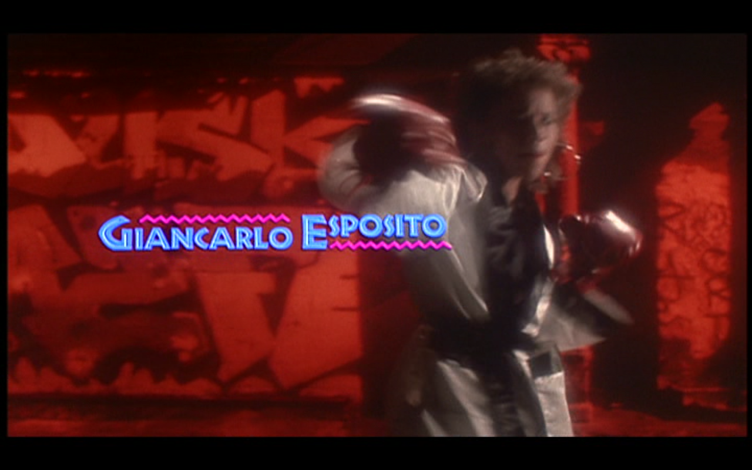
Paraphrase type (1): Statements in a work
‘Whatever statement we may seize upon as incorporating the “meaning” of the poem, immediately the imagery and the rhythm seem to set up tensions within it, warping and twisting it, qualifying and revising it.’
The ‘statement’ ‘Fight the Power’…

Slide 33
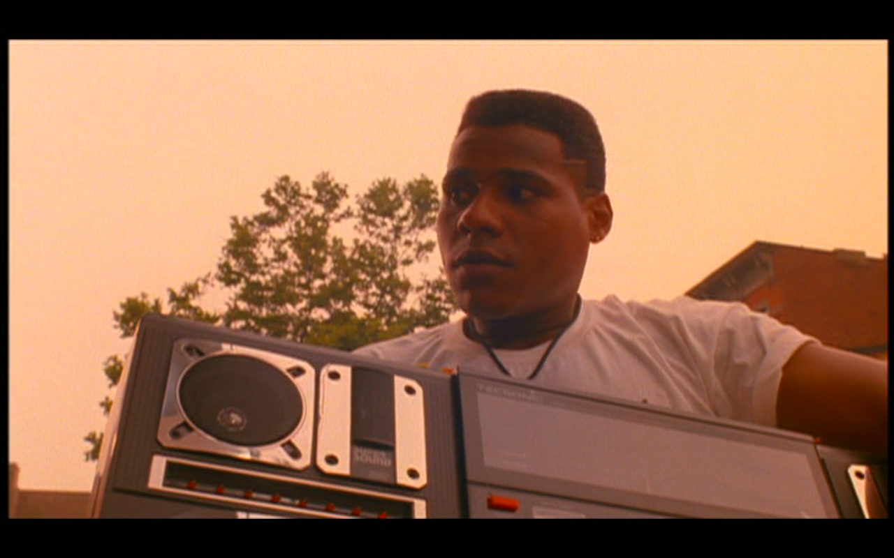
Paraphrase type (1): Statements in a work
‘Whatever statement we may seize upon as incorporating the “meaning” of the poem, immediately the imagery and the rhythm seem to set up tensions within it, warping and twisting it, qualifying and revising it.’

Slide 34
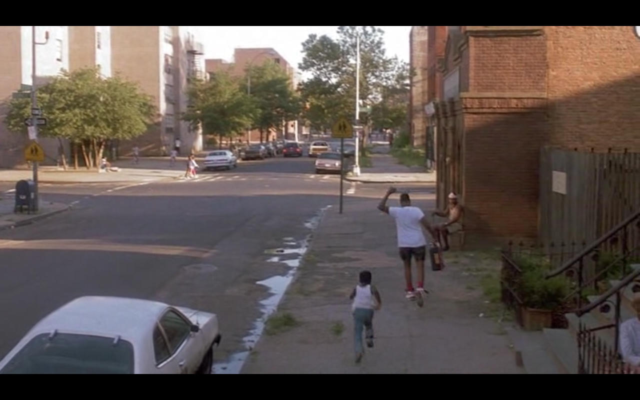
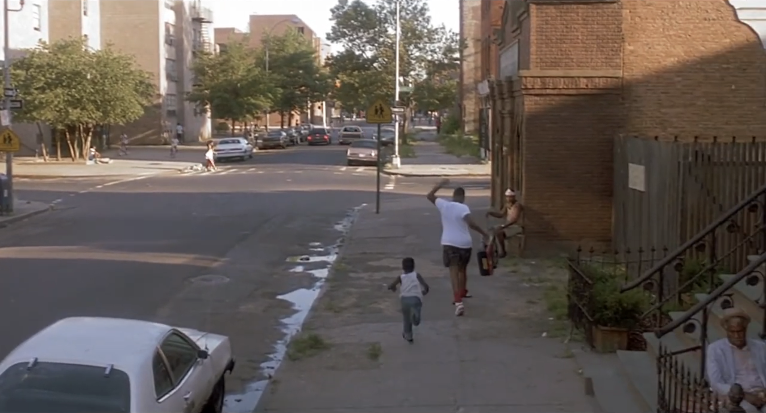
Paraphrase type (1): Statements in a work
‘Whatever statement we may seize upon as incorporating the “meaning” of the poem, immediately the imagery and the rhythm seem to set up tensions within it, warping and twisting it, qualifying and revising it.’
[…]

Slide 35
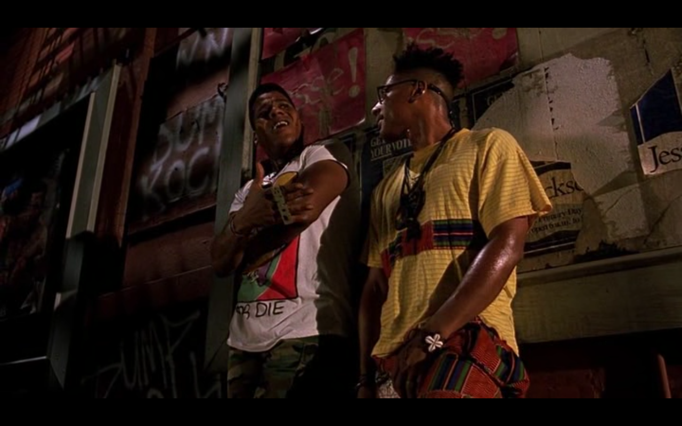
Paraphrase type (1): Statements in a work
‘Whatever statement we may seize upon as incorporating the “meaning” of the poem, immediately the imagery and the rhythm seem to set up tensions within it, warping and twisting it, qualifying and revising it.’

Slide 36

Paraphrase type (1): Statements in a work
‘Whatever statement we may seize upon as incorporating the “meaning” of the poem, immediately the imagery and the rhythm seem to set up tensions within it, warping and twisting it, qualifying and revising it.’
[…]

Slide 37
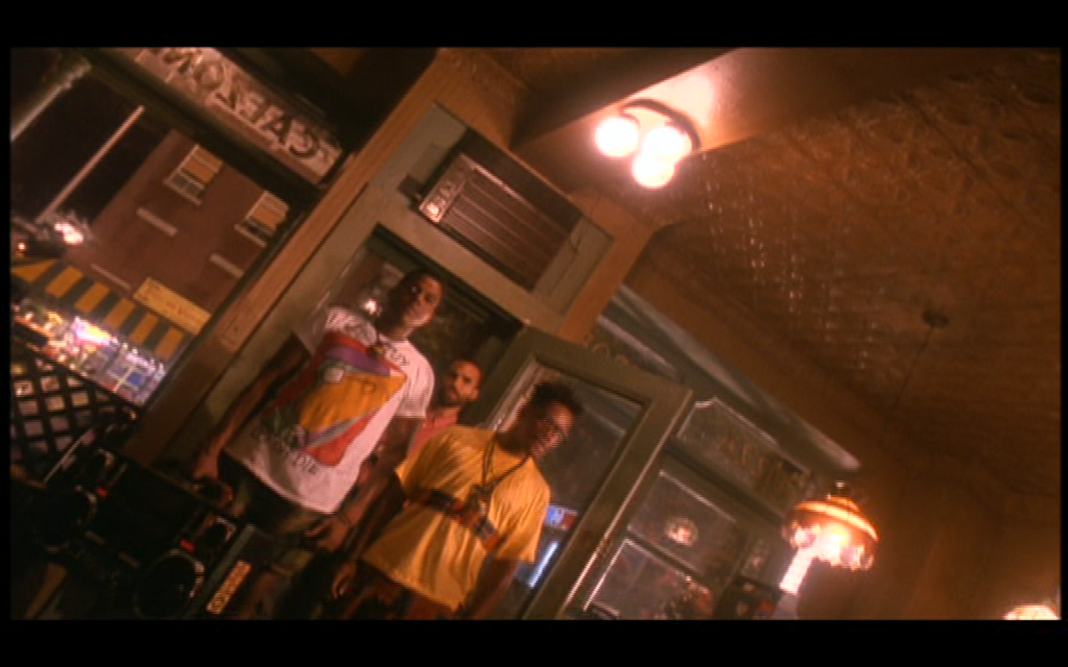
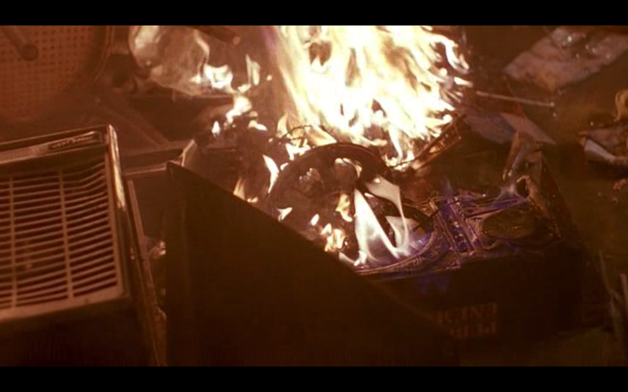
Paraphrase type (1): Statements in a work
‘Whatever statement we may seize upon as incorporating the “meaning” of the poem, immediately the imagery and the rhythm seem to set up tensions within it, warping and twisting it, qualifying and revising it.’
[…]

Slide 38
Paraphrase type (1): Statements in a work
‘Whatever statement we may seize upon as incorporating the “meaning” of the poem, immediately the imagery and the rhythm seem to set up tensions within it, warping and twisting it, qualifying and revising it.’
‘Irony is the most general term that we have for the kind of qualification which the various elements in a context receive from the context.’ (Brooks, 1947: 209)

Slide 39
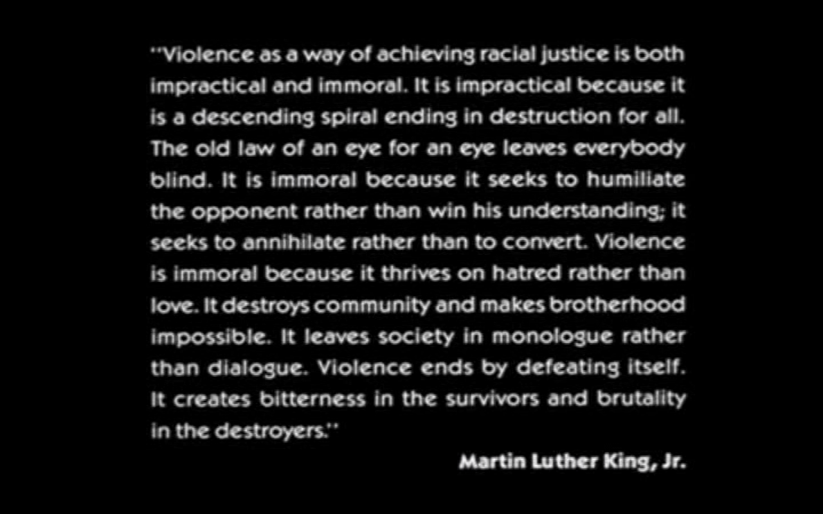
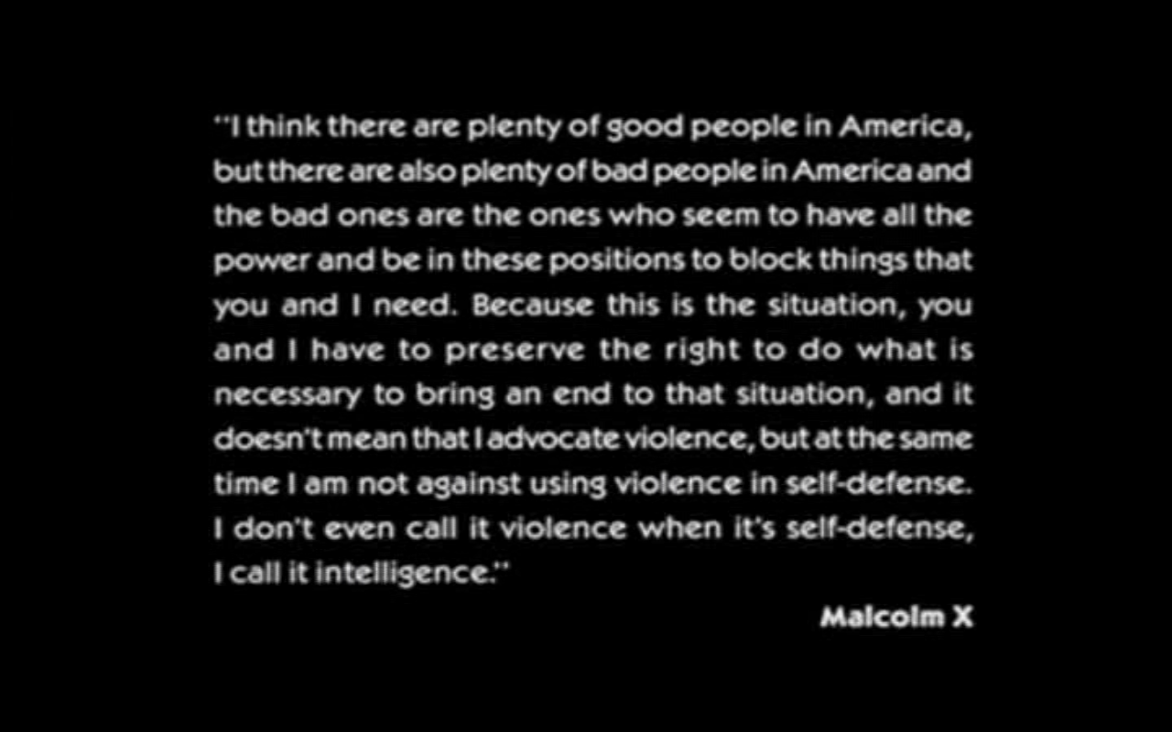
Paraphrase type (1): Statements in a work
‘Whatever statement we may seize upon as incorporating the “meaning” of the poem, immediately the imagery and the rhythm seem to set up tensions within it, warping and twisting it, qualifying and revising it.’
‘Irony is the most general term that we have for the kind of qualification which the various elements in a context receive from the context.’ (Brooks, 1947: 209)

Slide 40
Paraphrase type (1): Statements in a work
‘Whatever statement we may seize upon as incorporating the “meaning” of the poem, immediately the imagery and the rhythm seem to set up tensions within it, warping and twisting it, qualifying and revising it.’
…‘The reconcilement of opposites which the poet characteristically makes.’
(Brooks, 1947: 198)

Slide 41
Paraphrase type (1): Statements in a work
‘Whatever statement we may seize upon as incorporating the “meaning” of the poem, immediately the imagery and the rhythm seem to set up tensions within it, warping and twisting it, qualifying and revising it.’
…‘The reconcilement of opposites which the poet characteristically makes.’
(Brooks, 1947: 198)

Slide 42
Paraphrase type (2): Statements summarising a work

Slide 43
Paraphrase type (2): Statements summarising a work
‘Is it not possible to frame a proposition, a statement, which will adequately […] “say,” briefly and in the form of a proposition, what the poem “says” as a poem, […] no more and no less?’ (Brooks, 1947: 205)

Slide 44
Paraphrase type (2): Statements summarising a work
‘Is it not possible to frame a proposition, a statement, which will adequately […] “say,” briefly and in the form of a proposition, what the poem “says” as a poem, […] no more and no less?’ (Brooks, 1947: 205)
E.g: “…To achieve racial justice we must find a strategy which synthesises the wisdom of King and X”?

Slide 45
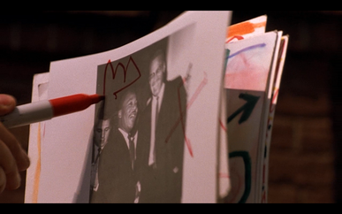
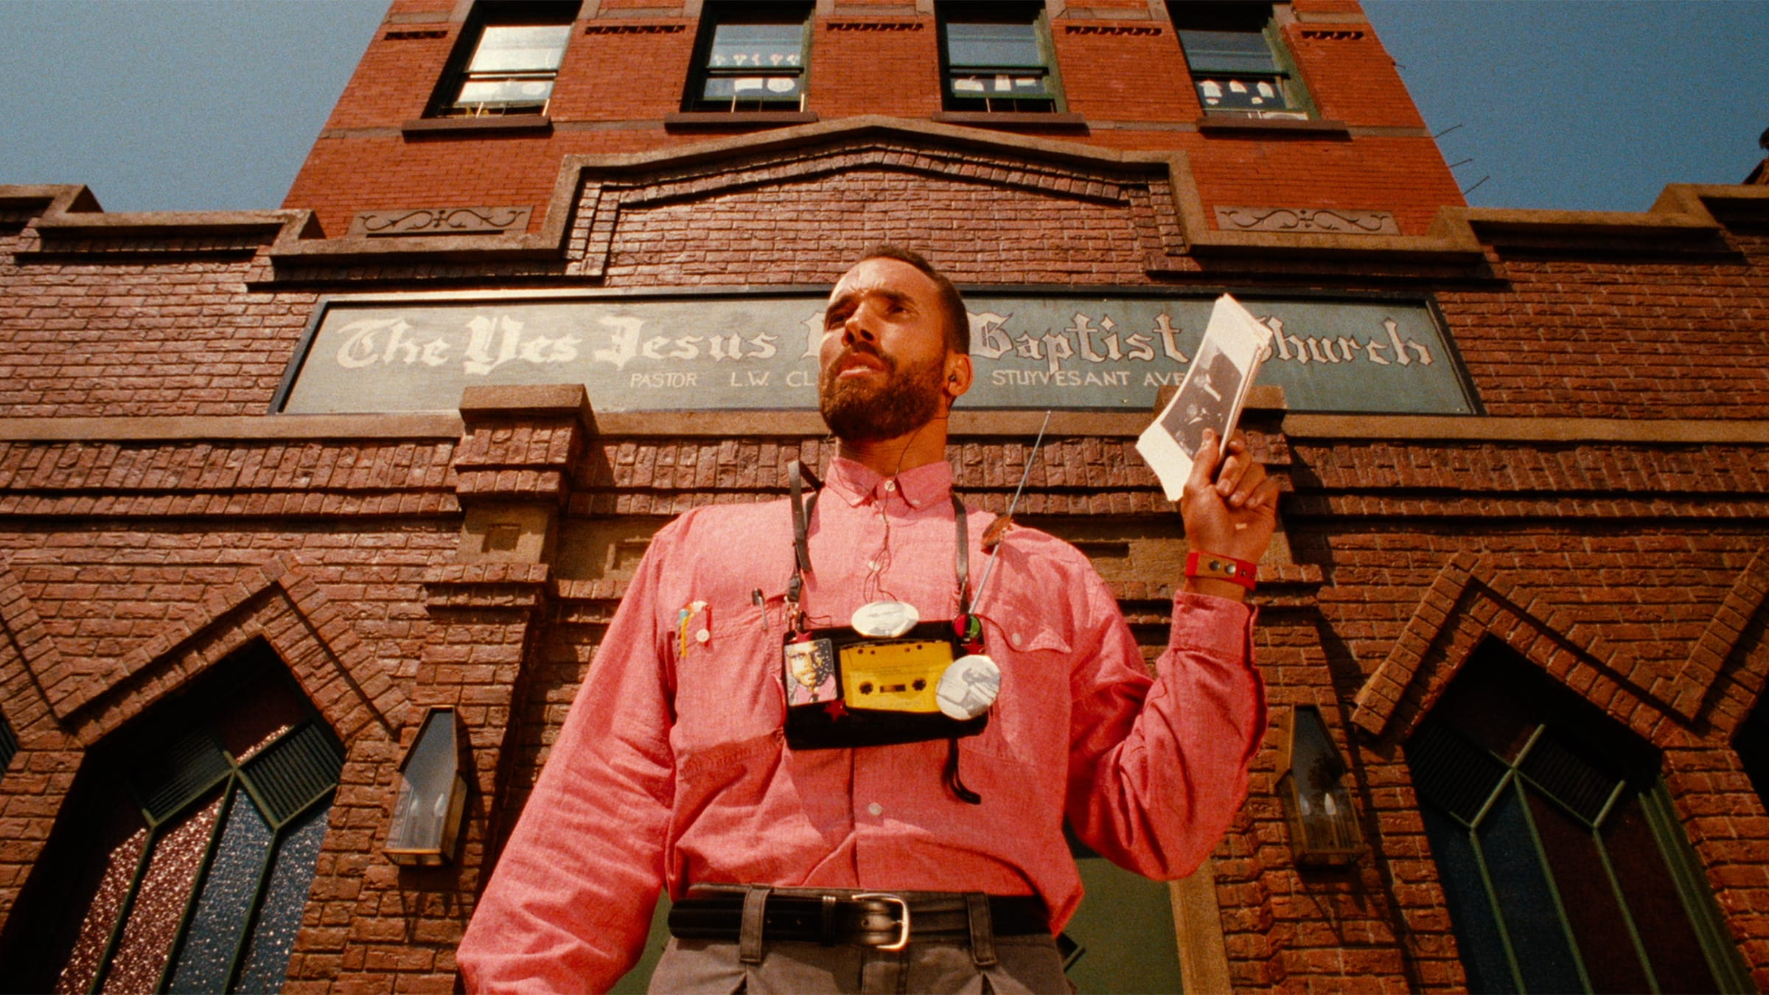
Paraphrase type (2): Statements summarising a work
‘Is it not possible to frame a proposition, a statement, which will adequately […] “say,” briefly and in the form of a proposition, what the poem “says” as a poem, […] no more and no less?’ (Brooks, 1947: 205)
E.g: “…To achieve racial justice we must find a strategy which synthesises the wisdom of King and X”?

Slide 46
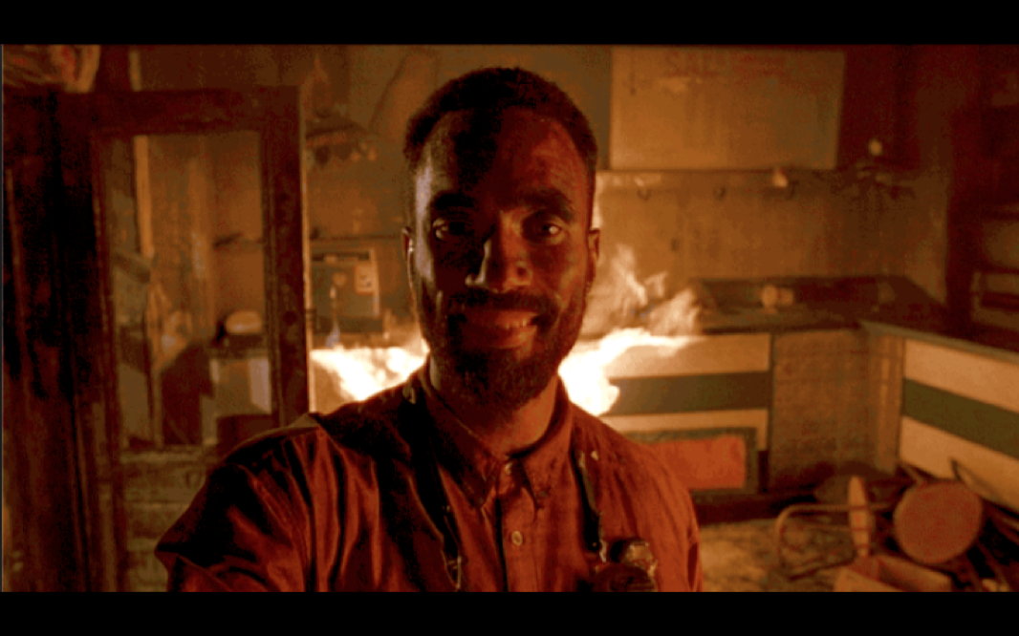
Paraphrase type (2): Statements summarising a work
‘Is it not possible to frame a proposition, a statement, which will adequately […] “say,” briefly and in the form of a proposition, what the poem “says” as a poem, […] no more and no less?’ (Brooks, 1947: 205)
E.g: “…To achieve racial justice we must find a strategy which synthesises the wisdom of King and X”?

Slide 47
Paraphrase type (2): Statements summarising a work
E.g: “…To achieve racial justice we must find a strategy which synthesises the wisdom of King and X”?

Slide 48
Paraphrase type (2): Statements summarising a work
‘The dimension in which the poem moves is not one which excludes ideas, but one which does include attitudes’ / ‘…a structure of meanings, evaluations and interpretations’
(Brooks, 1947: 205 / 195)

Slide 49

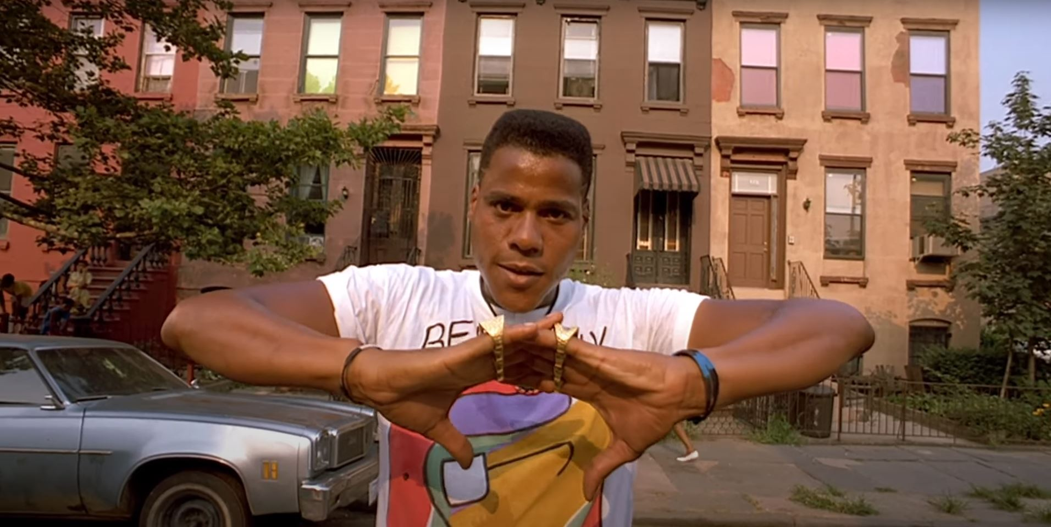
Paraphrase type (2): Statements summarising a work
Structure: Multiple, conflicting perspectives / attitudes, placed in tension:
…
‘The dimension in which the poem moves is not one which excludes ideas, but one which does include attitudes’ / ‘…a structure of meanings, evaluations and interpretations’
(Brooks, 1947: 205 / 195)

Slide 50
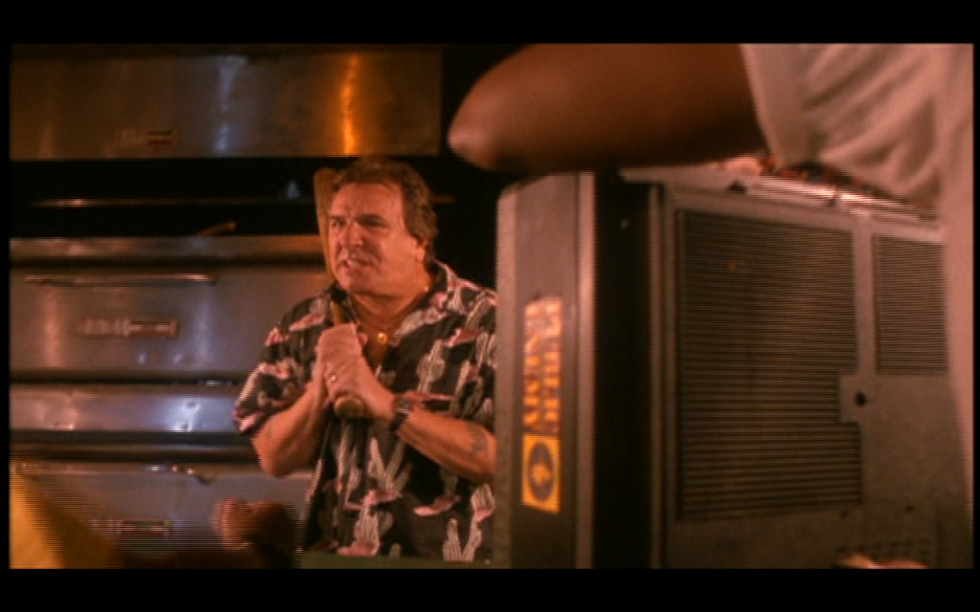

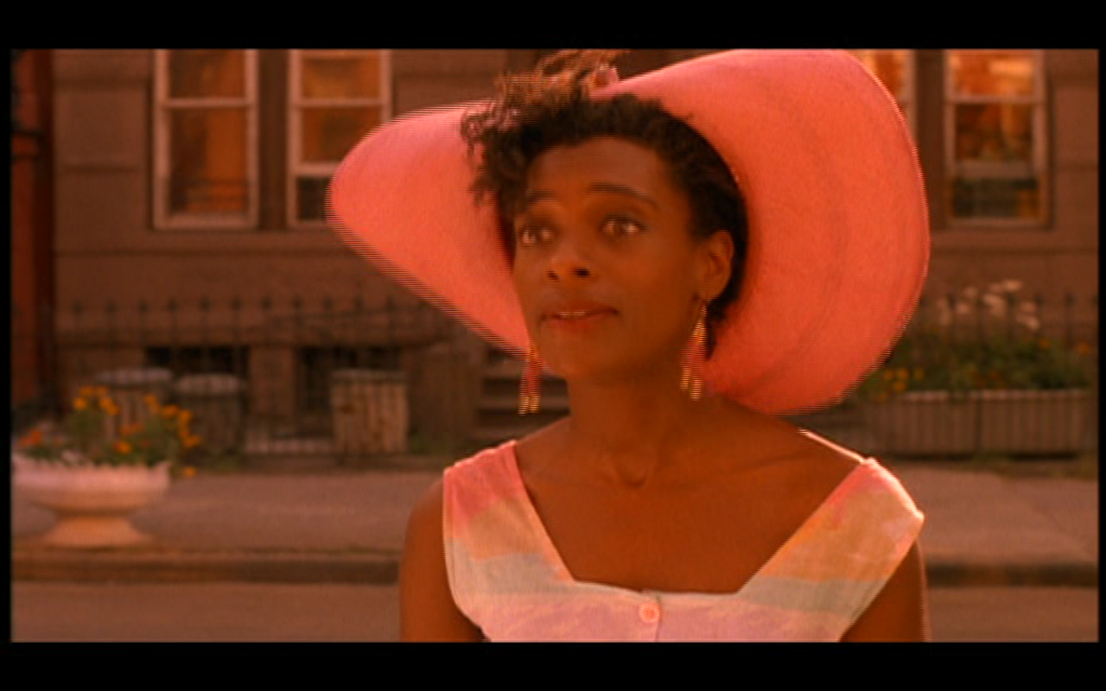
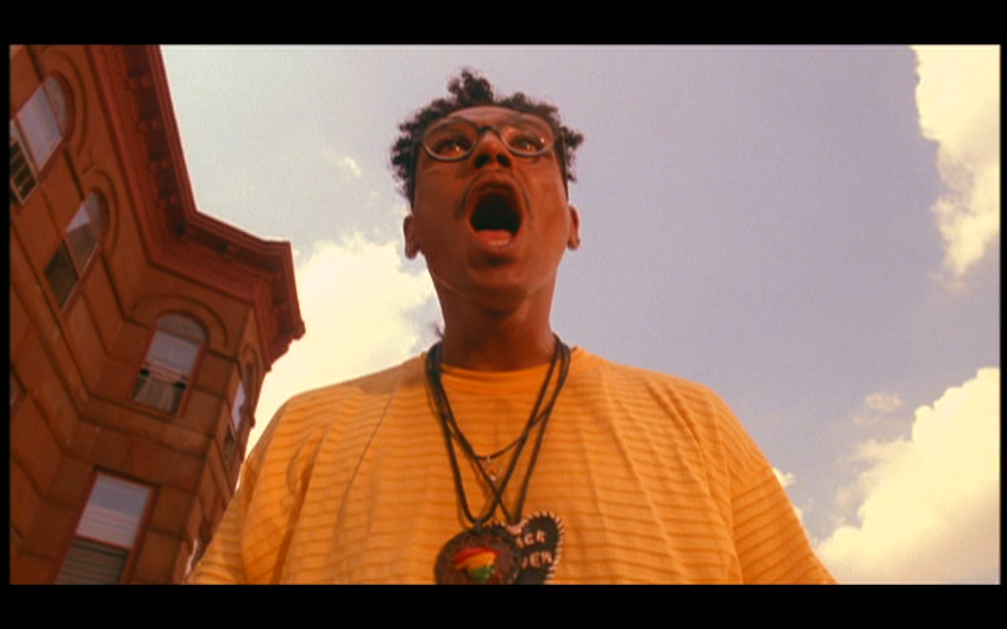

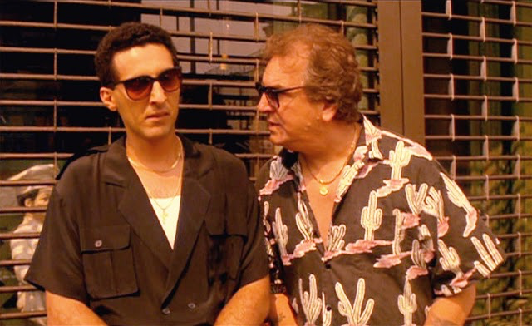
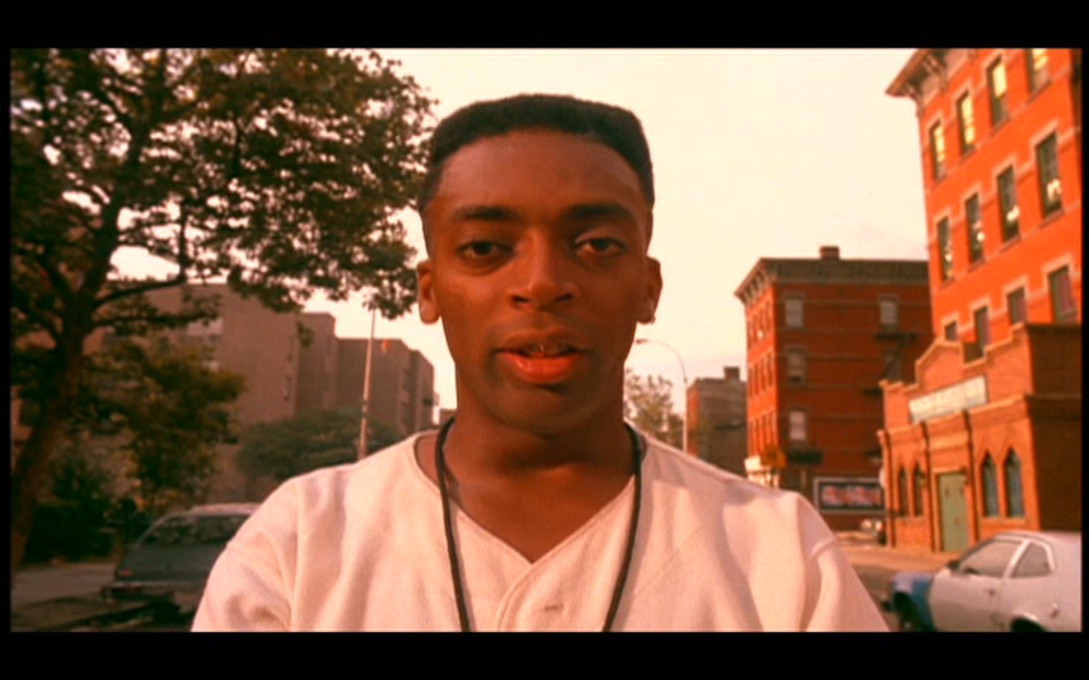
Paraphrase type (2): Statements summarising a work
Structure: Multiple, conflicting perspectives / attitudes, placed in tension:
…

Slide 51
Paraphrase type (2): Statements summarising a work
Questions:
- What other ‘statements’ in the film receive irony/tension/complexity from the work’s aesthetic structure? How?
- Are there any ‘statements’ in the film that you think are presented wholly sincerely and don’t receive irony/tension/complexity from surrounding film?

Slide 52
Bibliography
- Brooks, Cleanth (1947) ‘The Heresy of Paraphrase’, in The Well-Wrought Urn and Other Essays, New York: Harcourt Brace and Jovanovich, 176-96. Online: http://www.ux1.eiu.edu/~rlbeebe/heresy.pdf
- Frith, Simon. (1996) ‘The Value Problem in Cultural Studies’, in Performing Rites: on the Value of Popular Music, Oxford: Oxford University Press, 3-20.
- Glicksman, Marlaine (2002) [1989] 'Spike Lee's Bed-Stuy BBQ', in Spike Lee: Interviews, Cynthia Fuchs (ed), Mississippi: University of Mississippi Press, 13-24; online: https://www.asu.edu/courses/fms200s/total-readings/Glicksman_Spike%20Lee.pdf
- hooks, bell (1990) Yearning: Race, Gender, and Cultural Politics, Boston: South End Press.
- Mitchell, W. J. T. (2017) W.J.T. Mitchell's Image Theory: Living Pictures, Krešimir Purgar (ed), New York: Routledge.
- Pye, Douglas. (2007). ‘Movies and Tone’, in Gibbs, John & Douglas Pye (eds), Close-Up 02: Movies and Tone/Reading Rohmer/Voices in Film. London: Wallflower Press, 1–80.
- Robert Sklar, Jacquie Jones, Salim Muwakkil, Zeinabu Irene Davis, Charles Musser and Lisa Kennedy (1990) ‘What is the Right Thing? A Critical Symposium on Spike Lee's Do the Right Thing’, Cinéaste, Vol. 17.4, 32-39.

