Slide 1

GCRF Compass+:
Comprehensive Capacity-Building in Central Eurasia
Tackling sustainability challenges through the lens of resilience

Slide 2
Context
We are living in an unjust, fragile and geo-politically unstable world. This insecurity is driven by the twin crises of security and the environment (Black et al., 2022).
Dealing with these crises requires new ways of ‘being, knowing and doing’ (Escobar 2018).

Slide 3



Research Impact Forum • 26th January 2023
Discussions were centred around three key challenges:
Local perspectives on resilience
Regional challenges to sustainable governance and how to tackle them
Rethinking international support and global governance in a pluriversal world.

Slide 4
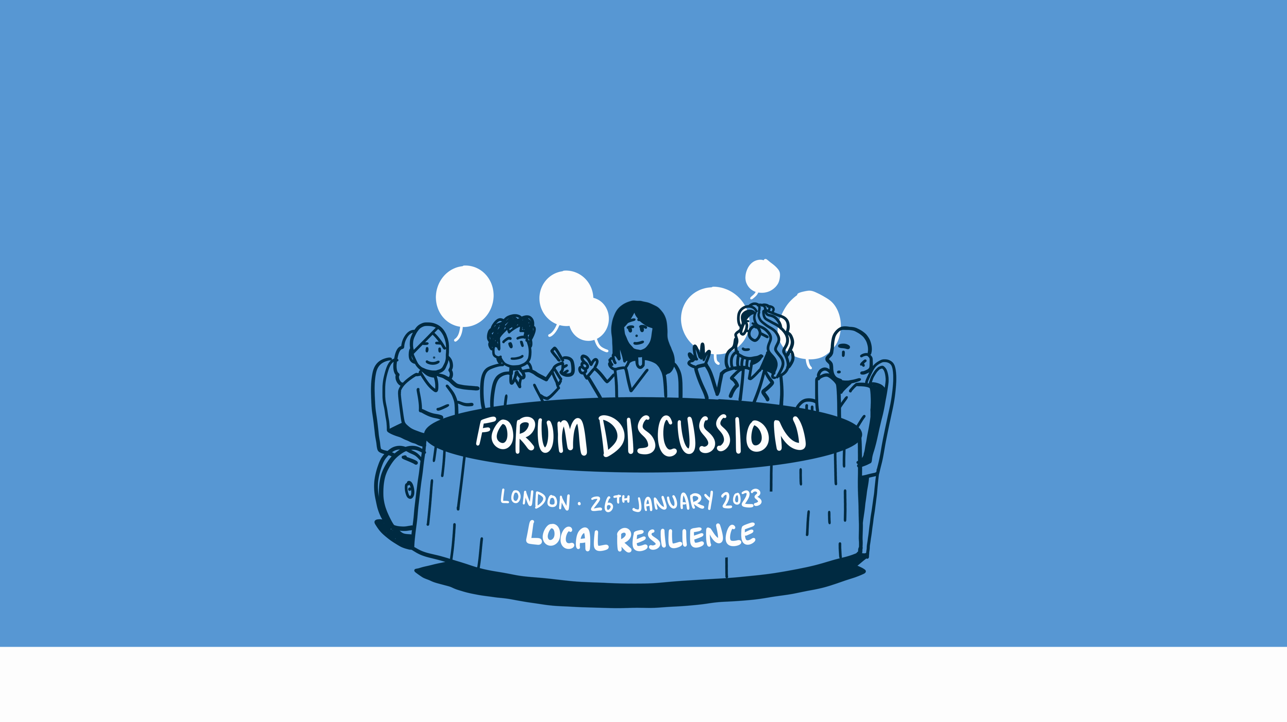

Slide 5
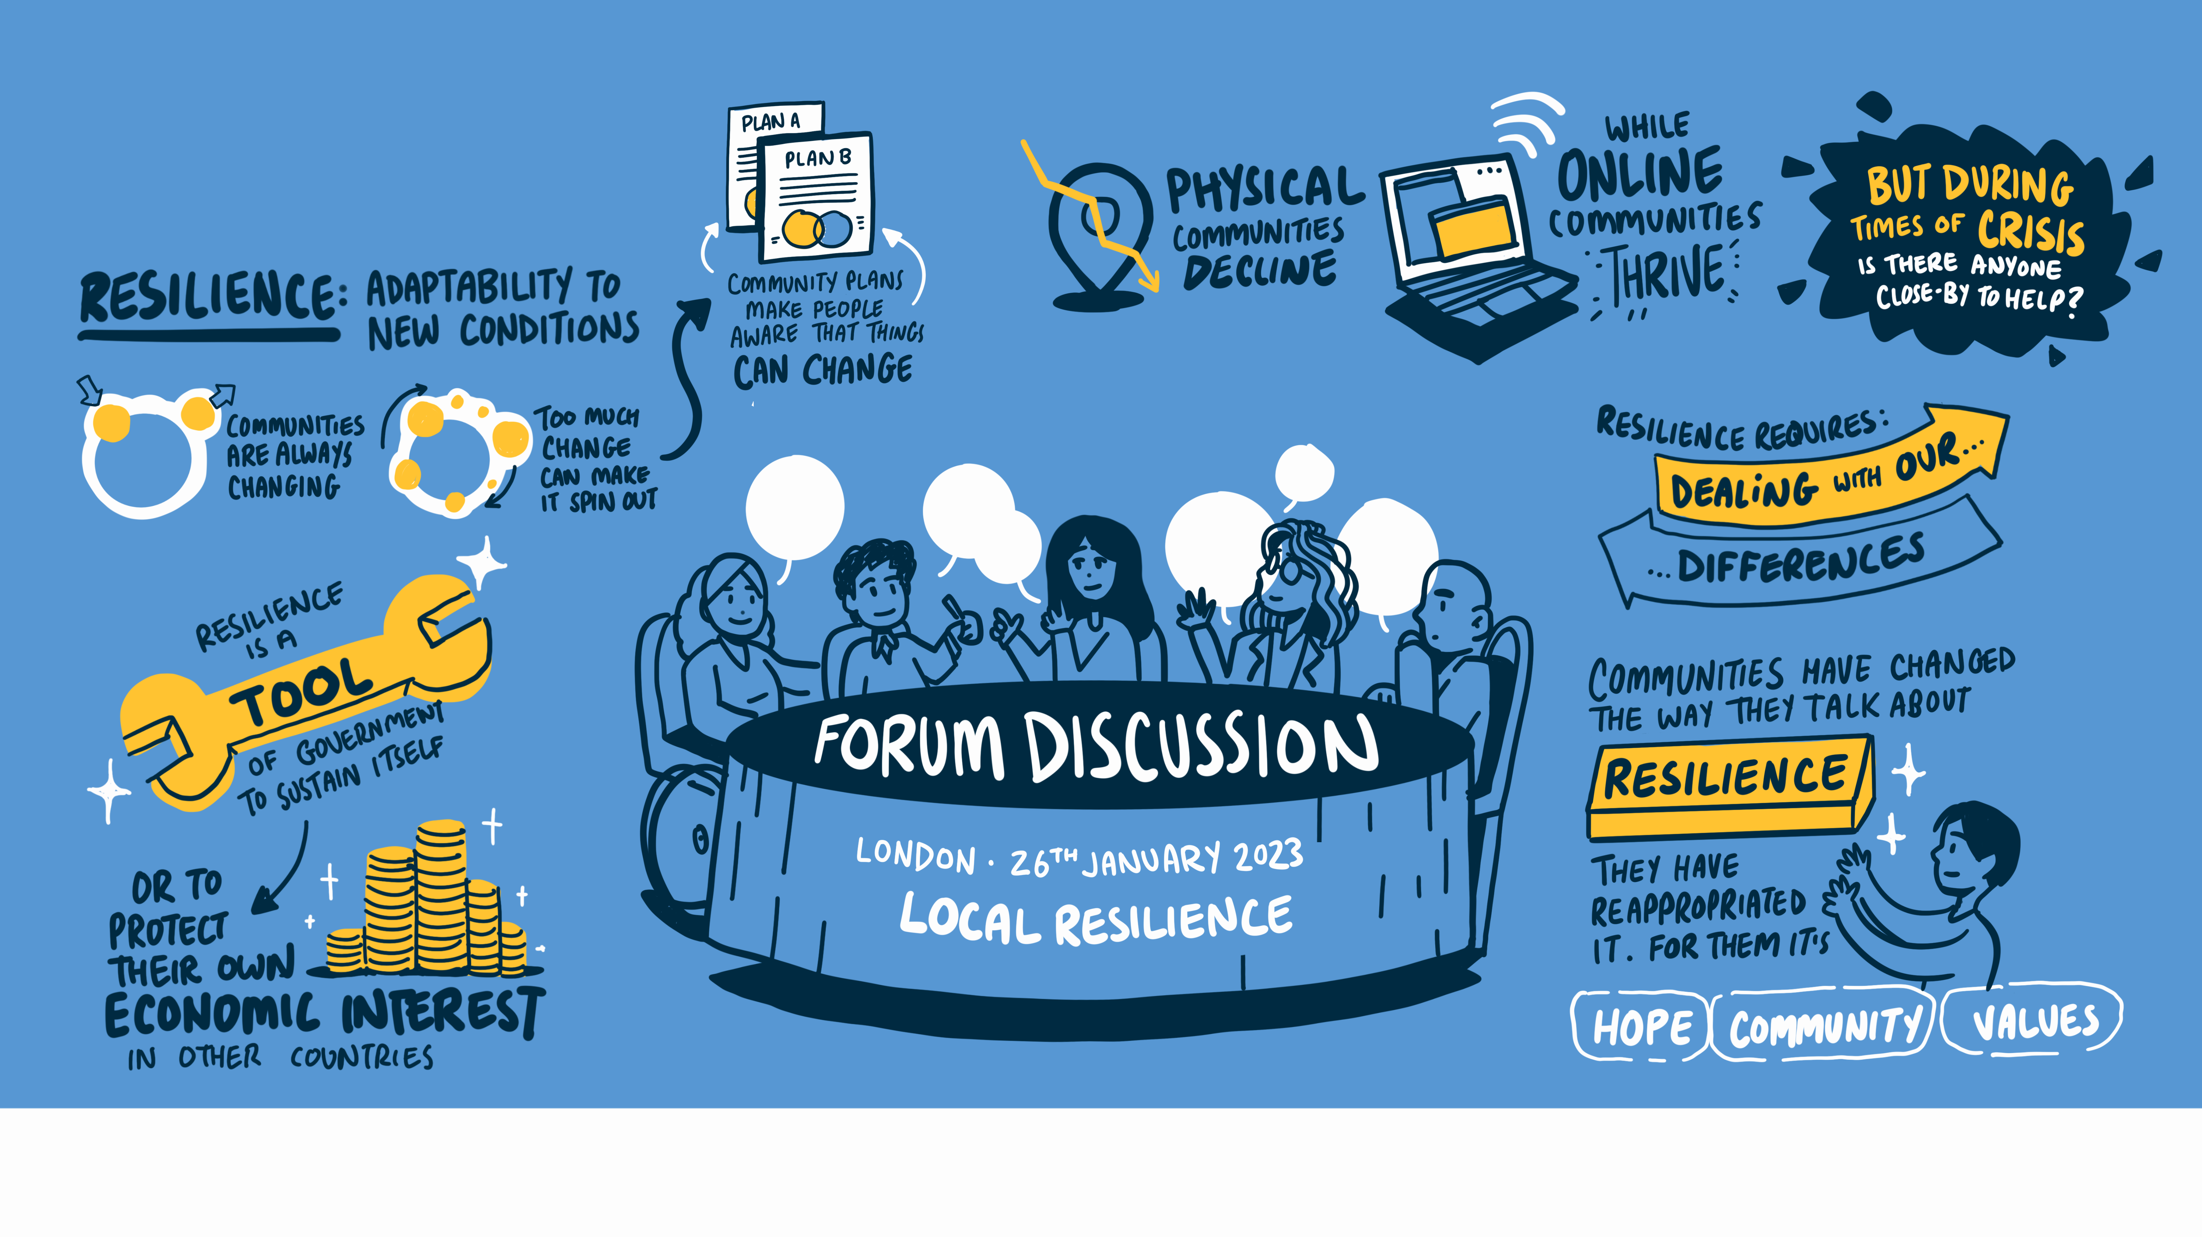

Slide 6

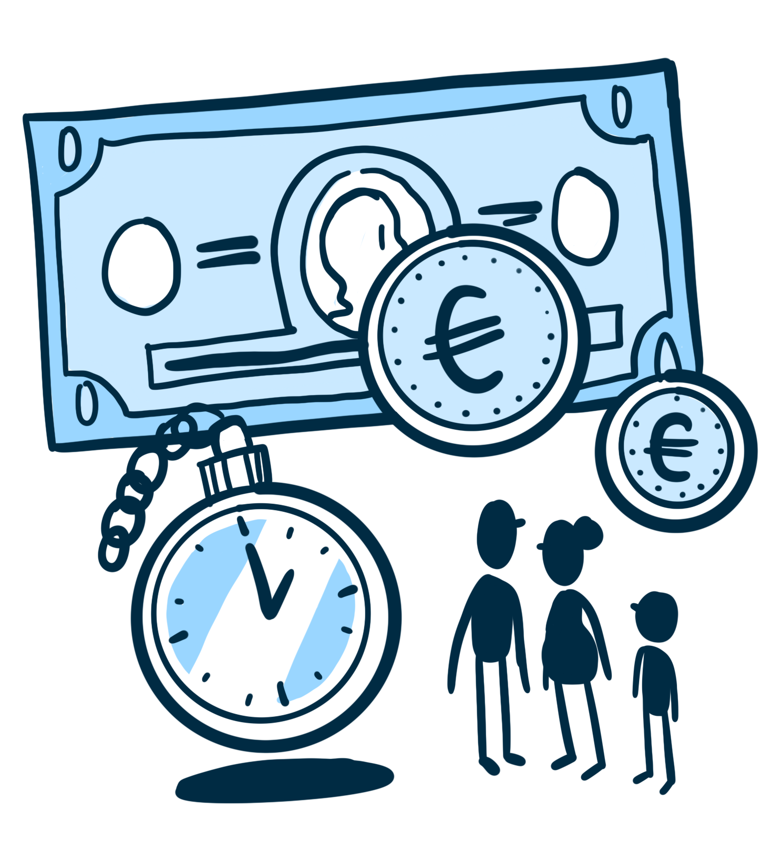
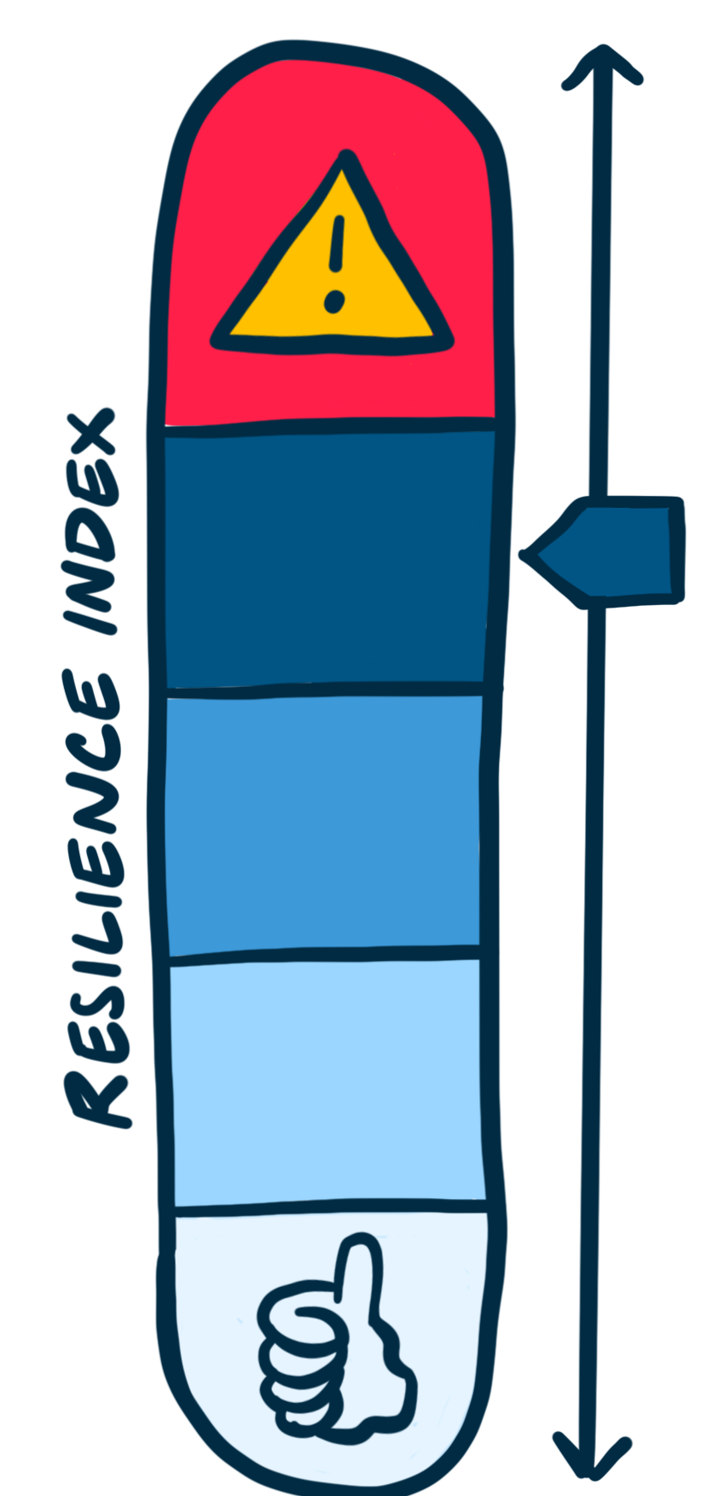

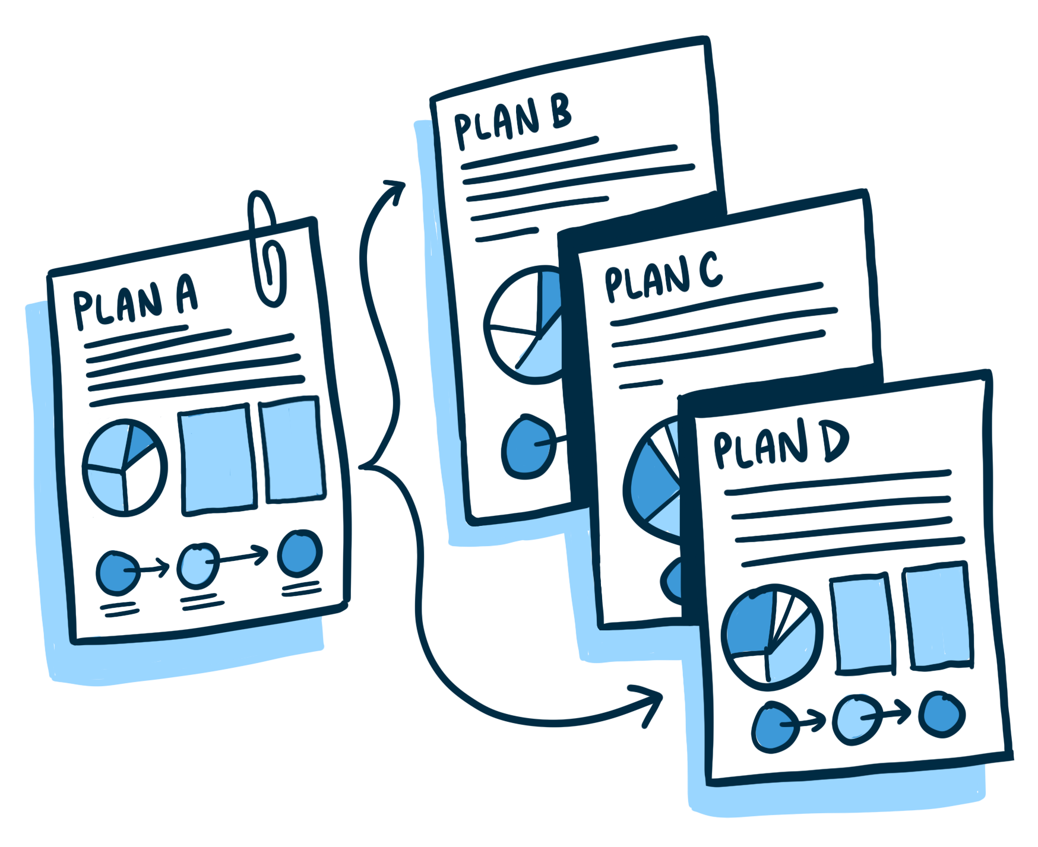
Policy Recommendations - Fostering responsive, agile and adaptable communities
Local perspectives on resilience
full page scribe style visual
Develop multiple plans for the future, including emergency response plans.
Communities should have a vision for the future to demonstrate to their constituent parts that they will continue to meet their needs.
Communities need resources to achieve their vision.
Create a resilience index to measure and quantify community resilience and policy success.
Ensure community voices are heard through open communication and raising awareness of the policy making process.

Slide 7
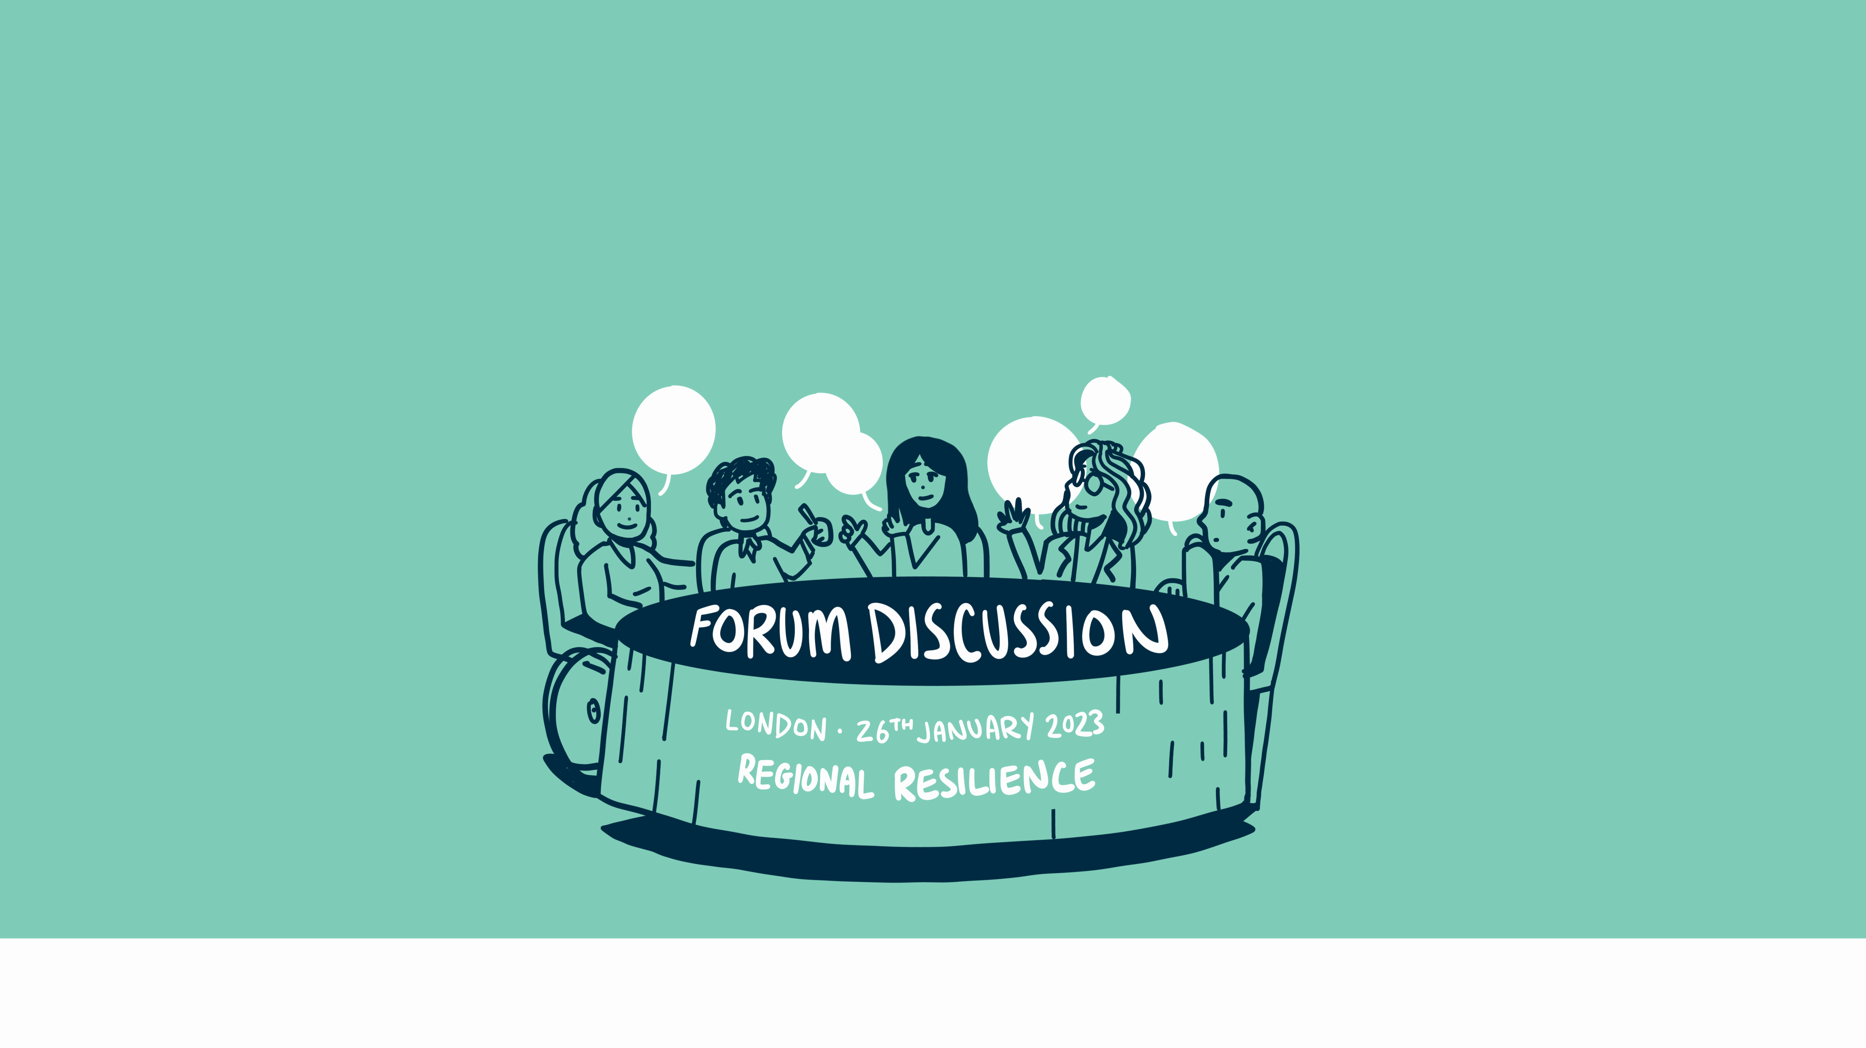

Slide 8
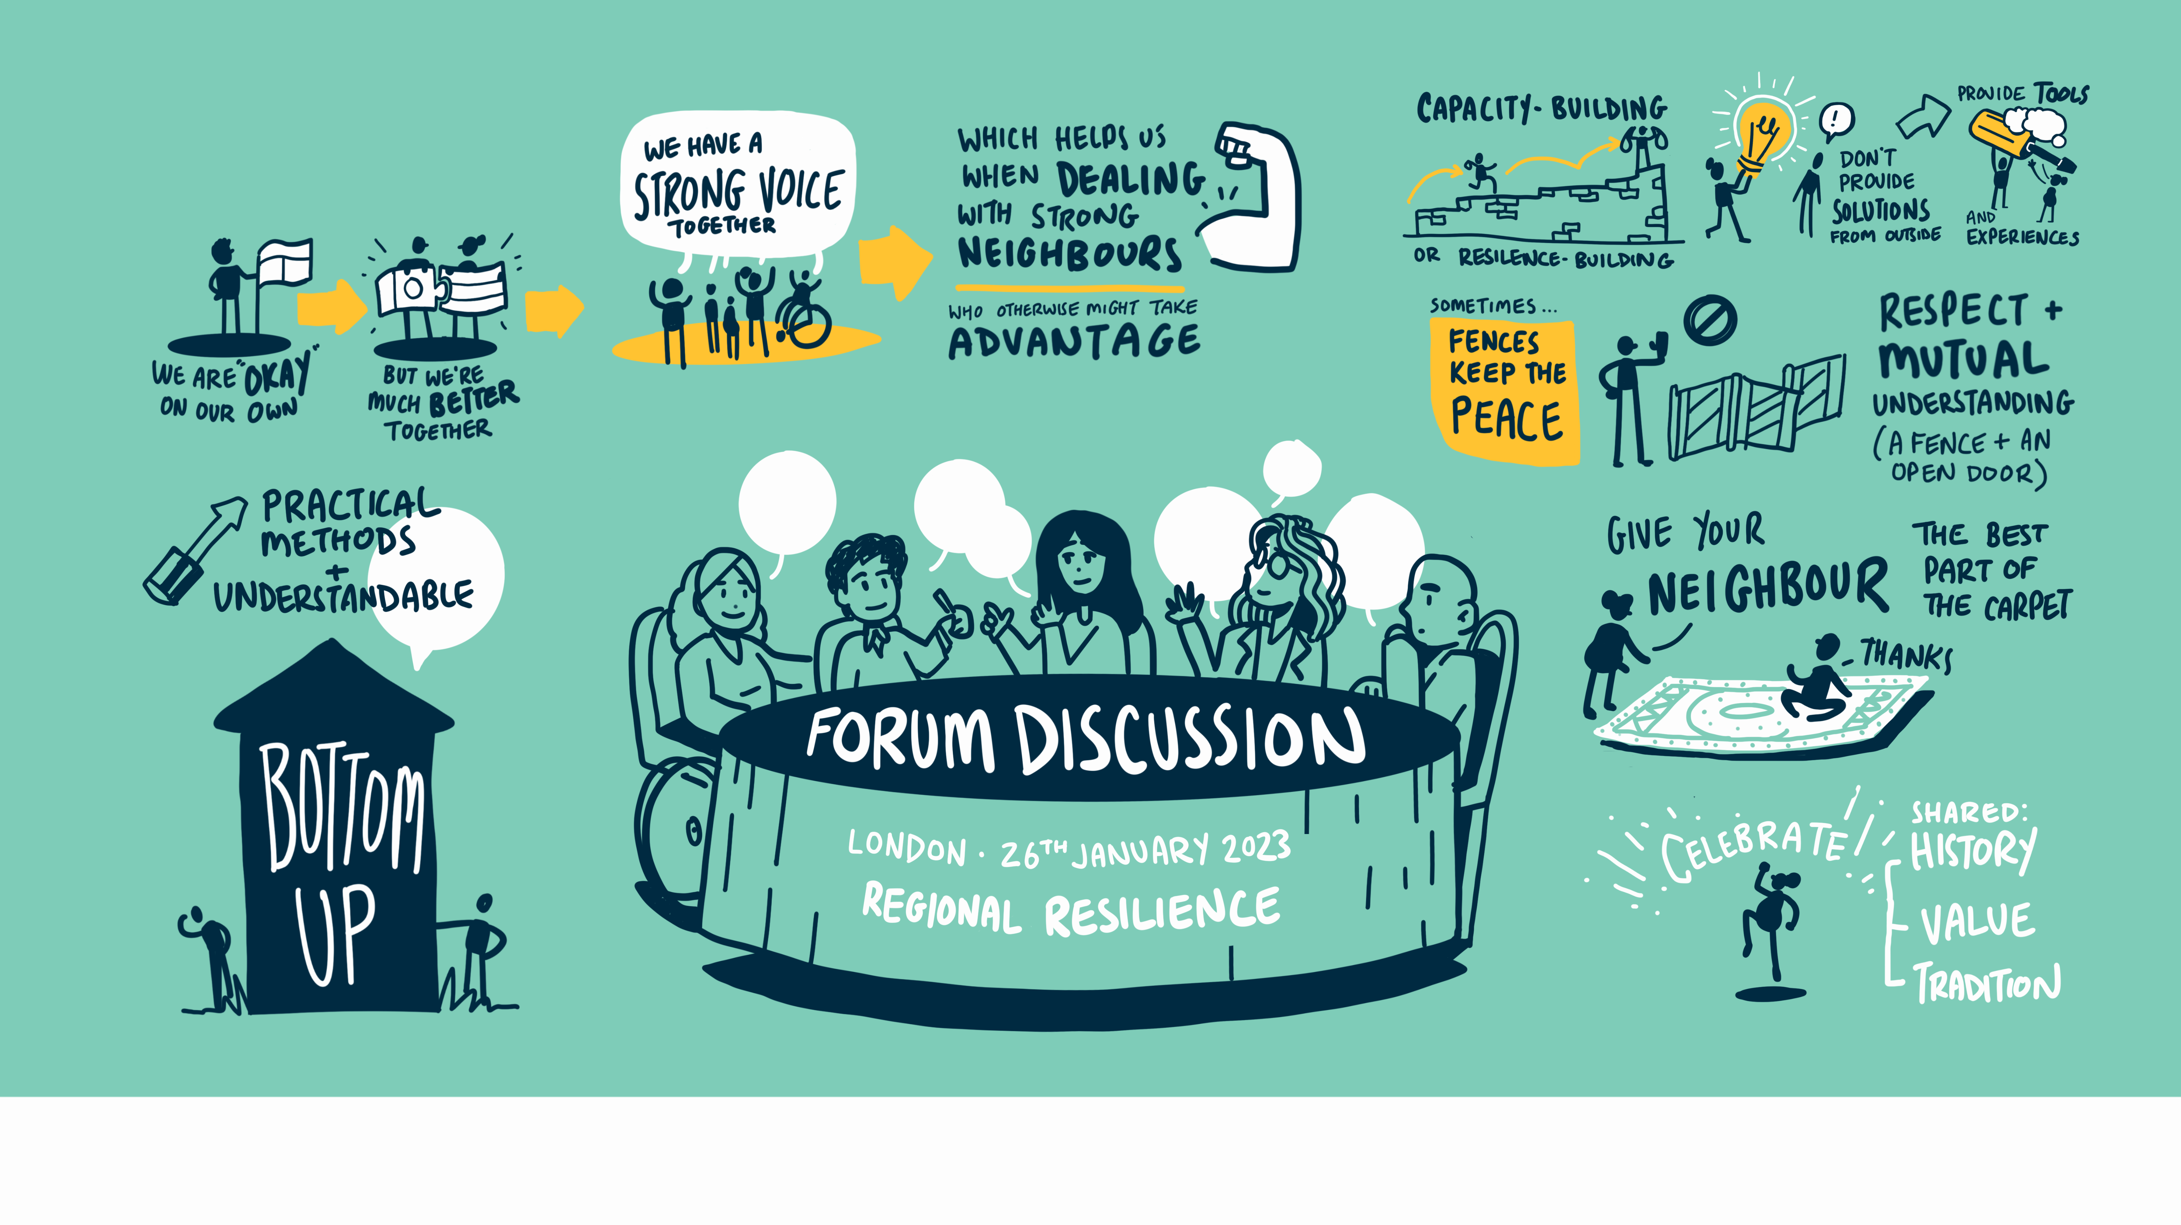

Slide 9



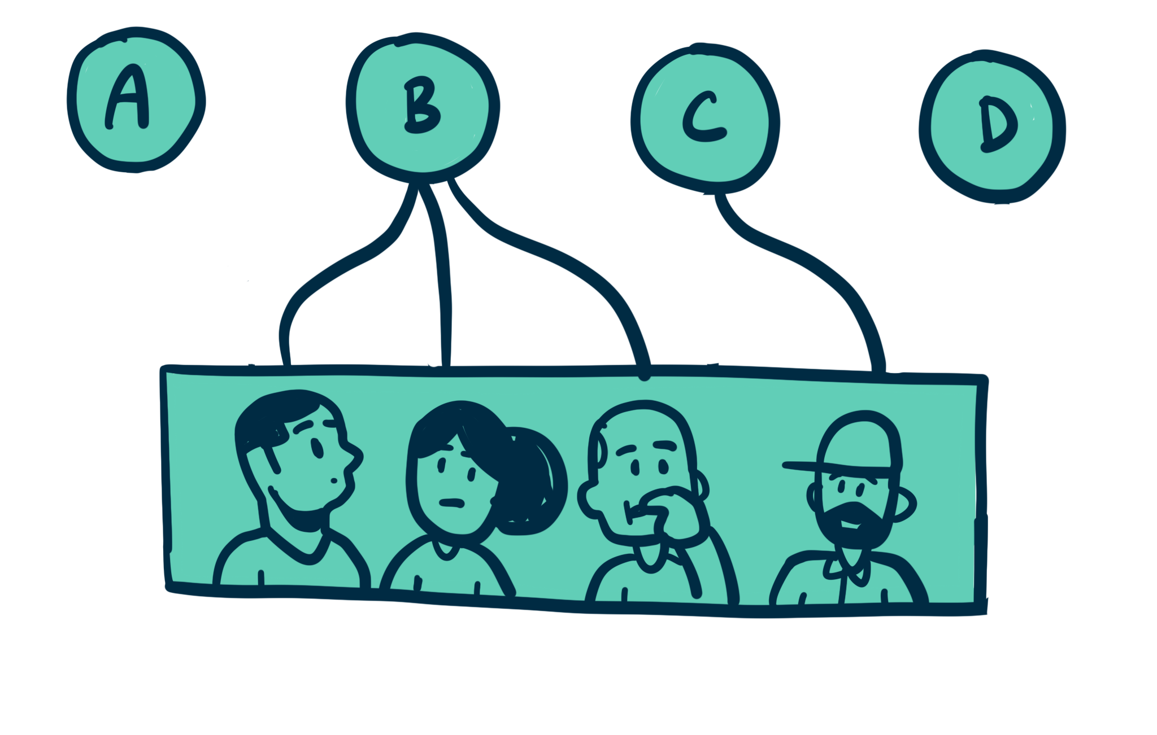
Policy Recommendations - Tackling regional challenges to sustainable governance
Evaluate whether and how regional perspectives and initiatives on resilience integrate with global perspectives and can be inter-compatible with national communities.
Policy recommendations for new institutions must be grounded firmly in empathetic leadership and bottom-up decision making rather than top-down decision making.
Promote community integration/exchange to foster regional resilience.
Ensure regional institutional arrangements are objective-focused.
Focus on environment-centric approaches.

Slide 10
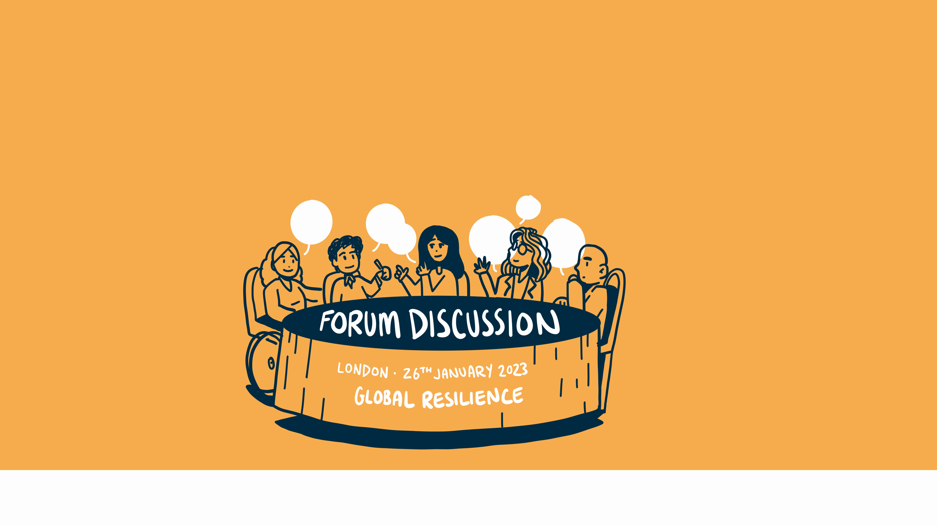

Slide 11
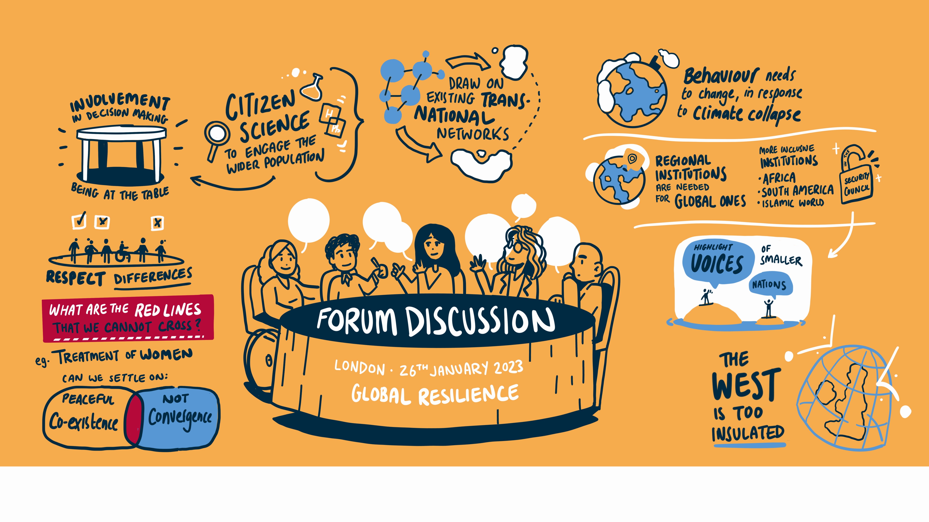

Slide 12
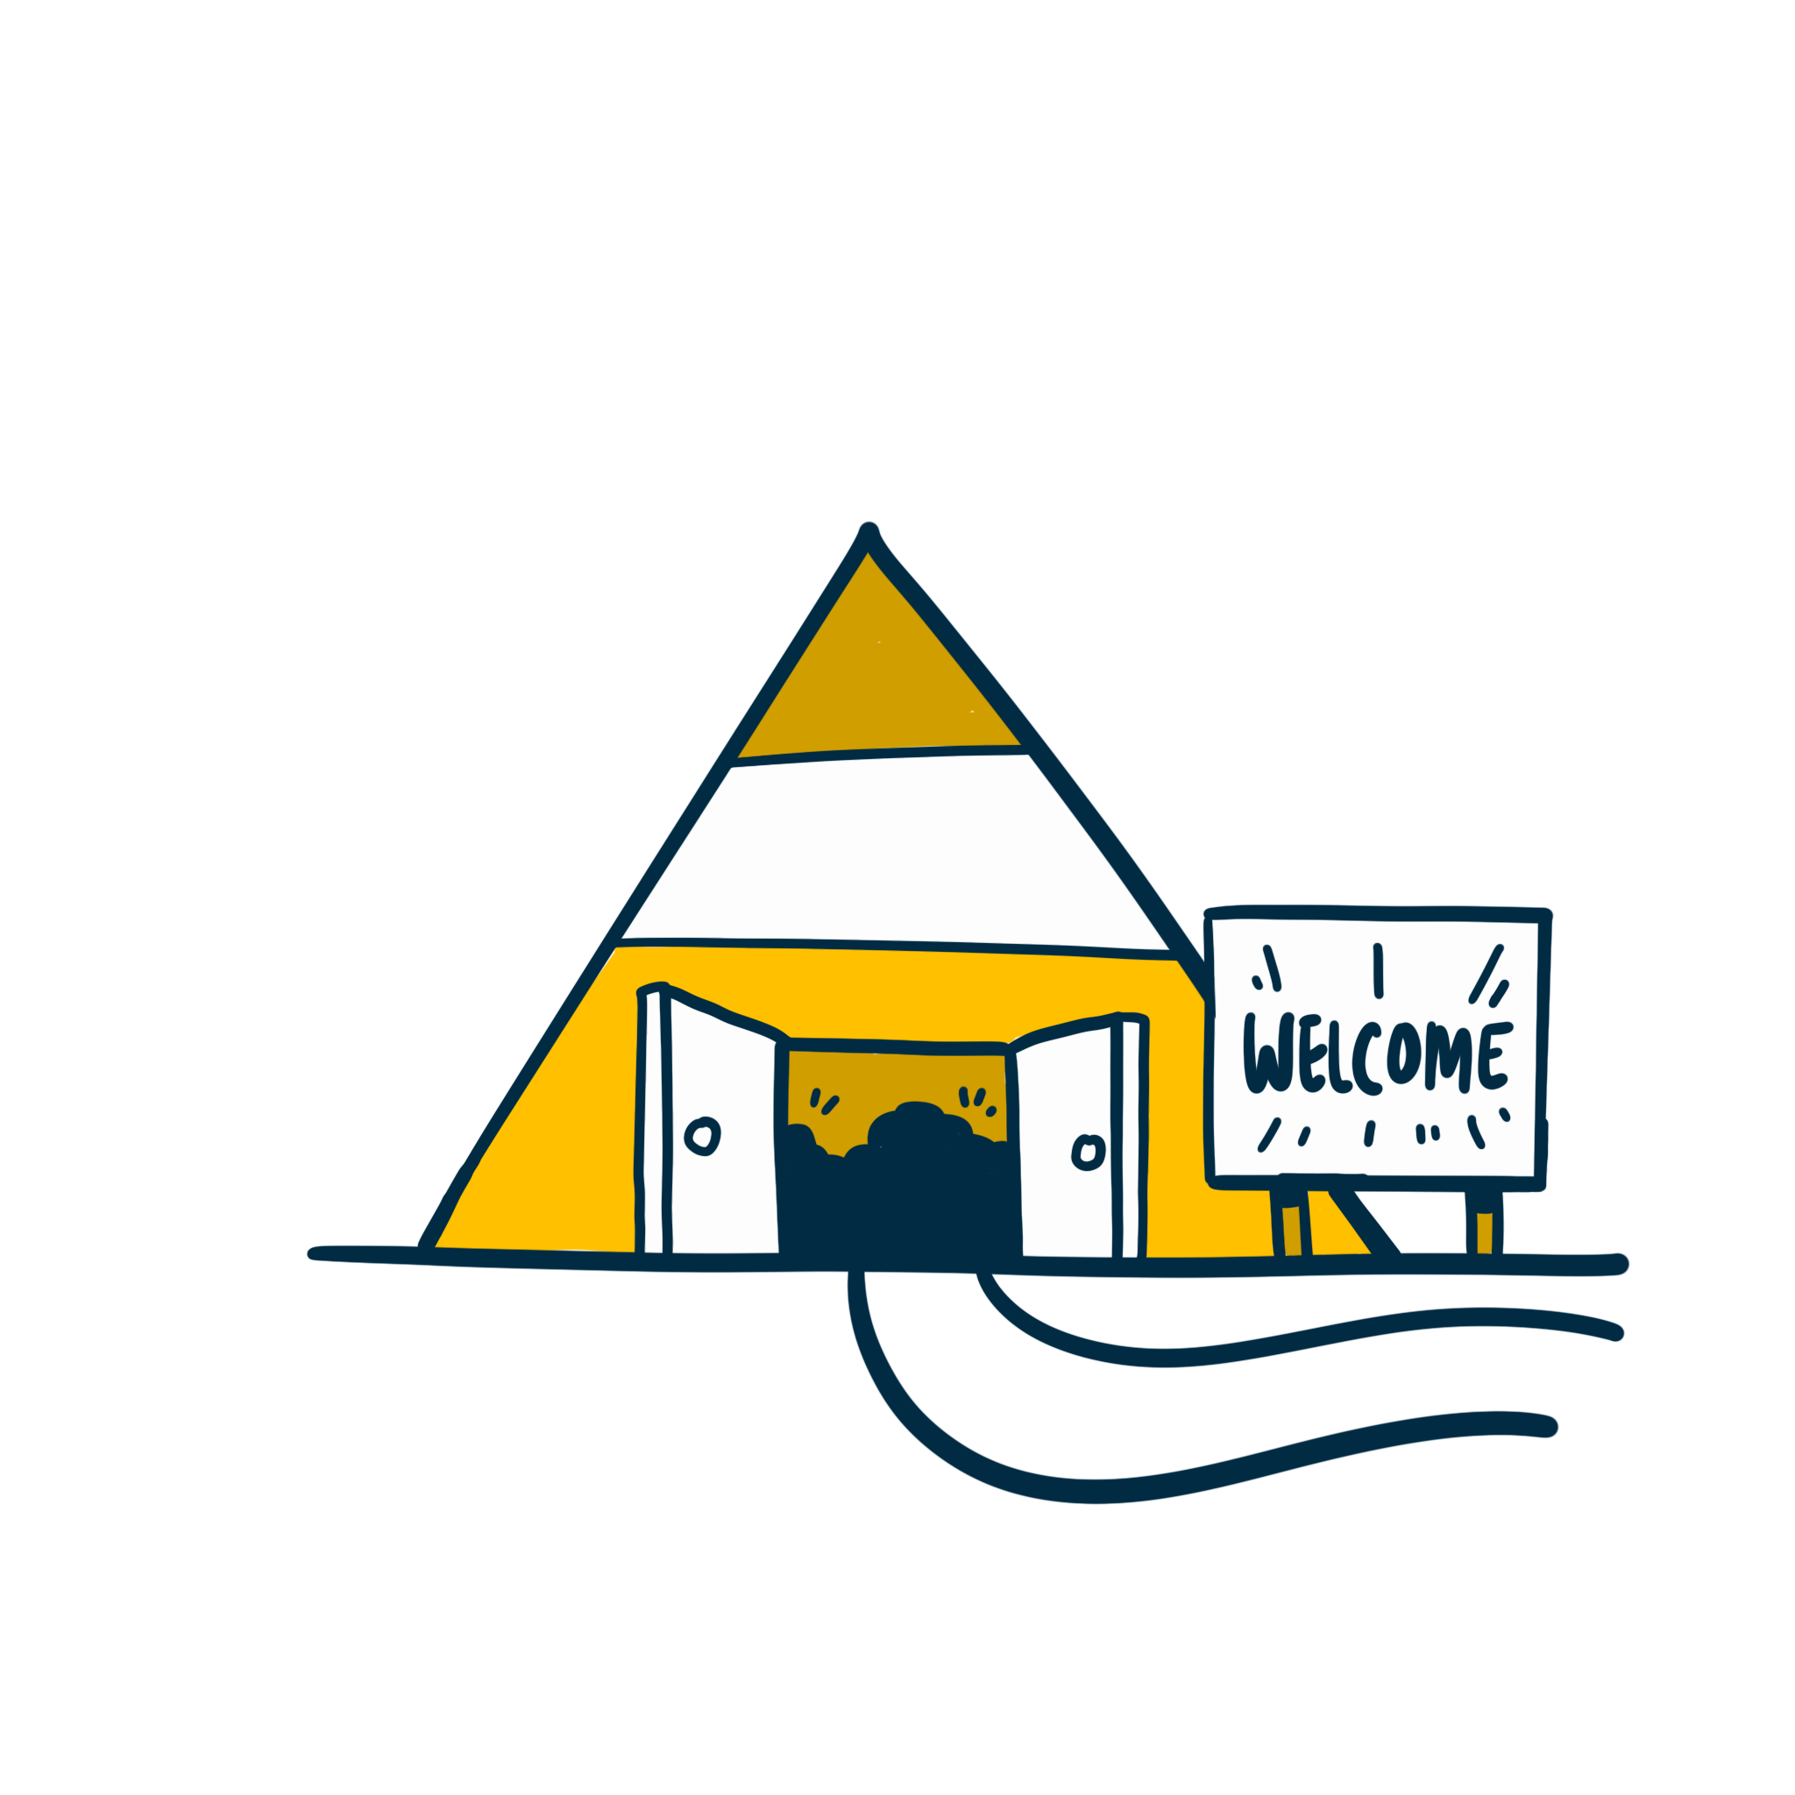



Policy Recommendations - Embedding resilience in global governance institutions
We need more internationally balanced governance structures.
We need more inclusive governance structures.
We need more responsive, goal-orientated institutions.
We need to reconcile diversity.

Slide 13

Where to next?
For more information about the Compass+ forum and the research visit:
Local perspectives on resilience
bit.ly/WarwickCompassPlus
full page scribe style visual
This research has been supported by GCRF GNCA UKRI: https://www.ukri.org/news/additional-funding-boost-for-gcrf-and-newton-projects/

