Slide 1
Becoming Innovators: Design Thinking and Innovation in Your Research
Dr Bo Kelestyn
Associate Professor
June 2023

Slide 2

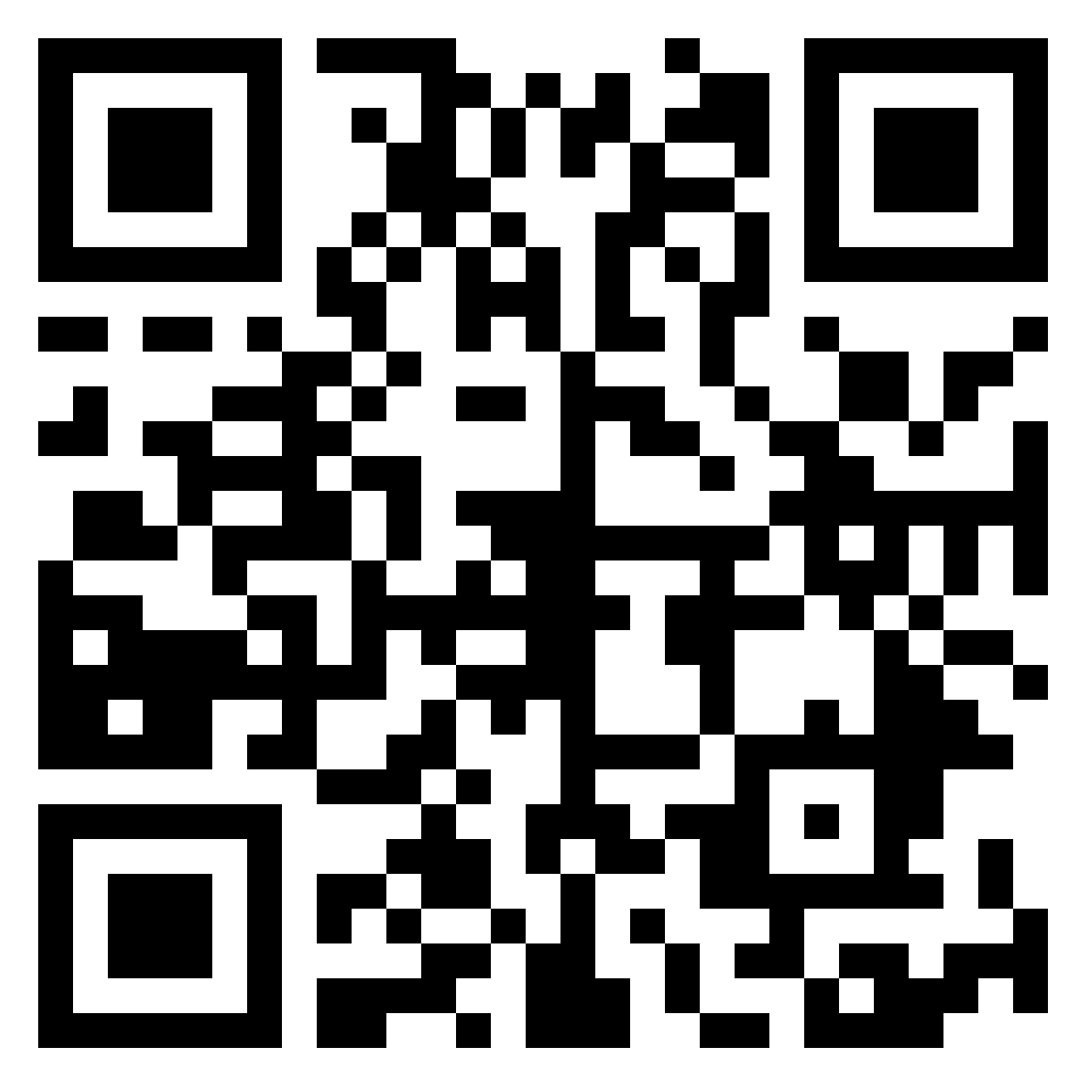
Notes:
To change the QR code

Slide 3

Warm up
Come up with as many questions as you can about this pencil in 30 seconds.
Try for at least 10 questions—the crazier, the better.

Slide 4
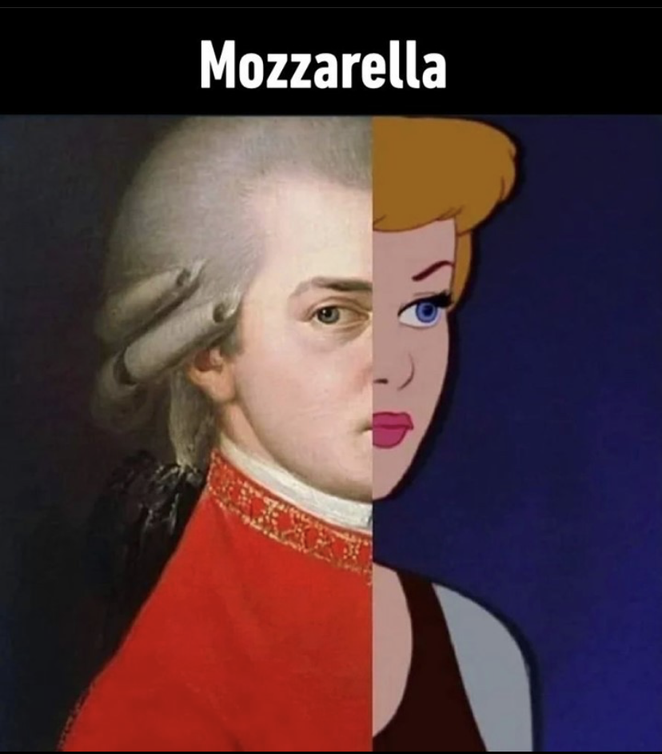
Innovation
Notes:
What’s the link?

Slide 5
What is Design Thinking?
the application of design practice and its related competencies beyond the context of design for and with those without design backgrounds (Chon & Sim, 2019, p. 189)
a way of finding human needs and creating new solutions using the tools and mindsets of design practitioners (Kelley & Kelley, 2013)
social technology = blend of tools and insights, applied to a work process (Liedtka, 2020)
human centered design
methodology for innovating routinely
JUST DO IT (Reis, 2011)

Slide 6
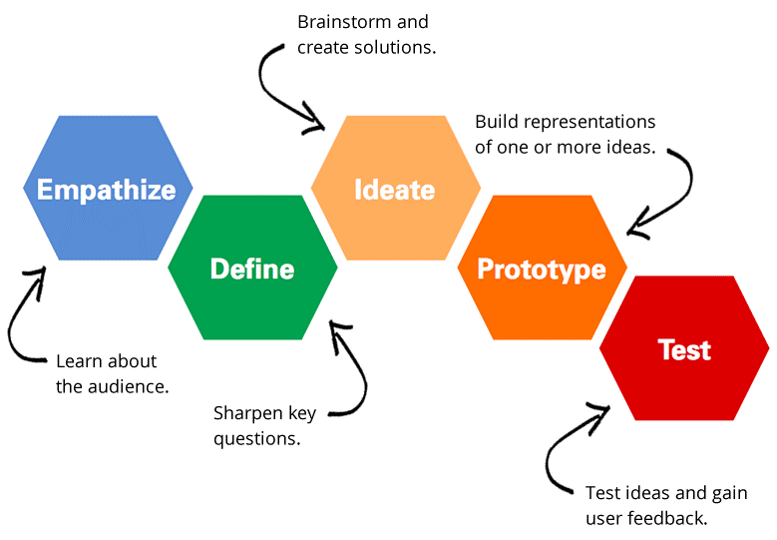
Key steps

Slide 7
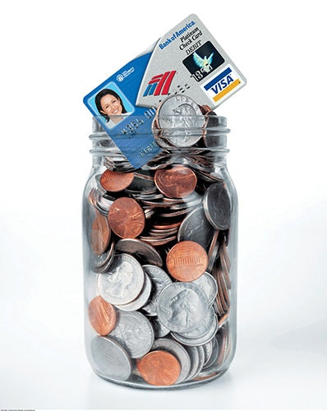
Bank of America: Keep the Change
Within the first year of launch:
2.5 million customers signed up for Keep the Change
over 700,000 opened new current accounts
1 million signed on for new savings accounts
Notes:
Without any major breakthrough in past few decades, the banks in the early 2000s faced a critical problem - how to get consumer segments (particularly boomer-age women) to open new savings accounts.
Bank of America hired a design research firm that observed a dozen families and interviewed people on the streets.
Critical insight formed was that people round up their deposits as it was more convenient. And so was born their product “Keep The Change”.
Every time one buys something with a BofA Visa debit card, the bank rounds up the purchase to the nearest dollar & transfers the difference from your current into savings.
Keep The Change brought out a shift in mindset, seen as unique and offering real ‘human’ value. Within the first year of launch, 2.5 million customers signed up for Keep the Change. Over 700,000 opened new current accounts accounts and 1 million signed on for new savings accounts.

Slide 8
Bank of America: Keep the Change
Notes:
Without any major breakthrough in past few decades, the banks in the early 2000s faced a critical problem - how to get consumer segments (particularly boomer-age women) to open new savings accounts.
Bank of America hired a design research firm that observed a dozen families and interviewed people on the streets.
Critical insight formed was that people round up their deposits as it was more convenient. And so was born their product “Keep The Change”.
Every time one buys something with a BofA Visa debit card, the bank rounds up the purchase to the nearest dollar & transfers the difference from your current into savings.
Keep The Change brought out a shift in mindset, seen as unique and offering real ‘human’ value. Within the first year of launch, 2.5 million customers signed up for Keep the Change. Over 700,000 opened new current accounts accounts and 1 million signed on for new savings accounts.

Slide 9
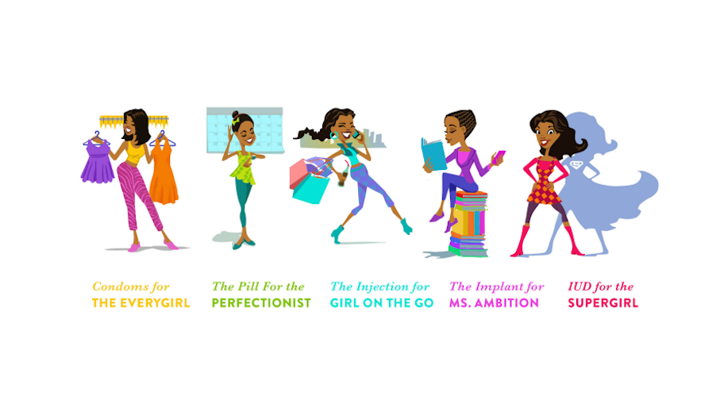
Diva Centres: The Divine Divas

Slide 10
Diva Centres: The Divine Divas
Girls who visit one of the three Diva Centres:
82% got contraceptive services and adopted some form of birth control
36% returned for another visit
Notes:
In Zambia where more than 1/3 of women give birth by age 18, access to safe, comprehensive reproductive health services is paramount in ensuring girls have the opportunity to finish school, start careers, and become mothers on their own terms.
Despite being one of the leading providers of contraception and family planning services in the country, Marie Stopes Zambia saw almost no teenage patients in their traditional clinics when they began to work with IDEO​.org in 2014.
Centres is somewhere girls come in to do their nails while having informal conversations about boys and sex. They hang out with friends, learn about contraception in their own terms from trained peers, and, when they’re ready, receive counseling and access to a variety of short and long-term birth control methods in a safe and judgment-free environment from a trained professional
Since then, girls who visit one of the three Diva Centres, 82% got contraceptive services and adopted some form of birth control and 36% returned for another visit.

Slide 11
What design thinking is NOT
Object/outcome/features
About artistic abilities
About hurdling
Urgency thinking (brown, 2017)
A one off activity = innovation theatre (Viki, 2020)
Tool of consumerism
For -> with
Notes:
Misnomer – approach – impact

Slide 12
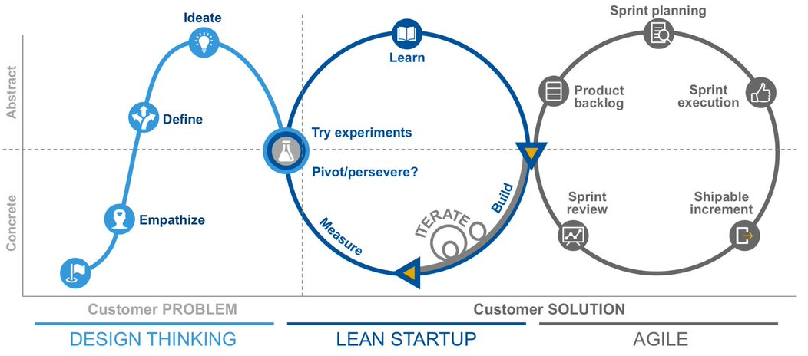
What design thinking is NOT
Notes:
Misnomer

Slide 13
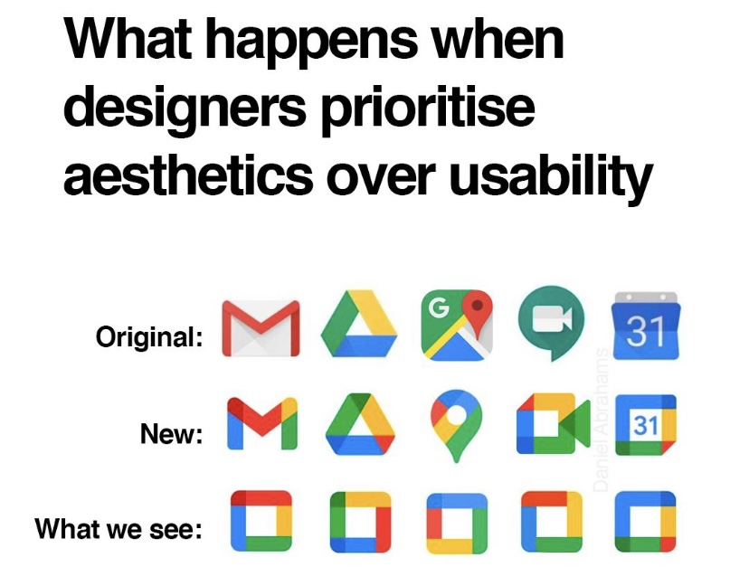

Slide 14
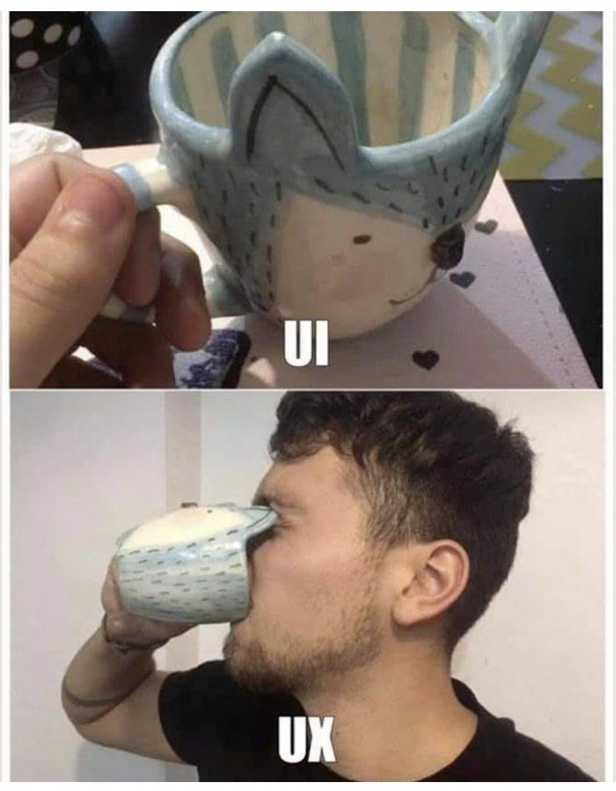

Slide 15
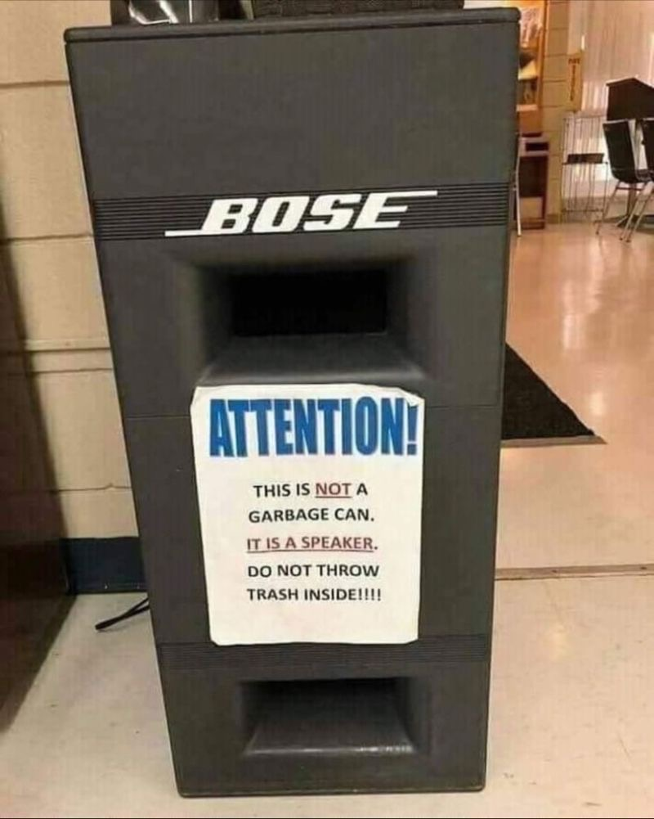

Slide 16
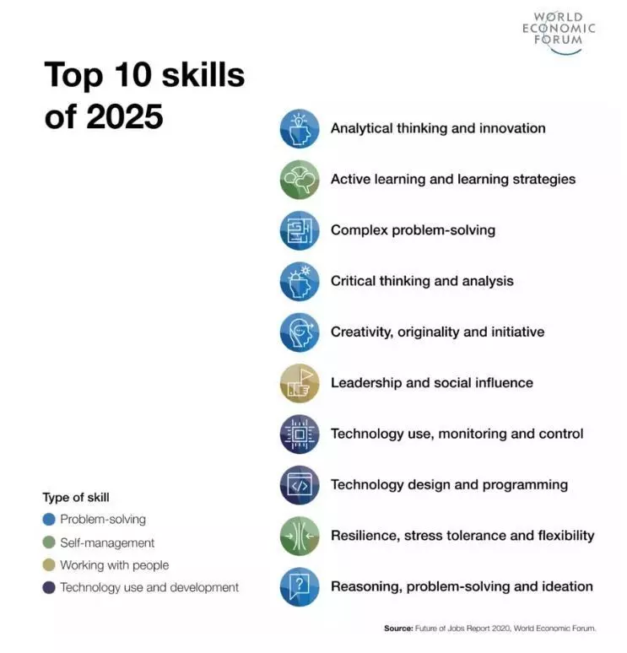

Slide 17
Some of what keeps me awake at night
“Building to think, not thinking to build” (T.Brown)
Designing for the seams
What is evidence?
Generativity (Zittrain, 2008)
Build back better (I. Kelman)
Speed - Security - Culture (I. Kelman)
Designing with, not just for
Designing for joy, not just utility

Slide 18
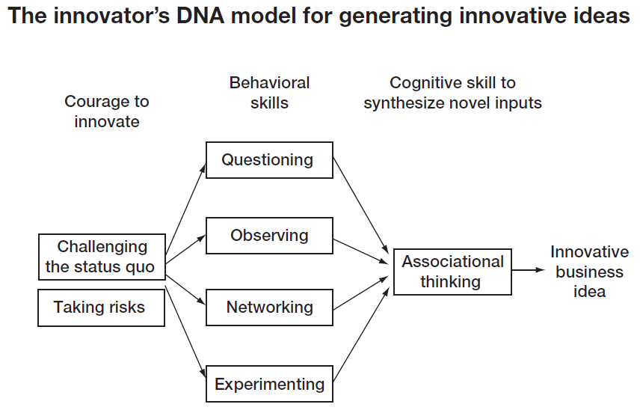
Innovator’s DNA (Dyer et al., 2011)
Notes:
We do not yet have the questions, let alone answers
Agency to act and humility to learn
Email has impact https://www.bbc.com/future/article/20200305-why-your-internet-habits-are-not-as-clean-as-you-think

Slide 19
Innovator’s DNA (Dyer et al., 2011) – IGSD edition
Zeal to create change
and break the barriers
(Self) Care
Learning community
Joy
Innovation &
Impact
Optimism
Interdisciplinary thinking
Curiosity

Slide 20
Start with 4Ws
Who has the problem: Who is the target user(s)?
What is the problem: Problems; pain points; tasks a user might want to achieve; what’s standing in their way?
Where does the problem present: Situation; context; what people are involved?
Why does it matter: Why does the problem need solving; what value might a solution bring? The 5 WHYs
If you obsess about HOW, you loose sight of WHY

Slide 21
Why?
Philosophy professors
Tell me why
Backstreet boys
3-year-olds
Design Thinking practitioners

Slide 22
To see the world differently (W. Berger, 2018, p.74)
What might I notice if I were encountering this for the first time?
What if I stand on the desk?
What is in the background?
What here would fascinate a 5 year old? Or a 90 year old?
What would Seinfeld be amused by?
What would Steve Jobs be frustrated by?

Slide 23
SCAMPER
Substitute:
What can be substituted?
What can be used in its place?
Who can be involved instead?
Which process could be used instead?
What other materials could be used instead?
Combine:
What can be combined?
What can be mixed?
How might certain parts be connected?
Which purposes could be combined?
Adapt:
What other are ideas are suggested by it?
Is there anything similar that could be applied/adapted to the problem?
Have there been similar situations in the past?
Modify, magnify, minify:
What modifications can be introduced?
Can the meaning be changed?
What can be increased/reduced?
What could be modernised?
Can it be enlarged/downsized?

Slide 24
SCAMPER
Put to other uses:
For what other purpose could it be used in its present state?
For what purpose could it be used if it were modified?
Eliminate:
What could be removed?
What are the things it would still work without/
Rearrange or reverse:
What other patterns would also work?
What modifications can be introduced?
What could be replaced/rearranged?

Slide 25
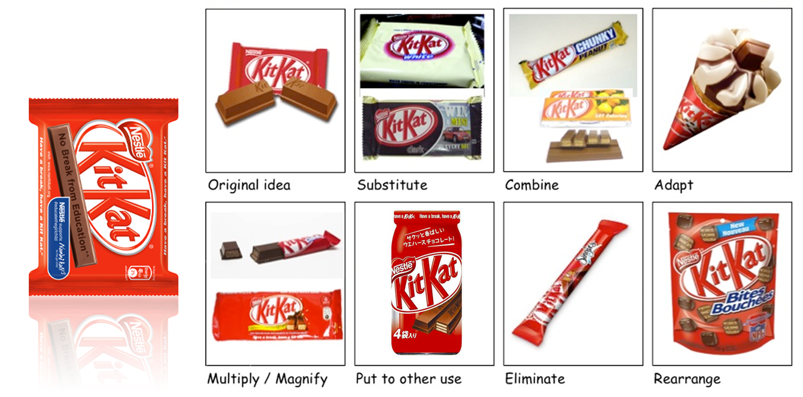
SCAMPER

Slide 26
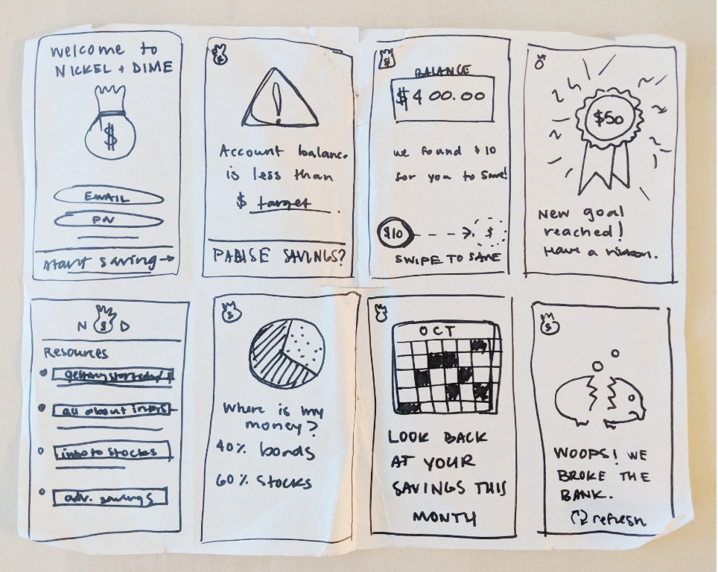
Crazy 8s
Individual exercise to iterate and improve your initial idea
What would be another good way to do … ?
Fold or line an A4 sheet to form 8 squares
60 secs each and 8 mins in total

Slide 27
Mindfulness
Seek inspiration in the ordinary and everyday
Get out of your head
Create space
Inspiration walks by IDEO U
Empathetic creativity meditation by Uniqorn Academy
Affirmations for design thinkers Bo with by Uniqorn Academy
It is only ideas gained from walking that have any worth (F. Nietzsche)

Slide 28
Thank you! bo.kelestyn@wbs.ac.uk
Dr Bo Kelestyn
Associate Professor
June 2023

