Slide 1

Research Culture
Trends in the
UK and beyond
Dr Rika Nair,
Research Culture Manager, University of Warwick
Notes:
Good afternoon. My name is Rika Nair and I’ve recently joined Research and Impact Services at the University as Research Culture Manager. I’ve been trying my best to get up to speed on sector wide trends in Research Culture, and with this presentation I hope to share some of what I’ve learned with you. Research culture is a topic which has always existed, but has gained enormous momentum in the last few years – to cover everything would take hours so today I will give a whistle stop tour. I will share the slides – all the logos are clickable and will take you to more detailed content that you can explore in your own time.

Slide 2
Research culture: Timeline
2012 - ‘Concordat to support Research Integrity’
2018 - House of Commons Science & Technology ‘Research Integrity Report’
2019 - Revised ‘Concordat to support Research Integrity’
2019 - Report by the REF Equality and Diversity Advisory Panel (EDAP)
2019 - Funders T&Cs on bullying and harassment
2018-2020 - Wellcome Trust / Royal Society discussions on Research Culture
2020 - Establishment of a national research integrity committee (UKRI)
2020 - UK R&D roadmap - New R&D People and Culture Strategy
Notes:
Research culture as topic has been gaining momentum – and this is in part due to the interest of the government in improving research culture, as set out in 2021 R&D People and Culture Strategy. In order to retain the UK’s leading role in research an innovation, the government has made a call to action to better support the people who conduct and enable research. This is the culture change they would like to see – from a status quo which is not inclusive to one which attracts and retains diverse talent.

Slide 3
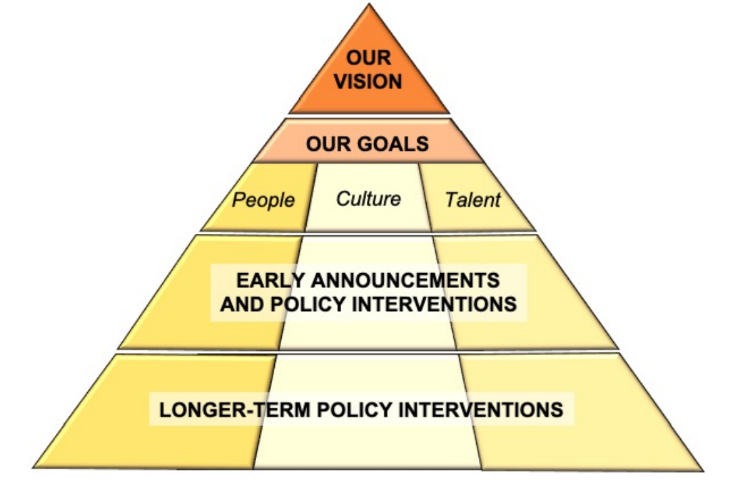
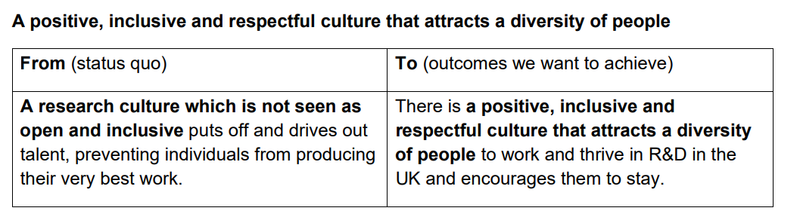
R&D People and Culture Strategy
“This R&D People and Culture Strategy is a call to action. It sets out, for the first time, a whole sector vision, backed by clear government commitments. It builds on all the work already being done by people and institutions across the sector to make the UK a truly great place for research and innovation, and invites the sector to work with us to drive lasting change.”
Notes:
Research culture as topic has been gaining momentum – and this is in part due to the interest of the government in improving research culture, as set out in 2021 R&D People and Culture Strategy. In order to retain the UK’s leading role in research an innovation, the government has made a call to action to better support the people who conduct and enable research. This is the culture change they would like to see – from a status quo which is not inclusive to one which attracts and retains diverse talent.

Slide 4



(Re-)Defining Research Culture
“… the behaviours, values, expectations, attitudes and norms of our research communities. It influences researchers’ career paths and determines the way that research is conducted and communicated.”
“Researchers are passionate about their work and proud to be part of the research community – they see it as a vocation, not just a job. Culture varies a great deal from place to place, and different individuals have very different experiences, with underrepresented groups experiencing the most challenges.”
Notes:
Kita has already covered definition of research culture. Here I have two definitions from the Royal Society and the Wellcome Trust. What I would like to highlight is that research culture is a collective endeavour – we are talking about communities and the product of all our actions. Another aspect to consider, is what makes research special. Research is very personal, many would say vocational. Therefore successes and failures are very personal – and it is easy to become overwhelmed. Research and therefore research culture is also very varied – it’s therefore important to recognise disciplinary norms. Different types of researcher will thrive in different ways, and it’s therefore okay to trust them to work out what ‘thriving’ means in their contexts.

Slide 5
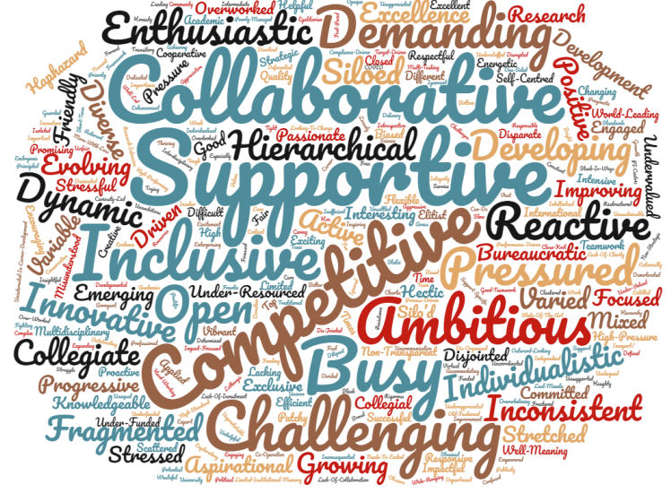

Word cloud of the three words survey respondents chose to describe their CURRENT local research culture (n=233)
Notes:
Apologies for this very busy slide. Here we have a word cloud from a survey ARMA conducted, where they asked respondents to choose three words to describe their current research cultures. As you can see, it is very complex, with some positive, some negative.

Slide 6
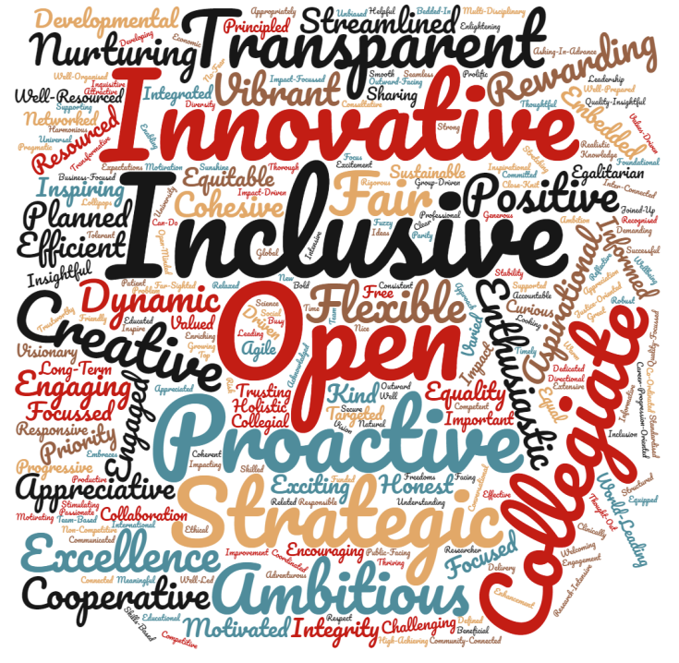
Word cloud of the three words survey respondents chose to describe their IDEAL local research culture (n=230)
Notes:
The next slide is a lot tidier, where ARMA asked for three words to describe their ideal local research culture. It’s not that different from the first slide though. It might be a slight oversimplication, but I would say my takeaway from this is that there are still all the good elements from the first slide. What has been removed are barriers. Barriers to inclusion, barriers to innovation and barriers to transparency and collaboration. Self-worth allows you to buffer more stress that is inherent to research.

Slide 7



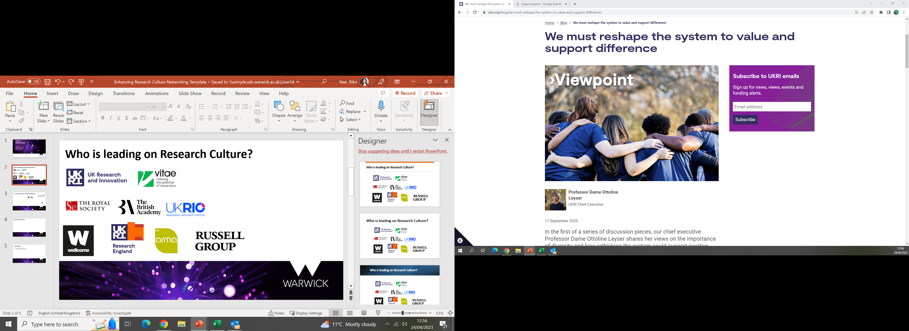
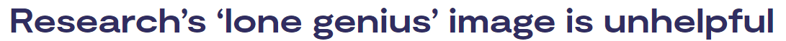





Who is leading on Research Culture?
Notes:
In the words of the UKRI Chief executive – there needs to be a culture shift to recognise diverse contributions in research – we can no longer perpetuate the myth of the lone researcher. Funders like UKRI are taking a leading role on research culture, and they are becoming increasingly concerned with no just what research they fund, but how that research is being conducted. Yesterday I attended an event where the Wellcome Trust and Cancer Research UK shared their priorities for research culture. They know they can influence research culture and use funding as a lever to incentivise good research culture. One trend is funders moving towards longer contracts to improve job security and wellbeing of researchers. As I mentioned at the start, you can click on any of these logos to see the latest statements and initiatives each of these organisations is leading on research culture.

Slide 8

Research Culture Surveys
Advance HE, 2021
More support for PGR wellbeing
More support from supervisors for professional development
ARMA Survey on Research Culture, 2020
“Them and us culture”
“Valued by direct team but not the university”
What researchers think of the culture they work in
Concerns about job security
Poor research culture of unhealthy competition, bullying, mental health issues
Notes:
What does UK Research culture look like? In this slide I’ve taken some of the key findings from three different surveys.

Slide 9
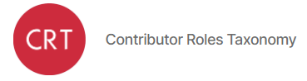



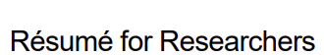




A selection of current Research Culture initiatives
CRediT
The Concordat to Support Research Integrity
Conceptualisation Data curation Formal analysis Funding acquisition Investigation Methodology Project administration | Resources Software Supervision Validation Visualisation Writing (original draft) Writing (review and editing)
Registered Reports
Notes:
There are already a number of impactful initiatives taking place – here is a selection. At the university for example we are signed up to the concordat for support career development of researchers, we are also working on our HR excellence in Research action plan. Recently, we are in the process of signing up to CoARA which will be mean we agree for example to minimising inappropriate use of certain metrics like impact factor in our research assessments. A few of our departments have achieved Athena SWAN (gender equality) bronze and silver. One initiatives I’d like to highlight it CRediT – which apparently has been around for along time but is finally gaining traction.

Slide 10
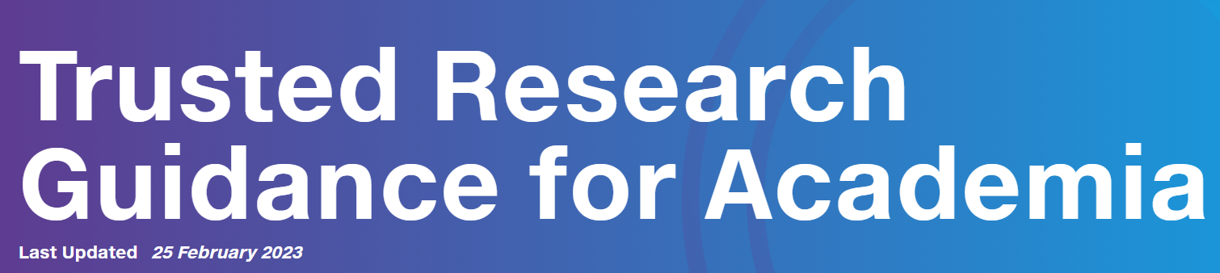

International Research Culture –
UK Government perspective
“The UK champions a rules-based system, which has served our interests as a global, outward-facing nation and continues to be of vital importance. This system has enabled global cooperation to protect shared fundamental values of respect for human dignity, human rights, freedom, democracy and equality. For academia this is demonstrated by the importance the UK places on the protection of academic freedom, something which is enshrined in law.”

Slide 11
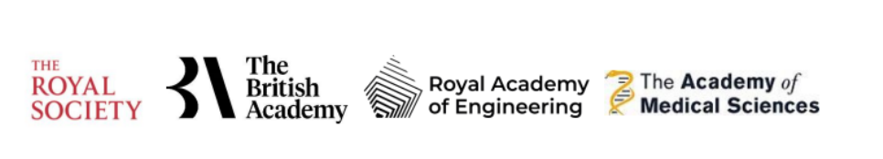

International Research Culture –
Towards equitable partnerships
Ensuring the UK is a partner of choice should be a focus moving forward. The recent cuts have damaged that reputation with all our partners worldwide, not simply those in developing countries.
International Development Strategy call for evidence
67% of respondents agreed or strongly agreed that unequal power dynamics impacted equity in research partnerships
Equitable Partnerships Hub

Slide 12
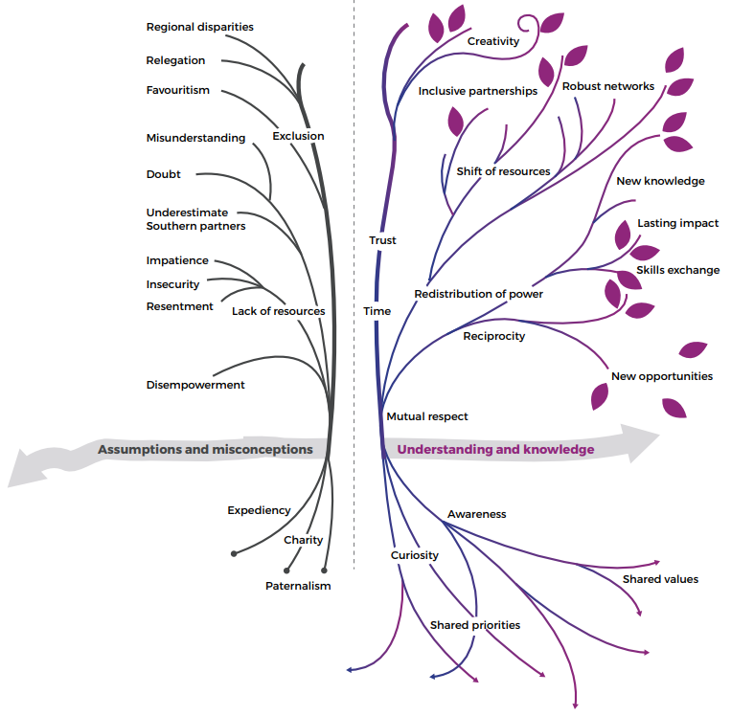
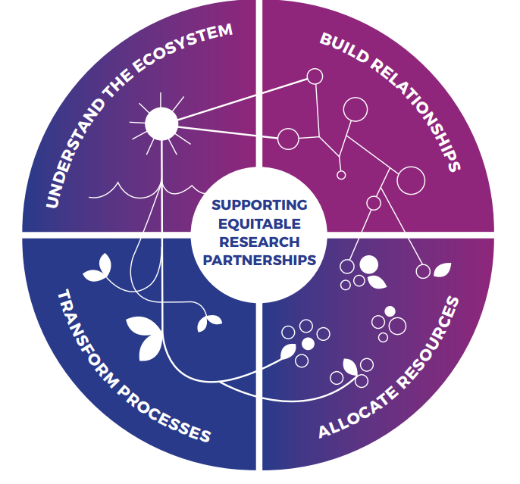
-
+
Equitable Partnerships Hub

Slide 13

Lead a Research Culture Project
Deadline: 5pm, Monday 3 July 2023
Panel meeting: Week commencing 24 July 2023
Decision announced to applicants: Tuesday 1 August 2023
Project start date (from): Monday 2 October 2023
Find out more: Enhancing Research Culture at Warwick Funding Call 2023-2024
Notes:
Type any questions as they come to you in the chat – there will be an opportunity for a Q&A session at the end of today’s presentation.

Slide 14
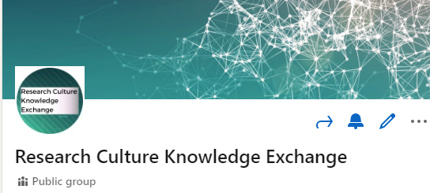
Thank you
• Warwick Research Culture webpages
• ResearchCulture@warwick.ac.uk
• Linkedin group

