Slide 1
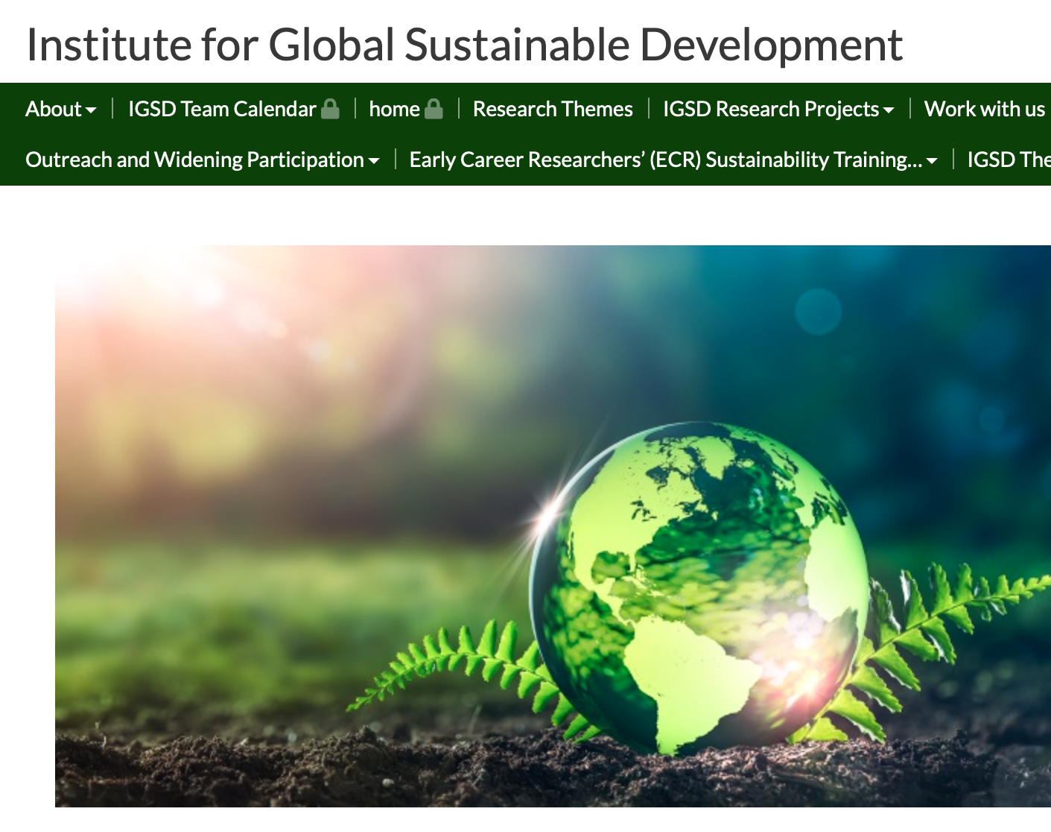
Welcome
Professor Stephanie Panichelli-Batalla
Head of the School for Cross-Faculty Studies

Slide 2
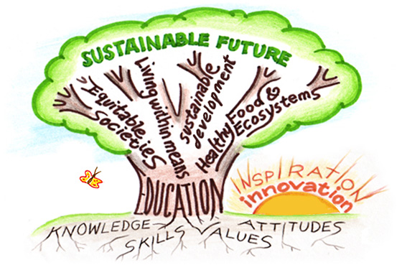
Education for Sustainable Development (ESD)
UNESCO definition (2019):
“ESD empowers learners to take informed decisions and responsible actions for environmental integrity, economic viability and a just society, for present and future generations, while respecting cultural diversity. It is about lifelong learning, and is an integral part of quality education. ESD is holistic and transformational education which addresses learning content and outcomes, pedagogy and the learning environment. It achieves its purpose by transforming society.”
ESD - not just about content but also understanding, skills, attributes and competencies.

Slide 3
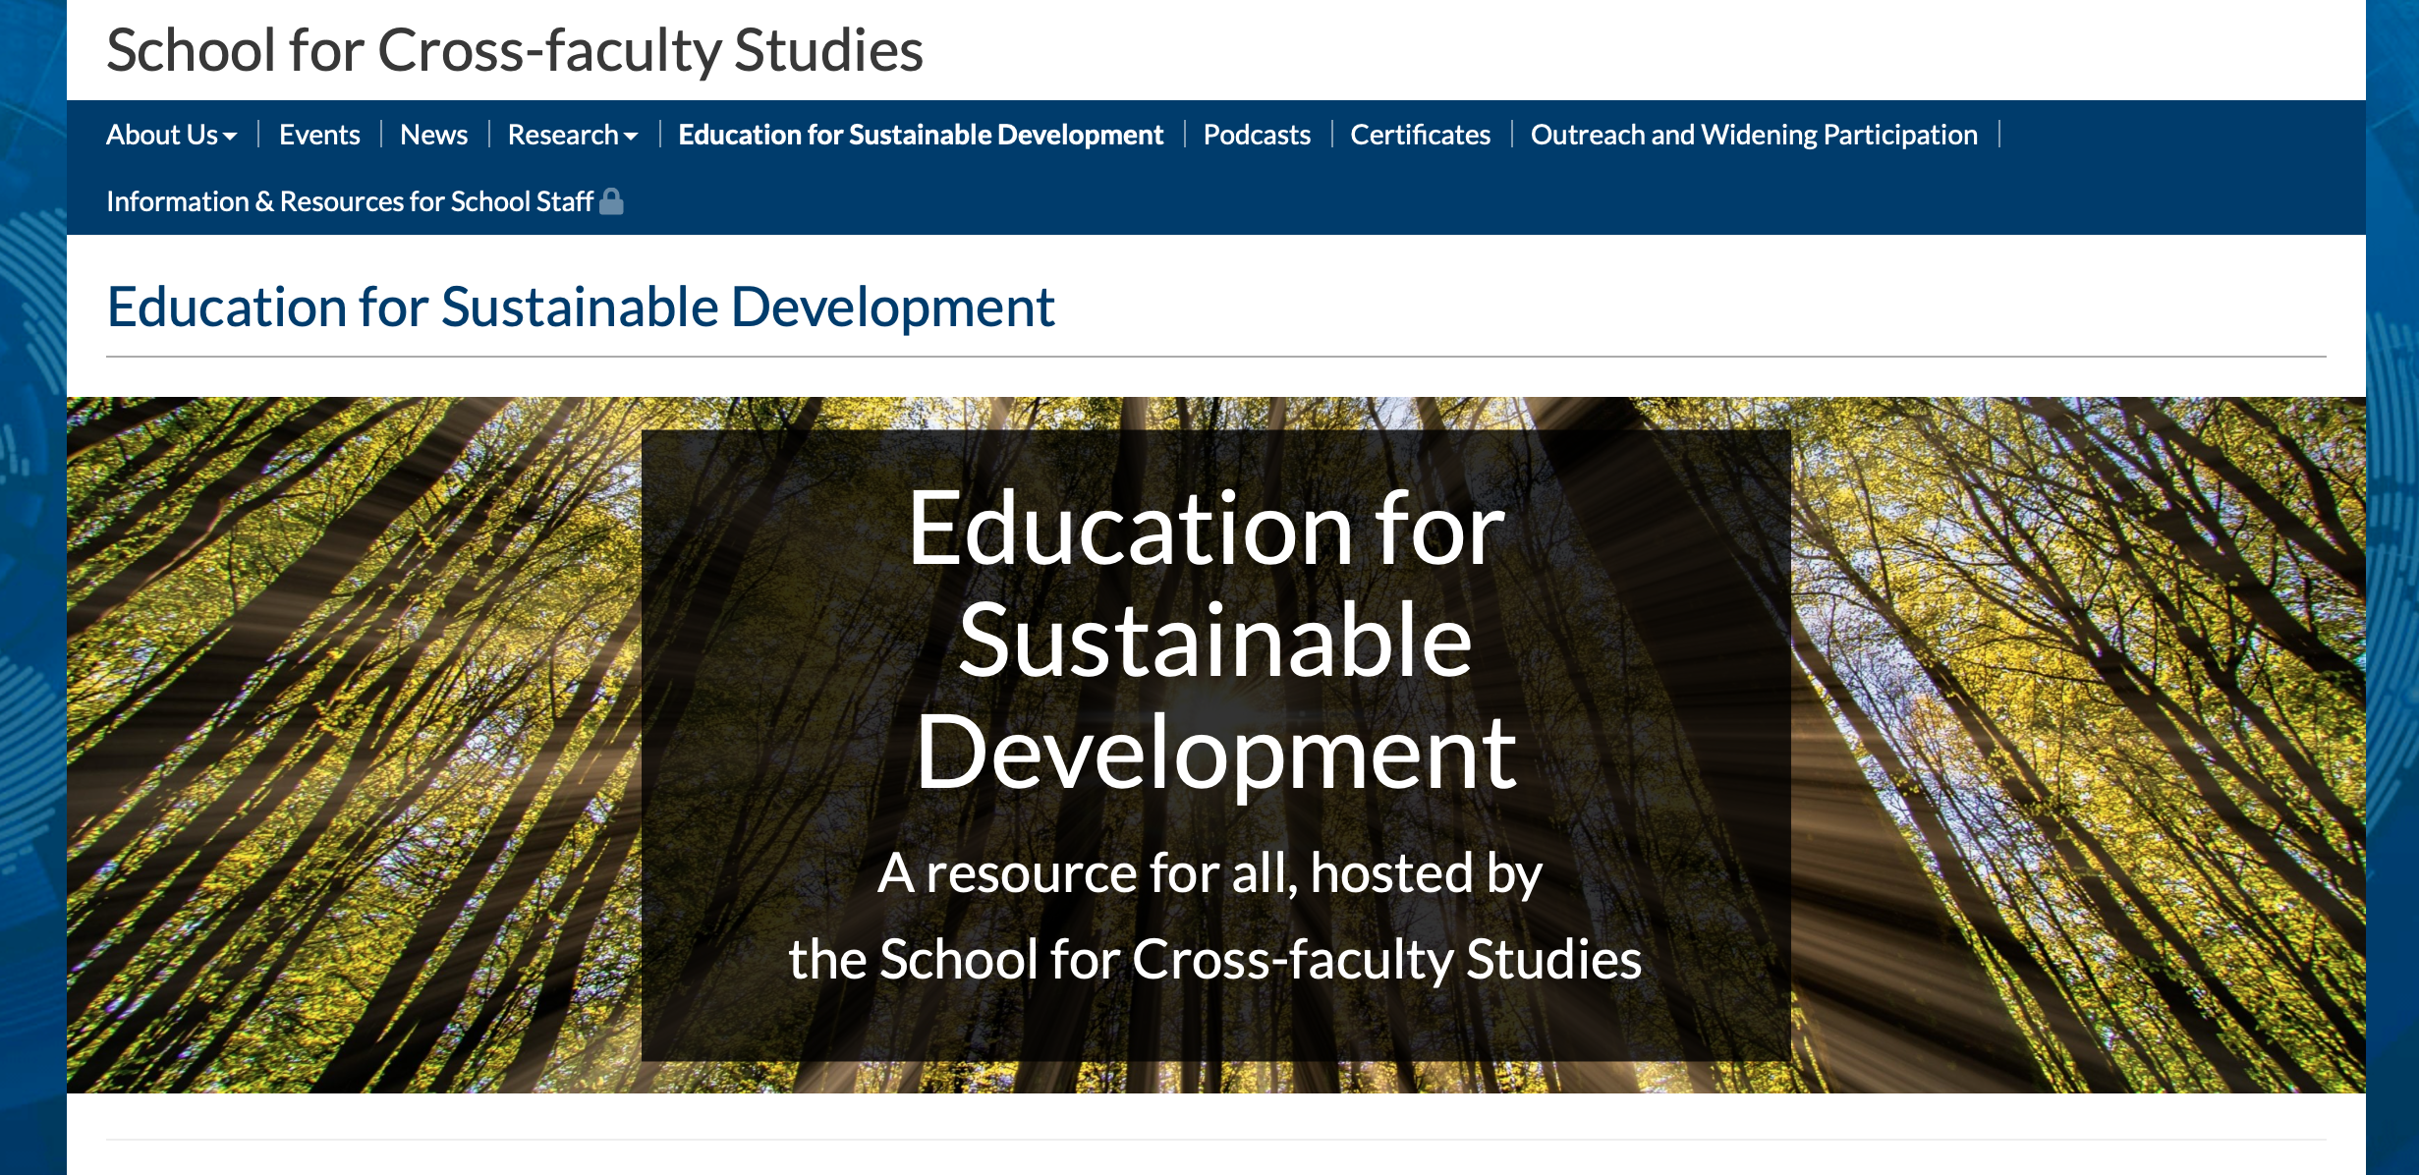

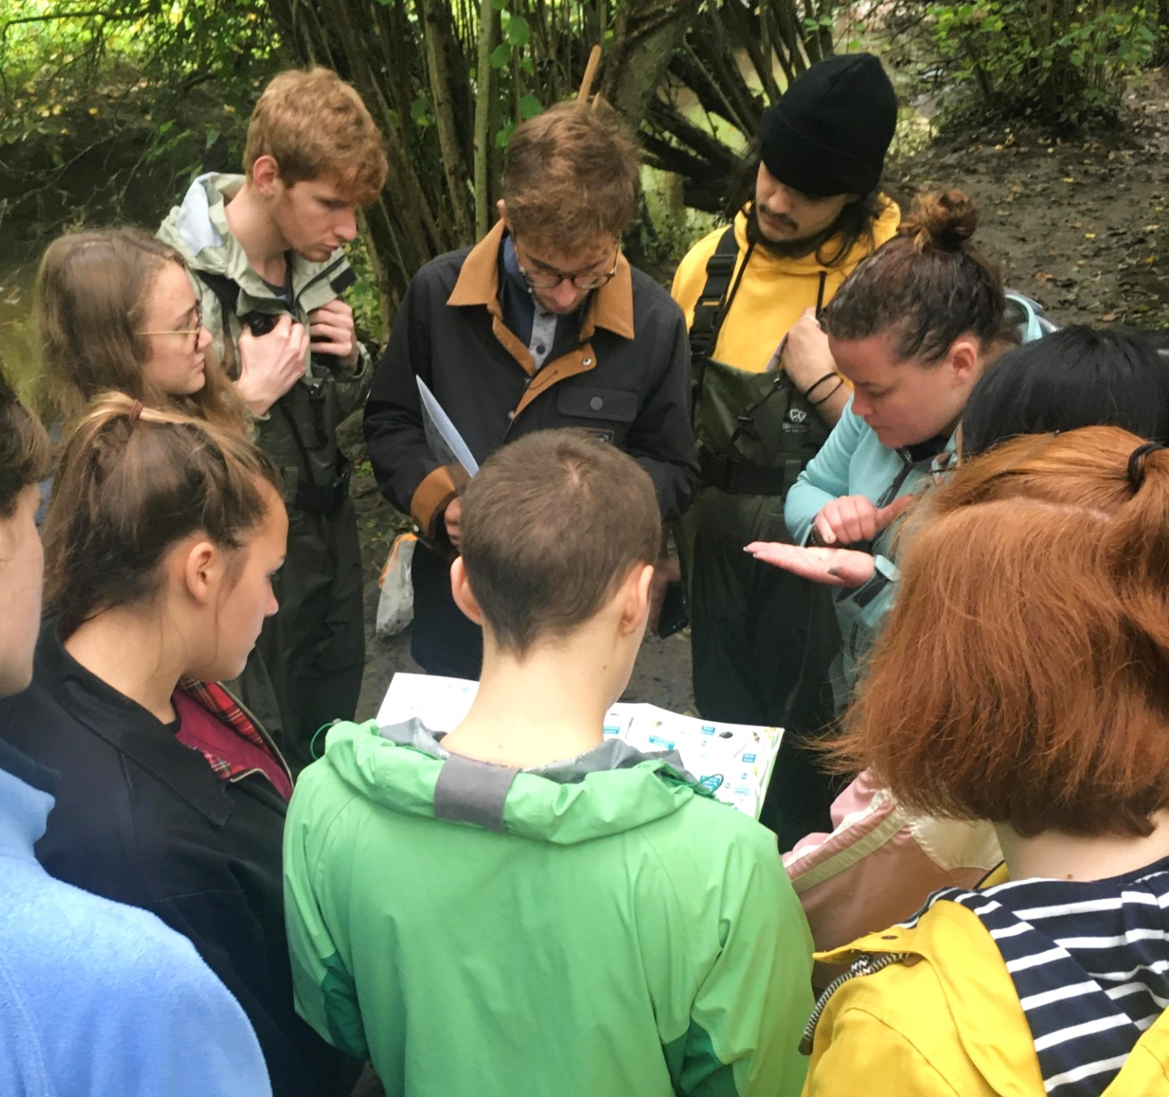
ESD at Warwick
Unique inter- and transdisciplinary degrees
ESD in the curriculum
Content
Students as co-creators
Campus as a living lab
On-campus consultancy projects
Inclusive Education Action Plan
Institutional Teaching and Learning Review (ITLR) – ESD as common theme
ESD Network

Slide 4


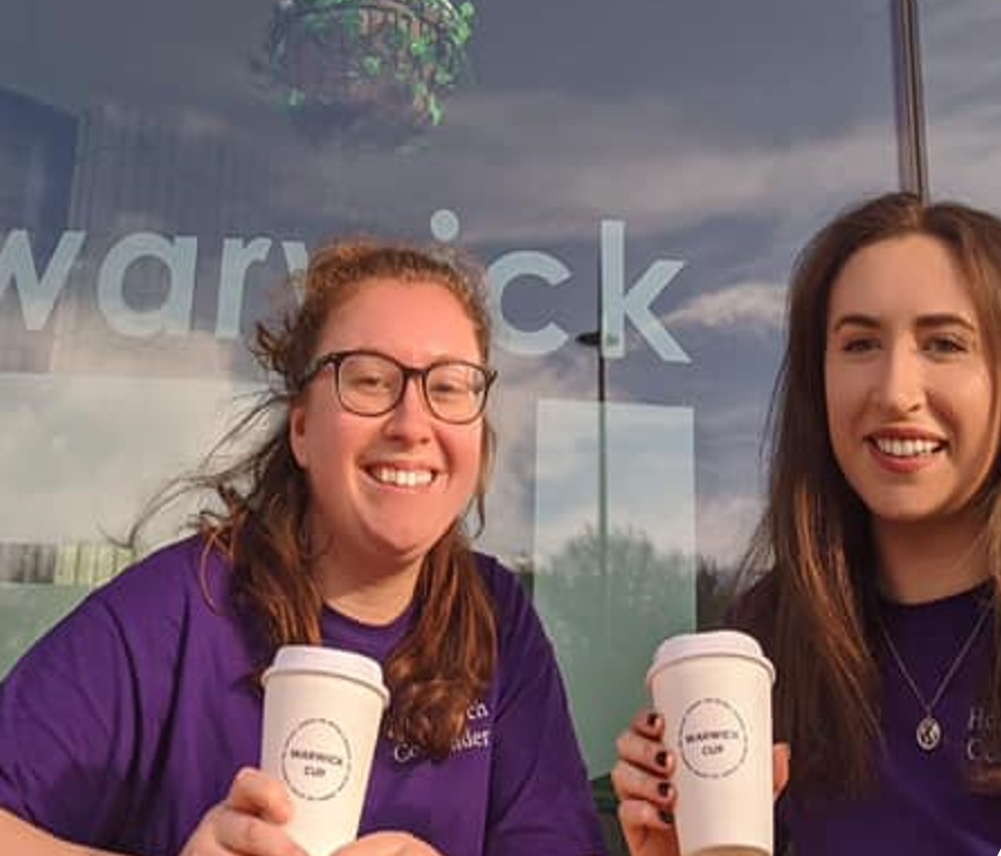
ESD at Warwick
Extracurricular opportunities
Placements
Community engagement - WIE
Warwick Core Skills - Certificates
Supporting students’ initiatives
Warwick Climate Negotiating Forum
Globus
Enterprise / Student Societies

Slide 5
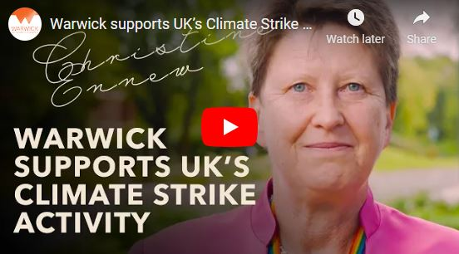
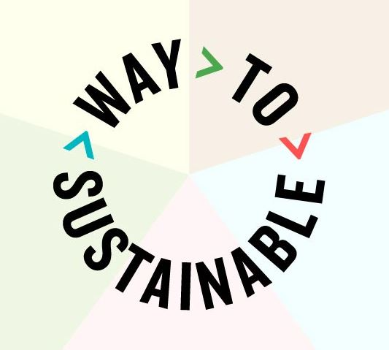
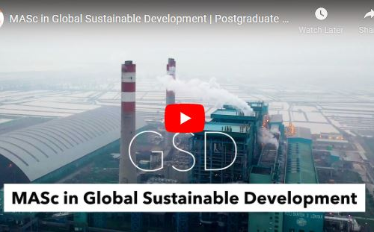
ESD and The Way to Sustainable
Enabling our students to become responsible global citizens, providing them with the skills and attributes to be active contributors in our journey towards the achievement of the SDGs.
Empowering our students to take responsibility and lead transformative change.
HE’s role
Warwick’s The Way to Sustainable
IGSD’s first Sustainability Training School

Slide 6

“The 2030 Agenda compels us to look beyond national boundaries and short-term interest and act in solidarity for the long-term. We can no longer afford to think and work in silos.”
Ban-ki Moon (Sept. 2015)

