Slide 1
Türkiye and Syria
Building back:
better
more sustainably
more resiliently
(and with fewer buzzwords)
Ilan Kelman, University College London
Twitter/Instagram @ILANKELMAN

Slide 2
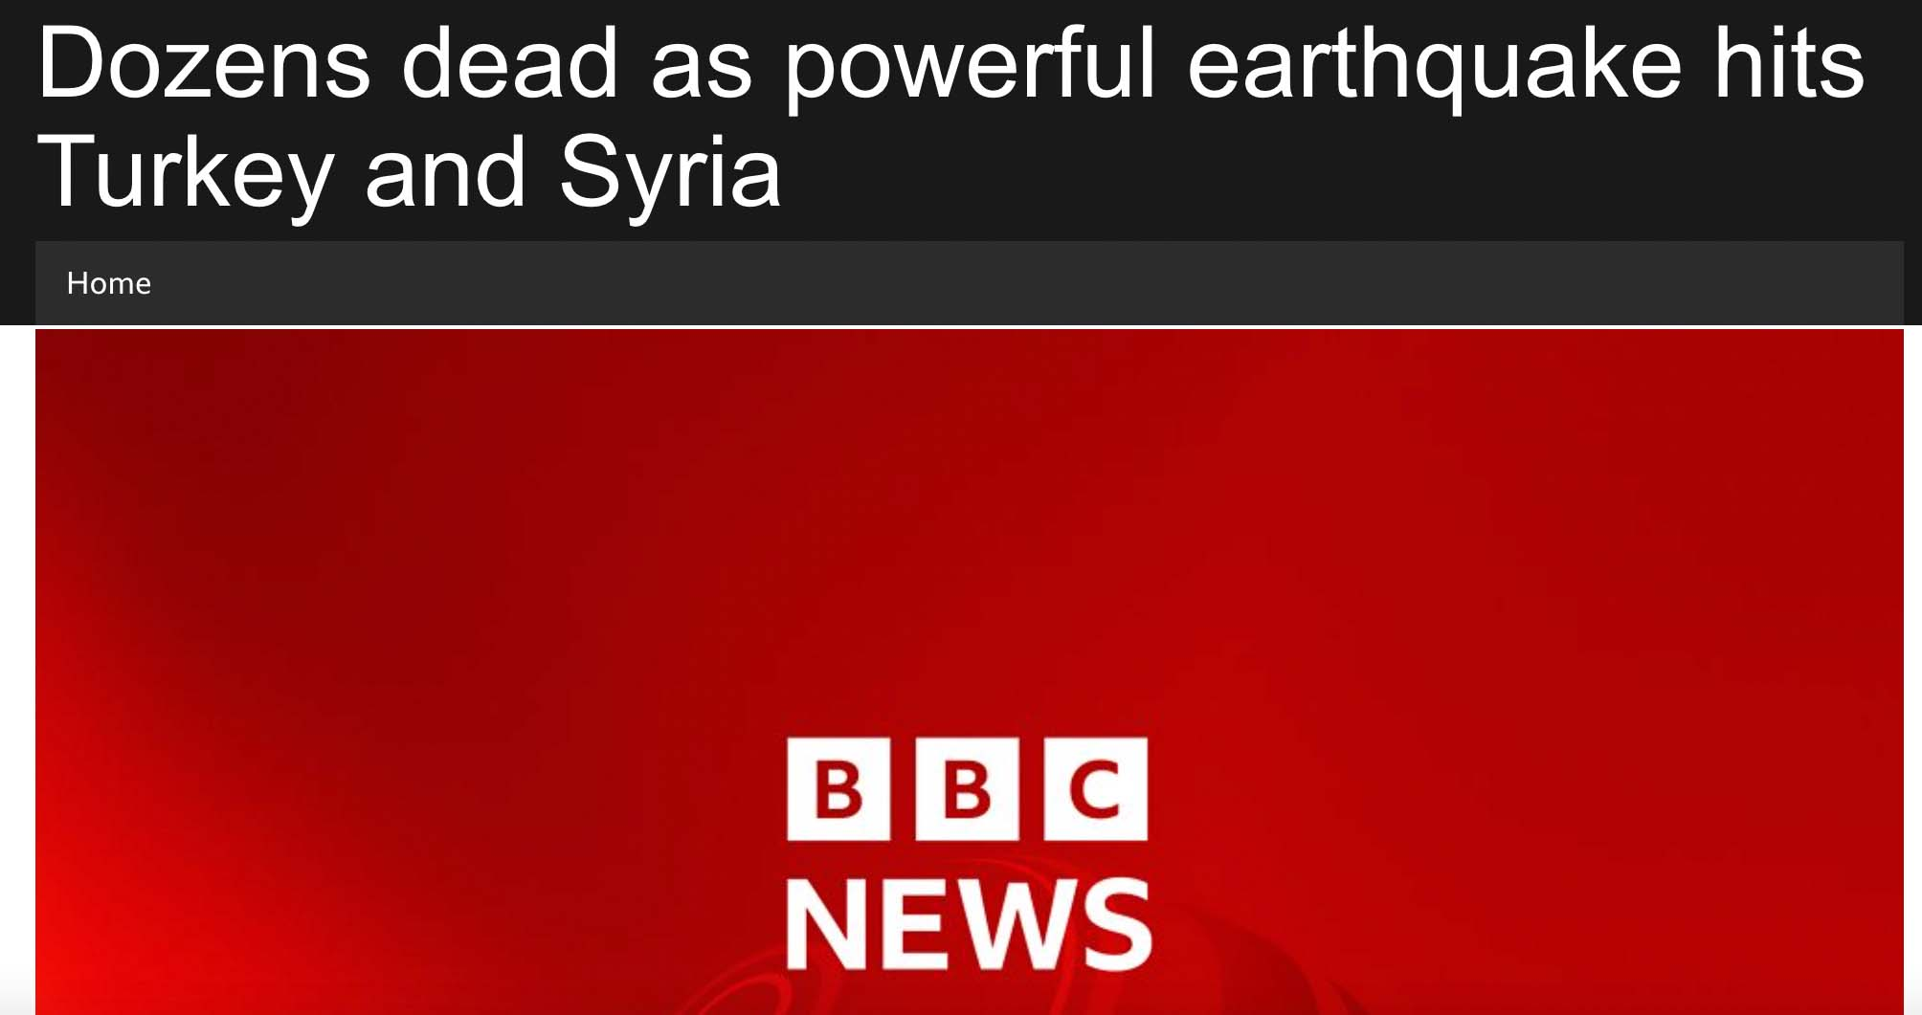

Slide 3
Disasters are not natural. Disasters happen slowly.

Slide 4
Disaster is not an event. Disaster is the everyday.

Slide 5
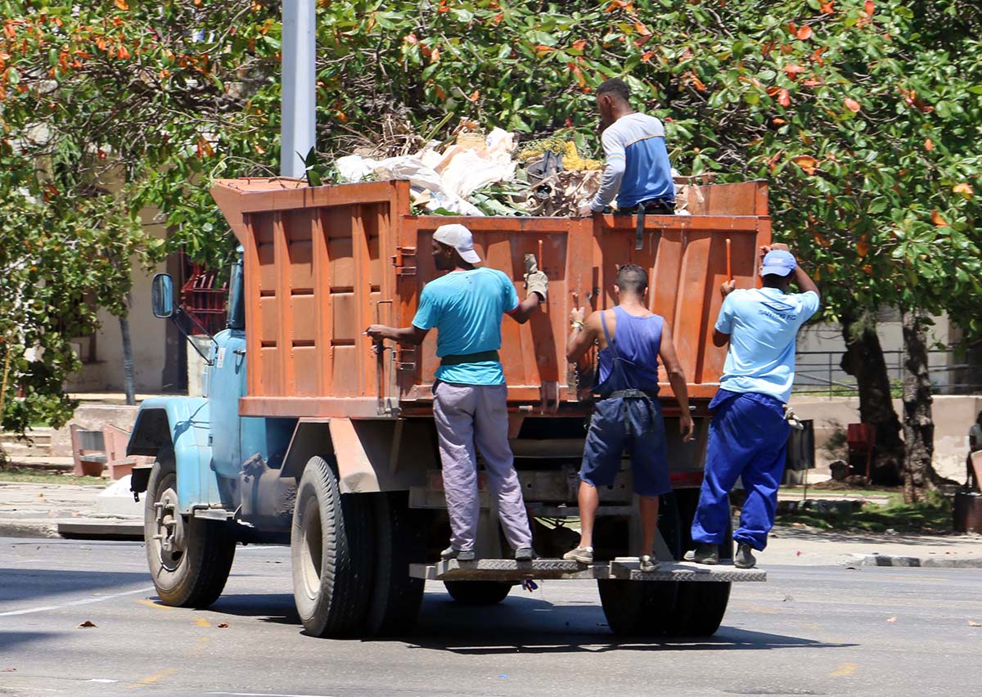

Slide 6
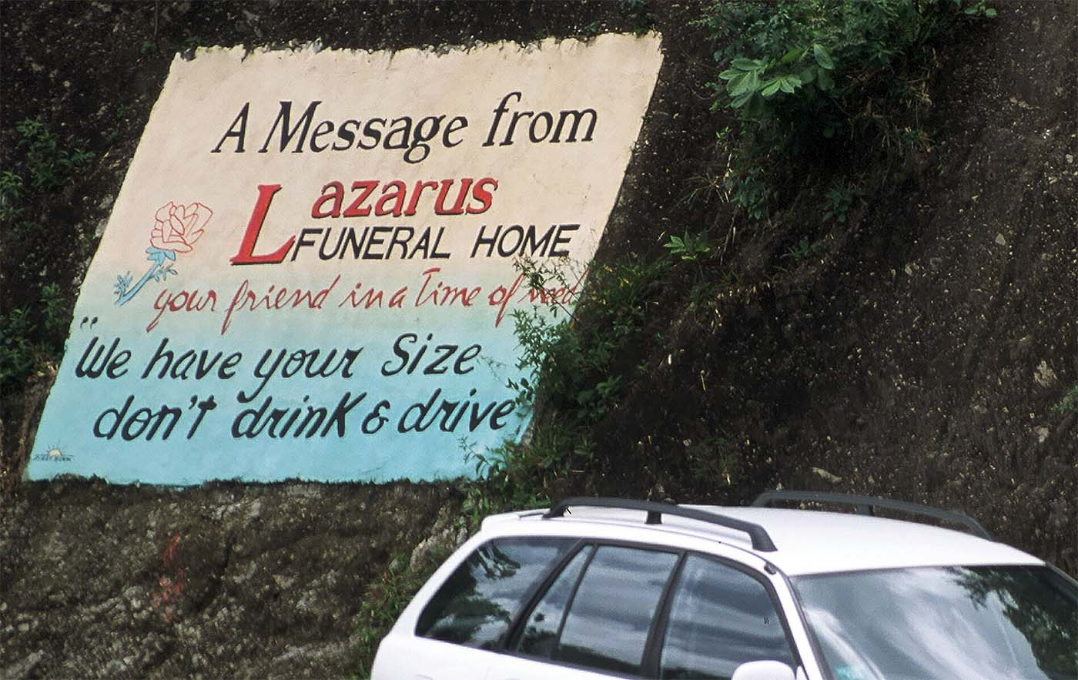

Slide 7
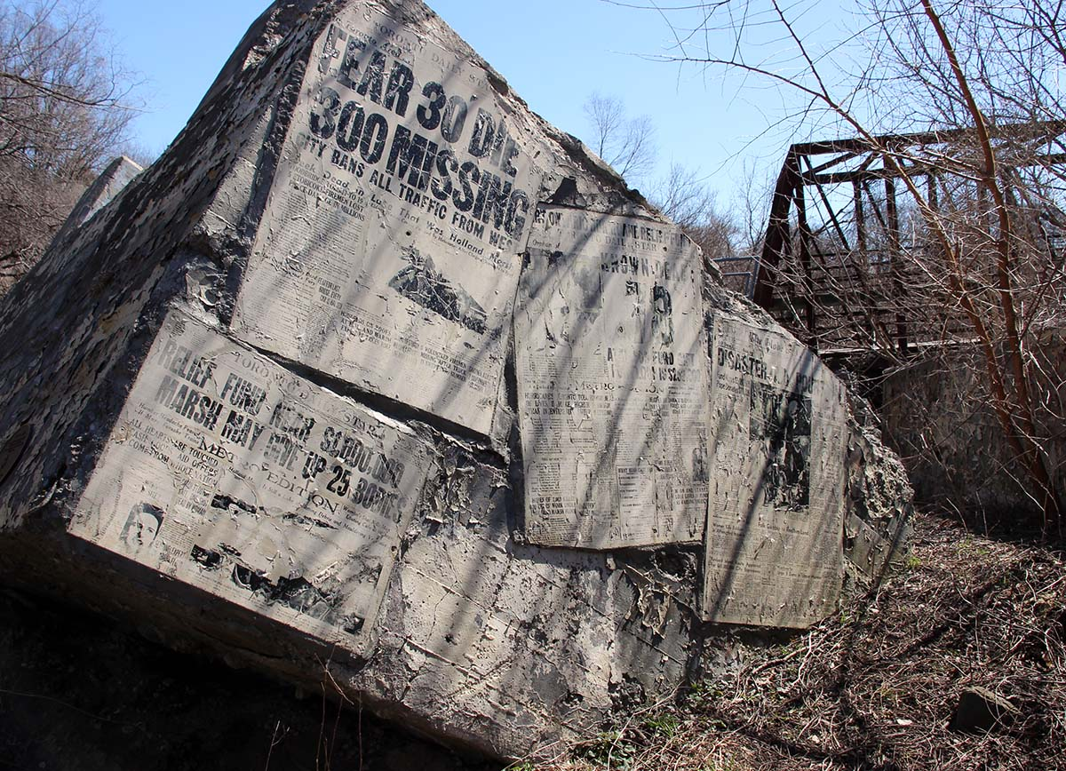

Slide 8
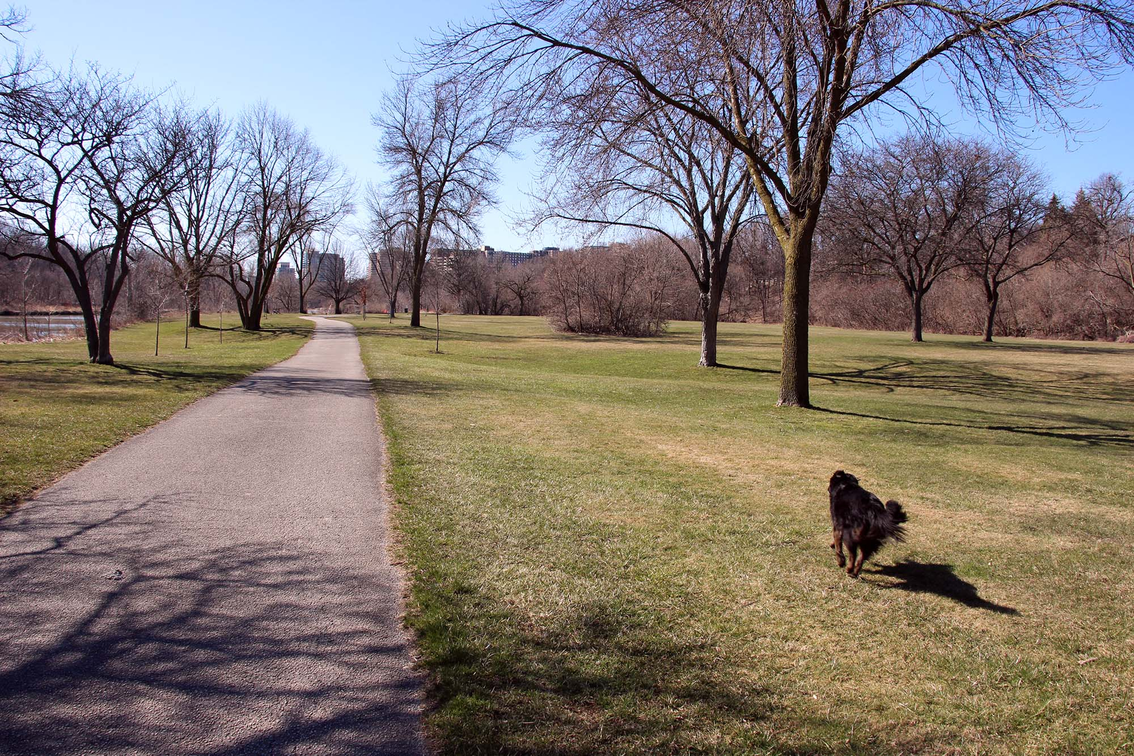

Slide 9
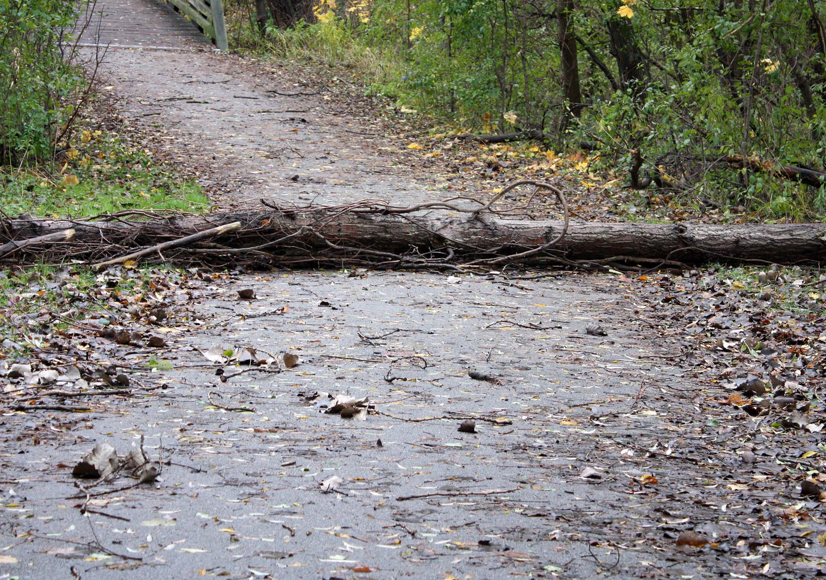

Slide 10
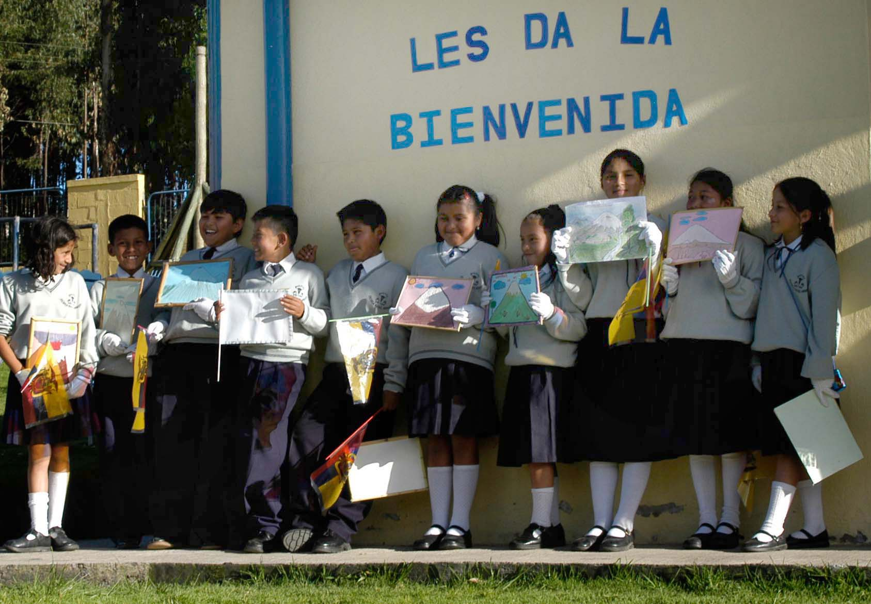

Slide 11
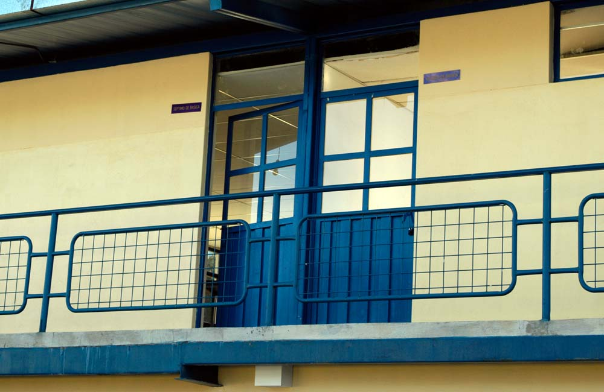

Slide 12
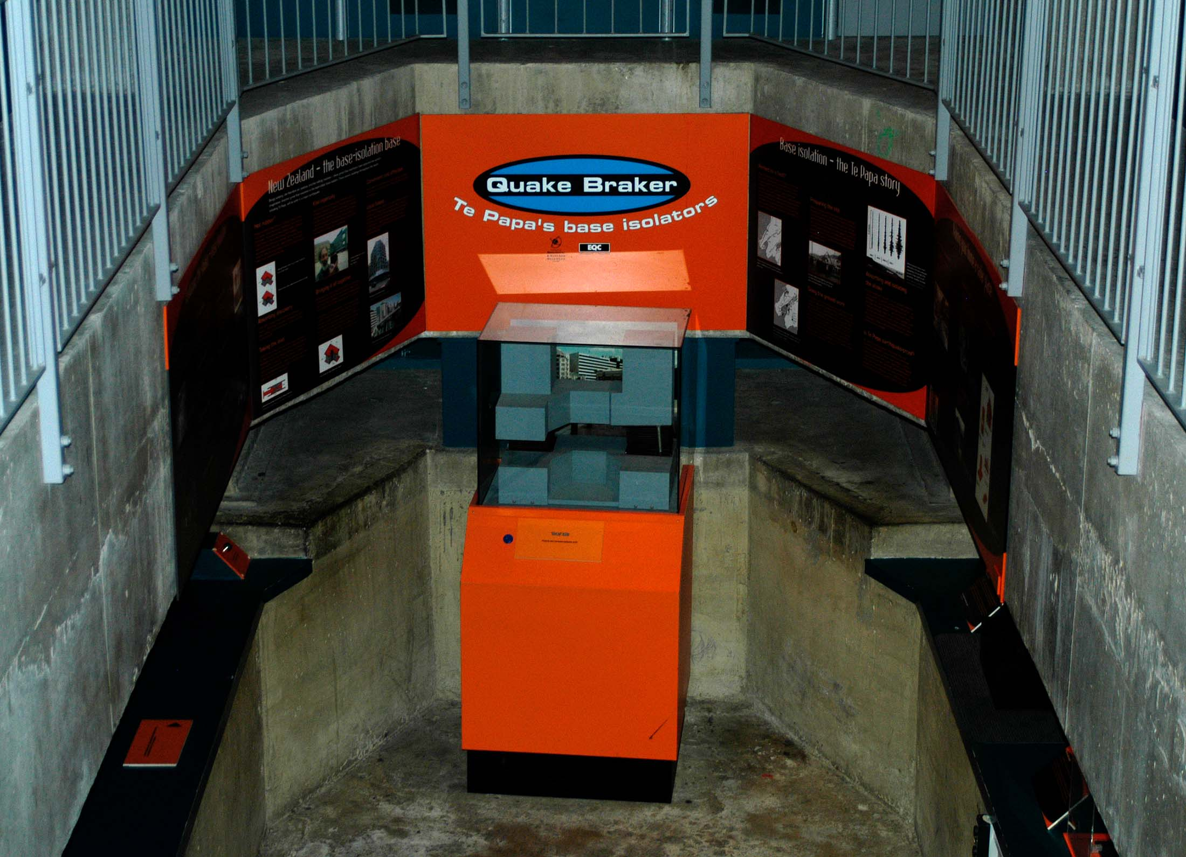

Slide 13
Build back better

Slide 14
Resilience

Slide 15
Sustainability

Slide 16
Buzzwords Jargon Buzzphrases Nomenclature Fuzzwords Flavour-of-the-decade Newspeak Flavour-of-the-minute

Slide 17
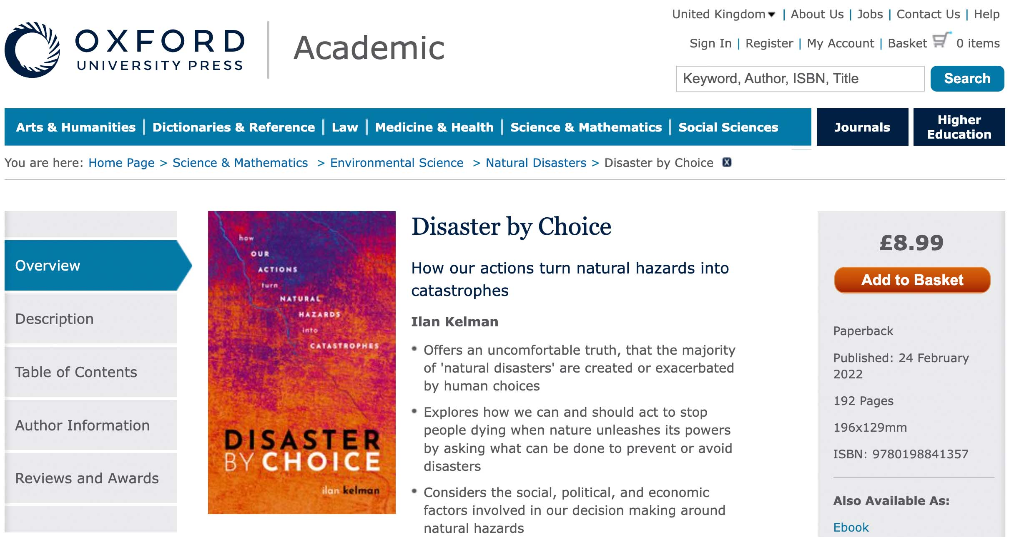

Slide 18
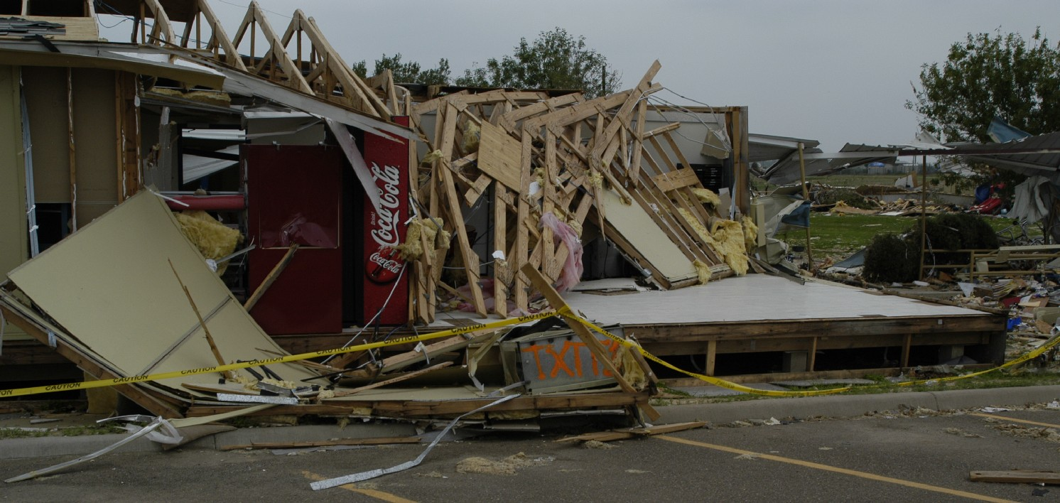

Slide 19
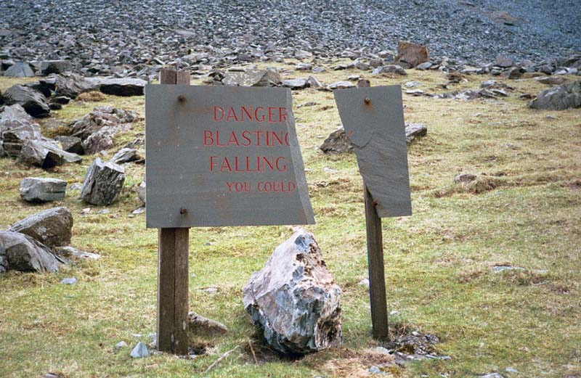
Ilan Kelman, University College London
Twitter/Instagram @ILANKELMAN

