Slide 1
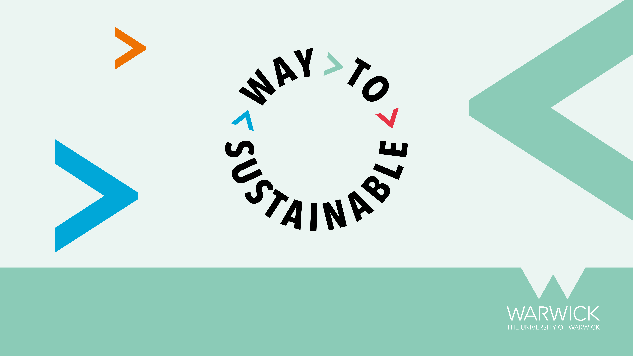

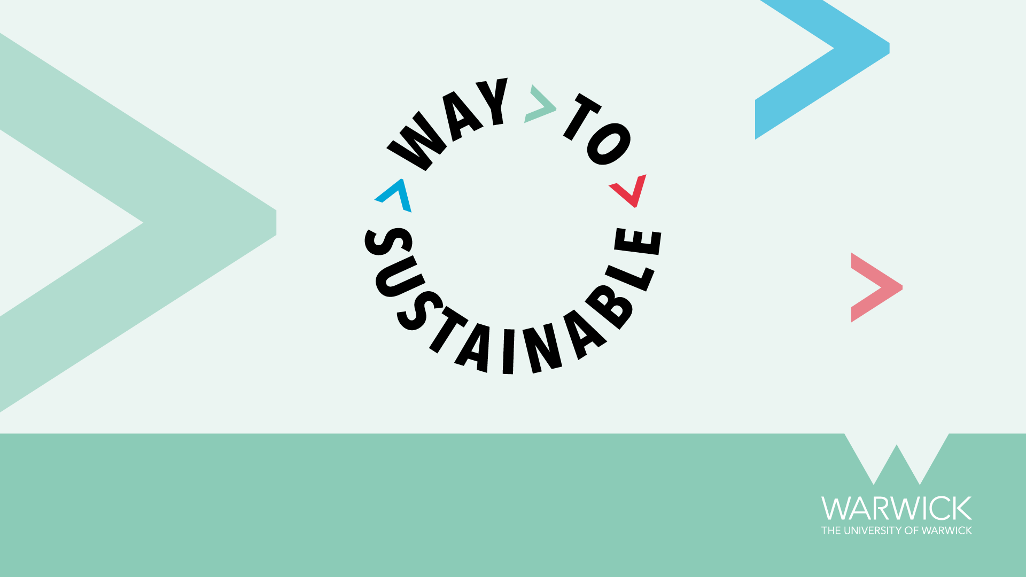
Our approach to addressing sustainability and the UN SDGs
IGSD ECR Conference
Notes:
At the heart of our university’s purpose lies the imperative to search for answers to the world’s most complex questions, and to share the knowledge we gain so that we contribute to creating a fairer, better world for all. Warwick’s Strategy 2030 presents a vision for the University as we build into the future, committing us to excellence with purpose; to having a positive impact on society. Our strategy commits us to growth and embeds sustainable development into our strategic plans and activities, so we must find better ways of operating to ensure our growth is environmentally sustainable.
If we are to be credible global citizens and leaders, we need to be prepared to roll up our sleeves, get involved and prove that change can happen. We accept that no one person, group, or organisation has all the answers, and the journey to a sustainable future will be unpredictable and demanding. But it is a path we must take, and we all must work together. We’re calling Warwick’s approach to sustainability ‘the Way to Sustainable’, a name that reflects our collective journey of continuous improvement and the important elements of curiosity, learning, engagement, collaborative planning, and action needed to achieve the most effective outcomes.

Slide 2

2019
Climate emergency declaration
CETF proposals
WTS
SDG accord
ESSAG
WTS paper to Council
Notes:
How we got to today

Slide 3
Since 2014, 100% of our major campus new builds have photovoltaic arrays installed on them to support the generation of electricity from the Sun
Our renewable energy sources generate enough power to run 263 homes for a year (based on 3,900kWh/household annually). The area they cover is equivalent to 46 tennis courts or 1,048 parking spaces
Warwick’s Scope 1 and 2 carbon emissions, relative to income, reduced by 52% between the academic years 2005/06 and 2020/21
Since October 2021, 100% of the electricity purchased by the University has been from green sources
In 2020/21 we generated 50% of our electricity and 100% of our own heat on campus through an efficient Combined Heating and Power system
Over 1,000 Green Champions giving our community a voice on how we embed sustainability
In 2021, we planted 1200 new trees. In 2022, we sowed 500m2 of wildflower meadows
In 2021, for the first time ever, Warwick achieved the official ‘Non-governmental Observer Status’ and sent a delegation of over 20 to COP26
Notes:
How we got to today

Slide 4
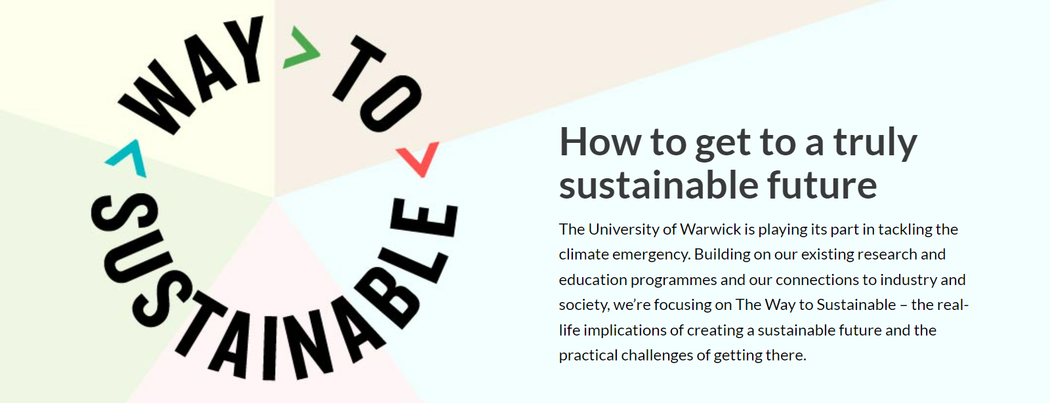
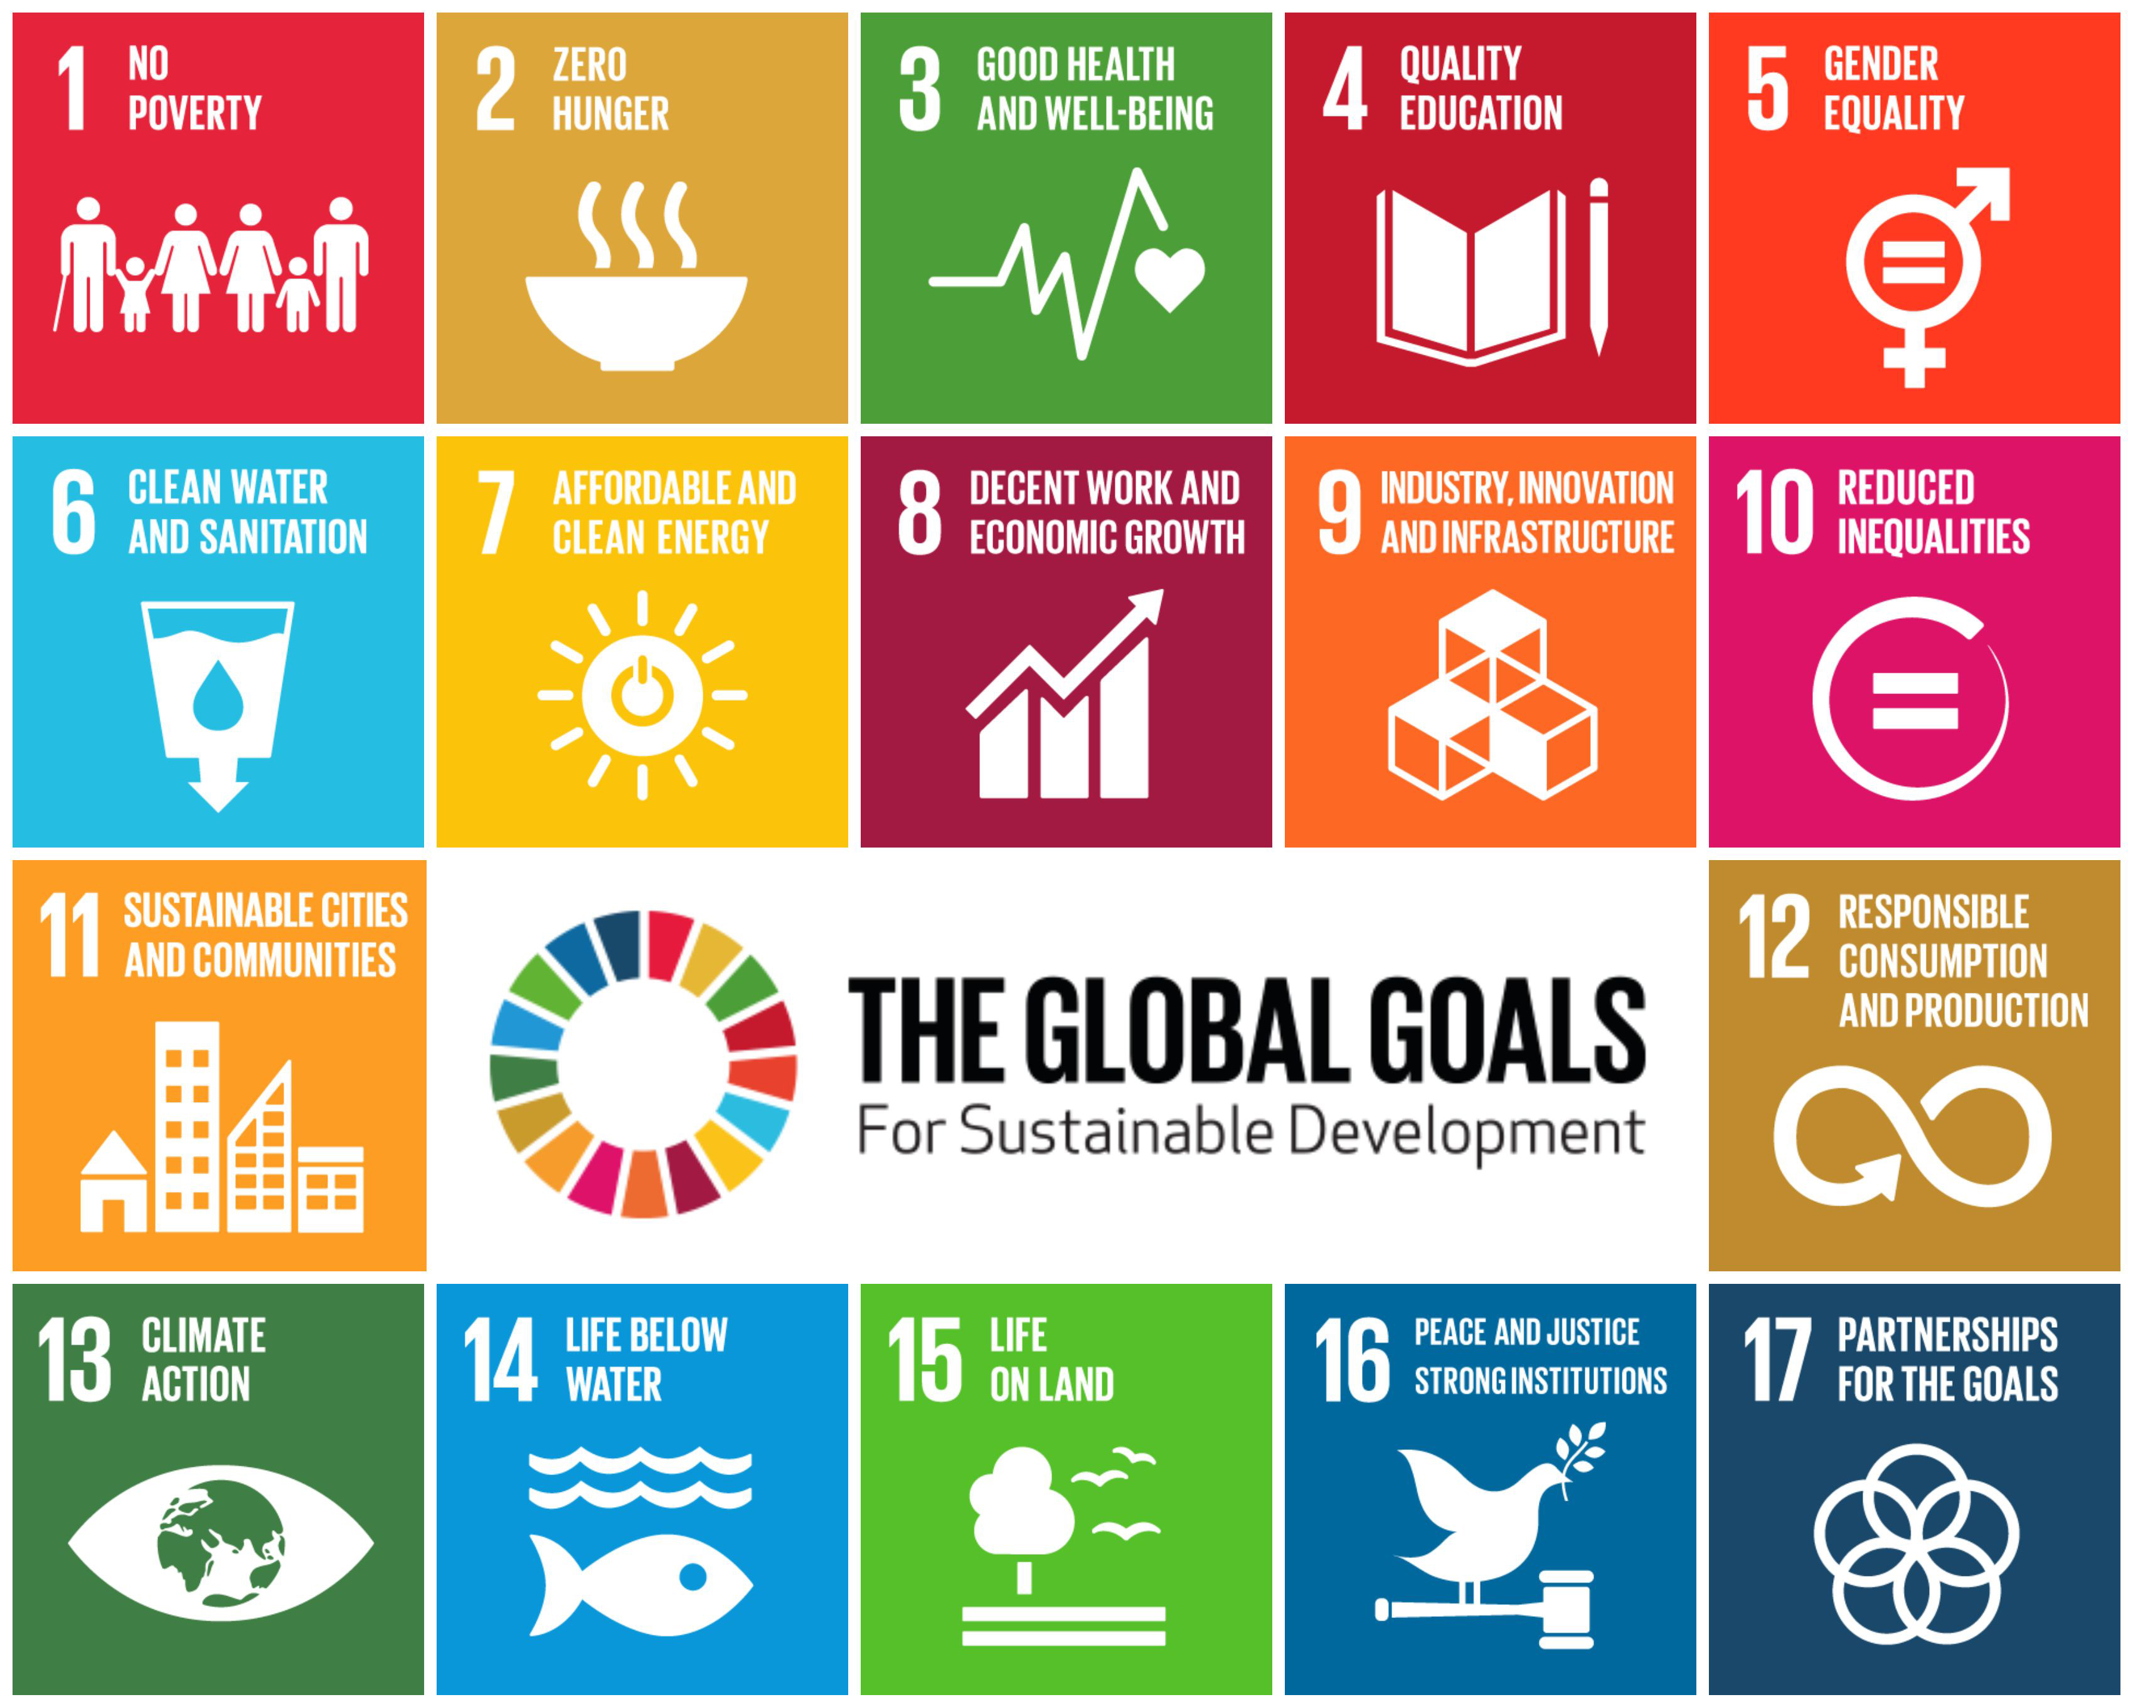
“Meeting the needs of the present without compromising the ability of future generations to meet their own needs.”
UN World Commission on Environment and Development
Notes:
Warwick doesn’t see itself as an ivory tower. That’s not who we are as a university and not why we were founded. It stands to reason, therefore, that our approach to sustainability is a manifestation of who we are as an organisation, what we stand for and what we care about. And what the world needs – which is for us all to come together, to mix minds, ideas and experience, to address climate change and its related challenges. Our approach to sustainability is as much about leading from the front as it is about empowering our communities and others to make change and embrace new perspectives, innovations and ideas. Through our approach – the Way to Sustainable - Warwick is making a statement about the importance of being the change you want to see and making a commitment to continuous improvement, to collaboration and to co creation of solutions that will address climate change and contribute to action in line with the UN SDGs.

Slide 5
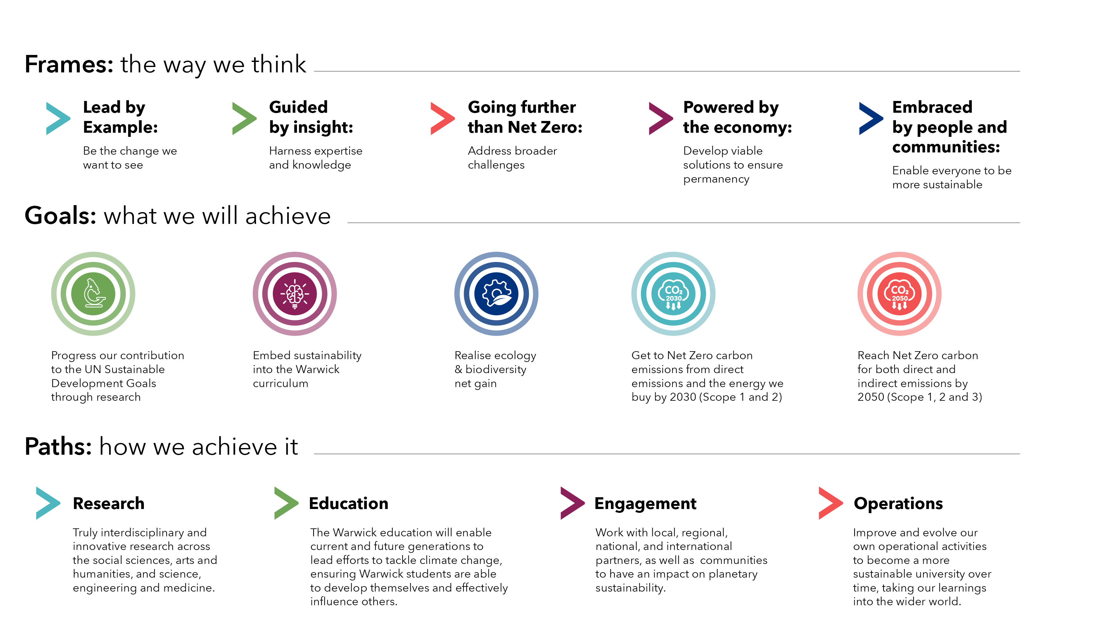

Slide 6
The Challenge (and opportunity) for a research intensive
Experimental research is carbon hungry
Equipment purchases and power consumption;
Experiment duration;
Storage (ultra cold freezers);
Consumables;
Space requirements.
Higher travel impacts via research related travel. (research activity and research disseminations.
The research we do has the potential to impact on carbon and on sustainability in its broadest sense – we can improve our own position and we can impact more broadly.
The Campus Living Lab – experiment with our own facilities – trialling CAVs, experimenting with battery storage, embedding PV into buildings, habitat management…………
Notes:
How we got to today

Slide 7
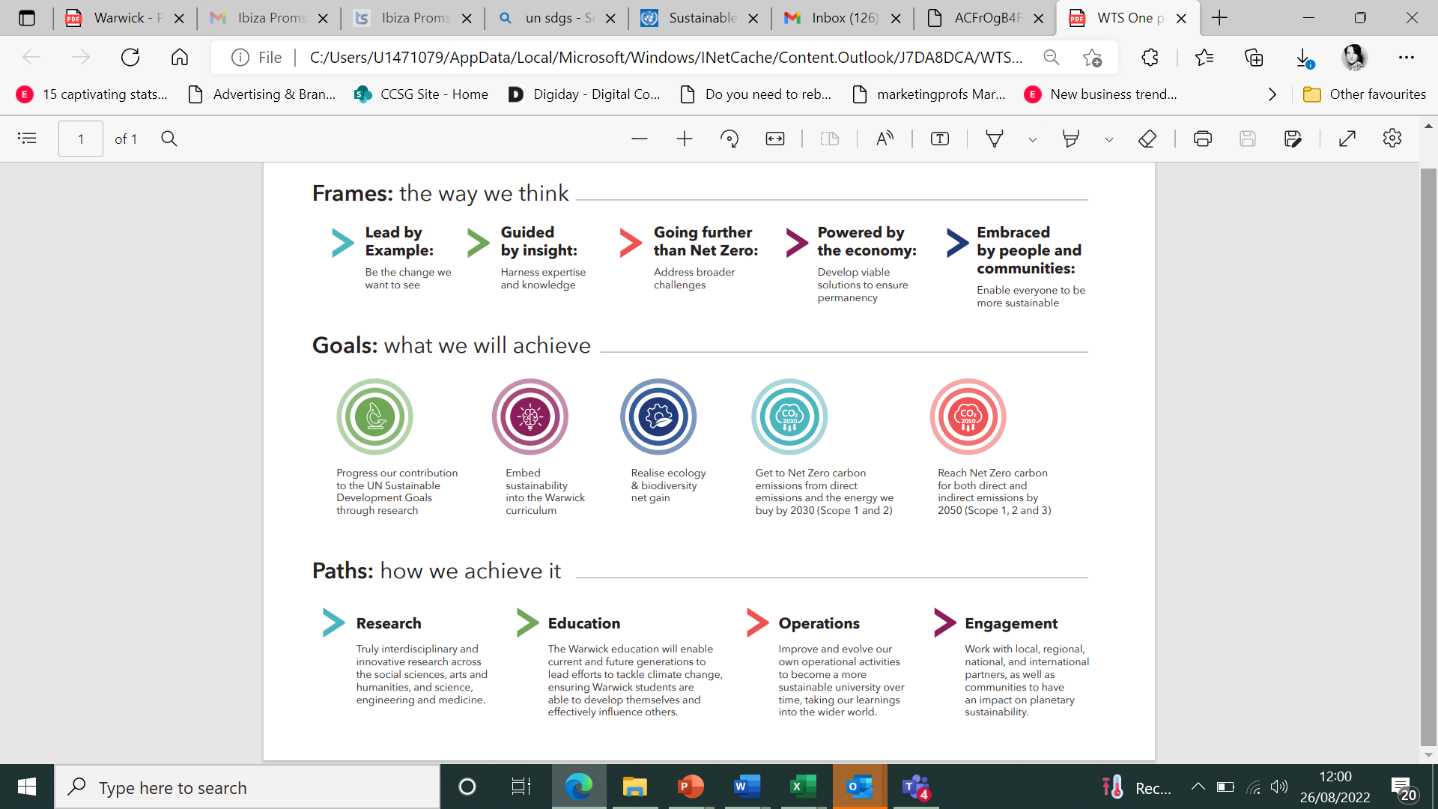
Our Emissions
Direct
Warwick’s Scope 1 carbon emissions arise from direct consumption of fossil fuels and greenhouse gases escaping from our operations. These fuels include natural gas, liquid propane gas, petrol, and diesel.
>95% of our Scope 1 emissions come from burning natural gas to provide heat and generate electricity
Indirect
Scope 2 indirect, carbon emissions arise from the fossil fuels burnt by others to supply us with energy. Historically, all our Scope 2 emissions arise from our purchased electricity.
Scope 3 emissions are not produced by Warwick directly and are not the result of activities from assets owned or controlled by the University. Instead, they are emissions connected to our value chain such as business travel, commuting, purchased goods and waste.
Notes:
This is Way to Sustainable on a page…. We have perspective which guides how we approach everything – we need to lead by example and show our commitment, rather than talk about it, we need to use our experts and their expertise to inform what we do, we need to not just talk about net zero but think bigger and broader about the context around environmental sustainability and extend our work into addressing the UN Sustainable Development Goals.

Slide 8
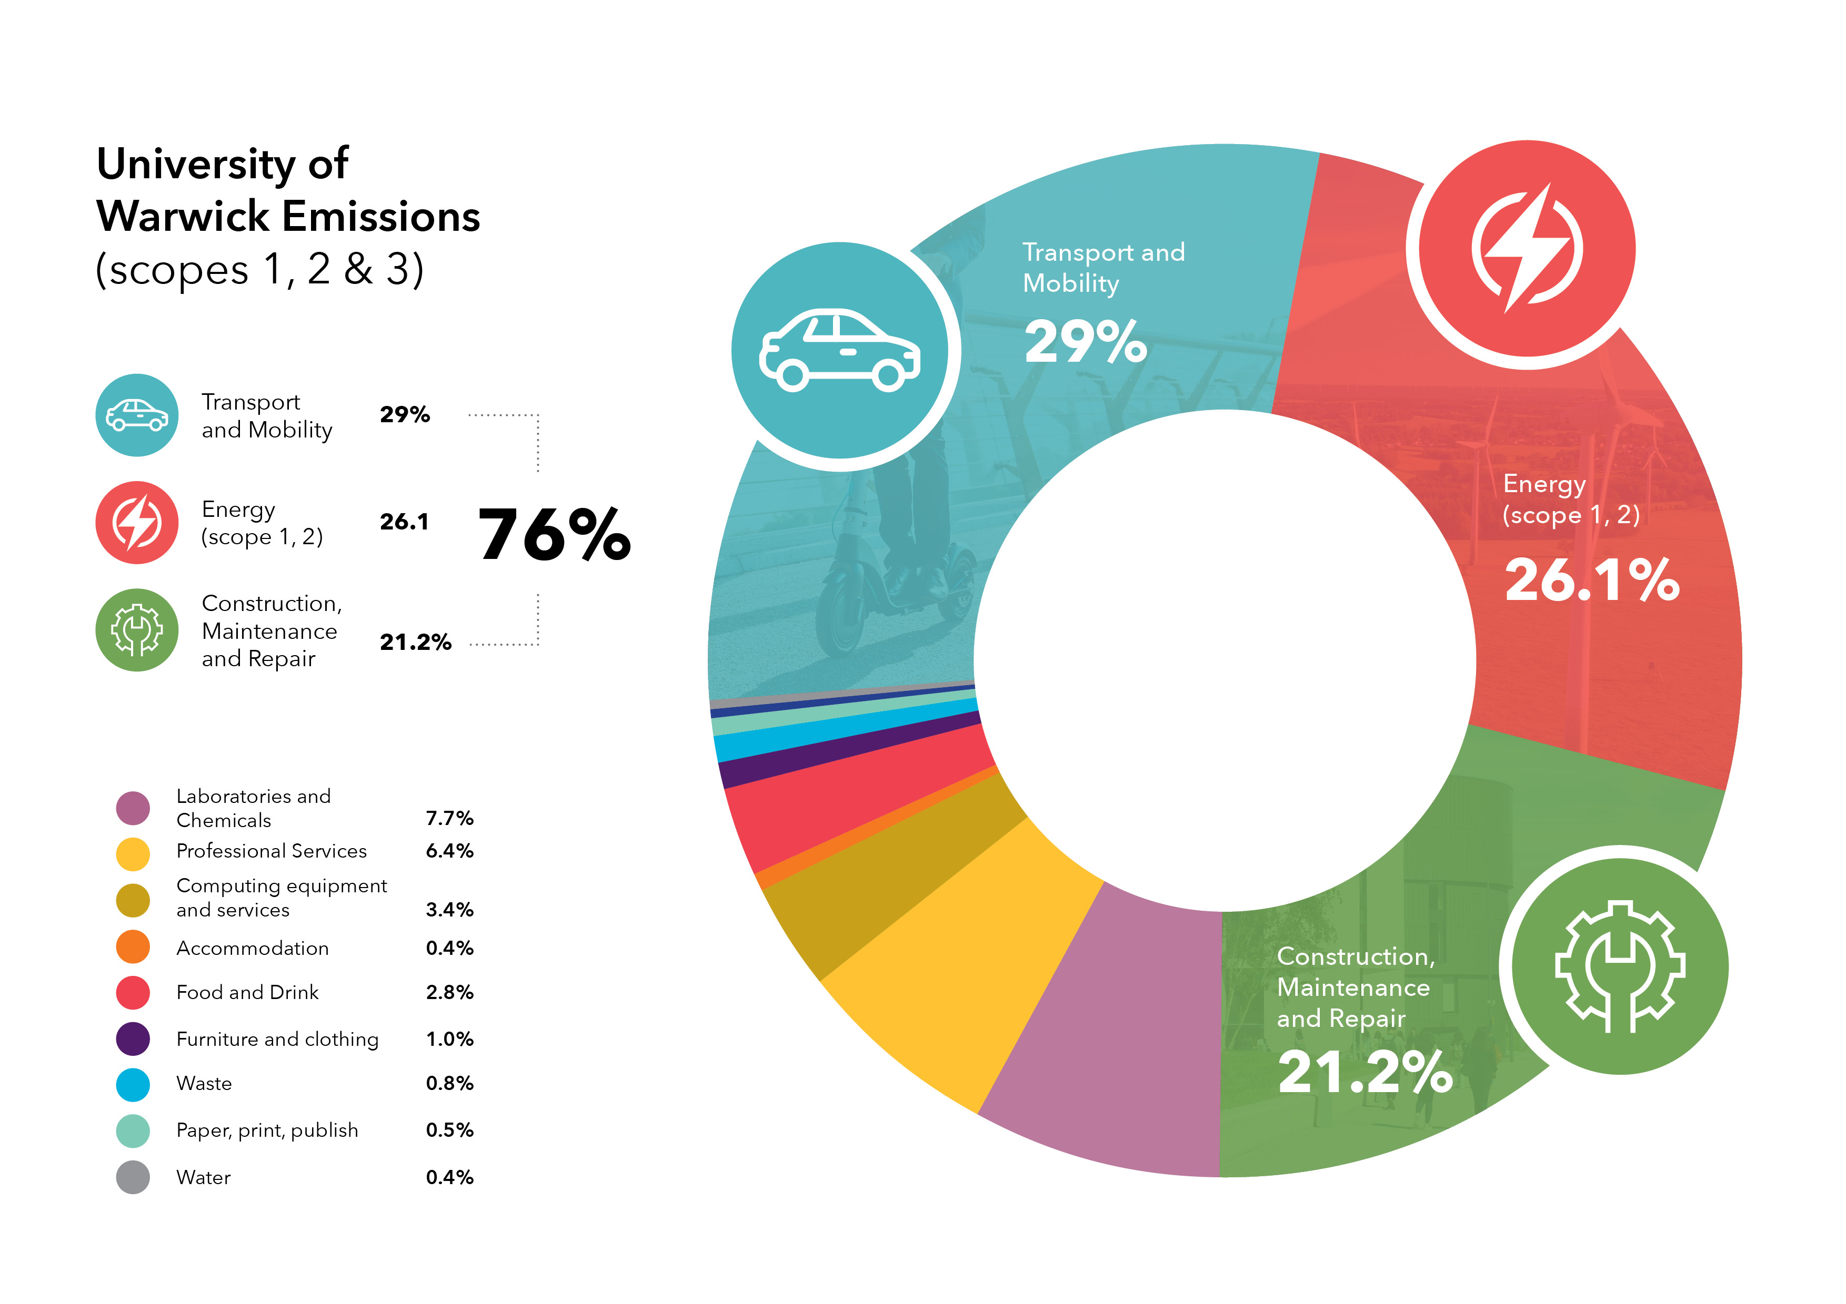
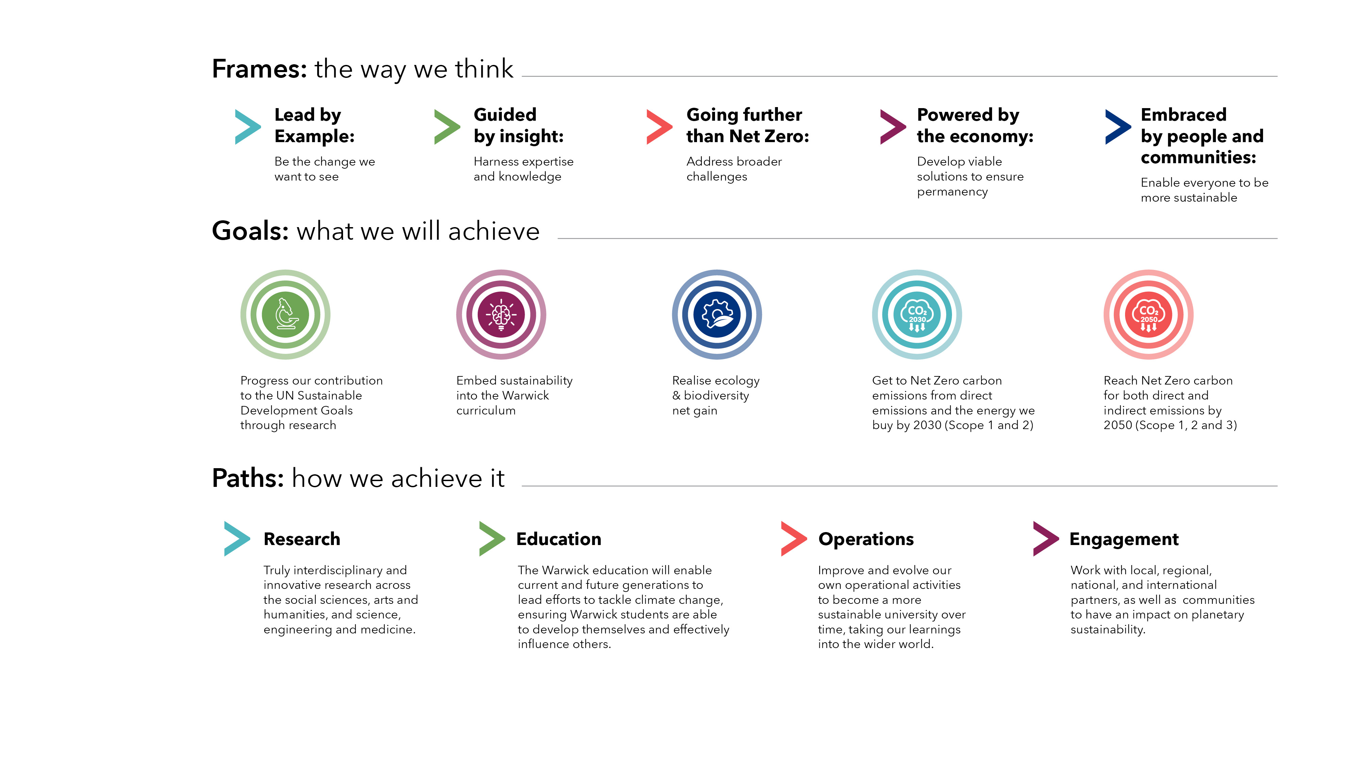

Slide 9
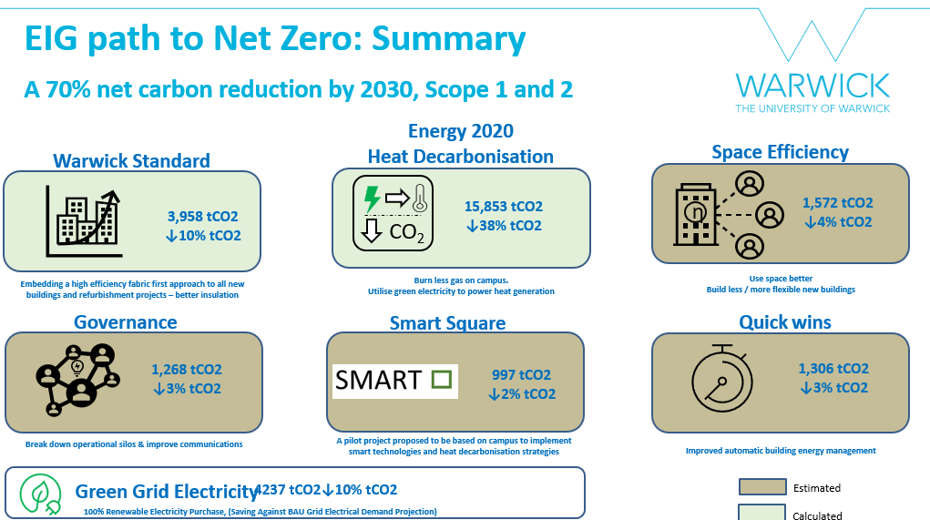
Carbon

Slide 10
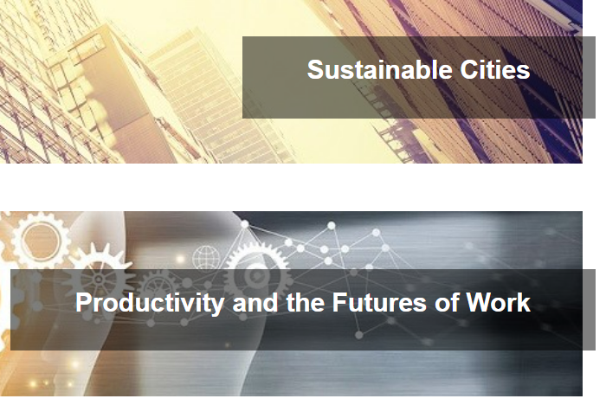
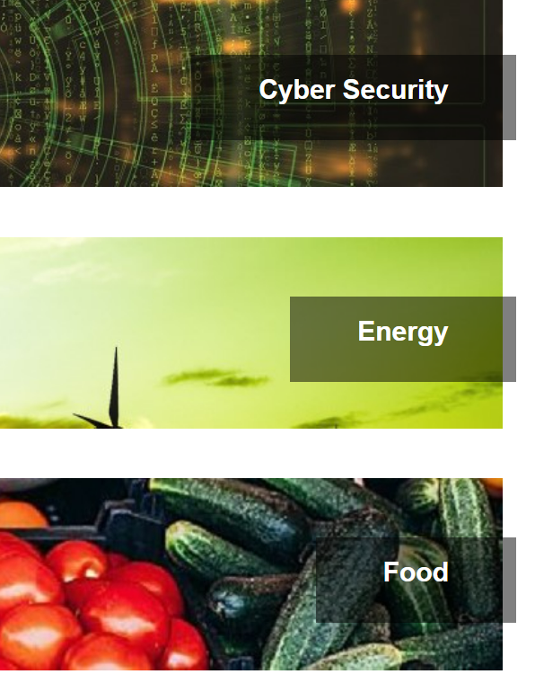
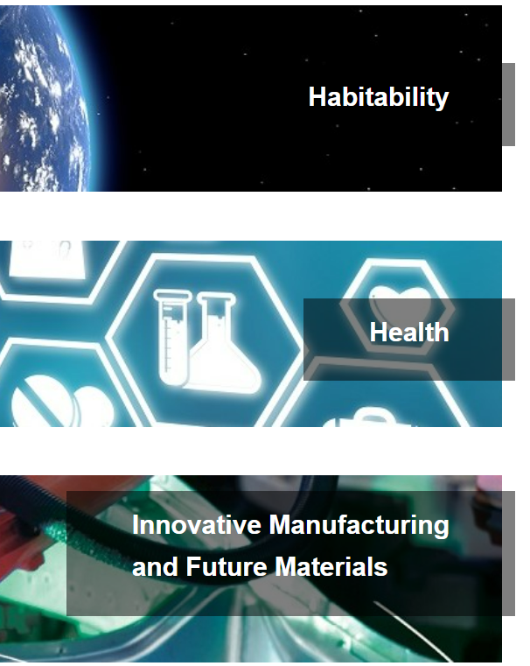

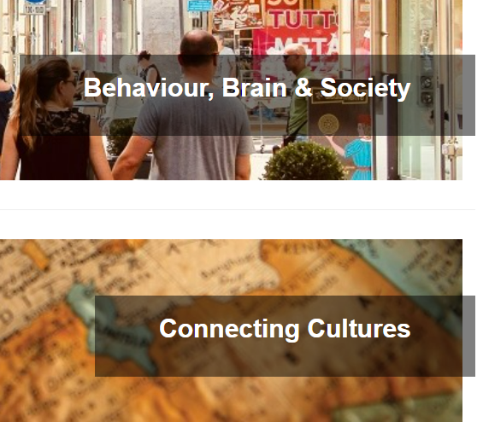

Goal
KPI
Current
Progress the University’s contributions to the UN SDGs
Number and range of staff, and PhD students, engaged with sustainability related research
Increase in research income for challenge-led research with transformative sustainability impact (UN SDGs)
Indicators of sustainability research impacting on policy, business, and government
LEAF accreditation for research facilities
2nd SDG report produced
Preparing for THE Impact Rankings
Mapping research and baselining data

Slide 11
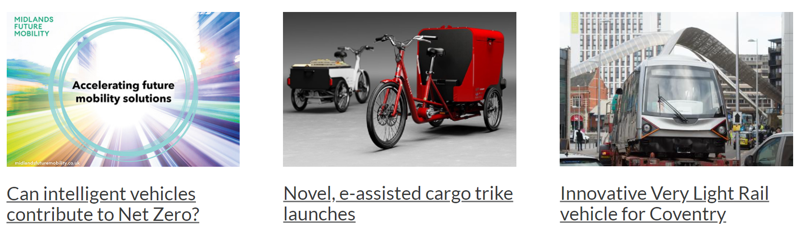
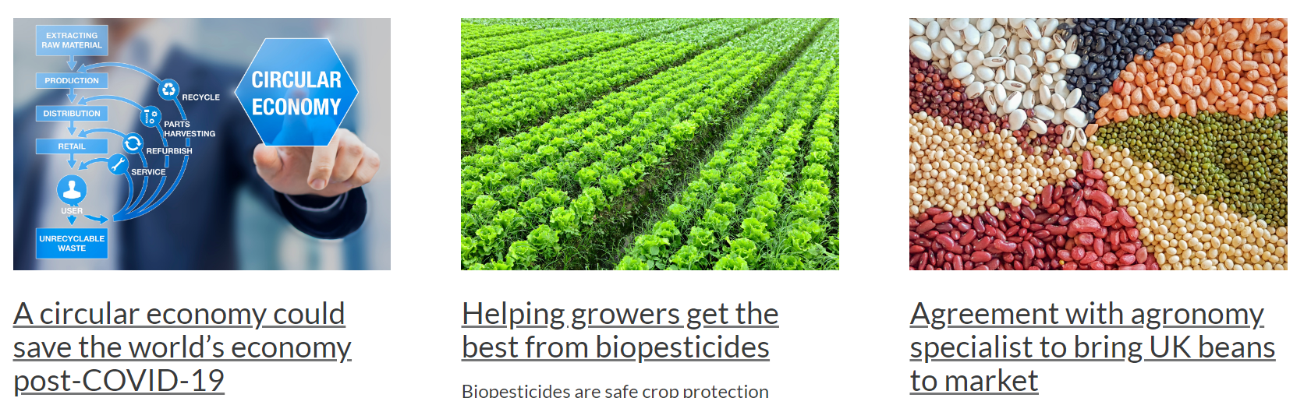

Slide 12
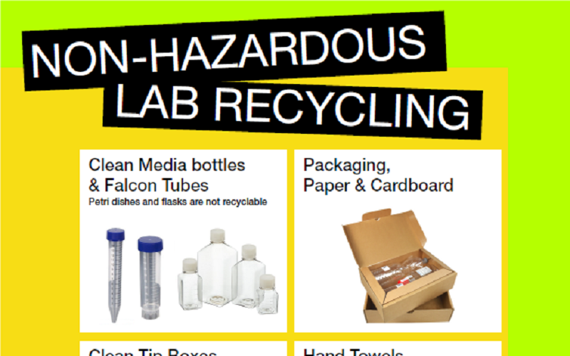
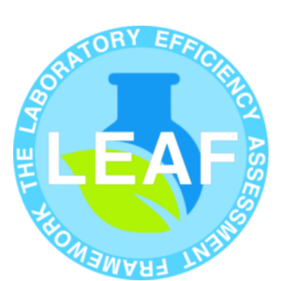
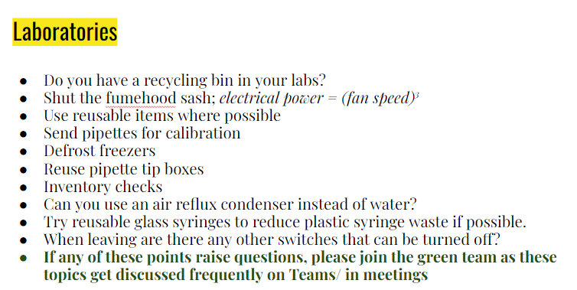
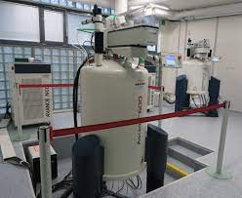
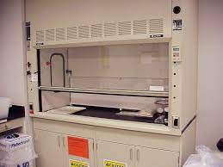
Laboratory Efficiency Assessment Framework (LEAF) accreditation
The University participates in the LEAF scheme, designed by UCL that facilitates and drives improvements in laboratory efficiency. Laboratory users work through set of criteria to achieve either a bronze, silver of gold award depending on how many actions they complete in relation to
Research quality
Equipment
Procurement
Water
Energy
Waste
Engagement and training

Slide 13
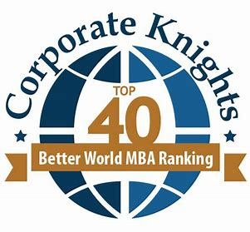
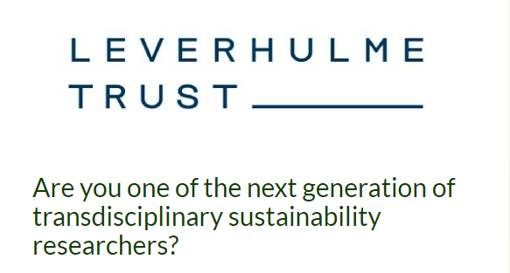
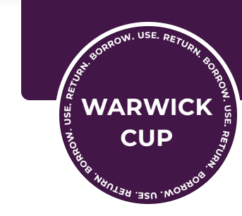

Goal
KPI
Current
Enable current and future students to lead efforts in tackling environmental, social, and economic challenges as reflected in the UN SDGs Enable the development of entrepreneurial skills in students, nurturing new ideas and innovations that boost sustainability in action
Mapping and baselining
Student uptake of sustainability related programmes and modules
Student uptake to skills and co-curricular offers
Scale of sustainability-related volunteering amongst student community
Growth in virtual mobility
Student feedback about our offer

Slide 14
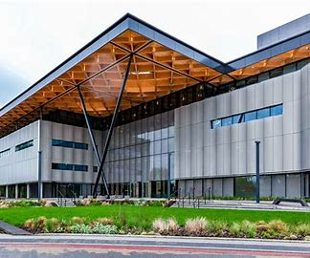
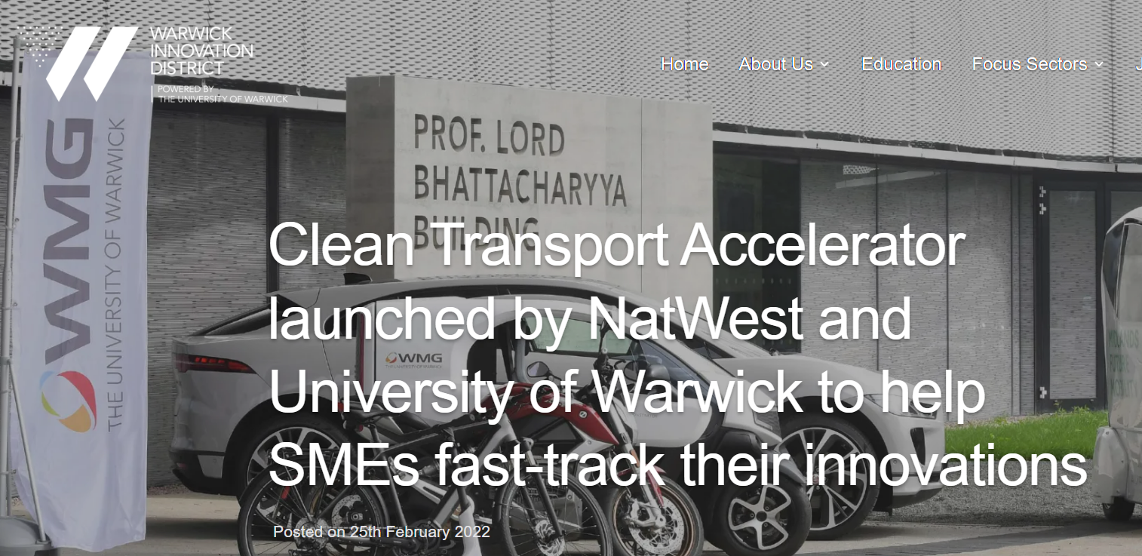




Goal
Broaden and deepen relationships with different partners and communities locally, regionally, nationally and internationally to achieve positive sustainability outcomes
KPI
Real-world change and influence realised through Warwick’s engagement with audiences and stakeholders
Reach and impact of our sustainability focused engagement events amongst communities and stakeholders
Range, quality, and outcome of the partnerships we form and maintain to address issues of sustainability in our region, country and globally
Value of opportunities brought to Warwick through new or extended operational or commercial partnerships

Slide 15
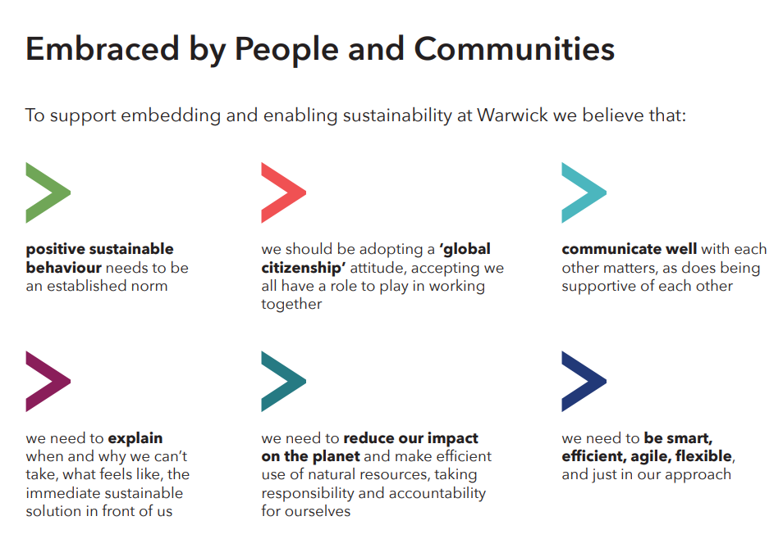

Slide 16
Our approach to addressing sustainability and the UN SDGs
Notes:
At the heart of our university’s purpose lies the imperative to search for answers to the world’s most complex questions, and to share the knowledge we gain so that we contribute to creating a fairer, better world for all. Warwick’s Strategy 2030 presents a vision for the University as we build into the future, committing us to excellence with purpose; to having a positive impact on society. Our strategy commits us to growth and embeds sustainable development into our strategic plans and activities, so we must find better ways of operating to ensure our growth is environmentally sustainable.
If we are to be credible global citizens and leaders, we need to be prepared to roll up our sleeves, get involved and prove that change can happen. We accept that no one person, group, or organisation has all the answers, and the journey to a sustainable future will be unpredictable and demanding. But it is a path we must take, and we all must work together. We’re calling Warwick’s approach to sustainability ‘the Way to Sustainable’, a name that reflects our collective journey of continuous improvement and the important elements of curiosity, learning, engagement, collaborative planning, and action needed to achieve the most effective outcomes.

