Slide 1

Planning your Liberal Arts Journey

Slide 2
plan modules
discuss with personal tutor
get approval from department
Complete enrolment on eVision
Module Enrolment

Slide 3
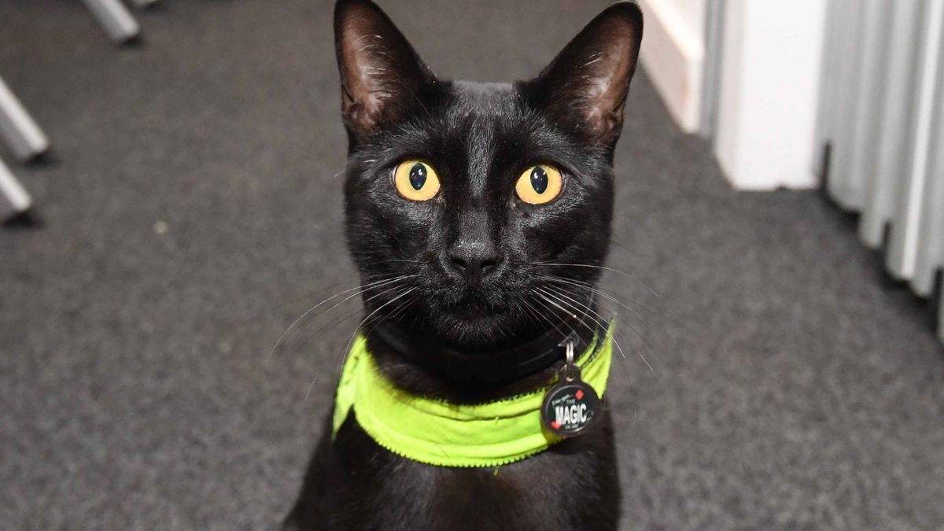
Year 1
120 CATS
Liberal Arts modules
60 CATS
Subject modules
60 CATS
Rolf, the campus cat. (1 CAT)

Slide 4
types of modules
core | compulsory
optional core | choice of which core module(s)
30 CATS | full year
15 CATS | Term 1 or Term 2

Slide 5
Liberal Arts modules
60 CATS
Core: Liberal Arts Principles and Praxis 0 CATS
Core: Truth & Misinformation 30 CATS
Optional core:
Research Skills module
15 CATS
Optional core:
Critical Issue module
15 CATS

Slide 6
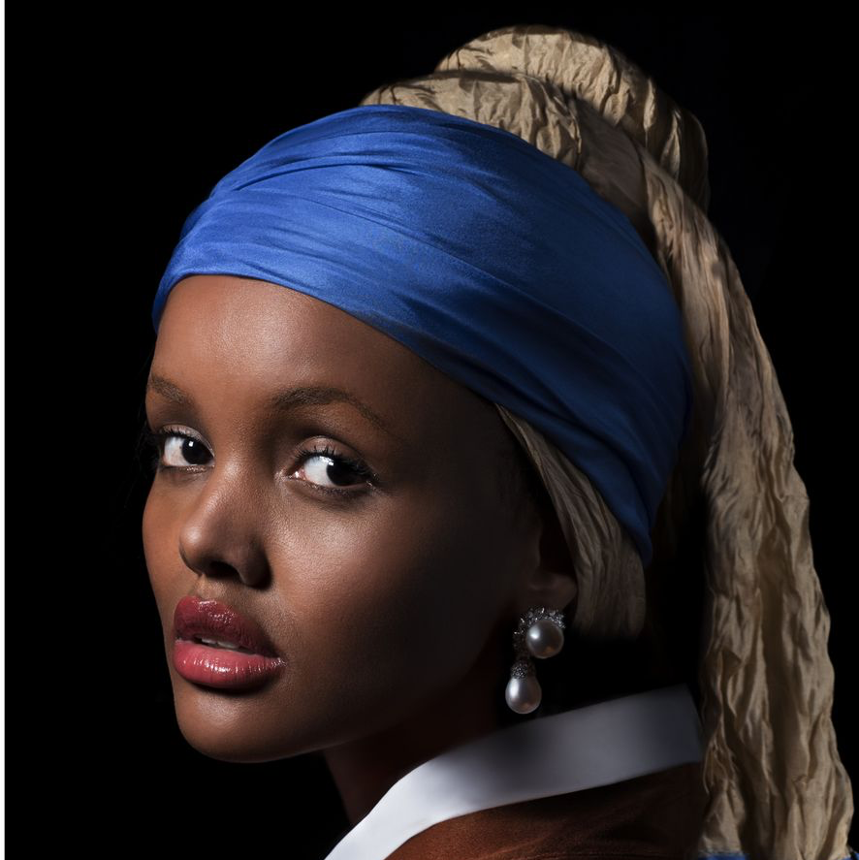




Critical Issue
Year 1
Research Skills
Beauty
Core Modules
Qualitative Research
or
Truth and Misinformation
+
+
Revolution
or
Principles and Praxis
or
Quantitative Research
Order

Slide 7
Liberal Arts
Business (WBS)
Law
Modern Languages
Philosophy
Sociology
Economics
GSD
Psychology
Life Sciences
History of Art
Culture Studies
Film and
TV Studies
Theatre and Performance
Design Studies
Classics

Slide 8
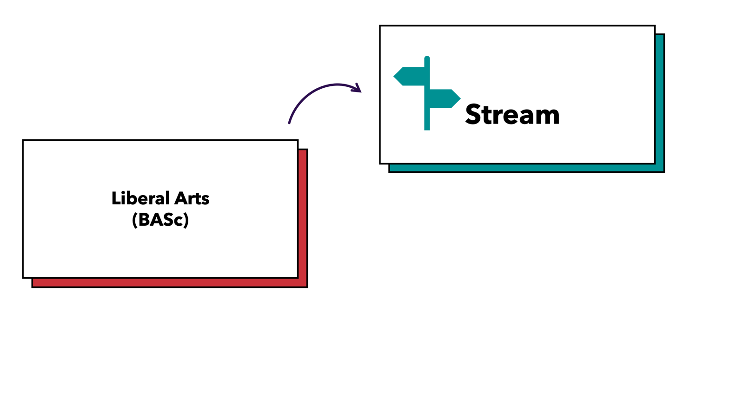

Slide 9



Slide 10
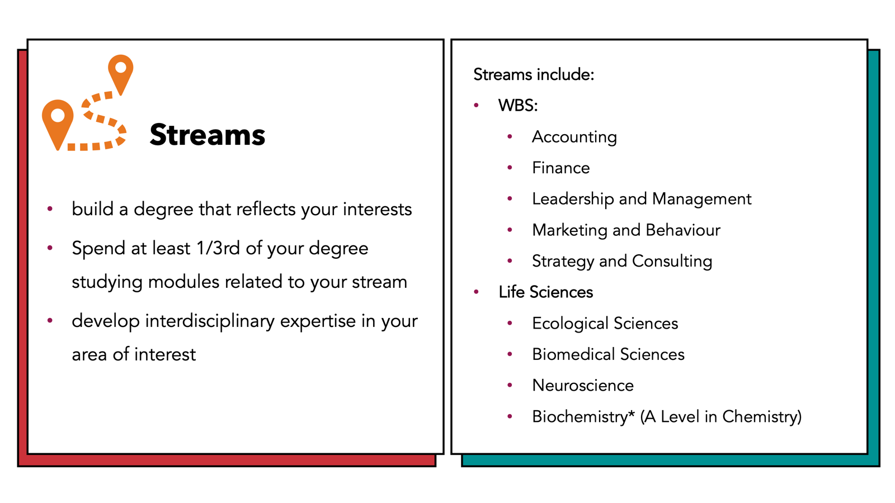

Slide 11
Subject modules
60 CATS
Stream Route
30 CATS
Free choice options
30 CATS
https://courses.warwick.ac.uk/

Slide 12
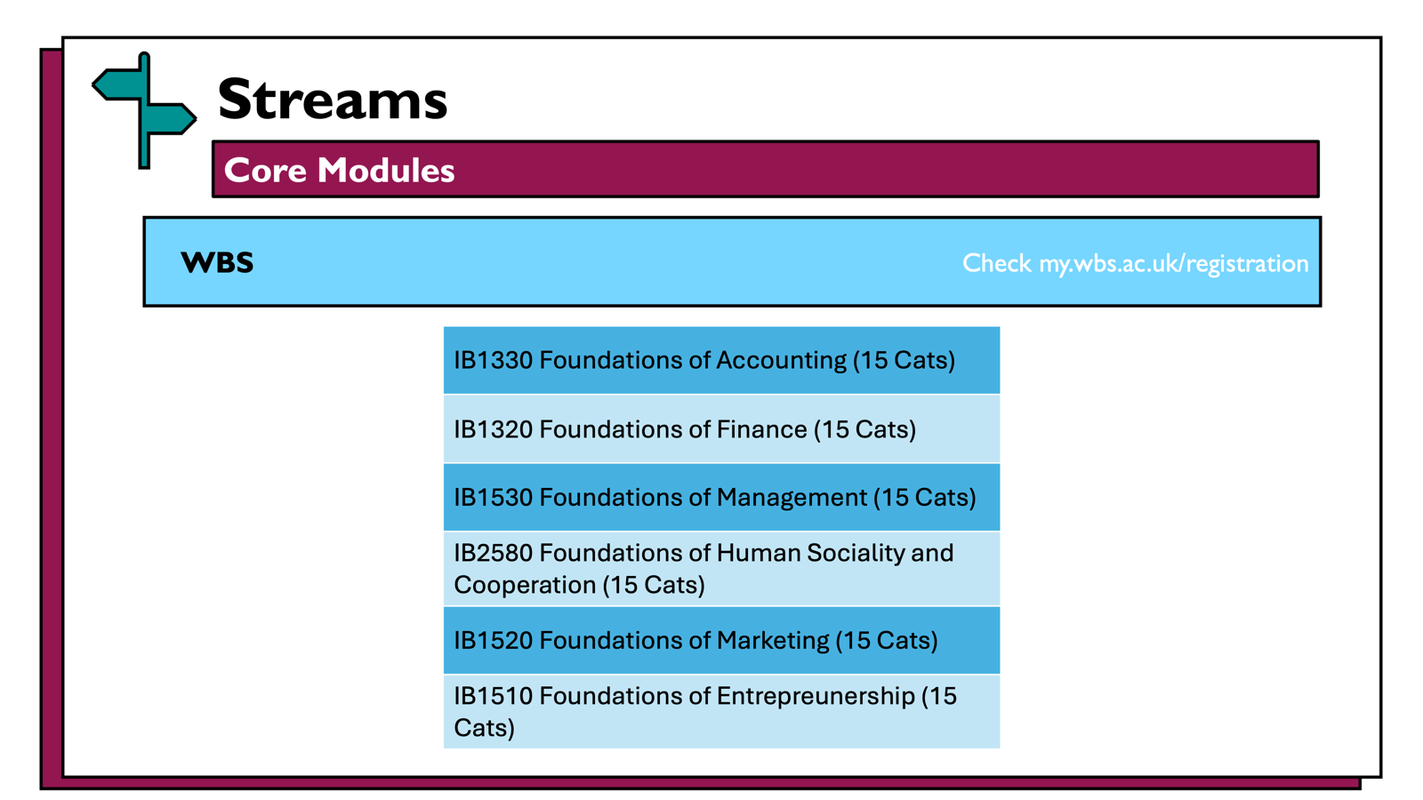

Slide 13
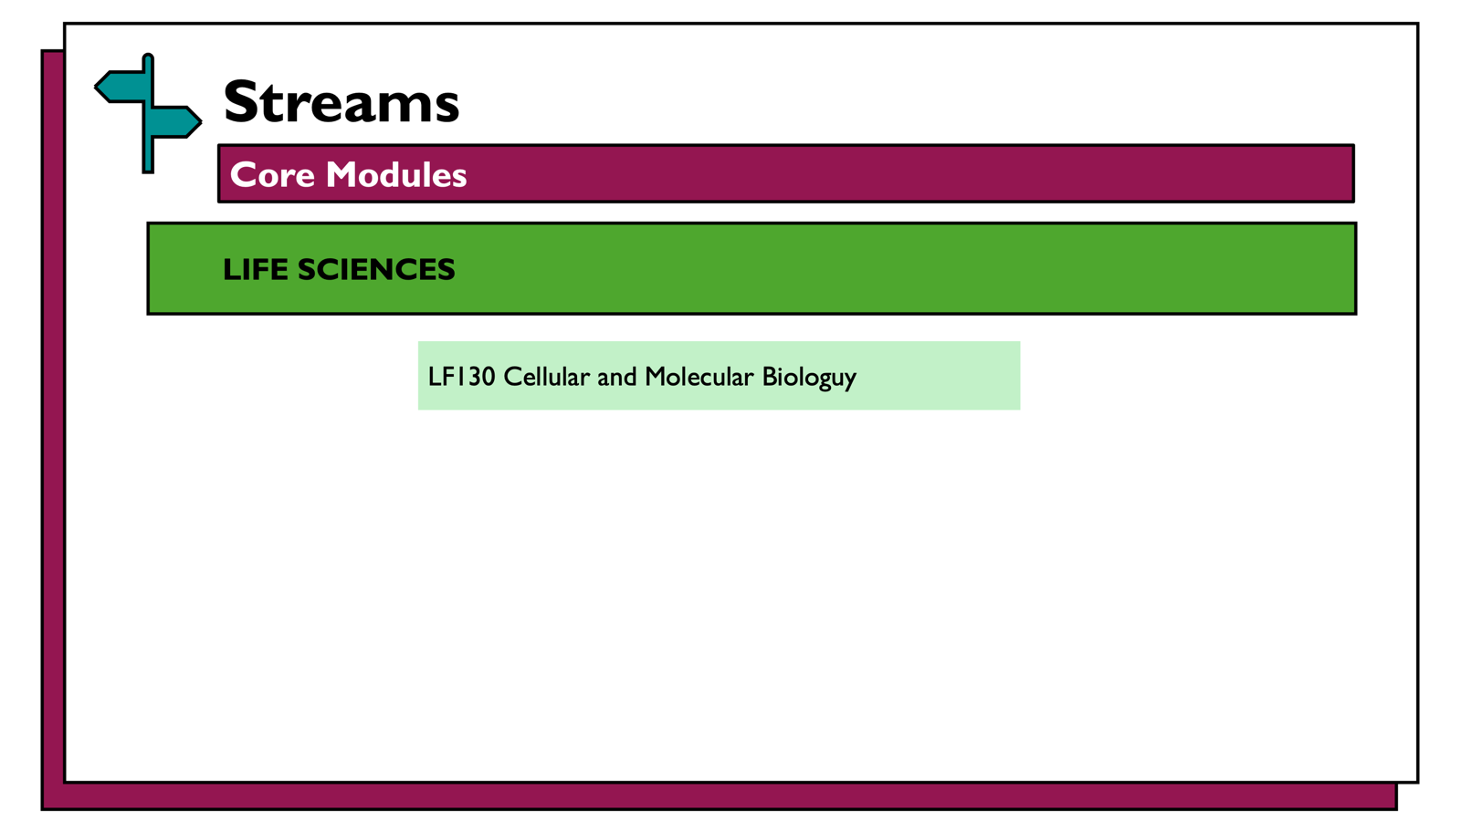

Slide 14
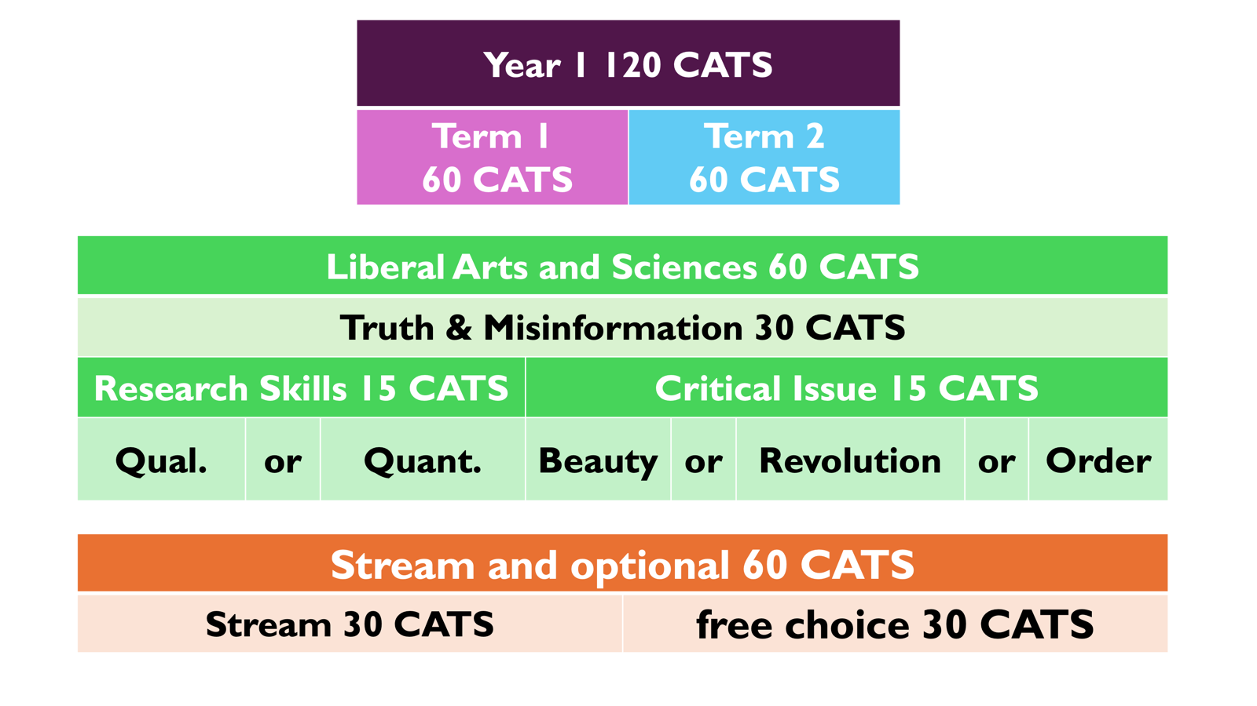

Slide 15
Disciplinary Route
Liberal Arts
(BA)
Interdisciplinary Pathway

Slide 16


Disciplinary Routes
degree title: Liberal Arts with Subject
Law

Slide 17
Interdisciplinary Pathways
Previous Pathways include:
Advertising, Gender, and Cultural Criticism
Black British Studies
Business Ethics
Conflict, Culture, and Society
Gender and Society
Health and Human Society
Imagination in Childhood Development
Social Justice
Sustainability
build a degree that reflects your interests
spend 50% of your degree studying modules related to your pathway
develop interdisciplinary expertise in your area of interest

Slide 18
Subject modules
60 CATS
Disciplinary Route
30 CATS
Free choice options
30 CATS
https://courses.warwick.ac.uk/

Slide 19
Types of Modules
core | compulsory
optional core | choice of which core module(s)
choice | choose any Year1module in this department
requisites | needed for future study

Slide 20
Disciplinary Routes
Core Modules
History
HI153 Making of the Modern World
Life Sciences
LF130 Cellular and Molecular Biology
Philosophy
PH134 Introduction to Philosophy
Theatre and Performance Studies
TH144 Theatre and Performance in Context
Film and Television Studies – Let Lauren know!
FI348 Film Analysis and Methods AND FI110 Screen Technologies

Slide 21
Disciplinary Routes
Core Modules
Modern Languages and Cultures – choose one:
FR102 Modern French Language for Beginners
GE103 Modern German for Beginners
HP102 Modern Spanish Language for Beginners
IT101 Italian For Beginners
LL2B9 Arabic Beginners (Extra)
LL2C2 Chinese Beginners
LL2A5 Japanese Beginners
LL2B8 Russian Beginners (Extra)

Slide 22
Disciplinary Routes
Core Modules
Economics:
EC107 Economics I
EC120 Quantitative Techniques module cluster
Law:
LA128 Understanding Law in Context

Slide 23
Disciplinary Routes
Core Modules – Optional Core
English – choose one:
GSD – choose two:
EN101 Epic to Novel
EN121 Medieval and Early Modern Literature
EN122 Modes of Reading
EN123 Modern World Literature
GD104 Economic Principles of GSD
GD105 Environmental Principles of GSD
GD106 Social Principles of GSD
Design Studies – core + choice:
take: DI102 Introduction to Design Practice | choose: any 15 CAT Year 1 Design Studies module

Slide 24
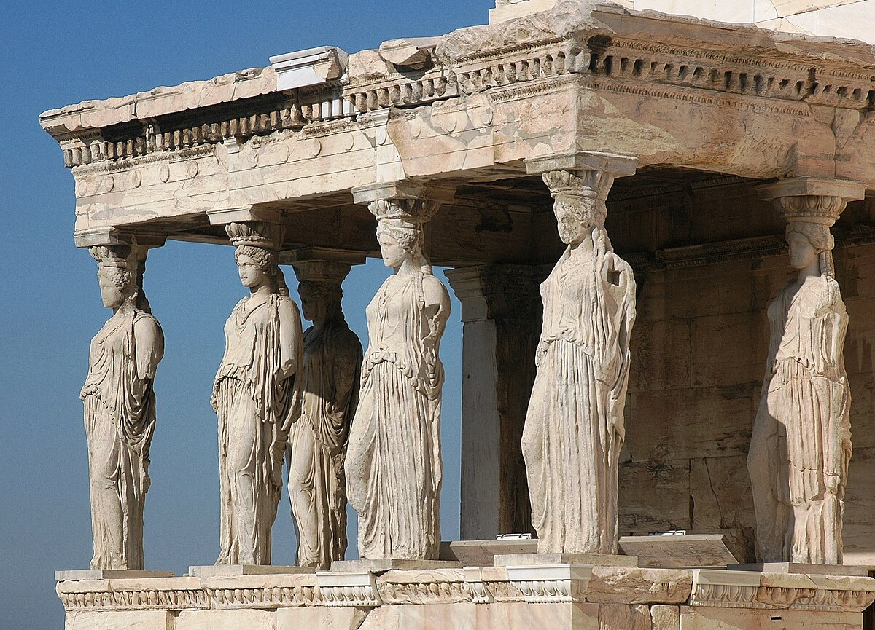
Disciplinary Routes
Core Modules – choice
Classics – choose either:
1 x 30 CAT Year 1 Classics module | 2 x 15 CAT Year 1 Classics modules
Education – choose either:
1 x 30 CAT Year 1 Education module | 2 x 15 CAT Year 1 Education modules

Slide 25
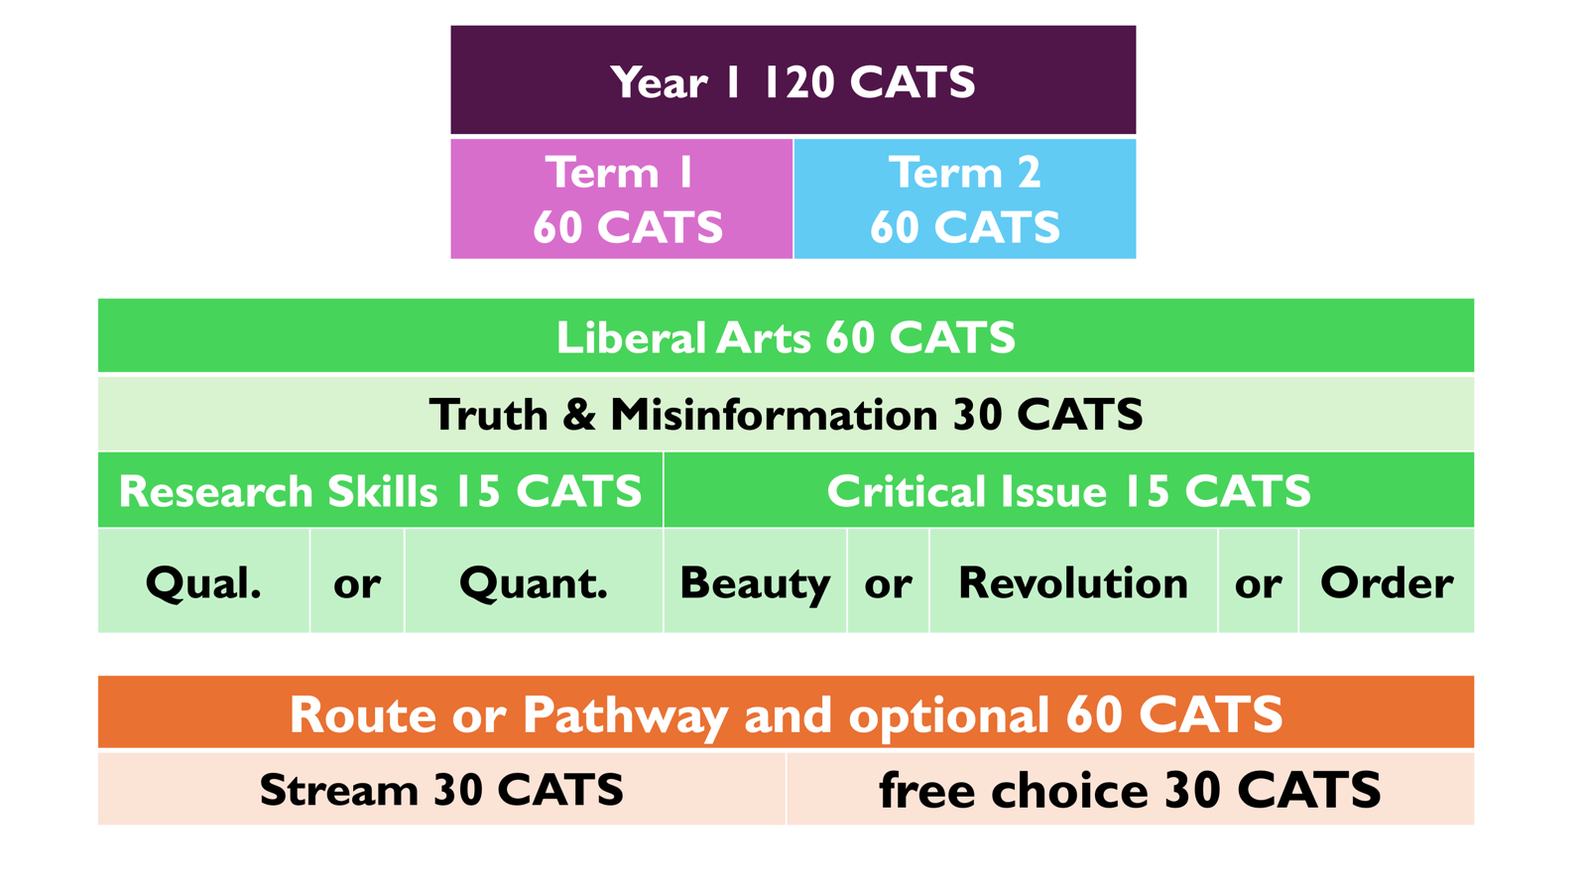

Slide 26

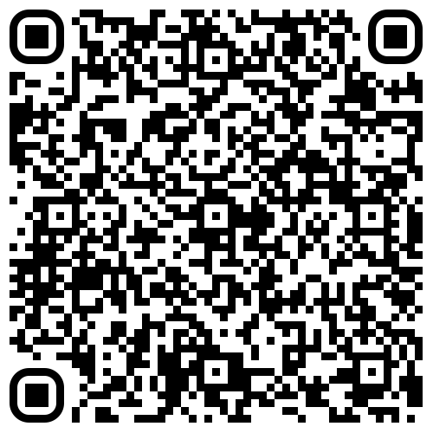
Year 1 Module Registration Information
module catalogue
Year 1 modules only
26/27 academic year

Slide 27
Module Enrolment
plan modules
discuss with personal tutor
get approval from department
Complete enrolment on eVision

