Slide 1

Welcome to
Liberal Arts!

Slide 2
Our Liberal Arts Team
Dr Bryan Brazeau
Dr Lauren Bird
Dr Kim Lockwood Clough
Bodrun Nahar
Your Liberal Arts team
Director of Undergraduate Studies
Director of Admissions
Exams Secretary
Senior Tutor (SCFS)
Disabled Student Champion
Placements and Employability Manager
Director of Warwick Venice Centre
Dr William Rupp
Dr Gavin Schwartz-Leeper
Kelsey Todd
Dr Camilo Uribe Botta
Director of Student Experience and Progression
Head of Liberal Arts
Director of Education (SCFS)
Interdisciplinary Programmes Officer

Slide 3
Introductions!
name (and pronouns, if you wish)
where you grew up
why you chose Liberal Arts at Warwick
either:
    your favourite food
    a food you never want to taste again

Slide 4
University of Warwick
Faculty of Arts
SCFS
School for Cross-Faculty Studies
Liberal Arts

Slide 5

we treat everyone with respect
we do not tolerate discrimination
we do not tolerate sexual misconduct, violence, or abuse
we keep our campus and community safe
Our values

Slide 6
We expect you to:
attend all teaching sessions (unless you’re unwell)
meet with your personal tutor at least 3 times per year – you can meet us more!
be active in your learning
check emails regularly
be open to new ideas
You can expect us to:
reply to emails within 3 working days
support your learning
answer questions, or direct you to someone who can
Working together

Slide 7
Personal tutor (Ramphal Building)
Undergraduate Office (R3.38)
Wellbeing Team
Disability Services
Community Safety Team
Residential Community
SU Advice
Support at University
We’re here to help!

Slide 8
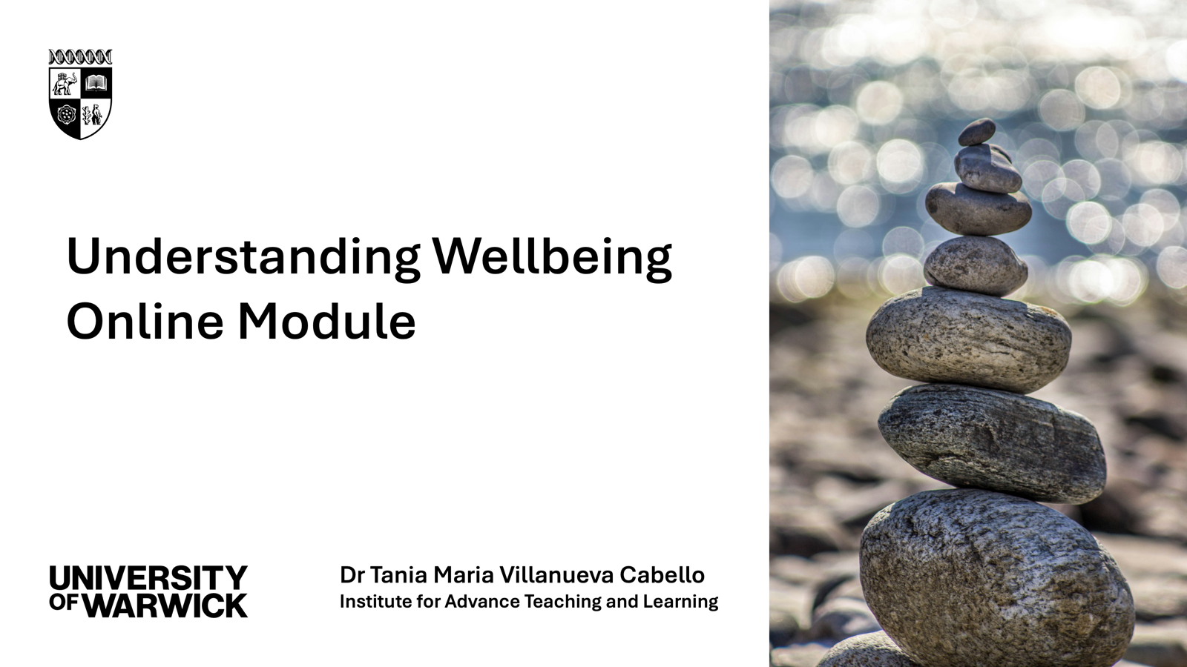

Slide 9


Slide 10
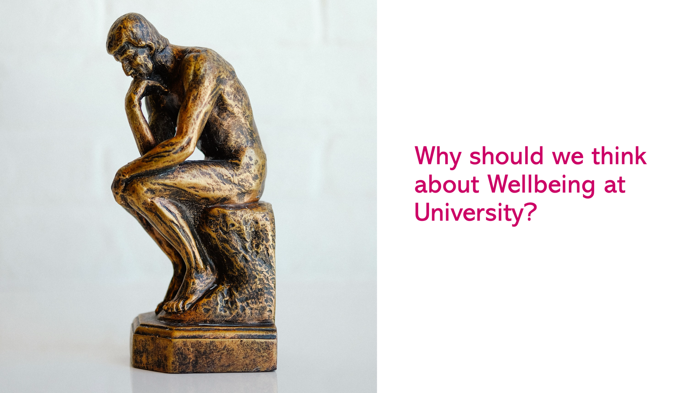

Slide 11
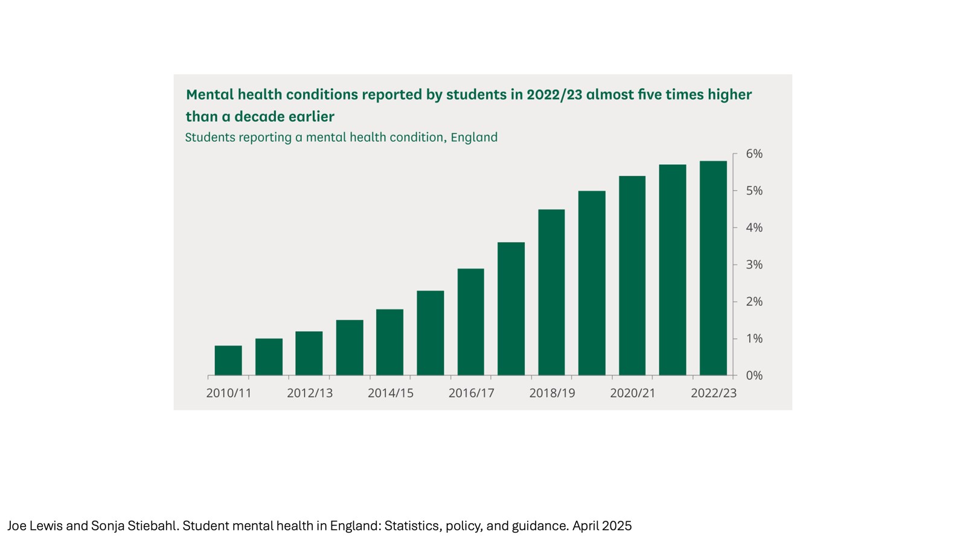

Slide 12
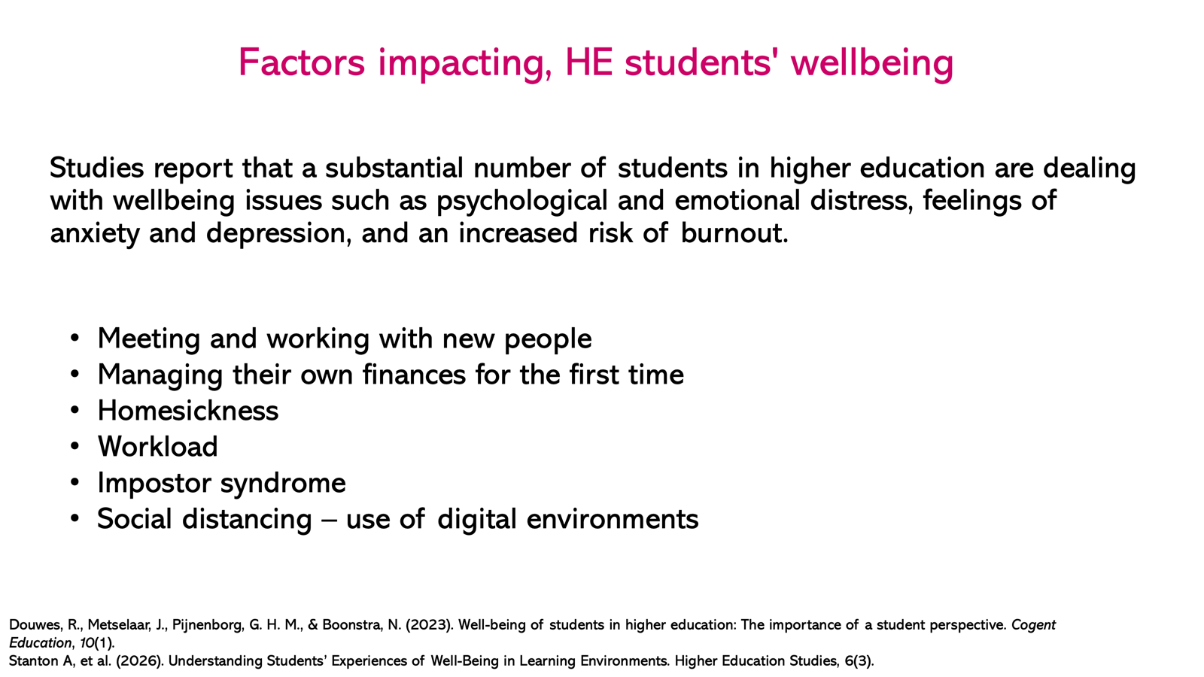

Slide 13
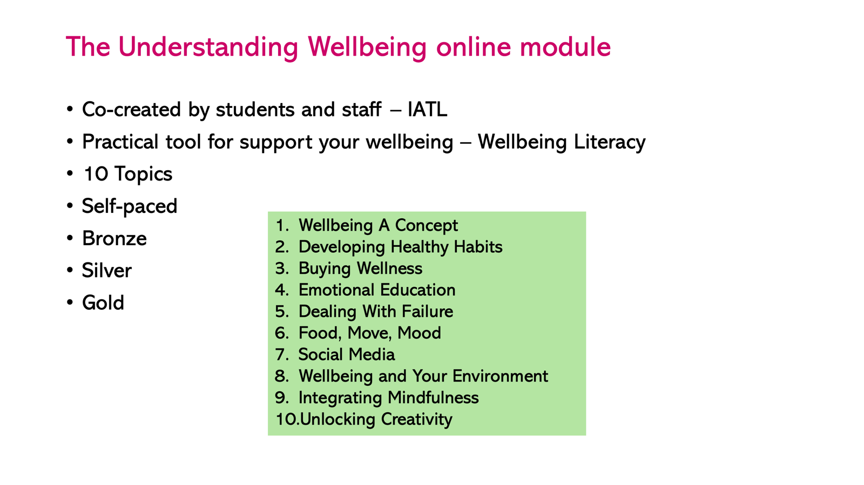

Slide 14
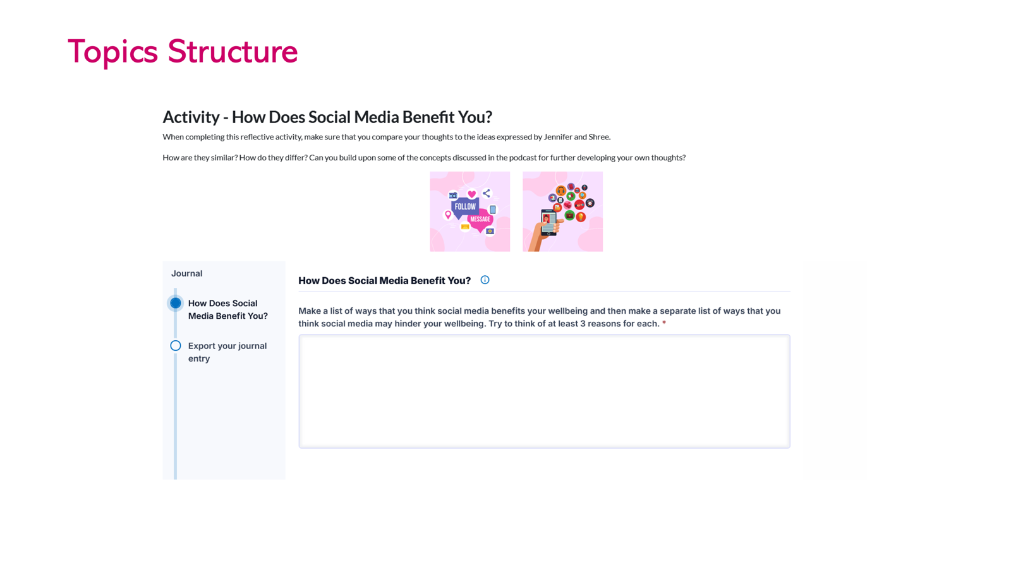

Slide 15
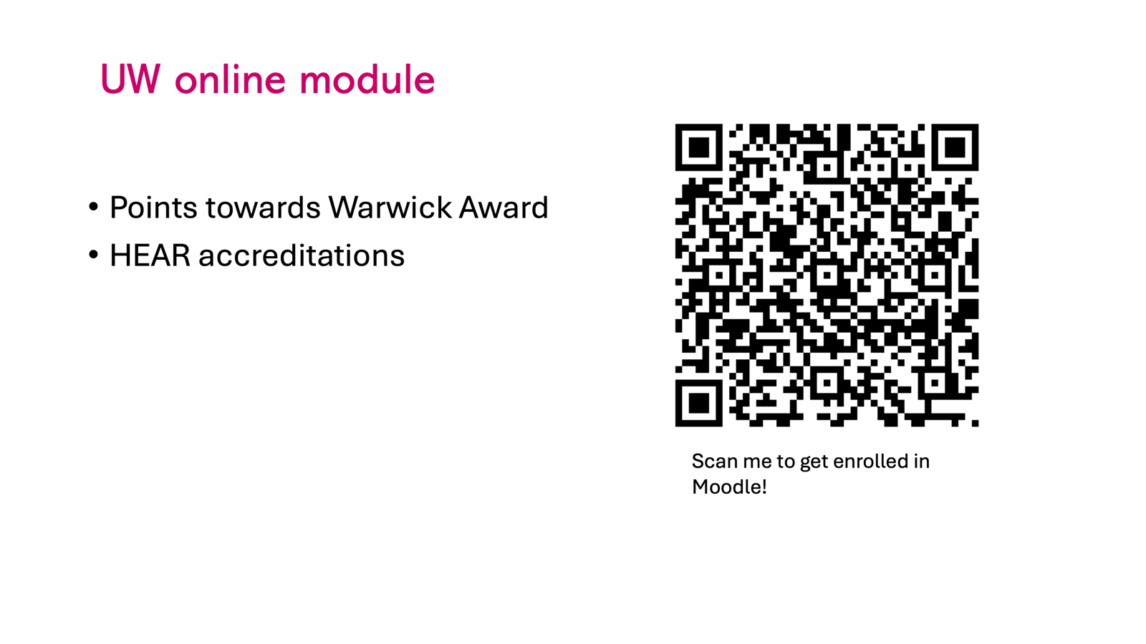

Slide 16

Checklist
contact Disability Services
Follow Liberal Arts Society on Instagram!
complete University enrolment
collect ID card
register for IT account
book meeting with personal tutor
download free Microsoft office apps
download MyWarwick app
Follow Liberal Arts Society on Instagram!

Slide 17
Monday 28 September
10:00-12:00 Welcome to Liberal Arts! R1.13

Slide 18
Tuesday 29 September
10:00-12:00pm | Planning your Liberal Arts Journey | R0.03
afternoon | Personal tutor meetings | see email
11:30-12:30pm | Latin and Greek Language (Classics)
12:00-1:00pm | School of Cross-faculty Studies Year 1 Module Fair | OC0.02
7:00 pm | Liberal Arts Society. Meet the Exec. | Terrace Bar

Slide 19
Wednesday 30 September
9:30-11:30am | Liberal Arts Module Selection Breakfast | R1.13
2:00-3:00pm | Law School Joint Degrees Welcome Session | S0.21
2:00-3:00pm | Economics Joint Degrees Welcome Session | Panorama
2:00-3:00pm | History Joint Degrees Welcome Session | OC0.04
2:00-3:00pm | English Joint Degrees Welcome Session | Wood Scaven Room

Slide 20
Thursday 1 October
11:00am – 5:00pm | Societies Fair | Sports Hub
11:00am-2:00pm | Philosophy Drop In session | S2.73
12:00-2:00 pm | School of Cross Faculty Studies Social Lunch | Ramphal Building Foyer
5:00-7:00pm | Liberal Arts Film and Pizza Evening | FAB0.21

Slide 21
Thursday 1 October / Languages
12:00 – 2:00 pm | French | FAB2.43
 | Italian | FAB4.76
 | German | FAB5.01
 | Hispanic Studies and Portuguese | FAB0.23
 | Arabic and Russian | FAB2.33
 | Chinese | FAB2.34
 | Japanese and Korean | FAB2.36
 | Translation and Transcultural Studies | FAB1.15

Slide 22


Slide 24
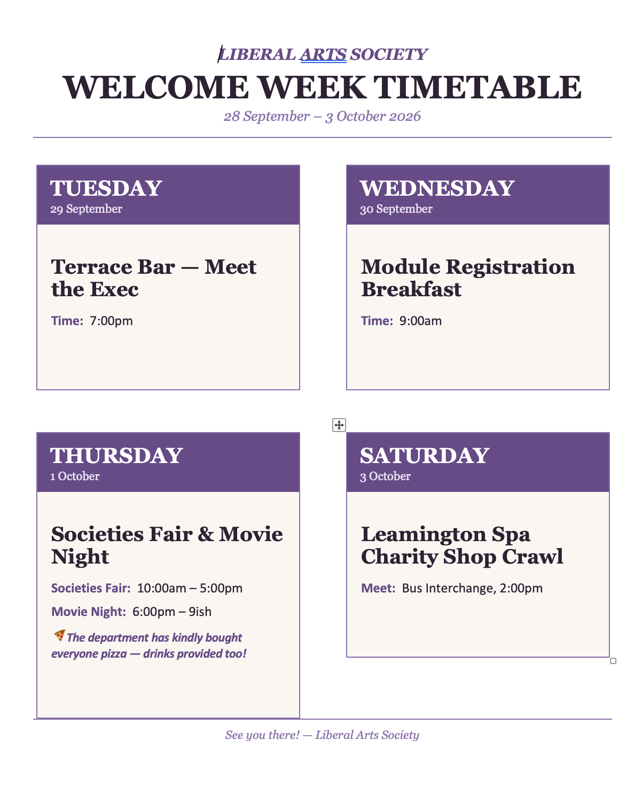

Slide 25
Questions?

