Slide 1

A TEL FRAMEWORK FOR THE CO-DESIGN OF AN ONLINE COURSE:
Experiences from a Monash-Warwick Alliance project

Slide 2
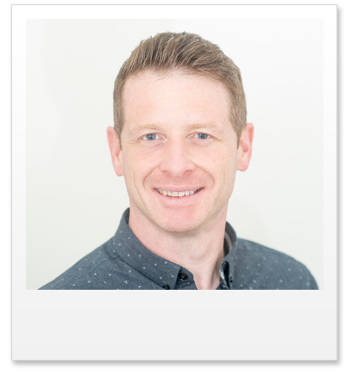
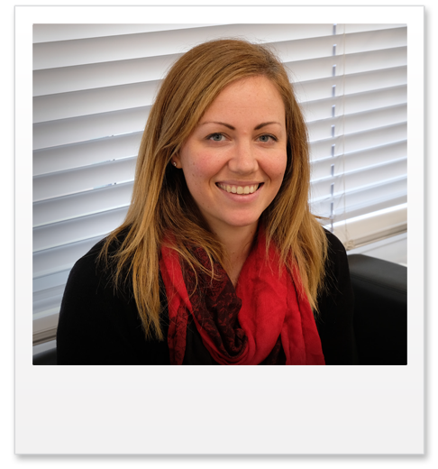
About the presenters
Staff from Warwick Medical School
Richard Clay Senior Academic Technologist
Dr Lucy Hammond Associate Professor Deputy Pro Dean Education and Director of Undergraduate Studies
Richard Clay
Dr Lucy Hammond

Slide 3
About the presentation
We will reflect on the experiences of Monash-Warwick Alliance project, which involves the co-design of online course for use in healthcare programmes, which will be used at both Warwick and Monash. Universities.
The presentation will demonstrate how a TEL framework and supporting technologies can be used to help the development of an online course and will focus on the use of:
Microsoft Teams for collaboration, communication and project management.
The ADDIE model to help organise and streamline the course development process.
Gagné's 9 Events of Instruction to design and create effective learning content.

Slide 4
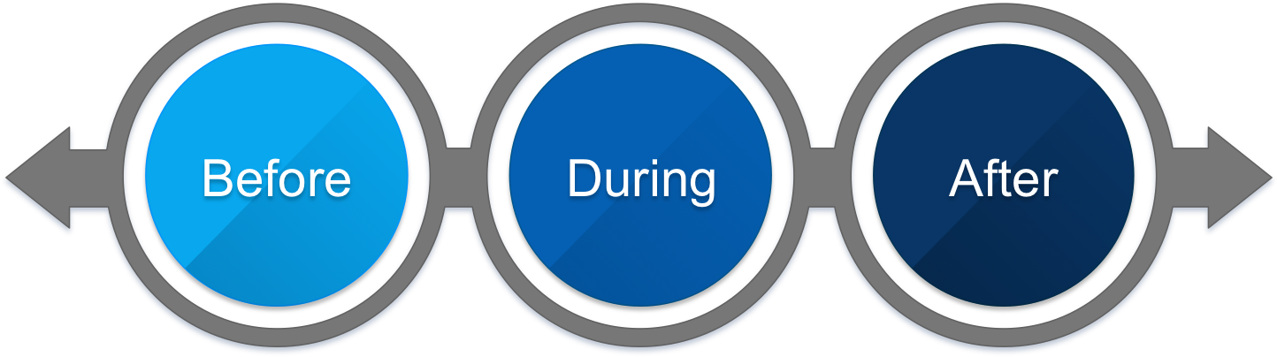

About the presentation
Perspectives from the learning technologist and academics who are part of the project team.
The presentation will is divided into three sections examining how TEL has been used during different phases of the project – before, during and after the visit to Australia.
Phase 1
Phase 2
Phase 3

Slide 5
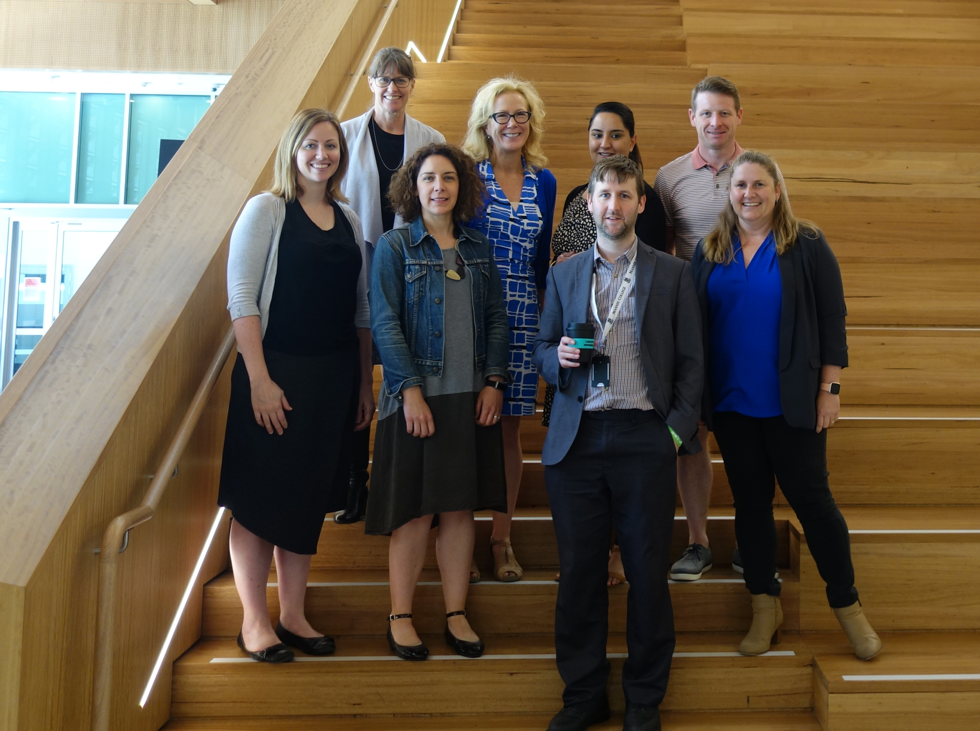
Background to the project
Developing Novel Tools for QUality Improvement Training (DoNTQUIT)
Aim: Create internationally oriented and inter-disciplinary focused learning objects to support a range of clinical and allied health professions operating in different healthcare systems.
Medicine
Pharmacy
Paramedic
Dentistry
Advanced Clinical Practice
The DoNTQUIT project team

Slide 6
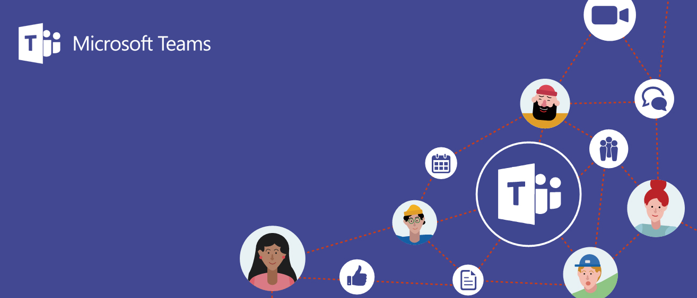
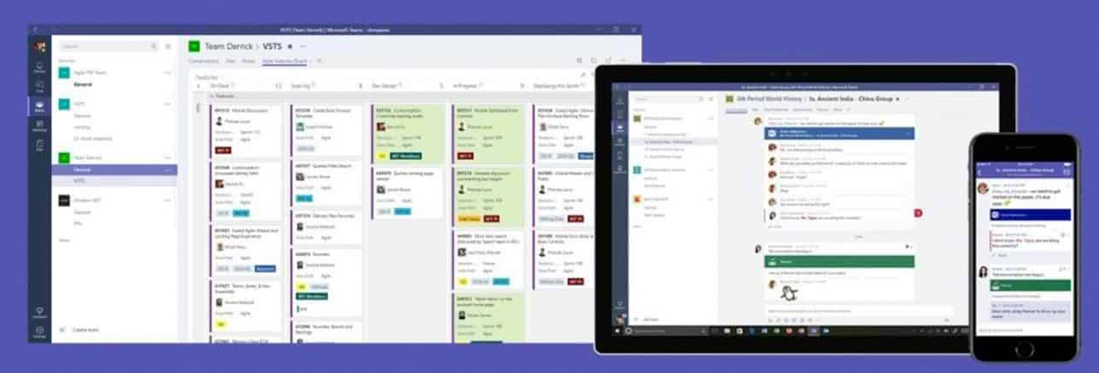
Phase 1: before the visit
Needed a platform to enable team members at Monash and Warwick to work together on the project and collaborate remotely.

Slide 7
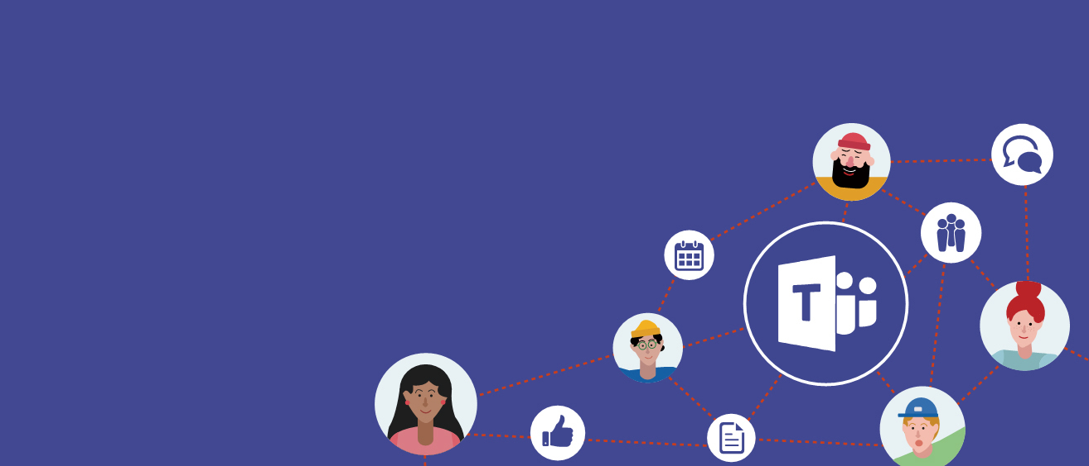
Microsoft Teams is a unified communication and collaboration platform that combines workplace chat, video meetings and file storage
Enabled guest access (Monash Staff)
Files sharing and collaborative working on documents
Asynchronous chat (different time zones)
Safe and secure storage within Warwick systems
Phase 1: Use of Teams before the visit (04/19 – 01/20)
Initial use of Teams.

Slide 8
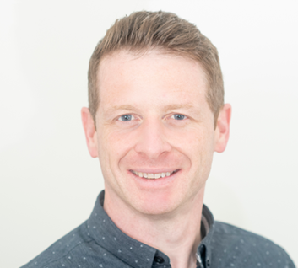
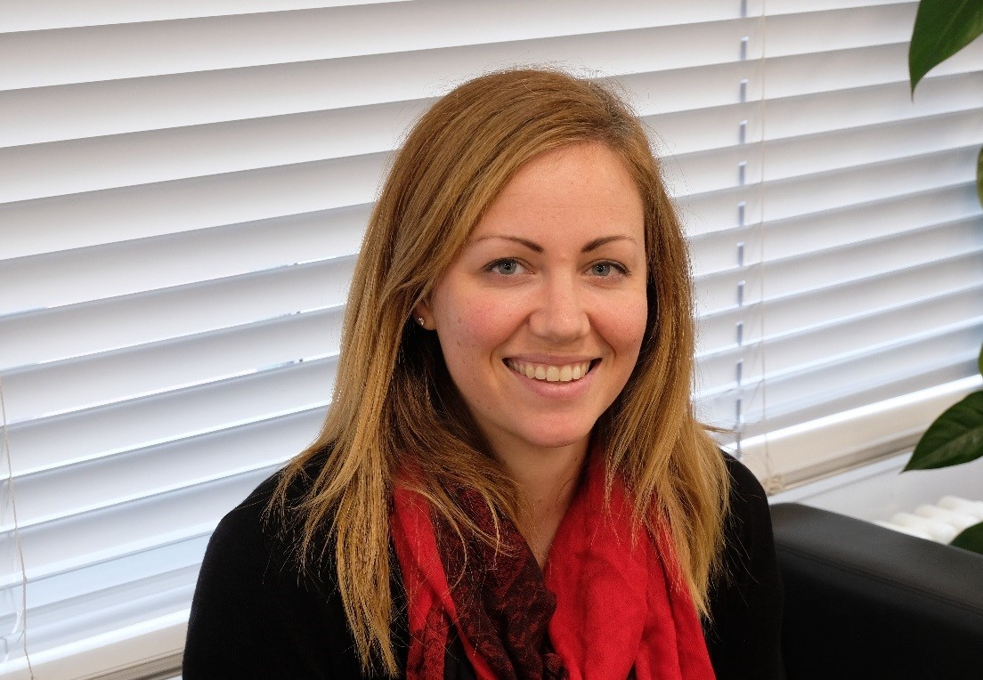
Initial perspectives on the use of Teams
Learning technologist
Academic
Useful to start organising the application process and to start getting to know the Team
Take up was quite slow – hard move away from email
Helped to get together with the Warwick team and to offer practical tips. e.g. notification settings, using the app, channels, mentioning people in chat
Some familiarity with Teams but limited exposure
Lack of awareness of functionality & potential
Issue with receiving notifications
Teams not used widely at Monash so unfamiliar to Monash side of the team

Slide 9
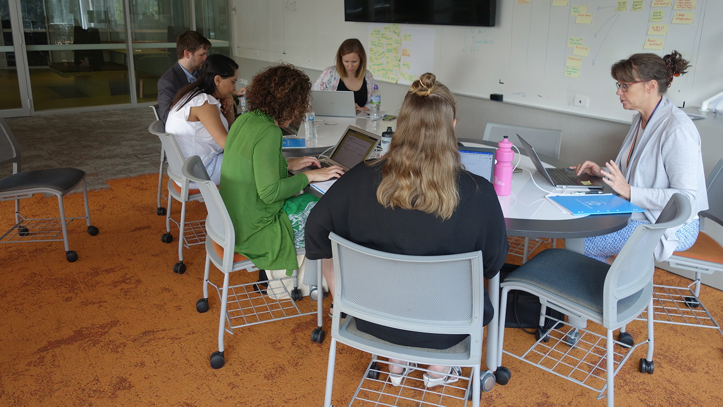
Phase 2: during the visit
During the visit to Monash, Teams continued to be a key technology and a TEL framework helped to guide the co-design of learning content.

Slide 10
Useful to follow up on and group daily activities and communicate when not together
Working collaboratively on documents and the co-design of storyboards
Assigning tasks using the planner tool
Hands on group training workshop with Teams:
Effective and potential use
Phase 2: Use of Teams during the visit (18/01/20 - 25/01/20)
Use of Teams whilst at Monash

Slide 11

Perspectives on the use of Teams

Slide 12
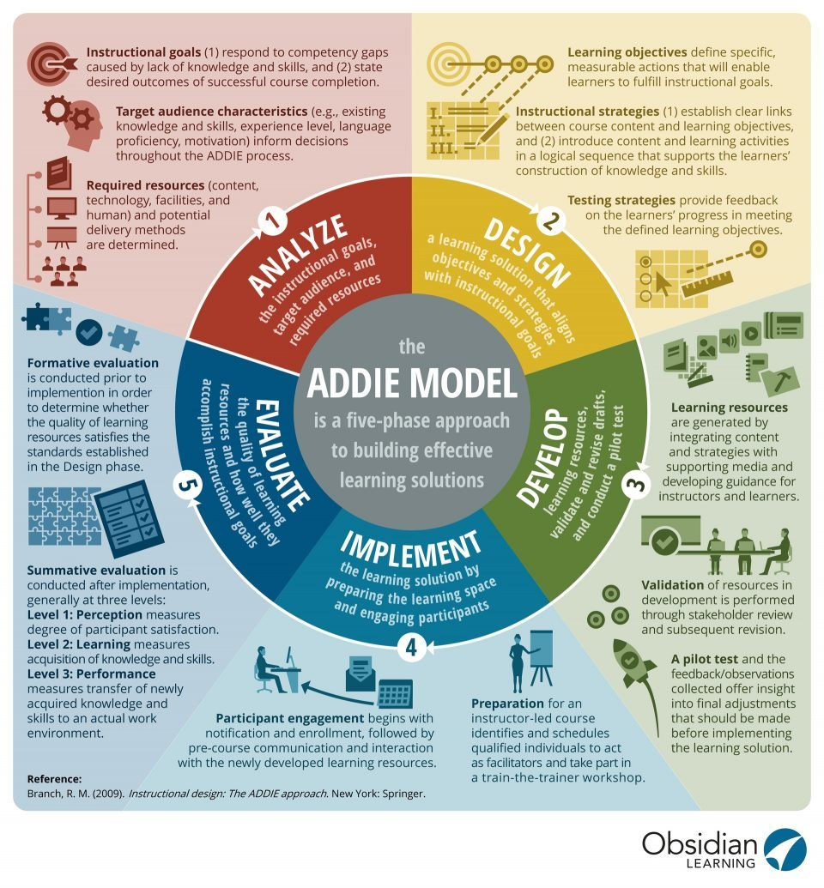
The ADDIE Model
An instructional design model used to help organize and streamline the production of course content
An acronym for the five stages of a development process: Analysis, Design, Development, Implementation, and Evaluation.
Provides a logical, step-by-step “roadmap” for building a course.
Recognised and established Model that has been proven to work (in use for 30+ years.
Aimed to reach the design phase during the visit, tackling other phases later in the project
Richard Clay
Dr Lucy Hammond

Slide 13
Perspectives on the use of ADDIE
Learning technologist
Academic
A framework help organize the workflow and streamline the production of course content.
Good to help to keep academics on track by focusing on clearly defines stages.
Ties in nicely with Teams and Planner tool
Co-design – managing people at different stages of the project
– not all progressing together
Keen to use an established model so a have a theoretical framework when comes to writing up/dissemination
Provided a structure for a large and potentially unwieldy overarching project, enabling identification of smaller and more manageable tasks
Associated kanban board enabled us to keep a list of tasks and accountability

Slide 14
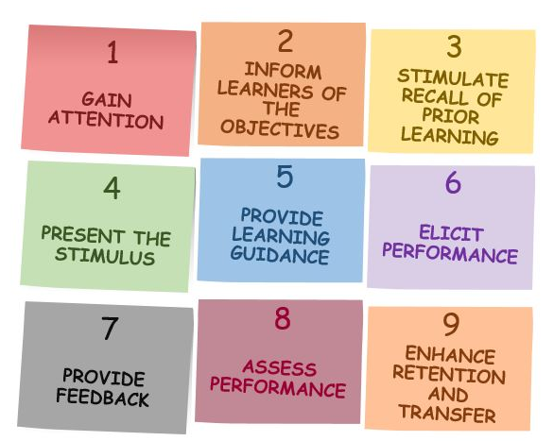
Gagné’s 9 events of instruction
A systematic instructional design process based on the information processing model, which shares a behaviourist approach to learning.
A series of nine events that are associated with and address the mental conditions for learning.
Each element is required for effective learning
A framework to prepare and deliver learning content and to design engaging and meaningful instruction.
Richard Clay
Dr Lucy Hammond

Slide 15
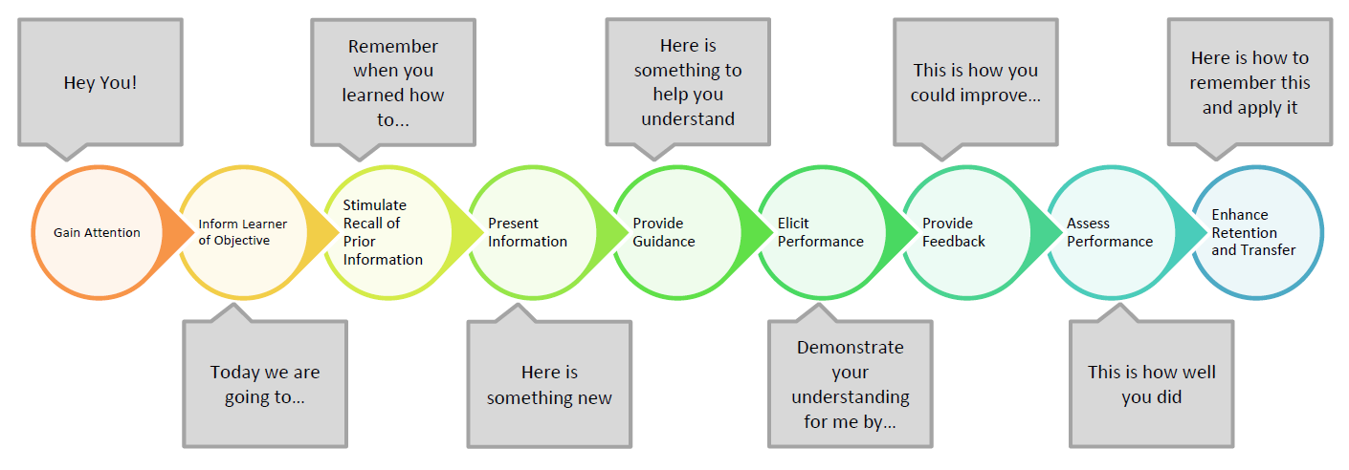
Gagné’s 9 events of instruction
A typical, linear order of events. In reality some are likely to overlap or intermingle.

Slide 16
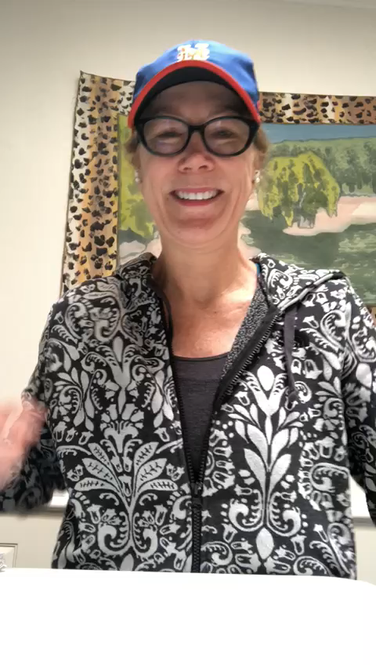
Perspectives on the use of Gagné's 9 events
Learning technologist
Academic
Provide a step-by-step checklist that helps you ensure that you present a comprehensive and successful learning experience
Each step is designed to help trainees understand and retain information effectively.
When is it appropriate to offer feedback, or ask for a demonstration of skills, to ensure that trainees understand your message?

Slide 17

Phase 3: after the visit
Continued use of the framework and supporting TEL tools to progress with the design and development phases of the project.

Slide 18
Developing storyboards and discussing ideas for content
Task management using Planner
Continued communication between the project team and the co-design of content
Specific instructions and advice (e.g. use of media)
Phase 3: Use of Teams after the visit (02/20 – now)
Use of Teams when back in the UK

Slide 19
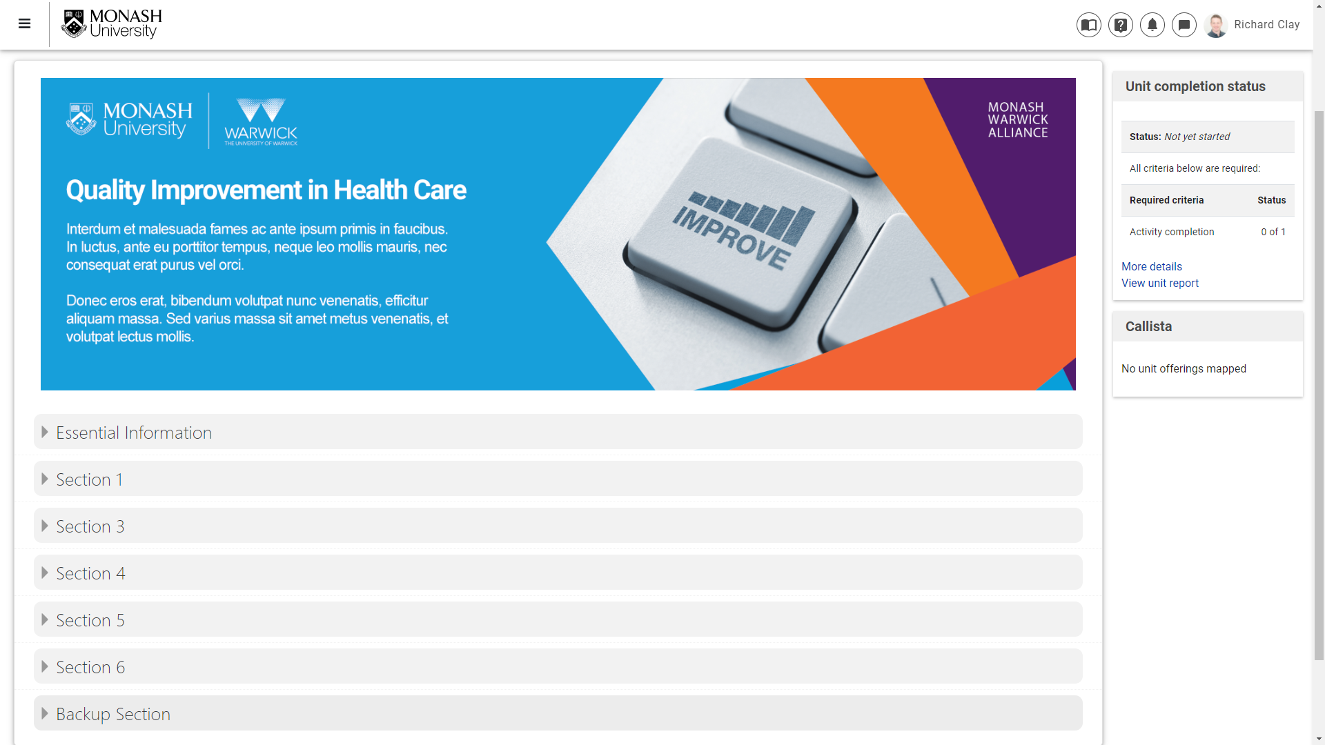
Developing the content in Moodle
Authoring learning content in the Monash VLE

Slide 20
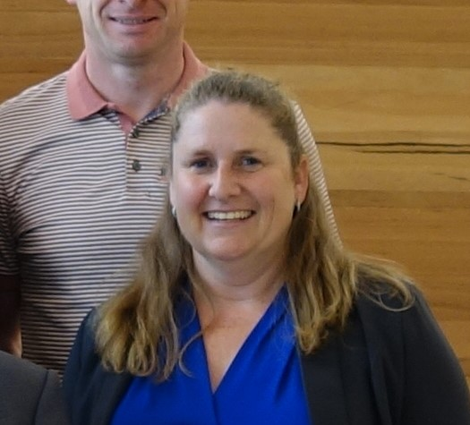
Current academic perspectives on the use of Teams
Academic
"Even when we were not physically in the same space, Teams allowed us to communicate and progress the work. The "posts" are not only a great way to communicate in our different time zones, but they also remain on the site for future reference. The planner works well to let colleagues know when I have finished my tasks and I am ready to move a job on to them. You can use Teams for teleconferencing as well so there are many ways for us to keep in touch!"

Slide 21
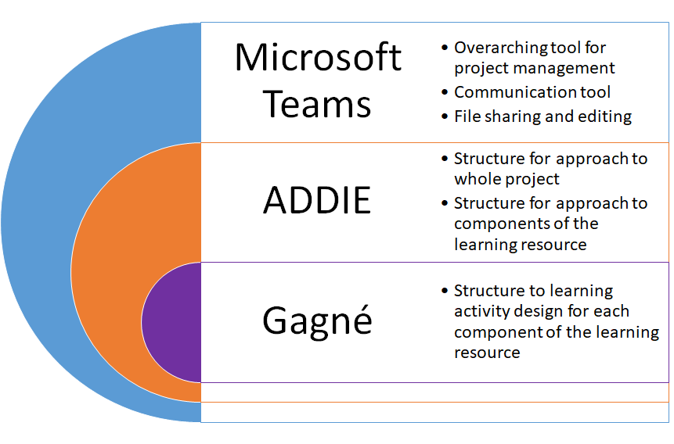
Summary of our TEL framework

Slide 22
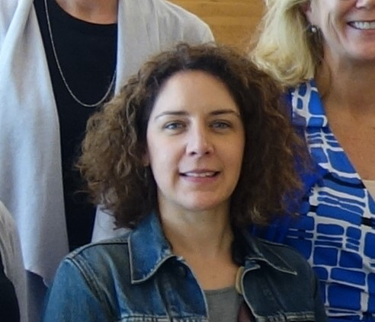
Final thoughts
"The tools we are using give a structure to the project and ensure we are all working together to the same outcome - even when we are very far apart.
This is especially important as Richard has to "translate" each contribution into a usable teaching resource on the moodle platform.
I had not previously worked in this type of team model and so was pretty daunting. However as soon as we completed the first story board and saw it come together I certainly felt more comfortable.
As a team I think this early success allowed us to dream and think big - challenging what was possible (or what Richard could hack to make happen) in an online educational resource."

Slide 23
Final thoughts
It was a bit daunting going out to Australia and being the only LT amongst 7 academics.
The use of recognised instructional design techniques gave me the confidence that I was working in the right way and leading others in the right direction.
I think framework we have used helped massively to keep people on track and on task and in producing content that is pedagogically sound. Without it I don’t think the team would have worked so efficiently together.

Slide 24

Any Questions

